Slide 1
Root Mean Squared Propagation
Harshavardhan

Slide 2
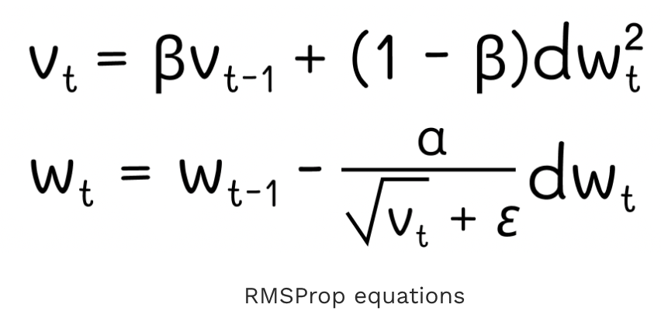
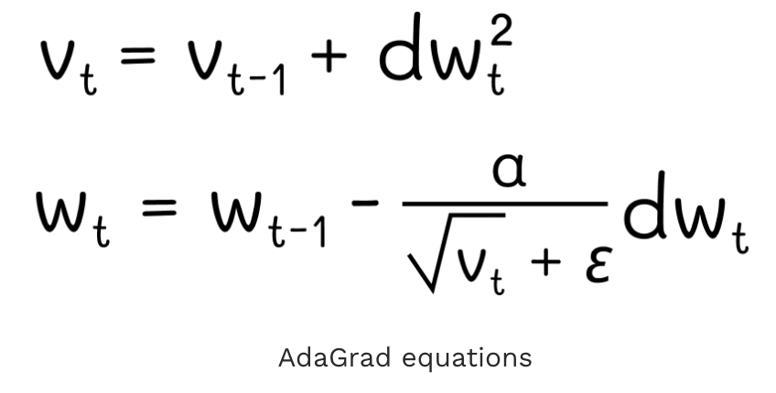
Concept
Each component is normalized by the exponential moving average of the component-wise magnitudes of previous gradient directions
Tieleman and Hinton (2012) Neural Networks for Machine Learning, Lecture 6, Coursera

Slide 3
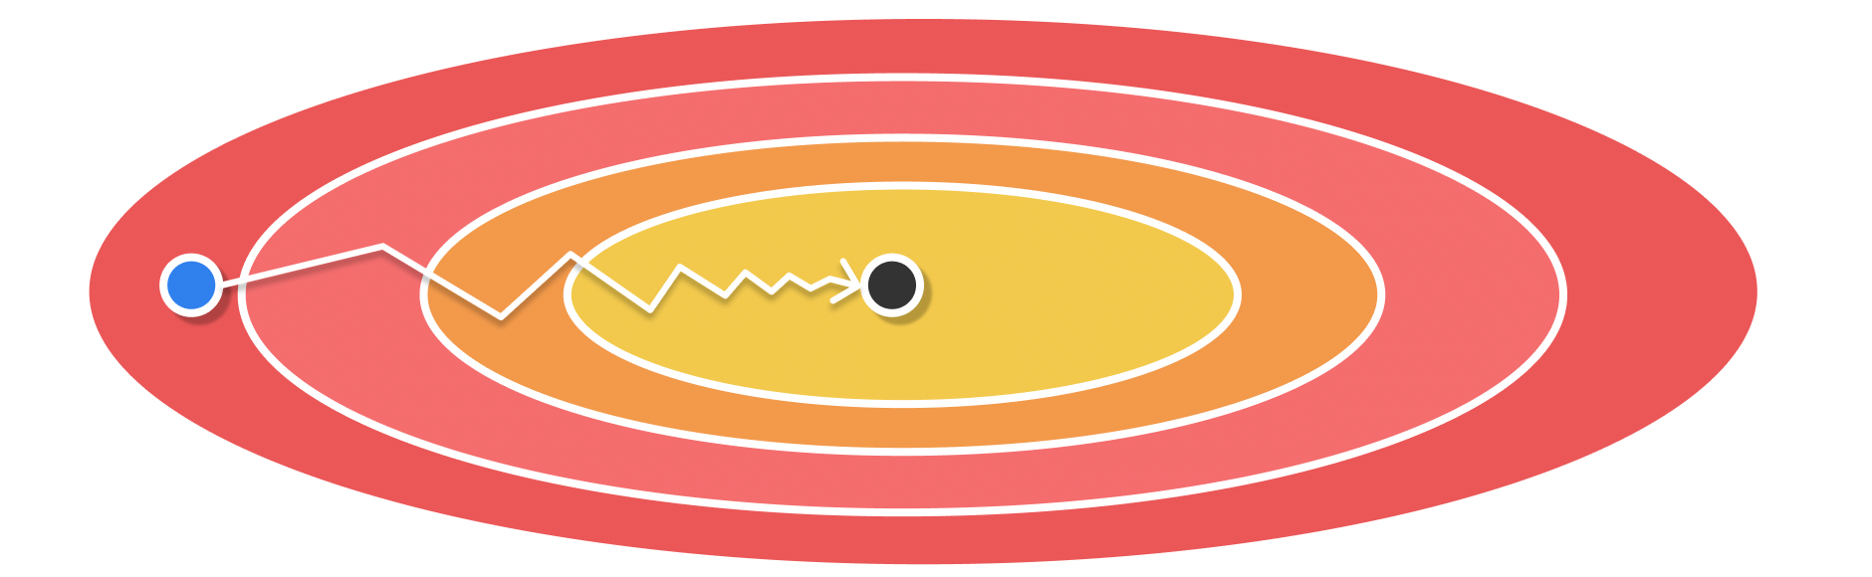
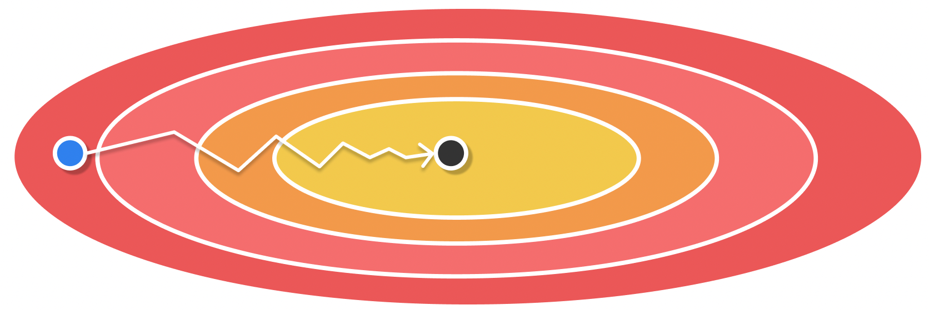
Adagrad vs RMSProp
RMSProp generally converges faster than AdaGrad
More emphasis on recent gradient values rather than equal importance between all gradients
Adagrad
RMSProp

Slide 4
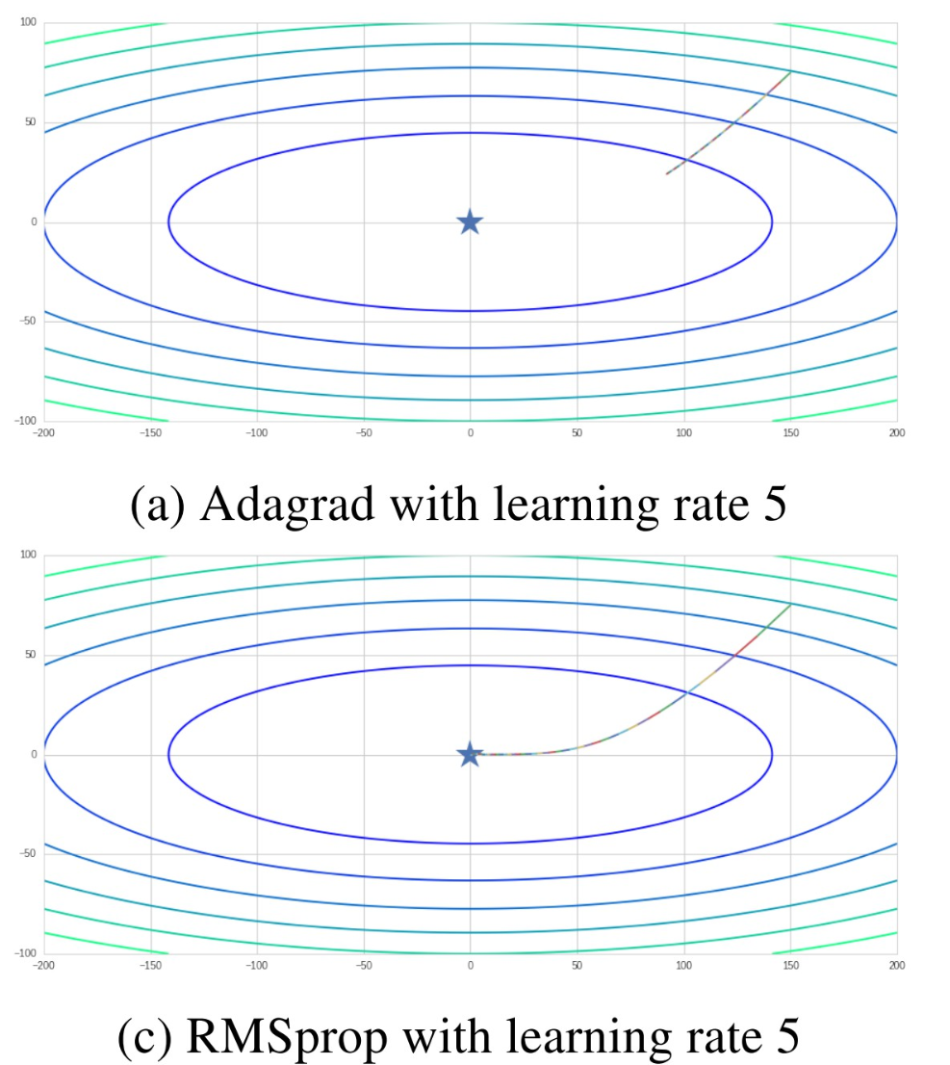

Slide 5
Aspect | AdaGrad | RMSProp
Learning Rate Behavior | Decays continuously over time because it divides by the cumulative sum of squared gradients | Learning rate adapts but stays roughly constant because it uses an exponentially decaying average of squared gradients
Effect on Convergence | Fast at the beginning (large steps) but often stalls later due to vanishing learning rate. | Consistent progress throughout training; avoids “freezing” and converges better on long training runs.
Best Use Cases | Convex, sparse problems (e.g., NLP embeddings, logistic regression). | Non-convex problems (deep networks, CNNs, RNNs) where training must continue improving over many epochs.
Sensitivity to Initial LR | Needs a slightly higher initial learning rate because it will decay over time. | Works well with moderate learning rate (commonly 1e-3) and is less sensitive to exact tuning.
Batch Size Effects | With large batches, cumulative history grows quickly → learning rate decays too fast → underfitting risk. With small batches, decay is slower and works better. | More robust to batch size choice — exponential averaging smooths noise, so even very small batch sizes remain stable.
Noise Handling | Noisy gradients can still shrink the learning rate too aggressively because every step is added to history. | Exponential averaging smooths noisy gradients, keeping effective step sizes stable.

