Slide 1
RNN explained
Jian

Slide 2
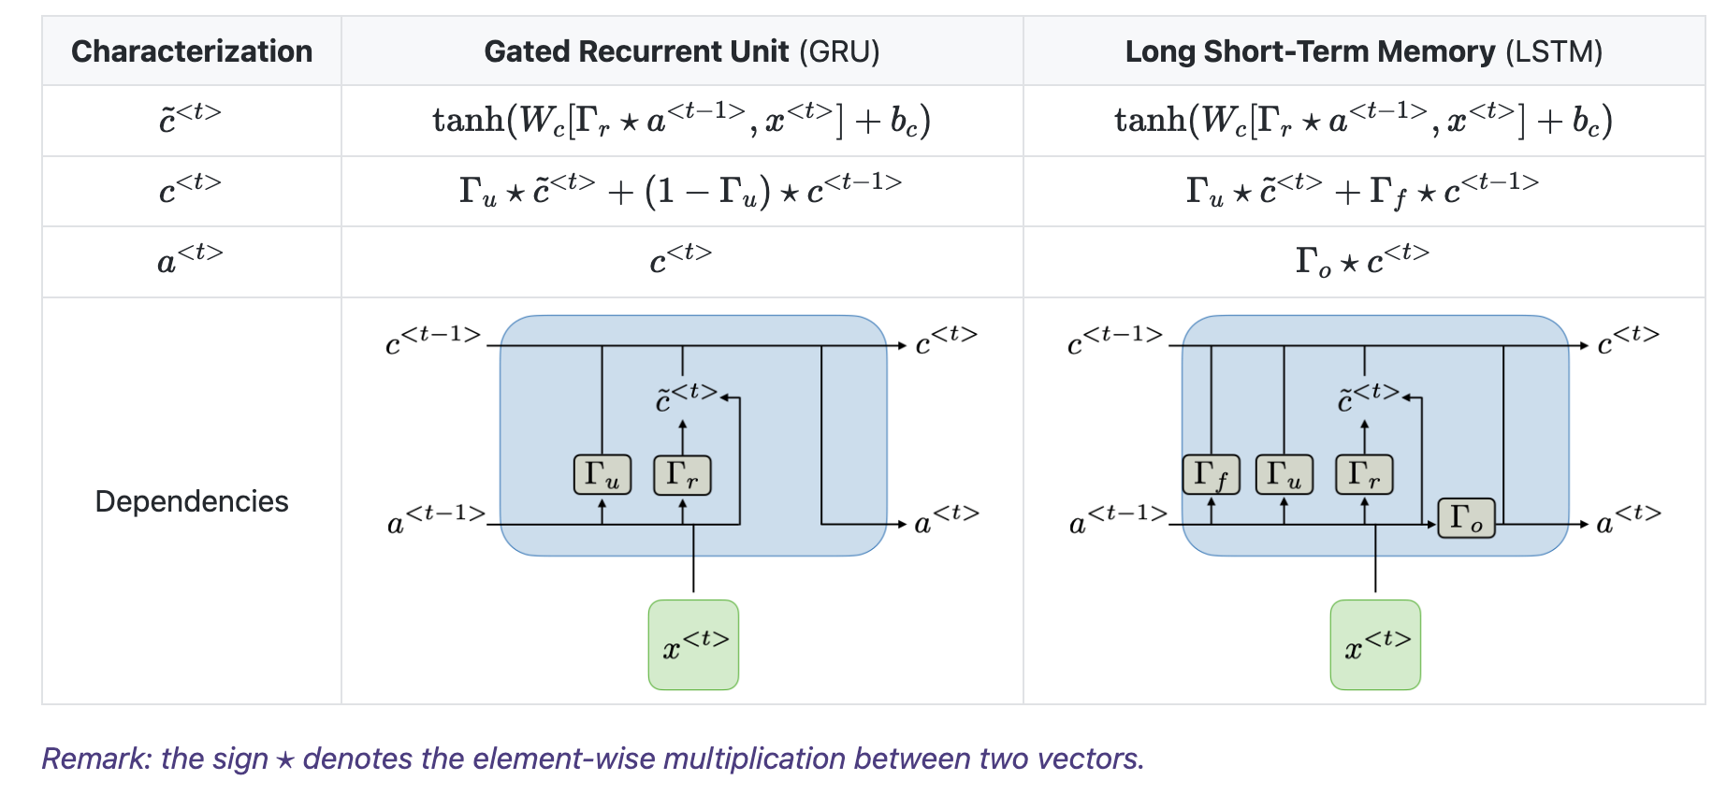

"u": update/input gate
"r": relevance/reset gate
"f": forget gate
"o": output gate
Cell state
Hidden state
What stays the same?
Same calculation for the candidate cell state via relevance/reset gate:
how previous hidden state info should be preserved?
What changes?
combining the update/input and forget gates into a single update ("u") gate (--> reduce number of weights/params)
Why this makes sense or can perform mostly equally to LSTM?
How previous cell state info should be preserved?
Copy cell state to hidden state
What should you choose in practice?
Trade-off between computational efficiency and expressive power
https://stanford.edu/~shervine/teaching/cs-230/cheatsheet-recurrent-neural-networks
Notes:
Because the update gate is trying to determine how much the old cell state should preserved

Slide 3
In practice: Trade-off between efficiency and expressiveness
RNNs | Pros | Cons
GRU | Simpler architecture (two gates) with less parameters Faster training to convergence Less prone to overfitting | Less flexible memory: the price of losing the "forgetting" gate and using a "coupled" scheme meaning whenever adding new info forces forgetting old ones
LSTM | Higher complexity (four gates) with more expressiveness Separation of the "forgetting" and "updating": meaning the model can choose to remember the past while also adding new info Additional output gate allows fine control of whether the model wants to reveal "memory" | Slower convergence Higher computing cost

Slide 4
Implementation of both in PyTorch
import torch
import torch.nn as nn
# Example configuration
input_size = 10 # Number of input features
hidden_size = 20 # Size of hidden state
num_layers = 2 # Number of stacked layers
seq_len = 5 # Sequence length
batch_size = 3 # Batch size
# Sample input tensor: (seq_len, batch_size, input_size)
x = torch.randn(seq_len, batch_size, input_size)
# LSTM implementation
lstm = nn.LSTM(input_size, hidden_size, num_layers)
h0 = torch.zeros(num_layers, batch_size, hidden_size) # Initial hidden state
c0 = torch.zeros(num_layers, batch_size, hidden_size) # Initial cell state
output_lstm, (hn_lstm, cn_lstm) = lstm(x, (h0, c0))
# GRU implementation
gru = nn.GRU(input_size, hidden_size, num_layers)
h0_gru = torch.zeros(num_layers, batch_size, hidden_size) # Initial hidden state
output_gru, hn_gru = gru(x, h0_gru)
print("LSTM output shape:", output_lstm.shape)
print("GRU output shape:", output_gru.shape)

