Slide 1
Masked attention & Cross attention in Transformer Explained
Jian Huang

Slide 2
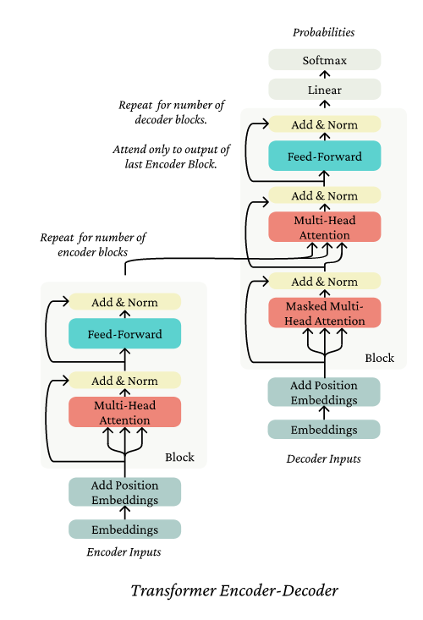
Overview of the transformer architecture
Cross multihead attention
Masked multihead attention
Apparently, there are still a kind of attention, meaning:
Still have Query, Key, Value attention operations
What are the differences?

Slide 3
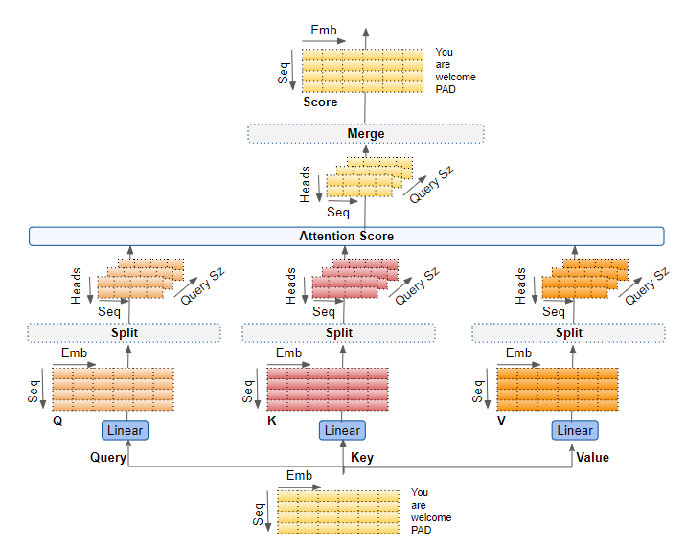
Multi-head attention
Transformers Explained Visually - Multi-head Attention, deep dive | Ketan Doshi Blog

Slide 4
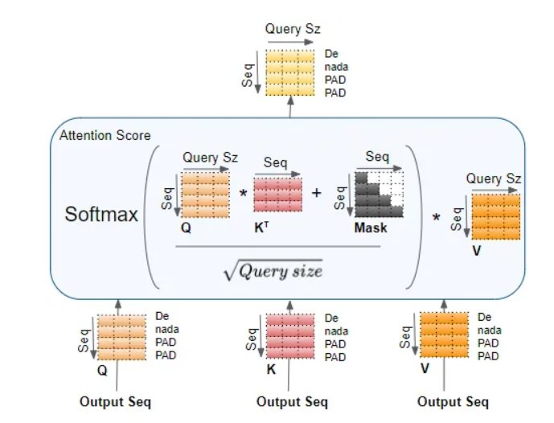
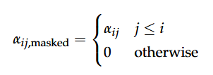
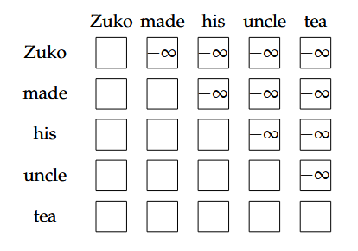
Operations for Masked attention
During softmax, negative infinity ==> 0 ==> no Value contribution for the final output

Slide 5




Masked attention is designed to casuality
To Learn to predict the next token, we must not look into the future and only depend on the past
"Zuko" has not "looked at" the "made" "his" "uncle" "tea"
"Zuko" "made "has not "looked at" the "his" "uncle" "tea"
…...
Enforce casuality:
What if we do not mask?
The "vallina" self-attention is bidirectional
~ meaning the learnt probability depends on both the past and future (information leakage)
Based on chain rule factorization:
~ predicting each token using only previous tokens
~ the probability of the whole sequence is the above equation

Slide 6
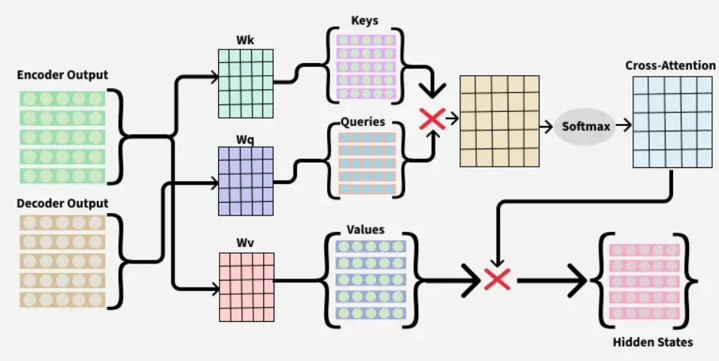
Cross attention
Use Queries from decoder output
Use Keys and Values from encoder output
Encoder: already learnt the "contextual" information (function as a "dictionary");
Decoder: only has the past as a prior and tries to "look up" the dictionary for predicting future
In a real generation taks, which part(s) do we actually use?

Slide 7
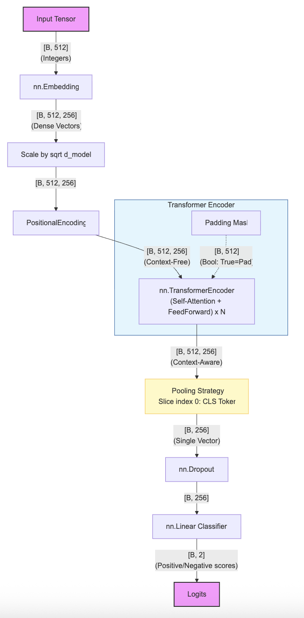
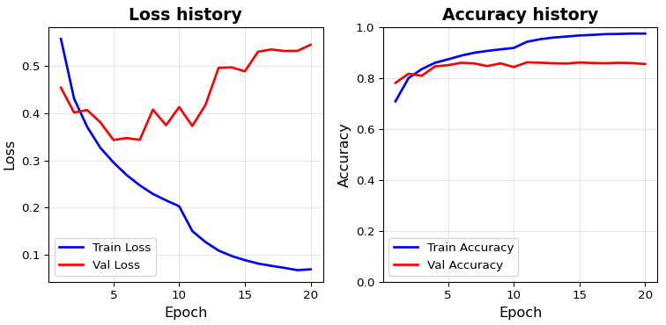
Code implementation for sentiment classification task
Dataset: IMDB reviews on movies
Sentiment: Positive/Negative
https://share.note.sx/jif6qmqd#20wDdSQgF9OKiEsOG3s5zW1hAteTl6W/gGRCY7OPtGo

