Slide 1
Introduction to the “language” of ML/DL
Jian
2025/09/12

Slide 2
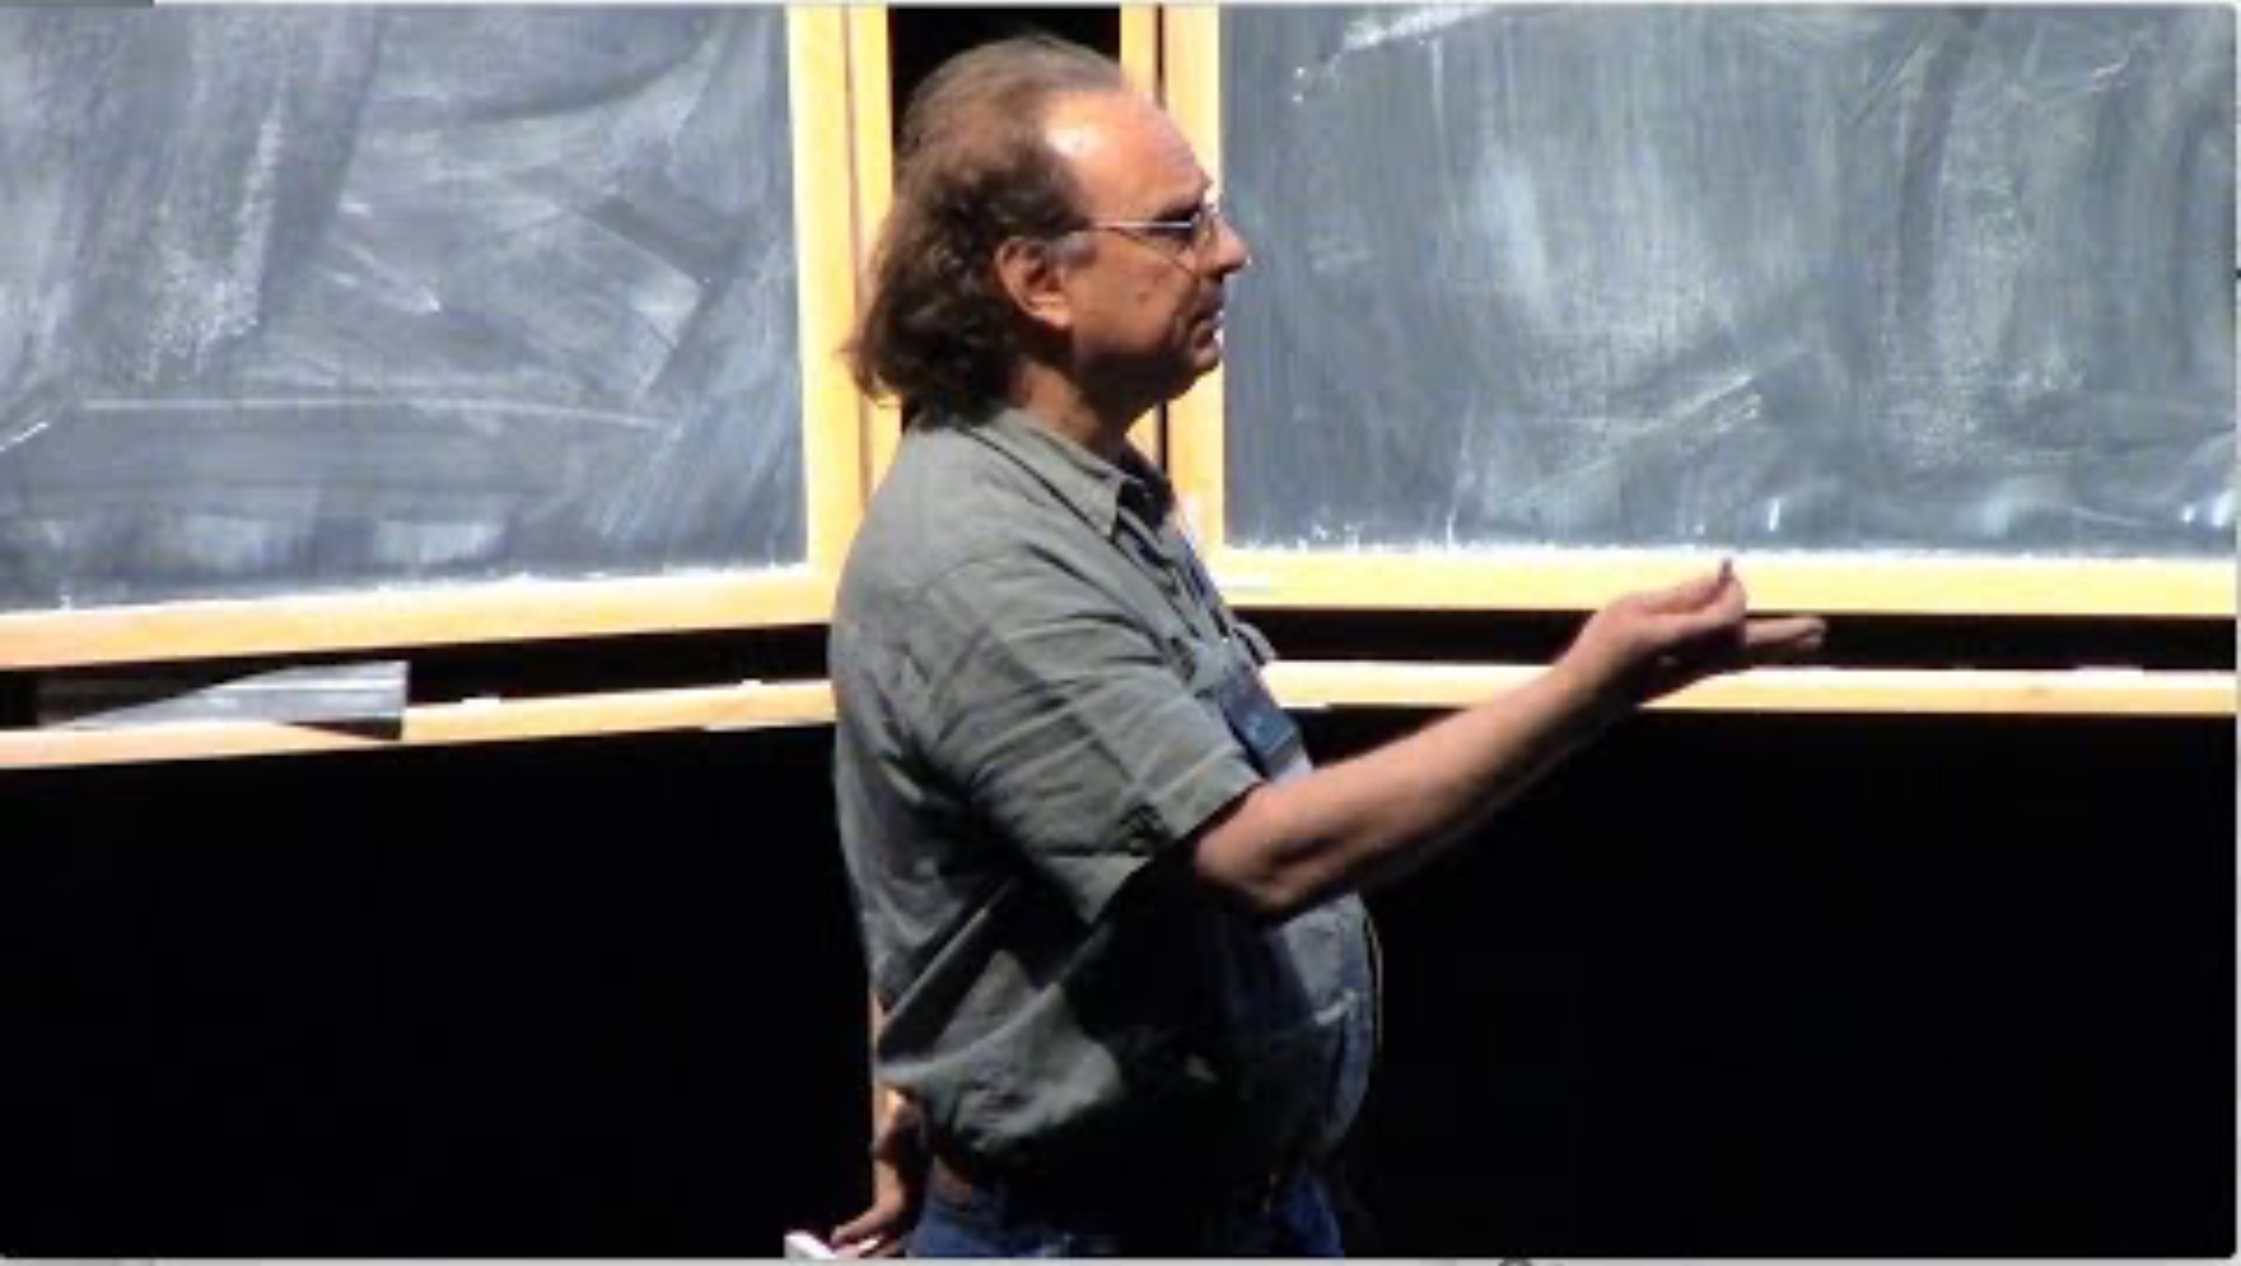
“Functions describe the world”
Prof. Thomas Garrity on mathematical maturity
Phenomena/relationships in the world can be modeled as mathematical functions

Slide 3
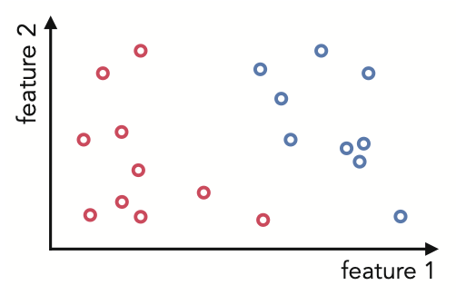
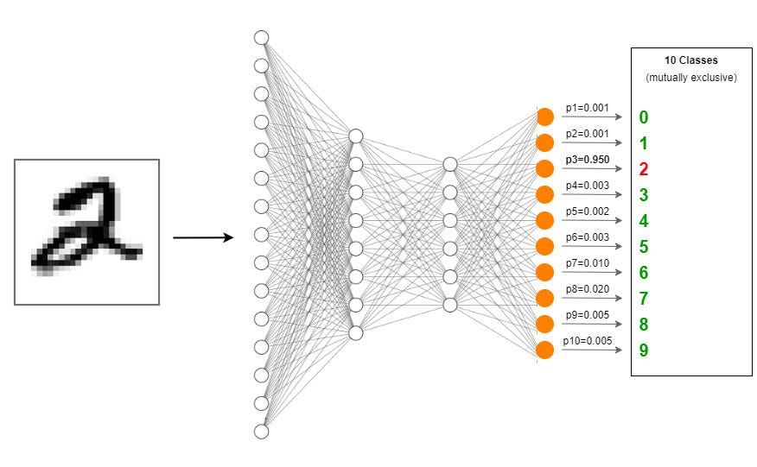
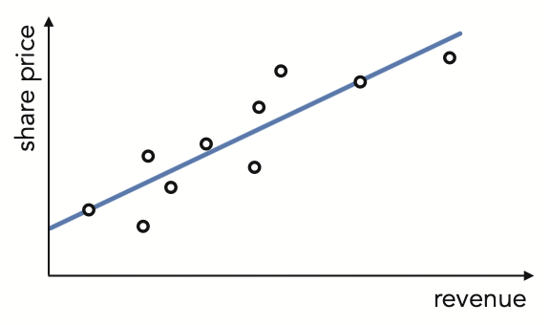
If that is true, our goal is simply to determine the functions
The goal of ML/DL is to find the best models to approximate those functions such that we can make accurate predictions.
f
Input Output
Linear regression
Classification
Image recognition
Difference of ML and DL?
Notes:
https://towardsdatascience.com/creating-a-multilayer-perceptron-mlp-classifier-model-to-identify-handwritten-digits-9bac1b16fe10/

Slide 4
General flow of a ML process
Data collection and preprocessing
Model selection (assumptions about the function forms)
Linear regression, decision trees, SVMs, random forests, neural networks, etc.
Training
Define loss function to describe “how far” we are from the ground truth
Run optimization algorithms to iteratively update parameters of the model
Evaluation
Performance of certain metrics on validation dataset
Hyperparameter search; regularization (early stopping etc.)
(Iteration: re-select new models; hyperparameters etc.)
Testing
generalizability

Slide 5
The language of machine learning
Model
Loss/cost function
Optimization scheme: Global and Local
0th order optimization (Kairong: random search; Harsha: coordinate search and descent)
1st order optimization (David)
2nd order optimization (Shrishti)
Learning rate
Training / Validation / Testing
Loss history
Performance metrics

Slide 6
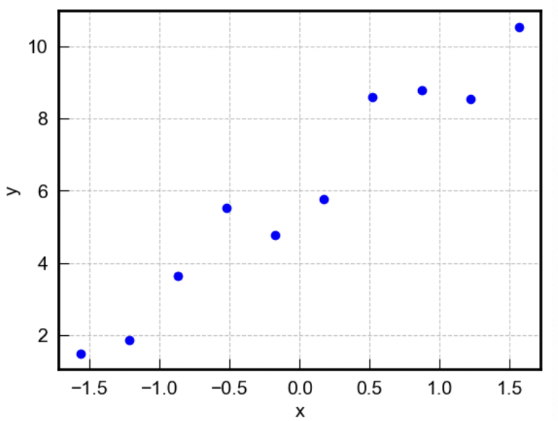

The simplest case: linear regression
y = w * x + b

Slide 7
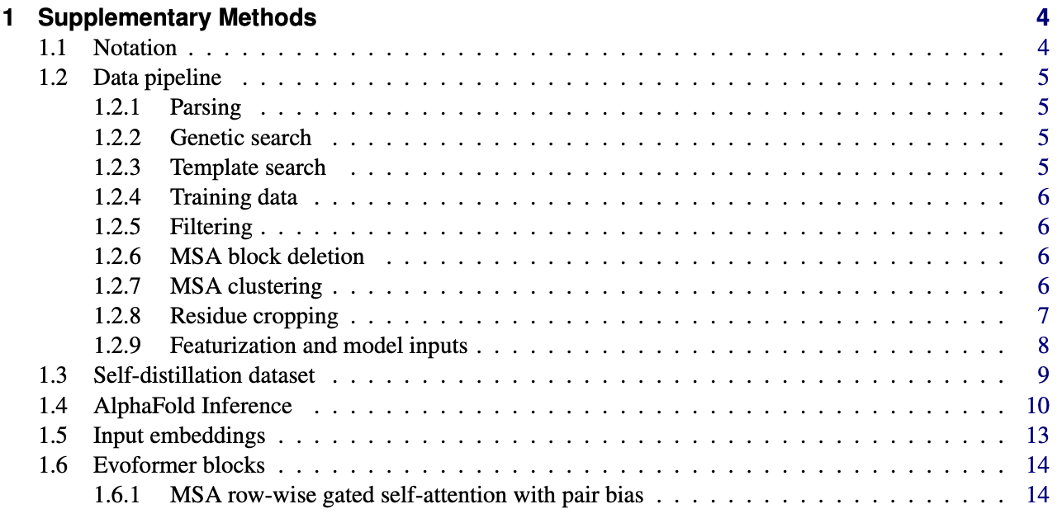
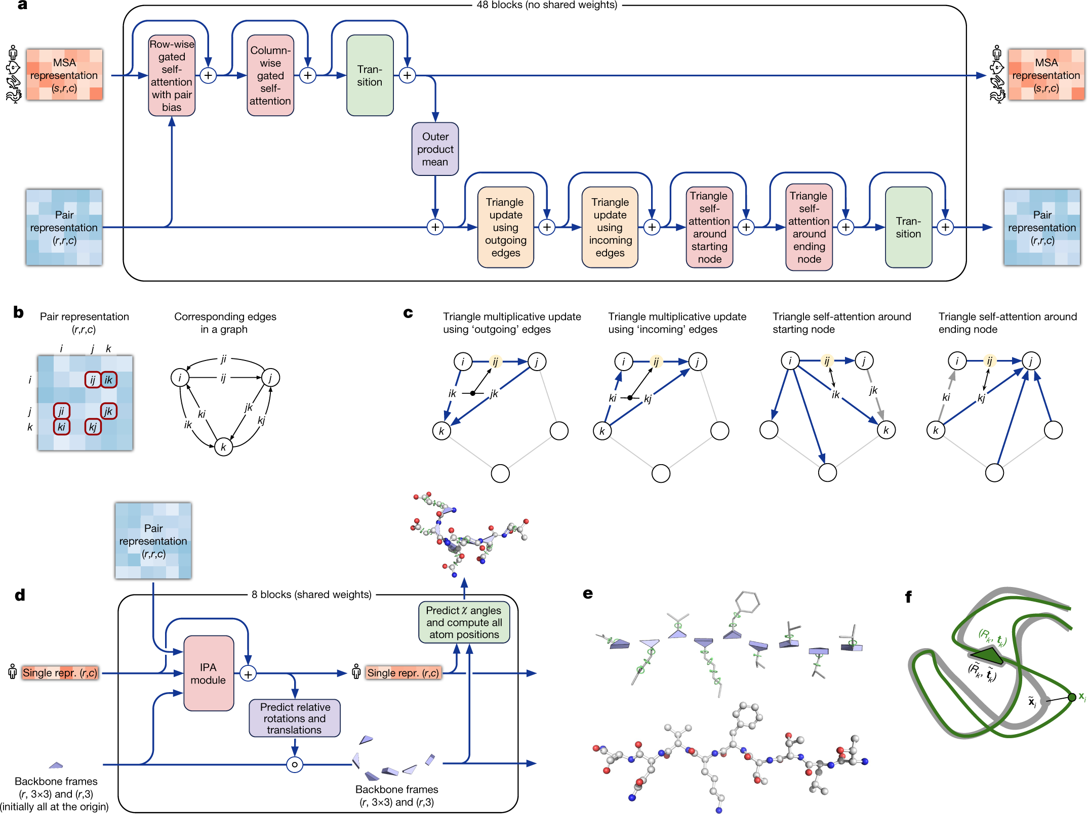
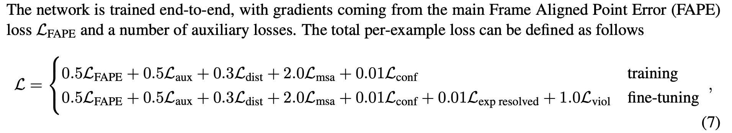
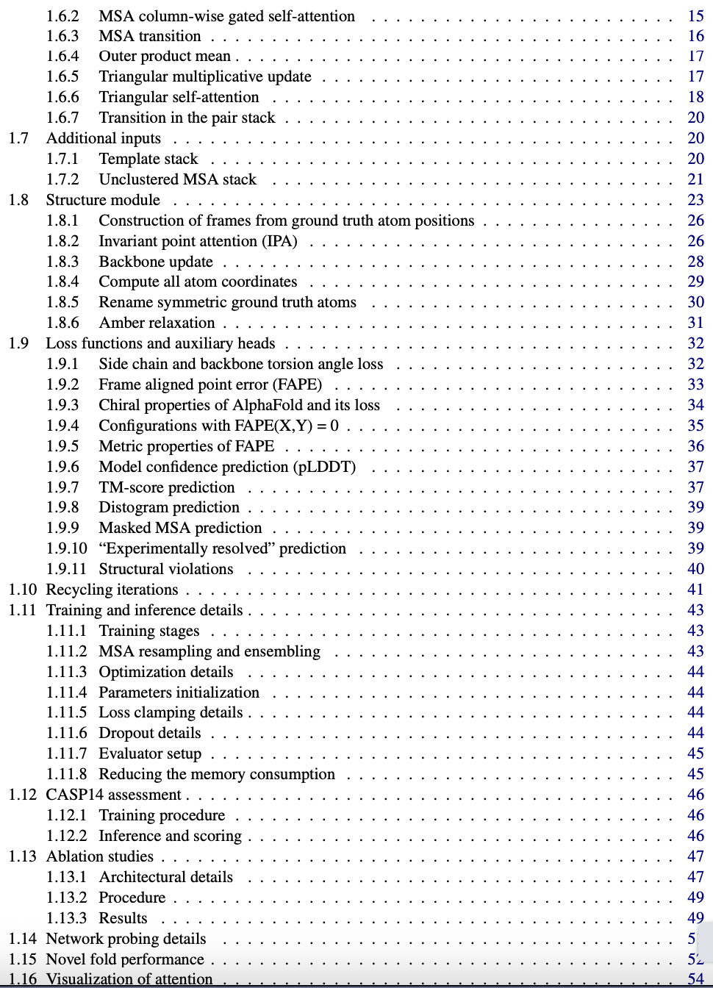
Even the most state-of-art models follow this pattern...

Slide 8
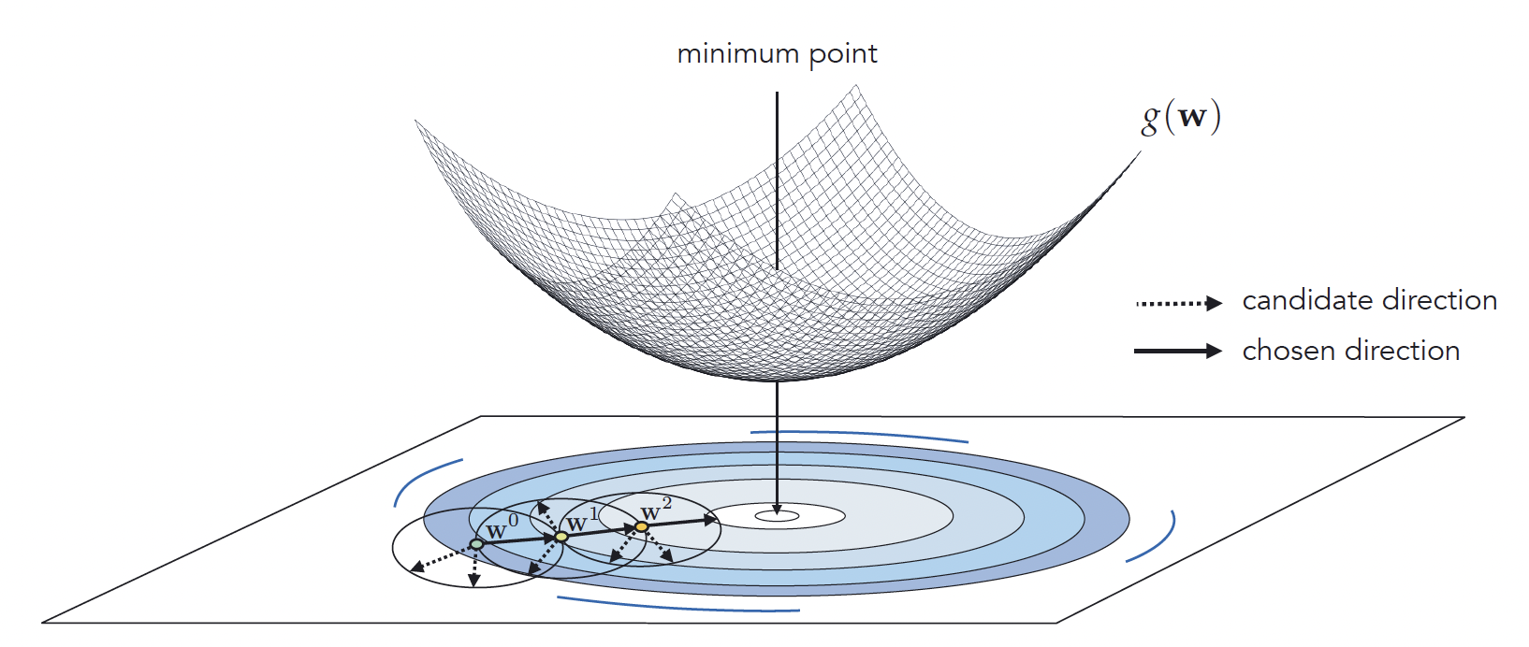
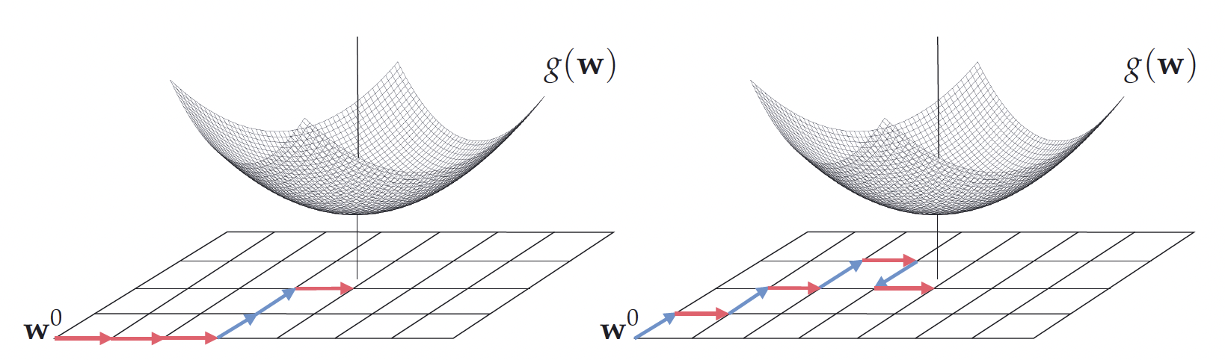
Local optimization schemes
Optimization scheme: Global and Local
0th order optimization (Kairong: random search; Harsha: coordinate search and descent)
1st order optimization (David)
2nd order optimization (Shrishti)

Slide 9
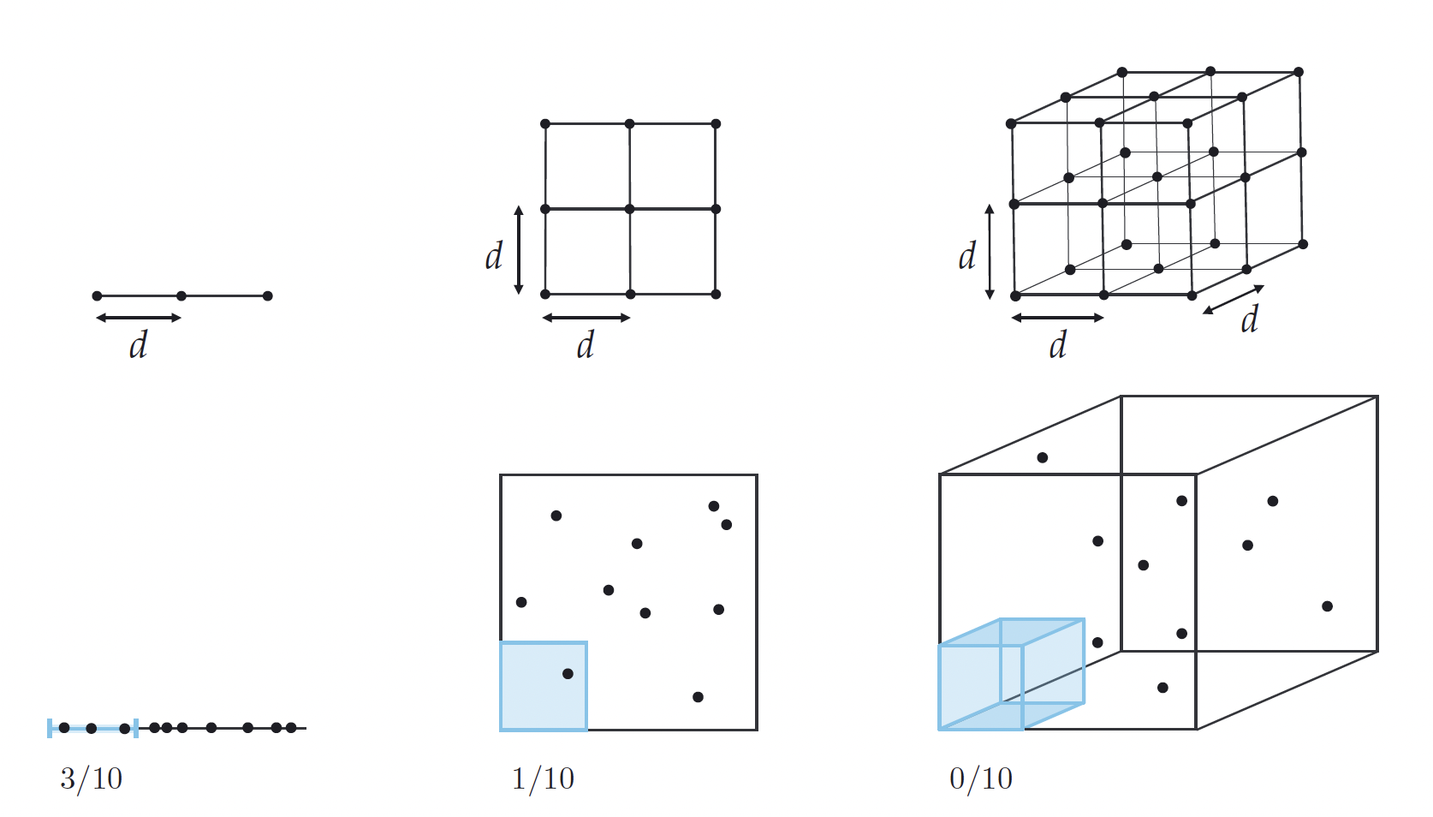
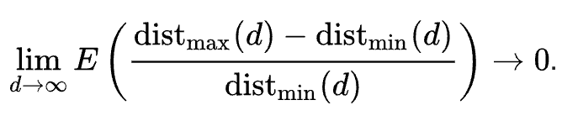
Curse of dimensionality
More search directions as D increases
High dimension data points are equally close/far
Distance metrics loss meaning in high dimension
Computational search source grows exponentially
Overfitting

Slide 10
Importance of learning rate
Learning rate affects how large the new update of input will be from the current
A reasonable choice of learning rate

Slide 11
Thank you.

