Slide 1
Convolutional neural network (CNN) explained
Jian Huang

Slide 2
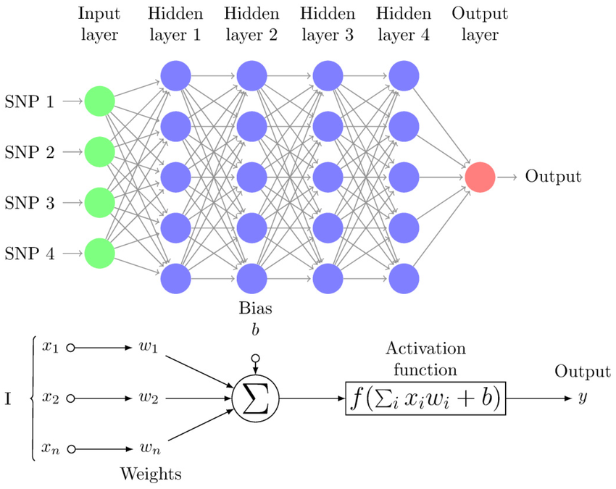
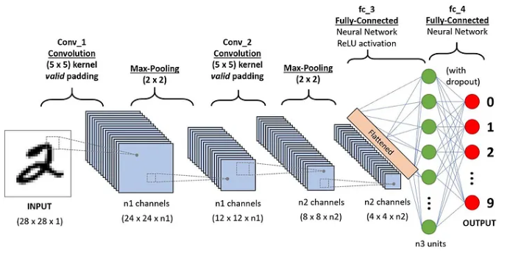
Overview
Multilayer perceptron
CNN
Convolution layer
Max-Pooling
Fully connected
Softmax
What to expect for input? Volume data: width * height * depth (depth=channels)
What to expect for output?
Why can those tricks help us with image-like data? [Filter/stride/padding; parameter sharing; max-pooling]
Pérez-Enciso, M. & Zingaretti, L. M. Genes 10, 553 (2019).
https://medium.com/@draj0718/convolutional-neural-networks-cnn-architectures-explained-716fb197b243

Slide 3
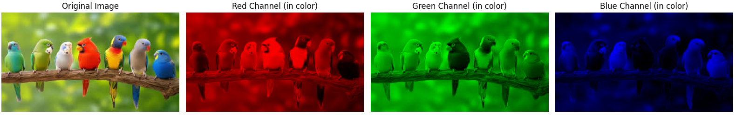
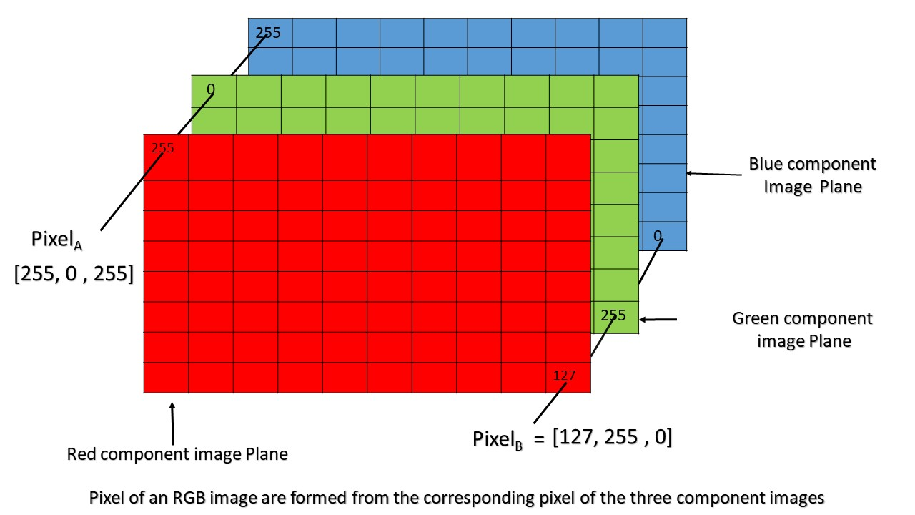
"Volume"-like input
Understand input: data with localized "patterns" (images, speeches, sentences...)
Width
Height
Depth (channels)
https://media.geeksforgeeks.org/wp-content/uploads/Pixel.jpg

Slide 4
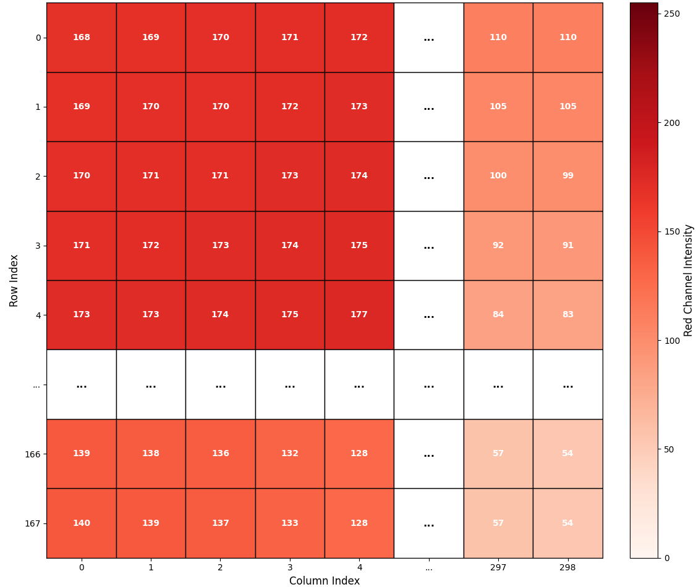
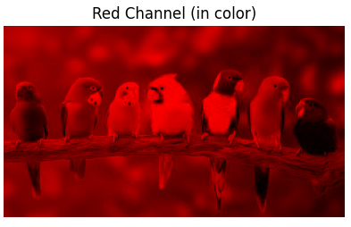
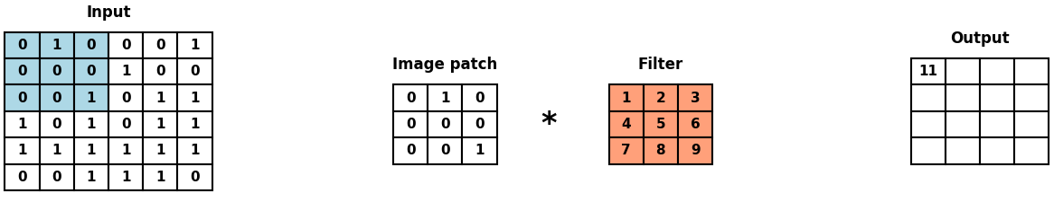
The "convolution" operation
Width
look at one channel first
Height
Depth (channels)
W=168; H=299
Value range: [0, 255]
Filter & the first convolution
Why are we using FILTER?
F = 3*3
(Kernel/Receptive field)

Slide 5
The "convolution" operation
Filter & the first convolution
(Kernel/Receptive field)
Sweep the filter on the width-height dimension with Stride=1
Why are we sharing parameters?
D = (W – F)/S + 1 = 6 – 3 + 1 = 4

Slide 6
Padding
P = 1
P = 2
0
0
0
0
0
0
0
0
0
0
0
0
0
0
0
0
0
0
0
0
0
0
0
0
Generally:
P = (F-1)/2 when S=1
D = (W – F + 2P)/S + 1 = (6 – 3 + 2)/1 + 1 = 6

Slide 7
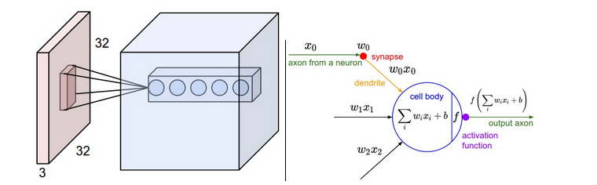
Now we consider depth/channel + multiple filters
Detect "beak"
Detect "tail"
Width
Height
Depth (channels)
W=H=32
F=3
S=1
P=1
Depth (channels)
1 filter --> 1 slice/feature map (32*32*1)
5 filters --> 5 slices/feature maps (32*32*5)
How many parameters are there?
1 filter: 3*3*3 + 1 = 28​
5 filters: 28 * 5​
(F*channels + 1)*Filter numbers​
There is no W and H!
Of note, the output is again a "volume" data (W'*H'*D')
D' = channels / number of filters in previous convolution layer
Another convolution layer can be added … so on and so forth ...
Why do we want multiple layers?

Slide 8
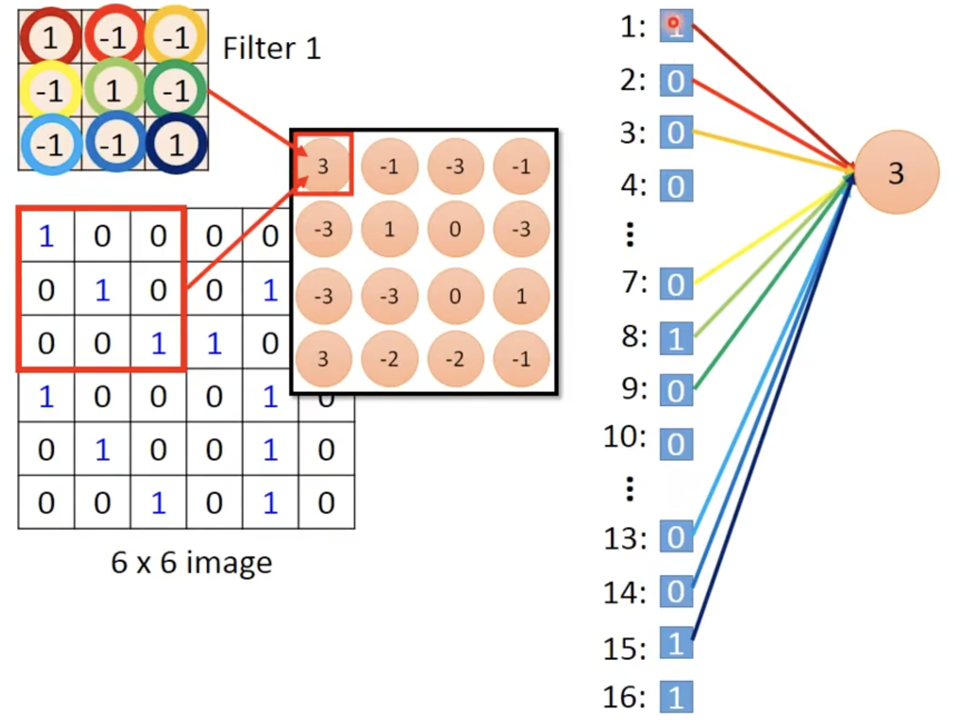
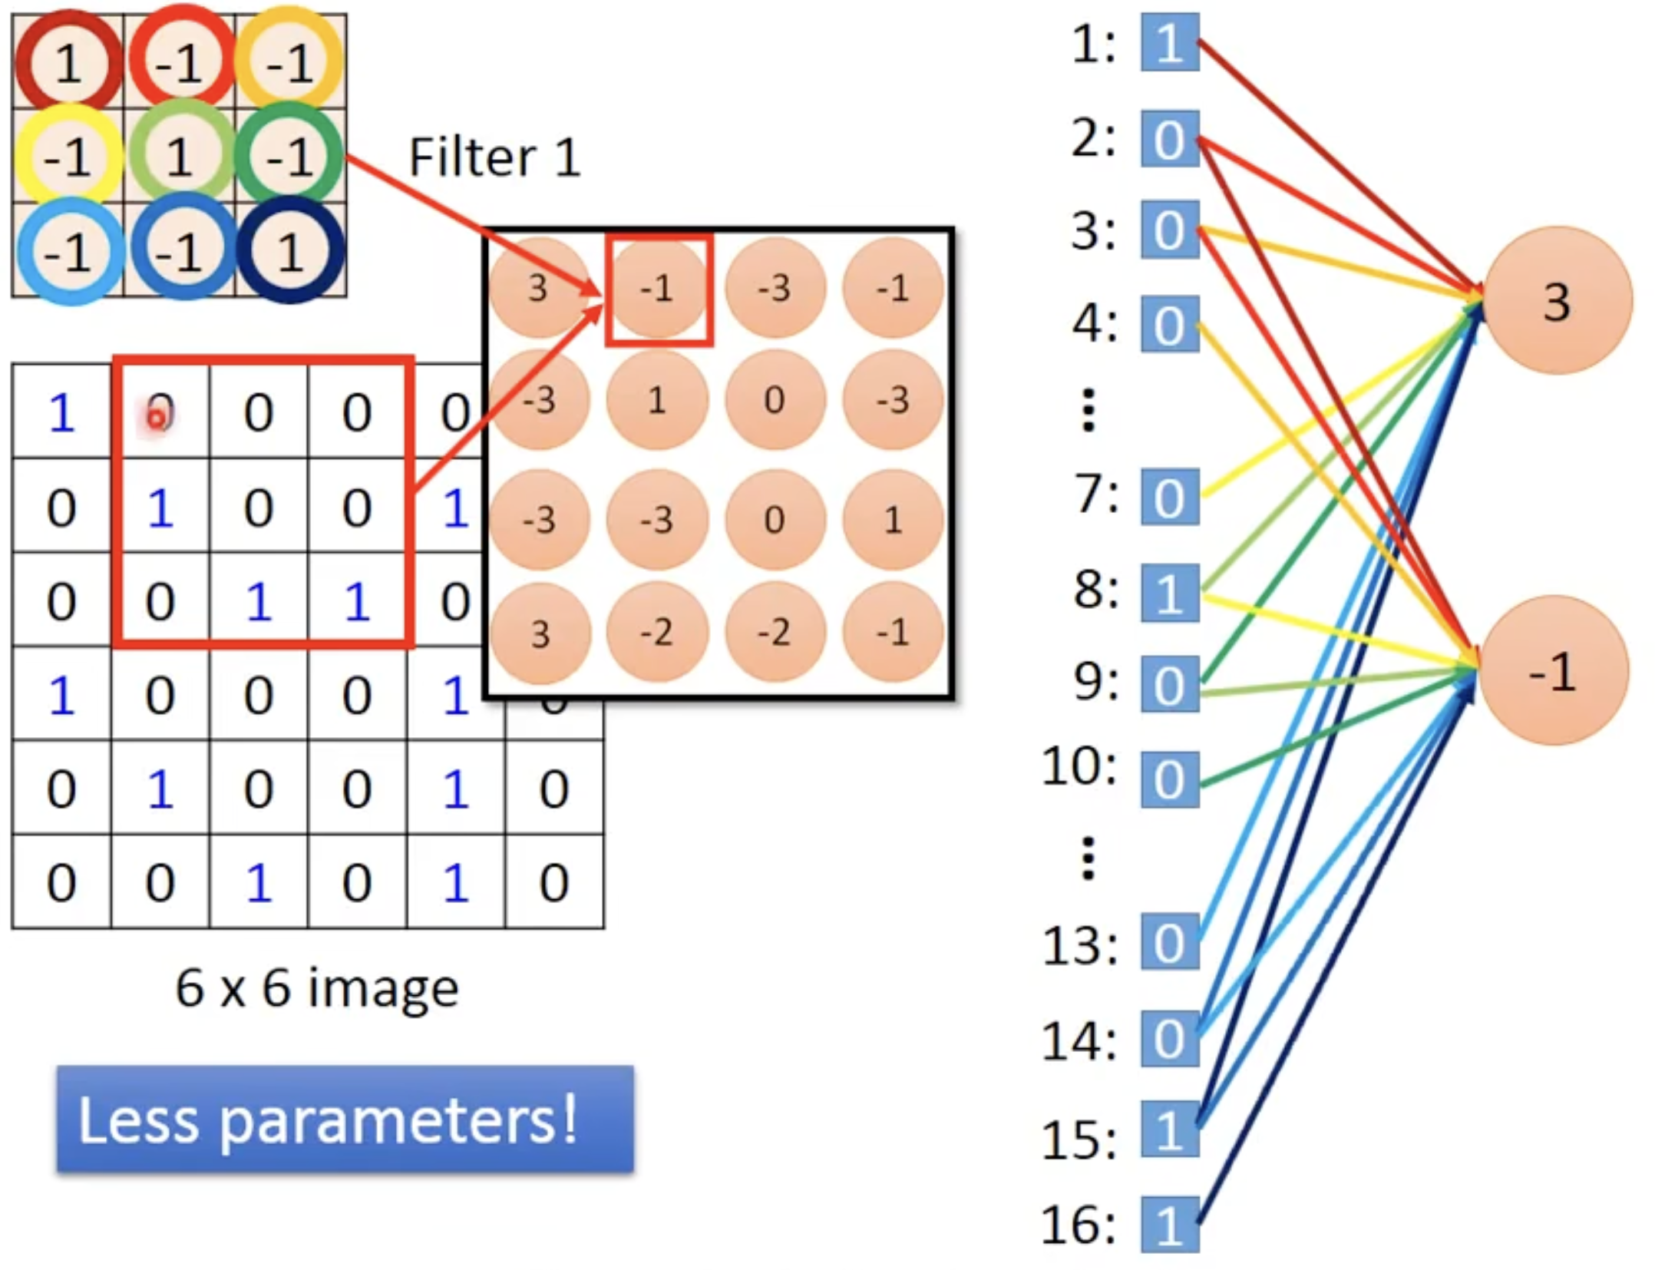
CNN is essentially a simplified and regularized FNN
Less parameters through sharing
Local pattern detection (connect pixels from localities in tensor)
https://www.youtube.com/watch?v=FrKWiRv254g

Slide 9
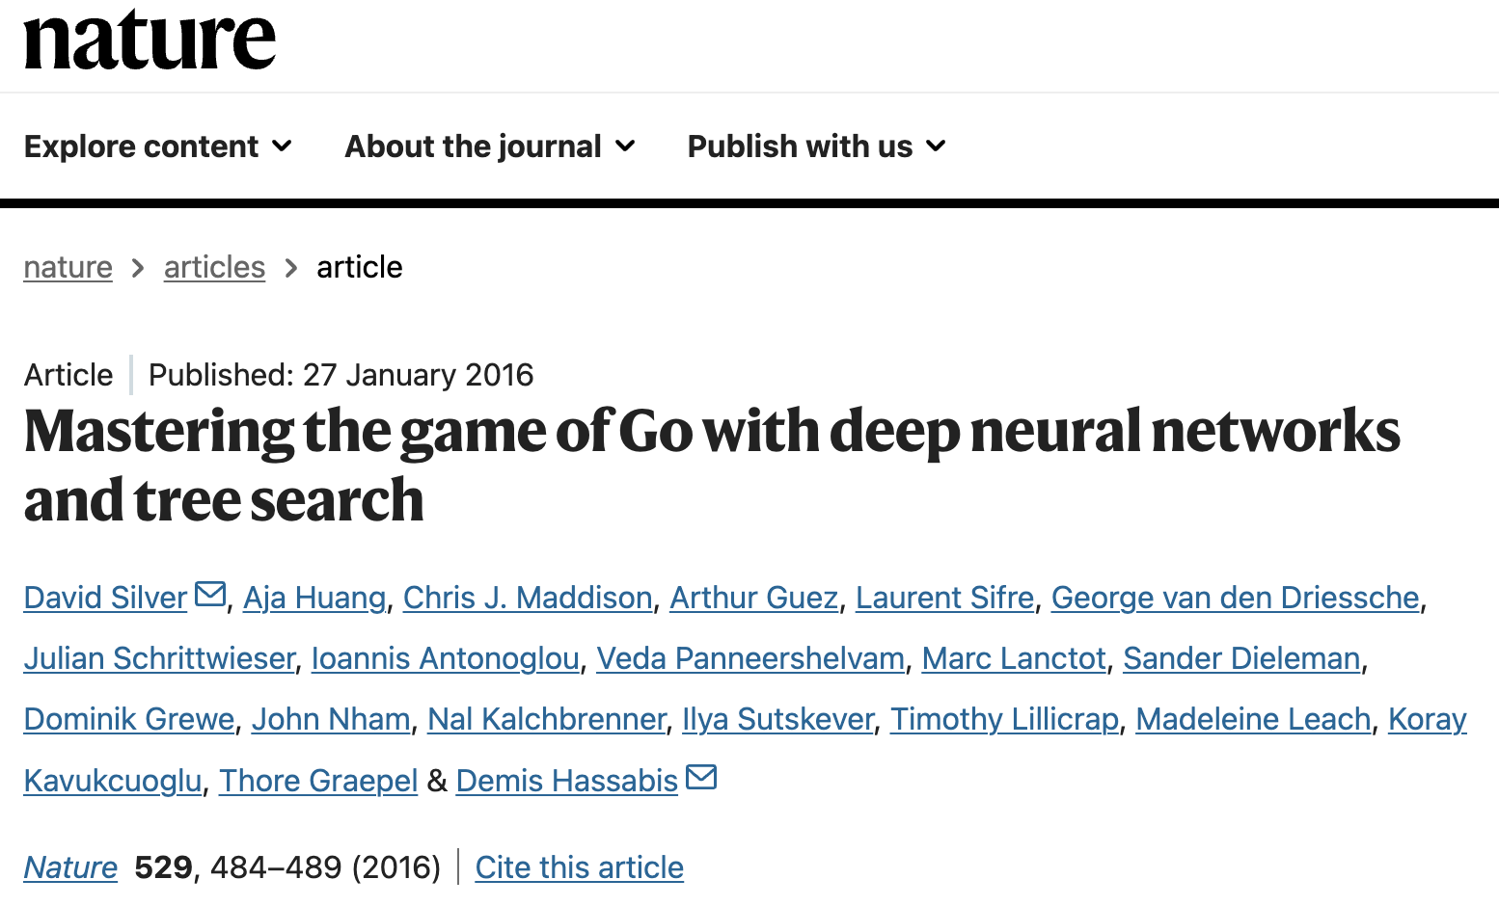
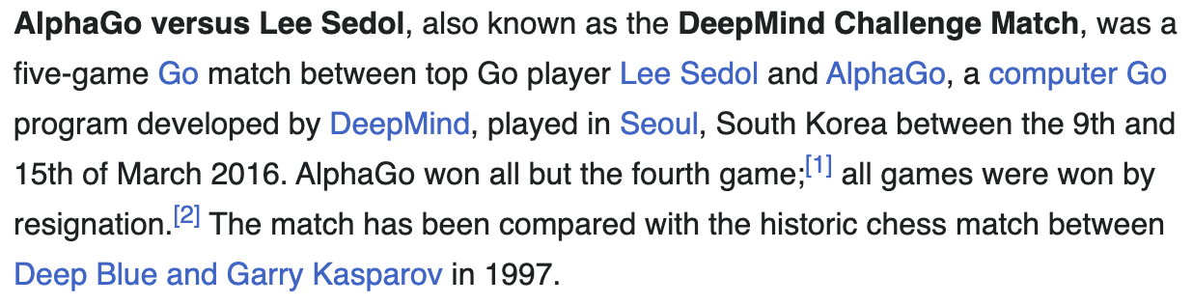
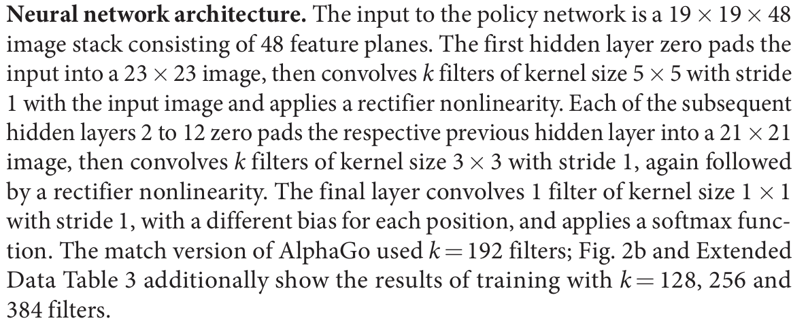
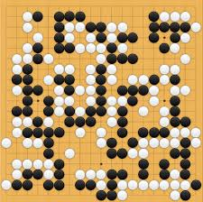
AlphaGo
19*19

Slide 10
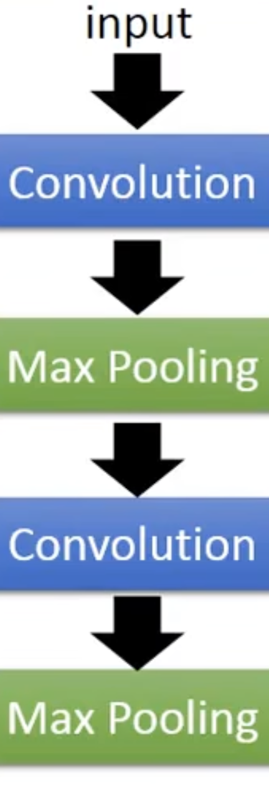
Max-pooling

Slide 11
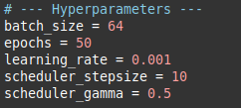
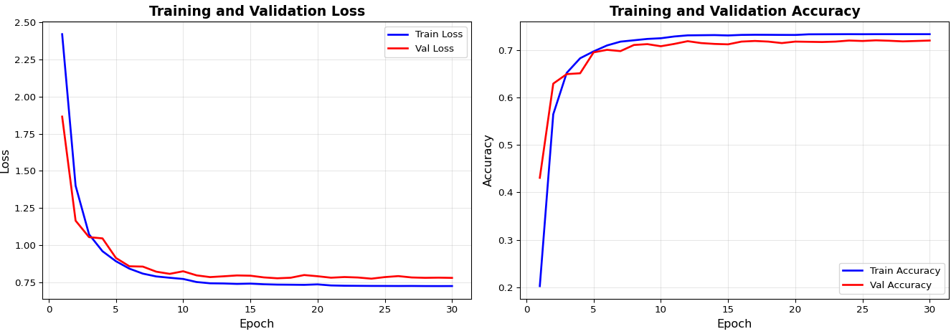
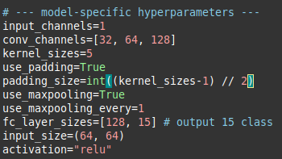
Training
Training : Validation : Testing = 0.7 : 0.15 : 0.15

