Slide 1
Nonlinear dimension reduction
Jian Huang
Chen lab
10/31/2025

Slide 2
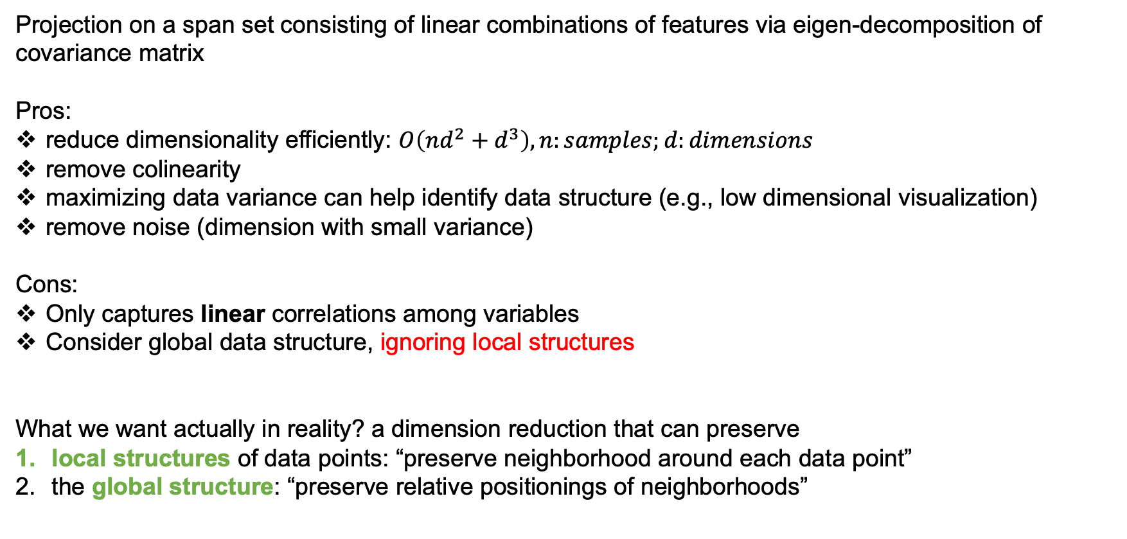
Starting with PCA: pros and cons
Projection on a span set consisting of linear combinations of features via eigen-decomposition of covariance matrix
Pros:
reduce dimensionality efficiently: $O\left(nd^{2}+d^{3}\right), n:samples;d:dimensions$
remove colinearity
maximizing data variance can help identify data structure (e.g., low dimensional visualization)
remove noise (dimension with small variance)
Cons:
Only captures linear correlations among variables
Consider global data structure, ignoring local structures
What we want actually in reality? a dimension reduction that can preserve
local structures of data points: “preserve neighborhood around each data point”
the global structure: “preserve relative positionings of neighborhoods”

Slide 3
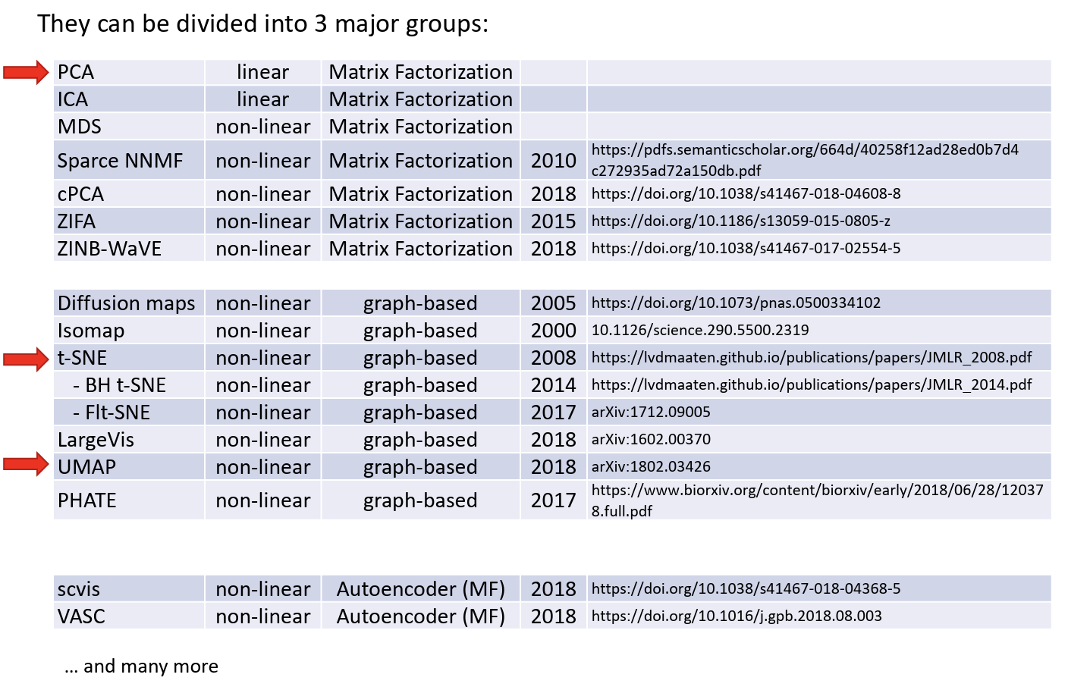
Overview of some popular NL dimension reduction methods

Slide 4
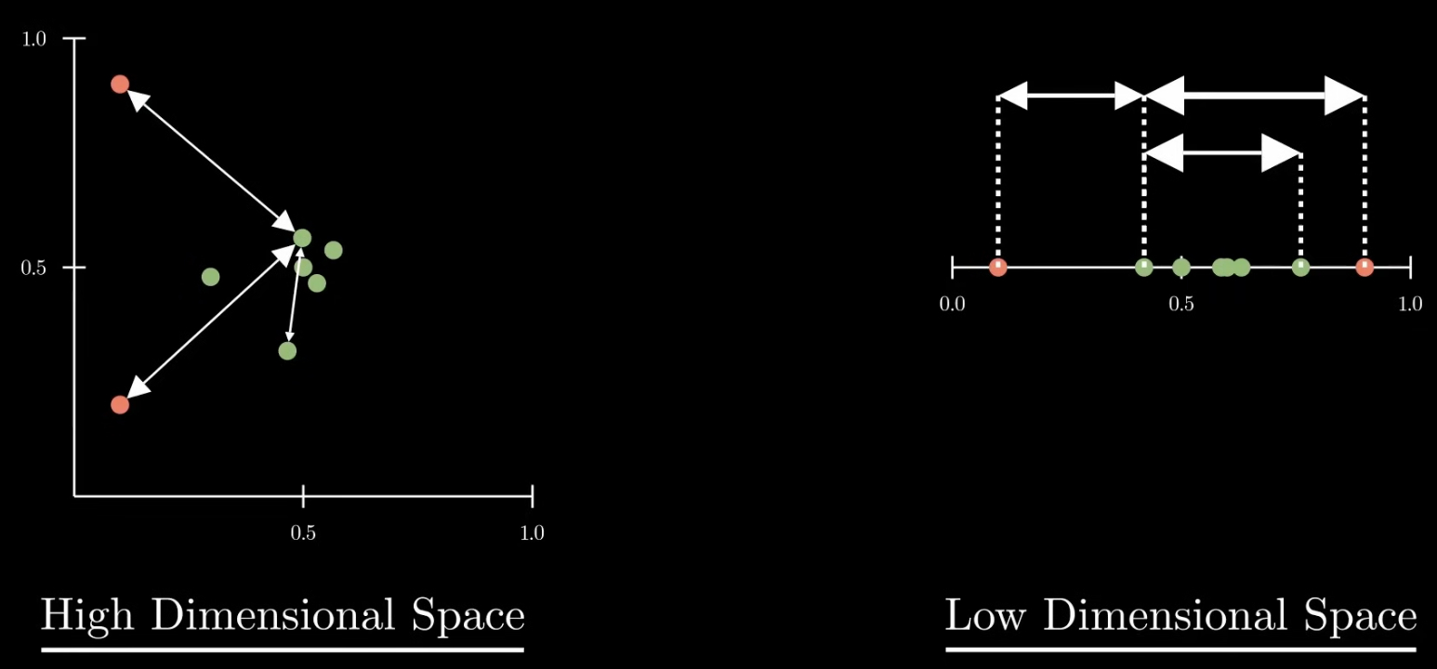
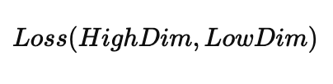
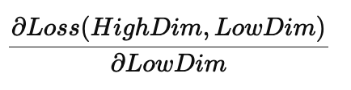
Basic principle behind graph-based methods
Overview of some popular NL dimension reduction methods
Basic idea: data points in high-D that are close to each other should also be close in the low-D
step 1: define local relationships between data points, for example, Euclidean distance
step 2: find a low-D representation that preserves those “neighborhood” relationship as faithful as possible
in ML language:
define a Loss that measures how different the local relationships (distances) are in high-D and the low-D reps
Minimize the Loss by improve low-D rep

Slide 5
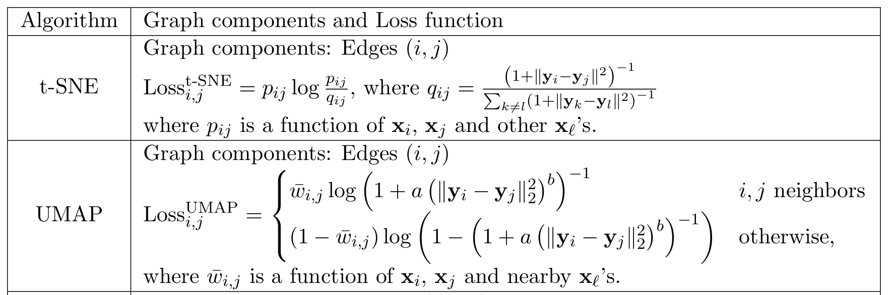
SNE, t-SNE and UMAP
Basic idea: data points in high-D that are close to each other should also be close in the low-D
step 1: define local relationships between data points, for example, Euclidean distance
step 2: find a low-D representation that preserves those relationship as faithful as possible
in ML language:
define a Loss that measures how difference the local relationships (distances) are in high-D and the low-D reps
Minimize the Loss by improve low-D rep

Slide 6
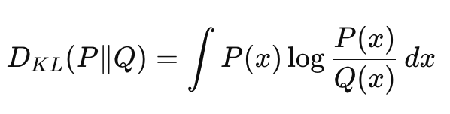
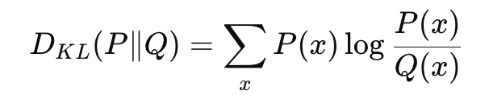
Kullback-Leibler (KL) divergence

Slide 7
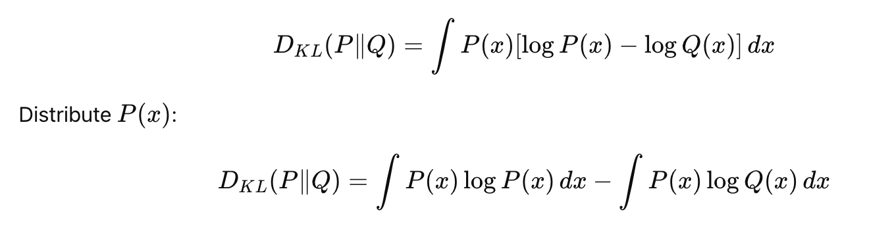
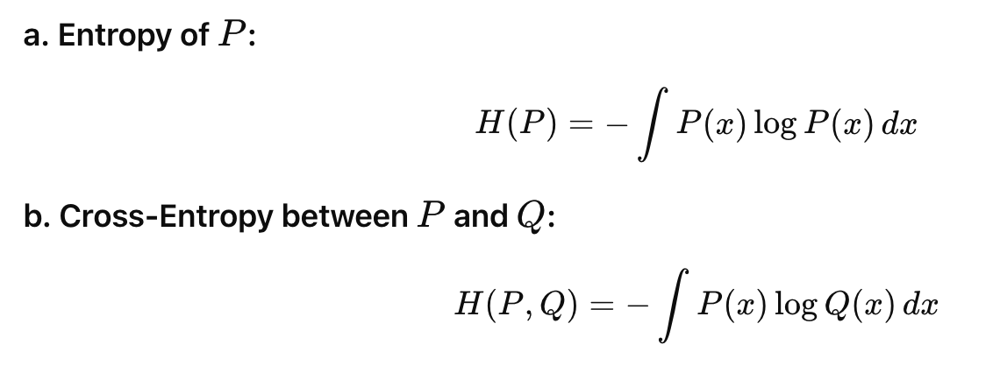
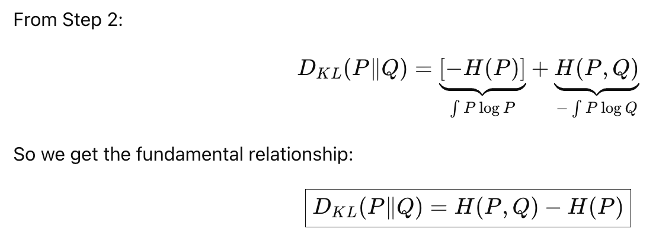
Equivalence between KL and cross-entropy Loss for ML algorithms
Shannon’s entropy
“Unpredictability”
cross-entropy

Slide 8
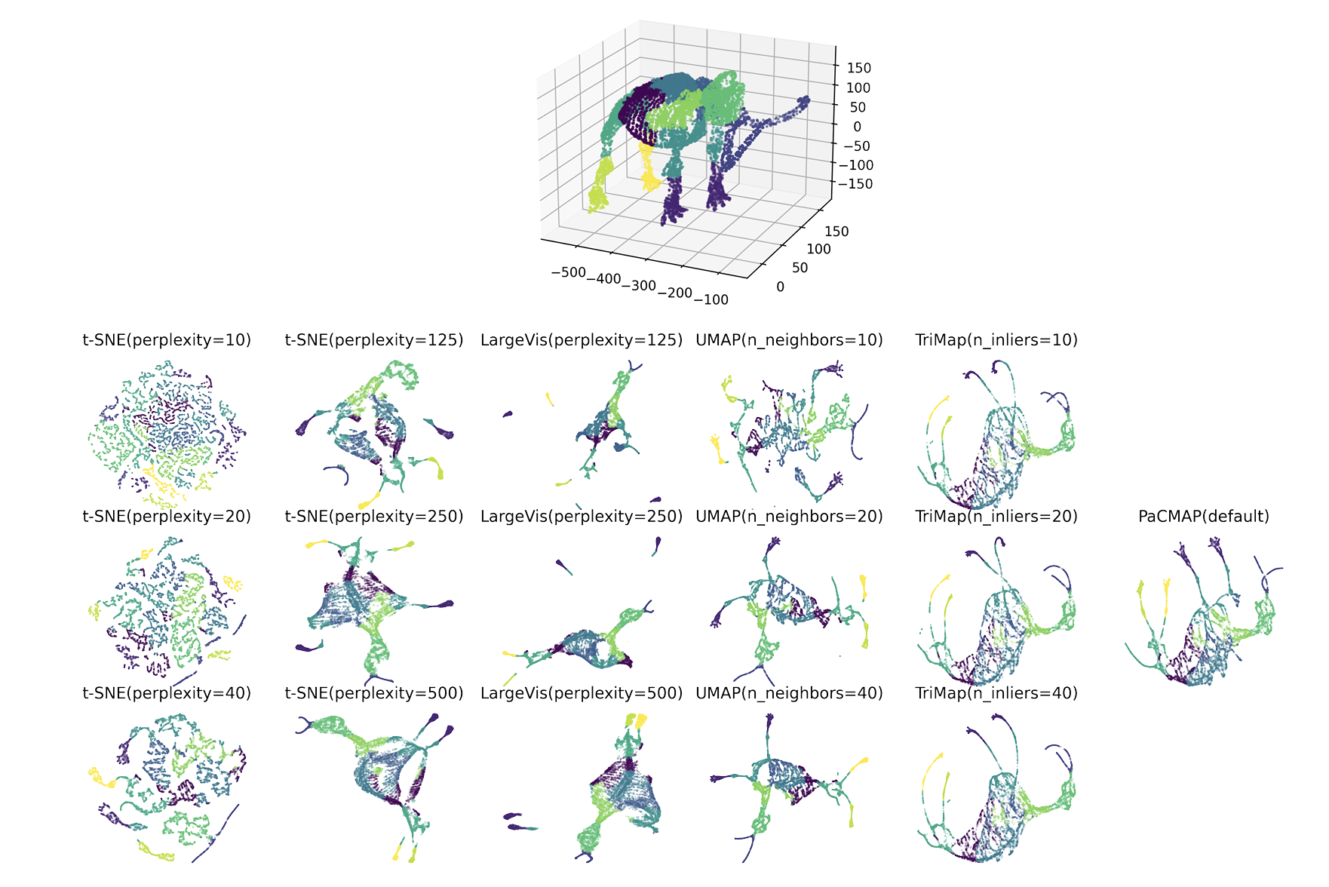

Slide 9
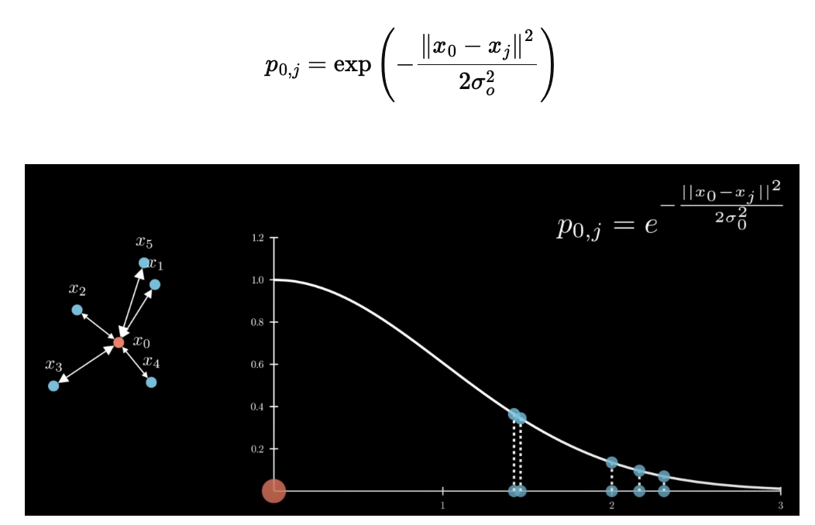
RBF kernelization in SNE

