Slide 1
Other strategies to deal with overfitting
Harshavardhan

Slide 2
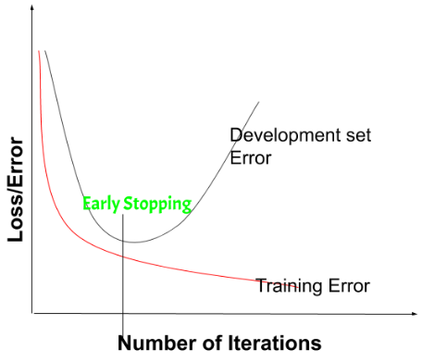
Early Stopping
Stops model training when overfitting signs appear
Data should be split as training, validation and testing
Monitors validation performance and loss
# of training epochs is a hyperparameter
Benefits
Reduces Overfitting
Saves Computational Resources and improves efficiency
Simple implementation
Limitations
Risk of Underfitting
Not Suitable for All Models
Dependency on the Validation Set

Slide 3
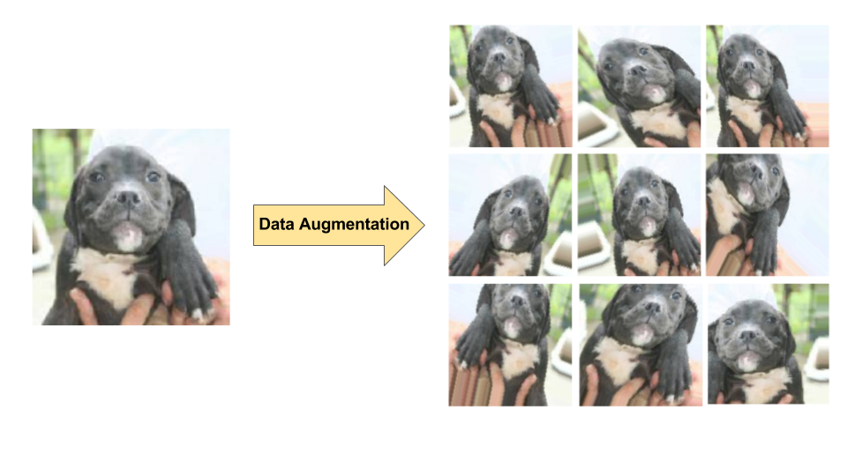
Data Augmentation
Artificially increase the size and diversity of a training dataset
Random transformations to existing data
Flipping
Cropping
Rotating
Color distortions
Disadvantages
Potential for introducing noise

Slide 4
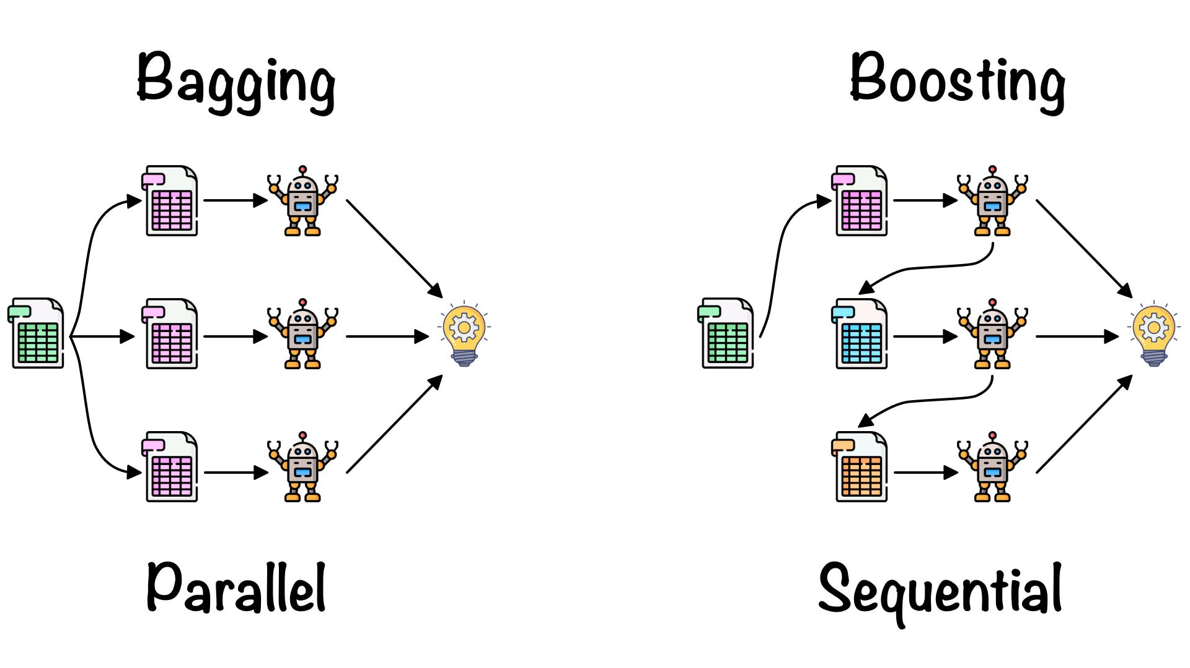
Ensemble methods
Use different models to train and predict and use the combined prediction from these individually trained models
Basic methods
Average prediction - Take average of predictions - Regression problems
Max vote - Take the max vote of the output - classification problems
Advanced methods
Bagging
Boosting
Stacking

Slide 5
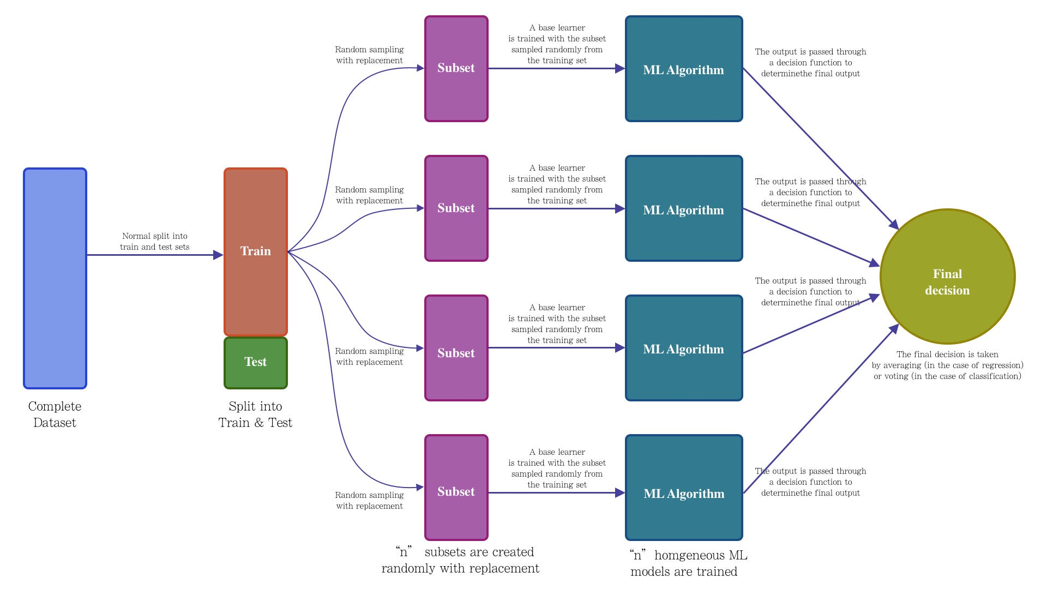
Bagging or Bootstrap Aggregation
Create multiple datasets from the train dataset by selecting observations with replacements
Run a base model on each of the created datasets independently
Combine the predictions of all the base models to each the final output

Slide 6
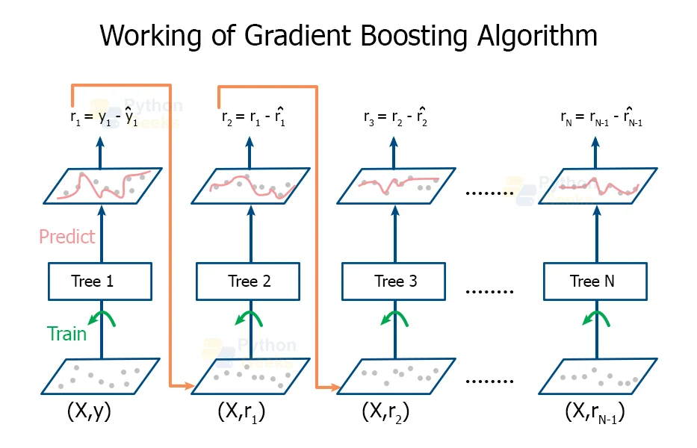
Boosting
Sequentially train the “weak learners”

