Slide 1
Developing web based mobile mapping applications with JavaScript
Matt Lane – OIR GIS Services, State of TN

Slide 2
USE HTML 5
New semantic elements
Geolocation
Local storage
File api

Slide 3
Reduce page load
Less requests
Single js
Single css
Compact ESRI api
Smaller requests
Minified files
Compression
Smaller images
JavaScript last when possible

Slide 4
Mapping is (slightly) different
Page zoom matters
Map height matters

Slide 5
Choose the correct approach
Mobile Enabled
Mobile Targeted
Mobile Native

Slide 6
Prototype the GUI
Sketch out design
Small
Medium
Large
Can show customer before code, head design problems off early
Some tools can export page markup

Slide 7
Mobile 1st approach (Responsive)
Design a site first for mobile
No js for structure, just markup and CSS
Small images
Small number of requests
Alter structure and dimensions as it sizes up to desktop
Choose media query breakpoints based on content, not device dimensions
Changes are dependent on needs
Devices dimensions change

Slide 8
Today’s examples
Mobile Enabled (responsive)
Traditional desktop oriented web layout
Grid system (bootstrap)
Mobile Targeted
jQuery mobile
Extras
Geolocation (follows your position)
Redirection of a desktop site to a mobile one

Slide 9
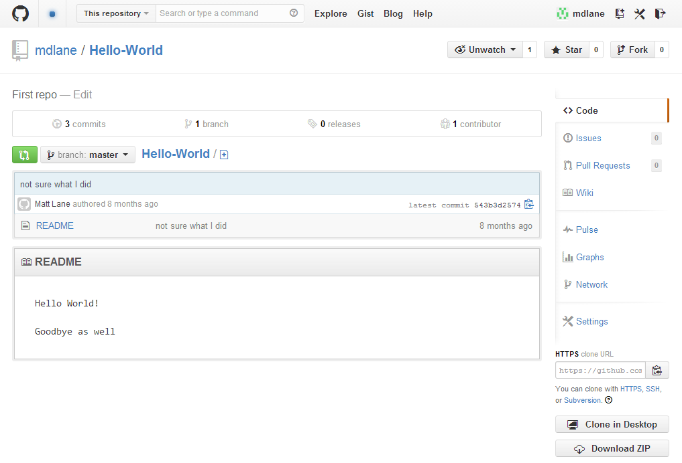
Wrap up
CONTACT
Matt Lane
matt.lane@tn.gov
615-741-7724
DOWNLOAD / FORK
https://github.com/mdlane/Hello-World

