Slide 1
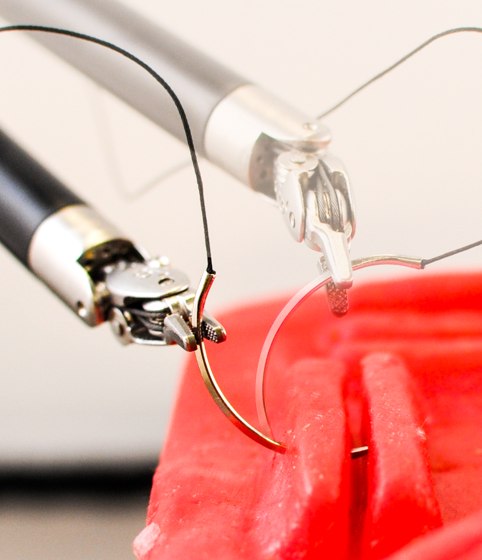
(a) Driving Simulator
(b) Grasping in Clutter in Box2D
(c) Surgical Needle Insertion
(d) Performance of SHIV

