Slide 1
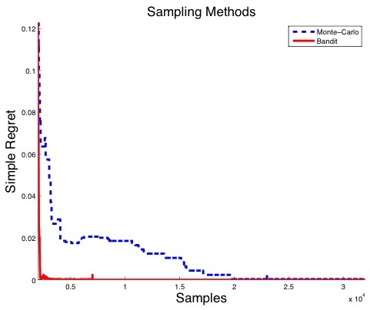

Slide 2
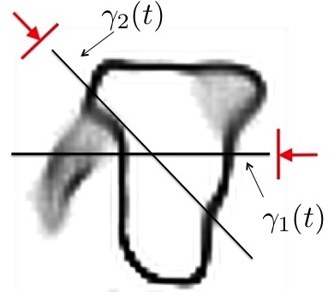

Slide 3
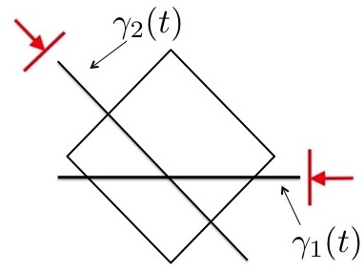

Slide 4


Slide 5
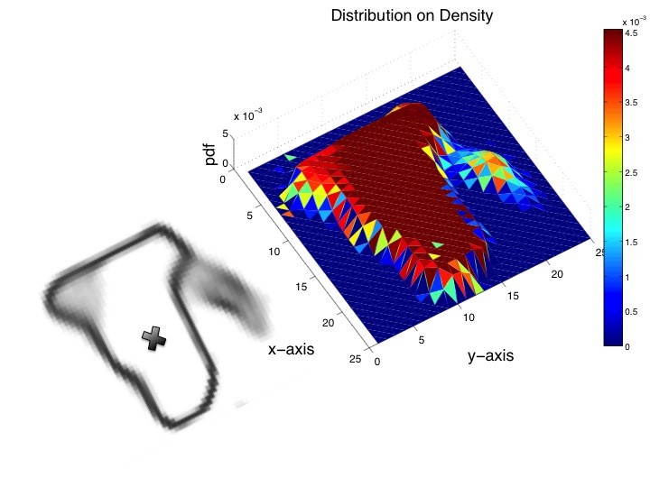

Slide 6
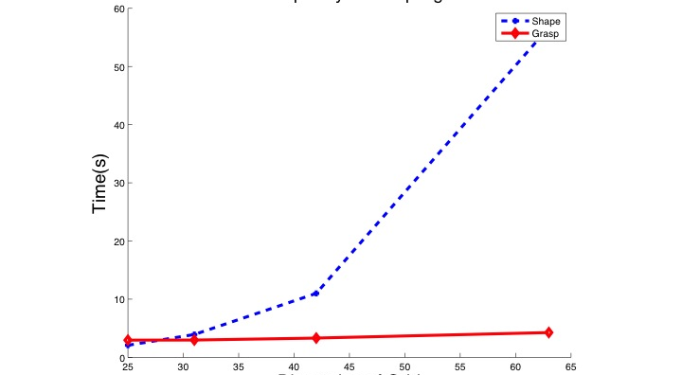

Slide 7
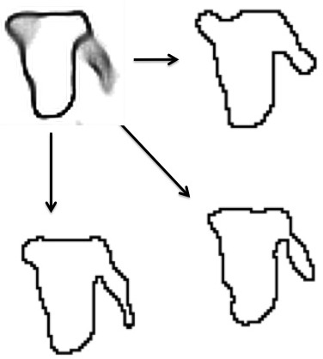

Slide 8
Pose
Motion
Shape
m

Slide 9
Pose
Approach
Shape
Contacts
Normals
Friction
Quality

Slide 11

Notes:
Grasp illustration

Slide 12




