Slide 1
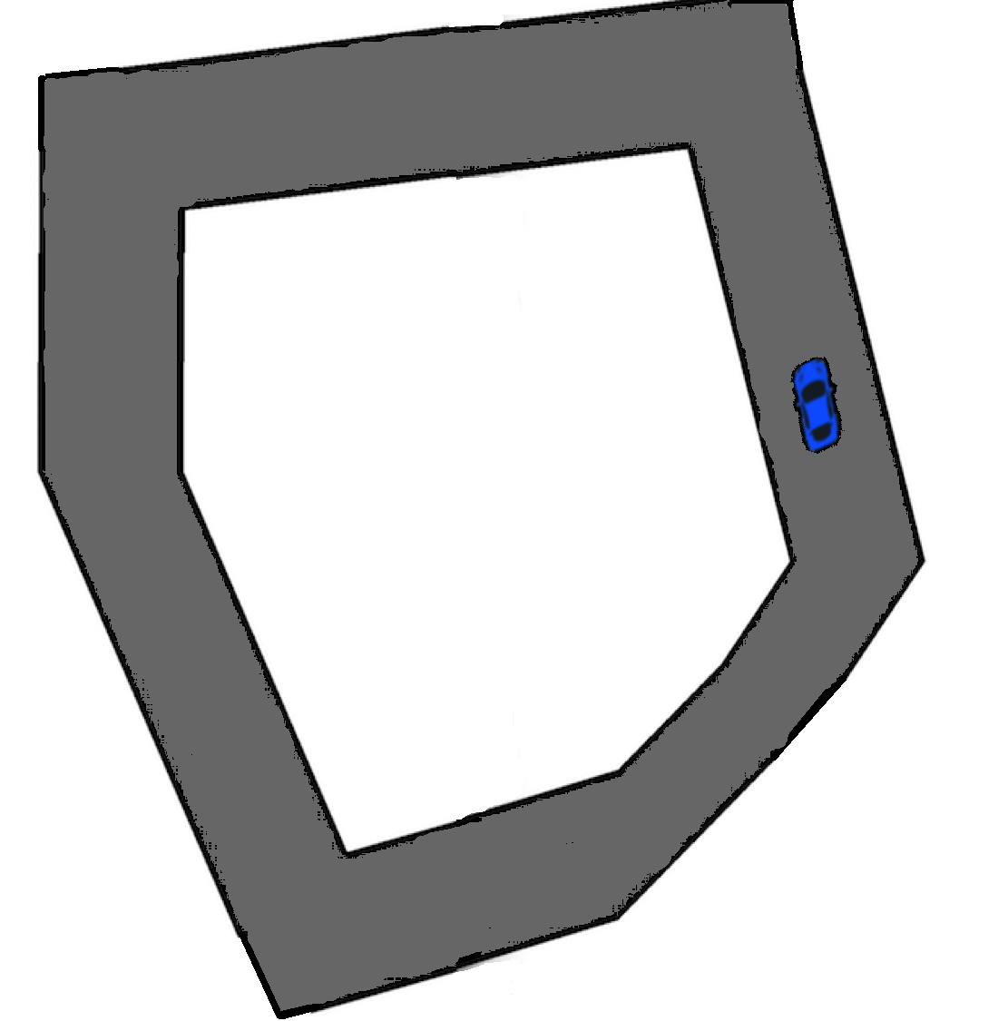
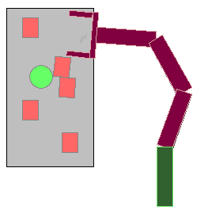
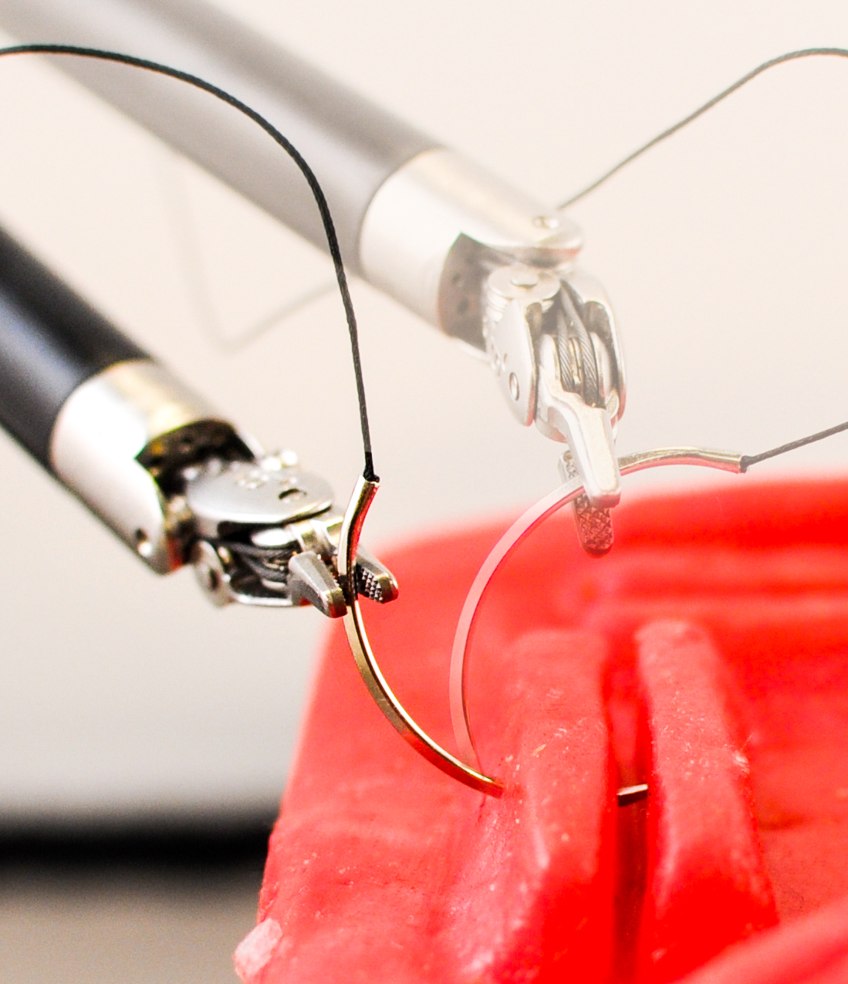
(a) Driving Simulator
(b) Grasping in Clutter
(c) Needle Insertion on DVRK

