Slide 1
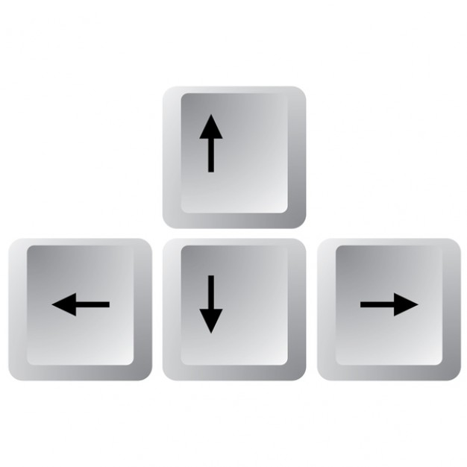
Speed Up
Turn Left
Turn Right
Slow Down

Slide 2
Move Left
Move Right

Slide 3
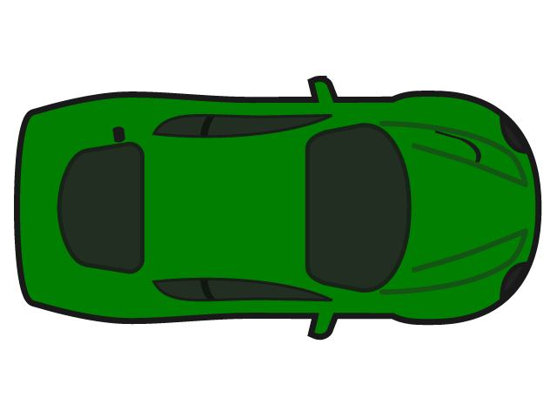
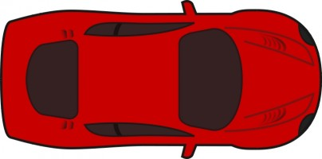
Speed Up
Slow Down

