Slide 1
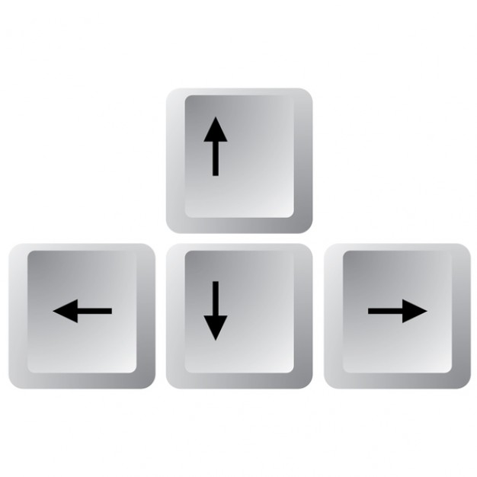
Speed Up
Turn Left
Turn Right
Slow Down

Slide 2
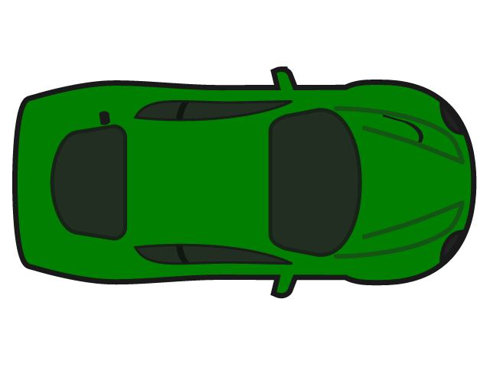
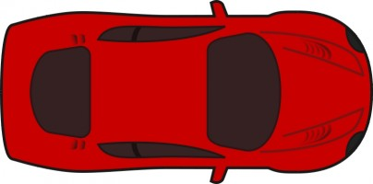
Speed Up
Slow Down

