Slide 1
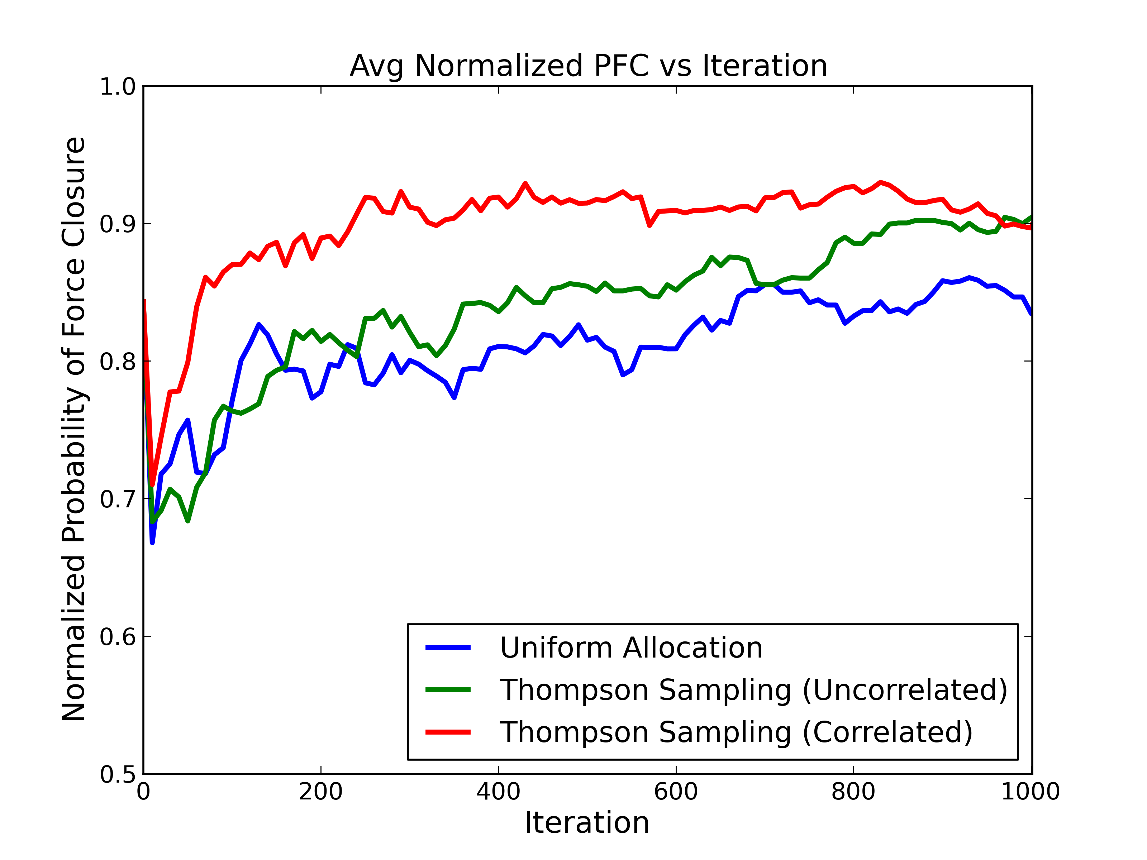
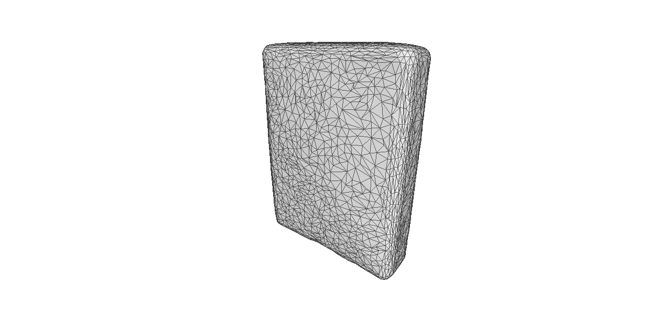

Slide 2
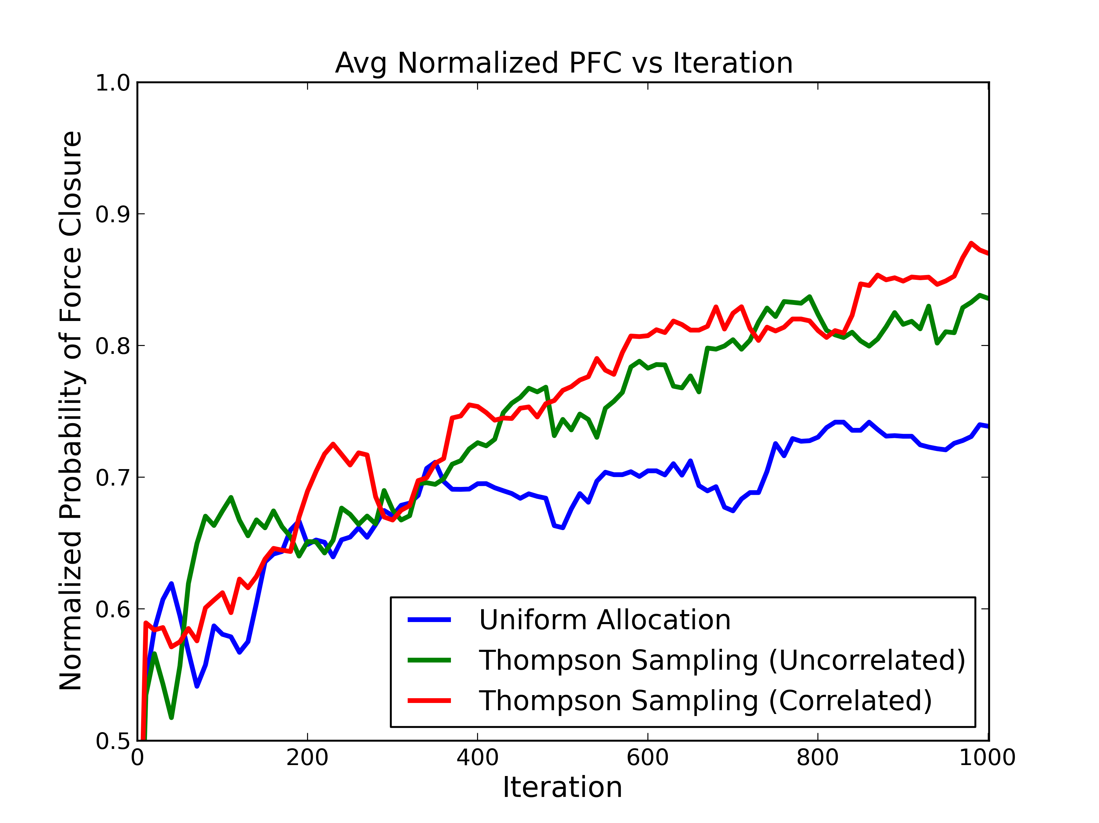
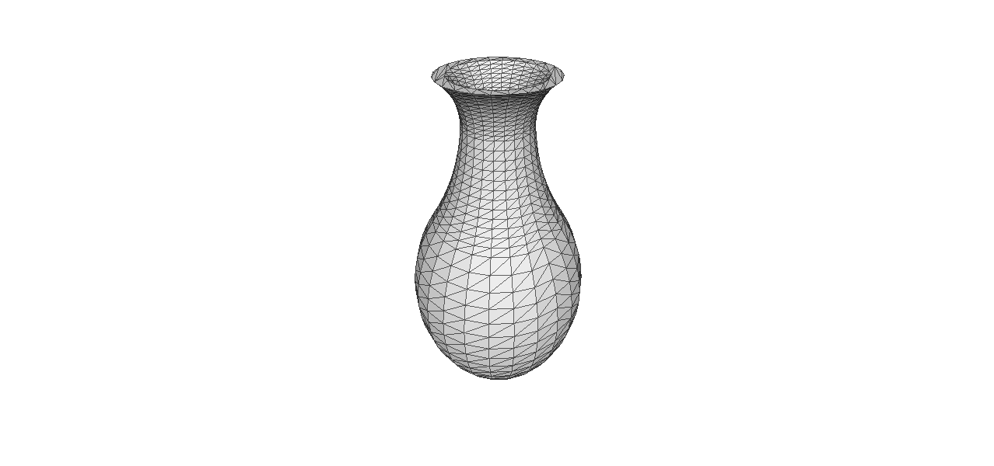

Slide 3
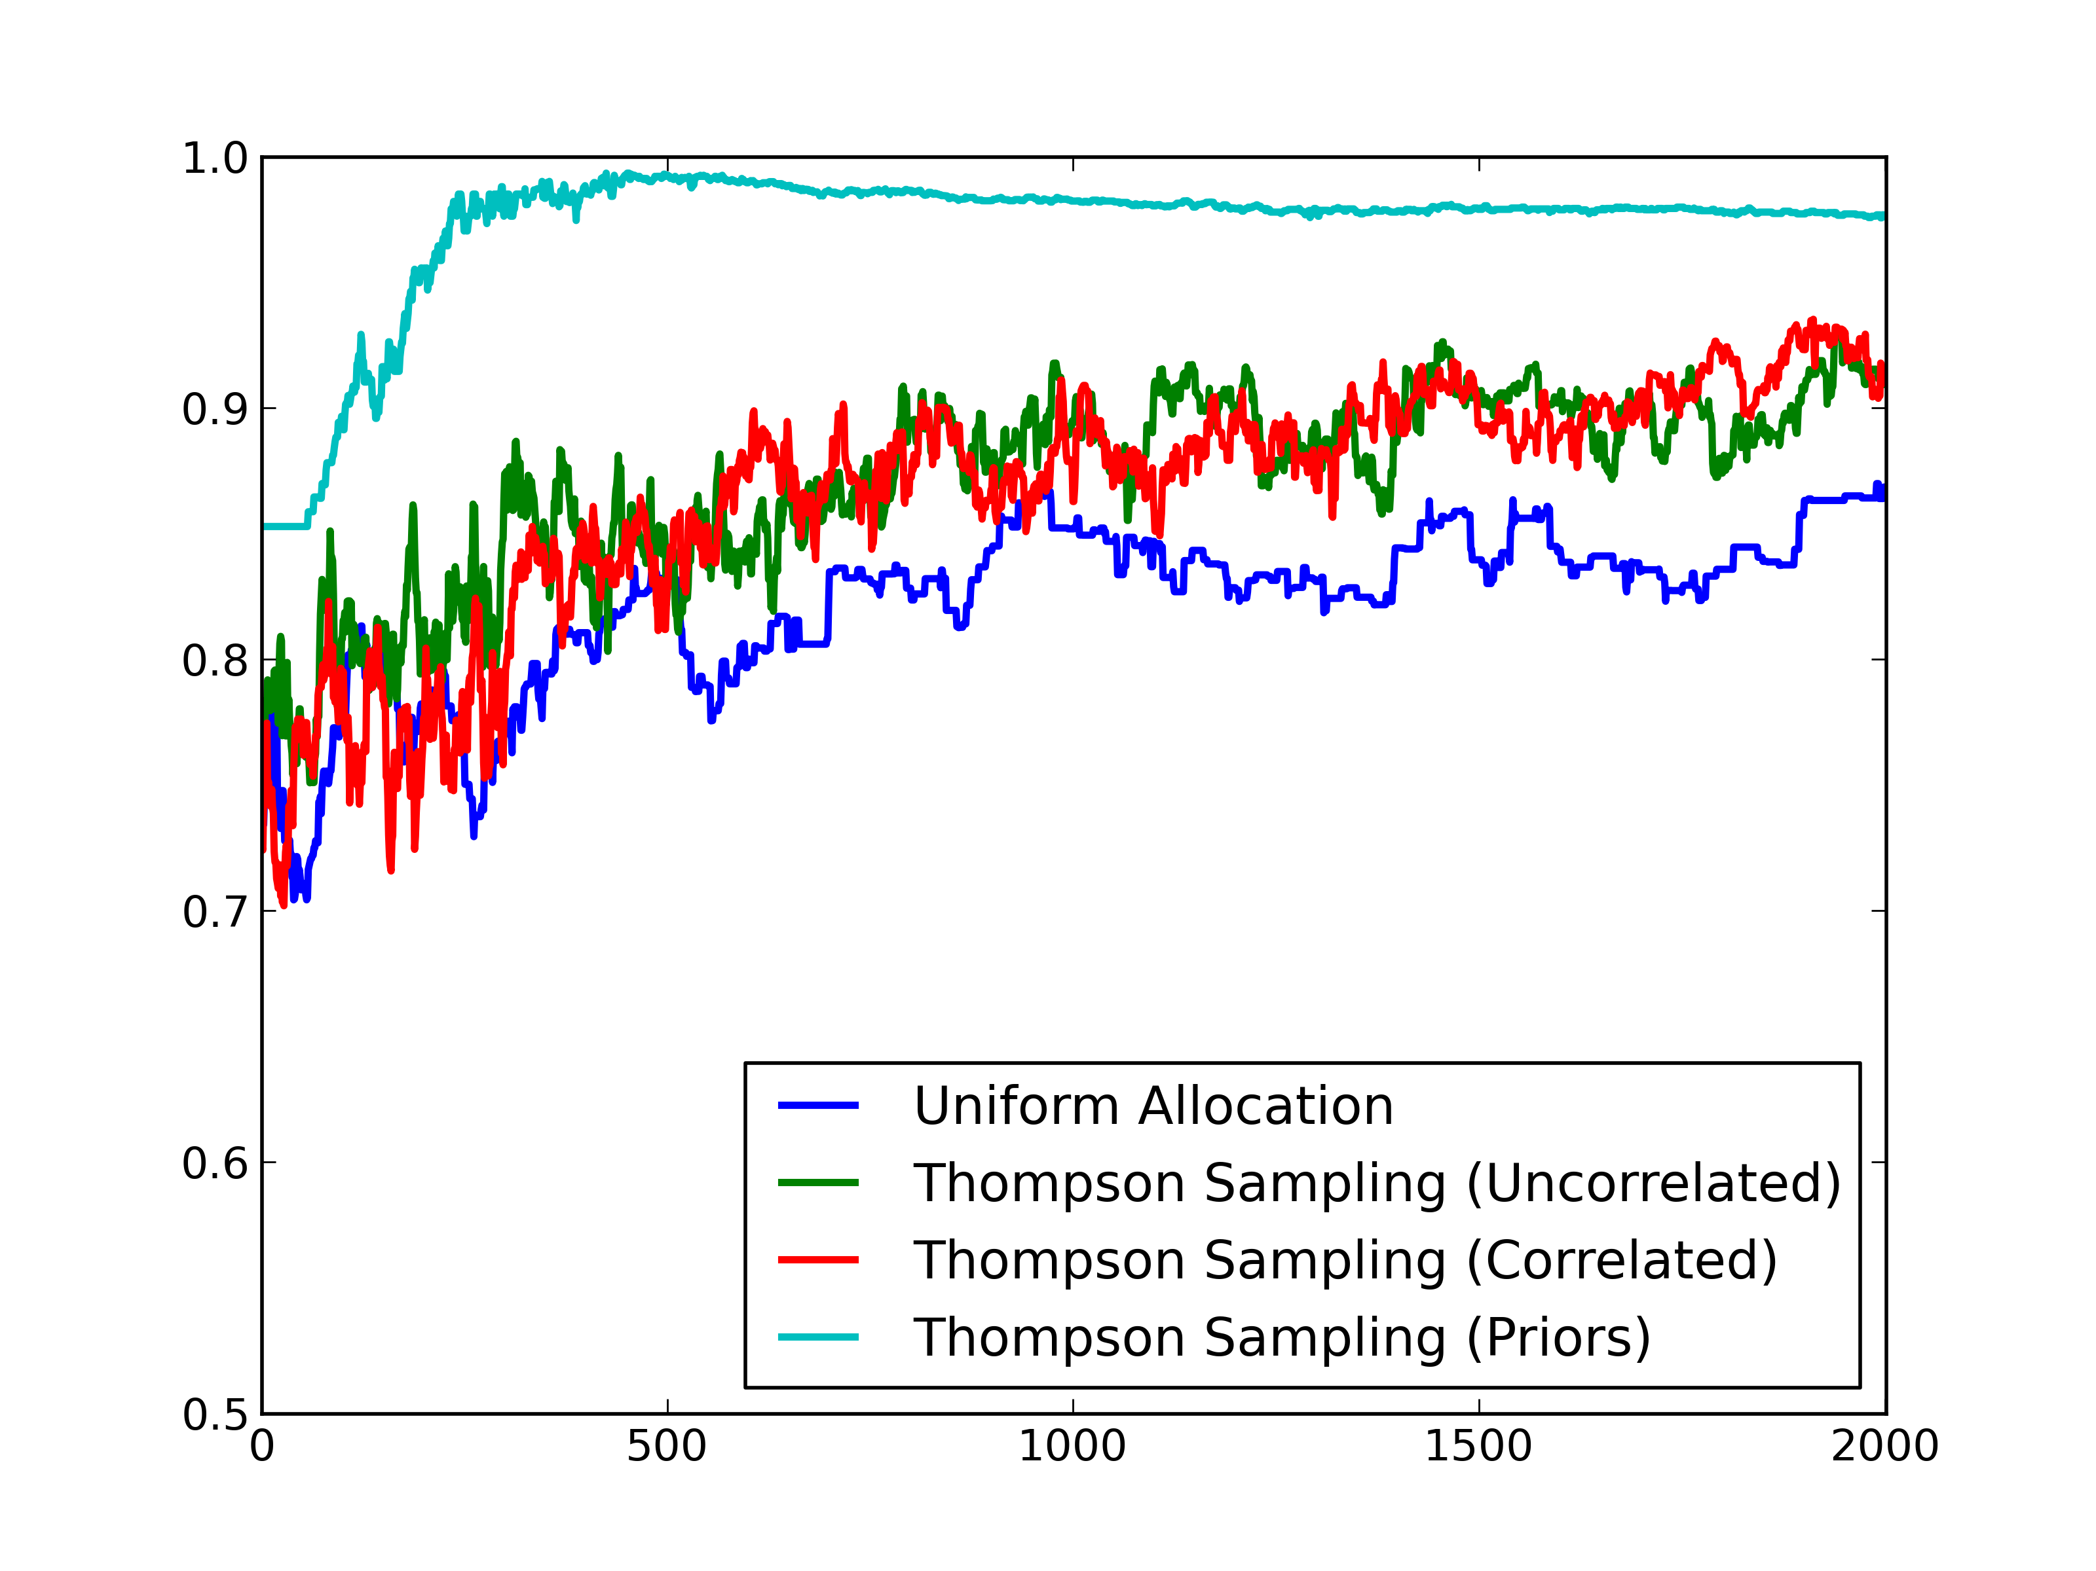
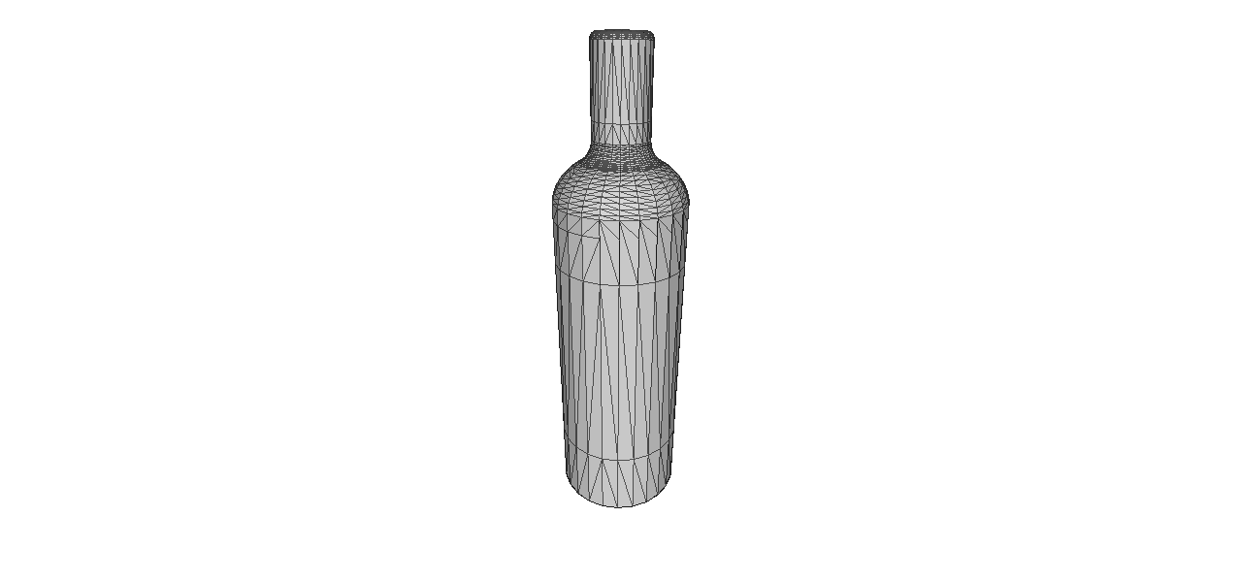

Slide 4
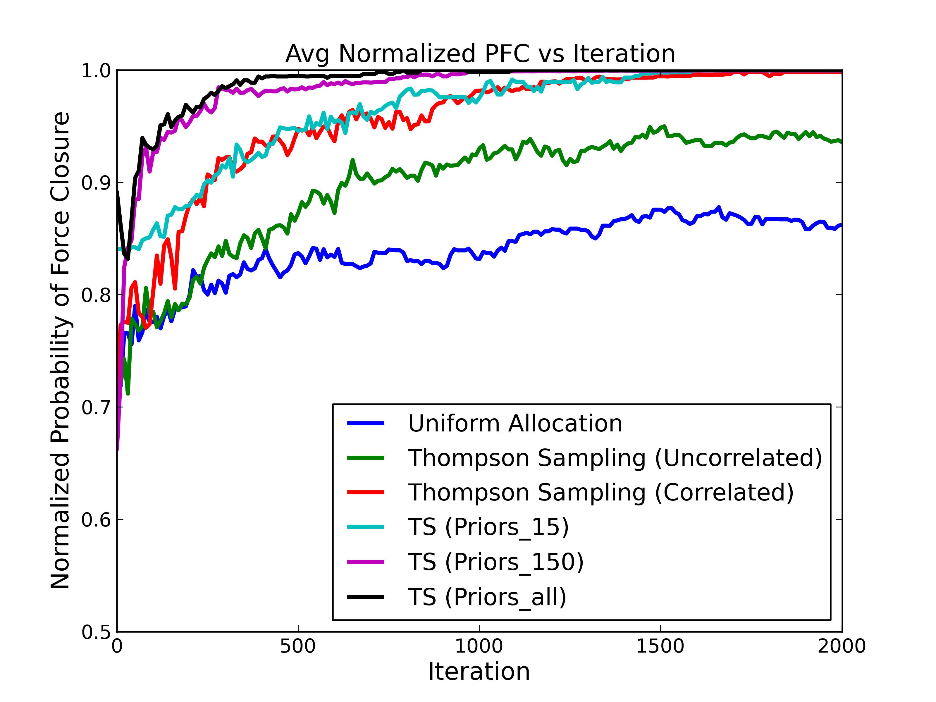

Slide 5
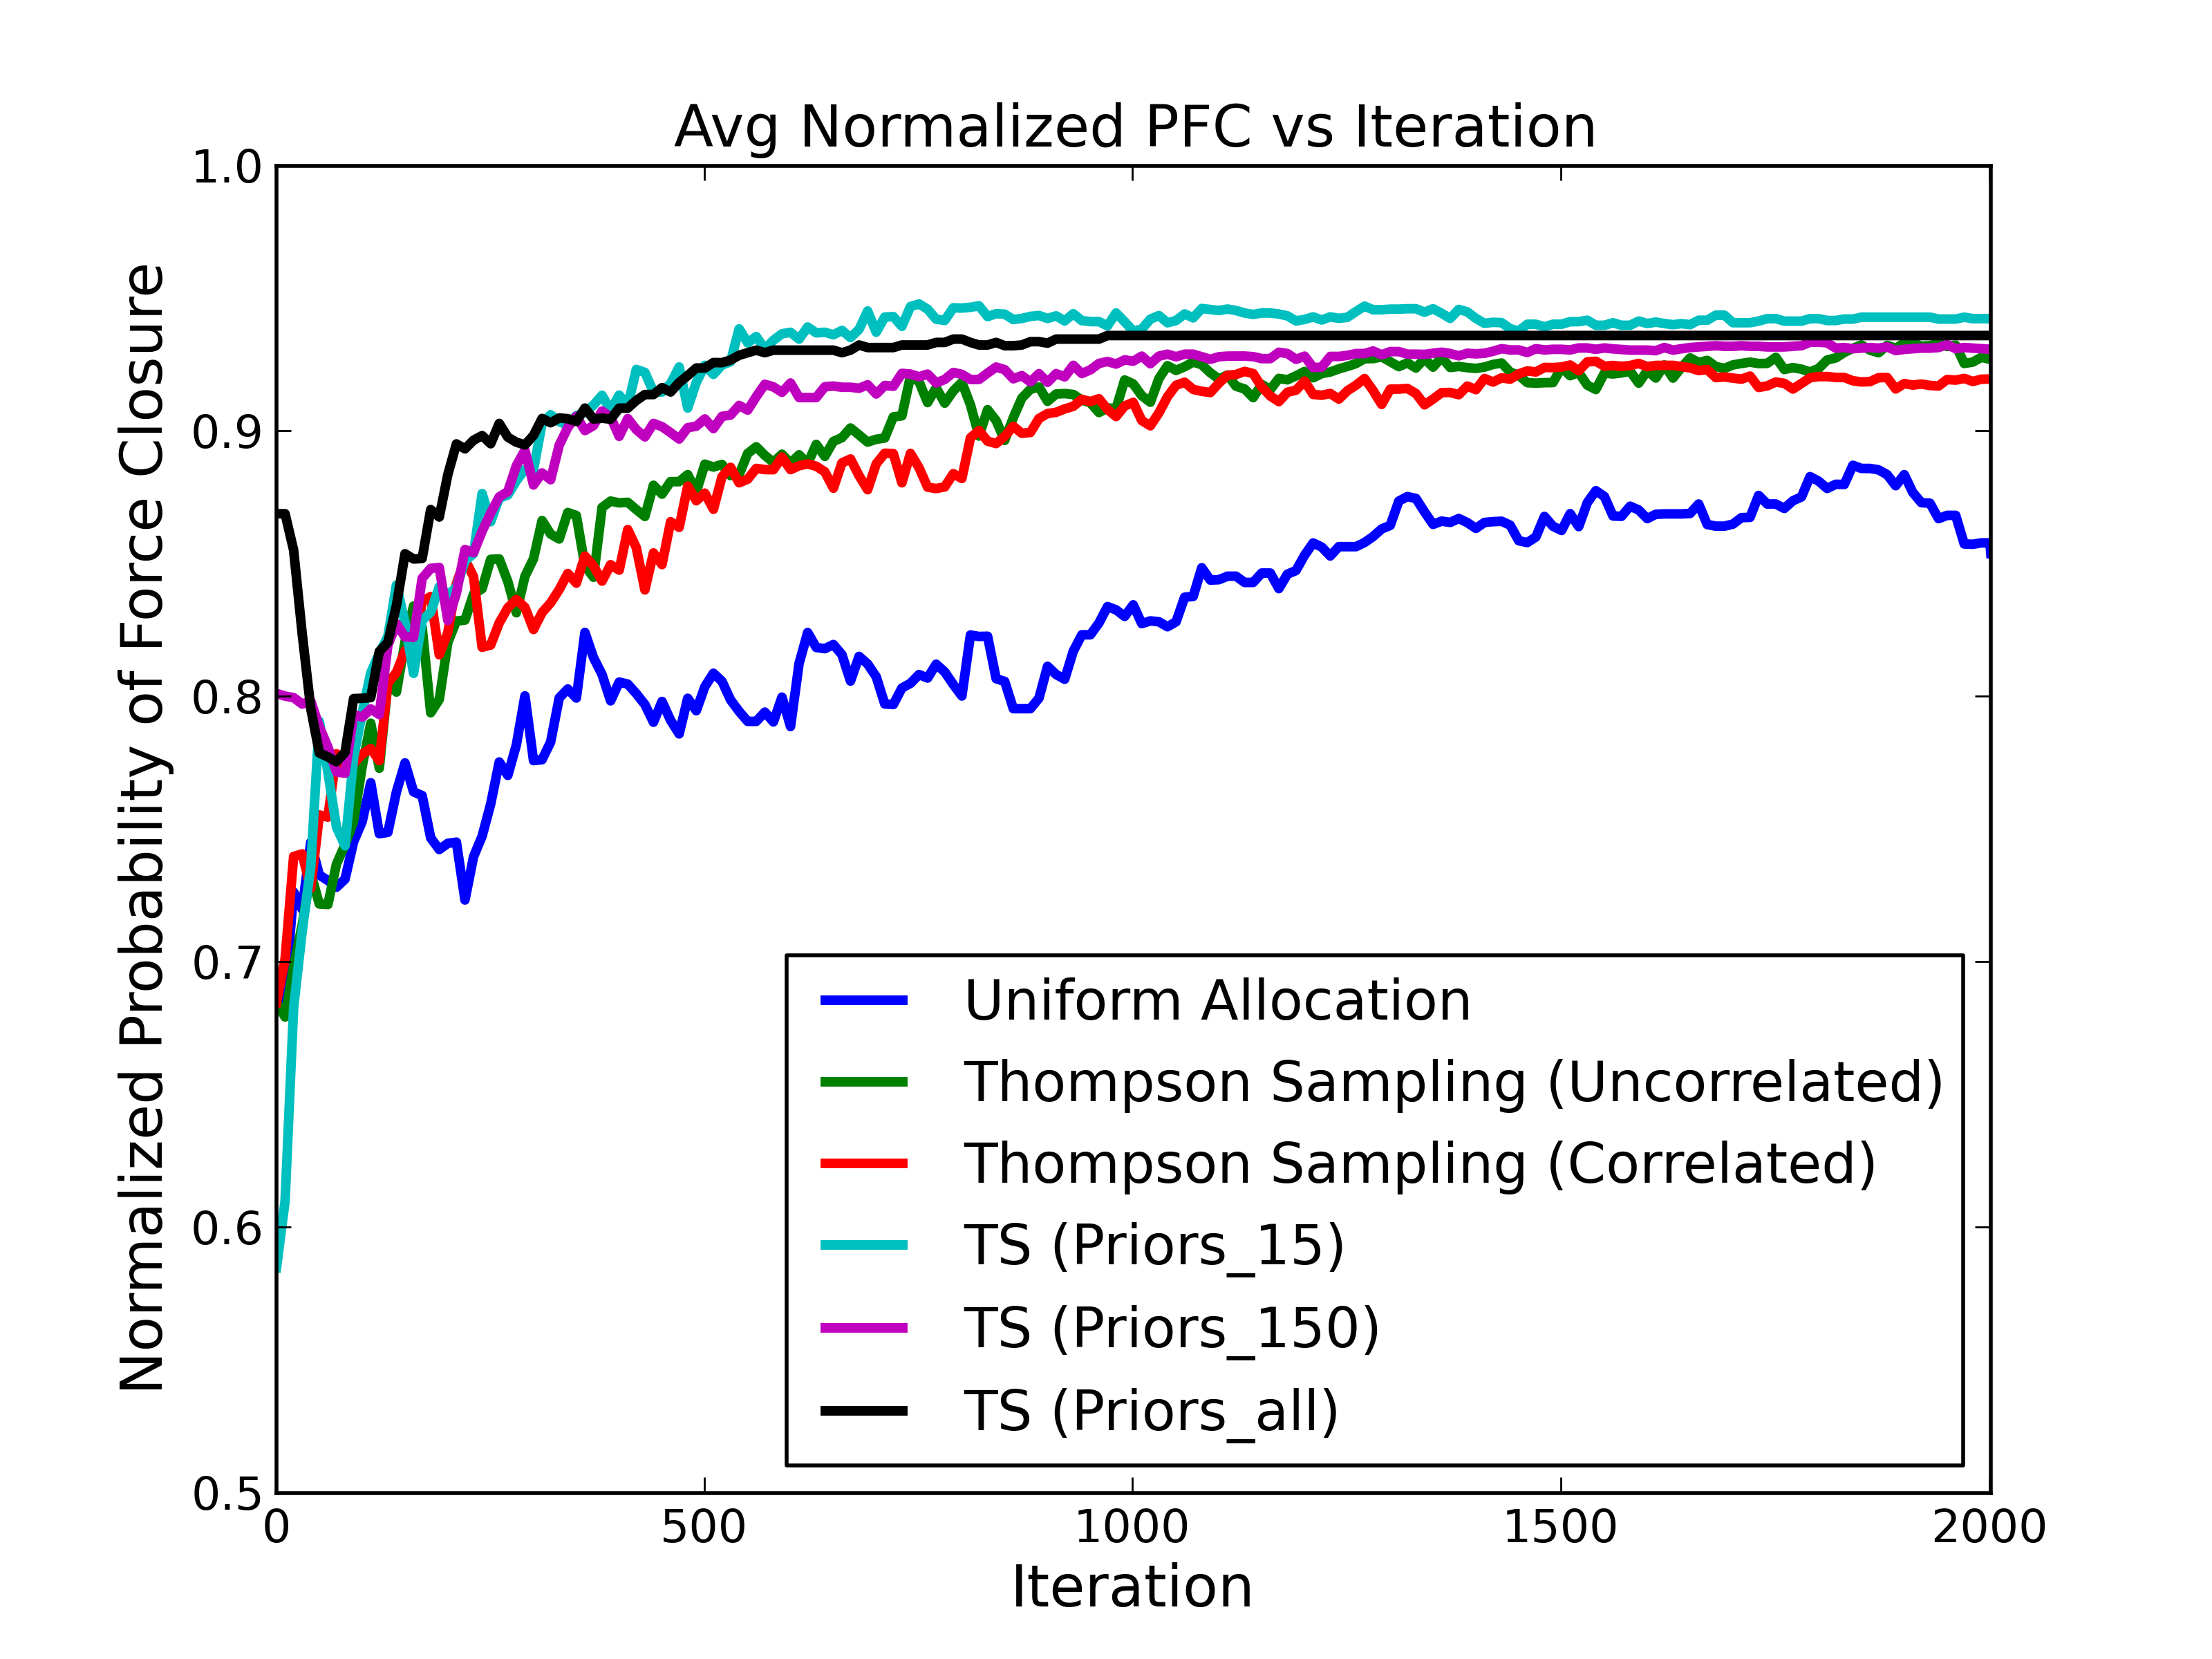
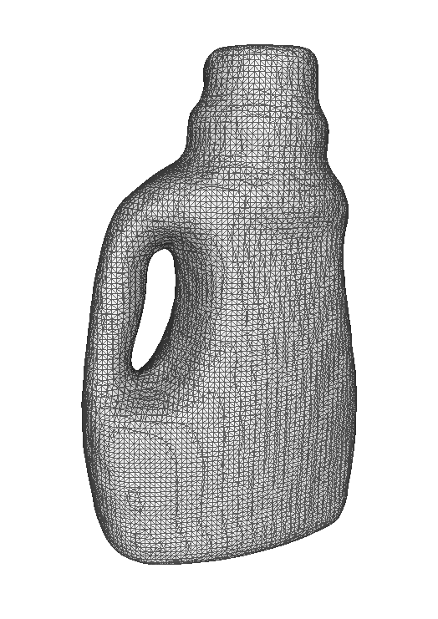

Slide 6
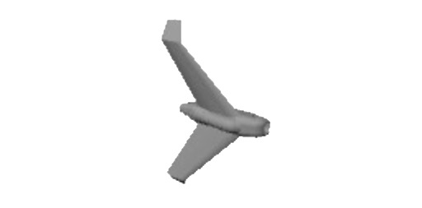
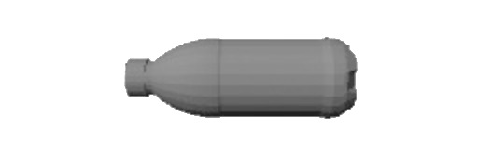

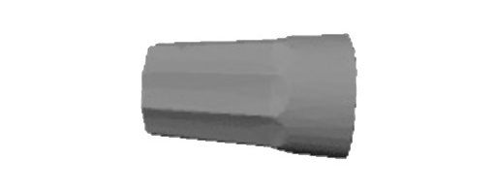
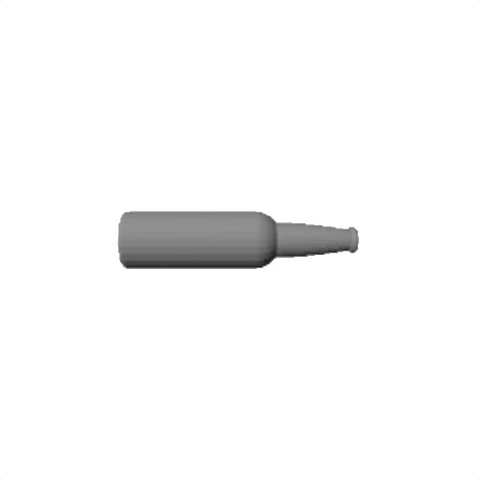

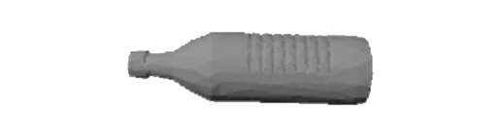
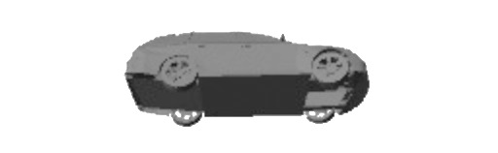
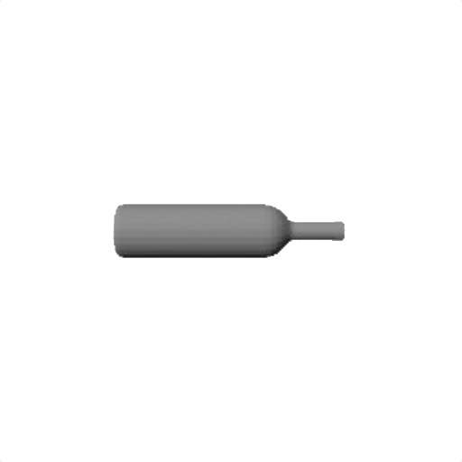

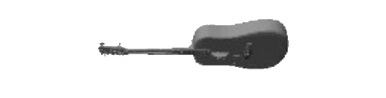

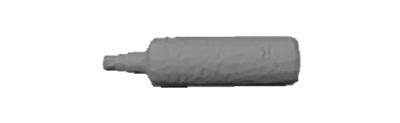
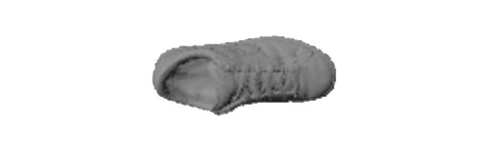
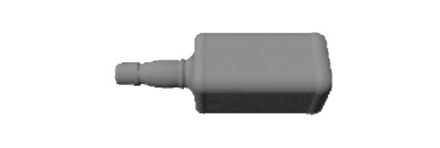

Network Size (# Objects)
15
150
1,500
Query Object
Increasing Similarity

Slide 7
Metric | Best of 2014 SHREC Challenge | Our CNN-based Method
Nearest Neighbor | 0.868 | 0.867
First Tier | 0.528 | 0.542
Second Tier | 0.661 | 0.682
E-Measure | 0.255 | 0.260
Discounted Cumulated Gain | 0.823 | 0.837

Slide 8
Dataset | # Models | Synthetic? | # Categories
KIT Object Database | 129 | N | N/A
Amazon Picking Challenge | 26 | N | N/A
BigBIRD | 120 | N | N/A
YCB | 80 | N | N/A
3D Net | 1371 | Y | 50
SHREC 2014 Large Scale Challenge | 8987 | Y | 171
ModelNet | 9449 | Y | 40

Slide 9
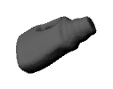
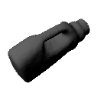
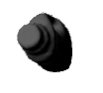
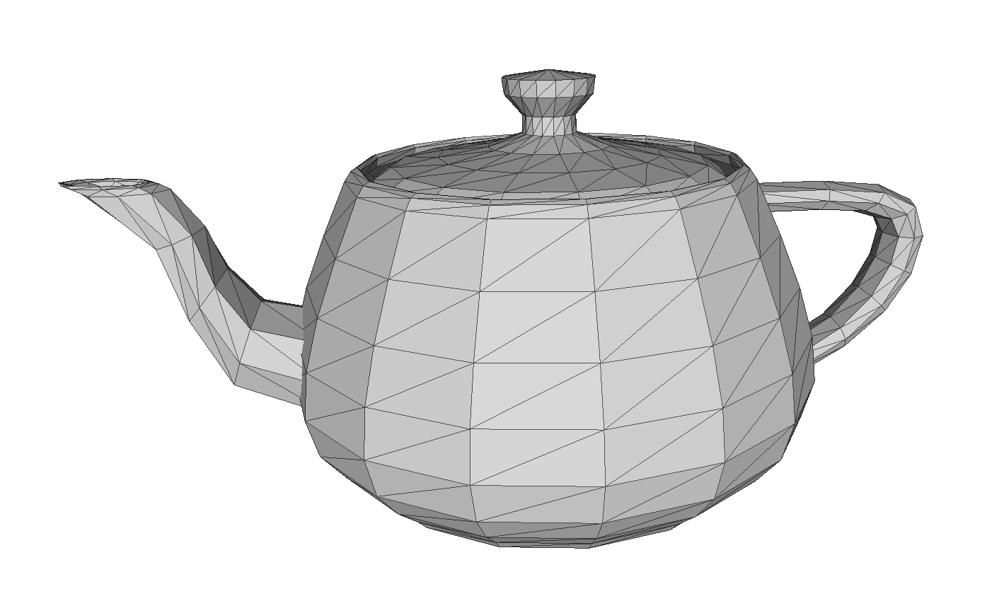
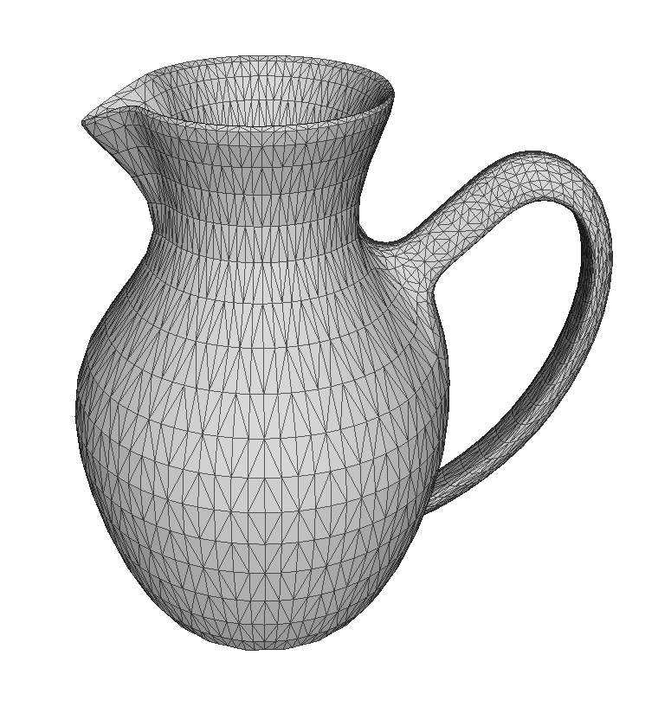
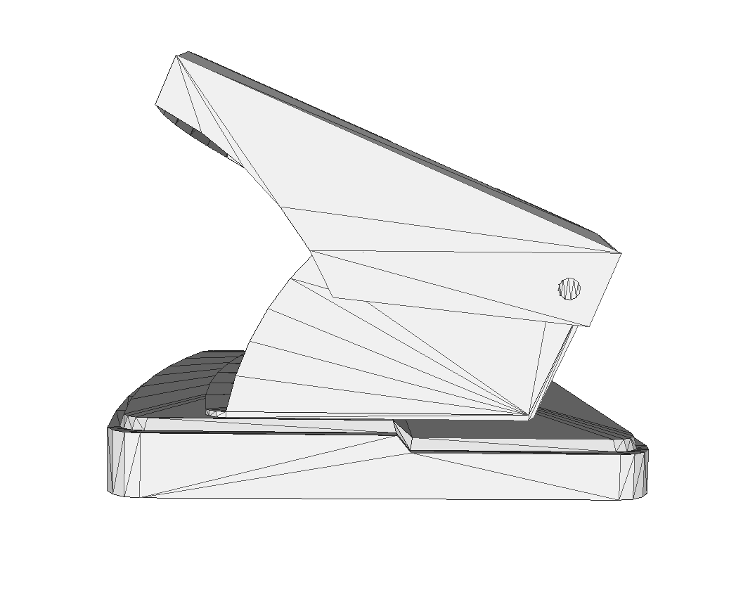
Notes:
Bunch of Misc Stuff

Slide 10
Pose
Approach
Contacts
Normals
Friction
Quality

