Slide 1



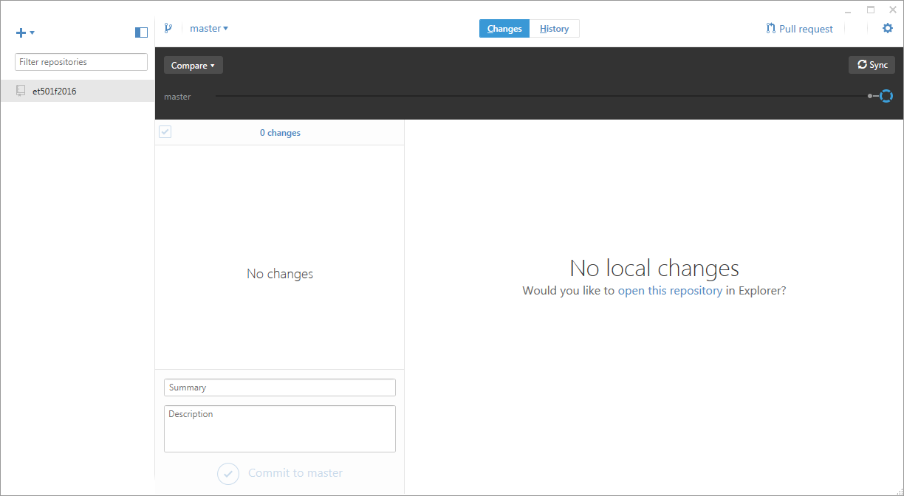
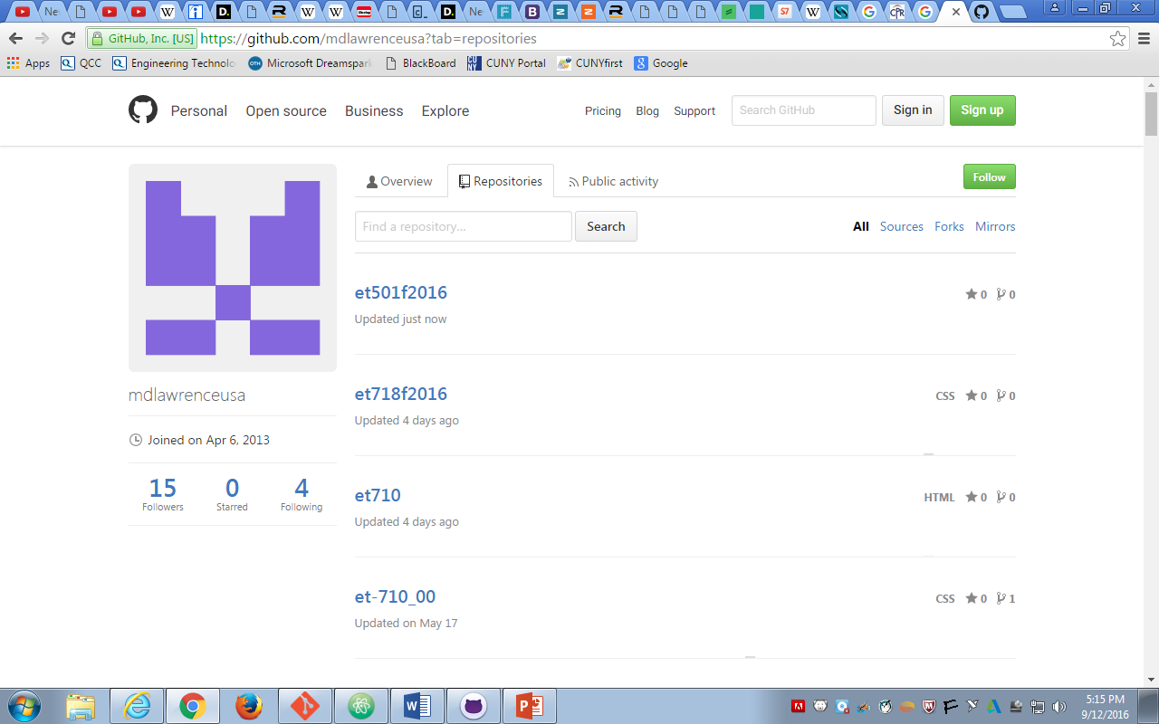
Local Repository
Github.Com
SYNC
SYNC
Internet

Slide 2
Ideas that matter
You have to be able to teach yourself

Slide 3
Today’s Tools
Project Management | Basecamp
Team Communication | #SLACK
Self paced code instruction | Code Academy

