Slide 1



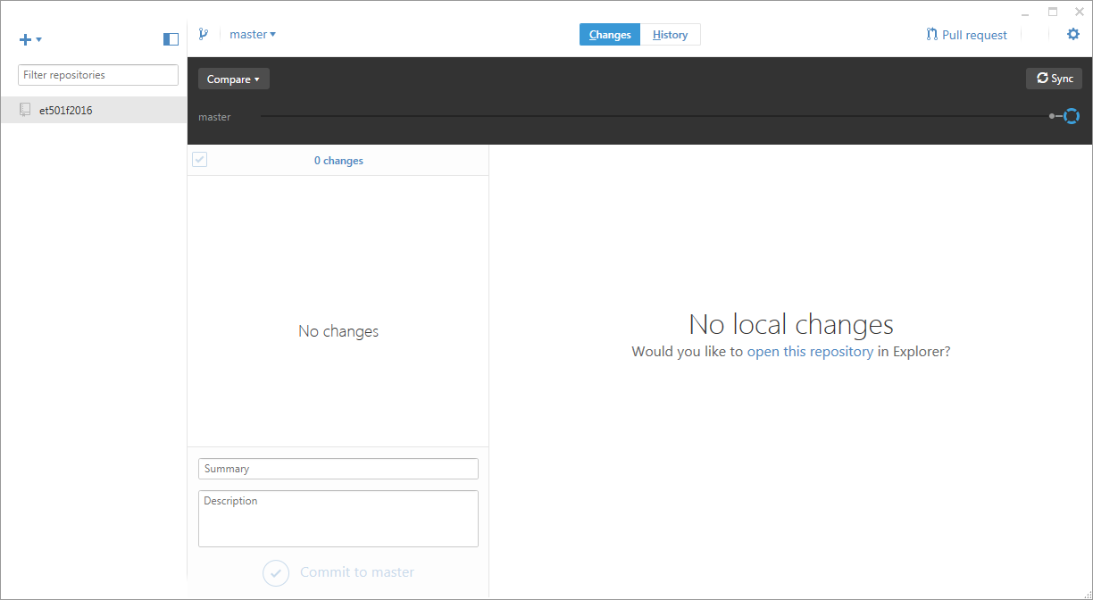
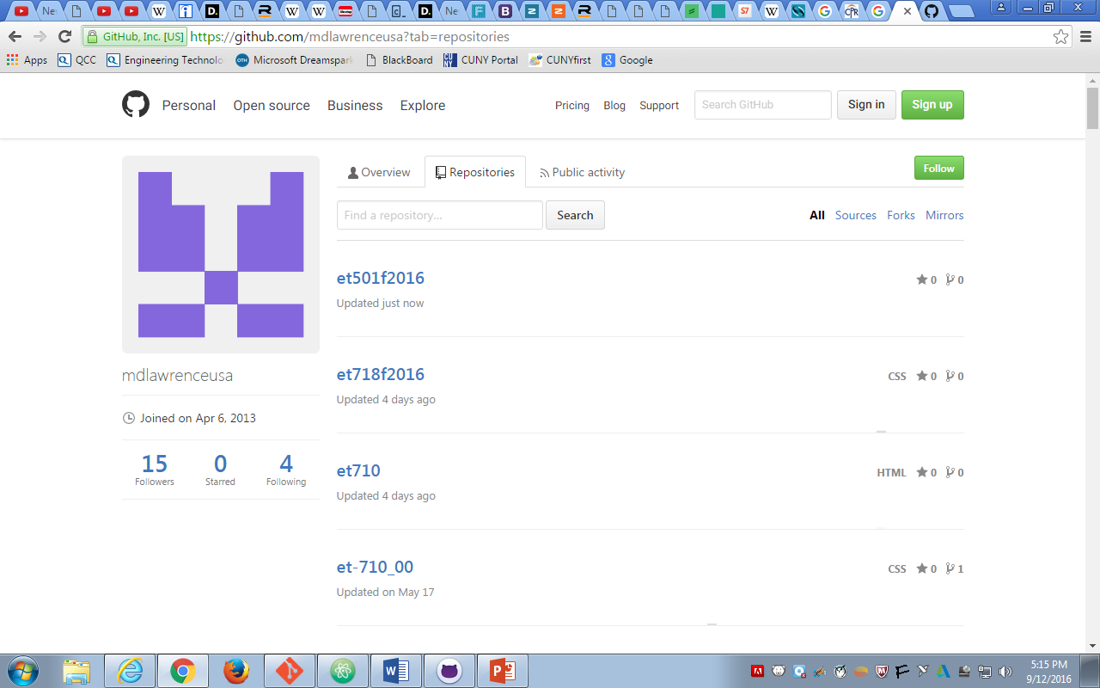
Local Repository
Github.Com
SYNC
SYNC
Internet

