Slide 1
HTML
CSS
JavaScript
Frameworks
AngularJS
Zurb Foundation
Full Stack – Rails, PHP, Java, C++, SQL
Mean Stack – NoSQL, Express JS, AngularJS, Node JS
Serverless – Lambda, Go
REST
HTTPS
TCP/IP
Transport
Front End (ET-710)
Back End (ET-718 - Rails Only)

Slide 2
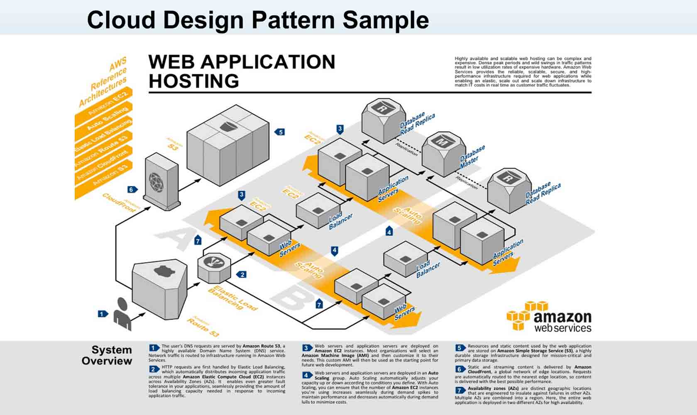

Slide 3
