Slide 1
WATER QUALITY PREDICTION AND MONITORING
AMANDA SAMKELISIWE MDLULI 202212052

Slide 2
01
PROBLEM STATEMENT
02
OBJECTIVES
03
METHODOLOGY
04
PROCESS
05
FINAL MODEL DATA
06
FEATURE SELECTION
07
FEATURE SELECTION
08
ALGORITHM & MODEL DETAILS
CONTENTS
09
RESULTS

Slide 3
PROBLEM STATEMENT
Water quality is crucial for public health, environmental sustainability, and
economic development, as contaminated sources can lead to serious health risks and economic losses. Key challenges include pollution from industrial, agricultural, and urban sources; insufficient data on water quality parameters in many regions;
significant temporal and spatial variability in water quality; and difficulties in
ensuring regulatory compliance, especially in remote or under-resourced areas.

Slide 4
OBJECTIVES
Ensure Water Safety
Safeguard environmental and human health by quickly identifying water quality issues (contamination, pollution, algal blooms).
Risk Reduction
Implement preventive measures to minimize water-related diseases and support ecosystem resilience through early warnings and adaptive management.
Resource Optimization
Enhance efficient use of water resources for drinking, agriculture, and industry, ensuring quality meets standards and user needs.
Public Awareness
Increase local understanding of water quality importance and pollution impacts, encouraging collective action for freshwater preservation.

Slide 5
METHODOLOGY
The CRISP-DM has been chosen as the selected methodology as it stands out as a versatile and comprehensive framework that can effectively guide water quality monitoring and prediction projects from start to finish. CRISP-DM follows 6 phases

Slide 6
PROCESS FLOWCHART AND IMPLEMENTATION
Business Understanding
Data Understanding
Data Preparation
Cleaning, engineering features
Modeling
Random Forest, SVM, and Decision Trees
Evaluation
accuracy, precision, and recall,F1 score
Deployment
Integrates trained models into operational environments
Notes:
Business objectives include ensuring water safety, reducing risks associated with water-related issues, optimizing resource utilization, and raising public awareness about water quality importance. These objectives aim to address the complex challenges of water quality management by integrating environmental, social, and economic considerations.

Slide 7
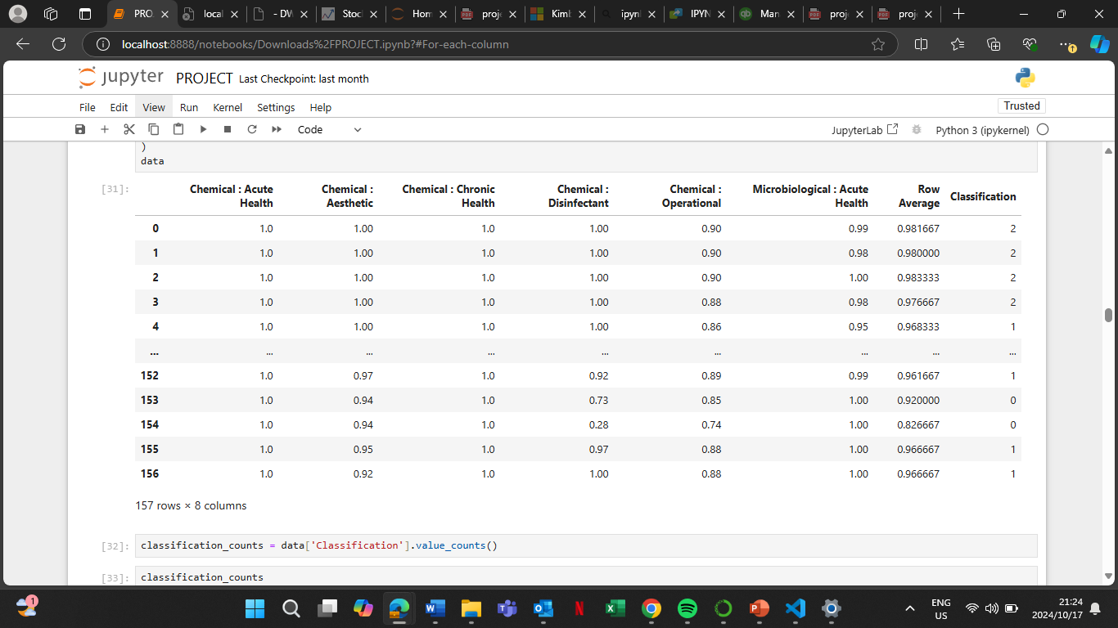
FINAL MODEL DATA

Slide 8
FEATURE SELECTION
Feature Selection
Dropped 'Works’, ’To’, ’From’ column.
Created 'Row Average' for chemical and microbiological metrics.
Classified data into four categories based on 'Row Average’ which determines water quality to be excellent, good, poor or bad.
Assigned numerical labels to categories.
Time Series Forecasting
Used ARIMA model to forecast 'Row Average’ as target variable to predict for the next 15 steps.
Evaluated using MSE, MAE, RMSE, MAPE metrics.
LSTM Model
Built and trained an LSTM model using TensorFlow for predicting 'Row Average' values as target variable as well.
Evaluated using MSE, MAE, RMSE, MAPE metrics.
Classification

Slide 9
ALGORITHM AND MODEL DETAILS
Logistic Regression
Description: Models binary outcomes using a logistic function.
Key Feature: Provides probabilities for class membership.
Decision Tree Classifier
Description: Partitions data into subsets using decision nodes.
Hyperparameters: Max Depth (25), Min Samples Split (30).
Random Forest Classifier
Description: Ensemble of decision trees; averages predictions to improve accuracy.
Key Feature: Reduces overfitting with multiple trees.
XGBoost Classifier
Description: Gradient boosting framework; builds trees sequentially.
Hyperparameters: Min Child Weight (10).
Support Vector Machine (SVM)
Description: Finds the optimal hyperplane for classification in high-dimensional space.
Key Feature: Maximizes margin between classes.
ARIMA Model
Description: Time series forecasting combining autoregressive and moving average components.
Order: (1, 1, 1) for trend capturing.
LSTM Model
Description: Recurrent neural network for sequence data; learns long-term dependencies.
Architecture: 2 LSTM layers with dropout; compiled with Adam optimizer.

Slide 10
RESULTS
Model | Accuracy
Logistic Regression | 70%
Decision Tree | 95%
Random Forest | 82.5%
XGBoost | 97.5%
SVM | 77.5%
ARIMA | MSE: 0.0030339281517290763 MAE: 0.04704053763007725 RMSE: 0.05508110521521038 MAPE: 5.194468740662259
LSTM | MSE: 0.002795463982696703 MAE: 0.04544311804241607 RMSE: 0.052872147513569966 MAPE: 5.078762171743039

Slide 11
ACTIONABLE INSIGHTS
Data Collection & Integration
Implement continuous monitoring systems for real-time data
Prediction Accuracy Monitoring
Regularly assess model performance using metrics and cross-validation.
Threshold Setting for Alerts
Establish critical thresholds to trigger alerts for unsafe water quality levels.

Slide 12
THANK YOU NOW TO CODE WALKTHROUGH

