Slide 1


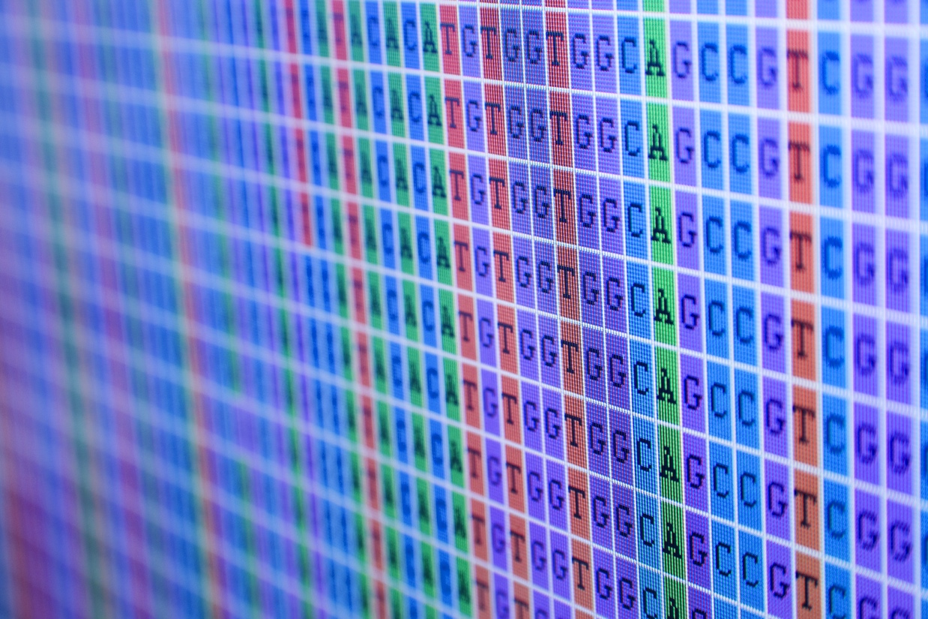
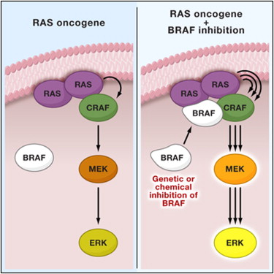
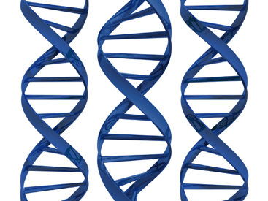
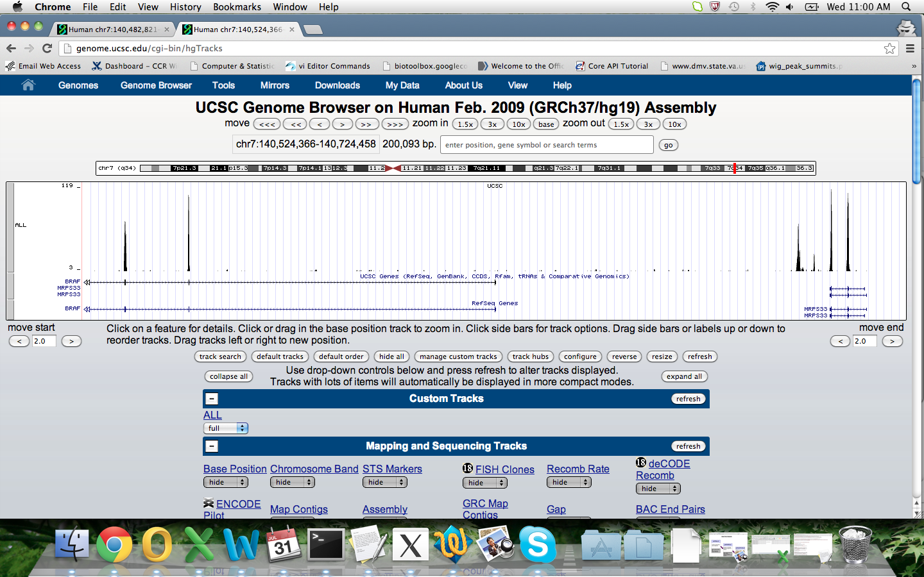
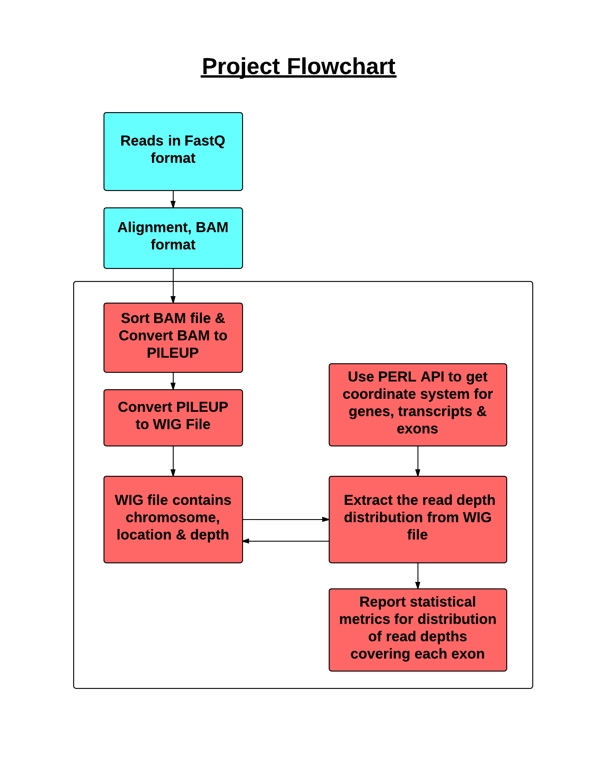
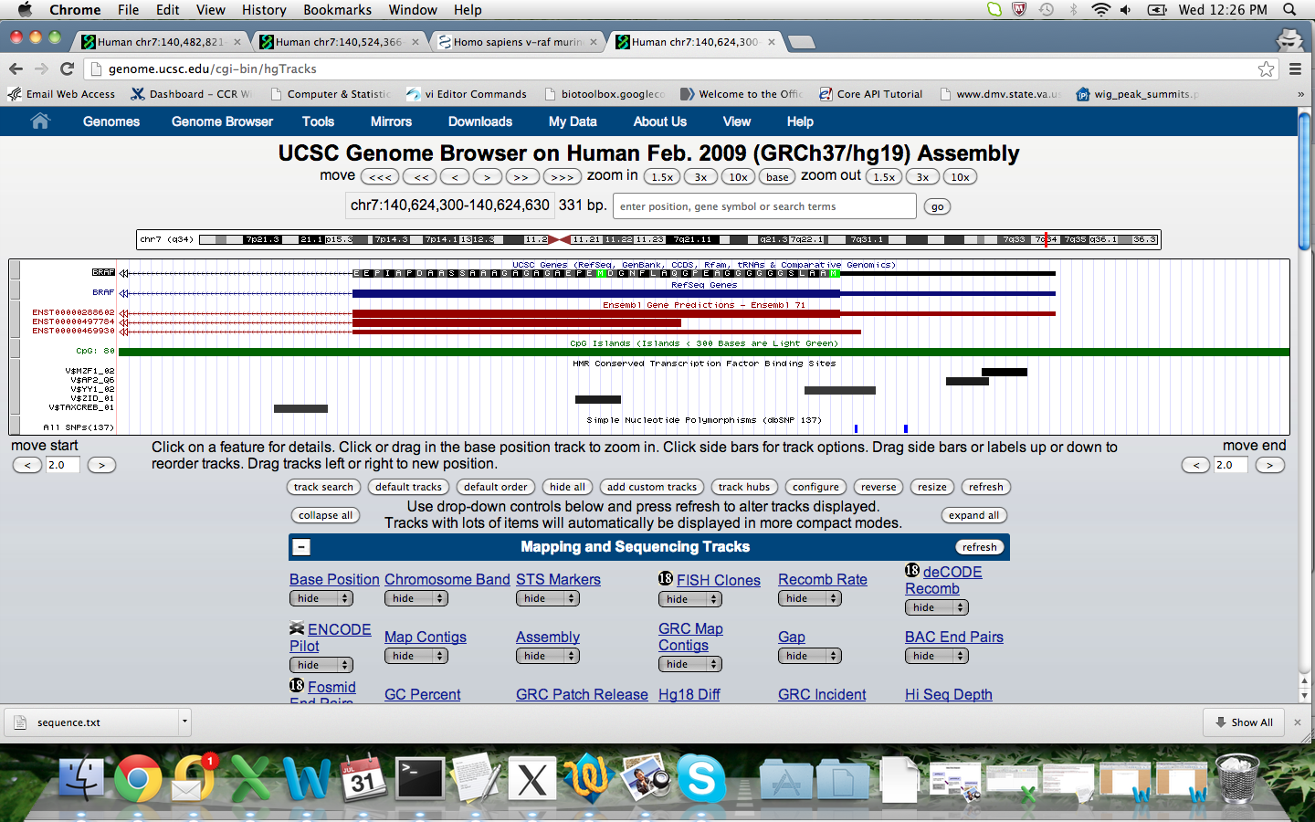
DepthFinder4NGS: NGS Coverage and Depth Assessment for Genes, Transcripts and Exons
Monica D Manam, Eric Stahlberg, Natalie Abrams and Yvonne JK Edwards
CCR-IFX Bioinformatics Core, National Cancer Institute, Advanced Biomedical Computing Center, SAIC-Frederick, Inc.,
Introduction
BRAF as a Cancer Biomarker and a Target for Therapy
Many research groups use next generation sequencing (NGS) technologies to search for genetic variation implicated in disease. NGS is a breakthrough technology enabling scientists to make new discoveries for the genetic causes of disease at an unprecedented rate. Even though hundreds of disease causing mutations have been discovered using the new NGS technologies, certain limitations and pitfalls to using these technologies have been identified [1,2].
One of the known limitations of the NGS is non-uniform sequence coverage across genomic regions. Some regions of the genome are very difficult to cover adequately using the NGS [1,2]. This is a major concern if these technologies are to be used for understanding disease or diagnostic and treatment purposes. Regions that are poorly covered need to be identified and where necessary sequenced using other strategies.
In NGS experiments, reads are generated. Reads are bases of a small fragment of DNA sequentially identified. These reads are aligned to a reference genome to assess the extent of read coverage for the target region. Most aligners generate alignments in the binary alignment (BAM) format [3].
Whilst there are many tools that provide read coverage on a per target region, there are virtually no tools that provide information on a base-per-base level and this type of information can be critical for NGS applications such as RNASEQ, ExomeSeq and whole genome sequencing.
So we developed PERL scripts to use the BAM files to assess the read coverage on a base-per-base level for regions of interest. For a given region of interest eg exons of a transcript, the PERL scripts find and report statistical read depth metrics such as the minimum depth, the maximum depth, the mode depth, the average depth plus the standard deviation, the percentage of exon covered by reads and the size of the exon. From these metrics, one can assess which regions are poorly covered by the reads generated from an NGS experiment.
BRAF is a human gene that makes a protein called B-Raf. The gene is also a proto-oncogene. The B-Raf protein is involved in sending signals inside cells, which are involved in directing cell growth.
Faulty, mutated forms of BRAF are known to cause human cancers. Mutations in this gene are known to allow BRAF to signal independently of upstream cues and result in overactive downstream signaling via MEK and ERK which leads to various cancers, including non-Hodgkin lymphoma, colorectal cancer, malignant melanoma, thyroid carcinoma, non-small cell lung carcinoma, and adenocarcinoma of lung. Figure 2 illustrates how the BRAF gene binds with other genes to promote cancer [7].
Human BRAF has five transcripts. The transcript encoded by RefSeq NM_004333 has 18 exons is used to test the DepthFinder4NGS scripts. Parts of the gene structure is shown below in the UCSC browsers (Figure 3).
Figure 2 BRAF signaling
BRAF as a Cancer Biomarker and a Target for Therapy
Figure 3
Software Development – DepthFinder4NGS
Figure 1
Project Flowchart
Data Flow Diagram
Figure 3 - Above | Figure 3 - Below
The UCSC plot shows exons 1-3 for BRAF. The gene is on the negative strand. The plot shows 3 tracks. Track 1 shows read depth for each of the exons; track 2 shows the UCSC genes annotated; track 3 provides RefSeq annotation. Exon 1 of the BRAF gene has low read coverage. The coverage metrics from the script depthFinder4NGS depicts low coverage (Table 1). The percentage coverage for exon 1 is 3.21 which is low and indicates that exon 1 has few reads covering it. | The UCSC plot shows BRAF exon 1 and intron 1 close up. The gene is on the negative strand. Exon 1 comprises a short 5’ UTR followed by a short coding region. The black track shows the UCSC genes defined. The navy track provides the RefSeq annotations. The red track shows the ENSEMBL transcripts. The green track highlights a CpG-island. The black rectangles show binding sites of transcription factors. The last track shows SNPs. This exon has low read coverage. Low coverage can be due to GC richness of this region. GC-rich regions tend to have poor read coverage from NGS experiments.
DepthFinder4NGS is a suite of three scripts (getWigs.pl, getGOISE.pl and getDepths.pl) developed to assess read coverage and depth obtained from NGS experiments (Figure 1). We developed a system to assess coverage for regions of interest such as a protein coding region, a lncRNA or a miRNA. The scripts work on NGS applications for various data types such as exomeSEQ, RNASEQ, whole genome sequencing and targeted re-sequencing. Data generated by the Illumina, 454, or Solid platforms can also be used. The development environment includes the MOAB server [4], PERL [5] and the ENSEMBL API [6]. The getWigs.pl script is dependent on SAMTOOLS [3]. The flowchart and the dataflow diagram (Figure 1) for software development of depthFinder4NGS are shown.
Testing: Exome sequences from Illumina sequences based on the Agilent Sure Select 50 MB capture kit were used to develop and test the tool. Sample depthFinder4NGS output for the test data sets are provided (Table 1 & Figure 3).
Benefits: The csv files generated from depthFinder4NGS can be entered into excel to ensure if regions of interest are covered adequately by an NGS experiment. The csv files can be reviewed by a researcher using excel. The format of the output provides an efficient way to assess regions that are poorly covered.
Table 1. DepthFinder4NGS Output from Test Data
SCRIPT NAME | SAMPLE OUTPUT
getWigs.pl | track type=wiggle_0 name=”Chr 7” description=”Only Depths" variableStep chrom=chr7 span=1 10558 3 10559 3
getGOISE.pl | ENSG00000157764Chr7:140424943-140624564, ENST00000497784Chr7:140434397-140624458, ENSE00001862791Chr7:140624366-140624458
getDepths.pl | ENSE00001862791Chr7:140624366-140624458Min 3 Max 3 Median 3 Mode 3 Mean 3 Stdev 0 ExonSize 93 Pcov 3.26
Conclusions
To identify genome regions poorly covered by NGS reads, we developed depthFinder4NGS, which generates depth metrics for exons, genes and other genome features.
The tool was successfully applied to characterize read coverage across the human BRAF gene in an exomeSeq experiment.
This tool will alert scientists to genomic areas prone to false negative results and thus help avoid costly NGS-inherent errors and biases.
References and Acknowledgments
Sirmaci A et al (2012). PLoS One. 7:e32000.
Hoppman-Chaney N et al (2010). Clin Chem. 56:1297-1306.
SAMTOOLS - v0.1.19
MOAB - v4.2.3
Ensembl PERL packages - v71
PERL packages - PERL – v5.16.2, CPAN - v5.0
http://www.biooncology.com/research-education/braf/references
Monica Manam completed a ten week internship within the CCRIFX Core for summer 2013; the internship was funded by the NCI.
Special thanks to all the CCRIFX Core members:
Eric Stahlberg (Director), Natalie Abrams, Yvonne Edwards, Parthav Jailwala, Li Jia, Manjula Kasoji, Anand Merchant, Eddie Salinas, Han Si and Nate Starner.
The CCRIFX Core Website – Please visit – Thank you.
http://ccrifx.cancer.gov/apps/site/default

