Slide 1
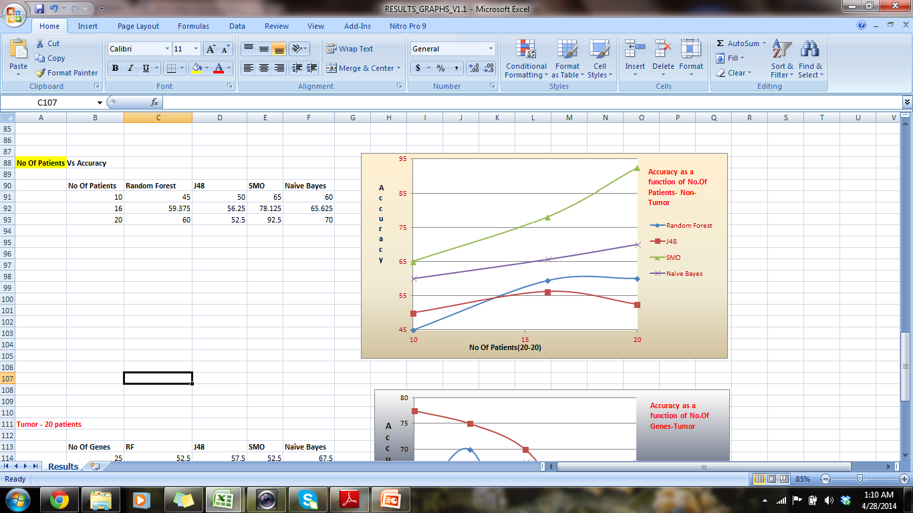
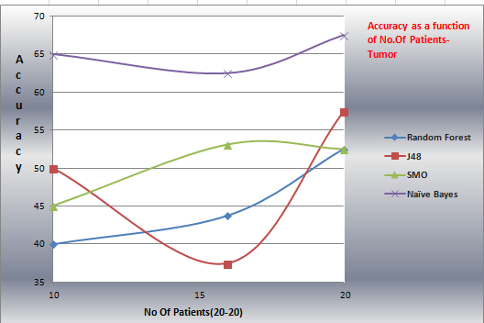
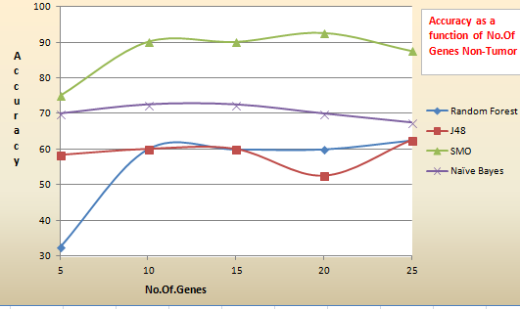
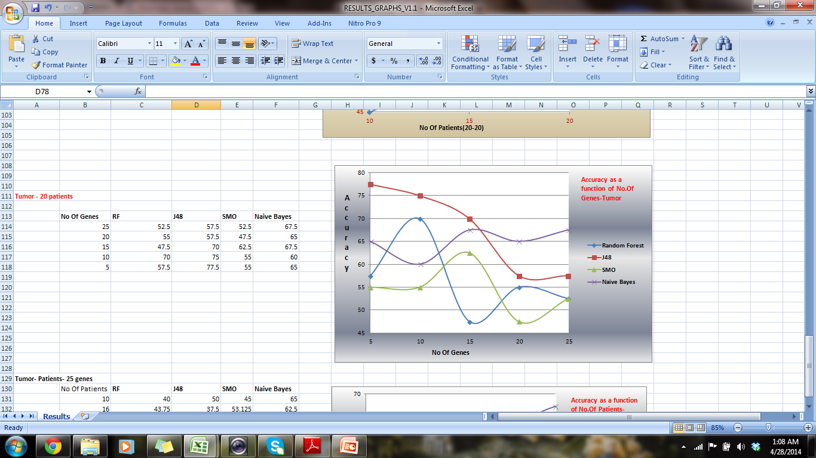
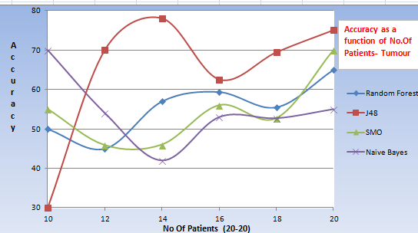
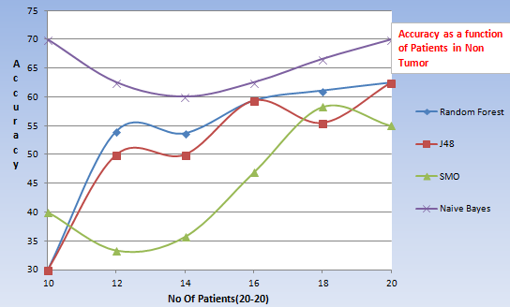
A Study on Gene expression in non-tumoral liver tissue and recurrence-free survival in hepatitis C virus-positive hepatocellular carcinoma
By
Monica Devi Manam , Dr.Iosif Vaisman
ABSTRACT:
The aim of this study was to understand gene expression signatures of hepatocellular carcinoma (HCC) recurrence in subjects with hepatitis C virus (HCV) infection. Traditional clinico-pathological endpoints are recognized as weak predictors of RFS. It has been suggested that gene expression profiling of HCC and non-tumoral liver tissue may improve prediction of RFS, aid in understanding of the underlying liver disease, and guide individualized patient management. Gene Dataset was taken from Geo database. Gene expression profiling data was used to determine the molecular signature of HCV-associated HCC and to develop a predictor of RFS using machine learning using various algorithms.
MATERIAL/DATA SET:
Gene Expression Dataset : Raw microarray data was archived from Gene Expression Omnibus (GSE17856) .Gene expression data of 25,073 transcripts collected on individual tumor and non-tumoral samples. Principal components analysis was done later for transcript abundance. 91 genes selected based on log-rank P-value and error rate of prediction were used to construct recurrence-free survival curves
METHOD: Differentiated the Tumor & Non-Tumor genes by making data sets with different number of values.
Used the below machine learning algorithms classify tumor & Non-tumor accuracies as a function of genes & patients.
SMO : Sequential minimal optimization is an algorithm for solving the quadratic programming (QP) problem that arises during the training of support vector machines.
J48: C4.5 is an algorithm used to generate a decision tree, J48 is the java implementation of it.
Random forests: are an ensemble learning method for classification :operate by constructing a multitude of decision trees.
Naive Bayes :classifier is a simple probabilistic based on applying Bayes theorem with strong (naive) independence assumptions
RESULT:
Tumor Vs Non-Tumor :
Non-Tumor Vs Tumor (Accuracy as a function of No.Of Patients)
Non-Tumor Vs Tumor (Accuracy as a function of No.Of genes)
  SMO and Naïve Bayes are the algorithms yielded the highest accuracy with top 20 genes ranked using SVM ranker attribute selection with a subset of 20 patients for Non-tumor dataset. Whereas the tumor dataset yielded poor results.
  CONCLUSION:
Tumor derived gene expression profiles did not produce a robust classifier of RFS in this project.
With the accuracies, we can clearly discriminate Tumor & Non-Tumor data
Based on Gene Expression profile , limited genes of 91 & 5,10, 15 taken : expression is not the same in Tumor & Non-tumor, which has no relation with survival model.
The gene expression predictor may hold important insights into the patho-biology of HCC recurrence and de novo tumor formation in patients.
  ACKNOWLEDGEMENT:
  I would like to thank Dr.Iosif Vaisman for mentoring me through this project
INTRODUCTION:
Hepatocellular carcinoma (HCC) is the fifth most common cancer worldwide by annual incidence and the third leading cause of cancer death . Wide geographic variation in age-adjusted incidence and death rates is well recognized
Several research groups have performed gene expression profiling of both tumor and nontumoral specimens and identified gene signatures of recurrence-free, or overall survival in HCC patients who undergo tumor resection. These studies carry an exciting potential to open the field to more selective chemoprevention as a follow-up to surgical interventions since patients with greatest risk of death or recurrence can be potentially identified and/or individualized therapies may be devised based on the molecular profiles of poor-prognosis markers of HCC
Molecular network signatures of HCV-associated HCC, as well as the outcome of the analysis of the predictive value of gene expression in tumor- and nontumoral tissue-derived samples
Hypothesis: To build a model for survival and reoccurrence rate of tumor in HCC cancer patients

