Slide 1
Hand Detection and Finger Counting
Made by:
Md Sakibul Alam
Hossain Mohammad Farhad
Mahadi Hasan
Akash Saha Md Ripon Bhuiya

Slide 2
Computer Vision
Computer Vision is the broad parent name for any computations involving visual content – that means images, videos, icons, and anything else with pixels involved. But within this parent idea, there are a few specific tasks that are core building blocks:
In object classification, you train a model on a dataset of specific objects, and the model classifies new objects as belonging to one or more of your training categories.
For object identification, your model will recognize a specific instance of an object – for example, parsing two faces in an image and tagging one as Tom Cruise and one as Katie Holmes.

Slide 3
Abstract
In computer vision, the task of recognizing an object in the scene is very common.
OpenCV, a open-source library for computer vision and digital image processing.
In this project we have made an application which is capable of recognizing hands in an video and of counting the number of lifted fingers.

Slide 4
Methodology
There are many possible approaches to solve this problem, each with different complexity and accuracy. Due to the lack of strong constraints on the scene’s composition and illumination, we had to exclude segmentation techniques based on thresholding grayscale images. Even though this techniques are generally fast and reliable (with the right images), our typical image histogram doesn’t have any recognizable separation of modes, therefore grayscale analysis is not a viable option.

Slide 5
To detect the Fingers and count them.
Find the roi(region of interest)
Hand Segmentation : Convert the video frame from BGR to HSV(or Gray)
Perform a Gaussian blur
Perform a Threshold
Find the Biggest Contour(this will be our hand)
Perform a ConvexHull and mark the ROI(region of interest
Count the no. of counters
Display it

Slide 6
SEGMENTING THE HAND SKIN
The most common is the RGB, where any pixel is composed by the union of three colors (red, green, blue). However, for color segmenting, the HSV color space is much better, because in there the information of color is dissociated from the information of illumination. HSV stands for Hue (the color information), S (Saturation, e.g., the percentage of ‘color’ present) and V (Value/brightness, e.g., the percentage of ‘white’ color present). Generally, human skin lies between (H=0,S=58) and (H=50,S=173).

Slide 7
For our convenience we have taken the values as
Lower skin [0,20,70]
Upper skin [20,255,255]
Note : In order to get good segmentation you need to fine-tune HSV bounds

Slide 8
Convex Hull
In order to detect fingertips, we are going to use the Convex Hull technique. In mathematics, Convex Hull is the smallest convex set that contains a set of points. And a convex set is a set of points such that, if we trace a straight line from any pair of points in the set, that line must be also be inside the region. The result is then a nice, smooth region, much easier to be analysed than our contour, that contains many imperfections.
Notes:
Contours can be explained simply as a curve joining all the continuous points (along the boundary), having same color or intensity.

Slide 9
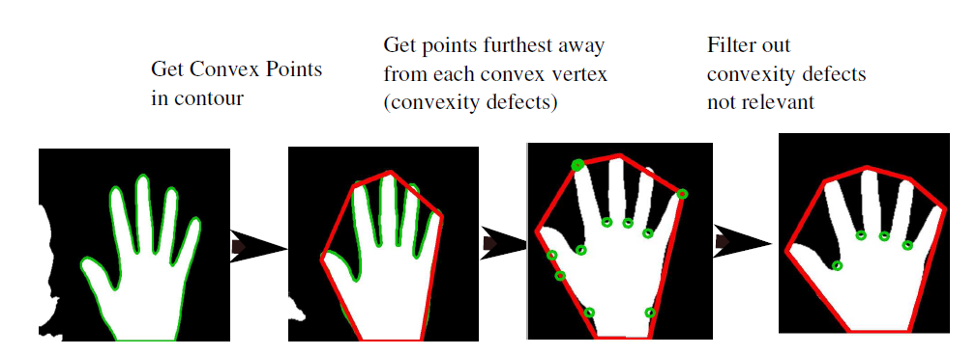
Convex Hull

Slide 10
Limitations
Your environment will stand-off big time against you in this technique because whenever you perform any sort of thresholding in OpenCV, you have to make sure that your background doesn’t interfere with the detection.
Moving objects/strong changes of illumination in the background

Slide 11
More Advanced Applications
We use this for
drawing with our fingers
creating mini games that would let you control the character with gestures using their webcam

Slide 12
Thank You

