Slide 1

Computer Graphics
Introduction
Lecture By:
Md. Manirujjaman
Lecturer
Dept. of CSE, DIU
Contact: 01772430221
Mail: manirujjaman25803690@gmail.com
Text Book Reference:
Computer Graphics 2nd Edition, Zhigang Xiang and Roy Plastock (2004)
Computer Graphics from scratch, Gabriel Gambetta (2021)
Slide originally created by Shuvo Sir (KUET CSE) . Modified by Md. Manirujjaman

Slide 2
Introduction
Computer graphics is concerned with the creation and manipulation of synthetic images and animations using the aid of computer.
Generate 2D images of a 3D world represented in a computer.
Main tasks:
Modeling: creating and representing the geometry of objects in the 3D world
Rendering: generating 2D images of the objects
Animation: describing how objects change in time

Slide 3
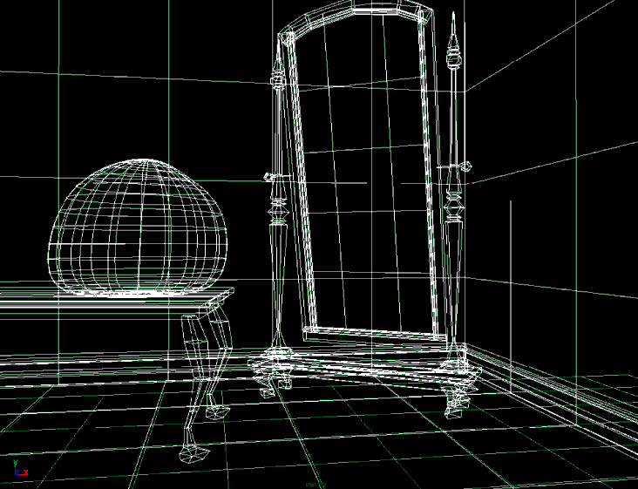
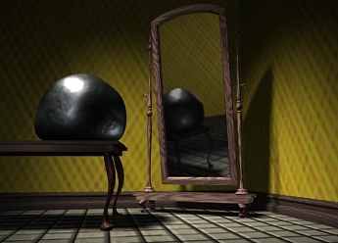
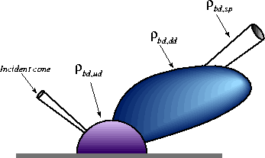
Introduction
3D geometry
projection
Simulation
physics

Slide 4
Application Areas
Computer Aided Design(CAD)
Presentation Graphics
Computer Art
Education and training
Visualization
Image processing
Entertainment
Movies Industry
Gaming Industry
Medical field
Graphical User Interface(GUI)

Slide 5
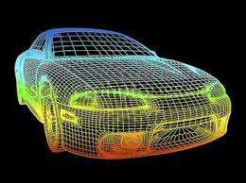
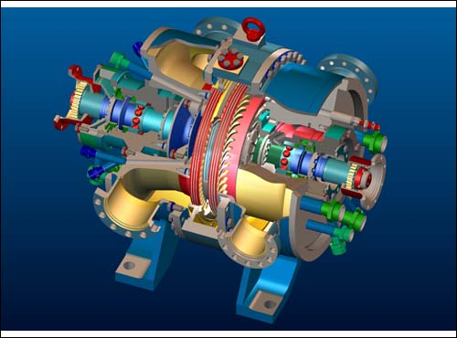
CAD
Major use of computer graphics is in design process, particularly for engineering and architectural systems.
This include design of buildings, automobiles, aircraft etc.
Notes:
In CAD, computer graphics are used to create, modify, analyze, and visualize designs before making the real product.
Architects can view a building in 3D. Engineers can rotate a machine part from different angles. Car designers can check shape, size, and structure.
Change the size of a door in a building plan Modify the shape of a car body Adjust machine parts without drawing again from the beginning.
AutoCAD:
2D drafting, architecture, engineering drawings.
Tinkercad
Beginner-level 3D design and education

Slide 6
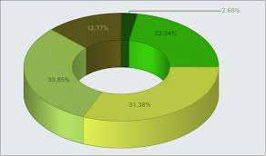
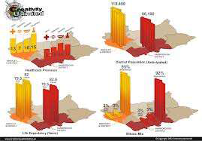
Presentation Graphics
Used to summarize the financial, mathematical, scientific and economic data.
Typical examples are bar charts, line graphs, pie charts etc.
Notes:
Bar Chart, Line Graph, Pie Chart, Column Chart

Slide 7


Computer Art
Artist uses special purpose hardware and programs that provides facilities for designing object shapes and specifying object motion.
Examples pixel paint, super paint etc.
Notes:
Adobe Photoshop,

Slide 8
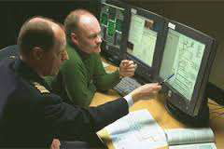
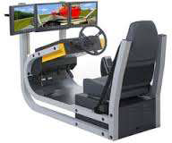
Education and Training
Computer generated models of physical, financial and economic system are often used as educational aids.
Various kinds of simulators program can be used to provide the trainings. E.g. automobile driving simulator.

Slide 9
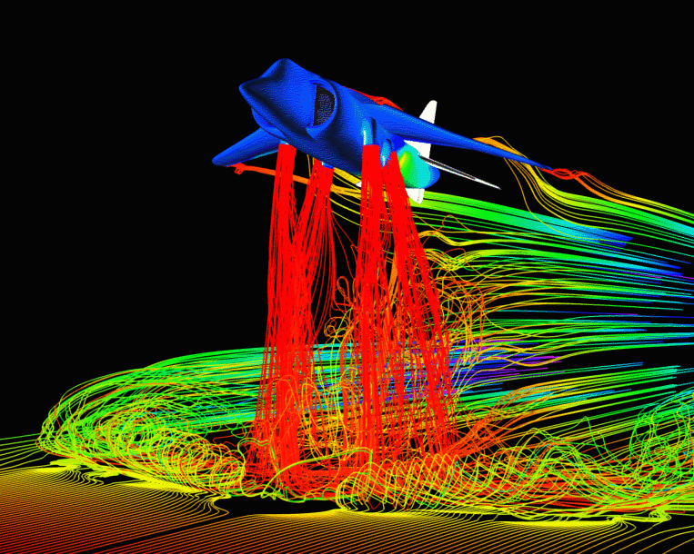
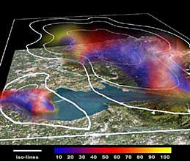
Visualization
Various techniques can be used to represent the large amount of data obtained from scientific, medical or business analysis.
These includes color coding, contour plots, graphs, charts etc.

Slide 10
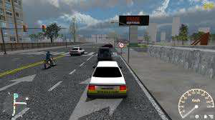

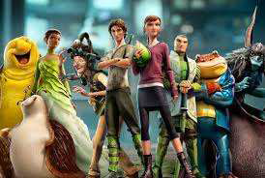
Entertainment
Computer graphics methods are now commonly used in making motion pictures, music videos , games and televisions shows.
Sometime graphics pictures are displayed by themselves and sometime combined with the actors and live scenes.

Slide 11
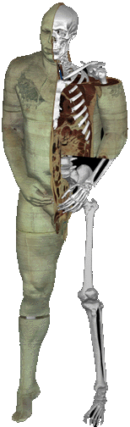
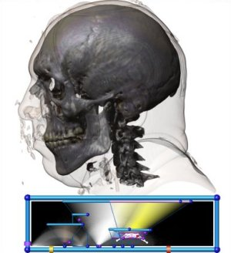
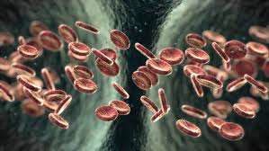
Medical Field
Computer graphics can also be used to represent the various internal parts and process of the human body.

Slide 12
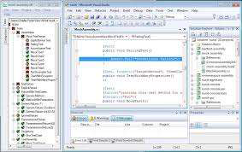
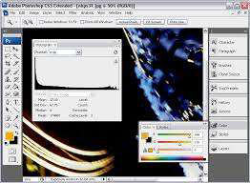
GUI
It is the interface of the software that communicates with the user with help of some input devices.
It contains number of windows , menus and icons for fast selection of processing options.

Slide 13
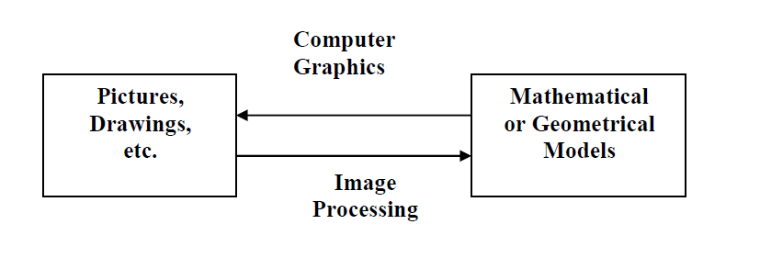
Image Processing
Computer graphics is used to create pictures.
Image processing applies techniques to modify or interpret the existing pictures.
It is used to:
Improve picture quality
Machine perception of visual information

Slide 14
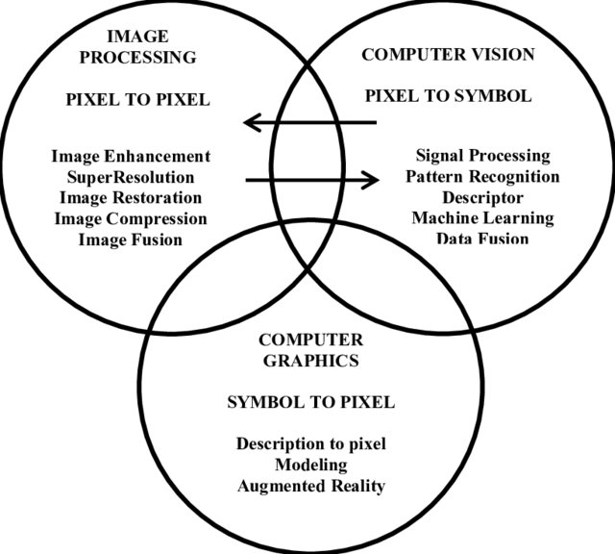
Image Processing Vs Computer Graphics

Slide 15
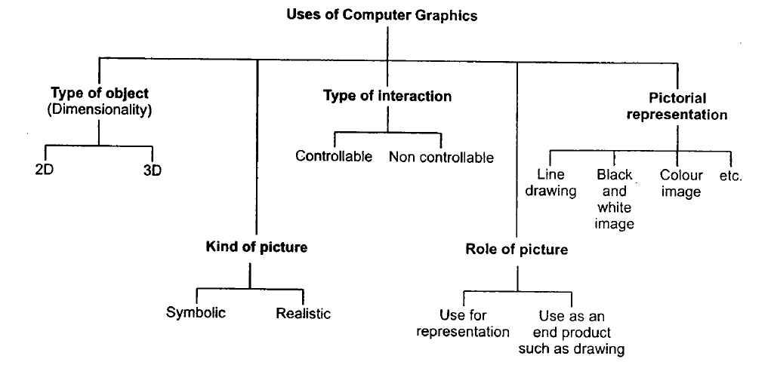
Classification of Computer Graphics

Slide 16
Graphics System
Typical graphical system consists of host computer with support of fast processor, large memory, frame buffer and
Hardwares
Input Devices
Output Devices
Softwares

Slide 17
Input Devices
Most systems have a keyboard and one or more additional devices specially designed for interactive input. This includes:
Touch Panels
Light Pens
Graphics Tablets
Micro-Phone
Film Recorder
Mouse
Joysticks
Data Gloves

Slide 18
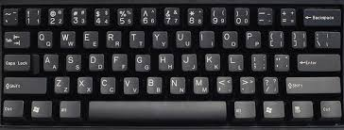
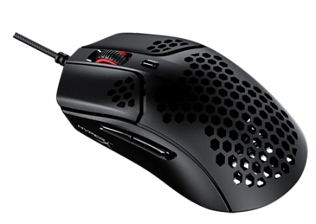

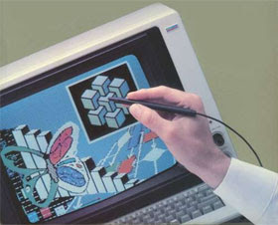
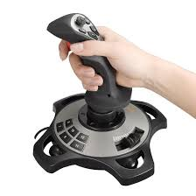
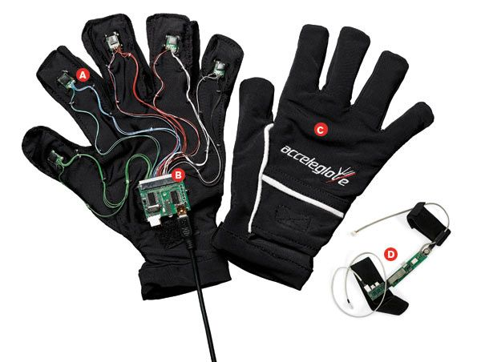
Input Devices

Slide 19
Output Devices
Computer Graphics can use many different output devices or display devices:
Cathode Ray Tube (CRT)
Vector/Random Scan Display
Raster Scan Display
Colored Monitors
LED, LCD, TFT Screens

Slide 20
The Cathode Ray Tubes (CRTs)
Most common display device today
Characterized by:
Evacuated glass bottle
Extremely high voltage
Heating element (filament)
Electrons pulled towards anode focusing cylinder
Vertical and horizontal deflection plates
Beam that strikes phosphor coating on front of tube

Slide 21
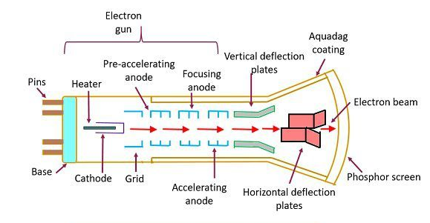
The Cathode Ray Tubes (CRTs)

Slide 22
CRT Components and Their Functions
Electron Gun: Produces a stream of electrons to form the image.
Pins: Connect the CRT to external circuits for power and control.
Heater: Heats the cathode to help it emit electrons.
Cathode: Releases electrons when heated.
Grid: Controls the number of electrons passing through, adjusting brightness.
Pre-Accelerating Anode: Begins speeding up the electrons after they leave the grid.
Accelerating Anode: Further accelerates the electrons toward the screen.
Focusing Anode: Narrows the electron beam to keep it sharp and precise.

Slide 23
CRT Components and Their Functions
Vertical Deflection Plates: Move the beam up and down to scan the screen vertically.
Horizontal Deflection Plates: Move the beam left and right to scan horizontally.
Aquadag Coating: Conductive layer that collects excess electrons and maintains voltage balance.
Electron Beam: The stream of electrons that creates the image by striking the screen.
Phosphor Screen: Glows when hit by electrons, forming visible images.
Base: Holds and supports the entire CRT structure.

Slide 24
How CRT works
The electron gun heats a filament and releases electrons.
Electromagnets focus these electrons into a narrow beam.
Deflection plates move the beam to any point on the screen.
The beam strikes phosphor dots on the screen, making them glow (red, green, or blue).
The glow fades quickly, so the screen is refreshed repeatedly to keep the image visible.

Slide 25
CRTs - Display Technologies
Two main types:
Vector/Random Display
Raster Display

Slide 26
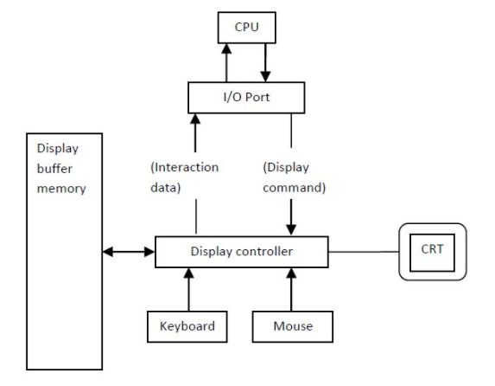
Vector Displays

Slide 27
Vector Displays
The architecture of vector display consists of display controller, CPU, display buffer memory and CRT.
Display controller is connected as an I/O peripheral to the CPU.
Display buffer stores computer produced display list or display program.
The Program contains point & line plotting commands with end point co-ordinates as well as character plotting commands.
Display controller interprets command and sends digital and point co-ordinates to a vector generator.

Slide 28
Vector Displays
Vector generator then converts the digital co-ordinate value to analog voltages for beam deflection circuits that displace an electron beam which points on the CRT’s screen.
As beam is deflected from end point to end point hence this techniques is also called random scan.
We know as beam strikes phosphors coated screen it emits light but that light decays after few milliseconds and therefore it is necessary to repeat through the display list to refresh the screen at least 30 times per second to avoid flicker.
As display buffer is used to store display list and used to refreshing, it is also called refresh buffer.

Slide 29
Vector Displays
If we want line between point p1 & p2 then we directly drive the beam deflection circuitry which focus beam directly from point p1 to p2
If we do not want to display line from p1 to p2 and just move then we can blank the beam as we move it.
To move the beam across the CRT, the information about both magnitude and direction is required. This information is generated with the help of vector graphics generator.

Slide 30
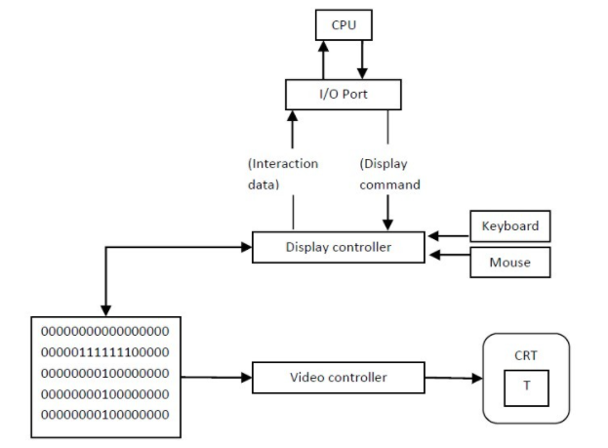
Raster Displays

Slide 31
Raster Displays
The architecture of Raster display. It consists of a display controller, CPU, video controller, refreshes buffer, keyboard, mouse, and CRT.
The display image is stored in the form of 1’s and 0’s in the refresh buffer.
The video controller reads this refresh buffer and produces the actual image on screen.
It will scan one line at a time from top to bottom & then back to the top.

Slide 32
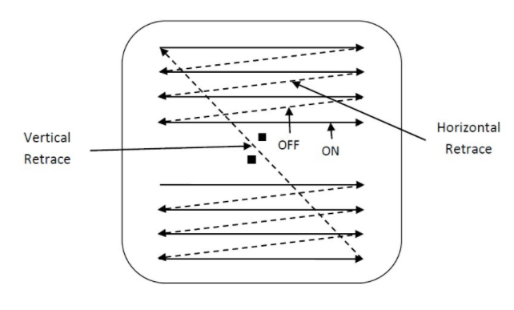
Raster Displays

Slide 33
Raster Displays
The horizontal and vertical deflection signals are generated to move the beam all over the screen in a pattern shown in Image.
Here beam is swept back & forth from left to the right.
When beam is moved from left to right it is ON.
When beam is moved from right to left it is OFF
The process of moving beam from right to left after completion of row is known as Horizontal Retrace.
When beam is reached at the bottom of the screen. It is made OFF and rapidly retraced back to the top left to start again and process of moving back to top is known as Vertical Retrace.

Slide 34
Raster Displays
The screen image is maintained by repeatedly scanning the same image by refreshing of Screen.
Frame Buffer is a special area of memory is dedicated to graphics. It holds set of intensity values for all the screen points
That intensity is retrieved from frame buffer and display on screen one row at a time.
Each screen point referred as pixel or Pel (Picture Element).
Each pixel can be specified by its row and column Numbers.

Slide 35
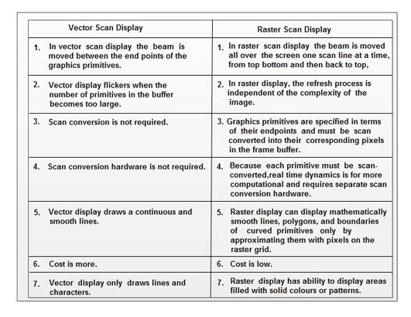
Vector vs Raster Displays

Slide 36
Color CRT Monitors
Displays color pictures by using combination of phosphors that emit different colored light.
Two techniques for producing color displays on CRT:
Beam Penetration Method
Shadow Mask Method

Slide 37
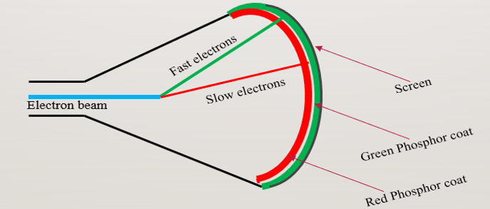
Beam Penetration Method
Used with random scan monitors
The screen has two layers of phosphor: usually red and green
Color depends on how far the electron beam penetrates through the two layers

Slide 38
Beam Penetration Method(cont.)
The speed of electrons – beam acceleration voltage.
Slow Electrons Red color
Fast Electrons Green color
Intermediate Speed Electrons Yellow and orange colors
Quality of Picture is not so good and is inexpensive.
Can display only four colors.

Slide 39
Thank You

