Slide 1
JavaScript
Md. Manirujjaman

Slide 2
What is JavaScript?
JavaScript is the programming language of the web.
It can update and change both HTML and CSS.
It can calculate, manipulate and validate data.
JavaScript to program the behavior of web pages

Slide 3
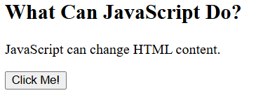
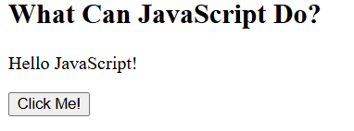
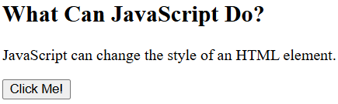
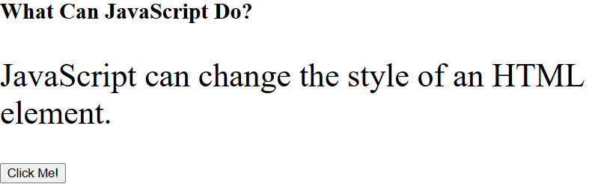
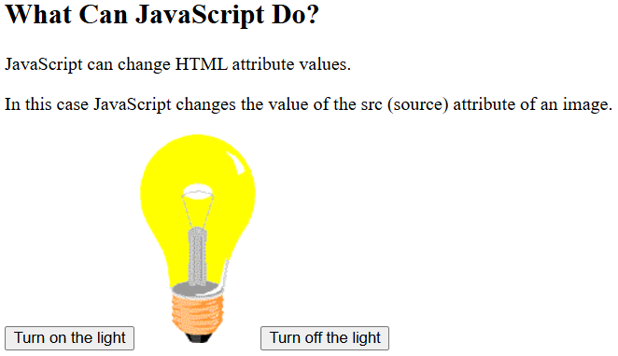
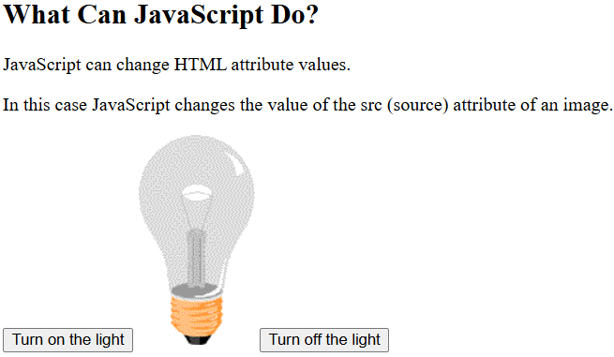
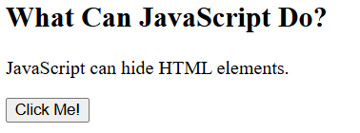
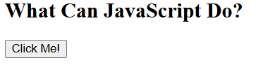
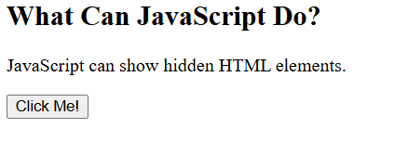

Slide 4
JavaScript Topics
Introduction.
Basic Syntex
Variables,
Data types,
Operators
Control Statement, Loops, Functions
Array, Strings.
Object.
DOM Manipulation (important for web)
document.getElementById()
document.querySelector()
Changing text: .innerHTML, .innerText
Changing style: .style.color = "red"
Creating elements: document.createElement()
10.Events
onclick, onmouseover, onkeyup
addEventListener()
11.Basic Form Validation
Checking if input is empty
Validating numbers/emails with simple conditions

Slide 5
Where Can JavaScript Code Be Placed?
<head>
<script>
alert("Head Section Script");
</script>
</head>
<body>
<script>
alert("Body Section Script");
</script>
</body>
Inside <script> tag in HTML
In <head> section →
runs before page loads
In <body> section →
runs as the page loads

Slide 6
External JavaScript File
Code is written in a separate .js file
Linked with <script src="script.js"></script>
Keeps code organized & reusable
Inline JavaScript
Placed directly inside HTML elements (not recommended for big projects)
<button onclick="alert('Hello!')">Click Me</button>
Best Practice: Use external .js file for cleaner, reusable, and maintainable code.

Slide 7
JavaScript Display Possibilities
JavaScript can "display" data in different ways:
Writing into an HTML element, using innerHTML or innerText.
Writing into the HTML output using document.write().
Writing into an alert box, using window.alert().
Writing into the browser console, using console.log().

Slide 8
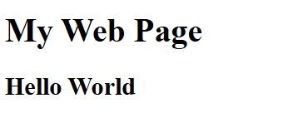
JavaScript Display Possibilities
Using innerHTML:
To access an HTML element, you can use the document.getElementById(id) method.Use the id attribute to identify the HTML element. Then use the innerHTML property to change the HTML content of the HTML element:
<!DOCTYPE html>
<html>
<body>
<h1>My Web Page</h1>
<p id="demo"></p>
<script>
document.getElementById("demo").innerHTML = "<h2>Hello World</h2>";
</script>
</body>
</html>

Slide 9
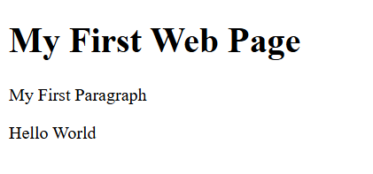
Using innerText
To access an HTML element, use the document.getElementById(id) method.
Then use the innerText property to change the inner text of the HTML element:
<!DOCTYPE html>
<html>
<body>
<h1>My First Web Page</h1>
<p>My First Paragraph</p>
<p id="demo"></p>
<script>
document.getElementById("demo").innerText = "Hello World";
</script>
</body>
</html>

Slide 10
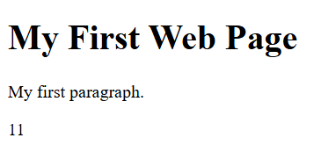
Using document.write()
For testing purposes, it is convenient to use document.write():
<!DOCTYPE html>
<html>
<body>
<h1>My First Web Page</h1>
<p>My first paragraph.</p>
<script>
document.write(5 + 6);
</script>
</body>
</html>

Slide 11
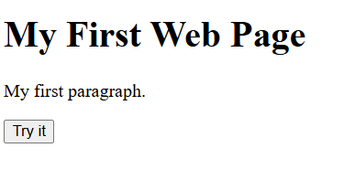
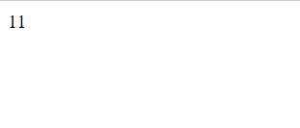
Using document.write() after an HTML document is loaded, will delete all existing HTML
<!DOCTYPE html>
<html>
<body>
<h1>My First Web Page</h1>
<p>My first paragraph.</p>
<button type="button" onclick="document.write(5 + 6)">Try it</button>
</body>
</html>

Slide 12
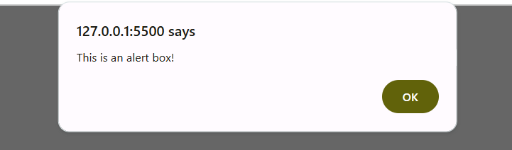
Using window.alert()
You can use an alert box to display data:
<!DOCTYPE html>
<html>
<body>
<h1>My First Web Page</h1>
<p>My first paragraph.</p>
<script>
window.alert("This is an alert box!");
</script>
</body>
</html>

Slide 13
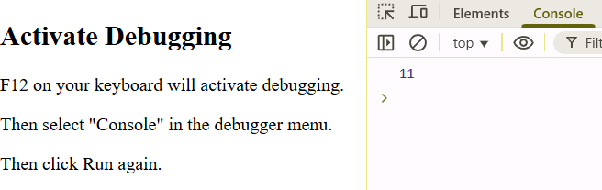
Using console.log()
For debugging purposes, you can call the console.log() method in the browser to display data.
<!DOCTYPE html>
<html>
<body>
<h2>Activate Debugging</h2>
<p>F12 on your keyboard will activate debugging.</p>
<p>Then select "Console" in the debugger menu.</p>
<p>Then click Run again.</p>
<script>
console.log(5 + 6);
</script>
</body>
</html>

Slide 14
JavaScript Print
JavaScript does not have any print object or print methods.
You cannot access output devices from JavaScript.
The only exception is that you can call the window.print() method in the browser to print the content of the current window.
<!DOCTYPE html>
<html>
<body>
<h1>Print this window</h1>
<button onclick="window.print()">Print this page</button>
</body>
</html>

Slide 15
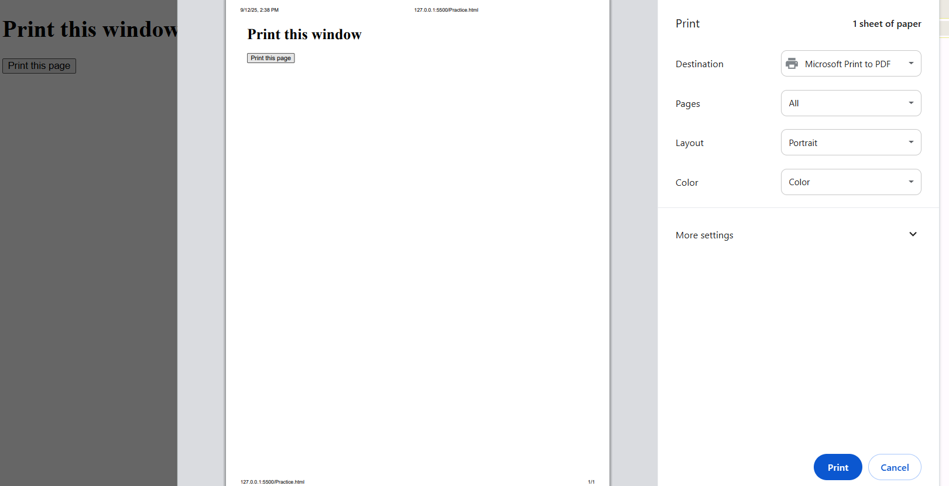

Slide 16
Comments, Variable, Datatypes.

Slide 17
Types of Comments in JavaScript
JavaScript supports two types of comments:
1. Single-line Comment
Starts with //
Everything after // on that line is ignored by JavaScript
2. Multi-line Comment
Starts with /* and ends with */
Can span across multiple lines
// This is a single-line comment
let k = 10; // Comment after code
/*
This is a multi-line comment
It can span multiple lines
*/

Slide 18
Variables are Containers for Data
JavaScript variables can be declared in 4 ways:
Modern JavaScript
Using let
Using const
Older JavaScript
Using var (Not Recommended)
Automatically (Not Recommended)

Slide 19
let x = 5; let y = 6; let z = x + y;
const x = 5; const y = 6; const z = x + y;
var x = 5; var y = 6; var z = x + y;
const price1 = 5; const price2 = 6; let total = price1 + price2;
const pi = 3.14; let person = "John Doe"; let answer = 'Yes I am!';
let _lastName = "Johnson"; let _x = 2; let _100 = 5;
let $ = "Hello World"; let $$$ = 2; let $myMoney = 5;

Slide 20
let person = "John Doe", carName = "Volvo", price = 200;
let person = "John Doe", carName = "Volvo", price = 200;
x = x + 5
let x = "John" + " " + "Doe";
let x = 2 + 3 + "5";
let x = "5" + 2 + 3;

Slide 21
JavaScript has 8 Datatypes
A JavaScript variable can hold 8 types of data
Type | Description | Size
String | A text of characters enclosed in quotes | 2 bytes per character
Number | A number representing a mathematical value | 8 bytes
Bigint | A number representing a large integer | Varies (depends on digits, minimum ~16 bytes)
Boolean | A data type representing true or false | 4 bytes (sometimes optimized to 1 bit internally)
Object | A collection of key-value pairs of data | Varies (minimum ~32 bytes + extra per property)
Undefined | A primitive variable with no assigned value | Usually 4–8 bytes (engine dependent)
Null | A primitive value representing object absence | 4 bytes
Symbol | A unique and primitive identifier | ~16–32 bytes

Slide 22
// Object const person = {firstName:"John", lastName:"Doe"}; // Array object const cars = ["Saab", "Volvo", "BMW"]; // Date object const date = new Date("2022-03-25"); // Undefined let x; let y; // Null let x = null; let y = null; // Symbol const x = Symbol(); const y = Symbol();
// Strings let color = "Yellow"; let lastName = "Johnson"; // Numbers let length = 16; let weight = 7.5; // Bigint let x = 1234567890123456789012345n; let y = BigInt(1234567890123456789012345) // Booleans let x = true; let y = false;

Slide 23
// Using double quotes: let carName1 = "Volvo XC60"; // Using single quotes: let carName2 = 'Volvo XC60';
// Single quote inside double quotes: let answer1 = "It's alright"; // Single quotes inside double quotes: let answer2 = "He is called 'Johnny'"; // Double quotes inside single quotes: let answer3 = 'He is called "Johnny"';
let y = 123e5; // 12300000 let z = 123e-5; // 0.00123

