Slide 1
Information System Development
Information System Management
Course No: 0612-301

Slide 2
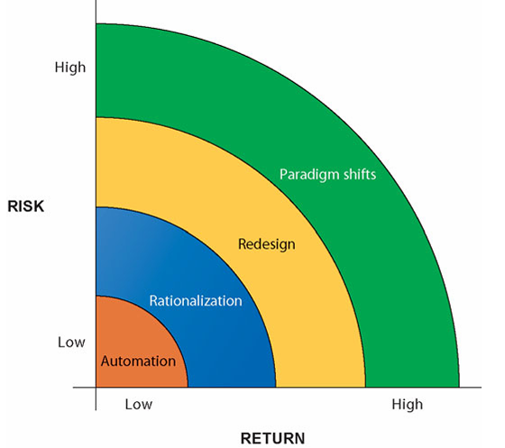
Information System Development
Building a new information system is one kind of planned organizational change.
Information technology can promote various degrees of organizational change –
Automation
Rationalization
Redesign
Paradigm shift
Notes:
This slide says that building a new information system is not only a technical project. It is also a planned organizational change.
That means when an organization introduces a new system, it changes:
how people work,
how departments communicate,
how decisions are made,
how data is stored and used,
and sometimes the whole business process.
1. Automation
Automation means using IT to do manual work automatically.
Example: Before: Employees manually write attendance in a register. After: Biometric attendance system automatically records attendance.
Risk: Low Return: Low to moderate Because the basic process remains almost the same.
2. Rationalization
Rationalization means improving the existing process after automation.
Example: After using biometric attendance, the HR department connects attendance data with salary calculation. Now late attendance and leave deduction are calculated automatically.
Risk: Medium Return: Higher than automation
3. Redesign
Redesign means changing the whole workflow, not just making the old process digital.
Example: A hospital changes its patient service system:
Before: Patient waits in line → fills paper form → pays manually → meets doctor.
After redesign: Patient books appointment online → pays online → gets digital token → doctor sees medical history directly.
Risk: High Return: High
4. Paradigm Shift
Paradigm shift means a complete transformation in how the organization works or delivers service.
Example: A traditional taxi company becomes an app-based ride-sharing platform like Uber.
This changes:
business model,
customer experience,
payment system,
driver management,
service delivery.
Risk: Very high Return: Very high

Slide 3
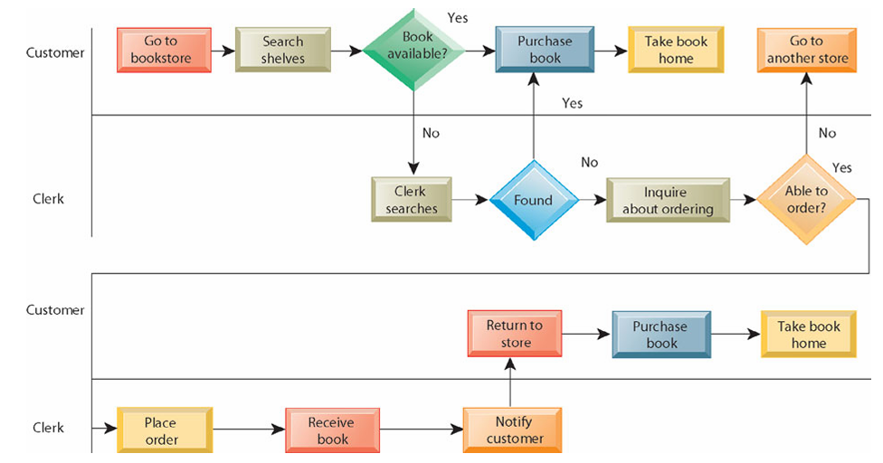
Information System Development
Before redesigning book-purchase process from a bookstore –

Slide 4
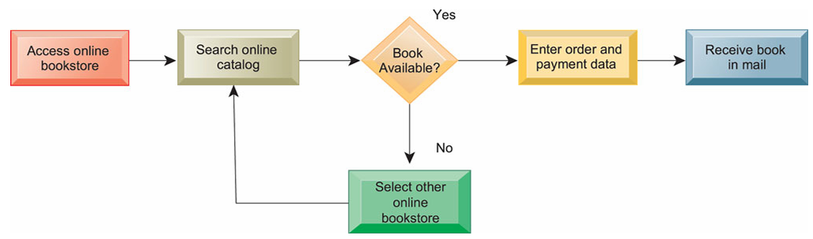
Information System Development
After redesigning book-purchase process by applying IT –

Slide 5
Information System Development
Successfully developed system may result in –
Improve efficiency and operational performance.
Optimized workflows.
Lower headcount i.e. reduced number of workers.
Fewer disputes, costs, and errors.
Accurate financial information.
High return on investment.

Slide 6
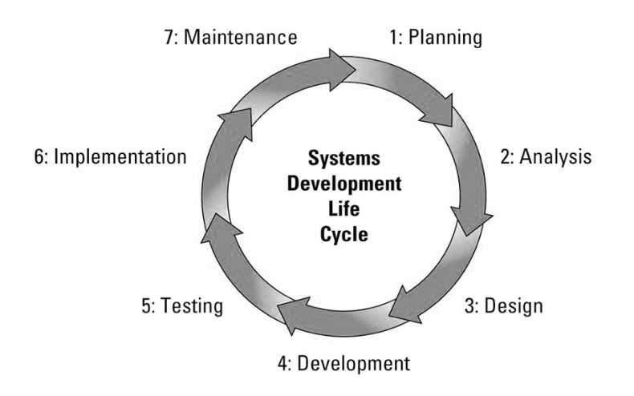
System Development Life Cycle (SDLC)
System Development Life Cycle (SDLC) has 7 steps –
Planning
Analysis
Design
Development
Testing
Implementation
Maintenance

Slide 7
SDLC
SDLC can mean various things –
System Development Life Cycle
Can be applied to any system.
Software Development Life Cycle
Focuses on software systems.
System Design Life Cycle
Focuses on the phase where the designing of the architecture, components, and interactions of the system takes place.

Slide 8
Planning
Identify the system objectives, recognize the needs.
Define the problems and scope.
Set timeline and schedule.
Allocate necessary resources.
Perform feasibility study i.e. preliminary analysis.
Consider threats, constraints, integration, and security of the system.

Slide 9
Planning
Feasibility Study –
Also called Preliminary Analysis/Preliminary Survey/Preliminary Investigation.
Evaluation of the existing system and analysis of the alternative candidates.
What are the user’s demonstration needs?
Is the problem worth solving?
How can the problem be redefined?
Technical feasibility, behavioral feasibility, cost/benefit analysis, etc.
Presented as a report.
Some considers it in planning phase, others put it in analysis phase.

Slide 10
Analysis
Gather, analyze, and validate the information.
Perform observations, interview, questionnaires, etc. with the end-users.
Perform detailed analysis.
Determine each stakeholders (user, customer, etc.) needs and perspectives.
Identify pros and cons, recommend solution.
Prepare a software requirement specification (SRS) document.
Produce the logical model of the system.

Slide 11
Design, Development
Design
Translate the gathered requirements into a detailed technical blueprint.
Design system architecture, database models, user interfaces, network, etc.
System elements such as input, output, and processing are designed.
Business rules, process diagrams, pseudocodes, etc. are detailed.
Prototype models are also produced.
Development
According to the design, the coding i.e. the development takes place at this phase.

Slide 12
Testing
Unit testing –
Testing an individual module or component in isolation.
UI testing –
Testing whether the graphical user interface is working properly or not.
Integration testing –
Testing how the parts of a system or subsystem work together.
Big-bang testing - take the entire integrated system and test it all at once.
Incremental testing –
First test each individual subsystem in isolation, and then continue testing while integrating more and more subsystems.
Can be horizontal or vertical.
For horizontal testing, simply test each sub-system in isolation.
Vertical testing can be top-down, bottom-up, or sandwich.

Slide 13
Testing
Black box testing –
The testers provide the system with inputs and observe the outputs.
They cannot see what is going on inside, the source code, the internal data, or the design documentation describing the system’s internals.
Glass box testing –
Also known as White box testing.
The tester can examine the design documents, the code, steps taken by algorithms during run time, and their internal data.
More time consuming than black box testing but also, more thorough.

Slide 14
Testing
Regression testing –
Give each failure a priority based on their criticality.
High priority bugs are fixed.
But, fixing bugs will cause new bugs. It is called ripple effect.
Do an impact analysis to find out all the possible effects of a change.
After making the change, run a subset of original test cases – regression testing.
Avoid running all the test cases, because that’s expensive.
Instead, cover as much as possible by regression testing.
ensure that the core features continue to work after any new changes or updates in the system.
Smoke testing –
determine if a new software build is ready for the next testing phase
smoke testing finds basic and critical issues in an application before more in-depth testing is done
Incompatibilities and show-stopper errors are found early.

Slide 15
Testing
Alpha testing –
Performed by users and clients, under the supervision of the software dev team.
Beta testing –
Performed by users and clients, in normal work environment, on a pre-release version.
User acceptance testing –
Users and customers do it on their own initiative.
Recovery testing
Security testing
Stress testing
Performance testing
Deployment testing

Slide 16
Implementation, Maintenance
Implementation
Deploy the system into live environment.
System installation, migrating data, and configuring infrastructure.
Training operational staffs and end-users.
Maintenance
Monitor, maintain, and update the system as needed.
Includes bug fixes, performance enhancements, security patches, etc.
User feedback is taken.

Slide 17
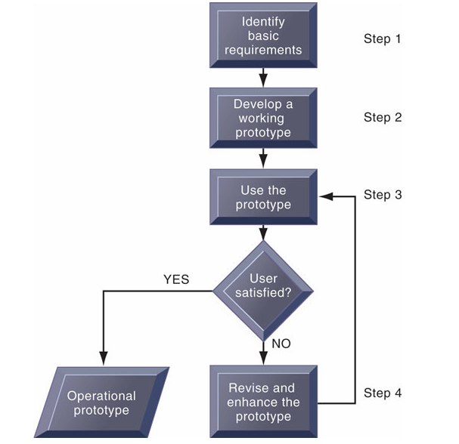
Prototyping
A working version of an information system or part of the system, but it is meant to be only a preliminary model.
Once operational, the prototype will be further refined until it conforms precisely to users’ requirements.
Prototyping is more explicitly iterative than the conventional life cycle.

Slide 18
Software Development Models
Opportunistic Approach
Big Bang Model
Waterfall SDLC Model
Spiral SDLC Model
Concurrent Engineering Model
Iterative Incremental Model
Evolutionary Model
Rapid Action Development (RAD) Model
V-Shaped Model
Agile Model

Slide 19
Software Development Models
The Opportunistic Approach
This model focuses on quickly building a basic prototype and then improving it continuously based on new ideas and feedback.
Used –
When system requirements are unclear or changing.
For small or medium-scale projects.
For research, experimental, or innovative projects.
When rapid prototype development is required.

Slide 20
Software Development Models
The Opportunistic Approach
Advantages:
Fast Initial Development
Flexible and Adaptive
Encourages Creativity and Innovation
Useful When Requirements Are Unclear
Continuous Improvement
Disadvantages:
Lack of Proper Planning
Difficult to Estimate Time and Cost
No Formal Documentation
Not Suitable for Large Projects
Risk of Continuous Modifications

Slide 21
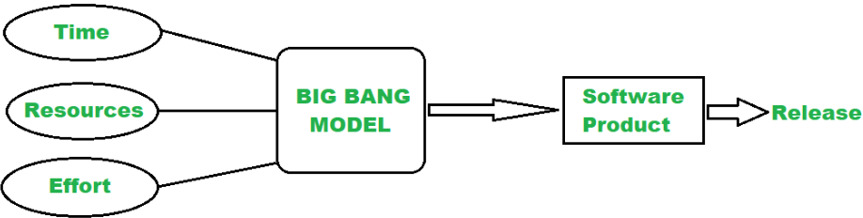
Software Development Models
The Big Bang Model
In this model, developers do not follow any specific process.
Development begins with the necessary funds and efforts in the form of inputs.
This model is ideal for small projects like academic projects or practical projects.

Slide 22
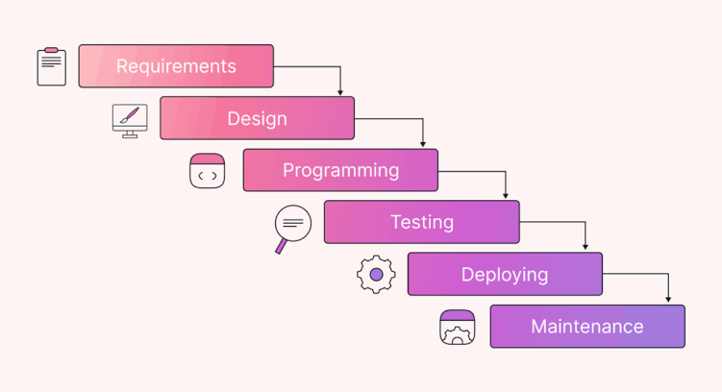
The Waterfall SDLC Model
Sequential Approach –
Each phase of the project is completed before moving on to the next one.
Document-driven –
Depends on documentation to ensure that the project is well-defined and the project team is working towards a clear set of goals.
Quality Control –
Places a high emphasis on quality control and testing at each phase of the project.
V & V - Verification and Validation.
Rigorous Planning –
Project scope, timelines, and deliverables are carefully defined and monitored.

Slide 23
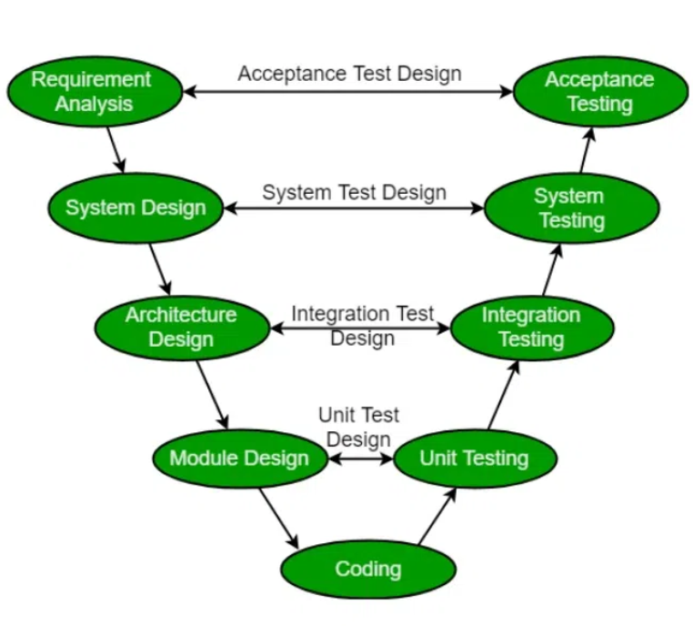
The V-shaped Model
Also known as the Verification and Validation model.
There are Verification phases on one side of the ‘V’ and Validation phases on the other side.
The Coding Phase joins the two sides of the V-Model.
Verification phases focus planning and designing the system.
Validation phases focus on testing and validation against the specifications.

Slide 24
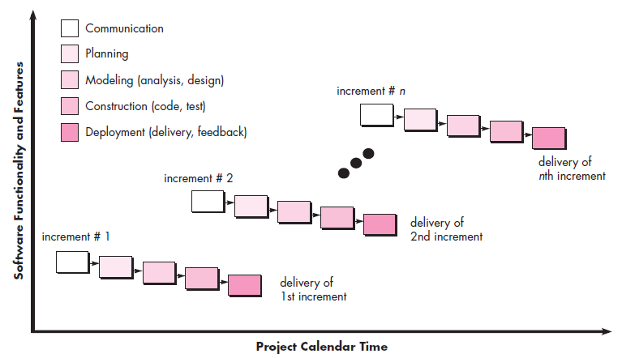
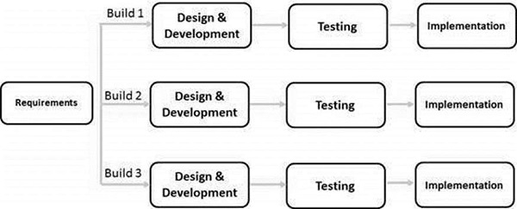
The Iterative Incremental Model
The basic idea behind this method is to develop a system through repeated cycles (iterative) and in smaller portions at a time (incremental).
Starts with a simple implementation of a small set of the software requirements and iteratively enhances the evolving versions.

Slide 25
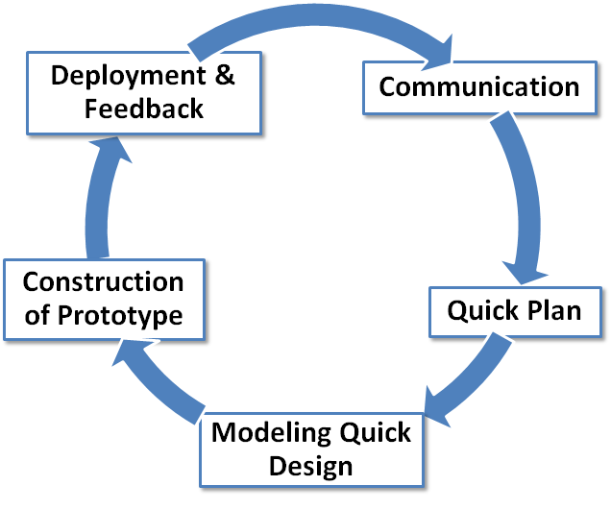
Evolutionary Process Model
Notes:
The main problem with the Waterfall and V-Model is that they assume requirements are clear and fixed from the beginning. In reality, clients often do not know exactly what they want, or they may understand their needs but cannot express them properly. As a result, requirements are frequently unclear or subject to change, making these models rigid and less suitable. For projects with evolving or uncertain requirements, other models like Iterative or Agile are preferred, as they can accommodate changes more effectively.

Slide 26
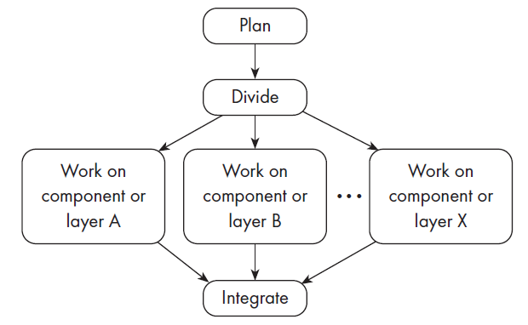
The Concurrent Engineering Model
Explicitly accounts for the divide and conquer principle.
Each team works on its own component, typically following a spiral or evolutionary approach.
There has to be some initial planning, and periodic integration

Slide 27
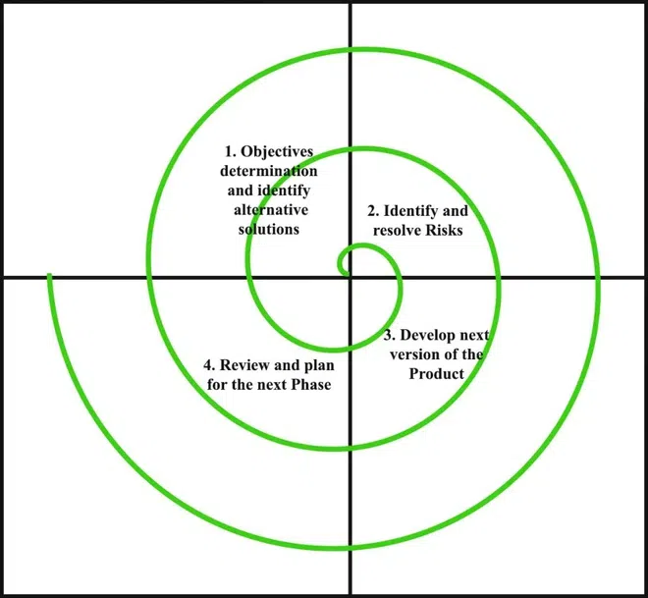
Spiral Model

Slide 28
Spiral Model
Risk Handling
Radius of spiral = Cost
Angular Dimension = Progress
Meta Model

Slide 29
Spiral Model
When to Use the Spiral Model
The project is large-scale and requires careful risk management.
Requirements are unclear at the beginning and expected to evolve over time.
The client wants to see progressive versions of the software for feedback.
High reliability and safety are critical (defense, aerospace).
The development team has strong expertise in risk evaluation.

Slide 30
Spiral Model
Advantages:
Risk handling
Large projects
Flexible
Customer satisfaction
Disadvantages
Complex
Expensive
Too much risk analysis
More time

Slide 31
The Rapid Action Development (RAD) Model
Focuses on delivering working software in a short timelines.
Emphasizes quick and iterative release cycles.
More flexible and responsive to user feedback and changing requirement.
The RAD model is used when the requirements are fully understood and the component-based construction approach is adopted.
Close teamwork among end users and information systems specialists.
Applies reusable softwares and frameworks.
Agile development is a type of RAD model.
Breaks the large project into a series of subproject and build them in short periods using iteration and continuous feedback.
Emphasizes face-to-face communication over written documents.

Slide 32
Agile Methodology
Agile (Move quickly). Most importance is given to the code.
Large projects are break down into small chunks which are called iterations.
This iteration will be released into the market.
Then taking customer feedback.
Then enhancing the project.
After that re-released.

Slide 33
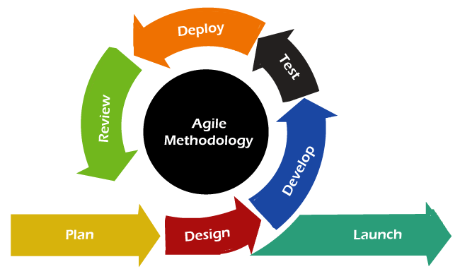
Agile Methodology

Slide 34
Agile Methodology
Advantages:
Frequent delivery
Face to face communication with client
Changes- frequently
Time- less
For large projects
Disadvantages:
Less documentation, design
Maintanance problem

