Slide 1
Data Mining (CSE 6506)
Association Rule Mining (ARM)- Part 2
Mahmuda Naznin
Department of Computer Science Engineering, BUET

Slide 2
Association Analysis: Basic Concepts and Algorithms
Algorithms and Complexity

Slide 3
Factors Affecting Complexity of Apriori
Choice of minimum support threshold
lowering support threshold results in more frequent itemsets
this may increase number of candidates and max length of frequent itemsets
Dimensionality (number of items) of the data set
more space is needed to store support count of each item
if number of frequent items also increases, both computation and I/O costs may also increase
Size of database
since Apriori makes multiple passes, run time of algorithm may increase with number of transactions
Average transaction width
transaction width increases with denser data sets
This may increase max length of frequent itemsets and traversals of hash tree (number of subsets in a transaction increases with its width)
Notes:
The complexity of the Apriori algorithm is affected by several factors including the choice of minimum support threshold, dimensionality of the dataset, size of the database, and average transaction width. A lower support threshold increases the number of frequent itemsets and candidates, while higher dimensionality and wider transactions increase the number of possible combinations. Additionally, larger databases increase the number of scans and I/O cost, making the algorithm more computationally expensive.

Slide 4
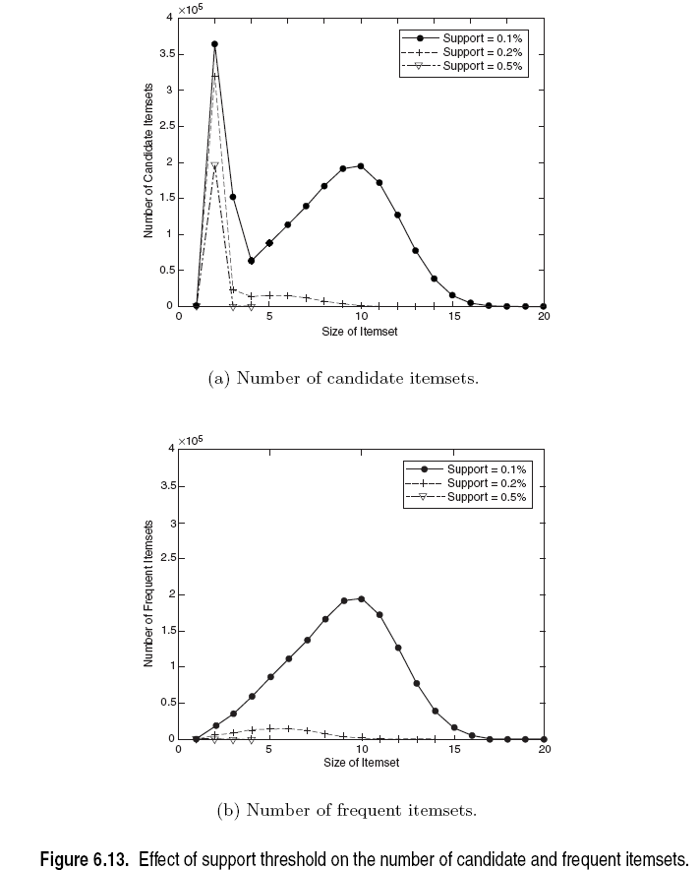
Factors Affecting Complexity of Apriori
Notes:
The graph shows that lowering the support threshold significantly increases both the number of candidate and frequent itemsets, leading to higher computational complexity in the Apriori algorithm. The number of itemsets increases rapidly for medium-sized itemsets and then decreases for larger sizes. Thus, a lower support threshold causes candidate explosion, while a higher support threshold reduces the number of itemsets and improves efficiency.

Slide 5
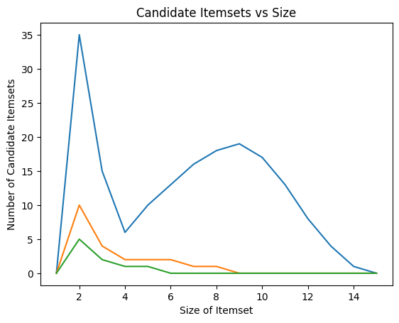
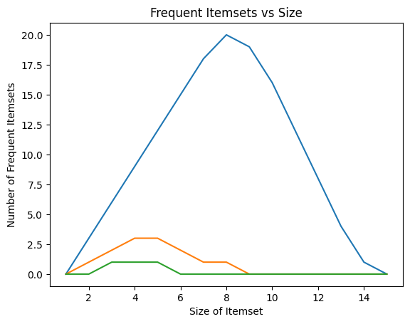
Notes:
Factors Affecting Complexity of Apriori – Short Explanation
Support threshold is the main factor:
Low support → many candidate itemsets → high complexity
High support → fewer candidates → low complexity
Number of candidate itemsets increases first, then decreases as itemset size grows.
More candidates → more database scans and computations.

Slide 6
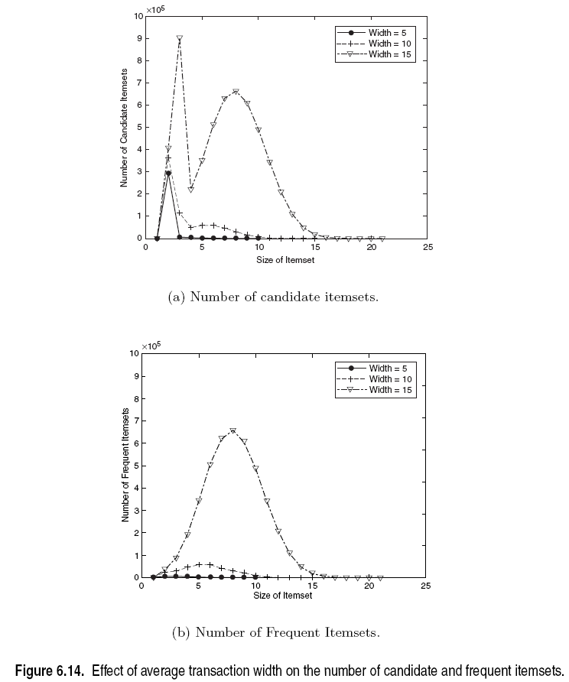
Factors Affecting Complexity of Apriori
Notes:
The graph shows that increasing the average transaction width significantly increases the number of candidate and frequent itemsets. Wider transactions contain more items, leading to a larger number of possible subsets and combinations. This results in higher computational complexity and memory usage in the Apriori algorithm, making it less efficient for dense datasets.
The number of candidate and frequent itemsets decreases as the size of itemsets increases because larger itemsets have lower support and are less likely to appear in many transactions. According to the Apriori property, if any subset of an itemset is infrequent, the entire itemset is pruned. This significantly reduces the number of candidates at higher levels, causing the number of itemsets to decrease regardless of transaction width.

Slide 7
Compact Representation of Frequent Itemsets
Some itemsets are redundant because they have identical support as their supersets
Number of frequent itemsets
Need a compact representation
Notes:
Some itemsets are redundant because they have the same support as their supersets when items always occur together in transactions. This leads to a very large number of frequent itemsets, as all subsets become frequent. Therefore, storing all itemsets is inefficient, and compact representations such as closed or maximal itemsets are used to reduce redundancy.

Slide 8
Maximal Frequent Itemset
An itemset is maximal frequent if it is frequent and none of its immediate supersets is frequent
Maximal Itemsets
Infrequent Itemsets
Border
Notes:
A maximal frequent itemset is a frequent itemset for which none of its supersets is frequent. It represents the largest frequent patterns and lies on the boundary between frequent and infrequent itemsets. Storing maximal frequent itemsets helps reduce redundancy since all their subsets are also frequent.

Slide 9
What are the Maximal Frequent Itemsets in this Data?
Minimum support threshold = 5

Slide 10
An illustrative example
Items
 | A | B | C | D | E | F | G | H | I | J
1
2
3
4
5
6
7
8
9
10
Support threshold (by count) : 5
Frequent itemsets: ?
Transactions

Slide 11
An illustrative example
Items
 | A | B | C | D | E | F | G | H | I | J
1
2
3
4
5
6
7
8
9
10
Support threshold (by count) : 5
Frequent itemsets: {F}
Transactions

Slide 12
An illustrative example
Items
 | A | B | C | D | E | F | G | H | I | J
1
2
3
4
5
6
7
8
9
10
Support threshold (by count) : 5
Frequent itemsets: {F}
Support threshold (by count): 4
Frequent itemsets: ?
Transactions

Slide 13
An illustrative example
Items
 | A | B | C | D | E | F | G | H | I | J
1
2
3
4
5
6
7
8
9
10
Support threshold (by count) : 5
Frequent itemsets: {F}
Support threshold (by count): 4
Frequent itemsets: {E}, {F}, {E,F}, {J}
Transactions

Slide 14
An illustrative example
Items
 | A | B | C | D | E | F | G | H | I | J
1
2
3
4
5
6
7
8
9
10
Support threshold (by count) : 5
Frequent itemsets: {F}
Support threshold (by count): 4
Frequent itemsets: {E}, {F}, {E,F}, {J}
Support threshold (by count): 3
Frequent itemsets: ?
Transactions

Slide 15
An illustrative example
Items
 | A | B | C | D | E | F | G | H | I | J
1
2
3
4
5
6
7
8
9
10
Support threshold (by count) : 5
Frequent itemsets: {F}
Support threshold (by count): 4
Frequent itemsets: {E}, {F}, {E,F}, {J}
Support threshold (by count): 3
Frequent itemsets:
All subsets of {C,D,E,F} + {J}
Transactions

Slide 16
An illustrative example
Items
 | A | B | C | D | E | F | G | H | I | J
1
2
3
4
5
6
7
8
9
10
Support threshold (by count) : 5
Frequent itemsets: {F}
Maximal itemsets: ?
Support threshold (by count): 4
Frequent itemsets: {E}, {F}, {E,F}, {J}
Maximal itemsets: ?
Support threshold (by count): 3
Frequent itemsets:
All subsets of {C,D,E,F} + {J}
Maximal itemsets: ?
Transactions

Slide 17
An illustrative example
Items
 | A | B | C | D | E | F | G | H | I | J
1
2
3
4
5
6
7
8
9
10
Support threshold (by count) : 5
Frequent itemsets: {F}
Maximal itemsets: {F}
Support threshold (by count): 4
Frequent itemsets: {E}, {F}, {E,F}, {J}
Maximal itemsets: ?
Support threshold (by count): 3
Frequent itemsets:
All subsets of {C,D,E,F} + {J}
Maximal itemsets: ?
Transactions

Slide 18
An illustrative example
Items
 | A | B | C | D | E | F | G | H | I | J
1
2
3
4
5
6
7
8
9
10
Support threshold (by count) : 5
Frequent itemsets: {F}
Maximal itemsets: {F}
Support threshold (by count): 4
Frequent itemsets: {E}, {F}, {E,F}, {J}
Maximal itemsets: {E,F}, {J}
Support threshold (by count): 3
Frequent itemsets:
All subsets of {C,D,E,F} + {J}
Maximal itemsets: ?
Transactions

Slide 19
An illustrative example
Items
 | A | B | C | D | E | F | G | H | I | J
1
2
3
4
5
6
7
8
9
10
Support threshold (by count) : 5
Frequent itemsets: {F}
Maximal itemsets: {F}
Support threshold (by count): 4
Frequent itemsets: {E}, {F}, {E,F}, {J}
Maximal itemsets: {E,F}, {J}
Support threshold (by count): 3
Frequent itemsets:
All subsets of {C,D,E,F} + {J}
Maximal itemsets:
{C,D,E,F}, {J}
Transactions

Slide 20
Another illustrative example
Items
 | A | B | C | D | E | F | G | H | I | J
1
2
3
4
5
6
7
8
9
10
Support threshold (by count) : 5
Maximal itemsets: {A}, {B}, {C}
Support threshold (by count): 4
Maximal itemsets: {A,B}, {A,C},{B,C}
Support threshold (by count): 3
Maximal itemsets: {A,B,C}
Transactions

Slide 21
Closed Itemset
An itemset X is closed if none of its immediate supersets has the same support as the itemset X.
X is not closed if at least one of its immediate supersets has support count as X.
Notes:
Closed Itemsets:
{B}
{A,B}
{B,C}
{B,D}
{C,D}
{A,B,D}
{A,B,C,D}

Slide 22
Maximal vs Closed Itemsets
Transaction Ids
Not supported by any transactions

Slide 23
Maximal vs Closed Frequent Itemsets
Minimum support = 2
Closed but not maximal
Closed and maximal
# Closed = 9
# Maximal = 4

Slide 24
What are the Closed Itemsets in this Data?

Slide 25
Example 1
Items
 | A | B | C | D | E | F | G | H | I | J
1
2
3
4
5
6
7
8
9
10
Itemsets | Support (counts) | Closed itemsets
{C} | 3
{D} | 2
{C,D} | 2
Transactions

Slide 26
Example 1
Items
 | A | B | C | D | E | F | G | H | I | J
1
2
3
4
5
6
7
8
9
10
Itemsets | Support (counts) | Closed itemsets
{C} | 3 | ✓
{D} | 2
{C,D} | 2 | ✓
Transactions

Slide 27
Example 2
Items
 | A | B | C | D | E | F | G | H | I | J
1
2
3
4
5
6
7
8
9
10
Itemsets | Support (counts) | Closed itemsets
{C} | 3
{D} | 2
{E} | 2
{C,D} | 2
{C,E} | 2
{D,E} | 2
{C,D,E} | 2
Transactions

Slide 28
Example 2
Items
 | A | B | C | D | E | F | G | H | I | J
1
2
3
4
5
6
7
8
9
10
Itemsets | Support (counts) | Closed itemsets
{C} | 3 | ✓
{D} | 2
{E} | 2
{C,D} | 2
{C,E} | 2
{D,E} | 2
{C,D,E} | 2 | ✓
Transactions

Slide 29
Example 3
Items
 | A | B | C | D | E | F | G | H | I | J
1
2
3
4
5
6
7
8
9
10
Closed itemsets: {C,D,E,F}, {C,F}
Transactions

Slide 30
Example 4
Items
 | A | B | C | D | E | F | G | H | I | J
1
2
3
4
5
6
7
8
9
10
Closed itemsets: {C,D,E,F}, {C}, {F}
Transactions

Slide 31
Maximal vs Closed Itemsets

Slide 32
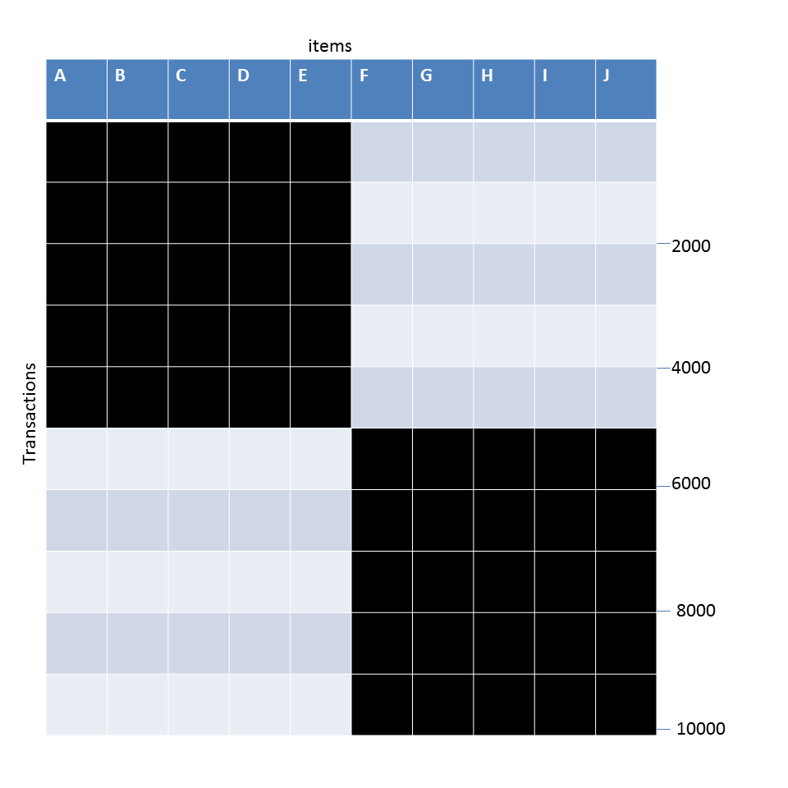
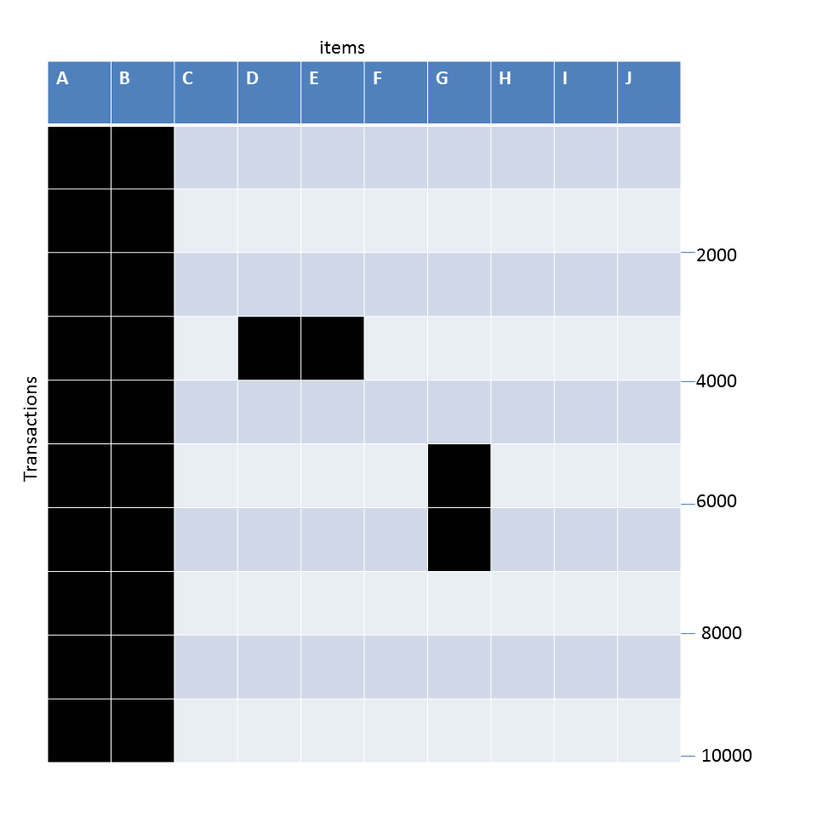
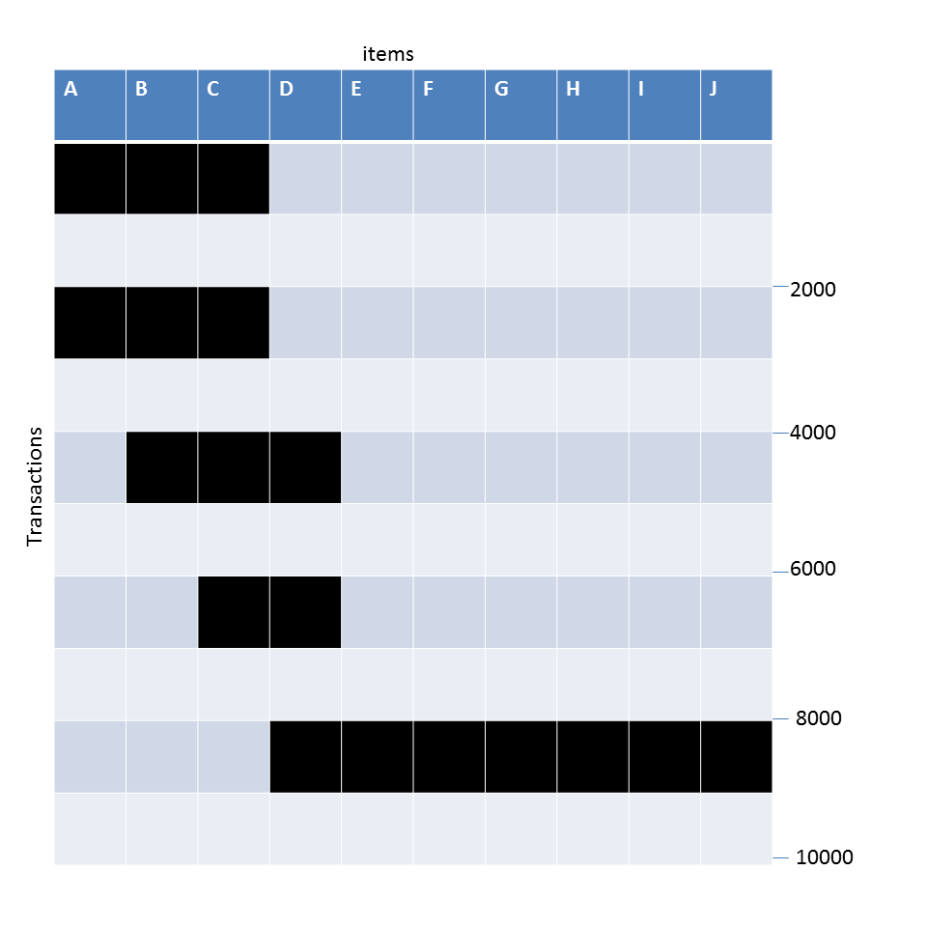
Example question
Given the following transaction data sets (dark cells indicate presence of an item in a transaction) and a support threshold of 20%, answer the following questions
What is the number of frequent itemsets for each dataset? Which dataset will produce the most number of frequent itemsets?
Which dataset will produce the longest frequent itemset?
Which dataset will produce frequent itemsets with highest maximum support?
Which dataset will produce frequent itemsets containing items with widely varying support levels (i.e., itemsets containing items with mixed support, ranging from 20% to more than 70%)?
What is the number of maximal frequent itemsets for each dataset? Which dataset will produce the most number of maximal frequent itemsets?
What is the number of closed frequent itemsets for each dataset? Which dataset will produce the most number of closed frequent itemsets?
Notes:
For dataset 1: Frequent itemsets=(2^5−1)+(2^5−1)=31+31 $=\boxed{62}$

Slide 33
Pattern Evaluation
Association rule algorithms can produce large number of rules
Interestingness measures can be used to prune/rank the patterns
In the original formulation, support & confidence are the only measures used
Notes:
Association rule algorithms produce many rules When we mine data, especially with low support, we get too many rules, many of which are not useful or meaningful. So we need to filter them 👉 That’s why we use interestingness measures to: Remove unimportant rules (pruning)
Rank rules based on usefulness (ranking)
Basic measures (original approach) Initially, only two measures were used: Support → how often the rule appears in the dataset
Confidence → how strong the rule is (probability of RHS given LHS)

Slide 34
1) What is pattern evaluation? Why is it needed?
Answer: Pattern evaluation is the process of checking whether discovered patterns or association rules are really useful, meaningful, and interesting. In association rule mining, a very large number of rules can be generated, especially when minimum support is low. Many of these rules are redundant or unimportant. Therefore, pattern evaluation is needed to prune unimportant rules and rank useful rules using interestingness measures.

Slide 35
2) Why are interestingness measures used in association rule mining?
Answer: Interestingness measures are used because association rule mining often produces too many rules. It is difficult to examine all rules manually. These measures help us remove weak or misleading rules and keep only the important ones. They are also used to rank rules according to their usefulness, strength, and dependence between items.

Slide 36
3) What are the basic interestingness measures used in the original formulation?
Answer: In the original formulation of association rule mining, the two basic measures are support and confidence.
Support shows how often an itemset or rule appears in the database.
Confidence shows how strong a rule is, that is, the probability of the right-hand side given the left-hand side.
These measures are simple and useful, but they are not always enough to measure real correlation.

Slide 37
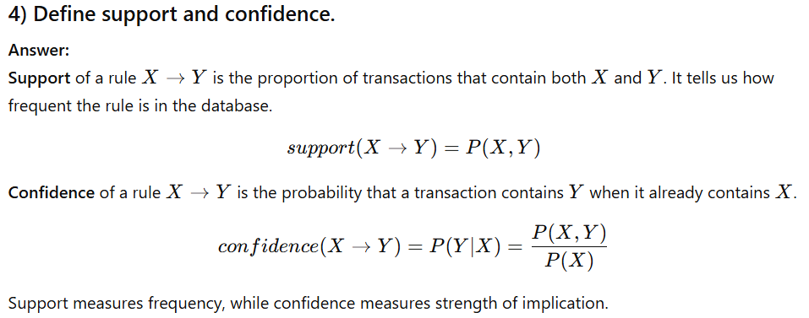

Slide 38
Computing Interestingness Measure
Given X → Y or {X,Y}, information needed to compute interestingness can be obtained from a contingency table
Contingency table
 | Y | Y
X | f₁₁ | f₁₀ | f₁₊
X | f₀₁ | f₀₀ | f_{o+}
 | f₊₁ | f₊₀ | N
f₁₁: support of X and Y f₁₀: support of X and Y f₀₁: support of X and Y f₀₀: support of X and Y
Used to define various measures
support, confidence, Gini, entropy, etc.

Slide 39
Drawback of Confidence
Customers | Tea | Coffee | …
C1 | 0 | 1 | …
C2 | 1 | 0 | …
C3 | 1 | 1 | …
C4 | 1 | 0 | …
…
 | Coffee | Coffee
Tea | 15 | 5 | 20
Tea | 75 | 5 | 80
 | 90 | 10 | 100
Association Rule: Tea → Coffee
Confidence ≅ P(Coffee|Tea) = 15/20 = 0.75
Confidence > 50%, meaning people who drink tea are more likely to drink coffee than not drink coffee
So rule seems reasonable
Notes:
Confidence does not measure real correlation; it only measures conditional probability and can be biased when the consequent is very frequent.
Confidence=P(Coffee∣Tea)=20/15​=0.75
P(Coffee)=90/100​=0.90
People drink coffee even without tea

Slide 40
Drawback of Confidence
 | Coffee | Coffee
Tea | 15 | 5 | 20
Tea | 75 | 5 | 80
 | 90 | 10 | 100
Association Rule: Tea → Coffee
Confidence= P(Coffee|Tea) = 15/20 = 0.75
but P(Coffee) = 0.9, which means knowing that a person drinks tea reduces the probability that the person drinks coffee!
Note that P(Coffee|Tea) = 75/80 = 0.9375
Notes:
Confidence is misleading because it ignores the base probability of the consequent. Even though confidence is high, Tea and Coffee are negatively correlated since $P\left(Coffee∣Tea\right)<P\left(Coffee\right)$.

Slide 41
What is the drawback of confidence?
Answer: The main drawback of confidence is that it does not measure true correlation between items. It only measures conditional probability. Confidence can be high even when the consequent item is already very frequent in the database. In that case, the rule may look strong, but actually the antecedent does not increase the chance of the consequent. So confidence can be misleading.
Suppose the rule is Tea → Coffee. Its confidence is high, for example 0.75, which seems to mean that tea drinkers often drink coffee. But if the overall probability of coffee is even higher, for example 0.90, then knowing that a person drinks tea actually lowers the chance that the person drinks coffee. So even though confidence is high, the rule is not positively associated. This shows that confidence alone is not enough to judge rule quality.

Slide 42
Measure for Association Rules
So, what kind of rules do we really want?
Confidence(X → Y) should be sufficiently high
To ensure that people who buy X will more likely buy Y than not buy Y
Confidence(X → Y) > support(Y)
Otherwise, rule will be misleading because having item X actually reduces the chance of having item Y in the same transaction
Is there any measure that capture this constraint?
Answer: Yes. There are many of them.
Notes:
Confidence > Support(Y) → X increases chance of Y (good rule)
Confidence = Support(Y) → X has no effect
Confidence < Support(Y) → X reduces chance of Y (bad rule)

Slide 43
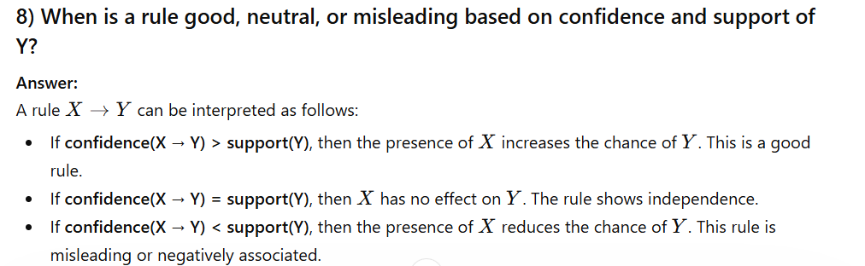

Slide 44
Statistical Independence
The criterion confidence(X → Y) = support(Y)
is equivalent to:
P(Y|X) = P(Y)
P(X,Y) = P(X) × P(Y)
If P(X,Y) > P(X) × P(Y) : X & Y are positively correlated
If P(X,Y) < P(X) × P(Y) : X & Y are negatively correlated
Notes:
confidence(X→Y)=support(Y)
Knowing X does NOT change probability of Y

Slide 45
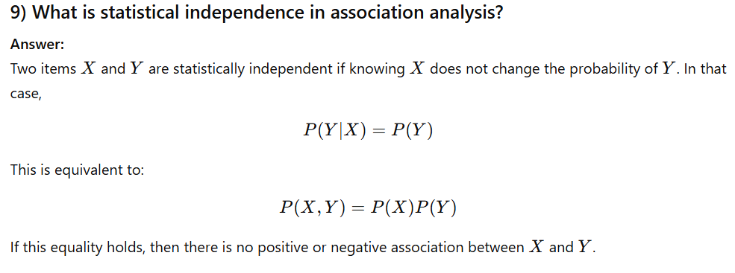

Slide 46
Measures that take into account statistical dependence
lift is used for rules while interest is used for itemsets
Notes:
1. Lift
Definition: Lift measures how much more likely Y occurs with X compared to when X is absent.
$$\text{Lift}=\frac{P\left(Y∣X\right)}{P\left(Y\right)}$$
2. Interest
Definition: Interest measures the strength of dependence between X and Y by comparing observed co-occurrence with expected co-occurrence under independence.
$$\text{Interest}=\frac{P\left(X , Y\right)}{P\left(X\right)P\left(Y\right)}$$
3. PS (Probability Difference)
Definition: PS measures the difference between the actual joint probability of X and Y and their expected probability if they were independent.
$$PS=P\left(X , Y\right)−P\left(X\right)P\left(Y\right)$$
4. Phi (φ) Coefficient
Definition: Phi coefficient measures the degree of correlation between X and Y, normalized between −1 and +1.
$$φ=\frac{P\left(X , Y\right)−P\left(X\right)P\left(Y\right)}{\sqrt{P\left(X\right)\left(1−P\left(X\right)\right)P\left(Y\right)\left(1−P\left(Y\right)\right)}}$$
Lift and Interest have the same formula, but Lift is used for rules while Interest is used for itemsets.

Slide 47
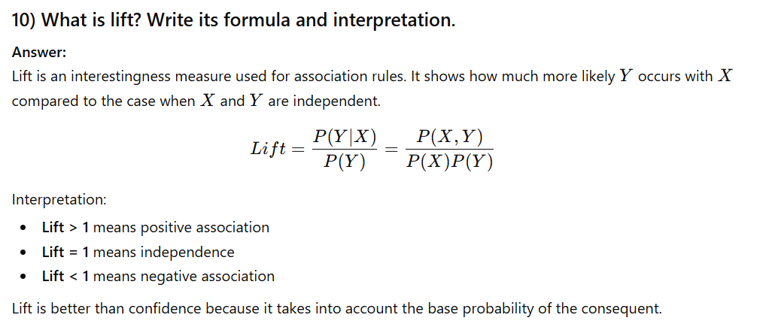

Slide 48
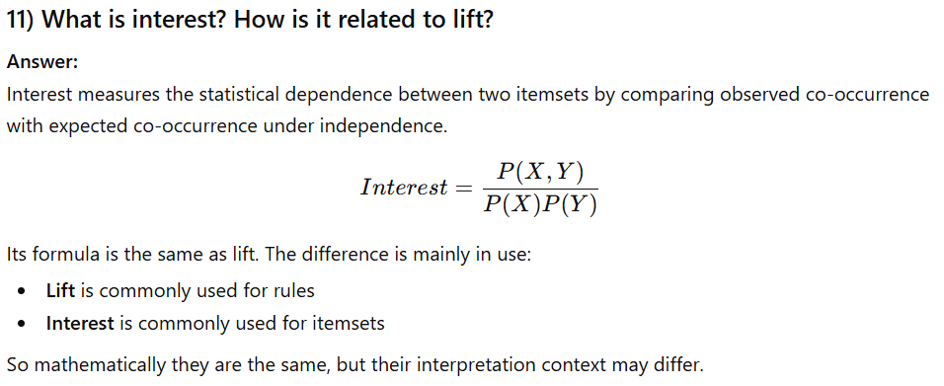

Slide 49
14) Why is lift better than confidence?
Answer: Lift is better than confidence because lift compares the observed association with the expected association under independence. Confidence only looks at conditional probability and ignores how common the consequent is in the full database. Therefore, confidence can be high even for misleading rules, while lift gives a better idea of true dependence.
15) Is confidence or lift enough for pruning all bad rules?
Answer: No, confidence and lift are not always enough. Confidence can be misleading, and lift only checks statistical dependence in a limited way. To evaluate rules more properly, we may need additional measures such as chi-square, phi coefficient, and other correlation-based measures.

Slide 50
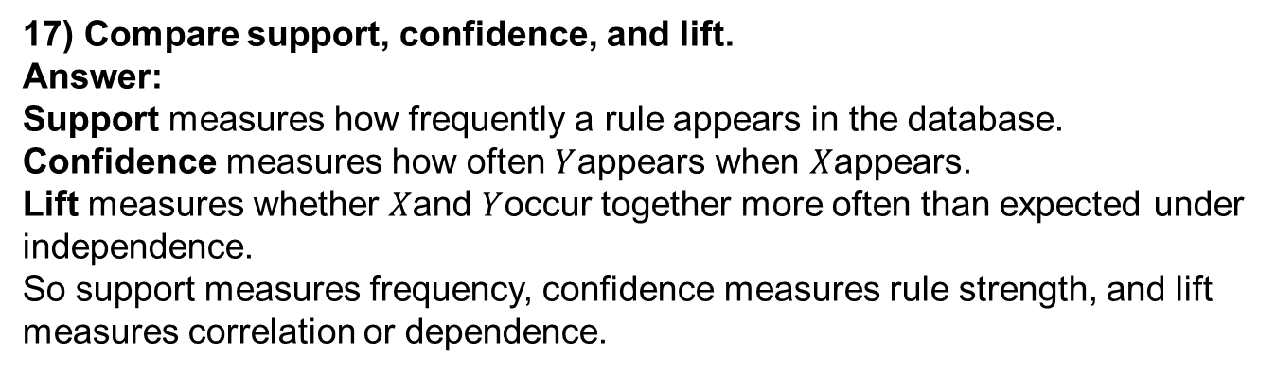
17) Compare support, confidence, and lift.
Answer: Support measures how frequently a rule appears in the database. Confidence measures how often $Y$appears when $X$appears. Lift measures whether $X$and $Y$occur together more often than expected under independence.
So support measures frequency, confidence measures rule strength, and lift measures correlation or dependence.

Slide 51
Example: Lift/Interest
 | Coffee | Coffee
Tea | 15 | 5 | 20
Tea | 75 | 5 | 80
 | 90 | 10 | 100
Association Rule: Tea → Coffee
Confidence= P(Coffee|Tea) = 0.75
but P(Coffee) = 0.9
Lift = 0.75/0.9= 0.8333 (< 1, therefore is negatively associated)
So, is it enough to use confidence/lift for pruning?
Notes:
Lift=0.8333<1⇒X and Y are negatively correlated
“Is confidence/lift enough for pruning?”
NO
Why?
Confidence can be misleading
Lift only checks pairwise relation
Does not consider all statistical aspects
We need:
χ² (chi-square) φ coefficient other measures

Slide 52
Lift or Interest
 | Y | Y
X | 10 | 0 | 10
X | 0 | 90 | 90
 | 10 | 90 | 100
 | Y | Y
X | 90 | 0 | 90
X | 0 | 10 | 10
 | 90 | 10 | 100
Statistical independence:
If P(X,Y)=P(X)P(Y) => Lift = 1
Notes:
Lift measures deviation from independence; a high lift indicates strong correlation even if support is low, while high support alone does not imply strong association.

Slide 53
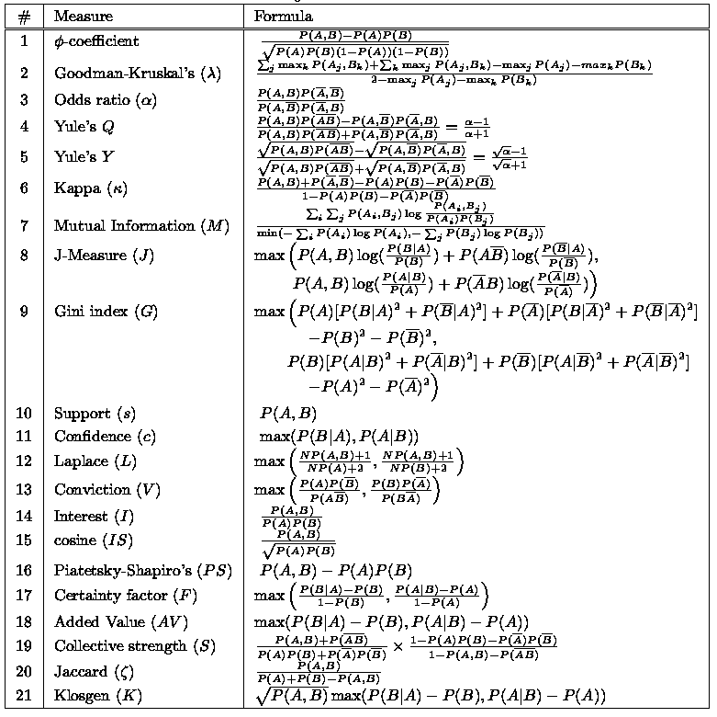
There are lots of measures proposed in the literature

Slide 54
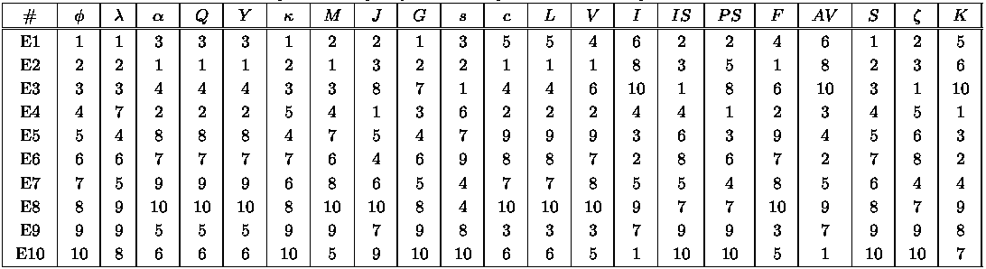
Comparing Different Measures
10 examples of contingency tables:
Rankings of contingency tables using various measures:

Slide 55
Property under Variable Permutation
Does M(A,B) = M(B,A)?
Symmetric measures:
support, lift, collective strength, cosine, Jaccard, etc
Asymmetric measures:
confidence, conviction, Laplace, J-measure, etc

Slide 56
Property under Row/Column Scaling
Grade-Gender Example (Mosteller, 1968):
 | Female | Male
High | 2 | 3 | 5
Low | 1 | 4 | 5
 | 3 | 7 | 10
 | Female | Male
High | 4 | 30 | 34
Low | 2 | 40 | 42
 | 6 | 70 | 76
2x
10x
Mosteller: Underlying association should be independent of the relative number of male and female students in the samples

Slide 57
Property under Inversion Operation
Transaction 1
.
.
.
.
.
Transaction N

Slide 58
Example: φ-Coefficient
φ-coefficient is analogous to correlation coefficient for continuous variables
 | Y | Y
X | 60 | 10 | 70
X | 10 | 20 | 30
 | 70 | 30 | 100
 | Y | Y
X | 20 | 10 | 30
X | 10 | 60 | 70
 | 30 | 70 | 100
φ Coefficient is the same for both tables

Slide 59
Property under Null Addition
Invariant measures:
support, cosine, Jaccard, etc
Non-invariant measures:
correlation, Gini, mutual information, odds ratio, etc

Slide 60
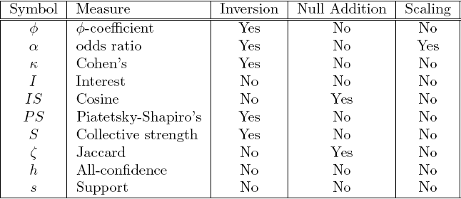
Different Measures have Different Properties

Slide 61
19) What is Simpson’s paradox?
Answer: Simpson’s paradox is a situation where a relationship observed in the whole dataset disappears or reverses when the data is divided into groups. This happens because of hidden variables or confounding factors. As a result, the overall pattern may be misleading. Proper stratification is needed to avoid generating false or spurious association patterns.
20) Why is Simpson’s paradox important in data mining?
Answer: Simpson’s paradox is important because it warns us that patterns found in aggregated data may not be real. A hidden variable may create a false relationship or reverse the direction of a true relationship. Therefore, before accepting a discovered pattern, we should check whether the pattern still holds within subgroups of the data.

Slide 62
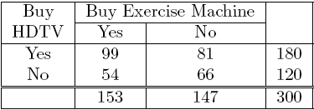
Simpson’s Paradox
=> Customers who buy HDTV are more likely to buy exercise machines

Slide 63
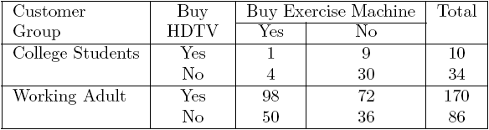
Simpson’s Paradox
College students:
Working adults:

Slide 64
Simpson’s Paradox
Observed relationship in data may be influenced by the presence of other confounding factors (hidden variables)
Hidden variables may cause the observed relationship to disappear or reverse its direction!
Proper stratification is needed to avoid generating spurious patterns
Notes:
Simpson’s Paradox occurs when an observed relationship in aggregated data reverses or disappears when the data is partitioned due to hidden variables.

Slide 65
21) What is meant by skewed support distribution?
Answer: In many real datasets, support distribution is skewed. This means a few items have very high support, while many items have very low support. This creates difficulty in selecting a proper minimum support threshold.
22) Why is it difficult to choose minimum support in skewed data?
Answer: If minimum support is set too high, then rare but important patterns will be missed. For example, rare items like expensive products may never appear in frequent itemsets. If minimum support is set too low, then the number of discovered itemsets becomes very large and computation becomes expensive. So choosing minimum support is difficult in skewed datasets.

Slide 66
23) What is a cross-support pattern?
Answer: A cross-support pattern is an itemset that contains items with very different support values. For example, one item may be very common, while another item is very rare. Such patterns are often not meaningful because the strong support of one item can dominate the pattern.
24) Why are cross-support patterns a problem?
Answer: Cross-support patterns are problematic because they may produce misleading association rules. For example, a rule from a rare item to a common item can have high confidence, but the reverse rule may have very low confidence. This indicates that the items do not have balanced support and may not form a truly coherent pattern.

Slide 67
25) What is h-confidence?
Answer: H-confidence, also called all-confidence, is a measure used to avoid cross-support patterns. It is defined as the minimum confidence among all possible association rules that can be generated from an itemset.
It checks whether all items in the itemset are strongly associated with one another. A high h-confidence means the itemset has strong affinity and similar support behavior.
26) Why is h-confidence used?
Answer: H-confidence is used to eliminate itemsets whose items have very different support values. It is useful for avoiding cross-support patterns. Unlike ordinary confidence, h-confidence evaluates the itemset more strictly by looking at the weakest rule implied by that itemset. Therefore, it helps identify strongly coherent groups of items.

Slide 68
27) What is a hyperclique pattern?
Answer: An itemset that satisfies a user-defined h-confidence threshold is called a hyperclique pattern. Hypercliques are useful because they represent groups of items with strong mutual affinity. They do not need to be frequent itemsets, so they can also find important low-support patterns.
28) What are the properties of hypercliques?
Answer: Important properties of hypercliques are:
They are itemsets with high h-confidence.
They are good for finding strong low-support patterns.
H-confidence is anti-monotone, so pruning becomes efficient.
Hypercliques have high-affinity property, meaning the items are strongly similar and do not have widely different support values.
Closed and maximal hypercliques can also be defined.

Slide 69
29) What does anti-monotone property of h-confidence mean?
Answer: The anti-monotone property means that if an itemset does not satisfy the h-confidence threshold, then none of its supersets can satisfy it either. This property is very useful in pruning because once a pattern fails, all larger patterns built from it can be removed immediately.
30) What is the advantage of h-confidence over support?
Answer: Support mainly checks frequency, but h-confidence checks coherence and affinity among items. Therefore, h-confidence can find meaningful low-support patterns that support-based methods may miss. It is especially useful when support distribution is skewed and when we want to avoid cross-support patterns.

Slide 70
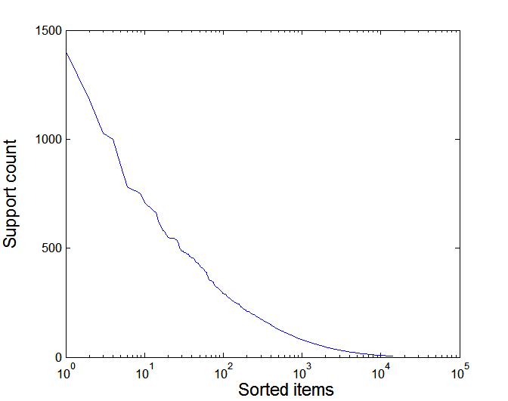
Effect of Support Distribution on Association Mining
Few items with high support
Many items with low support
Support distribution of a retail data set
Rank of item (in log scale)
Many real data sets have skewed support distribution

Slide 71
Effect of Support Distribution
Difficult to set the appropriate minsup threshold
If minsup is too high, we could miss itemsets involving interesting rare items (e.g., {caviar, vodka})
If minsup is too low, it is computationally expensive and the number of itemsets is very large

Slide 72
Cross-Support Patterns
A cross-support pattern involves items with varying degree of support
Example: {caviar,milk}
How to avoid such patterns?
caviar
milk

Slide 73
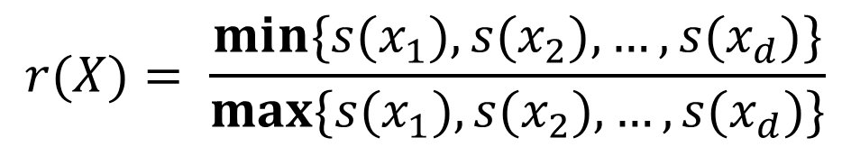
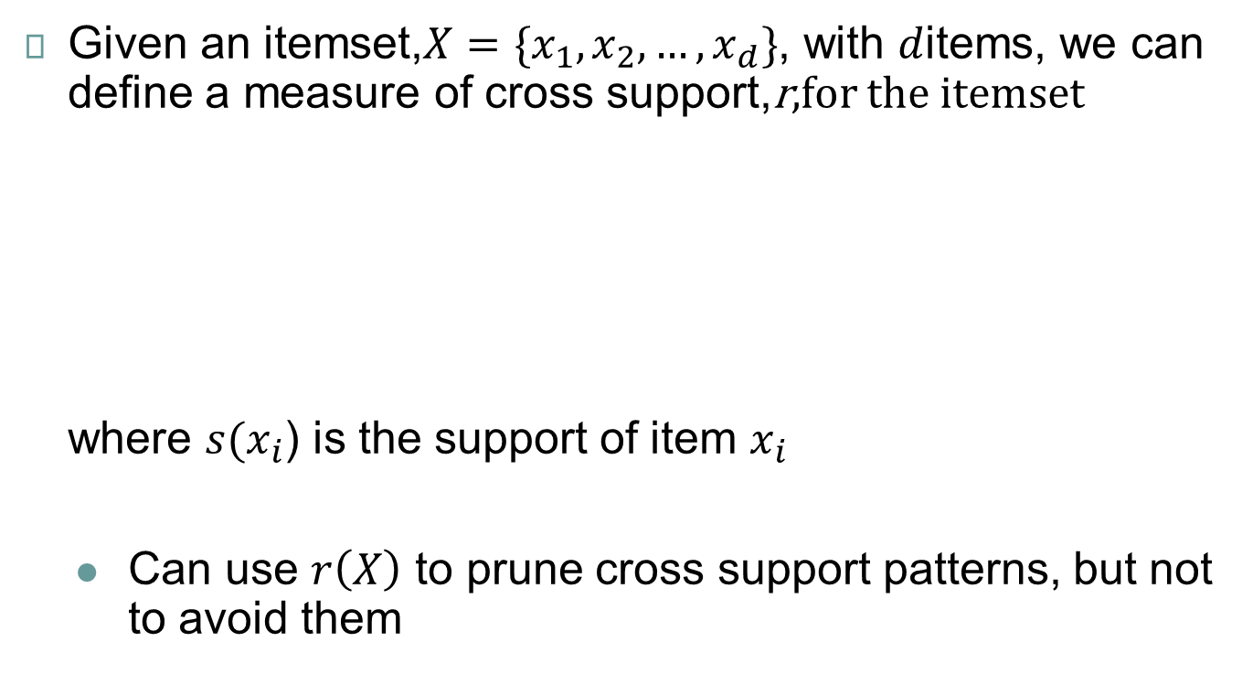
A Measure of Cross Support
$$r(X)= \frac{min\{s(x_{1}),s(x_{2}), …,s(x_{d})\}}{max\{s(x_{1}),s(x_{2}), …,s(x_{d})\}}$$
Given an itemset,$X=\{x_{1},x_{2},…,x_{d}\}$, with $d$items, we can define a measure of cross support,r,for the itemset where $s(x_{i}$) is the support of item $x_{i}$
Can use $r\left(X\right)$ to prune cross support patterns, but not to avoid them

Slide 74
Confidence and Cross-Support Patterns
Observation:
conf(caviar→milk) is very high
but
conf(milk→caviar) is very low
Therefore,
min( conf(caviar→milk), conf(milk→caviar) ) is also very low
caviar
milk

Slide 75
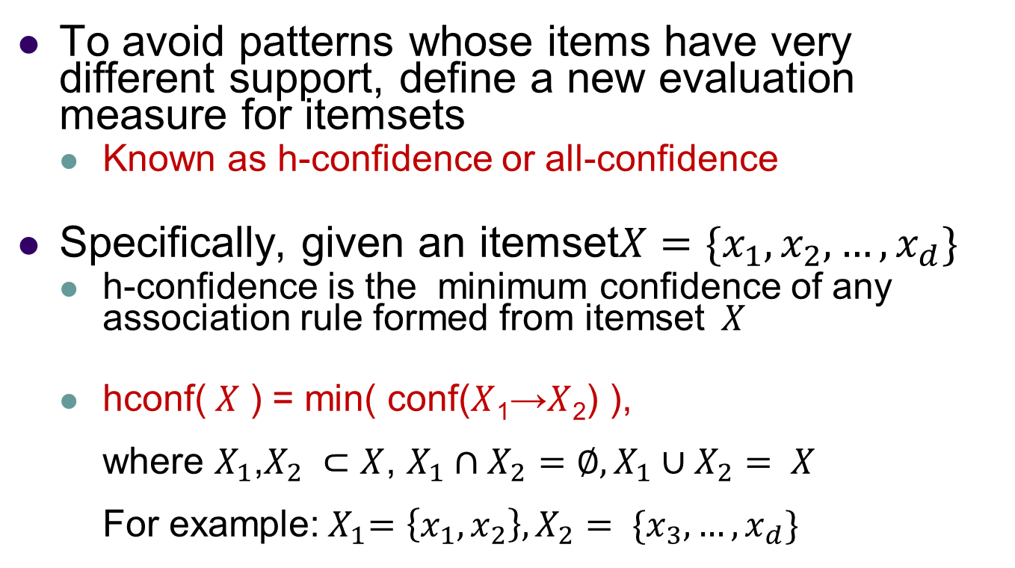
H-Confidence
To avoid patterns whose items have very different support, define a new evaluation measure for itemsets
Known as h-confidence or all-confidence
Specifically, given an itemset$X=\{x_{1},x_{2},…,x_{d}\}$
h-confidence is the minimum confidence of any association rule formed from itemset$X$
hconf($X$ ) = min( conf($X$₁→$X$₂) ), where $X_{1}$,$X_{2} ⊂X$, $X_{1}∩X_{2}=∅,X_{1}∪X_{2}= X$ For example:${ X}_{1}=\left\{x_{1},x_{2}\right\}, X_{2}= \{x_{3},…,x_{d}\}$

Slide 76
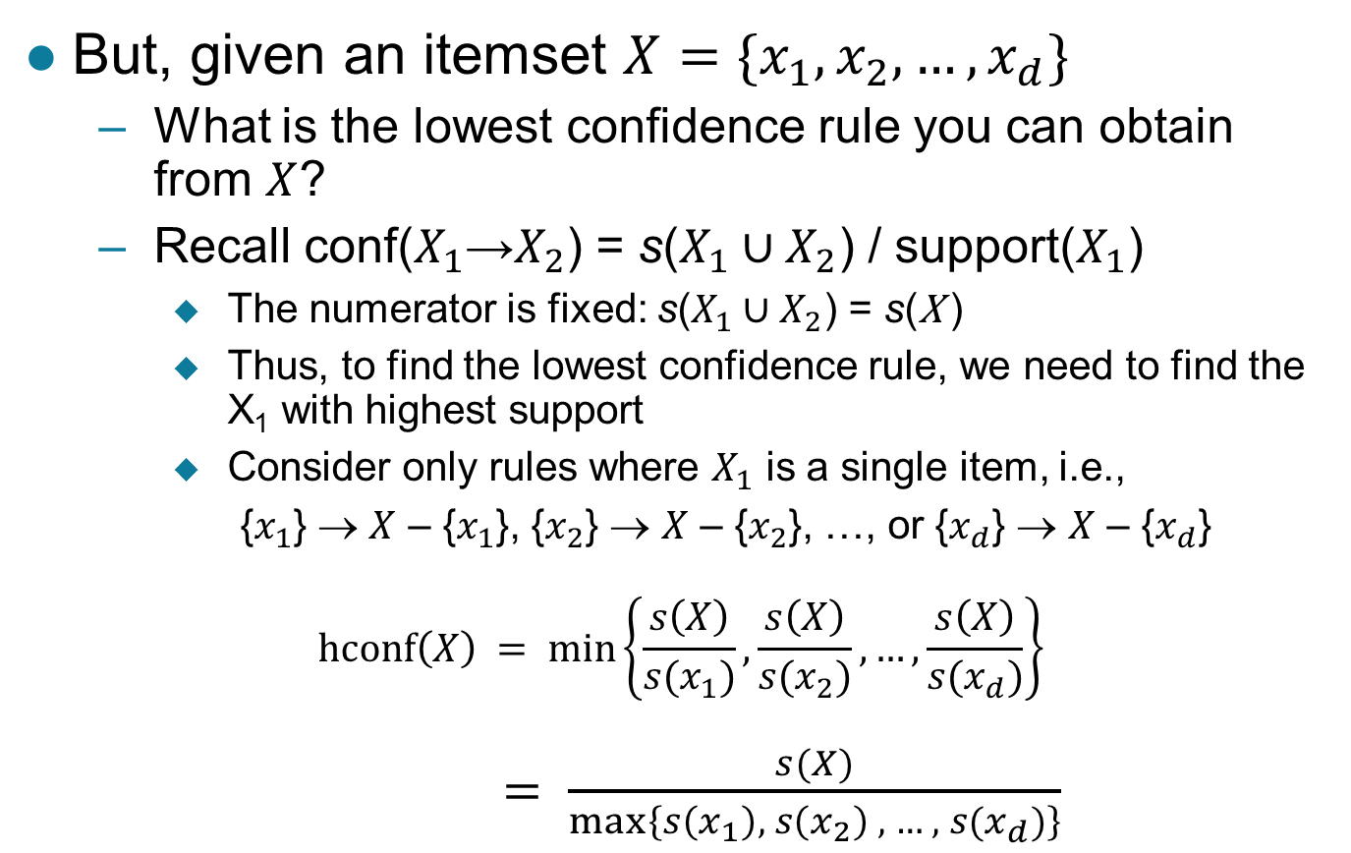
H-Confidence …
But, given an itemset$X=\{x_{1},x_{2},…,x_{d}\}$
What is the lowest confidence rule you can obtain from $X$?
Recall conf($X_{1}$→$X_{2}$) = s($X_{1}∪X_{2}$) / support($X_{1}$)
The numerator is fixed: s($X_{1}∪X_{2}$) = s(X )
Thus, to find the lowest confidence rule, we need to find the X₁ with highest support
Consider only rules where $X_{1}$ is a single item, i.e.,
{$x_{1}$} → $X$ – {$x_{1}$}, {$x_{2}$} → $X$ – {$x_{2}$}, …, or {$x_{d}$} → $X$ – {$x_{d}$}
$$hconf\left(X\right) = min\left\{\frac{s\left(X\right)}{s(x_{1})},\frac{s\left(X\right)}{s(x_{2})},…,\frac{s\left(X\right)}{s(x_{d})}\right\}$$ $$= \frac{s(X)}{max⁡\left\{s\left(x_{1}\right), s\left(x_{2}\right) , …, s(x_{d})\right\}}$$

Slide 77
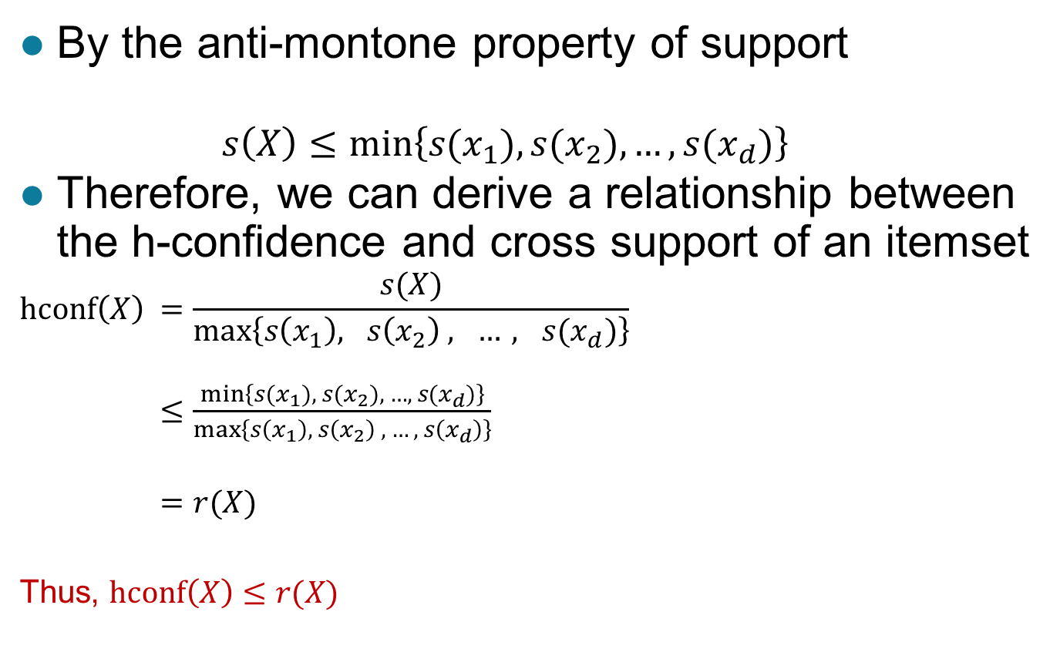
Cross Support and H-confidence
By the anti-montone property of support
$$s\left(X\right)≤min\left\{s(x_{1}),{s(x}_{2}), …,{s(x}_{d})\right\}$$
Therefore, we can derive a relationship between the h-confidence and cross support of an itemset
$$hconf\left(X\right) =\frac{s(X)}{max⁡\left\{s\left(x_{1}\right), s\left(x_{2}\right) , …, s(x_{d})\right\}}$$ $$≤\frac{min\left\{s(x_{1}),{ s(x}_{2}), …,{ s(x}_{d})\right\}}{\max\left\{s\left(x_{1}\right), s\left(x_{2}\right) , …, s\left(x_{d}\right)\right\}}$$
$$=r(X)$$
Thus, $hconf\left(X\right)≤r(X)$

Slide 78
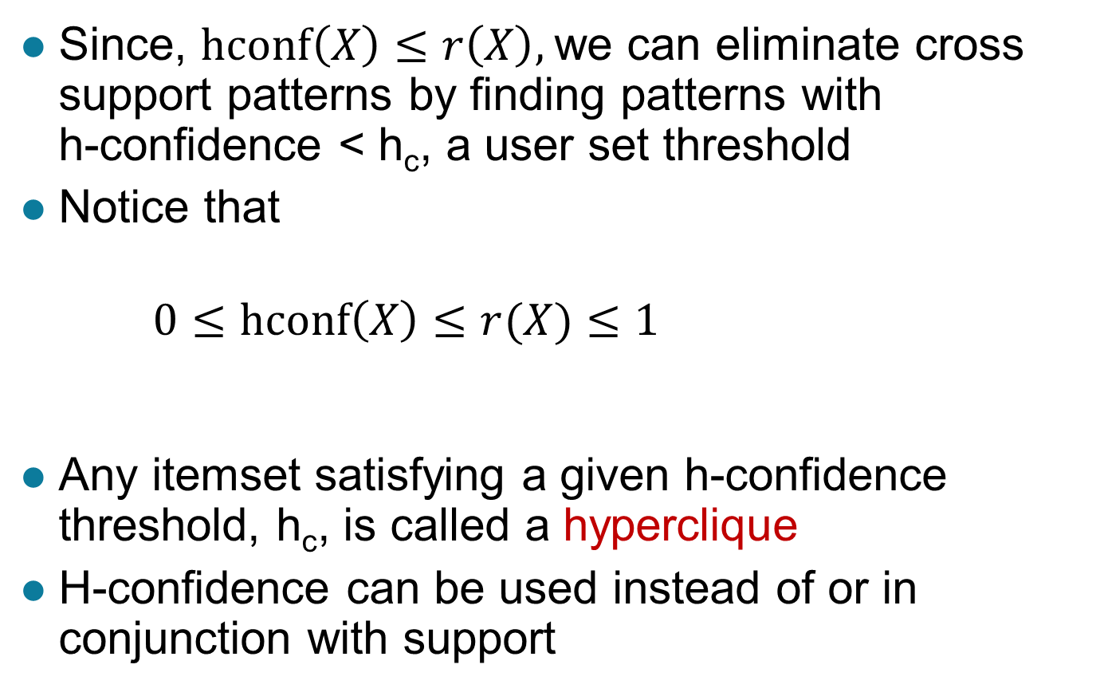
Cross Support and H-confidence …
Since, $hconf\left(X\right)≤r\left(X\right),$we can eliminate cross support patterns by finding patterns with h-confidence <h_{c}, a user set threshold
Notice that
$$0≤hconf\left(X\right)≤r(X)≤1$$
Any itemset satisfying a given h-confidence threshold, h_{c}, is called a hyperclique
H-confidence can be used instead of or in conjunction with support

Slide 79
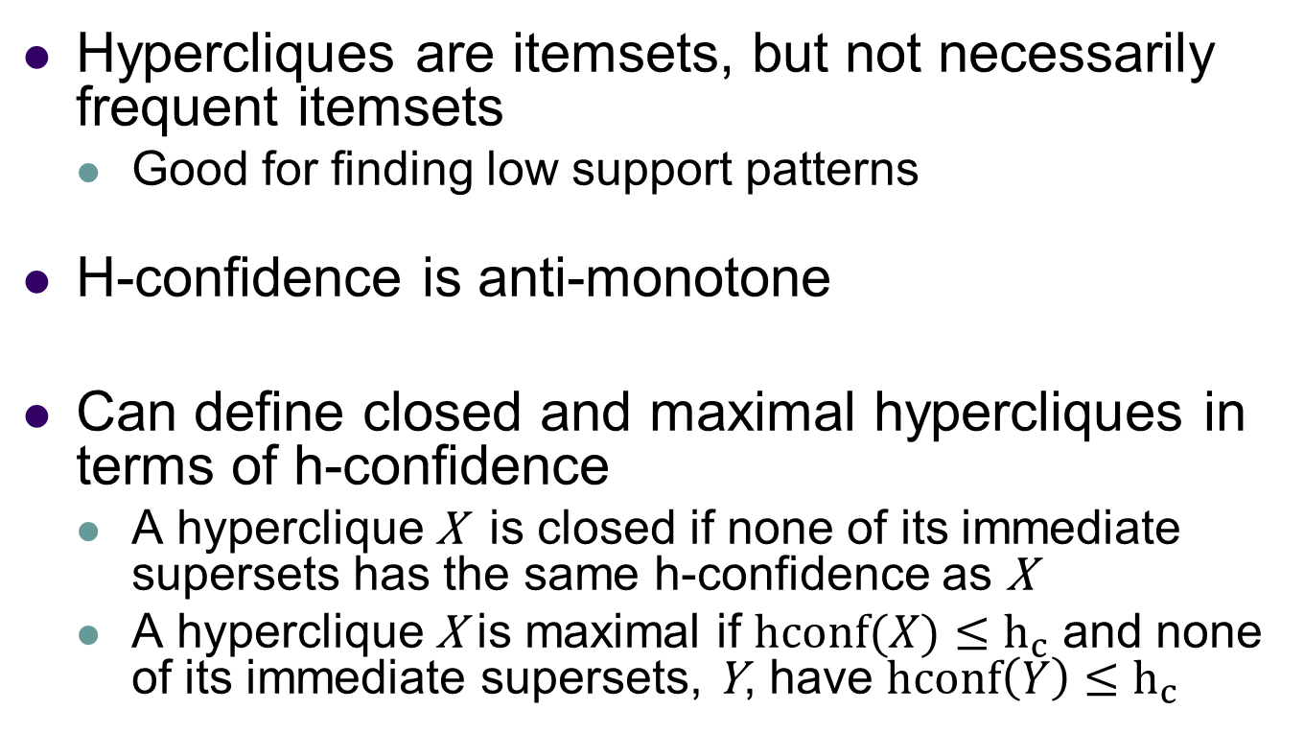
Properties of Hypercliques
Hypercliques are itemsets, but not necessarily frequent itemsets
Good for finding low support patterns
H-confidence is anti-monotone
Can define closed and maximal hypercliques in terms of h-confidence
A hyperclique X is closed if none of its immediate supersets has the same h-confidence as X
A hyperclique X is maximal if $hconf(X)≤h_{c}$ and none of its immediate supersets, Y, have $hconf\left(Y\right)≤h_{c}$

Slide 80
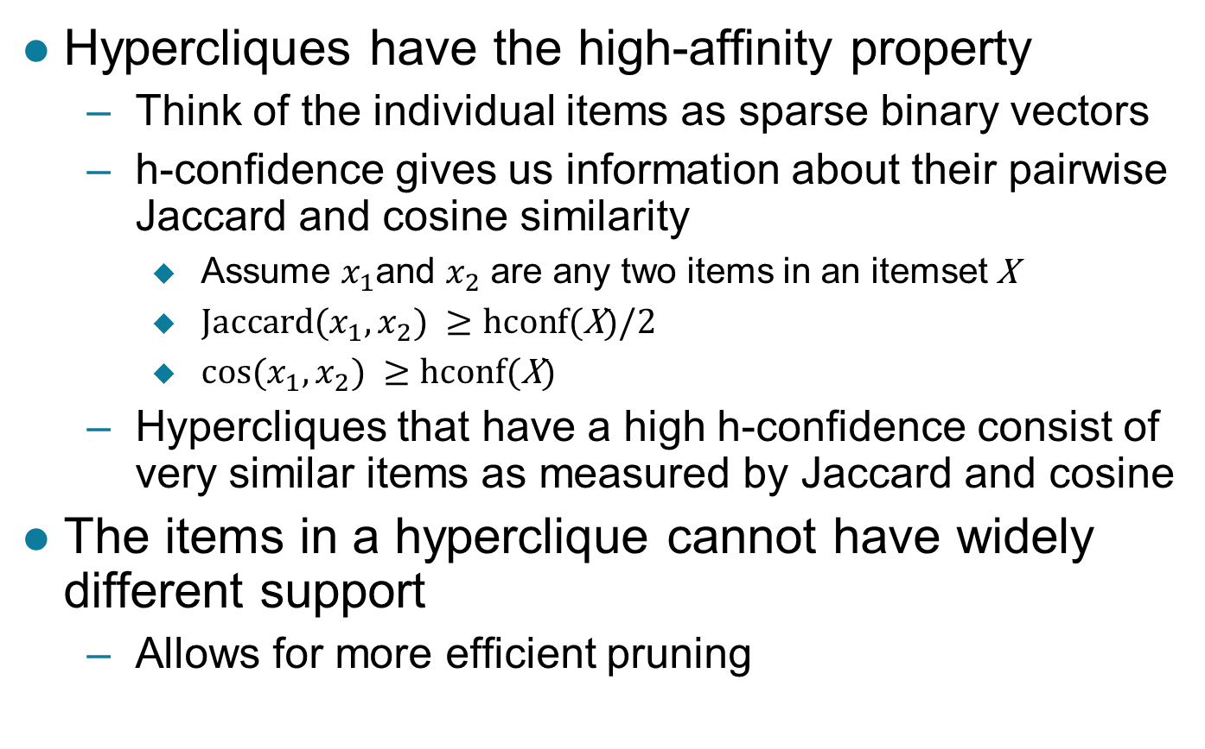
Properties of Hypercliques …
Hypercliques have the high-affinity property
Think of the individual items as sparse binary vectors
h-confidence gives us information about their pairwise Jaccard and cosine similarity
Assume $x_{1}$and $x_{2}$ are any two items in an itemsetX
${Jaccard⁡(x}_{1},x_{2}) ≥hcon$f(X)/2
${cos⁡(x}_{1},x_{2}) ≥hcon$f(X)
Hypercliquesthat have a high h-confidence consist of very similar items as measured by Jaccard and cosine
The items in a hyperclique cannot have widely different support
Allows for more efficient pruning

Slide 81
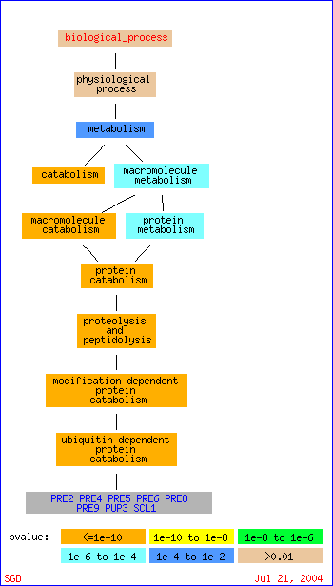
Example Applications of Hypercliques
Hypercliques are used to find strongly coherent groups of items
Words that occur together in documents
Proteins in a protein interaction network
In the figure at the right, a gene ontology hierarchy for biological process shows that the identified proteins in the hyperclique (PRE2, …, SCL1) perform the same function and are involved in the same biological process

Slide 82
Reading Material
Class Lecture
Text Book: (V. Kumar et al.) Chapter 6

Slide 83
Acknowledgements
Vipin Kumar et al. (University of Minnesota-Twin Cities)
Jiawei Han (University of Iillinoi-UC) (CS412)

