Slide 1
Data Mining (CSE 6506)
Clustering-2
Mahmuda Naznin
Department of Computer Science Engineering, BUET

Slide 2
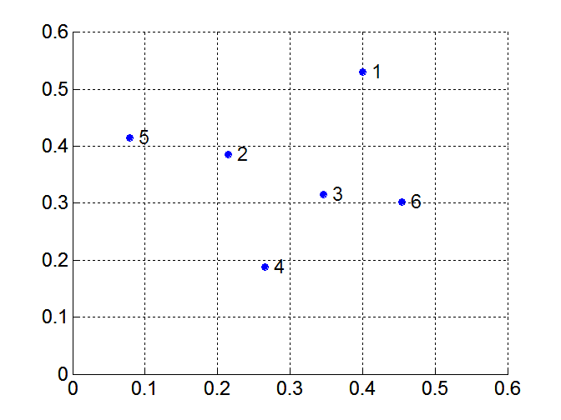
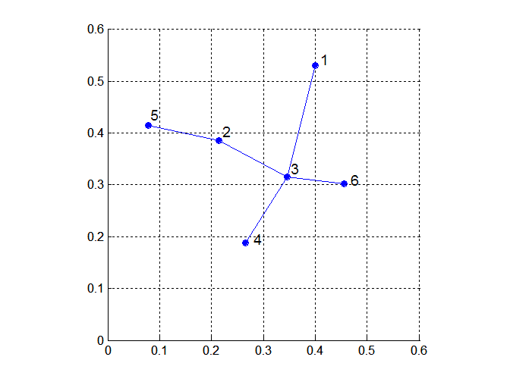
MST: Divisive Hierarchical Clustering
Build MST (Minimum Spanning Tree)
Start with a tree that consists of any point
In successive steps, look for the closest pair of points (p, q) such that one point (p) is in the current tree but the other (q) is not
Add q to the tree and put an edge between p and q
Notes:
How it actually works
Start with just one point in the tree
Now many points are still outside the tree
Find the closest point outside the tree to any point already inside the tree
Add that point and connect it with an edge
Repeat until all points are included
So when the slide says:
find the closest pair $\left(p , q\right)$such that $p$is in the current tree but $q$is not
it means:
$p$= a point already in the partially built tree
$q$= a point not added yet
Then clustering part
After the full MST is built, you cut the longest edge(s) to get separate clusters.
🔸 Summary (Easy to Remember)
Build tree by connecting nearest points
No loops allowed
Covers all points
Cut longest edges → clusters

Slide 3
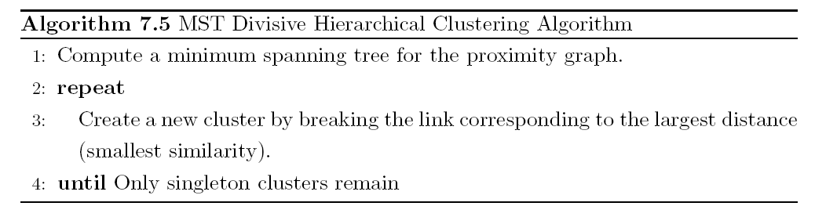
MST: Divisive Hierarchical Clustering
Use MST for constructing hierarchy of clusters

Slide 4
Hierarchical Clustering: Time and Space requirements
O(N²) space since it uses the proximity matrix.
N is the number of points.
O(N³) time in many cases
There are N steps and at each step the size, N², proximity matrix must be updated and searched
Complexity can be reduced to O(N² log(N) ) time with some cleverness
Notes:
Hierarchical Clustering: Time and Space Requirements
Space complexity = $O\left(N^{2}\right)$ because it stores the proximity (distance) matrix for all pairs of points.
Time complexity = $O\left(N^{3}\right)$in many cases because at each step it must search and update that matrix again.
Here, $N$= number of data points.
Hierarchical clustering can become slow and memory-heavy when the dataset is large.

Slide 5
Problems and Limitations
Once a decision is made to combine two clusters, it cannot be undone
No global objective function is directly minimized
Different schemes have problems with one or more of the following:
Sensitivity to noise and outliers
Difficulty handling clusters of different sizes and non-globular shapes
Breaking large clusters
Notes:
Problems and Limitations of Hierarchical Clustering
Once two clusters are merged, the decision cannot be changed.
It does not directly optimize one global objective function.
It is sensitive to noise and outliers.
It has trouble with clusters of different sizes and irregular shapes.
It may split large clusters incorrectly.

Slide 6
Extensions to Hierarchical Clustering
Major weakness of agglomerative clustering methods
Can never undo what was done previously
Do not scale well: time complexity of at least O(n²), where n is the number of total objects
Integration of hierarchical & distance-based clustering
BIRCH (1996): uses CF-tree and incrementally adjusts the quality of sub-clusters
CHAMELEON (1999): hierarchical clustering using dynamic modeling
Notes:
Extensions to Hierarchical Clustering
Agglomerative hierarchical clustering has two main problems:
it cannot undo previous merge decisions
it does not scale well for large datasets
To improve this, some methods combine hierarchical and distance-based clustering.
BIRCH (1996): uses a CF-tree and updates sub-clusters step by step.
CHAMELEON (1999): uses dynamic modeling for hierarchical clustering.

Slide 7
BIRCH (Balanced Iterative Reducing and Clustering Using Hierarchies)
Zhang, Ramakrishnan & Livny, SIGMOD’96
Incrementally construct a CF (Clustering Feature) tree, a hierarchical data structure for multiphase clustering
Phase 1: scan DB to build an initial in-memory CF tree (a multi-level compression of the data that tries to preserve the inherent clustering structure of the data)
Phase 2: use an arbitrary clustering algorithm to cluster the leaf nodes of the CF-tree
Scales linearly: finds a good clustering with a single scan and improves the quality with a few additional scans
Weakness: handles only numeric data, and sensitive to the order of the data record
Notes:
BIRCH (Balanced Iterative Reducing and Clustering Using Hierarchies) is a hierarchical clustering method proposed by Zhang, Ramakrishnan, and Livny in 1996.
It incrementally builds a CF-tree (Clustering Feature tree), which is a hierarchical structure for multiphase clustering.
Phase 1: scan the database to build an initial in-memory CF-tree, which compresses the data while trying to preserve the original clustering structure.
Phase 2: apply any clustering algorithm on the leaf nodes of the CF-tree.
BIRCH scales linearly, so it can find a good clustering with one scan and improve it with a few extra scans.
Weakness: it mainly handles numeric data and is sensitive to the order of input records.

Slide 8
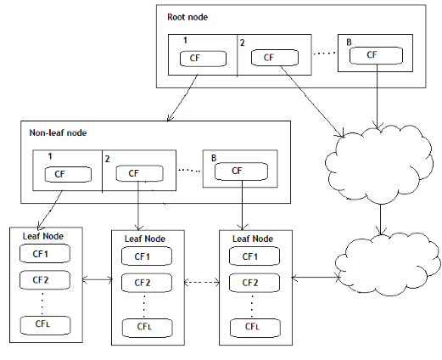
CF Tree
Each node including leaf nodes has several CFs, and the CFs of internal nodes have pointers to child nodes, and all leaf nodes are linked by a doubly linked list.

Slide 9
Clustering Feature Vector in BIRCH
LS represents the vector sum of the feature dimensions of the sample points in the CF
SS represents the square of the feature dimensions of the sample points in the CF.
Clustering Feature (CF): CF = (N, LS, SS)
N: Number of data points
LS: linear sum of N points:
SS: square sum of N points
CF = (5, (16,30),(54,190))
LS=(3+2+4+4+3), (4+6+5+7+8)
SS=(3²+2²+4²+4²+3²), (4²+6²+5²+7²+8²)
(3,4)
(2,6)
(4,5)
(4,7)
(3,8)
Notes:
Clustering Feature (CF) in BIRCH is a compact summary of a cluster, written as CF = (N, LS, SS). Here, N means the number of data points, LS means the sum of all point coordinates, and SS means the sum of the squared coordinates. For example, if the points are (3,4), (2,6), (4,5), (4,7), (3,8), then N = 5, LS = (16,30), and SS = (54,190). So, the CF becomes (5, (16,30), (54,190)). This helps BIRCH store a cluster in a short form instead of keeping all points separately, which saves memory and makes clustering faster.

Slide 10
CF Tree
For CF Tree, we generally have several important parameters,
The first parameter is the maximum CF number B of each internal node (number of children/branching factor)
The second parameter is the maximum CF number L of each leaf node (number of members in leave node/diameter of the cluster)
The third parameter is for the sample points in a CF in the leaf node. It is the maximum sample radius threshold T of each CF in the leaf node. That is to say, all sample points in this CF must be in the radius In a hyper-sphere less than T.
CF(Parent) = CF1(Child1)+CF2(Child2)
N=N1+N2 LS=LS1+LS2 SS=SS1+SS2
Notes:
CF Tree Parameters
A CF tree has some important parameters to control its structure.
B = maximum number of CF entries in an internal node. It is the branching factor, meaning how many child nodes an internal node can have.
L = maximum number of CF entries in a leaf node. It shows how many cluster summaries a leaf node can store.
T = threshold for points inside one CF in a leaf node. It limits how far the sample points can spread within that cluster.
So, T controls cluster size, while B and L control tree size and shape.
In a CF tree, a parent CF is formed by adding the CFs of its child nodes.
If two child CFs are combined:
N = N1 + N2
LS = LS1 + LS2
SS = SS1 + SS2
This makes the CF tree a compact and efficient summary of the dataset.

Slide 11
Insertion of CF Tree
1. Find the leaf node closest to the new sample and the closest CF node in the leaf node from the root node
2. After the new sample is added, if the radius of the hyper-sphere corresponding to this CF node still satisfies the threshold T, then all the CF triplets on the path are updated, and the insertion ends. Otherwise, go to 3.
3. If the number of CF nodes of the current leaf node is less than the threshold L, create a new CF node, put in a new sample and the new CF node into this leaf node, update all CF triplets on the path, and insertion Ends. Otherwise, go to 4
4. Divide the current leaf node into two new leaf nodes, select the two CF tuples with the farthest hyper-sphere among all CF tuples in the old leaf node, and distribute as the first CF node of the two new leaf nodes. Put other tuples and new sample tuples into corresponding leaf nodes according to the principle of distance.
5. In turn, check whether the parent node is also to be split. If it needs to be split in the same way as the leaf node.
Notes:
Insertion in CF Tree
First, BIRCH finds the closest leaf node and the closest CF entry for the new data point.
Then it tries to add the new point into that CF.
If the cluster still stays within the threshold T, the CF values on the path are updated, and the insertion stops.
If the threshold is not satisfied, BIRCH checks whether there is space in the leaf node.
If the leaf node has space (less than L entries), a new CF entry is created for the new point.
If the leaf node is already full, the leaf node is split into two new leaf nodes.
During splitting, the two farthest CF entries are chosen first, and the other entries are assigned based on distance.
After that, BIRCH checks the parent node.
If the parent also becomes full, it is split too.
So, insertion in a CF tree means: find closest place, insert if possible, otherwise create new entry or split nodes.

Slide 12
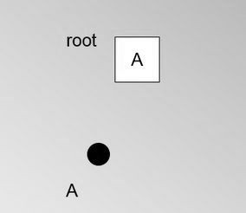
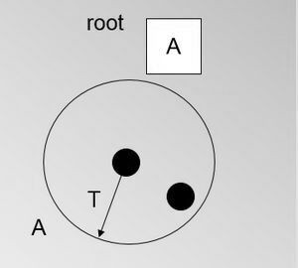
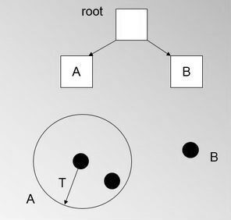
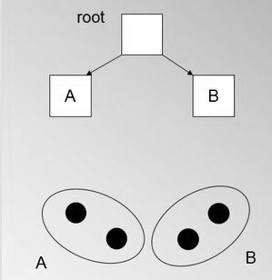
CF Tree insertion (L=2)

Slide 13
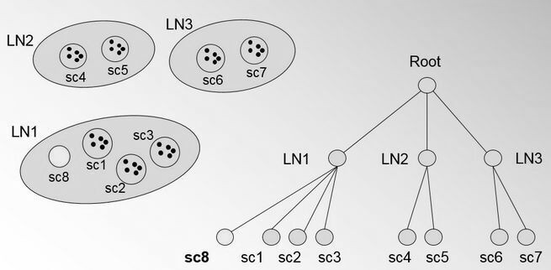
Split in CF Tree (B=3, L=3)
The leaf node LN1 has three CFs, and LN2 and LN3 each have two CFs.
The maximum CF number of our leaf nodes is L = 3. At this time a new sample point is coming, we find that it is closest to the LN1 node, so we start to judge whether it is within the super sphere corresponding to the three CFs of sc1, sc2, sc3
But, unfortunately, it is not, so it needs to create a new CF, sc8, to accommodate it. The problem is that L = 3, which means that the number of CFs of LN1 has reached the maximum value, and no new CF can be created.
At this point, it is necessary to split the LN1 leaf node into two.
Notes:
Split in CF Tree (B=3, L=3)
Here, L = 3, so each leaf node can store at most 3 CF entries.
LN1 already has 3 CFs: sc1, sc2, sc3.
A new sample point comes, and it is closest to LN1.
But this new point does not fit inside any existing CF in LN1.
So, it needs a new CF, called sc8.
Problem: LN1 is already full, because it already has 3 CFs.
So, LN1 must be split into two new leaf nodes.
Main idea:
A split happens when:
the point cannot be added to an existing CF, and
the leaf node has no free space for a new CF.

Slide 14
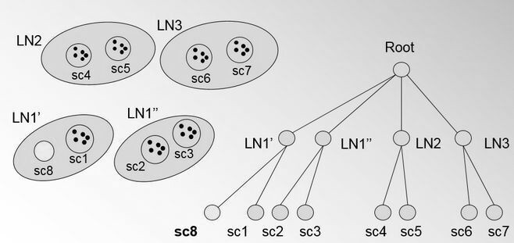
CF Tree
We will find the two furthest CFs in all CF tuples in LN1 as seed CFs of these two new leaf nodes, and then we will save all sc1, sc2, sc3 in the LN1 node, and the new tuple sc8 of the new sample point Divide it into two new leaf nodes.
Notes:
How the leaf node is split
To split LN1, BIRCH first finds the two farthest CFs inside LN1.
These two farthest CFs are used as the seeds of two new leaf nodes.
Then the other CFs and the new CF sc8 are assigned to the nearer seed.
As a result, LN1 is divided into two new leaf nodes: LN1′ and LN1″.
Main idea:
Split means:
choose two farthest groups first
then distribute the remaining groups based on distance
So after splitting, one old leaf node becomes two smaller leaf nodes.

Slide 15
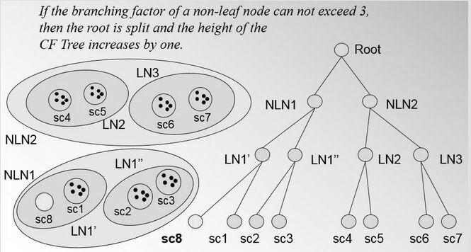
CF Tree
If the maximum CF number of our internal nodes B = 3, then splitting the leaf node into two will cause the maximum CF number of the root node to be exceeded, that is to say, our root node will now also split, the split method and The leaf nodes are split, and the split CF Tree is as follows:
Notes:
When the split goes upward
After splitting LN1, the root has to store one more child.
But here B = 3, so an internal node/root can have at most 3 children.
If the root already has 3 children, adding one more will exceed the limit.
So, the root also splits.
When the root splits, the height of the CF tree increases by 1.
Main idea:
Sometimes a leaf split causes a parent split, and that can continue upward. This is called split propagation.

Slide 16
The CF Tree Structure
Root
B = 6
L = 7
CF₁
CF₂
CF₃
CF₆
child₁
child₂
child₃
child₆
Non-leaf node
CF₁
CF₂
CF₃
CF₅
child₁
child₂
child₃
child₅
Leaf node
Leaf node
prev
CF₁
CF₂
CF₆
next
prev
CF₁
CF₂
CF₄
next
Notes:
Upper levels store summaries and pointers
Leaf nodes store final cluster summaries
leaf nodes are linked together for easy access

Slide 17
CF-Tree in BIRCH
Clustering Feature:
Summary of the statistics for a given subcluster: the 0-th, 1st, and 2nd moments of the subcluster from the statistical point of view
Registers crucial measurements for computing cluster and utilizes storage efficiently
A CF tree is a height-balanced tree that stores the clustering features for a hierarchical clustering
A non-leaf node in a tree has descendants or “children”
The non-leaf nodes store sums of the CFs of their children
A CF tree has two parameters
Branching factor B : max # of children
Threshold L: max diameter of sub-clusters stored at the leaf nodes
Notes:
CF-Tree in BIRCH
A Clustering Feature (CF) is a compact summary of a subcluster.
It stores important statistical information of the cluster and uses memory efficiently.
A CF-tree is a height-balanced tree used in BIRCH for hierarchical clustering.
It stores clustering features instead of storing all data points directly.
In a CF-tree, non-leaf nodes have child nodes.
These non-leaf nodes store the sum of the CFs of their children.
A CF-tree has two main parameters:
Branching factor (B): maximum number of children of a non-leaf node
Threshold (L): maximum diameter or size of subclusters stored in leaf nodes
Main idea
A CF-tree summarizes large datasets in a compact tree form, so clustering becomes faster and more memory-efficient.

Slide 18
BIRCH Algorithm
Cluster Diameter
For each point in the input
Find closest leaf entry
Add point to leaf entry and update CF
If entry diameter > max_diameter, then split leaf, and possibly parents
Algorithm is O(n)
Weakness
Sensitive to insertion order of data points
Since we fix the size of leaf nodes, so clusters may not be so natural
Clusters tend to be spherical given the radius and diameter measures
Notes:
BIRCH Algorithm
BIRCH uses cluster diameter to check how spread out a cluster is.
For each new data point, it finds the closest leaf entry in the CF-tree.
Then it adds the point to that leaf entry and updates the CF values.
If the cluster diameter becomes larger than the allowed maximum, the leaf node is split.
If needed, the parent nodes may also split.
The algorithm is efficient and works in about O(n) time for scanning data.
Weaknesses
It is sensitive to the insertion order of data points.
Because leaf size is fixed, the clusters may not always be fully natural.
Since it uses radius and diameter, it usually prefers spherical clusters.

Slide 19
CHAMELEON: Hierarchical Clustering Using Dynamic Modeling (1999)
CHAMELEON: G. Karypis, E. H. Han, and V. Kumar, 1999
Measures the similarity based on a dynamic model
Two clusters are merged only if the interconnectivity and closeness (proximity) between two clusters are high relative to the internal interconnectivity of the clusters and closeness of items within the clusters
Graph-based, and a two-phase algorithm
Use a graph-partitioning algorithm: Cluster objects into a large number of relatively small sub-clusters
Use an Agglomerative hierarchical clustering algorithm: find the genuine clusters by repeatedly combining these sub-clusters
Notes:
CHAMELEON (1999)
CHAMELEON is a graph-based hierarchical clustering algorithm proposed by Karypis, Han, and Kumar in 1999.
It uses a dynamic model to measure similarity between clusters.
Two clusters are merged only when their interconnectivity and closeness (proximity) are high relative to their internal structure.
So, CHAMELEON does not merge clusters only based on distance. It also checks how strongly the points inside the clusters are connected.
Two phases of CHAMELEON
Graph partitioning phase: First, the dataset is divided into many small sub-clusters.
Agglomerative hierarchical phase: Then, these small sub-clusters are repeatedly merged to form the real final clusters.

Slide 20
Overall Framework of CHAMELEON
Construct (K-NN)
Sparse Graph
Partition the Graph
Data Set
K-NN Graph
p and q are connected if q is among the top k closest neighbors of p
Merge Partition
Relative interconnectivity: connectivity of c₁ and c₂ over internal connectivity
Relative closeness: closeness of c₁ and c₂ over internal closeness
Final Clusters
Notes:
Overall Framework of CHAMELEON
1. Build a K-NN sparse graph
First, the dataset is converted into a K-nearest neighbor (K-NN) graph.
Two points are connected if one point is among the k nearest neighbors of the other.
This creates a sparse graph, so only important nearby connections are kept.
2. Partition the graph
Next, the large graph is divided into many small sub-clusters.
This is the first phase of CHAMELEON.
3. Merge the partitions
Then CHAMELEON starts merging those small sub-clusters.
But it does not merge them only by distance.
4. Check two conditions before merging
CHAMELEON checks:
Relative interconnectivity = how strongly two clusters are connected compared to how strongly points are connected inside each cluster.
Relative closeness = how close two clusters are compared to the closeness of points inside each cluster.

Slide 21
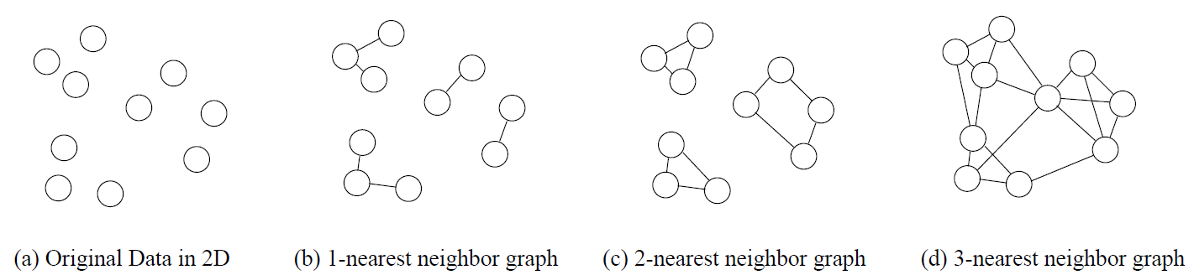
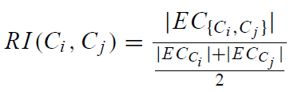
KNN Graphs & Interconnectivity
k-nearest graphs from an original data in 2D:
EC_{{Ci ,Cj } :}The absolute inter-connectivity between C_{i} and C_{j}: the sum of the weight of the edges that connect vertices in C_{i} to vertices in C_{j}
Internal inter-connectivity of a cluster C_{i} : the size of its min-cut bisector EC_{Ci} (i.e., the weighted sum of edges that partition the graph into two roughly equal parts)
Relative Inter-connectivity (RI):
Notes:
KNN Graphs and Interconnectivity
A KNN graph connects each data point to its k nearest neighbors.
When k increases, more edges are added, so the graph becomes more connected.
Interconnectivity between two clusters
The absolute interconnectivity between two clusters $C_{i}$and $C_{j}$means the total weight of the edges that connect points of one cluster to the other.
Internal interconnectivity of one cluster
The internal interconnectivity of a cluster means how strongly the points inside that cluster are connected.
It is measured using the min-cut bisector, which splits the cluster into two nearly equal parts.
Relative Interconnectivity (RI)
RI compares the connection between two clusters with the internal connection inside those clusters.
If RI is high, it means the two clusters are strongly connected and may be good candidates to merge.

Slide 22
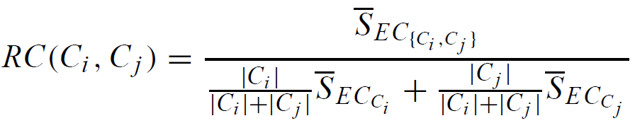



Relative Closeness & Merge of Sub-Clusters
Relative Closeness (RC) between a pair of clusters C_{i} and C_{j} : the absolute closeness between C_{i} and C_{j} normalized w.r.t. the internal closeness of the two clusters C_{i} and C_{j}
and are the average weights of the edges that belong in the min-cut bisector of clusters C_{i} and C_{j} , respectively, and is the average weight of the edges that connect vertices in C_{i} to vertices in C_{j}
Merge Sub-Clusters:
Merges only those pairs of clusters whose RI and RC are both above some user-specified thresholds
Merge those maximizing the function that combines RI and RC
Notes:
Relative Closeness and Merge of Sub-Clusters
Relative Closeness (RC) measures how close two clusters are compared to how close the points are inside each cluster.
It uses the average weight of edges between two clusters and compares it with the average internal edge weights of those clusters.
So, RC tells us whether two clusters are close enough to be merged in a meaningful way.
Merging rule in CHAMELEON
Two sub-clusters are merged only if both:
RI (Relative Interconnectivity) is high
RC (Relative Closeness) is high
Usually, the algorithm merges the pair of clusters that gives the best combined RI and RC value.

Slide 23
Density-Based Clustering Methods
Clustering based on density (local cluster criterion), such as density-connected points
Major features:
Discover clusters of arbitrary shape
Handle noise
One scan
Need density parameters as termination condition
Several interesting studies:
DBSCAN: Ester et al. (KDD’96)
OPTICS: Ankerst et al. (SIGMOD’99).
DENCLUE: Hinneburg & D. Keim (KDD’98)
CLIQUE: Agrawal et al. (SIGMOD’98) (more grid-based)
Notes:
Density-Based Clustering Methods
Density-based clustering groups data points based on high-density regions.
Points that are density-connected are placed in the same cluster.
Main features
It can find clusters of arbitrary shape.
It can handle noise and outliers.
It often works with one scan of the data.
It needs density parameters to decide when to stop or form clusters.

Slide 24
Density-Based Clustering: Basic Concepts
Two parameters:
Eps: Maximum radius of the neighbourhood
MinPts: Minimum number of points in an Eps-neighbourhood of that point
N_{Eps}(q): {p belongs to q | dist(p,q) ≤ Eps}
Directly density-reachable: A point p is directly density-reachable from a point q w.r.t. Eps, MinPts if
p belongs to N_{Eps}(q)
core point condition:
|N_{Eps} (q)| ≥ MinPts
p
MinPts = 5
Eps = 1 cm
q
Notes:
Density-Based Clustering: Basic Concepts
Density-based clustering mainly uses two parameters:
Eps (ε): the maximum radius of the neighborhood
MinPts: the minimum number of points required inside that neighborhood
$N_{Eps}\left(q\right)$means the set of points whose distance from point q is less than or equal to Eps. So, these are the neighbors of q within radius Eps.
Directly density-reachable
A point p is directly density-reachable from point q if:
p is inside the Eps-neighborhood of q, and
q is a core point
Core point condition
A point q is a core point if:
$$∣N_{Eps}\left(q\right)∣≥MinPts$$
That means the neighborhood of q contains at least MinPts points.

Slide 25
Density-Reachable and Density-Connected
Density-reachable:
A point p is density-reachable from a point q w.r.t. Eps, MinPts if there is a chain of points p₁, …, p_{n}, p₁ = q, p_{n} = p such that p_{i+1} is directly density-reachable from p_{i}
Density-connected
A point p is density-connected to a point q w.r.t. Eps, MinPts if there is a point o such that both, p and q are density-reachable from o w.r.t. Eps and MinPts
p
p₁
q
p
q
o
Notes:
Density-reachable
A point p is density-reachable from point q if we can go from q to p through a chain of nearby points.
In this chain, each next point must be directly density-reachable from the previous one.
So, even if p is not directly close to q, it can still belong to the same cluster through connected dense neighbors.
Density-connected
A point p is density-connected to point q if there is another point o from which both p and q are density-reachable.
This means p and q belong to the same dense region, even if they are not directly connected to each other.
Main idea
Density-reachable means one point can be reached through a chain of dense neighbors.
Density-connected means two points are connected through the same dense region, so they belong to the same cluster.

Slide 26
DBSCAN: Density-Based Spatial Clustering of Applications with Noise
Relies on a density-based notion of cluster: A cluster is defined as a maximal set of density-connected points
Discovers clusters of arbitrary shape in spatial databases with noise
Outlier
Border
Eps = 1cm
MinPts = 5
Core
Notes:
DBSCAN
DBSCAN stands for Density-Based Spatial Clustering of Applications with Noise.
It is a density-based clustering algorithm.
In DBSCAN, a cluster is defined as the largest group of density-connected points.
It can discover clusters of arbitrary shape, not only round clusters.
It can also identify noise or outliers.
Types of points in DBSCAN
Core point: a point that has at least MinPts points within distance Eps.
Border point: a point that is close to a core point but does not itself have enough neighbors to be a core point.
Outlier (noise): a point that does not belong to any cluster.

Slide 27
DBSCAN: The Algorithm
Arbitrary select a point p
If p is a core point, a cluster C is formed
Retrieve the set N points that are density-reachable from p w.r.t. Eps and MinPts.
If a point in N is not assigned to any other cluster assign it to C
If p is a border point, no points are density-reachable from p and DBSCAN visits the next point of the database
If p is an outlier DBSCAN visits the next point of the database
Continue the process until all of the points have been processed
If a spatial index is used, the computational complexity of DBSCAN is O(nlogn), where n is the number of database objects. Otherwise, the complexity is O(n²)
Notes:
DBSCAN Algorithm
First, DBSCAN selects any point p.
If p is a core point, a new cluster is created.
Then DBSCAN finds all points that are density-reachable from p.
All those reachable points are added to the same cluster.
If p is a border point, it does not start a new cluster.
If p is an outlier, DBSCAN ignores it for clustering and moves to the next point.
This process continues until all points are checked.
Complexity
If a spatial index is used, DBSCAN works in about O(n log n).
Otherwise, its complexity is O(n²).

Slide 28
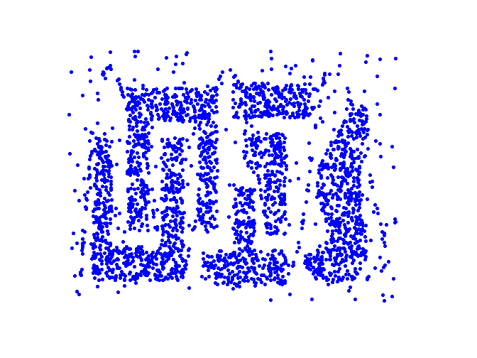
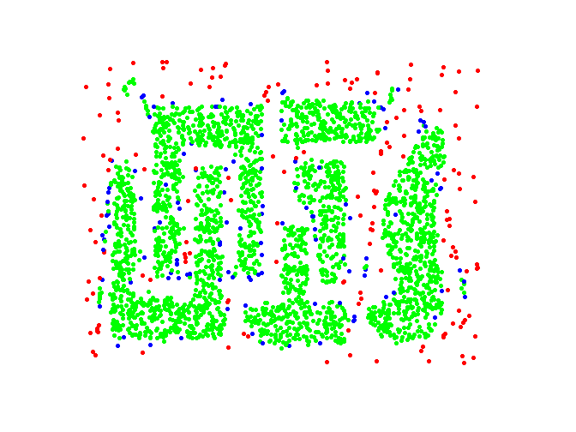
DBSCAN: Core, Border and Noise Points
Original Points
Point types: core, border and noise
Eps = 10, MinPts = 4

Slide 29
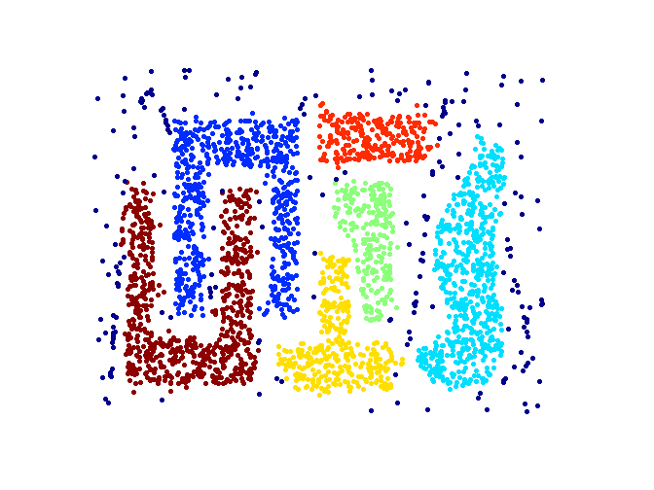
When DBSCAN Works Well
Original Points
Clusters
Resistant to Noise
Can handle clusters of different shapes and sizes

Slide 30
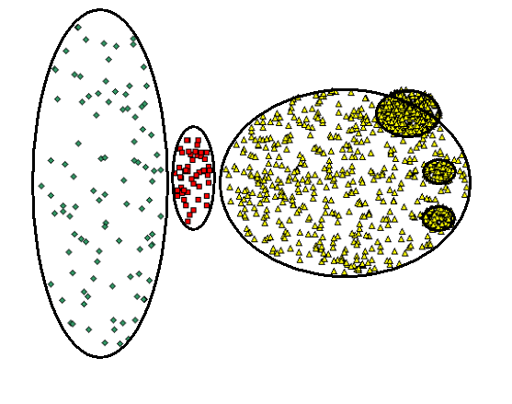
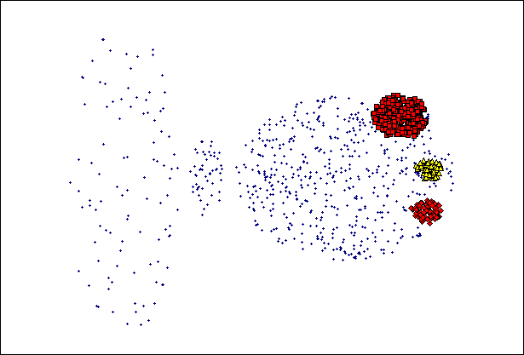
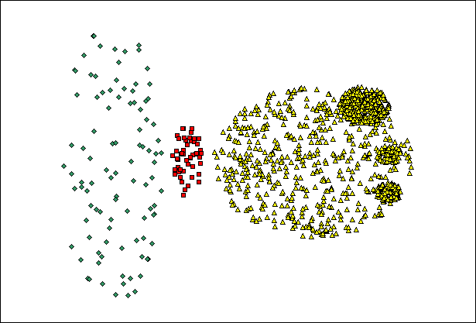
When DBSCAN Does NOT Work Well
(MinPts=4, Eps=9.75).
Original Points
Varying densities
High-dimensional data
(MinPts=4, Eps=9.92)

Slide 31
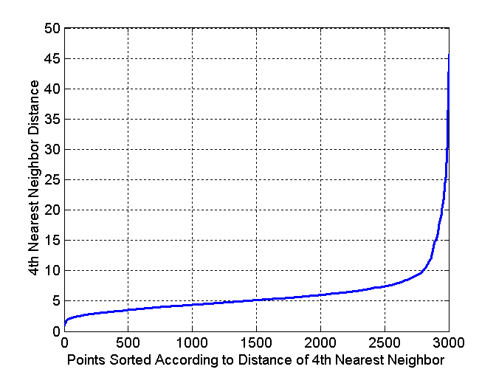
DBSCAN: Determining EPS and MinPts
Idea is that for points in a cluster, their k^{th} nearest neighbors are at roughly the same distance
Noise points have the k^{th} nearest neighbor at farther distance
So, plot sorted distance of every point to its k^{th} nearest neighbor
Notes:
Determining Eps and MinPts in DBSCAN
The idea is that points inside a cluster usually have their k-th nearest neighbor at a similar distance.
But noise points usually have their k-th nearest neighbor much farther away.
How to choose
First, choose a value of k. Usually, k = MinPts.
Then, for every point, compute the distance to its k-th nearest neighbor.
Sort these distances in increasing order and plot them.
How to find Eps
In the sorted k-distance graph, look for the point where the curve starts to rise sharply.
This bend is called the knee or elbow.
The distance value at that point is chosen as Eps.
How to find MinPts
MinPts is often chosen first based on the data dimension or experience.
Then the k-distance plot helps estimate a good Eps.

Slide 32
Grid-Based Clustering Method
Define a set of grid-cells
Assign objects to the appropriate grid cell and compute the density of each cell.
Eliminate cells, whose density is below a certain threshold Τ.
Form clusters from contiguous (adjacent) groups of dense cells (usually minimizing a given objective function)

Slide 33
Salary (10,000)
Vacation(week)
7
7
6
6
5
5
4
4
3
3
2
2
1
1
0
age
0
age
20
30
40
50
60
20
30
40
50
60
Vacation
Salary
30
50
age
33
Notes:
33
Grid-Based Clustering Method
First, divide the data space into a set of grid cells.
Then assign each data point to its correct grid cell and calculate the density of each cell.
Remove the cells whose density is below a chosen threshold T.
Finally, form clusters by joining adjacent dense cells.
Main idea
Grid-based clustering does not cluster points directly. It first groups points into cells, keeps only dense cells, and forms clusters from neighboring dense cells.

Slide 34
Strength and Weakness
Strength
automatically finds subspaces of the highest dimensionality such that high density clusters exist in those subspaces
insensitive to the order of records in input and does not presume some canonical data distribution
scales linearly with the size of input and has good scalability as the number of dimensions in the data increases
Weakness
The accuracy of the clustering result may be degraded at the expense of simplicity of the method
34
Notes:
34
Strength and Weakness
Strengths
It can automatically find high-density subspaces in high-dimensional data.
It is not sensitive to the input order of records.
It does not assume any fixed data distribution.
It scales linearly with input size, so it is good for large datasets.
It also works well when the number of dimensions increases.
Weakness
Because the method is simple, the clustering accuracy may decrease in some cases.

Slide 35
Summary
Cluster analysis groups objects based on their similarity and has wide applications
Measure of similarity can be computed for various types of data
Clustering algorithms can be categorized into partitioning methods, hierarchical methods, density-based methods, grid-based methods
Quality of clustering results can be evaluated in various ways

Slide 36
Acknowledgement
Reading Materials -Class Lecture
Text Book: (J. Han et al.) Chapter 10
Text Book: (V. Kumar et al.) Chapter 7

