Slide 1
Data Mining (CSE 6506)
Classification -Ensemble Methods
Mahmuda Naznin
Department of Computer Science Engineering, BUET

Slide 2
Classification
Classification: Basic Concepts
Decision Tree Induction
Bayes Classification Methods
Rule-Based Classification
Model Evaluation and Selection
Techniques to Improve Classification Accuracy: Ensemble Methods
Notes:
2

Slide 3
Model Evaluation and Selection
Evaluation metrics-
How can we measure accuracy?
Other metrics to consider?
Use validation test set of class-labeled tuples instead of training set when assessing accuracy
Methods for estimating a classifier’s accuracy-
Holdout method, random sub-sampling
Cross-validation
Bootstrap
Comparing classifiers-
ROC Curves

Slide 4
Model Evaluation and Selection
Positive tuples- tuples of the main class of interest
Negative tuples- tuples of the other class
True Positives- positive tuples correctly labeled
True Negatives- negative tuples correctly labeled
False Positives- negative tuples incorrectly labeled
False Negatives- positive tuples incorrectly labeled

Slide 5
Evaluation Metrics- Confusion Matrix
Confusion Matrix:
Actual class\Predicted class | C₁ | ¬ C₁
C₁ | True Positives (TP) | False Negatives (FN)
¬ C₁ | False Positives (FP) | True Negatives (TN)
Example of Confusion Matrix:
Actual class\Predicted class | buy_computer = yes | buy_computer = no | Total
buy_computer = yes | 6954 | 46 | 7000
buy_computer = no | 412 | 2588 | 3000
Total | 7366 | 2634 | 10000
Given m classes, an entry, CM_{i,j} in a confusion matrix indicates # of tuples in class i that were labeled by the classifier as class j
May have extra rows/columns to provide totals
Notes:
A confusion matrix is a table that compares actual class labels with predicted class labels to show how well a classifier performs.

Slide 6
Evaluation Metrics - Accuracy, Error Rate,
Classifier Accuracy, or recognition rate: percentage of test set tuples that are correctly classified
Accuracy = (TP + TN)/All
Error rate: 1 – accuracy, or
Error rate = (FP + FN)/All
A\P | C | ¬C
C | TP | FN | P
¬C | FP | TN | N
 | P’ | N’ | All
Notes:
Accuracy is the proportion of correctly classified instances among all instances.

Slide 7
Evaluation Metrics: Sensitivity,
Specificity
Class Imbalance Problem:
One class may be rare, e.g. fraud, or HIV-positive
Significant majority of the negative class and minority of the positive class
Sensitivity: True Positive recognition rate (TPR)
Sensitivity = TP/P= TP/(TP+FN)
Specificity: True Negative recognition rate (TNR)
Specificity = TN/N = TN/(TN+FP)
A\P | C | ¬C
C | TP | FN | P
¬C | FP | TN | N
 | P’ | N’ | All

Slide 8
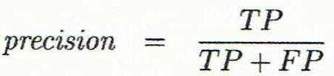
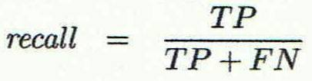
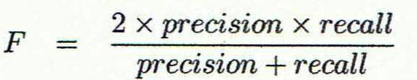
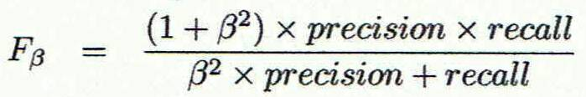
Evaluation Metrics- Precision, Recall, and F-measures
Precision: exactness – what % of tuples that the classifier labeled as positive are actually positive
Or Sensitivity
Recall: completeness – what % of positive tuples did the classifier label as positive?
Perfect score is 1.0
Inverse relationship between precision & recall
F measure (F₁ or F-score): harmonic mean of precision and recall,
F_{ß}: weighted measure of precision and recall
assigns ß times as much weight to recall as to precision
Notes:
F1-score gives one balanced measure of a model’s positive-class performance.

Slide 9
Classifier Evaluation Metrics- Example
Actual Class\Predicted class | cancer = yes | cancer = no | Total | Recognition(%)
cancer = yes | 90 | 210 | 300 | 30.00 (sensitivity)
cancer = no | 140 | 9560 | 9700 | 98.56 (specificity)
Total | 230 | 9770 | 10000 | 96.40 (accuracy)
Precision = 90/230 = 39.13% Recall = 90/300 = 30.00%

Slide 10
Evaluation Classifier Accuracy- Holdout Method
Holdout method
Given data is randomly partitioned into two independent sets
Training set (e.g., 2/3) for model construction
Test set (e.g., 1/3) for accuracy estimation
Random sampling: a variation of holdout
Repeat holdout k times, accuracy = avg. of the accuracies obtained
10
Notes:
In the holdout method, the whole dataset is divided randomly into two separate parts. One part is the training set, which is used to build or train the model, and the other part is the test set, which is used to check how accurate the trained model is on unseen data. For example, we may use 2/3 of the data for training and 1/3 for testing.
Then it mentions random sampling, which is just a repeated version of the holdout method. Instead of splitting the data only once, we split it k times, train and test the model each time, and then take the average of all accuracies. This gives a more reliable estimate because the result does not depend on only one random split.

Slide 11
Evaluating Classifier Accuracy- Cross-Validation Method
Cross-validation (k-fold, where k = 10 is most popular)
Randomly partition the data into k mutually exclusive subsets, each approximately equal size
At i-th iteration, use D_{i} as test set and others as training set
Leave-one-out: k folds where k = # of tuples, for small sized data. One set is isolated as test set
*Stratified cross-validation*: folds are stratified so that class distribution in each fold is approximately the same distribution as it has been in the initial dataset
11
Notes:
Cross-validation is a method to evaluate a classifier more reliably than one single train-test split. In k-fold cross-validation, the dataset is divided into k equal parts. Each time, one part is used for testing and the remaining parts are used for training. This process is repeated k times, so every part is used as the test set once, and the final accuracy is the average of all runs.
In leave-one-out, each data sample is treated as one fold, so in every run one sample is used for testing and all others for training. It is mostly used for small datasets. In stratified cross-validation, each fold keeps almost the same class proportion as the original dataset, which is especially useful when the data is imbalanced.

Slide 12

Evaluating Classifier Accuracy- Bootstrap
Bootstrap
Works well with small data sets
Samples the given training tuples uniformly with replacement
i.e., each time a tuple is selected, it is equally likely to be selected again and re-added to the training set
Several bootstrap methods, and a common one is .632 boostrap
A data set with d tuples is sampled d times, with replacement, resulting in a training set of d samples. The data tuples that did not make it into the training set end up forming the test set. About 63.2% of the original data end up in the bootstrap, and the remaining 36.8% form the test set (since (1 – 1/d)^{d} ≈ e⁻¹ = 0.368)
Repeat the sampling procedure k times, overall accuracy of the model:
12
Notes:
Bootstrap is an evaluation method that works well for small datasets. It creates a training set by randomly selecting samples with replacement, which means the same sample can be chosen more than once. Because of this, some original samples may appear multiple times in training, while some may not appear at all.
In .632 bootstrap, if a dataset has d samples, we draw d times with replacement to make the training set. On average, about 63.2% of the original data appear in the bootstrap training set, and the remaining 36.8% that were not selected are used as the test set. This process is repeated k times, and the final accuracy is computed by combining the training and test accuracies from all runs.

Slide 13
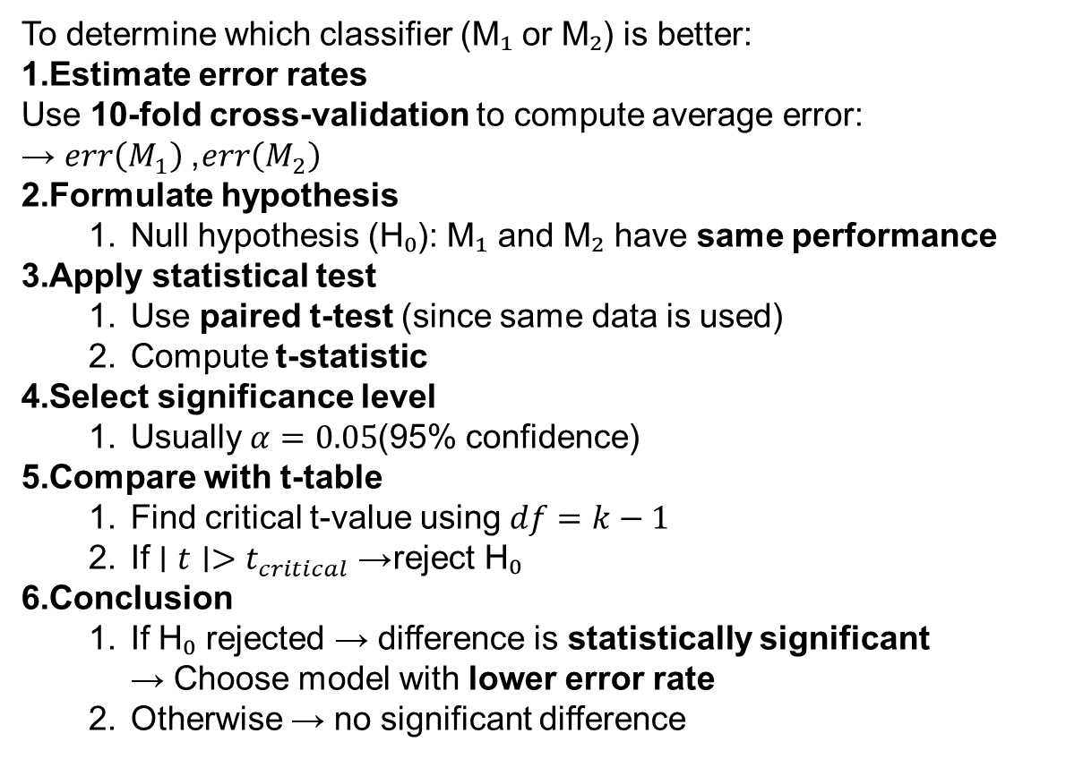
To determine which classifier (M₁ or M₂) is better:
Estimate error rates Use 10-fold cross-validation to compute average error: → $err\left(M_{1}\right)$, $err\left(M_{2}\right)$
Formulate hypothesis
Null hypothesis (H₀): M₁ and M₂ have same performance
Apply statistical test
Use paired t-test (since same data is used)
Compute t-statistic
Select significance level
Usually $α=0.05$(95% confidence)
Compare with t-table
Find critical t-value using $df=k−1$
If $∣t∣>t_{critical}$→ reject H₀
Conclusion
If H₀ rejected → difference is statistically significant → Choose model with lower error rate
Otherwise → no significant difference

Slide 14


Estimating Confidence Intervals- Two Classifier Models M₁ vs. M₂
Suppose we have 2 classifiers, M₁ and M₂, which one is better?
Use 10-fold cross-validation to obtain and
These mean error rates are just estimates of error on the true population of future data cases
What if the difference between the 2 error rates is just attributed to chance?
Use a test of statistical significance
Obtain confidence limits for our error estimates
14
Notes:
Use cross-validation to estimate errors, then apply statistical significance test and confidence intervals to determine if one model is truly better than the other.

Slide 15
Estimating Confidence Intervals- Using Null Hypothesis
Perform 10-fold cross-validation
Assume samples follow a t distribution with k–1 degrees of freedom (here, k=10)
Use t-test (or Student’s t-test)
Null Hypothesis- Initially two models M₁ & M₂ are the same
If we can reject null hypothesis, then
we conclude that the difference between M₁ & M₂ which is statistically significant
We chose the model with lower error rate
15
Notes:
First, use 10-fold cross-validation to get error values of both models.
Assume the results follow a t-distribution (used when sample size is small).
Set Null Hypothesis (H₀): → Model M₁ and M₂ have same performance (no real difference).
Apply t-test to check difference between their errors.
If we reject H₀ → difference is real (statistically significant).
Then choose the model with lower error rate.

Slide 16
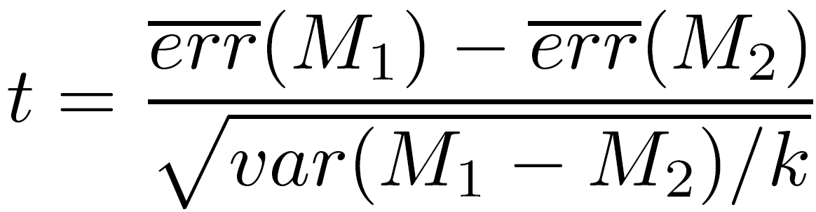
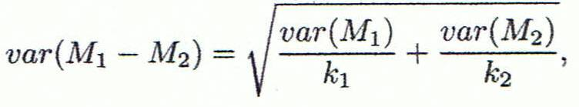
Estimating Confidence Intervals- t-test
If only 1 test set available- pair wise comparison
For i^{th} round of 10-fold cross-validation, the same cross partitioning is used to obtain err(M₁)_{i} and err(M₂)_{i}
Average over 10 rounds to get
t-test computes t-statistic with k-1 degrees of freedom:
If two test sets available- use non-paired t-test
and
where
where
where k₁ & k₂ are # of cross-validation samples used for M₁ & M₂, resp.
16
Notes:
Case 1: Only ONE test set (paired t-test)
In each fold, calculate error of both models → $err{\left(M_{1}\right)}_{i}$, $err{\left(M_{2}\right)}_{i}$
Compute difference for each fold.
Use t-test on these differences.
Degrees of freedom = $k−1$(here k = 10)
→ This checks if average difference is real or just random.
Case 2: TWO different test sets (non-paired t-test)
Errors of M₁ and M₂ come from different data.
Compare their averages separately.
Use non-paired t-test formula

Slide 17
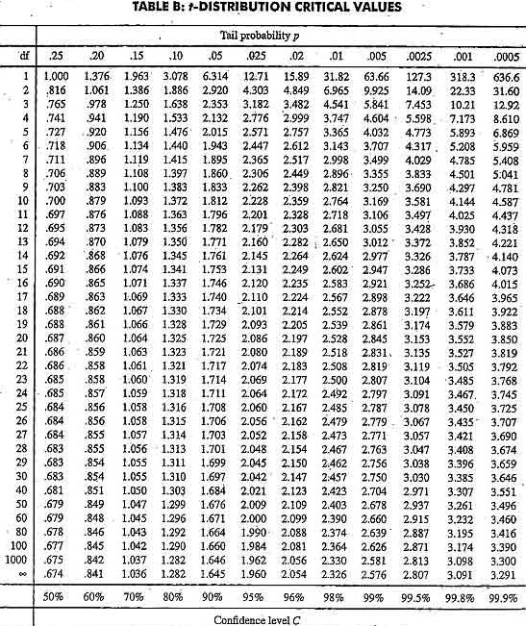
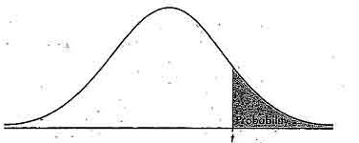
Estimating Confidence Intervals- Table for t-distribution
Symmetric
Significance level, e.g., sig = 0.05 or 5% means M₁ & M₂ are significantly different for 95% of population
Confidence limit, z = sig/2
17

Slide 18
Estimating Confidence Intervals- Statistical Significance
Are M₁ & M₂ significantly different?
We compute t.
We select significance level (e.g. sig = 5%)
We consult table for t-distribution: Find t value corresponding to k-1 degrees of freedom (here, 9)
t-distribution is symmetric: typically upper % points of distribution shown → look up value for confidence limit z=sig/2 (here, 0.025)
If t > z or t < -z, then t value lies in rejection region:
Reject null hypothesis that mean error rates of M₁ & M₂ are same
We conclude: statistically significant difference between M₁ & M₂
Otherwise, conclude that no difference among the models
18

Slide 19
Model Selection: ROC Curves
ROC (Receiver Operating Characteristics) curves: for visual comparison of classification models
Originated from signal detection theory
Shows the trade-off between the true positive rate (TPR) and the false positive rate (FPR)
The area under the ROC curve is a measure of the accuracy of the model
Rank the test tuples in decreasing order: the one that is most likely to belong to the positive class appears at the top of the list
The closer to the diagonal line (i.e., the closer the area is to 0.5), the less accurate is the model
Vertical axis represents the true positive rate
Horizontal axis rep. the false positive rate
The plot also shows a diagonal line
A model with perfect accuracy will have an area of 1.0
Notes:
ROC curve is used to compare classification models visually.
It comes from signal detection theory.
It shows the trade-off between True Positive Rate (TPR) and False Positive Rate (FPR).
Y-axis (vertical): True Positive Rate (TPR)
X-axis (horizontal): False Positive Rate (FPR)
The area under the curve (AUC) measures model performance:
AUC = 1.0 → perfect model
AUC ≈ 0.5 → poor model (random guess)
Data points are ranked by probability, with most likely positive cases at the top.
A curve closer to the top-left corner means better performance.
A curve closer to the diagonal line means lower accuracy.

Slide 20
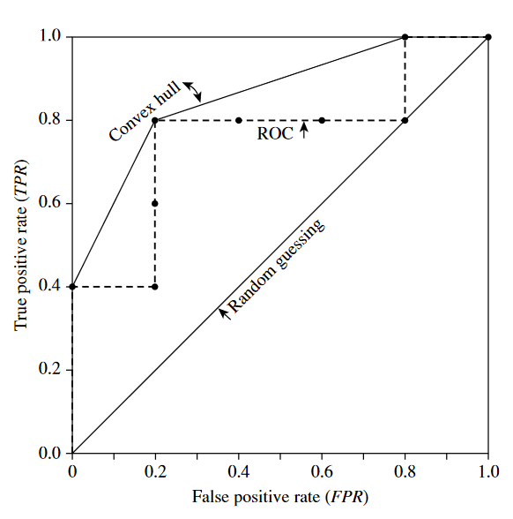
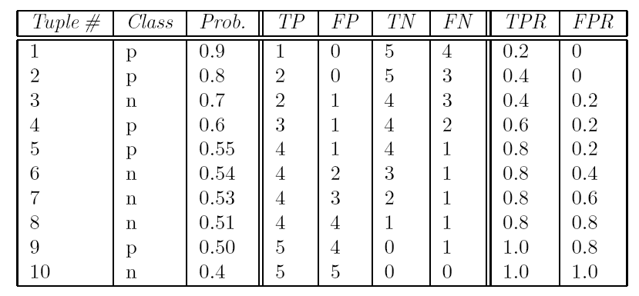
Model Selection-ROC Curves
True Positive Rate TPR: TP/P= TP/(TP+FN)
False Positive Rate FPR: FP/N= FP/(FP+TN)
Notes:
True Positive Rate (TPR): TPR = TP / (TP + FN) It shows how many actual positive cases are correctly identified. False Positive Rate (FPR): FPR = FP / (FP + TN) It shows how many negative cases are wrongly classified as positive.
Data is first sorted by predicted probability (highest to lowest).
Then, for each threshold, we calculate TP, FP, TN, FN, and get TPR & FPR.
These values are plotted to form the ROC curve.
The curve shows how TPR changes when FPR increases.
A better model will have high TPR and low FPR (curve goes toward top-left).
The diagonal line represents random guessing.

Slide 21
Metrics and Issues for Model Selection
Accuracy
Classifier accuracy- Predicting class label
Speed
Time to construct the model (training time)
Time to use the model (classification/prediction time)
Robustness- Handling noise and missing values
Scalability- Ability to deal with huge volume of data
Interpretability
Understanding and insight provided by the model
Other measures, e.g., goodness of rules, such as decision tree size or compactness of classification rules
Notes:
21

Slide 22
Classification
Classification: Basic Concepts
Decision Tree Induction
Bayes Classification Methods
Rule-Based Classification
Model Evaluation and Selection
Techniques to Improve Classification Accuracy: Ensemble Methods
Notes:
22

Slide 23
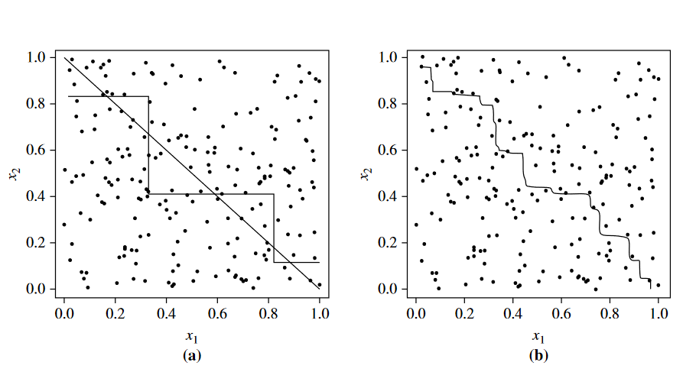
Increasing the Accuracy-
Ensemble Methods

Slide 24
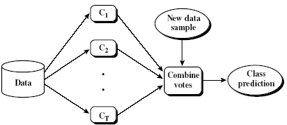
Increasing the Accuracy-
Ensemble Methods
Ensemble methods
Construct a set of classifiers from the training data
Predict class label of previously unseen records by aggregating predictions made by multiple classifiers
Popular ensemble methods
Bagging
Boosting
Notes:
Ensemble methods: Combine multiple classifiers instead of using a single model to improve accuracy. A set of classifiers is built from the training data. For new (unseen) data, predictions from all classifiers are combined (e.g., voting) to give the final result. This works because multiple models together reduce errors and give more reliable predictions.
Popular ensemble methods: Bagging: Builds multiple models using different random samples of data and combines their results.
Boosting: Builds models step-by-step, focusing more on previously misclassified data.

Slide 25
Ensemble Methods- Bagging vs. Boosting
Bagging
Construction of Bagging classifiers are independent
Equal voting
Boosting
Construction of a new Boosting classifier depends on the performance of its previous classifier, i.e. sequential construction (a series of classifiers)
Weighted voting
Notes:
Bagging (Bootstrap Aggregating):
Classifiers are built independently from different random samples of data.
Each model works separately.
Final prediction is made using equal voting (all models have same importance).
Boosting:
Classifiers are built sequentially (one after another).
Each new model focuses on errors of previous models.
Final prediction uses weighted voting (better models get more importance).
Key Difference:
Bagging → independent + equal voting
Boosting → sequential + weighted voting

Slide 26
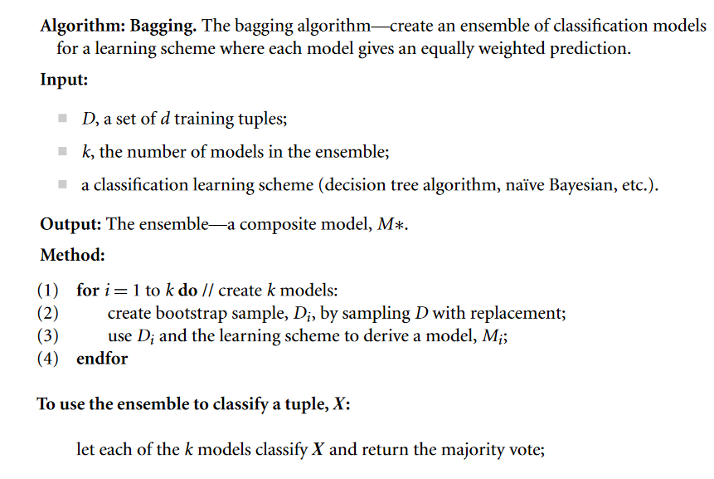
Bagging
Notes:
Idea: Bagging creates multiple models and combines them using equal voting to improve accuracy.
D: Training dataset
k: Number of models to build
Learning method: Any classifier (e.g., decision tree, Naive Bayes)
Output:
A final combined model (ensemble)
Method (Steps):
Repeat for i = 1 to k (create k models):
Create a bootstrap sample Di from D (random sampling with replacement).
Train a model Mi using Di.
End loop.
Prediction:
For a new data point X, all k models predict the class.
Final result is given by majority voting (most common class).

Slide 27
Bagging- Bootstrap Aggregation
Analogy: Diagnosis based on multiple doctors’ majority vote
Training
Given a set D of d tuples, at each iteration i, a training set D_{i} of d tuples is sampled with replacement from D (i.e., bootstrap)
A classifier model M_{i} is learned for each training set D_{i}
Classification: classify an unknown sample X
Each classifier M_{i} returns its class prediction
The bagged classifier M* counts the votes and assigns the class with the most votes to X
Prediction: can be applied to the prediction of continuous values by taking the average value of each prediction for a given test tuple
Accuracy
Often significantly better than a single classifier derived from D

Slide 28
Boosting (Weighted Voting)
Analogy: Consult several doctors, based on a combination of weighted diagnoses—weight assigned based on the previous diagnosis accuracy
How boosting works?
Weights are assigned to each training tuple
A series of k classifiers is iteratively learned
After a classifier M_{i} is learned, the weights are updated to allow the subsequent classifier, M_{i+1}, to pay more attention to the training tuples that were misclassified by M_{i}
The final M* combines the votes of each individual classifier, where the weight of each classifier's vote is a function of its accuracy
Notes:
Like taking opinions from multiple doctors, but more accurate doctors get more importance (weight).
How Boosting Works:
Each training sample is given a weight.
A sequence of k classifiers is built one after another (sequentially).
After each model $M_{i}$:
We increase weight of misclassified data.
Next model $M_{i+1}$focuses more on these difficult cases.
This process continues, so each new model learns from previous mistakes.
Final Prediction:
All models vote, but not equally.
More accurate models get higher weight.
Final result is based on weighted voting.

Slide 29
Boosting - Adaboost
Given a set of d class-labeled tuples, (X₁, y₁), …, (X_{d}, y_{d})
Initially, all the weights of tuples are set the same (1/d)
Generate k classifiers in k rounds. At round i,
Tuples from D are sampled (with replacement) to form a training set D_{i} of the same size
Each tuple’s chance of being selected is based on its weight
A classification model M_{i} is derived from D_{i}
Its error rate is calculated using a test set
If a tuple is misclassified, its weight is increased, o.w. it is decreased
Error rate: err(X_{j}) is the misclassification error of tuple X_{j}. Classifier M_{i} error rate is the sum of the weights of the misclassified tuples:
The weight of classifier M_{i}’s vote is
Notes:
Start with d training samples $\left(X_{1} , y_{1}\right),…,\left(X_{d} , y_{d}\right)$. Initially, all samples have equal weight = 1/d. Process (k rounds):
For each round $i$:
Create a training set $D_{i}$by sampling with replacement.
Samples are chosen based on their weights (higher weight → higher chance).
Train a model $M_{i}$using $D_{i}$.
Calculate error of $M_{i}$:
Error = sum of weights of misclassified samples.
Update weights:
If a sample is misclassified → increase its weight.
If correctly classified → decrease its weight.
Each model gets a vote weight based on its accuracy: More accurate model → higher weight.
Final result is given by weighted voting of all models.

Slide 30
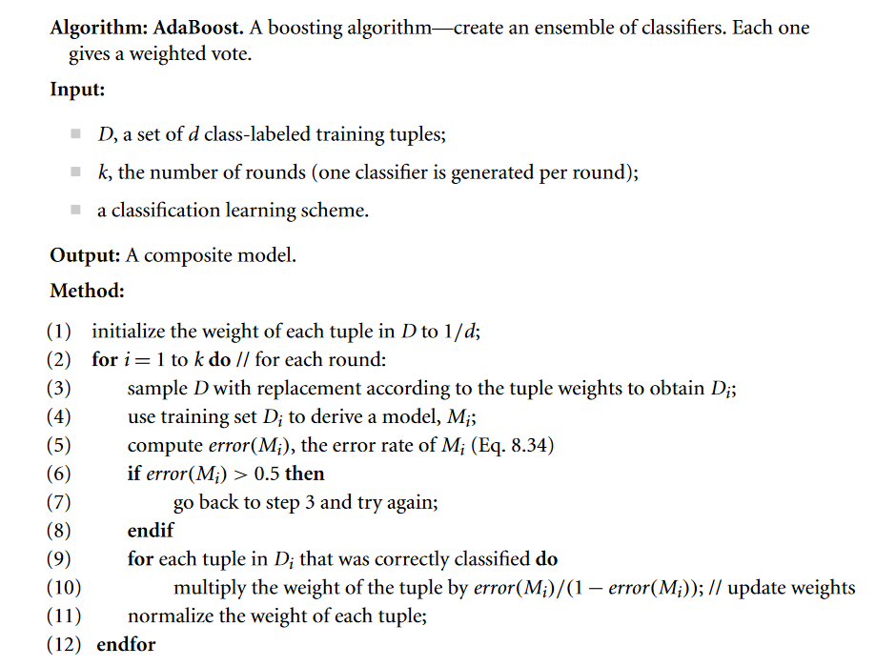
Boosting
Notes:
AdaBoost Algorithm – Exam Ready Steps
Idea: Build multiple classifiers sequentially, each giving a weighted vote.
Input:
D: Training dataset
k: Number of rounds (models)
Learning method: Any classifier
Output:
A combined (ensemble) model
Method (Steps):
Initialize weight of each sample = 1/d.
For i = 1 to k (each round):
Sample data based on weights to form $D_{i}$.
Train model $M_{i}$using $D_{i}$.
Compute error(M_i) (weighted error).
If error(M_i) > 0.5, discard and retrain.
Update weights:
Correctly classified → decrease weight
Misclassified → increase importance (relatively higher weight)
Normalize weights (so total = 1).
Final Prediction:
Combine all models using weighted voting (better models → higher weight).

Slide 31
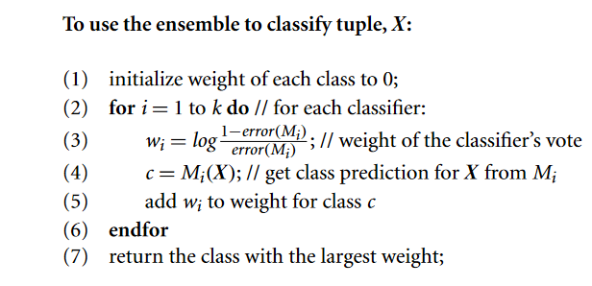
Boosting
Notes:
Boosting Prediction (Using Ensemble) – Exam Ready
To classify a new tuple X:
Initialize weight of each class = 0.
For each classifier $M_{i}$(i = 1 to k):
Compute classifier weight: $$w_{i}=\log\left(\frac{1−error\left(M_{i}\right)}{error\left(M_{i}\right)}\right)$$
Get prediction $c=M_{i}\left(X\right)$
Add $w_{i}$to the total weight of class $c$.
After all classifiers vote:
Choose the class with the highest total weight.

Slide 32
Ensemble Technique- Random Forest (Breiman 2001)
Random Forest:
Each classifier in the ensemble is a decision tree classifier and is generated using a random selection of attributes at each node to determine the split
During classification, each tree votes and the most popular class is returned
Two Methods to construct Random Forest:
Forest-RI (random input selection): Randomly select, at each node, F attributes as candidates for the split at the node.
Forest-RC (random linear combinations): Creates new attributes (or features) that are a linear combination of the existing attributes (reduces the correlation between individual classifiers)
Comparable in accuracy to Adaboost, but more robust to errors and outliers
Insensitive to the number of attributes selected for consideration at each split, and faster than bagging or boosting
Notes:
Random Forest – Exam Ready Explanation
Random Forest: An ensemble method where each model is a decision tree. Each tree is built using a random subset of features at each split.
During prediction:
Each tree gives a vote.
Final class = majority vote.
Methods to Build Random Forest:
Forest-RI (Random Input Selection): At each node, randomly select a subset of features to decide the split.
Forest-RC (Random Combination): Create new features by combining existing ones (linear combination) to reduce similarity between trees.
Advantages:
Accuracy is similar to AdaBoost, but more robust to noise and outliers.
Less sensitive to number of features selected at each split.
Usually faster than bagging and boosting.

Slide 33
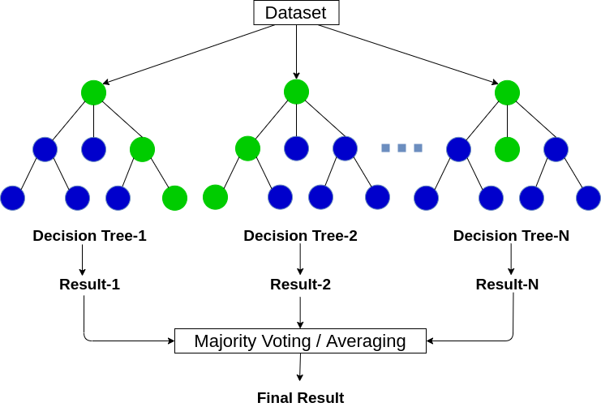
Random Forest

Slide 34
Classification-Class-Imbalanced Data Sets
Class-imbalance problem: Rare positive example but numerous negative ones, e.g., medical diagnosis, fraud, oil-spill, fault, etc.
Traditional methods assume a balanced distribution of classes and equal error costs: not suitable for class-imbalanced data
Typical methods for imbalance data in 2-class classification:
Oversampling- re-sampling of data from positive class
Under-sampling- randomly eliminate tuples from the negative class
Threshold-moving- moves the decision threshold t, so that the rare class tuples are easier to classify, and hence, less chance of costly false negative errors
Ensemble techniques: Ensemble multiple classifiers
Still difficult for handling class imbalance problem on multiclass tasks
Notes:
Class-Imbalanced Data Sets – Exam Ready Explanation
Class imbalance problem: One class (usually positive) has very few examples, while the other (negative) has many. Example: fraud detection, medical diagnosis.
Traditional methods assume balanced classes and equal error cost, so they do not work well for imbalanced data.
Methods to Handle Imbalance:
Oversampling: Increase samples of the minority (positive) class by resampling.
Undersampling: Reduce samples from the majority (negative) class.
Threshold-moving: Change decision threshold so that minority class is easier to detect, reducing false negatives.
Ensemble techniques: Use multiple classifiers together to improve performance.
Limitation: Handling imbalance is still difficult for multiclass problems.

Slide 35
Acknowledgement
Jiawei Han (UIUC) -Reading Materials
Vipin Kumar et al. (University of Minnesota at Twin Cities)

