Slide 1
Data Mining (CSE 6506) Clustering-1
Dr. Mahmuda Naznin
Department of Computer Science Engineering, BUET
October, 2019

Slide 2
What is Cluster Analysis?
Finding groups of objects such that the objects in a group will be similar (or related) to one another and different from (or unrelated to) the objects in other groups
Inter-cluster distances are maximized
Intra-cluster distances are minimized

Slide 3
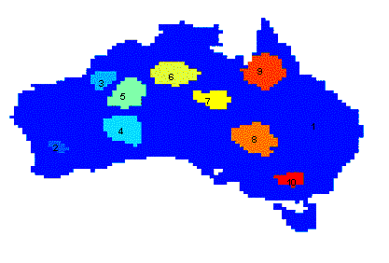
Applications of Cluster Analysis
Understanding
Group related documents for browsing, group genes and proteins that have similar functionality, or group stocks with similar price fluctuations
Summarization
Reduce the size of large data sets
Clustering precipitation in Australia

Slide 4
What is not Cluster Analysis?
Simple segmentation
Dividing students into different registration groups alphabetically, by last name
Results of a query
Groupings are a result of an external specification
Clustering is a grouping of objects based on the data
Supervised classification
Have class label information
Association Analysis
Local vs. global connections
Notes:
1. Simple segmentation
Just dividing data by a rule (like alphabetically).
Not based on similarity → so not clustering.
2. Results of a query
Groups are created by user-defined conditions.
But clustering groups data automatically based on similarity, not external rules.
3. Supervised classification
Uses known class labels (like “pass/fail”).
Clustering has no labels, it finds groups by itself.
4. Association Analysis
Finds relationships between items (like “buy bread → buy butter”).
Focus is on connections, not grouping similar items.

Slide 5
Cluster can be Ambiguous
How many clusters?
Six Clusters
Two Clusters
Four Clusters

Slide 6
Types of Clusterings
A clustering is a set of clusters
Important distinction between hierarchical and partitional sets of clusters
Partitional Clustering
A division of data objects into non-overlapping subsets (clusters) such that each data object is in exactly one subset
Hierarchical clustering
A set of nested clusters organized as a hierarchical tree
Notes:
1. Clustering
Clustering means a collection of groups (clusters).
2. Two main types
There are two important types:
Partitional clustering
Hierarchical clustering
3. Partitional Clustering
Data is divided into separate groups.
Each object belongs to only one cluster.
No overlap between clusters.
4. Hierarchical Clustering
Clusters are arranged like a tree structure.
Small clusters combine to form bigger ones (nested groups).

Slide 7
Partitional Clustering
Original Points
A Partitional Clustering

Slide 8
Hierarchical Clustering
Traditional Hierarchical Clustering
Traditional Dendrogram
Non-traditional Hierarchical Clustering
Non-traditional Dendrogram

Slide 9
Other Distinctions Between Sets of Clusters
Exclusive vs. non-exclusive
In non-exclusive clustering, points may belong to multiple clusters.
Can represent multiple classes or ‘border’ points
Fuzzy vs. non-fuzzy
In fuzzy clustering, a point belongs to every cluster with some weight between 0 and 1
Weights must sum to 1
Probabilistic clustering has similar characteristics
Partial vs. complete
In some cases, we only want to cluster some of the data
Heterogeneous vs. homogeneous
Clusters of widely different sizes, shapes, and densities
Notes:
1. Exclusive vs. Non-exclusive
Exclusive: each point belongs to only one cluster
Non-exclusive: a point can belong to multiple clusters
2. Fuzzy vs. Non-fuzzy
Fuzzy clustering: a point belongs to all clusters with a weight (0 to 1)
All weights together = 1
Similar to probability-based grouping
3. Partial vs. Complete
Partial: cluster only some data
Complete: cluster all data
4. Heterogeneous vs. Homogeneous
Heterogeneous: clusters are very different (size, shape, density)
Homogeneous: clusters are similar
Exclusive → one cluster / Non-exclusive → many Fuzzy → weighted membership Partial → some data / Complete → all data Heterogeneous → different clusters / Homogeneous → similar clusters

Slide 10
Types of Clusters
Well-separated clusters
Center-based clusters
Contiguous clusters
Density-based clusters
Property or Conceptual
Described by an Objective Function
Notes:
1. Well-separated clusters
Points in one cluster are far from other clusters
Easy to clearly separate groups
2. Center-based clusters
Each cluster has a center (centroid)
Points belong to the cluster whose center is closest
3. Contiguous clusters
Points in a cluster are connected or close to each other
Based on neighborhood (nearby points)
4. Density-based clusters
Clusters are areas with high data density
Low-density areas separate clusters
5. Property (Conceptual) clusters
Objects are grouped based on common properties or meaning
Not just distance, but shared characteristics
6. Objective-function based clusters
Clusters are formed by optimizing a function
Example: minimize distance within clusters

Slide 11
Types of Clusters: Well-Separated
Well-Separated Clusters:
A cluster is a set of points such that any point in a cluster is closer (or more similar) to every other point in the cluster than to any point not in the cluster.
3 well-separated clusters
Notes:
Well-separated clusters
Points in one cluster are far from other clusters
Easy to clearly separate groups

Slide 12
Types of Clusters: Center-Based
Center-based
A cluster is a set of objects such that an object in a cluster is closer (more similar) to the “center” of a cluster, than to the center of any other cluster
The center of a cluster is often a centroid, the average of all the points in the cluster, or a medoid, the most “representative” point of a cluster
4 center-based clusters
Notes:
. Center-based clusters
Each cluster has a center (centroid)
Points belong to the cluster whose center is closest

Slide 13
Types of Clusters: Contiguity-Based
Contiguous Cluster (Nearest Neighbor or Transitive)
A cluster is a set of points such that a point in a cluster is closer (or more similar) to one or more other points in the cluster than to any point not in the cluster.
8 contiguous clusters
Notes:
points form a cluster if they are connected through “near” links.
A point doesn’t need to be close to all points in the cluster— it’s enough to be close to at least one point in the cluster.
A is close to B, B is close to C ⇒ A, B, C become one cluster (transitive).
It can create long / irregular shape clusters, and sometimes “bridge” two groups if there is a small connection between them.

Slide 14
Types of Clusters: Density-Based
Density-based
A cluster is a dense region of points, which is separated by low-density regions, from other regions of high density.
Used when the clusters are irregular or intertwined, and when noise and outliers are present.
6 density-based clusters
Notes:
Idea: a cluster is a crowded area of points. Two clusters are separated by empty / low-density space.
How it works (intuition):
If many points are close together → they form a cluster.
If a point is alone or in a very sparse area → it is noise / outlier.
Can find irregular shapes (like “C” shape, curved clusters).
Handles noise naturally (doesn’t force every point into a cluster).

Slide 15
Types of Clusters: Conceptual Clusters
Shared Property or Conceptual Clusters
Finds clusters that share some common property or represent a particular concept.
.
2 Overlapping Circles

Slide 16
Characteristics of Cluster Data
Type of proximity or density measure
Central to clustering
Depends on data and application
Data characteristics that affect proximity and/or density are
Dimensionality
Sparseness
Attribute type
Special relationships in the data
For example, autocorrelation
Distribution of the data
Noise and Outliers
Often interfere with the operation of the clustering algorithm
Notes:
1. Proximity / Density measure
Clustering depends on how we measure similarity or closeness
This choice is very important and depends on the type of data and use
2. Data characteristics affecting clustering
Dimensionality
High dimensions → data becomes sparse (spread out)
Attribute type
Data can be numeric, categorical, etc.
Different types need different handling
Special relationships
Some data have internal patterns (like autocorrelation)
These relationships affect clustering
Data distribution
How data is spread (uniform, skewed, etc.) also matters
3. Noise and Outliers
Some data points are errors or very different
These can disturb clustering results
Clustering depends on distance/similarity measure Affected by: Dimensions
Attribute type
Relationships
Distribution
Noise & outliers → can harm clustering

Slide 17
Main Clustering Algorithms
Partitional clustering
Hierarchical clustering
Density-based clustering

Slide 18
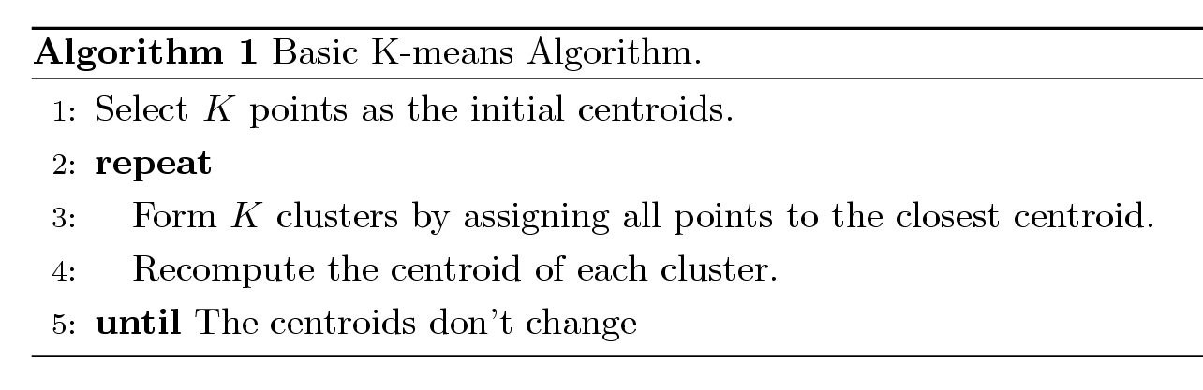
K-means Clustering
Partitional clustering approach.
Number of clusters, K, must be specified.
Each cluster is associated with a centroid (center point).
Each point is assigned to the cluster with the closest centroid.
The basic algorithm is very simple.
Notes:
K-means Clustering
It is a partitional clustering method.
You must choose the number of clusters (K) before starting.
Each cluster has a centroid (center point).
Each data point goes to the nearest centroid.
The method is simple and easy to use.
How it works (steps):
Choose K initial centroids
Repeat:
Assign each point to the nearest centroid
Recalculate the centroid of each cluster
Stop when centroids no longer change

Slide 19
Example of K-means Clustering

Slide 20
Example of K-means Clustering

Slide 21
K-means Clustering – Details
Initial centroids are often chosen randomly.
Clusters produced vary from one run to another.
The centroid is (typically) the mean of the points in the cluster.
‘Closeness’ is measured by Euclidean distance, cosine similarity, correlation, etc.
K-means will converge for common similarity measures mentioned above.
Most of the convergence happens in the first few iterations.
Often the stopping condition is changed to ‘Until relatively few points change clusters’
Complexity is O( n * K * I * d )
n = number of points, K = number of clusters, I = number of iterations, d = number of attributes
Notes:
1. Initial centroids
Starting centers are usually chosen randomly
So results may change each time
2. Centroid meaning
Centroid = average (mean) of all points in a cluster
3. Measuring closeness
Distance/similarity is measured using:
Euclidean distance
Cosine similarity
Correlation
4. Convergence
K-means will eventually stop (converge)
Most changes happen in the first few iterations
Sometimes we stop when very few points change clusters
5. Complexity
Time = O(n × K × I × d)
n = number of points
K = clusters
I = iterations
d = attributes (features)

Slide 22
Evaluating K-means Clusters
Most common measure is Sum of Squared Error (SSE)
For each point, the error is the distance to the nearest cluster
To get SSE, we square these errors and sum them.
x is a data point in cluster C_{i} and m_{i} is the representative point for cluster C_{i}
m_{i} corresponds to the center (mean) of the cluster
Given two sets of clusters, we prefer the one with the smallest error
One easy way to reduce SSE is to increase K, the number of clusters
A good clustering with smaller K may have a lower SSE than a poor clustering with higher K
Notes:
Evaluating K-means (SSE)
The main measure is SSE (Sum of Squared Error)
For each point, find distance to its nearest cluster center
Then square the distance and add all together
Meaning of terms
$x$= data point
$m_{i}$= centroid (mean) of cluster $C_{i}$
Important ideas
Smaller SSE = better clustering
If comparing two clusterings → choose lower SSE
Increasing number of clusters (K) usually reduces SSE
But more clusters ≠ always better (may overfit)

Slide 23
Two different K-means Clusterings
Original Points
Optimal Clustering
Sub-optimal Clustering

Slide 24
Limitations of K-means
K-means has problems when clusters are of differing
Sizes
Densities
Non-globular shapes
K-means has problems when the data contains outliers.
Notes:
1. Problem with different clusters
K-means does not work well when clusters have:
Different sizes → big vs small clusters
Different densities → some dense, some sparse
Non-globular shapes → not round (e.g., curved shapes)
2. Problem with outliers
Outliers (very different points) can pull the centroid
This can give wrong clusters.

Slide 25
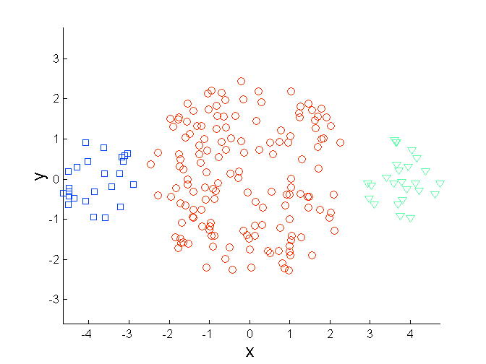
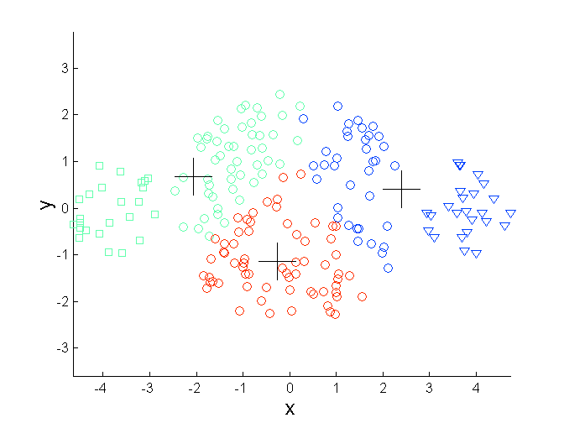
Limitations of K-means: Differing Sizes
Original Points
K-means (3 Clusters)

Slide 26
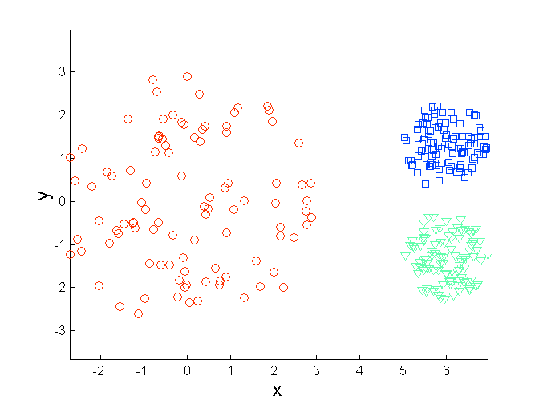
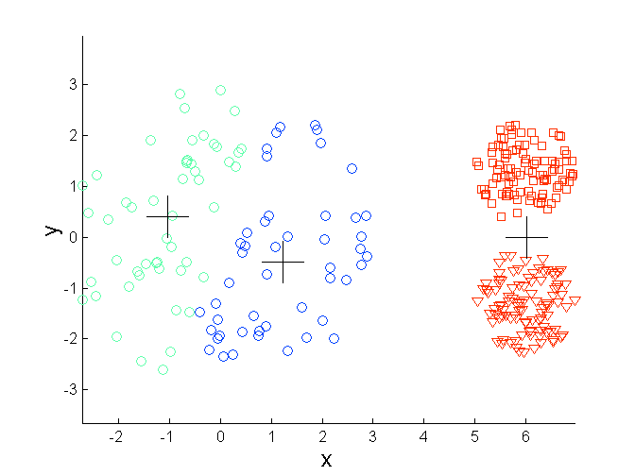
Limitations of K-means: Differing Density
Original Points
K-means (3 Clusters)

Slide 27
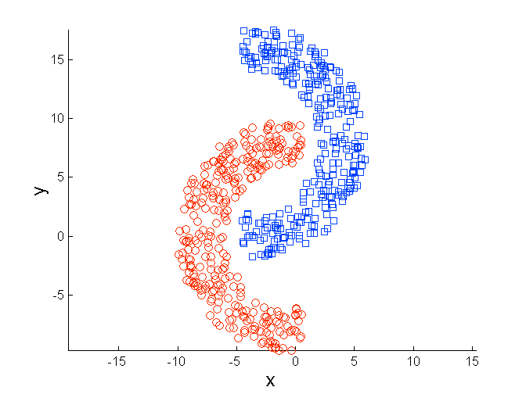
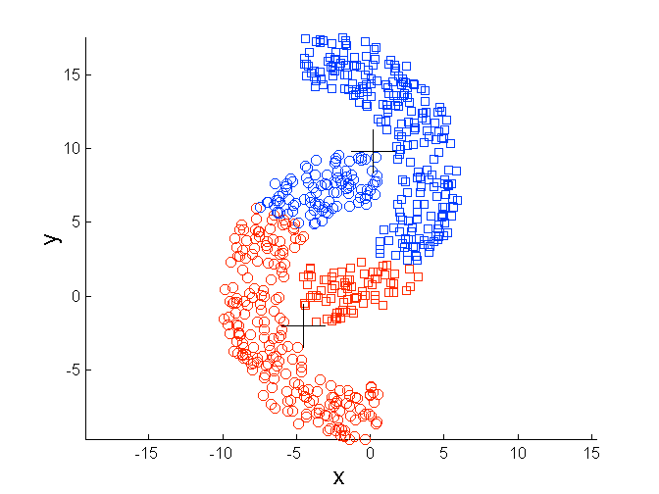
Limitations of K-means: Non-globular Shapes
Original Points
K-means (2 Clusters)

Slide 28
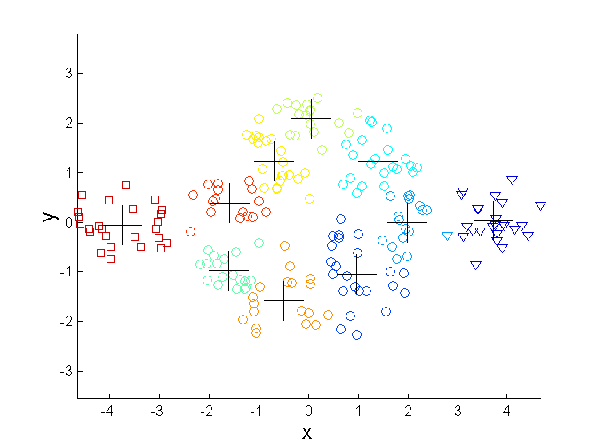
Overcoming K-means Limitations
Original Points K-means Clusters
One solution is to use many clusters.
Find parts of clusters, but need to put together.
Notes:
Overcoming K-means Limitations
K-means may fail when clusters are complex (different shapes/sizes).
One idea: use more clusters (larger K).
How it helps
Instead of finding one big cluster, K-means finds many small parts.
These small clusters can later be combined to form better shapes.
From the figure
Left: original data (natural groups)
Right: K-means splits into many small clusters
These small clusters approximate the real structure

Slide 29
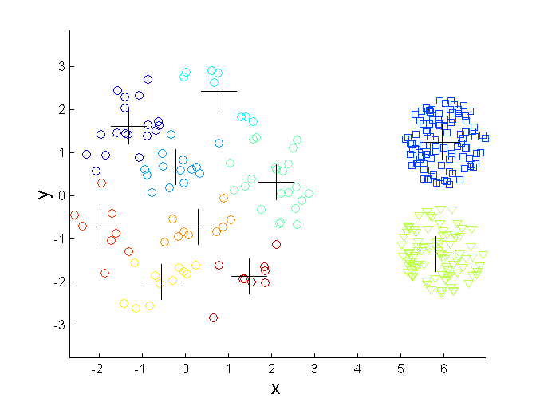
Overcoming K-means Limitations
Original Points K-means Clusters

Slide 30
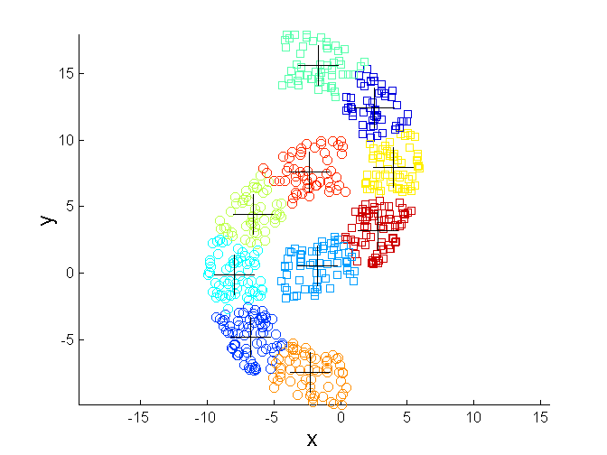
Overcoming K-means Limitations
Original Points K-means Clusters

Slide 31
Importance of Choosing Initial Centroids

Slide 32
Importance of Choosing Initial Centroids

Slide 33
Importance of Choosing Initial Centroids …

Slide 34
Importance of Choosing Initial Centroids …

Slide 35
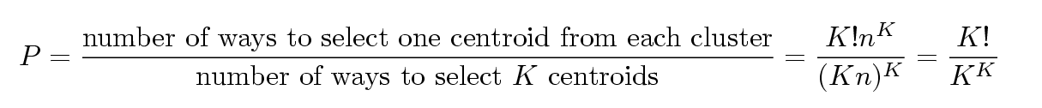
Problems with Selecting Initial Points
If there is K clusters then the chance of selecting one centroid from each cluster is small.
Chance is relatively small when K is large
If clusters are the same size for n data, then
For example, if K = 10, then probability = 10!/10¹⁰ = 0.00036
Sometimes the initial centroids will readjust themselves in ‘right’ way, and sometimes they don’t
Consider an example of five pairs of clusters
Notes:
Problem with Initial Centroids
K-means starts with random initial points (centroids).
If there are K clusters, picking one correct centroid from each cluster is very unlikely.
Why?
When K is large, the chance becomes very small.
Even if clusters are equal in size, probability is still low.
Example
If $K=10$, probability ≈ 0.00036 → very small
Effect
Sometimes centroids adjust correctly → good result
Sometimes they don’t → poor clustering

Slide 36
Solutions to Initial Centroids Problem
Multiple runs
Helps, but probability is not good enough
Sampling and use hierarchical clustering to determine initial centroids
Select more than k initial centroids and then select among these initial centroids
Select most widely separated
Post-processing
Generate a larger number of clusters and then perform a hierarchical clustering (merging)
Bisecting K-means
Notes:
Solutions to the initial centroid problem (K-means)
Multiple runs
Run K-means many times with different random starts, then keep the best result (lowest SSE).
Helps, but not always enough when $K$is large.
Use sampling + hierarchical clustering to pick start centroids
Take a sample of data, do hierarchical clustering, and use the cluster centers as better initial centroids.
Pick more than $K$candidates, then choose $K$
First select many candidate points, then choose the most widely separated $K$points as initial centroids (spread out starts).
Post-processing (cluster then merge)
First create more clusters than needed, then merge similar clusters using hierarchical clustering.
Bisecting K-means
Start with 1 cluster, then repeatedly split one cluster into two until you get $K$clusters.

Slide 37
Empty Clusters
K-means can yield empty clusters
Empty Cluster

Slide 38
Handling Empty Clusters
Several strategies
Choose the point that contributes most to SSE
Choose a point from the cluster with the highest SSE
If there are several empty clusters, the above can be repeated several times.
Notes:
When a cluster becomes empty (no points assigned), we re-initialize its centroid using one of these strategies:
Pick the point that contributes most to SSE
Find the point with the largest squared distance from its current centroid (biggest error).
Make that point the new centroid of the empty cluster.
Pick a point from the cluster with the highest SSE
First find which cluster has the largest total SSE (worst / most spread).
Take a point from that cluster (often a far point) and set it as the new centroid.
If multiple clusters are empty
Repeat the same steps for each empty cluster until all have centroids.

Slide 39
Updating Centers Incrementally
In the basic K-means algorithm, centroids are updated after all points are assigned to a centroid
An alternative is to update the centroids after each assignment (incremental approach)
Each assignment updates zero or two centroids
More expensive
Introduces an order dependency
Never get an empty cluster
Can use “weights” to change the impact
Notes:
Updating centers incrementally (online K-means)
Basic K-means: assign all points to nearest centroid, then update centroids once at the end of the iteration.
Incremental version: after each single assignment, update the centroid(s) immediately.
Each move updates 0 or 2 centroids (old cluster centroid and new cluster centroid).
More expensive (more frequent updates).
Order dependent (different data order → can give different result).
No empty cluster (because you update as you go).
You can use weights to control how much a new point changes the centroid.

Slide 40
Pre-processing and Post-processing
Pre-processing
Normalize the data
Eliminate outliers
Post-processing
Eliminate small clusters that may represent outliers
Split ‘loose’ clusters, i.e., clusters with relatively high SSE
Merge clusters that are ‘close’ and that have relatively low SSE
Notes:
Pre-processing and Post-processing
Pre-processing (before K-means)
Normalize the data (so one feature doesn’t dominate).
Eliminate outliers (because they can pull centroids).
Post-processing (after K-means)
Remove very small clusters (they may actually be outliers).
Split “loose” clusters (clusters with relatively high SSE).
Merge “close” clusters (clusters that are near each other and have low SSE).

Slide 41
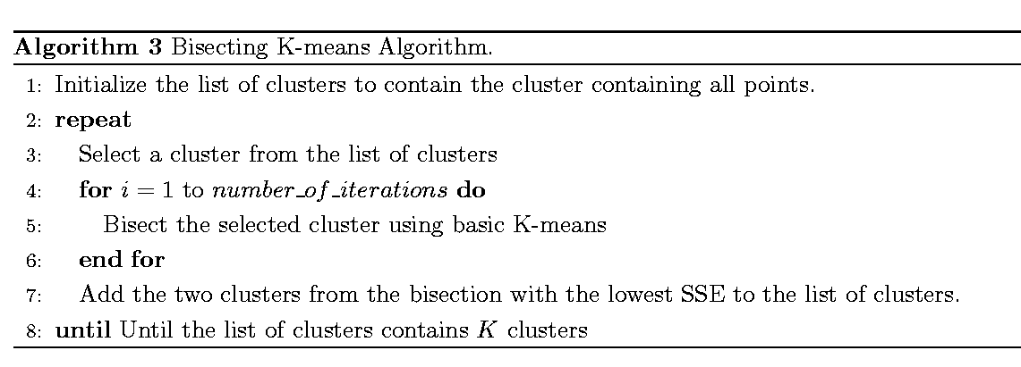
Bisecting K-means
Bisecting K-means algorithm
Variant of K-means that can produce a partitional or a hierarchical clustering
Notes:
Bisecting K-means
It is a variation of K-means
Can create both partitional and hierarchical clusters
How it works (steps):
Start with all data in one cluster
Repeat:
Pick one cluster
Split it into 2 clusters using K-means (K=2)
Do this several times
Choose the split with the lowest SSE (best split)
Add the two new clusters
Continue until we get K clusters
🔸 Summary (Easy to Remember)
Start with one cluster
Split into two again and again
Choose best split (low SSE)
Stop when K clusters are formed

Slide 42
Variations of the K-Means Method
Most of the variants of the k-means which differ in
Selection of the initial k means
Dissimilarity calculations
Strategies to calculate cluster means
Handling categorical data: k-modes
Replacing means of clusters with modes
Using new dissimilarity measures to deal with categorical objects
Using a frequency-based method to update modes of clusters
A mixture of categorical and numerical data: k-prototype method
Notes:
Variations of the K-means Method — simple
Most K-means variations differ in these parts:
How initial centroids are chosen
How distance / dissimilarity is measured
How cluster centers are updated
For categorical data: K-modes
K-means works well for numeric data, but for categorical data we use K-modes.
It uses mode instead of mean (most frequent category value in a cluster)
It uses a different dissimilarity measure for categorical values
It updates clusters using a frequency-based method
For mixed data: K-prototypes
If data has both numeric and categorical features, we use K-prototypes.

Slide 43
Problem of the K-Means Method
The K-means algorithm is sensitive to outliers
Since an object with an extremely large value may substantially distort the distribution of the data. Centroid is not the data point.
K-Medoids: Instead of taking the mean value of the object in a cluster as a reference point, medoids can be used, which is the most centrally located object in a cluster
10
10
9
9
8
8
7
7
6
6
5
5
4
4
3
3
2
2
1
1
0
0
1
2
3
4
5
6
7
8
9
10
0
0
1
2
3
4
5
6
7
8
9
10
Notes:
Problem of the K-means Method — simple
K-means is sensitive to outliers.
An object with a very large or extreme value can pull the centroid (mean) toward itself.
So the cluster center may become distorted.
Also, the centroid is not necessarily a real data point.
Solution: K-medoids
Instead of using the mean as the cluster center, use a medoid.
A medoid is the most centrally located actual data point in the cluster.
Because it uses a real point, K-medoids is less affected by outliers than K-means.
In short:
K-means → affected by outliers
Centroid = average (not real point)
K-medoids → use real central point
Better for noisy data

Slide 44
K-Medoid Clustering Method
K-Medoids Clustering: Find representative objects (medoids) in clusters
PAM (Partitioning Around Medoids, Kaufmann & Rousseeuw 1987)
Starts from an initial set of medoids and iteratively replaces one of the medoids by one of the non-medoids if it improves the total distance of the resulting clustering
PAM works effectively for small data sets, but does not scale well for large data sets (due to the computational complexity)
Notes:
PAM in K-medoids
PAM stands for Partitioning Around Medoids.
It is a K-medoids clustering algorithm that finds representative real data points called medoids.
How PAM works
Start with an initial set of medoids.
Assign each data point to the nearest medoid.
Try replacing a medoid with a non-medoid point.
If the replacement reduces total distance / cost, keep it.
Repeat until no better swap is found.
Main point
PAM uses real data points as centers, not means.
So it is more robust to outliers than K-means.
Limitation
PAM works well for small datasets.
It is computationally expensive for large datasets.

Slide 45
PAM
Input: k the number of clusters,
D: a data set containing n objects.
Output: A set of k clusters.
Method:
(1) arbitrarily choose k objects in D as the initial representative objects or seeds O_{j} j = 1, 2…k
(2) repeat
(3) assign each remaining object to the cluster with the nearest representative object
(4) randomly select a non-representative object O_{random}
(5) compute the total cost S, of swapping representative object O_{j} , with O_{random}
(6) if S < 0 then swap O_{j} with O_{random} to form the new set of k representative objects;
(7) until no change
Notes:
PAM algorithm — simple steps
Input:
$k$= number of clusters
$D$= dataset with $n$ objects
Output:
$k$clusters
Method
Choose $k$objects randomly from the dataset as the initial medoids (representative objects).
Assign every other object to the cluster of the nearest medoid.
Pick a non-medoid object randomly.
Compute the swap cost $S$: what happens if we replace one current medoid $O_{j}$with that non-medoid $O_{random}$.
If $S<0$, the swap reduces total cost, so perform the swap.
Repeat the process until no change improves the clustering.
Main idea
PAM keeps trying to replace current medoids with better objects until the total distance becomes minimum.

Slide 46
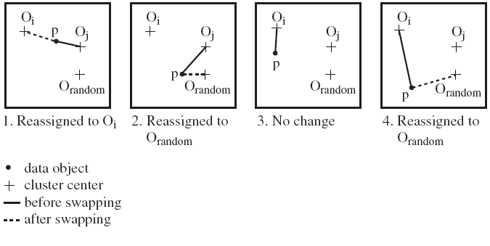
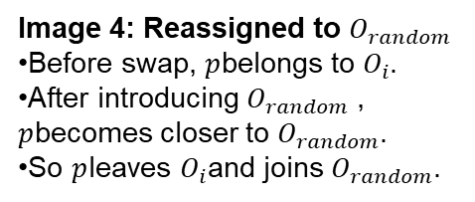
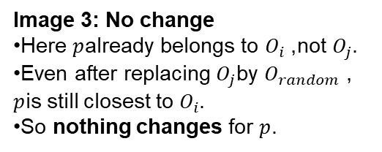
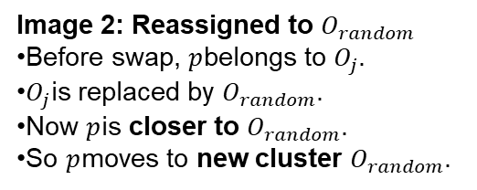
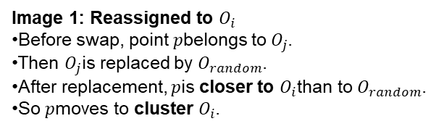
PAM Clustering: Finding the Best Cluster Center
Image 2: Reassigned to $O_{random}$
Before swap, $p$belongs to $O_{j}$.
$O_{j}$is replaced by $O_{random}$.
Now $p$is closer to $O_{random}$.
So $p$moves to new cluster $O_{random}$.
Image 3: No change
Here $p$already belongs to $O_{i}$, not $O_{j}$.
Even after replacing $O_{j}$by $O_{random}$, $p$is still closest to $O_{i}$.
So nothing changes for $p$.
Image 1: Reassigned to $O_{i}$
Before swap, point $p$belongs to $O_{j}$.
Then $O_{j}$is replaced by $O_{random}$.
After replacement, $p$is closer to $O_{i}$than to $O_{random}$.
So $p$moves to cluster $O_{i}$.
Image 4: Reassigned to $O_{random}$
Before swap, $p$belongs to $O_{i}$.
After introducing $O_{random}$, $p$becomes closer to $O_{random}$.
So $p$leaves $O_{i}$and joins $O_{random}$.

Slide 47
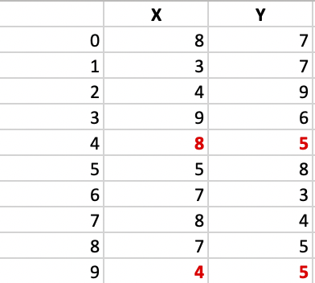
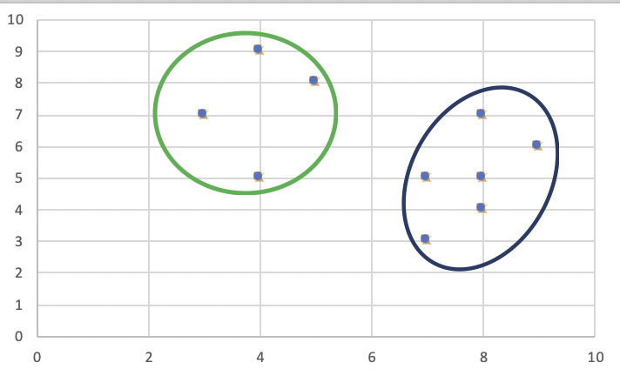
Example of PAM
Step 1:
Let the randomly selected 2 medoids, so select k = 2 and let C1 -(4, 5) and C2 -(8, 5) are the two medoids.

Slide 48
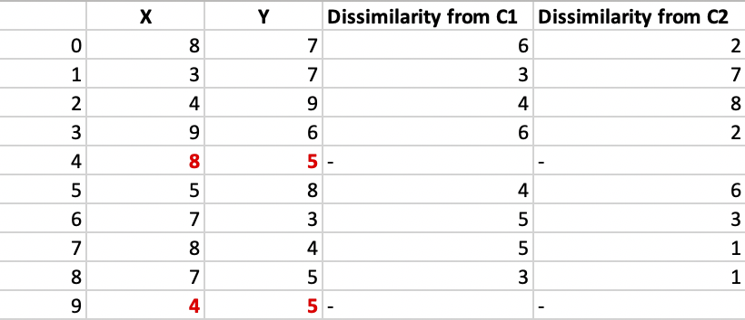
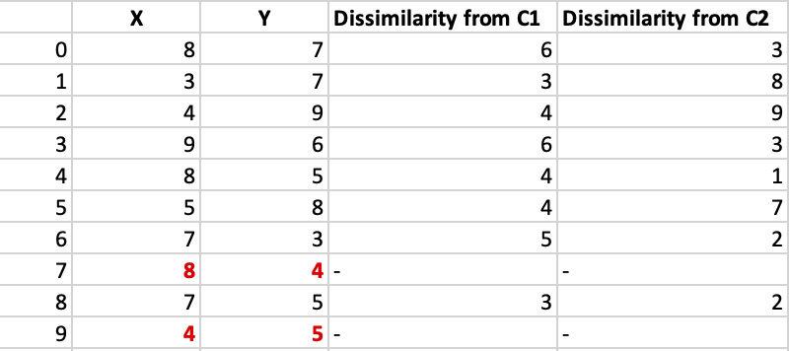
Example of PAM (Contd.)
Step 2: Each point is assigned to the cluster of that medoid whose dissimilarity is less. The points 1, 2, 5 go to cluster C1 and 0, 3, 6, 7, 8 go to cluster C2. The Cost = (3 + 4 + 4) + (3 + 1 + 1 + 2 + 2) = 20
Step 3: randomly select one non-medoid point and recalculate the cost. Let be randomly selected point be (8, 4). The dissimilarity of each non-medoid point with the medoids – C1 (4, 5) and C2 (8, 4) is calculated and tabulated. New Cost = (3 + 4 + 4) + (2 + 2 + 1 + 3 + 3) = 22
Swap Cost = New Cost – Previous Cost = 22 – 20 and 2 >0
As the swap cost is not less than zero, we undo the swap.

Slide 49
Example of PAM
The time complexity is O(K-(n-K)²)
Advantages:
It is simple to understand and easy to implement.
K-Medoid Algorithm is fast and converges in a fixed number of steps.
PAM is less sensitive to outliers than other partitioning algorithms.
Disadvantages:
The main disadvantage of K-Medoid algorithms is that it is not suitable for clustering non-spherical (arbitrary shaped) groups of objects. This is because it relies on minimizing the distances between the non-medoid objects and the medoid (the cluster centre) – briefly, it uses compactness as clustering criteria instead of connectivity.
It may obtain different results for different runs on the same dataset because the first K medoids are chosen randomly.
Notes:
PAM / K-medoids — short notes
Time complexity:
$$O(K\left(n−K{\left.)\right.}^{2})\right.$$
Advantages
Simple to understand and implement
Converges in a fixed number of steps
Less sensitive to outliers than many partitioning methods
Disadvantages
Not suitable for non-spherical / arbitrary-shaped clusters because it focuses on compactness (distance to medoid), not connectivity
Can give different results in different runs because the initial $K$medoids are chosen randomly

Slide 50
Problems with PAM
PAM is more robust than k-means in the presence of noise and outliers because a medoid is less influenced by outliers or other extreme values than a mean
PAM works efficiently for small data sets but does not scale well for large data sets.
Sampling-based method
CLARA(Clustering LARge Applications)
Notes:
Problems with PAM — simple
PAM is more robust than K-means when there is noise and outliers because a medoid is less affected by extreme values than a mean.
But PAM works well only for small datasets. It does not scale well for large datasets.
To handle large datasets, a sampling-based method is used:
CLARA = Clustering Large Applications.

Slide 51
CLARA (Clustering Large Applications) (1990)
CLARA (Kaufmann and Rousseeuw in 1990)
Built in statistical analysis packages, such as SPlus
It draws multiple samples of the data set, applies PAM on each sample, and gives the best clustering as the output
Strength: deals with larger data sets than PAM
Weakness:
Efficiency depends on the sample size
A good clustering based on samples will not necessarily represent a good clustering of the whole data set if the sample is biased
Notes:
CLARA — simple
CLARA stands for Clustering Large Applications.
It is a method designed to handle larger datasets than PAM.
How CLARA works
It takes multiple samples from the whole dataset.
It applies PAM on each sample.
Then it chooses the best clustering among those sample results.
Strength
Works better than PAM for large datasets.
Weakness
Performance depends on the sample size.
If the sample is biased / not representative, the final clustering may also be poor.

Slide 52
CLARANS (“Randomized” CLARA)
CLARANS (A Clustering Algorithm based on Randomized Search) (Ng and Han’94)
Draws sample of neighbors dynamically
The clustering process can be presented as searching a graph where every node is a potential solution, that is, a set of k medoids
If the local optimum is found, it starts with new randomly selected node in search for a new local optimum
Advantages: More efficient and scalable than both PAM and CLARA
Notes:
CLARANS stands for Clustering Large Applications based on Randomized Search.
It is a randomized version of CLARA.
Main idea
Start with one random set of $k$medoids
Make a small random change (for example: replace one current medoid with another point)
Check if this new set is better
If better → move to that new set
If not better → try another random change
After some tries, if no better set is found, it assumes it reached a local optimum
Then it starts again from another random set and repeats
Finally, it keeps the best solution found
Advantage
More efficient and scalable than both PAM and CLARA.

Slide 53
Hierarchical Clustering
Produces a set of nested clusters organized as a hierarchical tree
Can be visualized as a dendrogram
A tree like diagram that records the sequences of merges or splits
Notes:
Forms nested clusters in a tree-like structure
Can be shown using a dendrogram
A dendrogram records the order of merges or splits
Useful for seeing data grouping at different levels

Slide 54
Strengths of Hierarchical Clustering
Do not have to assume any particular number of clusters like k means clustering.
Any desired number of clusters can be obtained by ‘cutting’ the dendrogram at the proper level
They may correspond to meaningful taxonomies
Example in biological sciences (e.g., animal kingdom, phylogeny reconstruction, …)
Notes:
Strengths of Hierarchical Clustering
No need to choose $K$first
You can get any number of clusters by cutting the dendrogram
Can show meaningful hierarchical relationships
Useful in areas like biology / taxonomy
In one line:
No need to choose K beforehand, flexible cluster selection, and produces meaningful hierarchical structures (like taxonomy).

Slide 55
Hierarchical Clustering
Two main types of hierarchical clustering
Agglomerative:
Start with the points as individual clusters
At each step, merge the closest pair of clusters until only one cluster (or k clusters) left
Divisive:
Start with one, all-inclusive cluster
At each step, split a cluster until each cluster contains an individual point (or there are k clusters)
Traditional hierarchical algorithms use a similarity or distance matrix
Merge or split one cluster at a time
Notes:
Two types of Hierarchical Clustering
Agglomerative
Start with each point as its own cluster
Then merge the closest clusters step by step
Divisive
Start with all points in one cluster
Then split the cluster step by step
It usually uses a similarity / distance matrix
At each step, only one merge or one split happens

Slide 56
AGNES (Agglomerative Nesting)
Every object is placed into a cluster of its own
Merge the clusters according to the minimum Euclidean distance between the nearest objects in the clusters
If arriving a “whole” cluster, exit; otherwise repeat the process
Eventually all nodes belong to the same cluster
Notes:
AGNES (Agglomerative Nesting) — short
Start with each object as a separate cluster
Find the closest two clusters
Merge them
Repeat this process again and again
Finally, all objects become one cluster (or stop earlier if the required number of clusters is reached)

Slide 57
DIANA (Divisive Analysis)
All the objects are placed in one cluster
Split the clusters according to the maximum Euclidean distance between the nearest objects in the clusters
If each cluster contains only one object, exit; otherwise repeat the process
Eventually each node forms a cluster on its own
Notes:
DIANA (Divisive Analysis) — short
Start with all objects in one cluster
Find the cluster to split
Divide it into smaller clusters
Repeat the splitting process
Finally, each object becomes its own cluster (or stop earlier when the required number of clusters is reached)

Slide 58
Hierarchical Clustering
Step 0
Step 1
Step 2
Step 3
Step 4
agglomerative
(AGNES)
a
a b
b
a b c d e
c
c d e
d
d e
e
divisive
(DIANA)
Step 4
Step 3
Step 2
Step 1
Step 0

Slide 59
Distance between Clusters
Single link: smallest distance between an element in one cluster and an element in the other, i.e., dist(K_{i}, K_{j}) = min(t_{ip}, t_{jq})
Complete link: largest distance between an element in one cluster and an element in the other, i.e., dist(K_{i}, K_{j}) = max(t_{ip}, t_{jq})
Average: avg distance between an element in one cluster and an element in the other, i.e., dist(K_{i}, K_{j}) = avg(t_{ip}, t_{jq})
Centroid: distance between the centroids of two clusters, i.e., dist(K_{i}, K_{j}) = dist(C_{i}, C_{j})
Medoid: distance between the medoids of two clusters, i.e., dist(K_{i}, K_{j}) = dist(M_{i}, M_{j})
Medoid: a chosen, centrally located object in the cluster
59
Notes:
59
Distance between Clusters
Single link: distance between the closest two points from two clusters
Complete link: distance between the farthest two points from two clusters
Average link: average distance between points of two clusters
Centroid method: distance between the centers (centroids) of two clusters
Medoid method: distance between the medoids of two clusters
Medoid = a real point that is most centrally located in a cluster

Slide 60
Centroid, Radius and Diameter
Centroid: the “middle” of a cluster
Radius: square root of average distance from any point of the cluster to its centroid
Diameter: square root of average mean squared distance between all pairs of points in the cluster
Notes:
60
Centroid, Radius, and Diameter — simple
Centroid: the center / middle point of a cluster (usually the average of all points)
Radius: shows how far, on average, the cluster points are from the centroid
Diameter: shows how spread out the cluster is by measuring the average distance between all pairs of points
In short
Centroid = cluster center
Radius = spread from center
Diameter = overall spread inside the cluster

Slide 61
How to Define Inter-Cluster Distance
Similarity?
MIN
MAX
Group Average
Distance Between Centroids
Other methods driven by an objective function
Ward’s Method uses squared error

Slide 62
How to Define Inter-Cluster Similarity
MIN
MAX
Group Average
Distance Between Centroids
Other methods driven by an objective function
Ward’s Method uses squared error

Slide 63
How to Define Inter-Cluster Similarity
MIN
MAX
Group Average
Distance Between Centroids
Other methods driven by an objective function
Ward’s Method uses squared error
Proximity Matrix

Slide 64
How to Define Inter-Cluster Similarity
MIN
MAX
Group Average
Distance Between Centroids
Other methods driven by an objective function
Ward’s Method uses squared error

Slide 65
How to Define Inter-Cluster Similarity
×
×
MIN
MAX
Group Average
Distance Between Centroids
Other methods driven by an objective function
Ward’s Method uses squared error

Slide 66
Agglomerative Clustering
Most popular hierarchical clustering technique
Basic algorithm is straightforward
Compute the proximity matrix
Let each data point be a cluster
Repeat
Merge the two closest clusters
Update the proximity matrix
Until only a single cluster remains
Key operation is the computation of the proximity of two clusters
Different approaches to defining the distance between clusters distinguish the different algorithms
Notes:
Agglomerative Clustering — simple steps
Start with each data point as a separate cluster
Compute the proximity (distance) matrix
Find the two closest clusters
Merge them
Update the proximity matrix
Repeat until one cluster remains (or stop earlier when the required number of clusters is reached)
Key idea
The main task is how to measure the distance between two clusters.

Slide 67
Starting Situation
Start with clusters of individual points and a proximity matrix
p1
p2
p3
p4
p5
. . .
p1
p2
p3
p4
p5
.
.
.
Proximity Matrix

Slide 68
Intermediate Situation
After some merging steps, we have some clusters
C1
C2
C3
C4
C5
C1
C2
C3
C3
C4
C4
C5
Proximity Matrix
C1
C2
C5

Slide 69
Intermediate Situation
We want to merge the two closest clusters (C2 and C5) and update the proximity matrix.
C1
C2
C3
C4
C5
C1
C2
C3
C3
C4
C4
C5
Proximity Matrix
C1
C2
C5

Slide 70
After Merging
The question is “How do we update the proximity matrix?”
C2 U C5
C1
C3
C4
C1
?
C2 U C5
? ? ? ?
C3
C3
?
C4
C4
?
Proximity Matrix
C1
C2 U C5

Slide 71
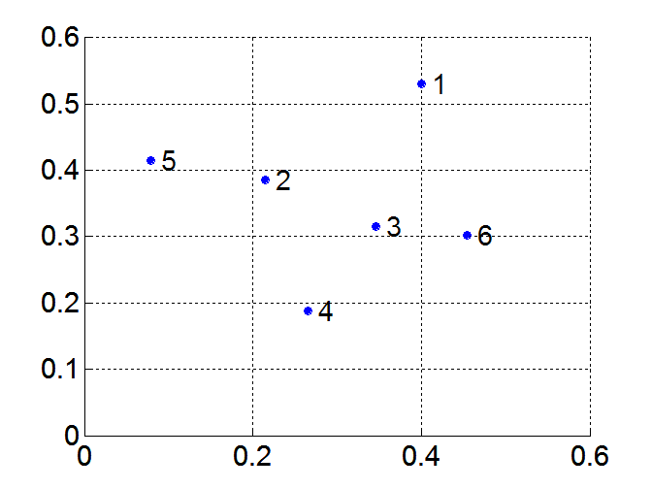
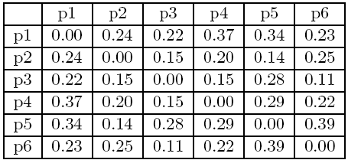
MIN or Single Link
Proximity of two clusters is based on the two closest points in the different clusters
Determined by one pair of points, i.e., by one link in the proximity graph
Example:
Distance Matrix:
Notes:
The smallest distance between any one point in the first cluster and one point in the second cluster.
So clustering depends on the closest pair of points between two clusters.
Single link = nearest-neighbor distance
If cluster A and cluster B have many points, we only look at the two nearest points between them. That minimum distance is used as the cluster distance.

Slide 72
Hierarchical Clustering: MIN
5
1
3
5
2
1
2
3
6
4
4
Cluster 3:
Dist({3,6}, {2,5})=min(dist(3,2), dist(6,2), dist(3,5), dis(6,5))=min(.15, .25, .28, .39)=.15
Dendrogram
Dist({3,6}, {4})=min(dist(3,4), dist(6,4))=min(.15, .22)=.15
Dist({3,6}, {1})=min(dist(3,1), dist(6,1))=min(.22, .23)=.22

Slide 73
Strength of MIN
Original Points
Six Clusters
Can handle non-elliptical shapes

Slide 74
Limitations of MIN
Two Clusters
Original Points
Sensitive to noise and outliers
Three Clusters
Notes:
Because MIN (single-link) uses only the closest pair of points, a single noisy/outlier point can create a false link and incorrectly merge clusters.

Slide 75


MAX or Complete Linkage
Proximity of two clusters is based on the two most distant points in the different clusters
Determined by all pairs of points in the two clusters
Distance Matrix:

Slide 76
Hierarchical Clustering: MAX (Complete link)
4
1
2
5
5
2
3
6
3
1
4
Cluster 3:
Dist({3,6}, {2,5})=max(dist(3,2), dist(6,2), dist(3,5), dis(6,5))=max(.15, .25, .28, .39)=.39
Dist({3,6}, {4})=max(dist(3,4), dist(6,4))=max(.15, .22)=.22
Dendrogram
Dist({3,6}, {1})=max(dist(3,1), dist(6,1))=max(.22, .23)=.23

Slide 77
Strength of MAX
Original Points
Two Clusters
Less susceptible to noise and outliers

Slide 78
Limitations of MAX
Original Points
Two Clusters
Tends to break large clusters
Biased towards globular clusters
Notes:
Because MAX (complete-link) uses the farthest pair of points between clusters, large or spread-out clusters look very far apart, so it tends to split them and prefers compact, globular clusters.

Slide 79
Group Average
Proximity of two clusters is the average of pairwise proximity between points in the two clusters.
Need to use average connectivity for scalability since total proximity favors large clusters
Distance Matrix:

Slide 80
Hierarchical Clustering: Group Average
5
4
1
2
5
2
3
6
1
4
3
Cluster 4:
Dist({3,4, 6}, {1})=(.22+.37+.23)/(3*1)=.28
Dist({2, 5}, {1})=(.24+.34)/(2*1)=.2889
Dendrogram
Dist({3,4, 6}, {2,5})=(.15+.28+.25+.39+.20+.29)/(3*2)=.26

Slide 81
Hierarchical Clustering: Group Average
Compromise between Single and Complete Link
Strengths
Less susceptible to noise and outliers
Limitations
Biased towards globular clusters
Notes:
Because group average uses the average of all pairwise distances, it is less affected by one noisy point than single-link, but it still prefers compact, round (globular) clusters since spread-out shapes increase the average distance.

Slide 82
Cluster Similarity: Ward’s Method
Similarity of two clusters is based on the increase in squared error when two clusters are merged
Similar to group average if distance between points is distance squared
Less susceptible to noise and outliers
Biased towards globular clusters
Hierarchical analogue of K-means
Can be used to initialize K-means to find K
Notes:
Ward’s Method — simple
It merges the two clusters that cause the smallest increase in squared error (SSE).
So it tries to keep clusters compact after merging.
Why less sensitive to noise/outliers?
Because it considers the overall cluster variance, not just one closest or farthest point.
Why biased toward globular clusters?
Because minimizing SSE naturally prefers compact, round-shaped clusters.
Main note
It is the hierarchical version of K-means
It can also help initialize K-means to find good clusters

Slide 83
Hierarchical Clustering: Comparison
5
1
4
1
3
2
5
5
5
2
1
MIN
MAX
2
2
3
6
3
3
6
1
4
4
4
5
Ward’s Method
5
1
4
1
2
2
5
2
5
2
Group Average
3
6
3
6
3
1
1
4
4
4
3

Slide 84
Reading Material
Class Lecture
Text Book: (J. Han et al.) Chapter 10
Text Book: (V. Kumar et al.) Chapter 7

Slide 85
Acknowledgements
Jiawei Han (UIUC) (CS412)
Vipin Kumar et al. (University of Minnesota)

