Slide 1
JavaScript-02
Kindly read this slide on slide show mood

Slide 2
Conditional Statements
When to use Conditionals
Use if to specify a code block to be executed, if a specified condition is true
Use else to specify a code block to be executed, if the same condition is false
Use else if to specify a new condition to test, if the first condition is false
Use switch to specify many alternative code blocks to be executed
Use (? :) (ternary) as a shorthand for if...else
if
if...else
if...else if...else
switch
ternary (? :)

Slide 3
The if Statement
The else if Statement
if (condition) { // code to execute if the condition is true }
if (condition1) { // code to execute if condition1 is true } else if (condition2) { // code to execute if the cond1 is false and condition2 is true } else { // code to execute if the condition1 is false and condition2 is false }
The else Statement
if (condition) { // code to execute if the condition is true } else { // code to execute if the condition is false }

Slide 4
Ternary Operator (? :)
The else if Statement
condition ? expression1 : expression2
if (condition1) { // code to execute if condition1 is true } else if (condition2) { // code to execute if the condition1 is false and condition2 is true } else { // code to execute if the condition1 is false and condition2 is false }
The switch Statement
switch(expression) { case x: // code block break; case y: // code block break; default: // code block }

Slide 5
JavaScript Loops
Loops can execute a block of code a number of times.
The For Loop
for (expr1; expr2; expr) { // code block to be executed }
exp1 is executed one time before the execution of the code block.
exp2 defines the condition for executing the code block.
exp3 is executed every time the code block has been executed.
let text=“”;
for (let i = 0; i < 5; i++) { text += "The number is " + i + "<br>"; }

Slide 6
let i = 5; for (i = 0; i < 10; i++) { // some code }
// what is the value of i?
let i = 5; for (let i = 0; i < 10; i++) { // some code } // what is the value of i here
let text = ""; for (let i = 0; i < len; i++) { text += cars[i]; }
const cars = ["BMW", "Volvo", "Saab", "Ford"]; let len = cars.length;
let i = 2; let text = ""; for (; i < len; i++) { text += cars[i] + "<br>"; }
let text = ""; for (; i < len; ) { text += cars[i] + "<br>"; i++; }
let i, x = ‘’ “;
for (i = 0; i <= 5; i++) {
x += i;
}
What will be the output of above code?

Slide 7
The While Loop
while (condition) { // code block to be executed }
while (i < 10) { text += "The number is " + i; i++; }

Slide 8
The Do While Loop
do { text += "The number is " + i; i++; } while (i < 10);
do { // code block to be executed } while (condition);
let i = 15, x = ''; do { x += 'The number is ' + i; } while (i < 10);
Output?

Slide 9
Break in Loops
for (let i = 0; i < 10; i++) { if (i === 3) { break; } text += "The number is " + i + "<br>"; }
JavaScript Labels
let text = ""; loop1: for (let j = 1; j < 5; j++) { loop2: for (let i = 1; i < 5; i++) { if (i === 3) { break loop1; } text += i; } }
labelname: statement;
labelname: { statements }

Slide 10
let text = ""; loop1: for (let j = 1; j < 5; j++) { loop2: for (let i = 1; i < 5; i++) { if (i === 3) { break loop2; } text += i; } }
const cars = ["BMW", "Volvo", "Saab", "Ford"]; list: { text += cars[0] + "<br>"; text += cars[1] + "<br>"; break list; text += cars[2] + "<br>"; text += cars[3] + "<br>"; }

Slide 11
The Continue Statement
The continue statement skips the current iteration in a loop.
for (let i = 1; i < 10; i++) { if (i === 3) { continue; } text += "The number is " + i + "<br>"; }
console.log(text);
let text = ""; loop1: for (let j = 1; j < 5; j++) { loop2: for (let i = 1; i < 5; i++) { if (i === 3) { continue loop1; } text += i; } }
console.log(text)
let text = ""; loop1: for (let j = 1; j < 5; j++) { loop2: for (let i = 1; i < 5; i++) { if (i === 3) { continue loop2; } text += i; } } console.log(text);
Write the output of above codes.

Slide 12
JavaScript Strings
Strings are for storing text
Strings are written with quotes
let answer1 = "It's alright"; let answer2 = "He is called 'Johnny'"; let answer3 = 'He is called "Johnny"';
let text = "ABCDEFGHIJKLMNOPQRSTUVWXYZ"; let length = text.length;
let text = "We are the so-called "Vikings" from the north.";
let text = "We are the so-called \"Vikings\" from the north.";
let text= 'It\'s alright.';

Slide 13
String Templates
Template Strings use back-ticks (``) rather than the quotes ("") to define a string:
let text = `Hello World!`;
Template Strings allow multiline strings:
let text = `The quick brown fox jumps over the lazy dog`;
Template Strings allow both single and double quotes inside a string:
let text = `He's often called "Johnny"`;

Slide 14
Template Strings allow variables in strings.
Template strings provide an easy way to interpolate variables in strings.
let firstName = "John"; let lastName = "Doe"; let text = `Welcome ${firstName}, ${lastName}!`;
Template Strings allow interpolation of expressions in strings:
let price = 10; let VAT = 0.25; let total = `Total: ${(price * (1 + VAT)).toFixed(2)}`;

Slide 15
Basic String Methods
Javascript strings are primitive and immutable: All string methods produce a new string without altering the original string.
let str = " Hello JavaScript! ";
let result1 = str.at(2);
let result2 = str.charAt(2);
let result3 = str.toUpperCase();
let result4 = str.toLowerCase();
let result5 = str.slice(2, 7);
let result6 = str.substring(2, 7);
let result7 = str.substr(2, 5);
let shortStr = "123";
let result11 = shortStr.padStart(6, '0');
let result12 = shortStr.padEnd(6, '0');

Slide 16
JavaScript Functions
Functions are fundamental building blocks in all programming.
Functions enable better code organization, modularity, and efficiency.
Functions are reusable block of code designed to perform a particular task.
Functions execute when they are "called" or "invoked"

Slide 17
function name(p1, p2, p3) { // code }
// Function to compute the product of p1 and p2
function myFunction(p1, p2) {
return p1 * p2;
}
let result = myFunction(4, 3);
function toCelsius(fahrenheit) { return (5/9) * (fahrenheit-32); } let value = toCelsius;

Slide 18
Arrow functions = a concise way to write function expressions good for simple functions that you use only once
(parameters) => some code.
An arrow function is a shorter way to write functions in Javascript
function myFunction(a,b){
return a*b;
}
let result = myFunction(4, 3);
myFunction = function (a, b) {return a * b;}
let result = myFunction(4, 5);
/ This will not work let myFunction = (x, y) => { x * y } ; // This will not work let myFunction = (x, y) => return x * y ; // Only this will work let myFunction = (x, y) => { return x * y };
myFunction = (a, b) => a * b;
let result = myFunction(4, 5);

Slide 19
Function Parameters and Arguments
function functionName(parameter1, parameter2, parameter3) { // code to be executed }
JavaScript function definitions do not specify data types for parameters.
JavaScript functions do not perform type checking on the passed arguments.
JavaScript functions do not check the number of arguments received.
If a function is called with missing arguments (less than declared), the missing values are set to undefined.
Sometimes this is acceptable, but sometimes it is better to assign a default value to the parameter
function myFunction(x, y) { if (y === undefined) { y = 2; }}
myFunction(5);
function myFunction(x, y = 10) //default argument
{ return x + y; } myFunction(5);

Slide 20
The rest parameter (...) allows a function to treat an indefinite number of arguments as an array
function sum(...args) {
let sum = 0;
for (let i = 0; i < args.length; i++) {
sum += args[i];
}
return sum;
}
console.log(sum(1, 2, 3, 4, 5));
Arguments are Passed by Value
JavaScript arguments are passed by value: The function only gets to know the values, not the argument's locations.
If a function changes an argument's value, it does not change the parameter's original value.
Changes to arguments are not visible (reflected) outside the function.

Slide 21
function changeObject(obj) {
obj.name = "Updated";
}
let person = { name: "Manirujjaman" };
console.log("Before function call:", person.name);
changeObject(person);
console.log("Outside function:", person.name);
Objects are Passed by Reference (Actually reference by value)
If a function changes an object property, it changes the original value.
Changes to object properties are visible (reflected) outside the function.

Slide 22
DOM
Document Object Model

Slide 23

With the HTML DOM, JavaScript can access and change all the elements of an HTML document.
When a web page is loaded, the browser creates a Document Object Model of the page.
The HTML DOM model is constructed as a tree of Objects:

Slide 24
With the object model, JavaScript gets all the power it needs to create dynamic HTML:
JavaScript can change all the HTML elements in the page
JavaScript can change all the HTML attributes in the page
JavaScript can change all the CSS styles in the page
JavaScript can remove existing HTML elements and attributes
JavaScript can add new HTML elements and attributes
JavaScript can react to all existing HTML events in the page
JavaScript can create new HTML events in the page

Slide 25
JavaScript - HTML DOM Methods
HTML DOM methods are actions you can perform (on HTML Elements).
1. Finding (Selecting) Elements
These methods help you find elements in the HTML document:
document.getElementById("id")
→ Find element by ID
document.getElementsByClassName("class")
→ Find elements by class name (HTMLCollection)
document.getElementsByTagName("tag")
→ Find elements by tag name (HTMLCollection)
document.querySelector("selector")
→ Find first matching element (like CSS selector)
document.querySelectorAll("selector")
→ Find all matching elements (NodeList)
2. Changing Content
Used to modify text or HTML:
element.innerHTML = "new content“
→ Change HTML content
element.textContent = "new text"
→ Change only text
element.innerText = "new text"
→ Change visible text

Slide 26
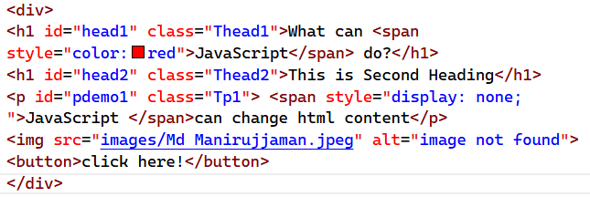
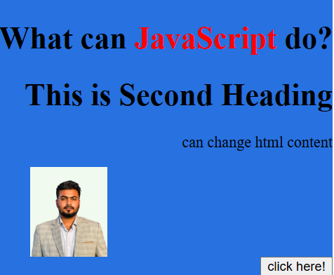
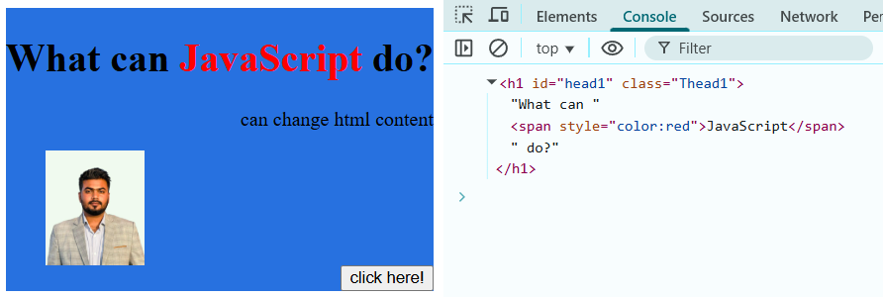
let head=document.getElementById("head1");
//let head=document.getElementsByClassName("Thead1");
//let head=document.getElementsByTagName("h1");
//let head=document.querySelector(".Thead1");
//let head=document.querySelector("#head1");
//let head=document.querySelector("h1");
console.log(head);

Slide 27
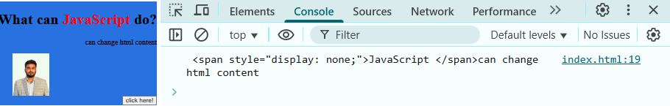
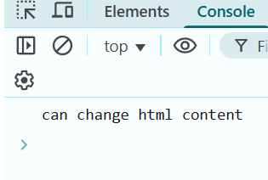
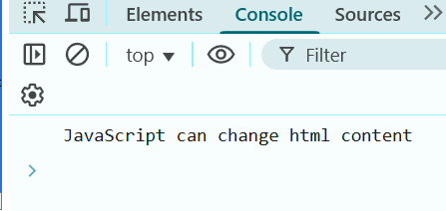
let para=document.getElementById("pdemo1");
console.log(para.innerHTML);
let para=document.getElementById("pdemo1");
console.log(para.innerText);
let para=document.getElementById("pdemo1");
console.log(para.textContent);

Slide 28
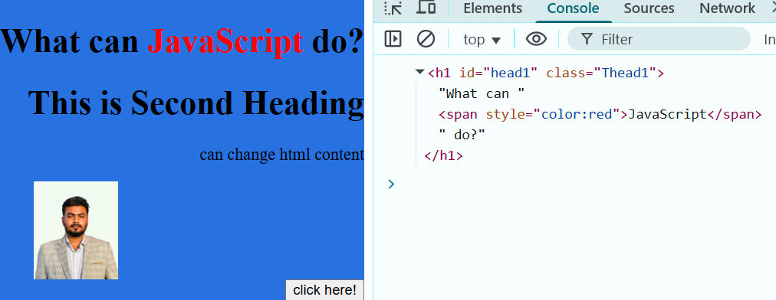
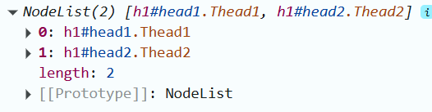
let head=document.querySelector("h1");
console.log(head);
let head=document.querySelectorAll("h1");
console.log(head);

Slide 29
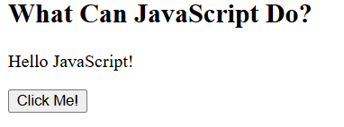
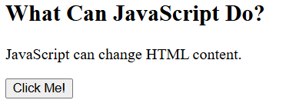
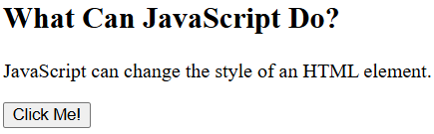
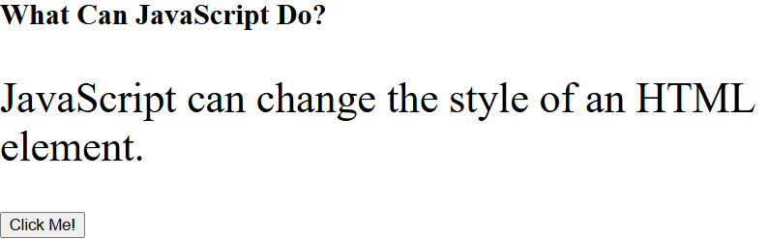
<button type="button" onclick='document.getElementById("demo").innerHTML = "Hello JavaScript!"'>Click Me!</button>
<button type="button" onclick="document.getElementById('demo').style.fontSize='35px'">Click Me!</button>

Slide 30
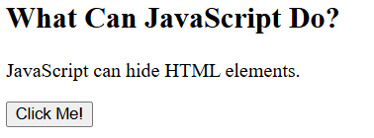
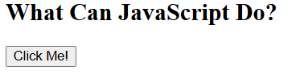
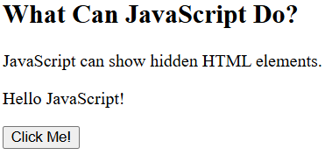
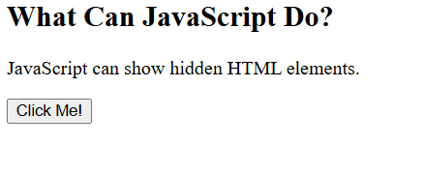
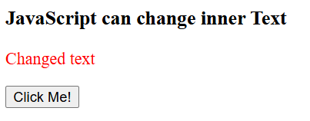
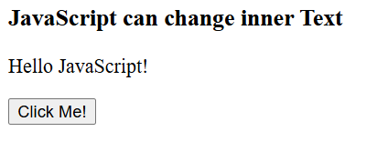
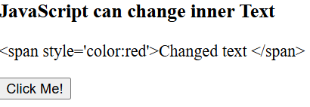
<button type="button" onclick="document.getElementById('demo').style.display='none'">Click Me!</button>
<button type="button" onclick="document.getElementById('demo').style.display='block'">Click Me!</button>
<button type="button" onclick="document.getElementById('demo').innerText='<span style=\'color:red\'>Changed text </span>'">Click Me!</button>

Slide 31
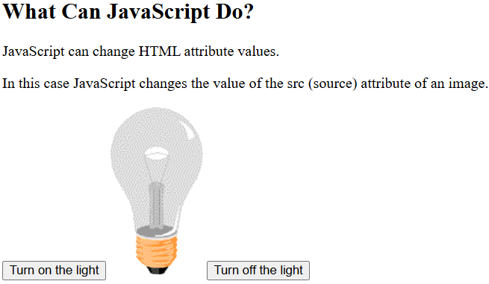
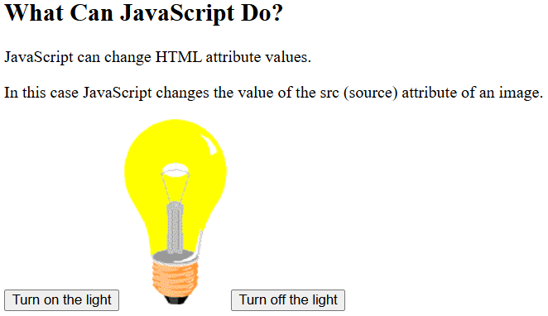
<button onclick="document.getElementById('myImage').src='images/LightOn.png'">Turn on the light</button>
<img id="myImage" src="images/imageOff.png" style="width:100px">
<button onclick="document.getElementById('myImage').src='images/imageOff.png'">Turn off the light</button>

Slide 32
Others properties of DOM
document.body: Represents the <body> element of the webpage. Everything you see (text, images, buttons) lives inside document.body.
document.head: Represents the <head> part of the document (metadata, title, scripts, links, styles).
document.forms: This is a collection of all <form> elements in the document. You can access forms by index or name.

Slide 33
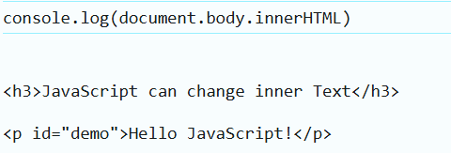
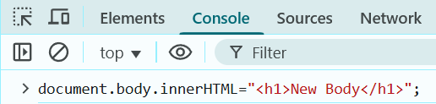

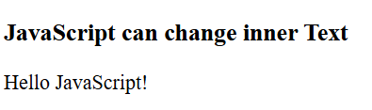
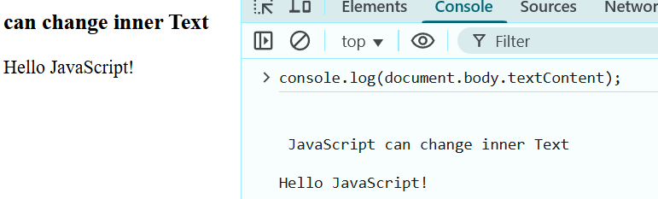
document.body
console.log(document.body.innerHTML); // prints all body content
doucment.body.innerHTML = "<h1>New Body</h1>";
.textContent Return Text Only

Slide 34
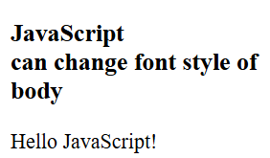
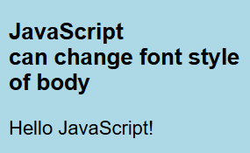
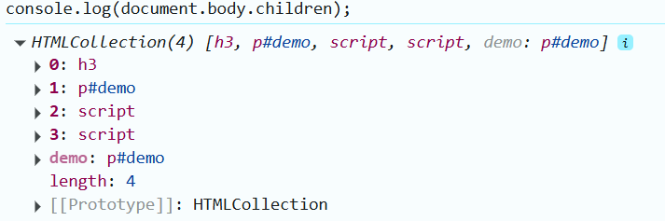
document.body
document.body.style.backgroundColor = "lightblue";
document.body.style.fontFamily = "Arial";

Slide 35
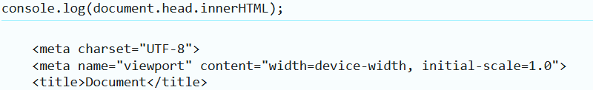
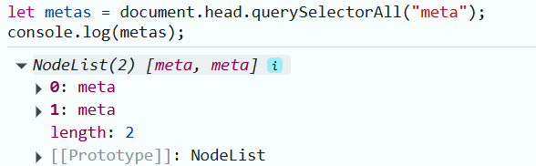
document.head
Shows or changes everything inside <head>
access <meta> tags inside the head.

Slide 36
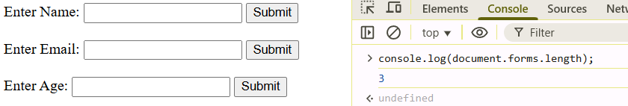
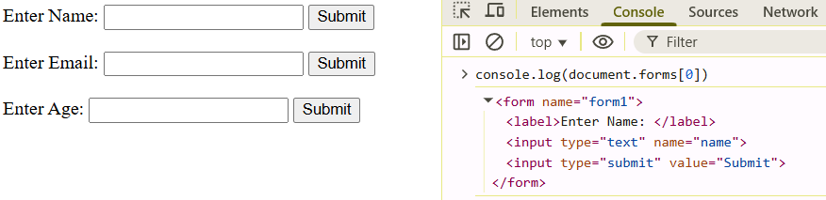
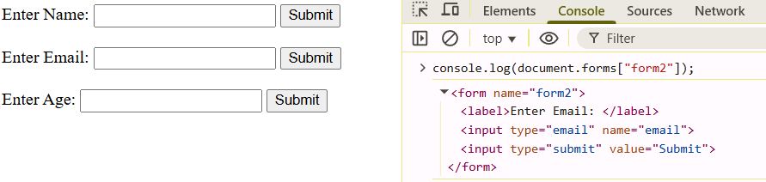
document.forms
document.forms is a collection of all <form> elements on the page.
Each form can be accessed by index or name.
.length shows the number of forms.
Accessing form by index.
Accessing form by form name

Slide 37
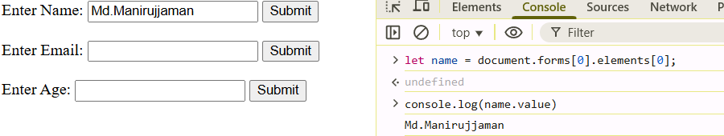
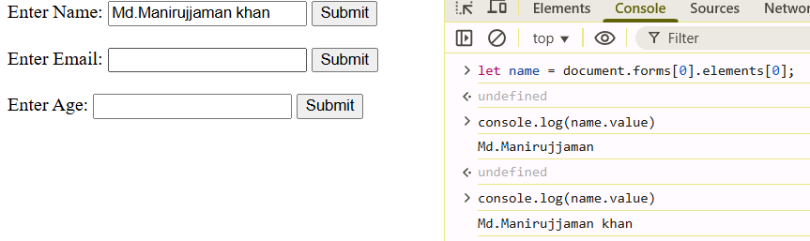
document.forms

Slide 38
Events
Events are actions or occurrences that happen in the browser.
JavaScript can be used to “listen” and “respond” to these events.
Events make a webpage interactive.
The onclick Event
The onclick event is one of the most commonly used events.
It is triggered when a user clicks on an element.
Usually applied to buttons, links, or any clickable HTML element.

Slide 39
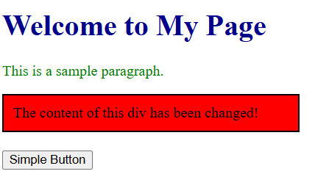
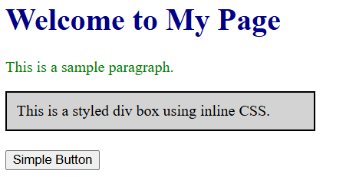
The onclick Event
<button type="button" onclick="changDiv()">Simple Button</button>
<script>
changDiv=()=>{
let divBox = document.getElementById("myDiv");
divBox.innerHTML = "The content of this div has been changed!";
divBox.style.backgroundColor = "Red";
}
</script>
The ondblclick Event
<button type="button" ondblclick="changDiv()">Simple Button</button>

Slide 40
.addEventListener
Inline event issues.
Mixes HTML structure + JavaScript behavior → looks messy.
Only one handler allowed → new one overwrites the old.
Advantages of addEventListener:
Keeps HTML clean (all JavaScript is separated).
Supports multiple handlers (all run).
Easier to maintain and more flexible.
<button type="button" id="myBtn">Simple Button</button>
<script>
changDiv=()=>{
let divBox = document.getElementById("myDiv");
divBox.innerHTML = "The content of this div has been changed!";
divBox.style.backgroundColor = "Red";
}
document.getElementById("myBtn").addEventListener("click", changDiv);
</script>

Slide 41
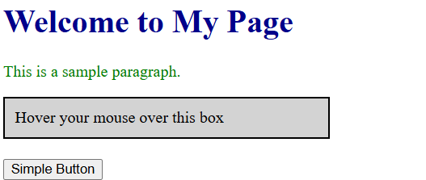
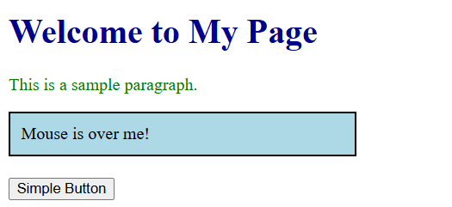
.mouseover Event
Triggered when the mouse pointer enters an element.
Commonly used to highlight or change styles on hover.
Can be applied to buttons, divs, links, etc.
.mouseout Event
Triggered when the mouse pointer leaves an element.
Often used to reset the style after mouseover.
Works together with mouseover to create hover effects.
document.getElementById("myDiv").addEventListener("mouseover", () => {
let divBox = document.getElementById("myDiv");
divBox.style.backgroundColor = "lightblue";
divBox.innerHTML = "Mouse is over me!";
});
document.getElementById("myDiv").addEventListener("mouseout", () => {
let divBox = document.getElementById("myDiv");
divBox.style.backgroundColor = "lightgray";
divBox.innerHTML = "Hover your mouse over this box";
});

Slide 42
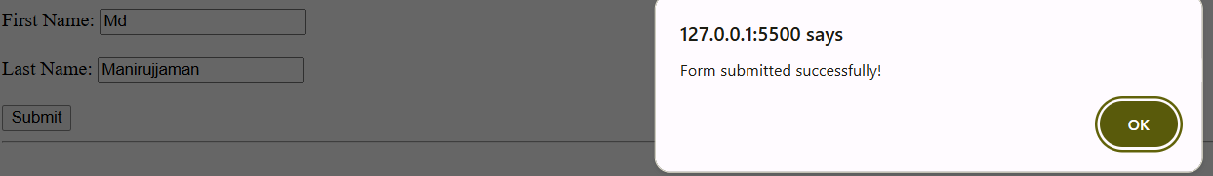
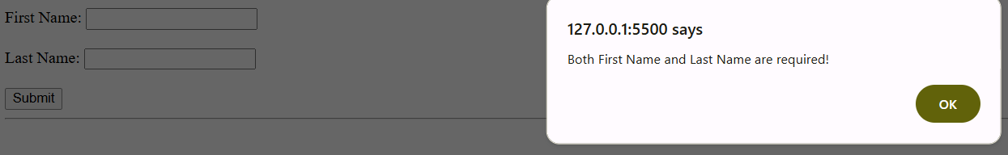
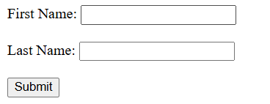
.onsubmit Event
Triggered when the form is submitted (e.g., clicking the Submit button).
Used to validate input data before sending it to the server.
If validation fails, we can use event.preventDefault() to stop the form from submitting.
document.getElementById("myForm").addEventListener("submit", (event) => {
let fname = document.forms["form1"]["fname"].value;
let lname = document.forms["form1"]["lname"].value;
if (fname === "" || lname === "") {
alert("Both First Name and Last Name are required!");
event.preventDefault(); // stops form from submitting
} else {
alert("Form submitted successfully!");
}
});

Slide 43
Other Form Events
onchange → Triggered when the value of an input changes.
onfocus → Triggered when an element gains focus.
onblur → Triggered when an element loses focus.
oninput → Triggered immediately when the user types or changes input.
Try experimenting with these yourself!
Keyboard Events
onkeydown → Triggered when a key is pressed down.
onkeyup → Triggered when a key is released.
Practice and explore these on your own!
find events related practice code in following link
https://jsbin.com/fuhuval/edit?html,output

Slide 44
Thank You

