Slide 1



Agenda

Slide 2
Math Functions & Module
·
·
·
·

Slide 3

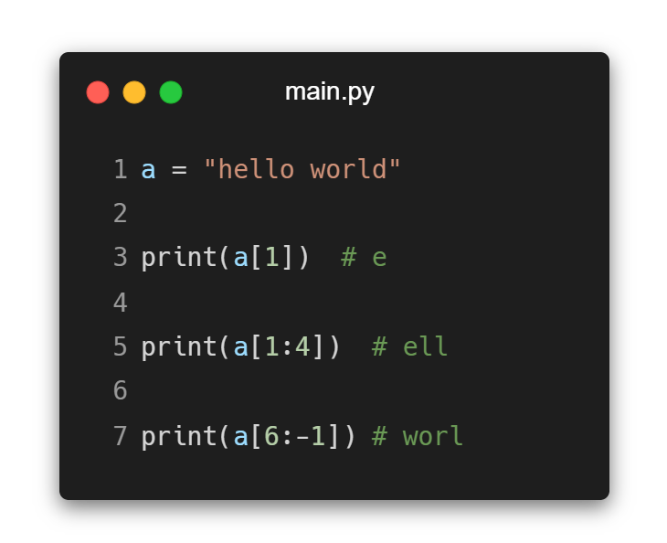




String in Python
0
1
2
3
4
H | E | L | L | O
-5 -4 -3 -2 -1
String slicing in Python is a way to get specific parts of a string by using start, end and step values.

Slide 4
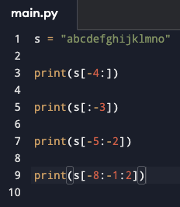
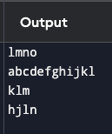
String in Python

Slide 5

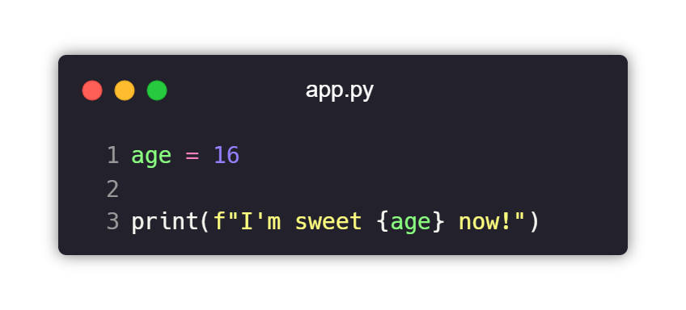



Formatted String

Slide 6
String Methods
Method | Description
.lower() | Make every character lowercase
.strip() | Removes characters
.replace(“Hi”, “Hello”) | Replaces “Hi” with “Hello”

Slide 7

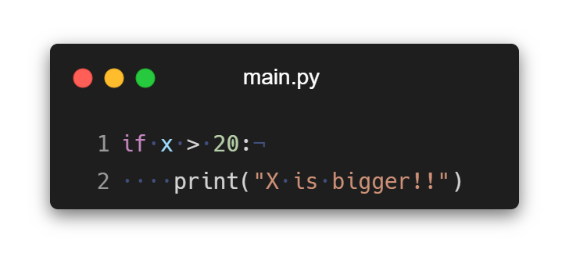
Python Indentation

Slide 8




Decision Making

Slide 9

Test
Expression
False
“ if ”
in Python
True
Body of if

Slide 10


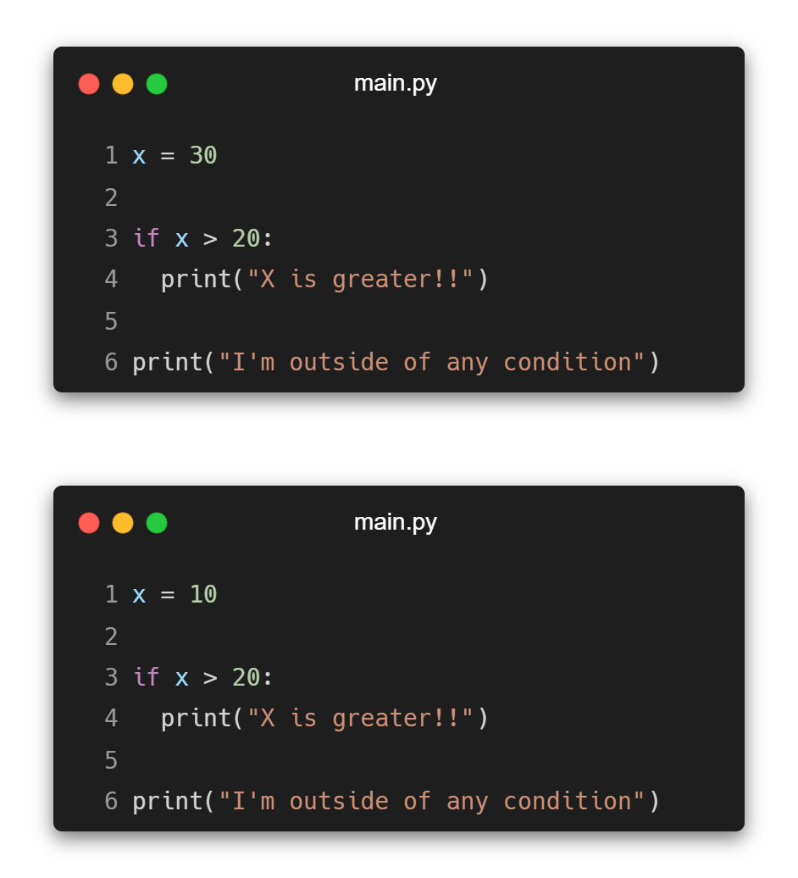
“ if ”
in Python

Slide 11

True
Test Expression
False
“ if … else ”
in Python
Body of if
Body if else

Slide 12
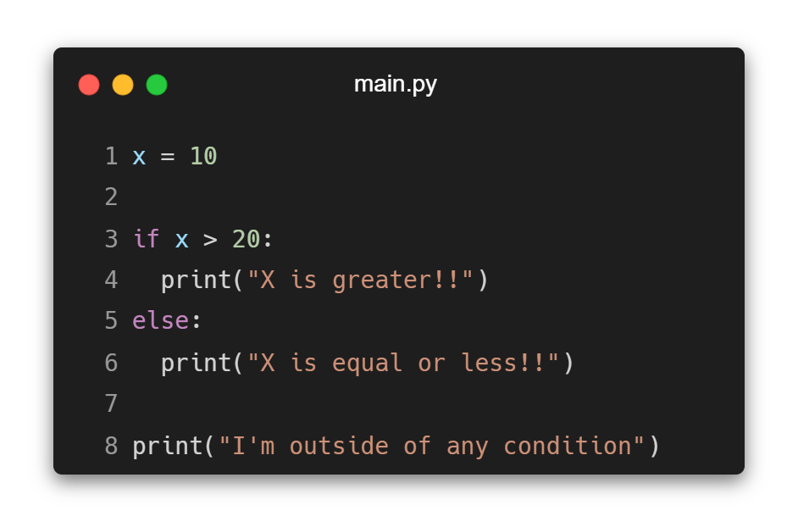
“ if … else ”
in Python

Slide 13



Test Expression 1
True
body 1
“ if … elif … else ”
in Python
False
Test Expression 2
False
True
body 2
Test Expression 3
True
body 3
False

Slide 14
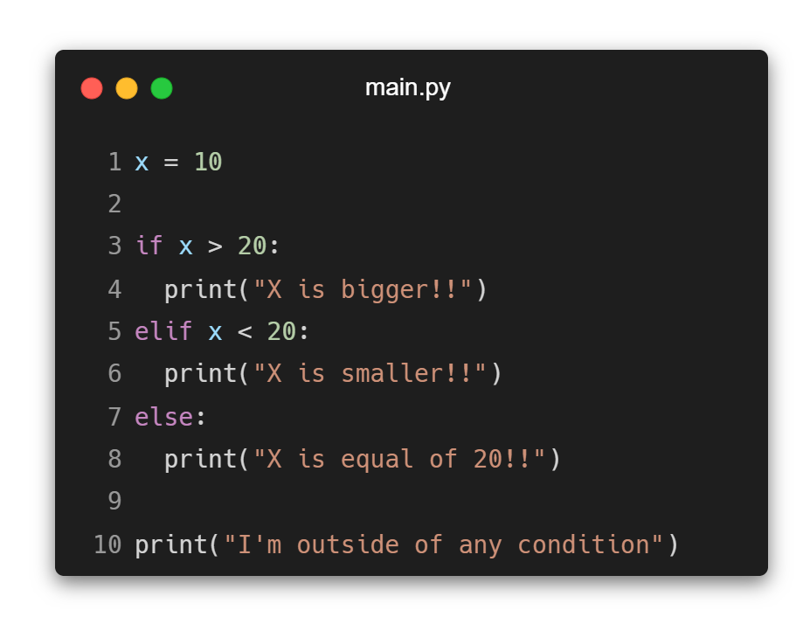
“ if … elif … else ”
in Python

Slide 15
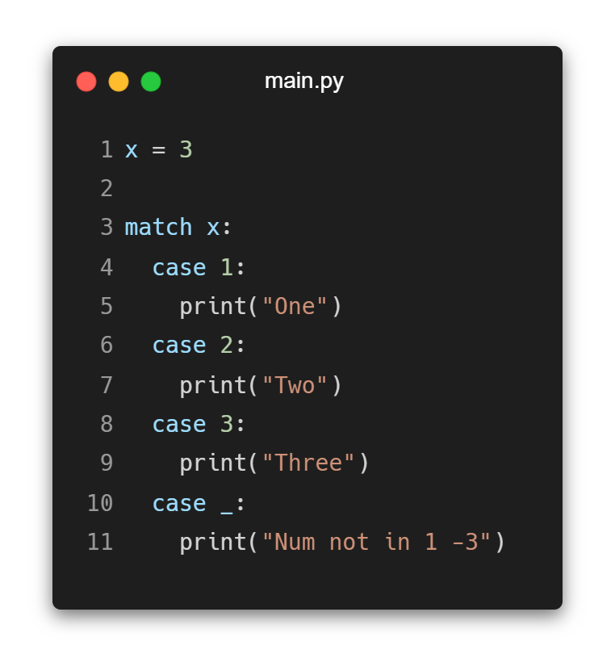
“ match … case ”
in Python

Slide 16






Looping

Slide 17
Test
Expression
False
“ while ”
in Python
True
Body of while

Slide 18
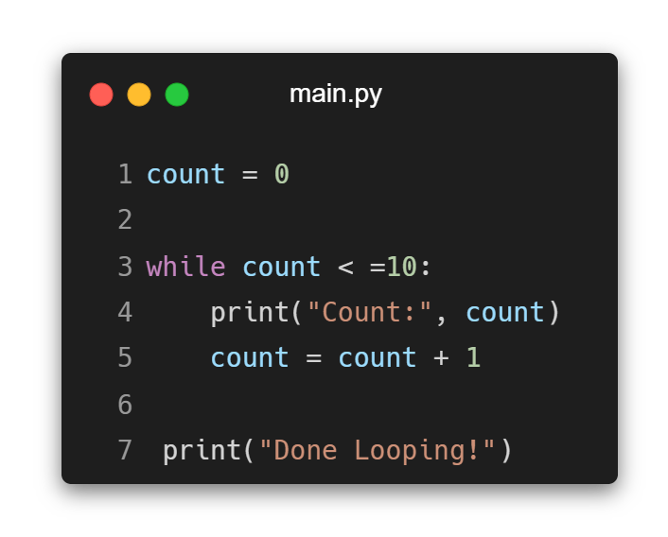
“ while ”
in Python

Slide 19
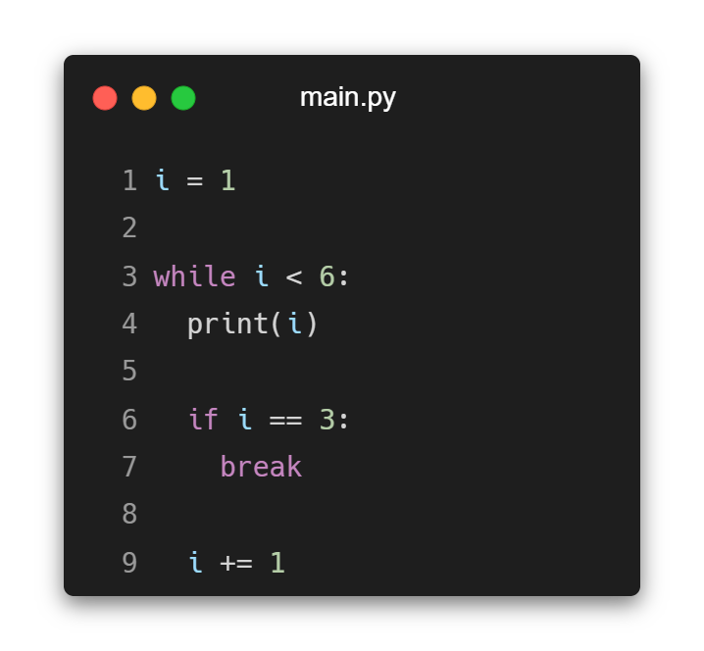
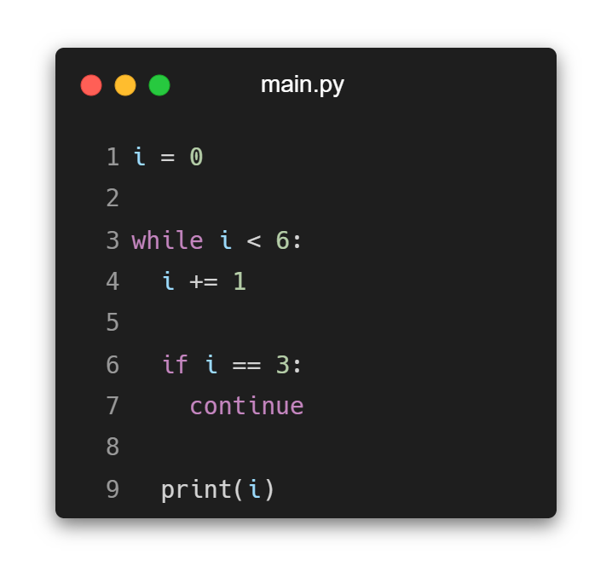
Break & Continue in Python

Slide 20
For Loop in Python

Slide 21


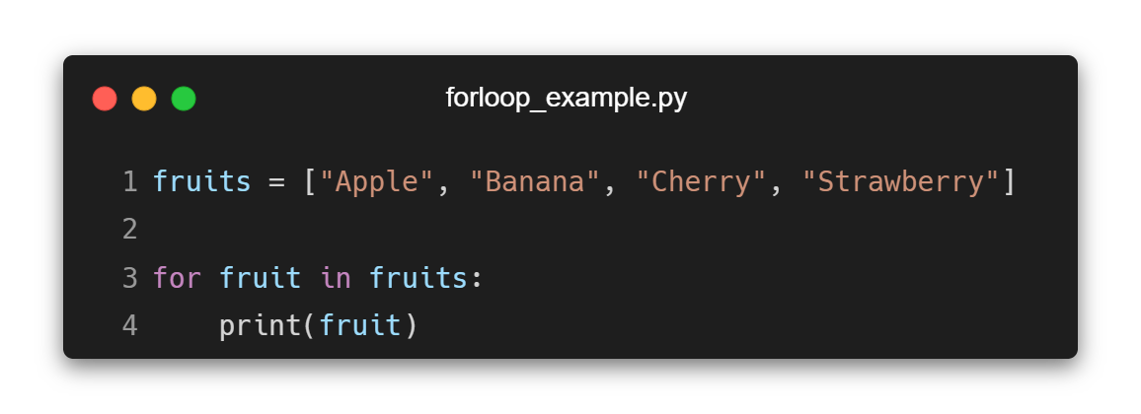
Iterating Items with For Loop
Notes:
fruits = ["Apple", "Banana", "Cherry", "Strawberry"]
for fruit in fruits:
print(fruit)
print(type(fruit))

Slide 22
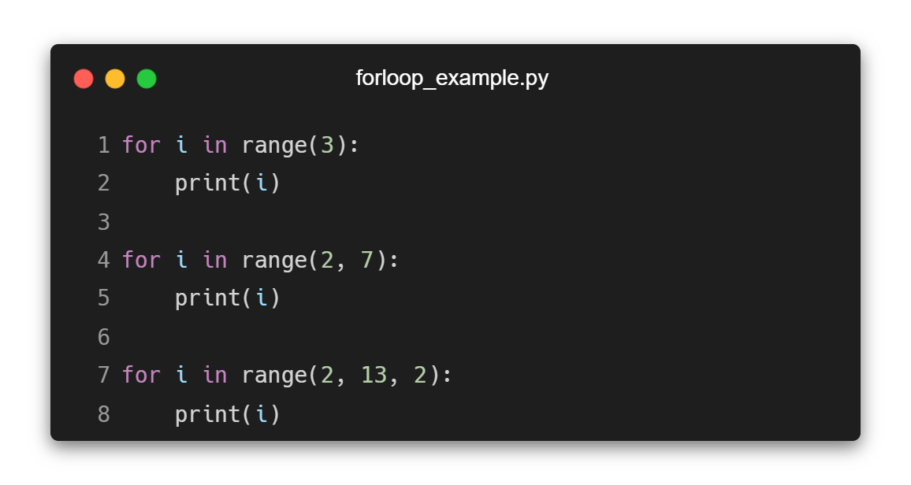
Range in For Loop
Notes:
for i in range(3):
print(i)
for i in range(2, 7):
print(i)
for i in range(2, 13, 2):
print(i)

Slide 23

Some Practice Problems in Python
·
·

Slide 24










Thank you

