Slide 1



Agenda

Slide 2




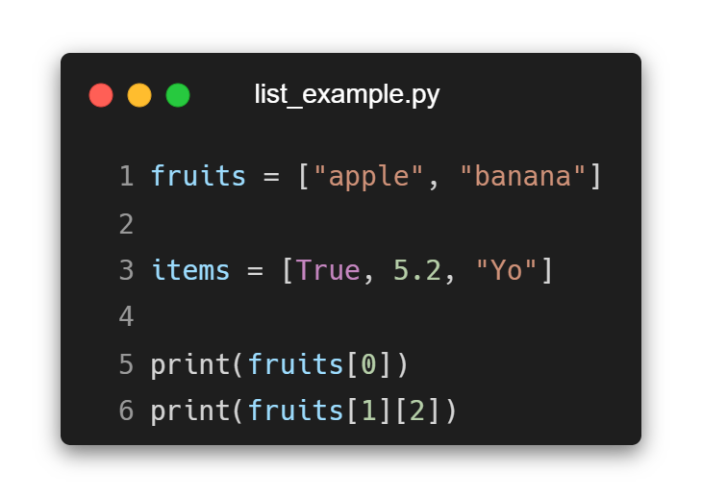



List &Tuple in Python
This means that once a tuple is created its elements cannot be changed, added or removed.
Notes:
fruits = ["apple", "banana"]
items = [True, 5.2, "Yo"]
print(fruits[0])
print(fruits[1][2])
fruits = ("apple", "banana")
items = (True, 5.2, "Yo")
print(fruits[0])
print(fruits[1][2])

Slide 3

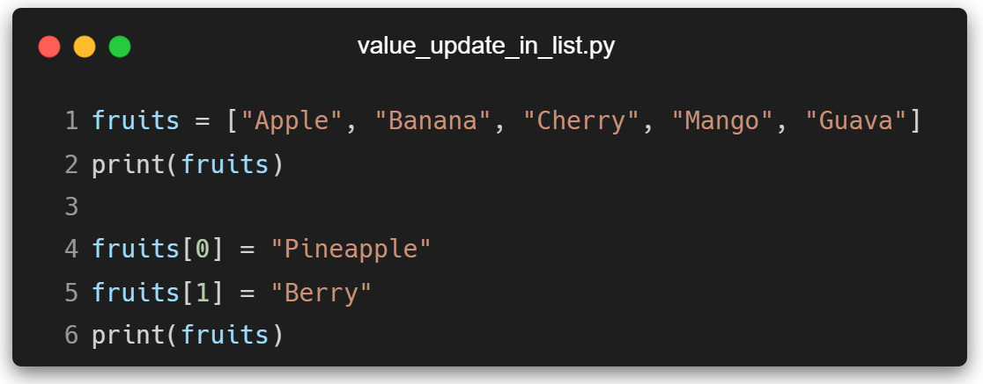


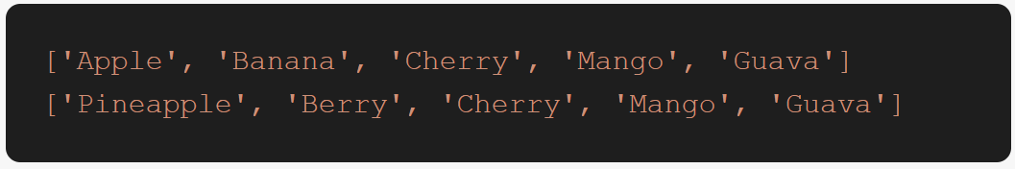
Update Value of List in Python

Slide 4
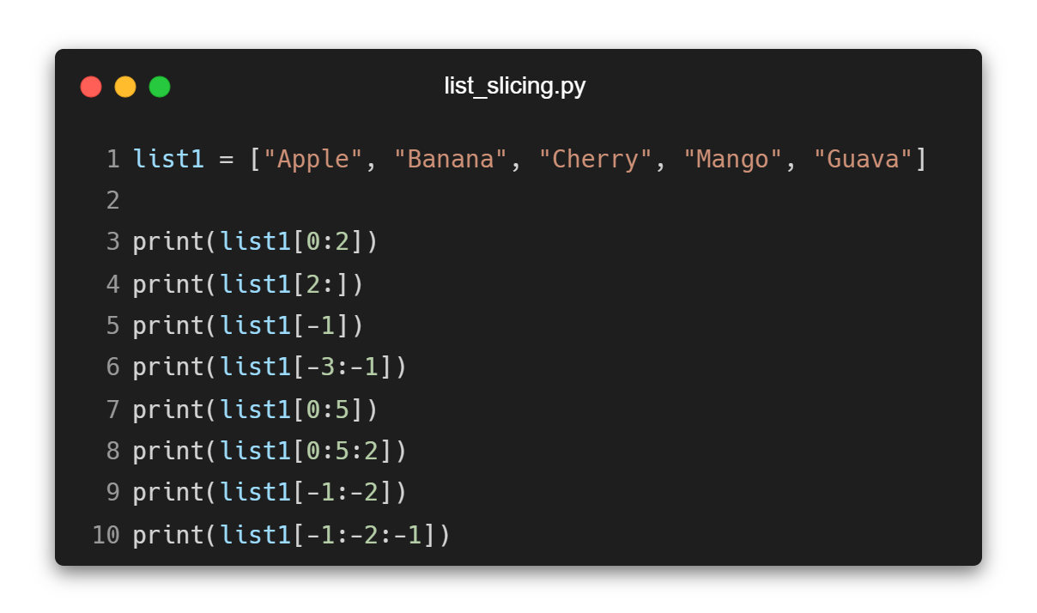

List &Tuple Slicing in Python
Notes:
list1 = ["Apple", "Banana", "Cherry", "Mango", "Guava"]
print(list1[0:2])
print(list1[2:])
print(list1[-1])
print(list1[-3:-1])
print(list1[0:5])
print(list1[0:5:2])
print(list1[-1:-2])
print(list1[-1:-2:-1])

Slide 5
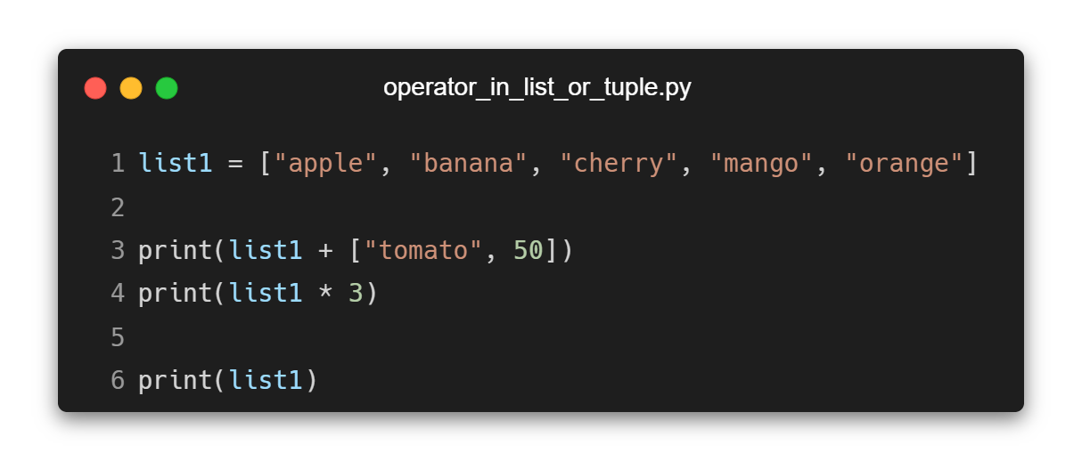
Operators on List & Tuple in Python
Notes:
list1 = ["apple", "banana", "cherry", "mango", "orange"]
print(list1 + ["tomato", 50])
print(list1 * 3)
print(list1)

Slide 6
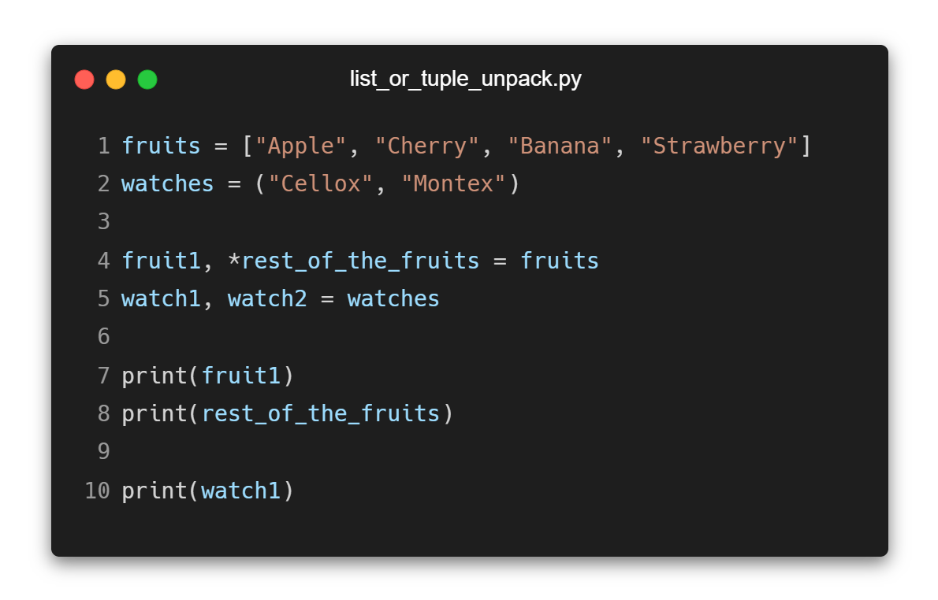
Unpacking List &Tuple in Python
The * means:
Collect the remaining items into a list
Notes:
fruits = ["Apple", "Cherry", "Banana", "Strawberry"]
watches = ("Cellox", "Montex")
fruit1, *rest_of_the_fruits = fruits
watch1, watch2 = watches
print(fruit1)
print(rest_of_the_fruits)
print(watch1)

Slide 7
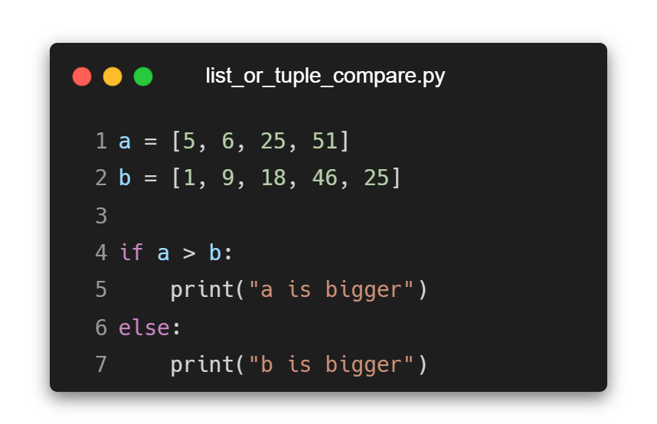
List & Tuple Compare in Python
Notes:
a = [5, 6, 25, 51]
b = [1, 9, 18, 46, 25]
if a > b:
print("a is bigger")
else:
print("b is bigger")

Slide 8
List Methods in Python
These functions modify the original list.
Method | Description | Returns
append() | Adds an element at the end of the list | None
extend() | Appends all items from another list at the end of the current list | None
insert() | Inserts an item into specified index | None
reverse() | Reverses all items in the list | None

Slide 9
List Methods in Python
These functions modify the original list.
Method | Description | Returns
pop() | Returns an item and removes it | Removed Item
remove() | Removes an item from the list | None
clear() | Removes all element from the list | None
sort() | Sorts the list | None

Slide 10
List Methods in Python
These functions don’t modify the original list.
Method | Description | Returns
index() | Finds the index of an item in the list | Index of the Item
count() | Finds the number of specified elements in the list | Number of Item

Slide 11
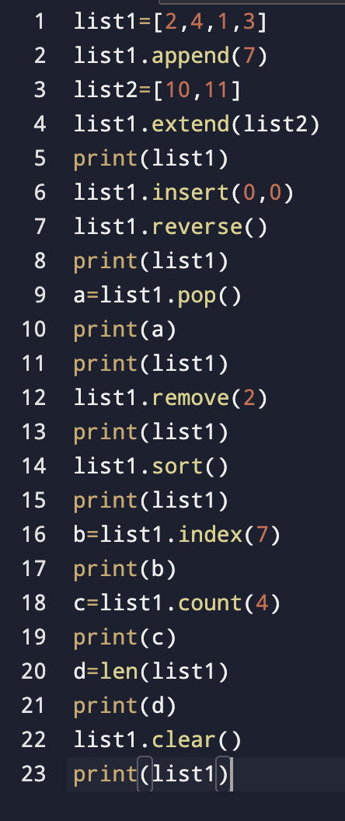
List Methods in Python
Notes:
list1 = [2, 4, 1, 3]
list1.append(7)
list2 = [10, 11]
list1.extend(list2)
print(list1)
list1.insert(0, 0)
list1.reverse()
print(list1)
a = list1.pop()
print(a)
print(list1)
list1.remove(2)
print(list1)
list1.sort()
print(list1)
b = list1.index(7)
print(b)
c = list1.count(4)
print(c)
d = len(list1)
print(d)
list1.clear()
print(list1)

Slide 12
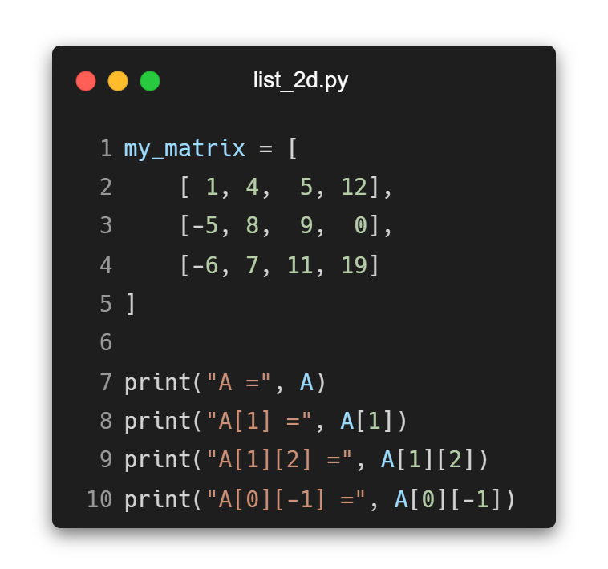
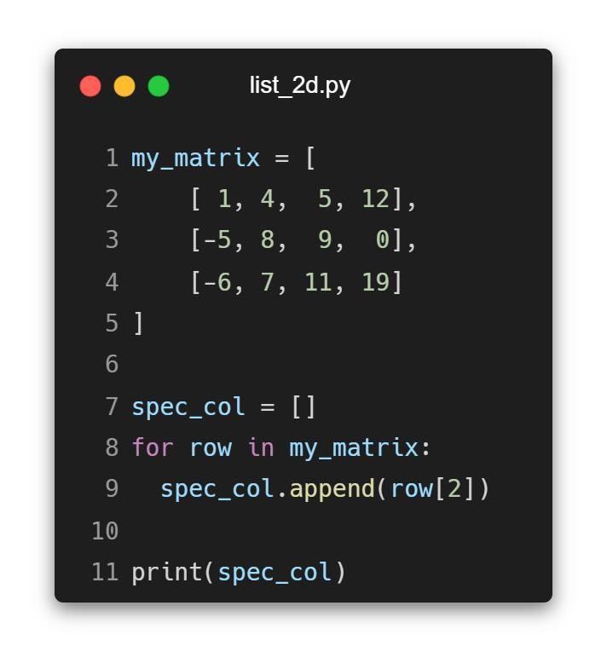
2D List (Matrix) in Python

Slide 13

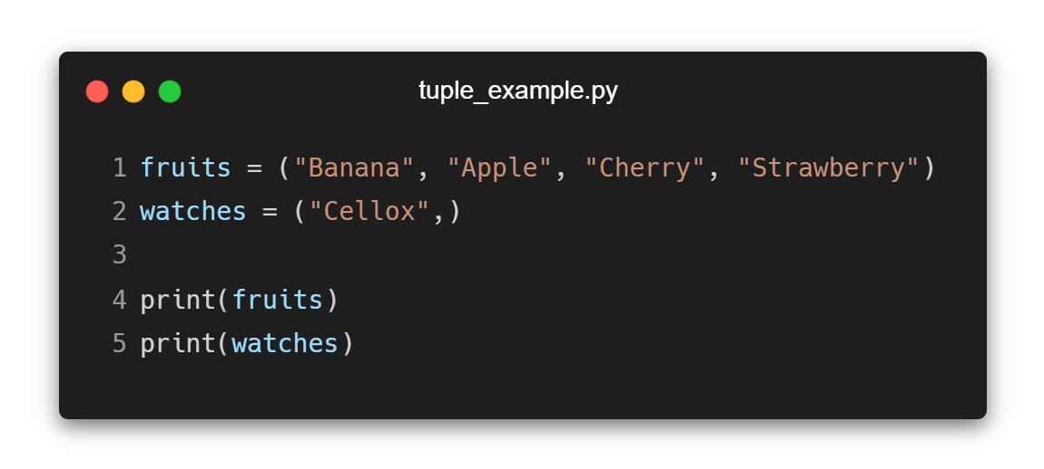
Tuples in Python

Slide 14



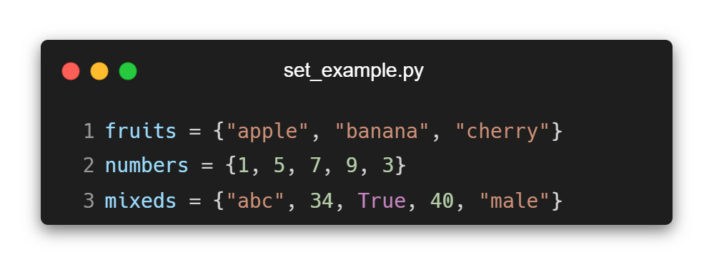
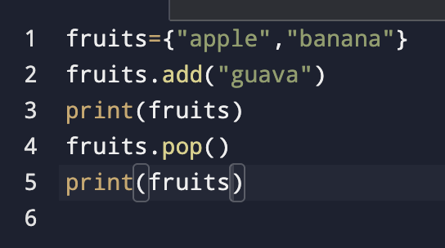
Sets in Python

Slide 15
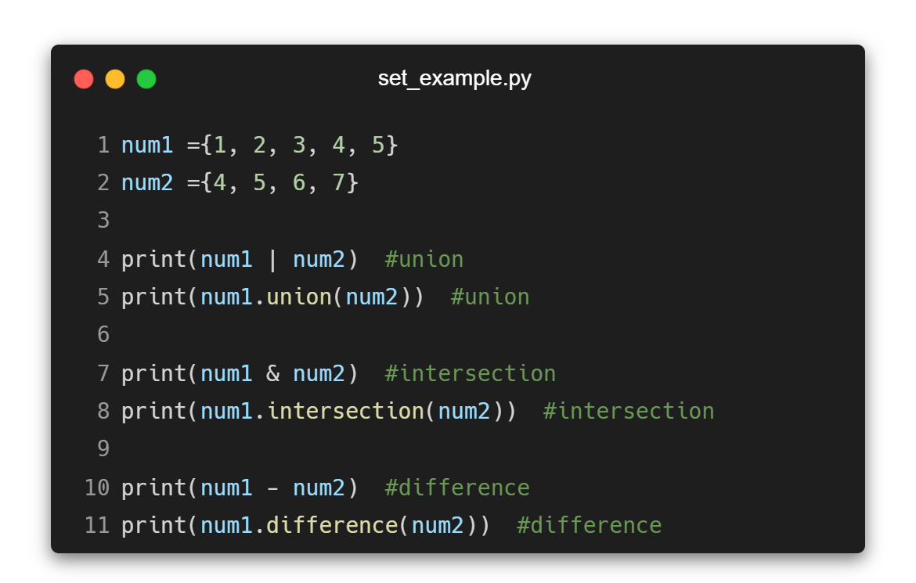
Set Operations in Python

Slide 16


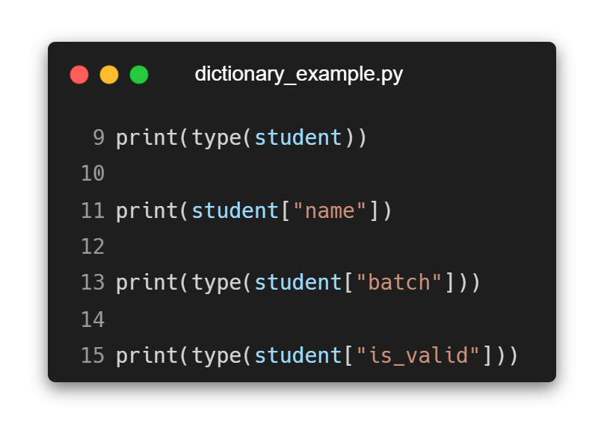
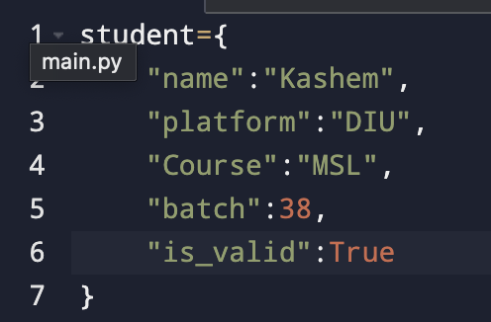
Dictionary in Python

Slide 17
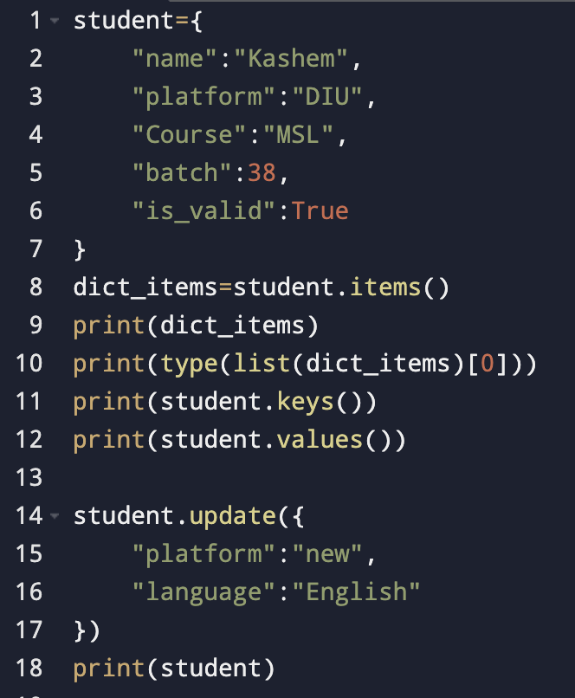
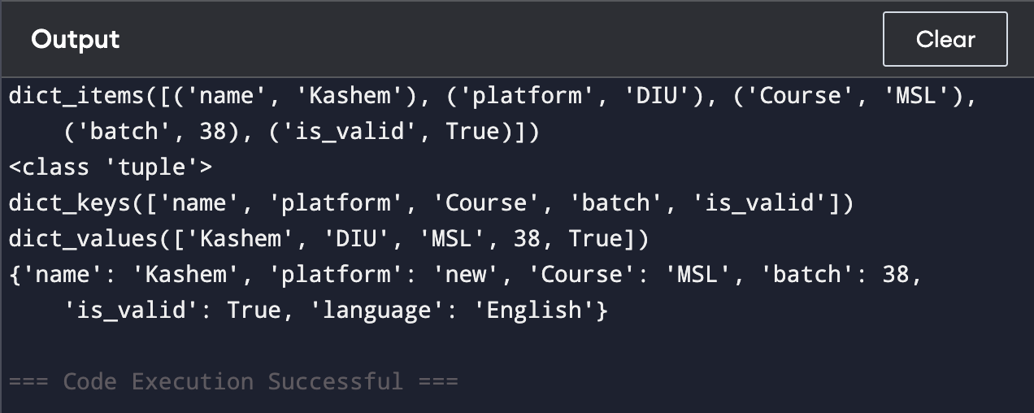
Operations in Dictionary

Slide 18
Important Notes
List is a collection which is ordered and changeable. Allows duplicate members.
Tuple is a collection which is ordered and unchangeable. Allows duplicate members.
Set is a collection which is unordered, unchangeable*, and unindexed. No duplicate members.
Dictionary is a collection which is ordered** and changeable. No duplicate members.

Slide 19






For Loop in Python

Slide 20


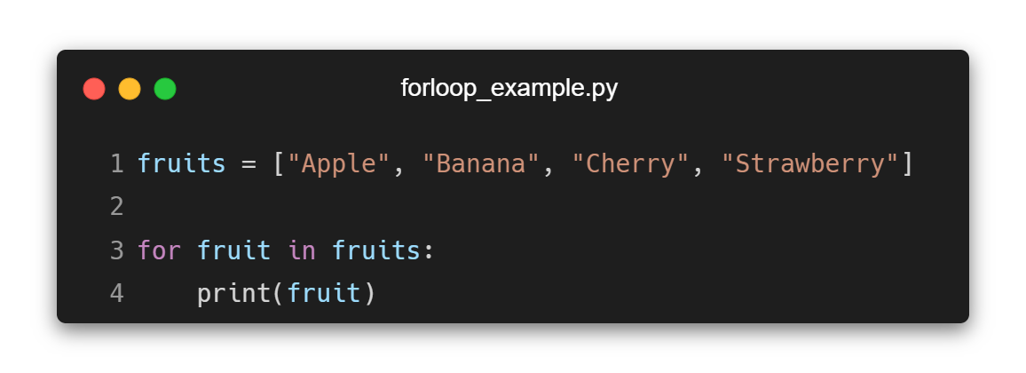
Iterating Items with For Loop

Slide 21
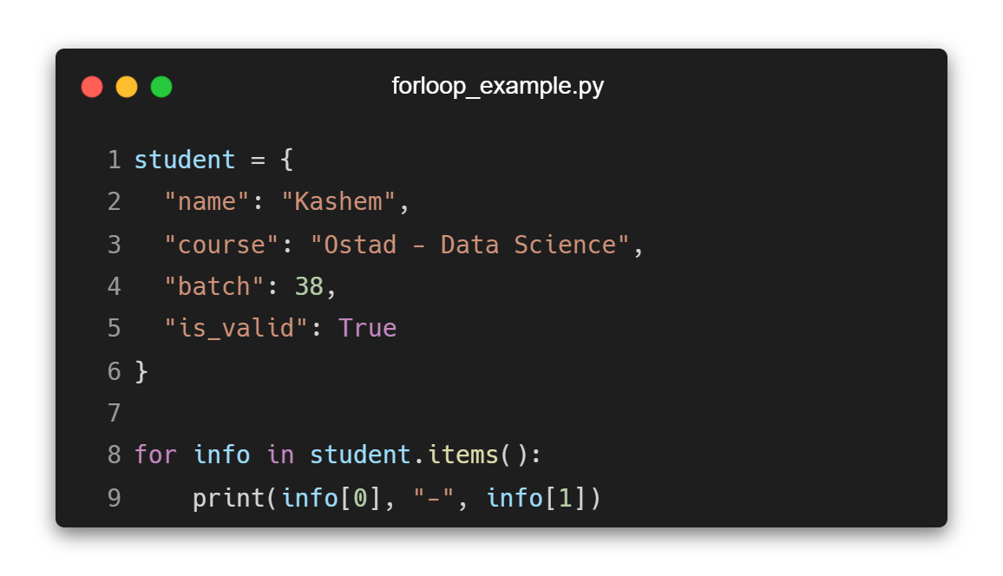
Looping in Dictionary

Slide 22
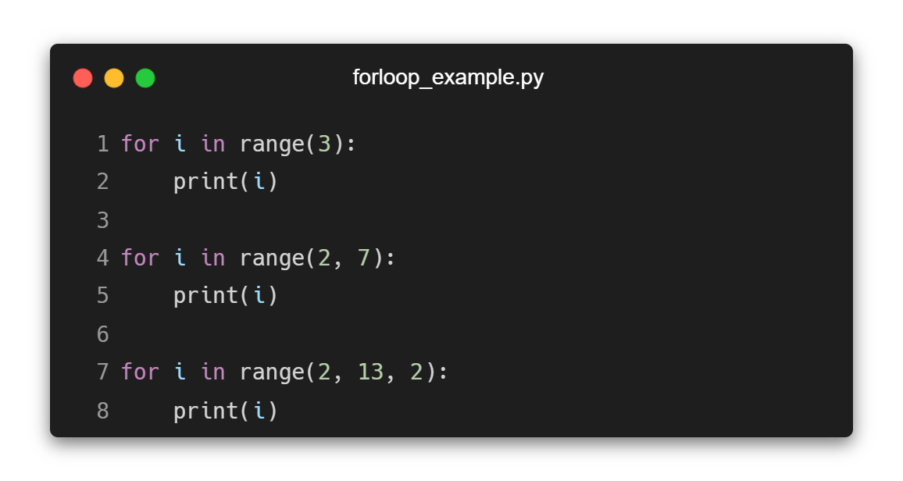
Range in For Loop

Slide 23

Some Practice Problems in Python
·
·

Slide 24





Practice Problem

Slide 25





Practice Problem

Slide 26

Thank you

