Slide 1




Agenda

Slide 2
Functions

Slide 3

Functions
A function is a block of code which only runs when it is called.
You can pass data, known as parameters, into a function.
A function can return data as a result.
1.
2.

Slide 4


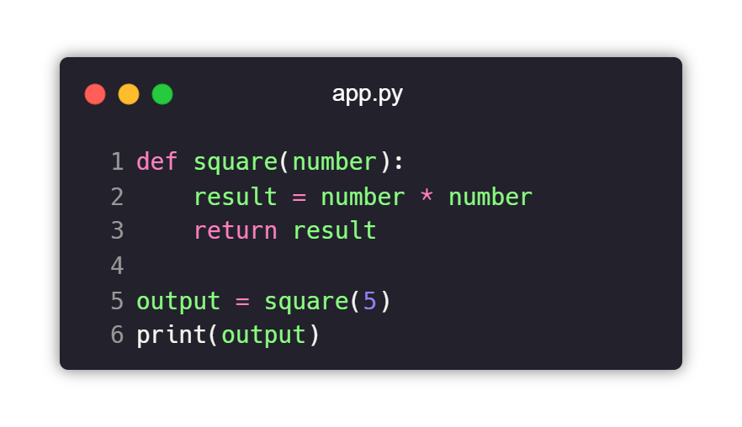


Functions
I.
II.

Slide 5








Functions
1.
2.
3.
4.
5.

Slide 6
Lambda Function

Slide 7


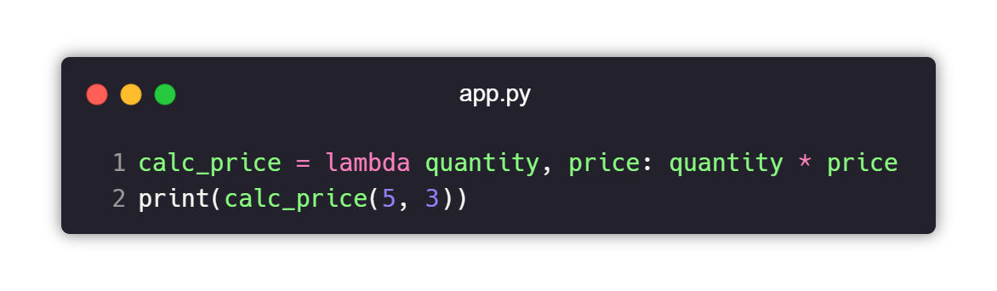
Lambda Function

Slide 8
Variable Scope

Slide 9
Iterator
The iter() function returns an iterator object.
fruits=["apple","mango","banana"]
name=iter(fruits)
print(next(name))
print(next(name))
print(next(name))

Slide 10
Generator
A generator function is a special type of function
that returns an iterator object.

Slide 11
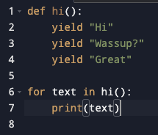
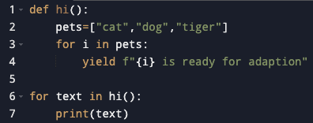

Slide 12
















Thank you

