Slide 1
Software Integration & Maintenance
Fahim Foysal Abak
Lecture, Dept. of CSE
Dhaka International University

Slide 2
Test Strategies for Conventional Software
Unit Testing
Integration Testing
Regression Testing
Smoke Testing

Slide 3
Unit Testing
Focuses testing on the function or software module
Concentrates on the internal processing logic and data structures
Is simplified when a module is designed with high cohesion
  Reduces the number of test cases
  Allows errors to be more easily predicted and uncovered
Concentrates on critical modules and those with high cyclomatic complexity when testing resources are limited
Notes:
“Focuses testing on the function or software module” means, suppose there is a function called calculateCGPA(). In unit testing, I will test only whether this function gives the correct result.
“Concentrates on the internal processing logic and data structures” means we do not only check the final output; we also check whether the internal logic works correctly. For example, conditions, loops, calculations, and temporary data should all work properly.
“High cohesion” means a module should ideally perform one specific task. For example, calculateSalary() should only calculate salary. Then the module becomes small and focused, so testing becomes easier.
high cyclomatic complexity—means a module has many if, else, loops, and decision paths, so it has more possible execution paths. Therefore, when testing resources are limited, critical and complex modules should be tested first.

Slide 4
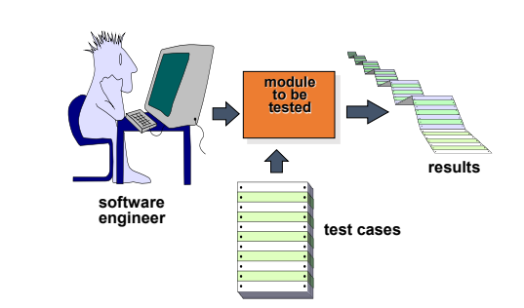
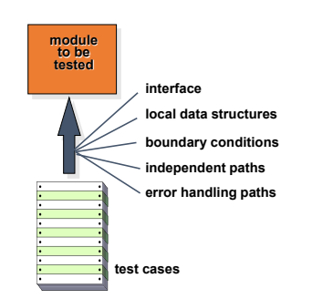
Unit Testing
Notes:
In the left diagram, the software engineer first creates test cases and then uses those test cases to test a specific module. The output produced by the module is compared with the expected result.
For the interface, we check whether the module correctly accepts the input and produces the expected output.
For local data structures, we check whether internal variables and temporary data are stored and updated correctly.
For boundary conditions, we test values at or near the limits, such as 0, 1, the full balance, and slightly more than the balance.
if amount <= balance
withdrawal successful
else
insufficient balance
For independent paths, we test each different logical path separately, such as the successful withdrawal path and the insufficient balance path.
For error handling paths, we check whether the module handles invalid input or system errors properly instead of crashing.

Slide 5
Targets for Unit Test Cases
Module interface
  Ensure that information flows properly into and out of the module.
Local data structures
  Ensure that data stored temporarily maintains its integrity during all steps in an algorithm execution.
Boundary conditions
  Ensure that the module operates properly at boundary values established to limit or restrict processing.
Independent paths (basis paths)
  Paths are exercised to ensure that all statements in a module have been executed at least once
Error handling paths
  Ensure that the algorithms respond correctly to specific error conditions

Slide 6
Cyclomatic Complexity
Code
CFG
V(G)
Unit Testing focuses on internal logic, data structures, boundary conditions, and independent paths.
Cyclomatic Complexity helps us decide which module is risky and how many independent paths should be tested.
It is most useful when a function has many if, else, loop, switch, && or || decisions.

Slide 7
Why Cyclomatic Complexity is Used
Definition
Testing use
Cyclomatic Complexity is a software metric that counts the number of linearly independent paths through a program module.
Find complex and risky modules early.
Estimate minimum basis-path test cases.
Guide white-box / structural testing.
Prioritize testing when time is limited.
Improve maintainability by detecting overly complex code.
In testing, it gives the minimum number of basis-path test cases needed to cover all independent logical paths.
Cyclomatic Complexity does not prove the software is correct.
It only tells us how many independent control paths should be tested.

Slide 8
Control Flow Graph (CFG): Basic Concepts
A Control Flow Graph shows how control moves through a program.
Node: one statement or a group of sequential statements.
Edge: possible transfer of control from one node to another.
Decision / Predicate node: a condition that creates alternative branches.
Independent path: a path that introduces at least one new edge not included in previous paths.
Start
x > 0?
T
F
A
B
End
Reading the CFG
One decision node creates two branches.
The paths are: Start → decision → A → End
and Start → decision → B → End.

Slide 9
Cyclomatic Complexity Formulas
Use any one formula that matches the information you have.
1) Graph formula
V(G) = E − N + 2P
E = number of edges, N = number of nodes
2) Decision formula
V(G) = D + 1
D = number of decision / predicate nodes
3) Region formula
V(G) = number of regions in CFG
Includes the outside region.
4) Shortcut
For most exam examples:
count if, else-if, loop, switch cases carefully;
then apply V(G)=D+1.
Result meaning: If V(G)=4, at least 4 independent paths should be tested for basis-path testing.

Slide 10
Example 1: if Statement
1
Start
int signValue(int x) {
int sign = 0;
if (x < 0)
sign = -1;
return sign;
}
2
sign=0
3
x<0?
T
Nodes: 1,2,3,4,5 → N=5
Edges: 1→2, 2→3, 3T→4, 4→5, 3F→5 → E=5
Decision points: x<0 → D=1
4
sign=-1
F
5
return
CFG
Calculation: V(G)=E−N+2 = 5−5+2 = 2 OR V(G)=D+1 = 1+1 = 2 Independent paths: P1: 1-2-3T-4-5, P2: 1-2-3F-5

Slide 11
Example 2: if-else Statement
1
Start
int max2(int a, int b) {
if (a > b)
return a;
else
return b;
}
2
a>b?
T
F
3
return a
4
return b
Nodes: 1,2,3,4,5 → N=5
Edges: 1→2, 2T→3, 2F→4, 3→5, 4→5 → E=5
Decision points: a>b → D=1
5
End
Calculation: V(G)=5−5+2=2. Meaning: the function has two independent branches. Paths: P1: 1-2T-3-5, P2: 1-2F-4-5.

Slide 12
Example 3: Nested Conditions
1
Start
int ticketPrice(int age, bool student) {
int price = 100;
if (age < 12)
price = 50;
else {
if (student)
price = 70;
}
return price;
}
2
price=100
3
age<12?
T
F
4
price=50
5
student?
T
F
6
price=70
Decision points: age<12 and student → D=2
So V(G)=D+1=3. The CFG also gives E−N+2 = 8−7+2 = 3.
7
return
Independent paths: P1: age<12 → price=50 → return.
P2: age≥12 and student=true → price=70 → return.
P3: age≥12 and student=false → return original price.

Slide 13
Example 4: Loop Structure
1
Start
int sumN(int n) {
int sum = 0;
for (int i = 1; i <= n; i++) {
sum += i;
}
return sum;
}
2
sum=0, i=1
3
i<=n?
F
6
return
T
4
sum+=i
Decision points: loop condition i<=n → D=1
Nodes N=6; Edges E=6; V(G)=6−6+2=2.
5
i++
Independent paths: P1: loop skipped when n<1. P2: loop executes at least once and comes back to the condition. More iterations do not create new independent paths; they repeat the same loop edge.

Slide 14
Example 5: Loop + if
1
Start
int countPositive(int arr[], int n) {
int count = 0;
for (int i = 0; i < n; i++) {
if (arr[i] > 0)
count++;
}
return count;
}
2
count=0
i=0
3
i<n?
F
7
return
T
4
arr[i]>0?
Decision points: for condition + if condition → D=2
V(G)=D+1=3. From the graph: N=7, E=8, so V(G)=8−7+2=3.
F
T
6
i++
5
count++
Independent paths: P1: loop skipped. P2: loop enters and arr[i]>0 true. P3: loop enters and arr[i]>0 false. These 3 tests cover the basis paths.

Slide 15
Example 6: && / || Conditions
1
Start
bool canAccess(int age, bool hasID) {
if (age >= 18 && hasID)
return true;
return false;
}
2
age>=18?
T
3
hasID?
F
Important teaching point
Basic shortcut may count the if statement as one decision.
For path/condition testing, expand age>=18 and hasID as separate condition checks.
T
F
4
return true
5
return false
6
End
Expanded CFG calculation: Decisions D=2, so V(G)=3. Independent paths: P1: age<18 → false. P2: age≥18 and hasID=true → true. P3: age≥18 and hasID=false → false.
Notes:
Example-01:
1. int x = 0;
2. int parity;
3. int count = 0;
4. while (x < 100) {
5. count++;
6. if (A[x] % 2 == 0)
7. parity = 0;
8. else
9. parity = 1;
10. switch (parity) {
11. case 0:
12. println("Even");
13. break;
14. case 1:
15. println("Odd");
16. break;
17. default:
18. println("Error");
19. }
20. x++;
21. }
22. println("Finished");
Example-02:

Slide 16
From Independent Paths to Test Cases
After calculating V(G), convert each independent path into at least one concrete test case.
Path
Condition idea
Sample input
Expected result
P1
age < 18
age=16, hasID=true
false
P2
age >= 18 and hasID=true
age=20, hasID=true
true
P3
age >= 18 and hasID=false
age=20, hasID=false
false
Do not stop at the number. The testing value comes from converting paths into real inputs.
V(G) gives a minimum for basis-path testing; boundary testing and error handling may need extra test cases.
For loops, test zero iteration, one iteration, and multiple iterations when meaningful.

Slide 17
Example: Calculate V(G)
int classify(int mark) {
if (mark < 0 || mark > 100)
return -1;
if (mark >= 80)
return 4;
else if (mark >= 50)
return 2;
return 0;
}
First condition has OR: mark < 0 OR mark > 100.
For basic class calculation, count decision statements: if, if, else-if → D=3, so V(G)=4.
For short-circuit expanded CFG, the OR condition can be split into two condition checks, so path needs may be higher.
Use this example to discuss why different tools may report different values.
Basic calculation: V(G)=D+1 = 3+1 = 4
Independent path ideas: invalid mark, A grade, pass, fail

Slide 18
Finding Cyclomatic Complexity to test case design
Start with one simple function, not formula first.
Ask students: How many different ways can control move through this code?
Draw CFG step by step: Start → statements → decisions → return/end.
Label nodes and edges clearly before applying formula.
Calculate using both methods when possible: E−N+2 and D+1.
Finally, convert independent paths into test cases.
Recommended board sequence
1
Code
2
CFG
3
N, E, D
4
V(G)
5
Independent paths
6
Test cases
Simple sentence for students:
“Cyclomatic Complexity tells us the minimum number of independent logical paths we should test.”

Slide 19
Practice Questions
Calculate V(G), list independent paths, and suggest test inputs.
int f1(int x) {
if (x > 10) x++;
return x;
}
int f2(int n) {
int s = 0;
while (n > 0) {
if (n % 2 == 0) s += n;
n--;
}
return s;
}
int f3(int a, int b) {
if (a > 0 && b > 0) return 1;
else return 0;
}
Notes:
1. int x = 10;
2. int y = 5;
3. if (x > 0) {
4. if (y > 0)
5. cout << "Both Positive";
6. else
7. cout << "Only X Positive";
8. }
9. else {
10. cout << "X Not Positive";
11. }
12. while (y < 10) {
13. if (y % 2 == 0)
14. cout << "Even";
15. y++;
16. }
17. cout << "End";

Slide 20
Common Mistakes and Corrections
Mistake 1: Counting lines of code instead of decisions.
Correction: Count branches/decision logic, not statements.
Mistake 2: Thinking V(G)=total possible inputs.
Correction: V(G) counts independent paths, not all input combinations.
Mistake 3: Ignoring loop false path.
Correction: Every loop has a path where the condition becomes false.
Mistake 4: Reporting only the number.
Correction: Also list independent paths and convert them into test cases.
Complex code is not only hard to understand; it also requires more basis-path tests.

Slide 21
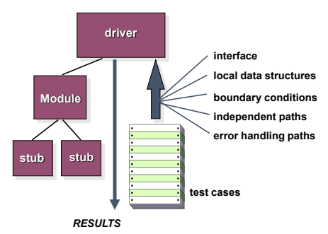
Unit Test Environment
Notes:
Suppose we have a large software system, but I do not want to test the whole software. I want to test only one Module.
The problem is that a module usually does not work completely alone. Something above it calls the module, and the module may call some lower-level functions. During unit testing, those related parts may not yet be ready.
So we use two temporary helpers:
Driver = imitates the upper-level caller
Stub = imitates the lower-level modules being called
Now suppose we are testing a placeOrder() function.
Normally, the customer interface would call placeOrder(). But if the user interface has not been developed yet, a Driver acts like the fake user interface and sends input to placeOrder().
Inside placeOrder(), it may call paymentCheck() and sendSMS(). If these functions are also not ready yet, we create Stubs that return fake responses.
So the flow becomes:
Driver → placeOrder() Module → Stubs → Result
This allows us to test one module independently even before the full system is ready.” Lecture 6

Slide 22
Drivers and Stubs for Unit Testing
Driver
  A simple main program that accepts test case data, passes such data to the component being tested, and prints the returned results
Stubs
  Serve to replace modules that are subordinate to (called by) the component to be tested
  It uses the module’s exact interface, may do minimal data manipulation, provides verification of entry, and returns control to the module undergoing testing
Drivers and stubs both represent overhead
  Both must be written but don’t constitute part of the installed software product
Notes:
Driver is a temporary main program that takes test case input, sends it to the module being tested, and displays the result.
Stub is a temporary replacement module. It is used in place of lower-level modules that are called by the tested module but are not yet ready.
Important: Both Driver and Stub are used only for testing. They are not part of the final software product. So, creating them requires extra effort—this is called overhead.

Slide 23
Integration Testing
Defined as a systematic technique for constructing the software architecture
  • At the same time integration is occurring, conduct tests to uncover errors associated with interfaces
Objective is to take unit tested modules and build a program structure based on the prescribed design
Two Approaches
  • Non-incremental Integration Testing
  • Incremental Integration Testing
Notes:
“In Unit Testing, we tested each module separately. Now the question is: each module may work correctly individually, but will they work correctly when connected together? This is where Integration Testing is used.
In Integration Testing, we connect unit-tested modules according to the software design and check whether data and control flow correctly from one module to another. Even if individual modules work correctly, errors may exist in their interfaces or communication.
For example, consider a Food Delivery System:
Order Module → Payment Module → Notification Module
All three modules may pass unit testing. However, when connected, the Order Module may send data in a format that the Payment Module does not expect. This is an interface error, which Integration Testing is designed to detect.
There are two approaches:
Non-incremental Integration Testing
Incremental Integration Testing.”

Slide 24
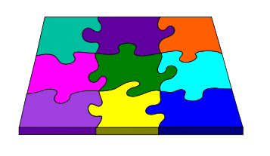
Integration Testing Strategies
Options:
• the “big bang” approach
• an incremental construction strategy
Notes:
1. Big Bang Approach
All modules are completed first and then integrated and tested together at once.
Example:
Login + Cart + Payment + Order + Notification are all connected and tested together.
The problem is that if an error occurs, it becomes difficult to identify which module or interface caused the problem.
2. Incremental Construction Strategy
Instead of integrating all modules at once, modules are added and tested step by step.
Example:
First test Login + Cart,
then add Payment,
then Order,
then Notification.
This makes it easier to identify which newly added module caused the error.”

Slide 25
Incremental Integration Testing
Three kinds
  • Top-down integration
  • Bottom-up integration
  • Sandwich integration
• The program is constructed and tested in small increments
• Errors are easier to isolate and correct
• Interfaces are more likely to be tested completely
• A systematic test approach is applied
Notes:
Top-down Integration
Testing starts from the top and moves downward.
First Main Menu
then Cart
then Payment
finally Bank API
If the Payment module is not ready, a temporary stub can be used.
Real idea:
Test the main control first, then add lower-level services gradually.
Bottom-up Integration
Testing starts from the bottom and moves upward.
First Bank API
then Payment
then Cart
finally Main Menu
If the upper-level module is not ready, a temporary driver can be used.
Real idea:
Test low-level services first, then gradually connect upper modules.
Sandwich Integration
Testing starts from both directions.
From the top: Main Menu → Cart
From the bottom: Bank API → Payment
Finally, connect them in the middle

Slide 26
Top-down Integration
Top-Down Integration
Modules are integrated by moving downward through the control hierarchy, beginning with the main module.
Subordinate modules are incorporated in either a depth-first or breadth-first fashion:
  DF (Depth-First): All modules on a major control path are integrated.
  BF (Breadth-First): All modules directly subordinate at each level are integrated.
Advantages
This approach verifies major control or decision points early in the test process.
Disadvantages
Stubs need to be created to substitute for modules that have not been built or tested yet; this code is later discarded.
Because stubs are used to replace lower-level modules, no significant data flow can occur until much later in the integration/testing process.
Notes:
Main System
/ | \
Student Accounts Library
/ \ / \ / \
Admission Result Fee Payroll Book Search
/ \ | / \
Form Verify Payment Issue Return

Slide 27
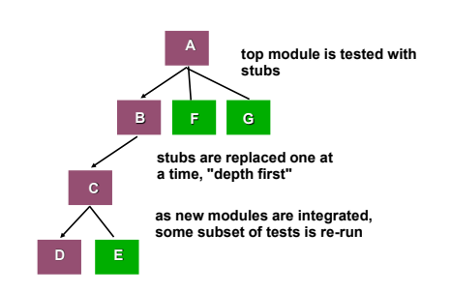
Top-down Integration

Slide 28
Bottom-up Integration
Integration and testing start with the most atomic (lowest-level) modules in the control hierarchy.
Advantages
This approach verifies low-level data processing early in the testing process.
The need for stubs is eliminated.
Disadvantages
Driver modules need to be built to test the lower-level modules; this code is later discarded or expanded into a full-featured version.
Drivers do not contain the complete algorithms that will eventually use the services of the lower-level modules; therefore, testing may be incomplete or additional testing may be required later when upper-level modules become available.
Notes:
“Bottom-up Integration starts testing from the lowest-level modules and gradually moves upward.
Suppose we have:
Main System
|
Cart
|
Payment
|
Bank API
In bottom-up integration, we test:
Bank API → Payment → Cart → Main System
Advantage
Low-level data processing is tested early.
For example, we can verify early whether the Bank API returns the correct response.
No stub is needed, because testing starts from the real lower-level modules.
Disadvantage
The upper-level modules, such as Payment or Cart, may not yet be ready.
Therefore, a temporary Driver is needed to test the lower-level module.
For example, if the Payment module is not ready, a Driver can act like Payment and call the Bank API.
However, the Driver does not contain the complete logic of the real upper-level module. So testing may be incomplete, and additional testing may be required later.”

Slide 29
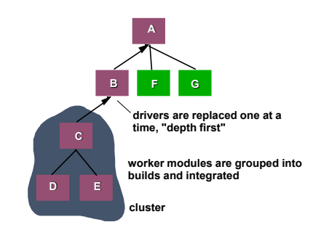
Bottom-up Integration

Slide 30
Sandwich Integration
Combines both top-down and bottom-up
integration approaches
Applied to both high-level and low-level modules
Uses functional groups of modules, completing one group before moving to the next
Groups are based on control and data processing for specific program features
Integration within a group alternates between high-level and low-level modules
Once a functional group is complete, testing moves to the next group
Gains advantages of both top-down and bottom-up while minimizing drivers and stubs
Requires a disciplined approach to avoid a “big bang” scenario

Slide 31
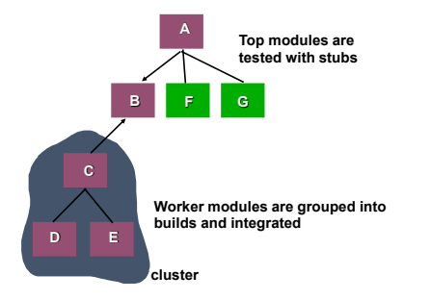
Sandwich Testing

Slide 32
Regression Testing
Definition: Re-execution of selected tests to ensure changes do not introduce unintended side effects
Purpose: Ensures that corrections or changes in software, documentation, or supporting data do not create new errors
Execution:
  Can be conducted manually by re-running a subset of test cases
  Can use automated capture/playback tools for efficiency

Slide 33
Smoke Testing
Daily Builds: A common approach to assemble product software regularly
Smoke Testing Steps:
  Integrate translated software components into a build
  Build includes all data files, libraries, reusable modules, and engineered components needed for product functions
  Conduct tests designed to expose errors that prevent the build from functioning correctly
  Focus on uncovering “show stopper” errors that could delay the project
  Integrated builds are smoke tested daily as part of the full product
  Integration can follow top-down or bottom-up approach
Notes:
Suppose a software company combines the developers’ new code every day and creates a new build. This build contains the major modules, libraries, data files, and reusable components.
Before starting detailed testing, the team first checks:
Does the application open?
Does login work?
Does the main dashboard load?
Do the critical features run?
Does the system crash immediately?
This quick basic check is called Smoke Testing.
1. Integrate translated software components into a build
The code or modules developed by different developers are compiled and combined into one build.
Example: Login, Cart, Payment, and Database modules are combined into a new e-commerce build.
2. Build includes all data files, libraries, reusable modules, and engineered components
A build must include not only source code but also the libraries, data files, reusable modules, and supporting components required to run the software.
3. Conduct tests designed to expose errors that prevent the build from functioning correctly
Quick tests are performed to check whether the basic functions of the build work correctly.
Example: Does the app open? Does login work? Does the database connect?
4. Focus on uncovering “show-stopper” errors
Smoke testing mainly looks for critical errors, not small UI problems.
Example: The app does not launch, login is completely broken, or the database is unavailable.
5. Integrated builds are smoke tested daily
Each new daily build is smoke tested again to detect whether recent code changes have broken the system.
6. Integration can follow top-down or bottom-up approach
The modules may be integrated using either top-down or bottom-up integration, and the resulting build can still be smoke tested.

Slide 34
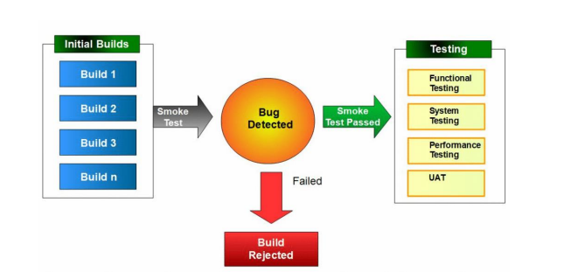
Smoke Testing
Notes:
Build 1, Build 2, Build 3 ... Build n represent successive runnable versions of the same software project over time.
Example:
Build 1 → Login + Search
Build 2 → Login + Search + Cart fix
Build 3 → Login + Search + Cart + Payment update
Each new build contains the previous working software plus new stable changes or fixes. Build n simply means any later build number.
The left side shows the initial builds—Build 1, Build 2, Build 3, and so on. These are different regular or daily software builds.
Each build first goes through a Smoke Test.
Then there are two possibilities:
If a critical bug is found → Smoke Test Failed → Build Rejected
If no major problem is found → Smoke Test Passed
If the build passes the smoke test, it moves to detailed testing such as:
Functional Testing
System Testing
Performance Testing
UAT
So, Smoke Testing works like a gatekeeper.
It first checks whether the build is basically stable before allowing detailed testing.

Slide 35
Benefits of Smoke Testing
Minimizes integration risk by catching issues early
Early detection of incompatibilities and show-stopper errors reduces schedule impact
Improves overall product quality
Uncovers errors at functional, architectural, and component levels
Simplifies error diagnosis and correction
Likely to reveal errors in the newest integrated components
Easier progress assessment as more software is integrated and verified
Managers gain visibility into project advancement
Notes:
1. Minimizes integration risk
Serious problems are detected early after new modules are integrated.
2. Reduces schedule impact
Finding show-stopper errors early prevents major delays later in the project.
3. Improves product quality
Regularly checking each build prevents serious defects from remaining unnoticed.
4. Finds errors at different levels
Smoke testing can reveal serious functional, architectural, and component-level problems.
5. Easier error diagnosis
If a recent build fails, developers can focus on the latest changes.
6. Finds errors in newest components
Newly integrated components are more likely to contain the latest problems.
7. Easier progress assessment
Successful builds help the team measure how much of the software has been integrated and verified.
8. Managers get project visibility
Managers can see whether the project is progressing normally or repeatedly facing build failures.

Slide 36
Test Strategies for Object-Oriented Software
With object-oriented software, you can no longer test a single operation in isolation (conventional thinking)
Traditional top-down or bottom-up integration testing has little meaning
Class testing for object-oriented software is the equivalent of unit testing for conventional software
Focuses on operations encapsulated by the class and the state behavior of the class
Notes:
The main idea of this slide is that in object-oriented software, testing cannot always focus on a single operation in isolation, because methods and the state of a class are closely related.
Suppose we have a BankAccount class with:
deposit()
withdraw()
checkBalance()
Testing only the withdraw() method is not always enough because its behavior depends on the current state of the object, such as the account balance.
Example:
Initial balance = 1000
withdraw(500) → balance becomes 500
withdraw(700) → insufficient balance condition occurs
So, we must test both the operations and the changing state of the class.
Object-oriented system-এ classes অনেক সময় inheritance, composition, collaboration দিয়ে connected থাকে। তাই শুধু hierarchy ধরে top-down বা bottom-up integration সবসময় natural না।

Slide 37
Test Strategies for Object-Oriented Software
Drivers can be used
• To test operations at the lowest level and for testing whole groups of classes
• To replace the user interface so that tests of system functionality can be conducted prior to implementation of the actual interface
Stubs can be used
• In situations in which collaboration between classes is required but one or more of the collaborating classes has not yet been fully implemented

Slide 38
Test Strategies for Object-Oriented Software
Two different object-oriented testing strategies
Thread-based testing
• Integrates the set of classes required to respond to one input or event for the system
• Each thread is integrated and tested individually
• Regression testing is applied to ensure that no side effects occur
Use-based testing
• First tests the independent classes that use very few, if any, server classes
• Then the next layer of classes, called dependent classes, are integrated
• This sequence of testing layer of dependent classes continues until the entire system is constructed
Notes:
1. Thread-based testing
In this approach, all classes required to respond to a single event or user action are integrated and tested together.
Example: In a food delivery app, when a user clicks “Place Order”, the system may use:
OrderClass → PaymentClass → RestaurantClass → NotificationClass
This complete chain is tested as one thread.
Another event, such as Cancel Order (Cancel Order → OrderClass → RefundClass → NotificationClass) , forms another thread and is tested separately.
After testing individual threads, regression testing is used to ensure that adding or changing one thread does not break previously working threads.
Use-Based testing
In this approach, the system first tests independent classes that depend on very few other classes.
Example:
In an e-commerce system:
Product
PriceCalculator
Inventory
Cart
Order
Product and PriceCalculator are tested first.
Then dependent classes are added:
Cart depends on Product + PriceCalculator
Then:
Order depends on Cart + Inventory
This continues layer by layer until the full system is constructed.

Slide 39
Alpha and Beta Testing
Alpha testing
• Conducted at the developer’s site by end users
• Software is used in a natural setting with developers watching intently
• Testing is conducted in a controlled environment
The software is almost ready, but it has not yet been released to the public.
The company invites selected end users to use the app at the developer’s site or in a controlled test environment.
Users perform real tasks such as:
Login
Balance checking
Money transfer
Bill payment
The developers observe:
where users become confused
where errors occur
which buttons do not work
which parts of the workflow are difficult

Slide 40
Alpha and Beta Testing
Beta testing
• Conducted at end-user sites
• Developer is generally not present
• It serves as a live application of the software in an environment that cannot be controlled by the developer
• The end-user records all problems that are encountered and reports these to the developers at regular intervals
• After beta testing is complete, software engineers make software modifications and prepare for release of the software product to the entire customer base
Notes:
After alpha testing, the software is given to selected real users in their own real environment.
The developer is usually not present.
Example:
The Mobile Banking App is given to 500 selected customers.
They use it on:
different Android phones
different network speeds
different locations
different usage patterns
This may reveal problems that were not found in the developer’s controlled environment.
For example:
payment timeout on a slow network
app crash on a specific phone model
notifications not working on some devices
Users report these problems. Developers then make final changes and prepare the software for full release.

Slide 41
Recovery testing
• Tests for recovery from system faults
• Forces the software to fail in a variety of ways and verifies that recovery is properly performed
• Tests re-initialization, check pointing mechanisms, data recovery, and restart for correctness
Example: Force a banking server to crash during a transaction and check whether the system restarts correctly and restores the transaction data.
Security testing
• Verifies that protection mechanisms built into a system will, in fact, protect it from improper access.
Example: Try logging into an admin account with an unauthorized user and check whether the system blocks the access.

Slide 42
Stress testing
• Executes a system in a manner that demands resources in abnormal quantity, frequency, or volume.
Example: Send 100,000 users to an e-commerce website at the same time and check whether the system crashes or stays stable.
Performance testing
• Tests the run-time performance of software within the context of an integrated system
• Often coupled with stress testing and usually requires both hardware and software instrumentation
• Can uncover situations that lead to degradation and possible system failure
Notes:
Performance Testing checks how fast, stable, and efficient the software is while it is running.
It mainly measures:
response time
number of users the system can handle
CPU and memory usage
whether the system becomes slow as the load increases
Standard example
Suppose 10,000 users use an online banking app at the same time to log in and check their balances.
Performance testing measures:
whether login responds within 2 seconds
whether the balance page loads quickly
whether CPU and memory usage remain acceptable
whether the system becomes slow or crashes

Slide 43
Characteristics of Testable Software
Operable
– The better it works (i.e., better quality), the easier it is to test
• Observable
– Incorrect output is easily identified; internal errors are automatically detected
• Controllable
– The states and variables of the software can be controlled directly by the tester
• Decomposable
– The software is built from independent modules that can be tested independently

Slide 44
Characteristics of Testable Software
Simple
– The program should exhibit functional, structural, and code simplicity
• Stable
– Changes to the software during testing are infrequent and do not invalidate existing tests
• Understandable
– The architectural design is well understood; documentation is available and organized

Slide 45
Test Characteristics
• A good test has a high probability of finding an error
  – The tester must understand the software and how it might fail
• A good test is not redundant
  – Testing time is limited; one test should not serve the same purpose as another test
• A good test should be “best of breed”
  – Tests that have the highest likelihood of uncovering a whole class of errors should be used
• A good test should be neither too simple nor too complex
  – Each test should be executed separately; combining a series of tests could cause side effects and mask certain errors

Slide 46
Test Case Design
Bugs lurk in corners and congregate at boundaries.
- Boris Beizer
OBJECTIVE
  to uncover errors
CRITERIA
  in a complete manner
CONSTRAINT
  with a minimum of effort and time

Slide 47
Thank You.

