Slide 1
PETSc Tutorial
Numerical Software Libraries for
the Scalable Solution of PDEs
Satish Balay, Kris Buschelman, Bill Gropp,
Dinesh Kaushik, Matt Knepley,
Lois Curfman McInnes, Barry Smith, Hong Zhang
Mathematics and Computer Science Division
Argonne National Laboratory
http://www.mcs.anl.gov/petsc
Intended for use with version 2.1.3 of PETSc

Slide 2
Tutorial Objectives
Introduce the Portable, Extensible Toolkit for Scientific Computation (PETSc)
Demonstrate how to write a complete parallel implicit PDE solver using PETSc
Introduce PETSc interfaces to other software packages
Explain how to learn more about PETSc

Slide 3
The Role of PETSc
Developing parallel, non-trivial PDE solvers that deliver high performance is still difficult and requires months (or even years) of concentrated effort.
PETSc is a toolkit that can ease these difficulties and reduce the development time, but it is not a black-box PDE solver nor a silver bullet.

Slide 4
What is PETSc?
A freely available and supported research code
  Available via http://www.mcs.anl.gov/petsc
  Free for everyone, including industrial users
  Hyperlinked documentation and manual pages for all routines
  Many tutorial-style examples
  Support via email: petsc-maint@mcs.anl.gov
  Usable from Fortran 77/90, C, and C++
Portable to any parallel system supporting MPI, including
  Tightly coupled systems
    Cray T3E, SGI Origin, IBM SP, HP 9000, Sun Enterprise
  Loosely coupled systems, e.g., networks of workstations
    Compaq, HP, IBM, SGI, Sun
    PCs running Linux or Windows
PETSc history
  Begun in September 1991
  Now: over 8,500 downloads since 1995 (versions 2.0 and 2.1)
PETSc funding and support
  Department of Energy: MICS Program, DOE2000, SciDAC
  National Science Foundation, Multidisciplinary Challenge Program, CISE

Slide 5








The PETSc Team
Satish
Balay
Matt
Knepley
Lois
Curfman
McInnes
Kris
Buschelman
Bill
Gropp
Barry
Smith
Dinesh
Kaushik
Hong
Zhang

Slide 6
PETSc Concepts
How to specify the mathematics of the problem
  Data objects
    vectors, matrices
How to solve the problem
  Solvers
    linear, nonlinear, and time stepping (ODE) solvers
Parallel computing complications
  Parallel data layout
    structured and unstructured meshes

Slide 7
Tutorial Topics (short course)
8:30-8:50
Lois
Getting started
  motivating examples
  programming paradigm
Data objects
  vectors (e.g., field
  variables)
  matrices (e.g., sparse Jacobians)
Viewers
  object information
  visualization
Solvers
  Linear
Profiling and performance tuning
10:20-10:45
Lois
Solvers (cont.)
  nonlinear
  timestepping (and ODEs)
Data layout and ghost values
  structured and unstructured mesh problems
Putting it all together
  a complete example
Debugging and error handling
New features
Using PETSc with other software packages
8:50-9:20
Satish
10:45-11:45
Satish
Demo
Demo
9:20-10:00
Lois
11:45-12:10
Lois
Demo
Break

Slide 8
Tutorial Topics (Long Course)
Getting started
  motivating examples
  programming paradigm
Data objects
  vectors (e.g., field
  variables)
  matrices (e.g., sparse Jacobians)
Viewers
  object information
  visualization
Solvers
  Linear
Profiling and performance tuning
Solvers (cont.)
  nonlinear
  timestepping (and ODEs)
Data layout and ghost values
  structured and unstructured mesh problems
Putting it all together
  a complete example
Debugging and error handling
New features
Using PETSc with other software packages

Slide 9
Tutorial Topics:
Using PETSc with Other Packages
Linear solvers
  AMG http://www.mgnet.org/mgnet-codes-gmd.html
  BlockSolve95 http://www.mcs.anl.gov/BlockSolve95
  ILUTP http://www.cs.umn.edu/~saad/
  LUSOL http://www.sbsi-sol-optimize.com
  SPAI http://www.sam.math.ethz.ch/~grote/spai
  SuperLU http://www.nersc.gov/~xiaoye/SuperLU
Optimization software
  TAO http://www.mcs.anl.gov/tao
  Veltisto http://www.cs.nyu.edu/~biros/veltisto
Mesh and discretization tools
  Overture http://www.llnl.gov/CASC/Overture
  SAMRAI http://www.llnl.gov/CASC/SAMRAI
  SUMAA3d http://www.mcs.anl.gov/sumaa3d
ODE solvers
  PVODE http://www.llnl.gov/CASC/PVODE
Others
  Matlab http://www.mathworks.com
  ParMETIS http://www.cs.umn.edu/~karypis/metis/parmetis

Slide 10
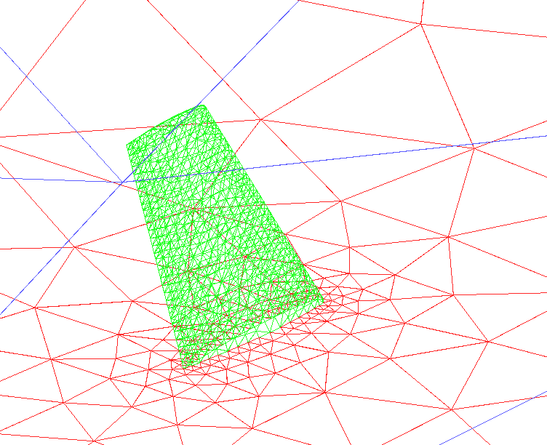
CFD on an Unstructured Mesh
3D incompressible Euler
Tetrahedral grid
Up to 11 million unknowns
Based on a legacy NASA code, FUN3d, developed by W. K. Anderson
Fully implicit steady-state
Primary PETSc tools: nonlinear solvers (SNES) and vector scatters (VecScatter)
Results courtesy of Dinesh Kaushik and David Keyes, Old Dominion Univ., partially funded by NSF and ASCI level 2 grant

Slide 11
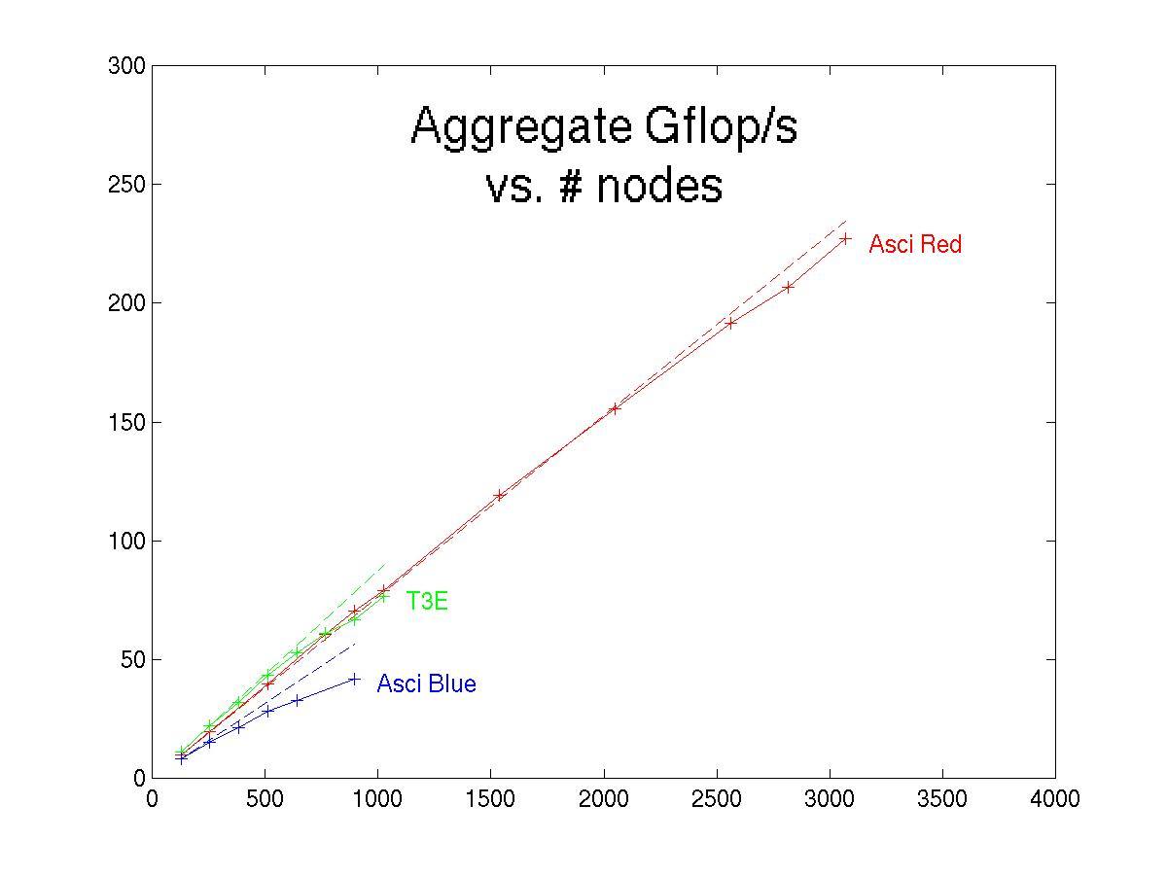
Fixed-size Parallel Scaling Results (GFlop/s)
Dimension=11,047,096

Slide 12
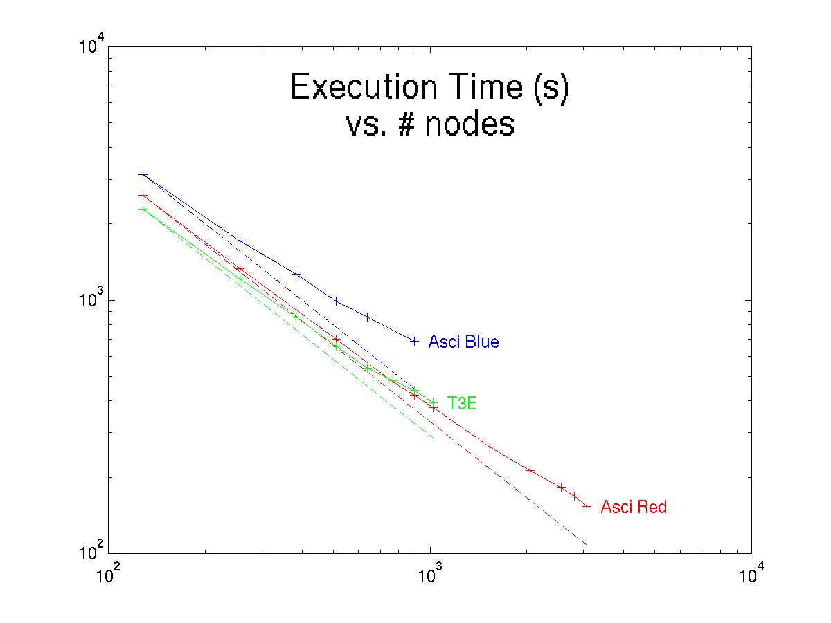
Fixed-size Parallel Scaling Results
(Time in seconds)

Slide 13
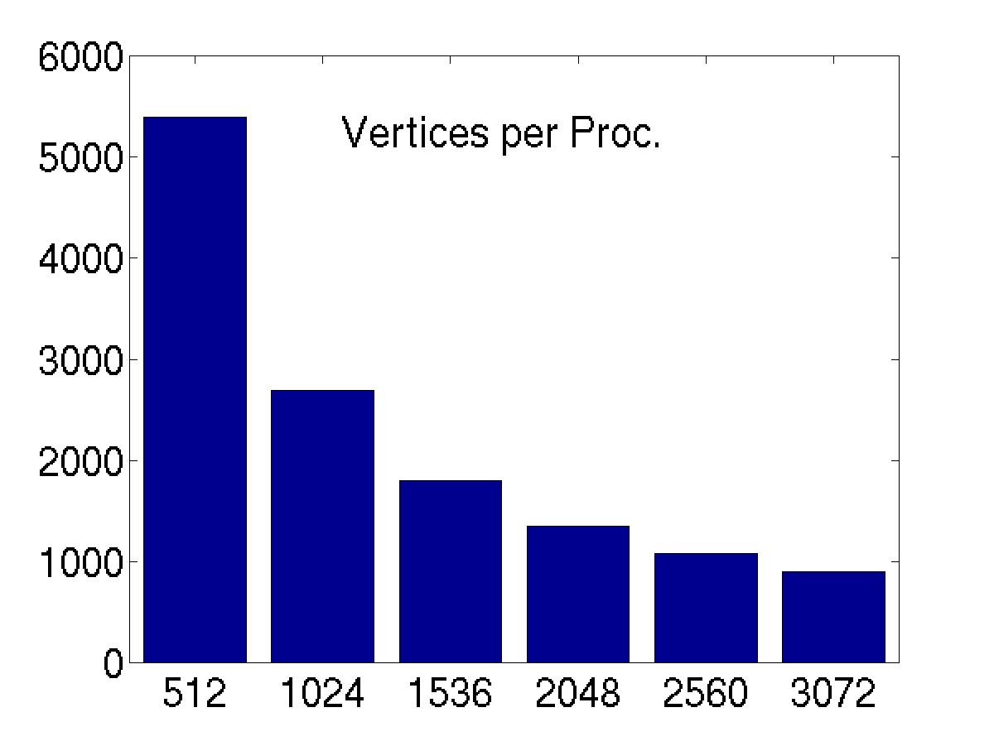
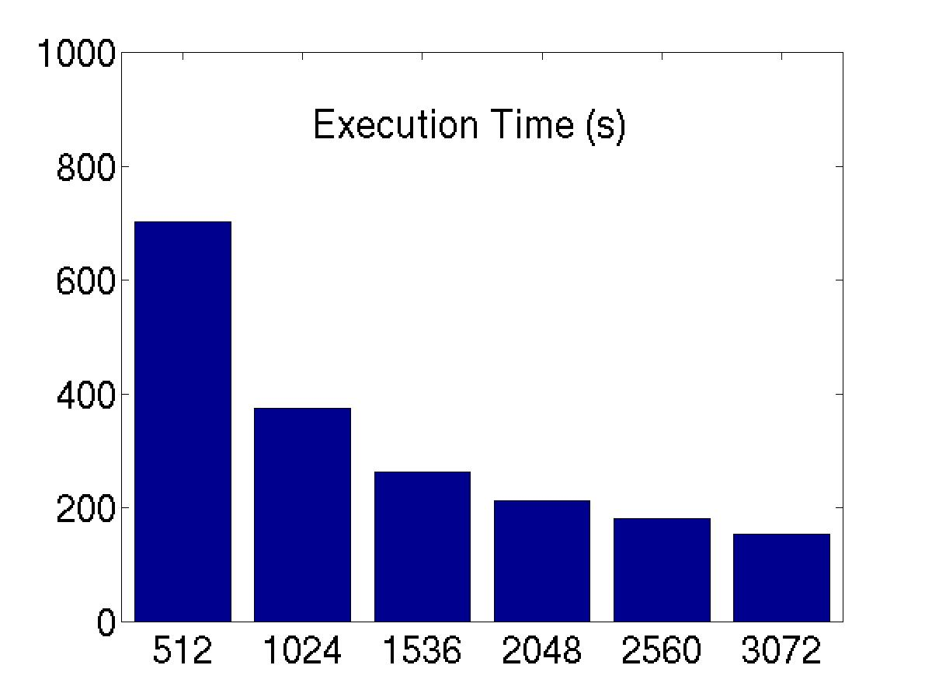
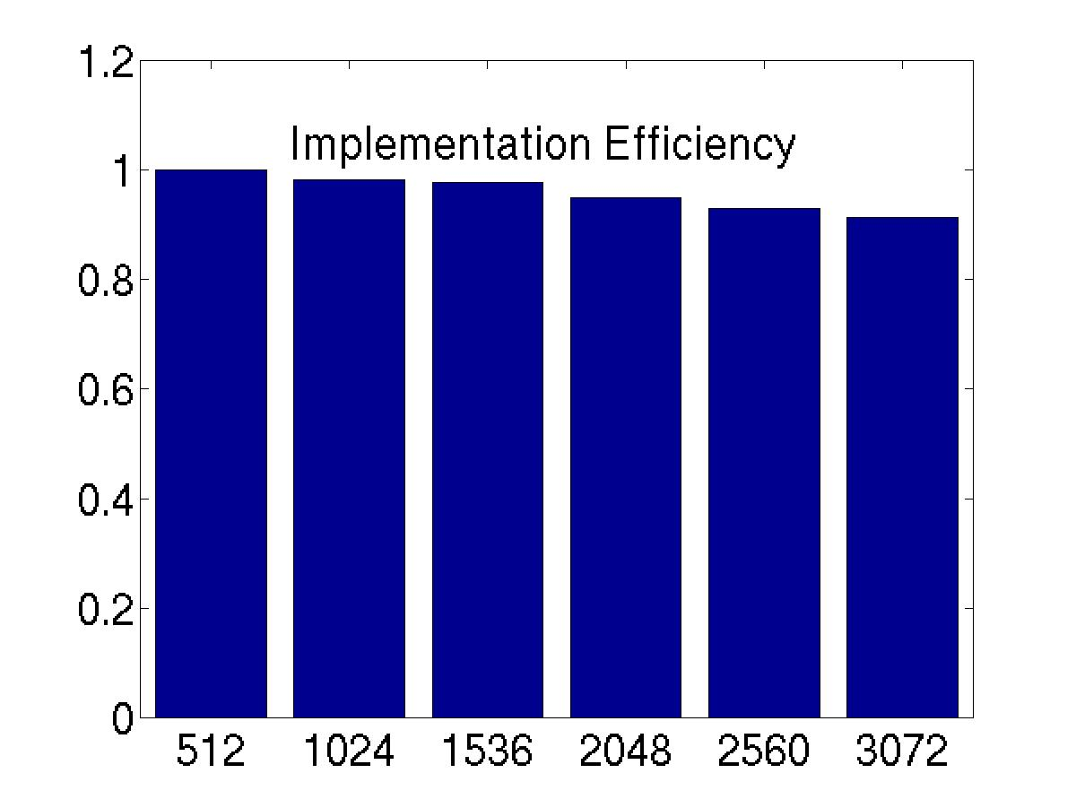
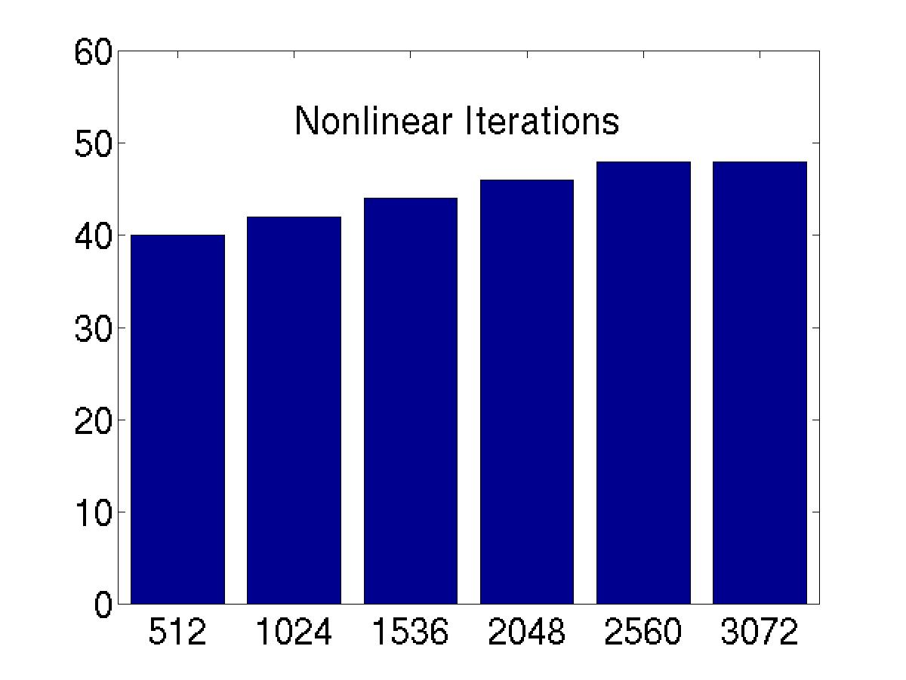
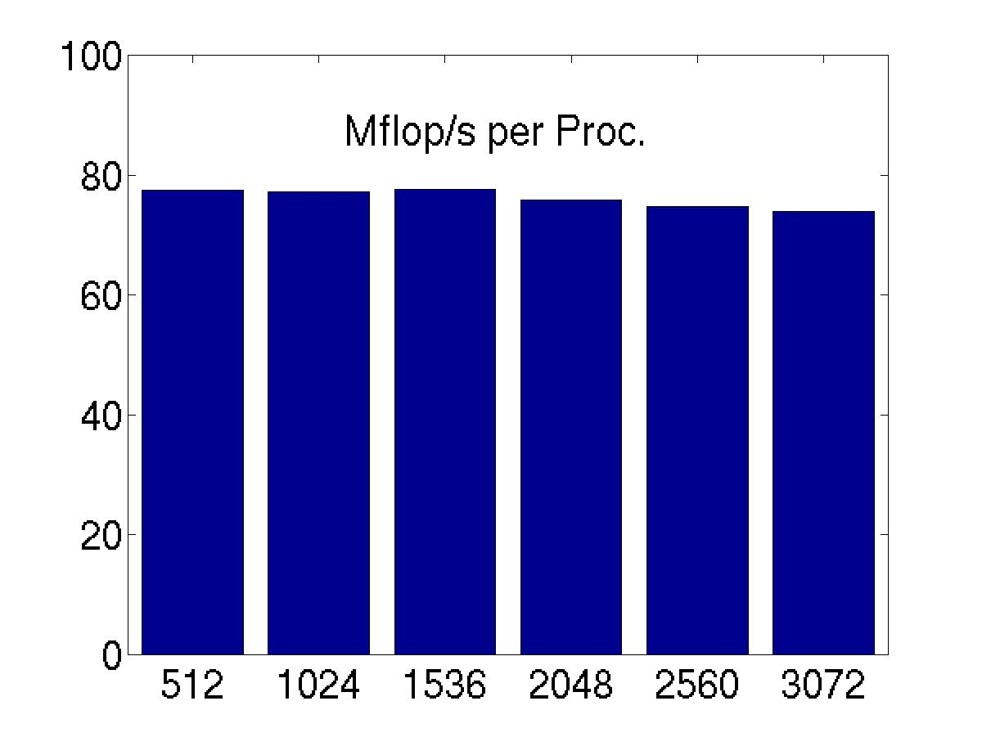
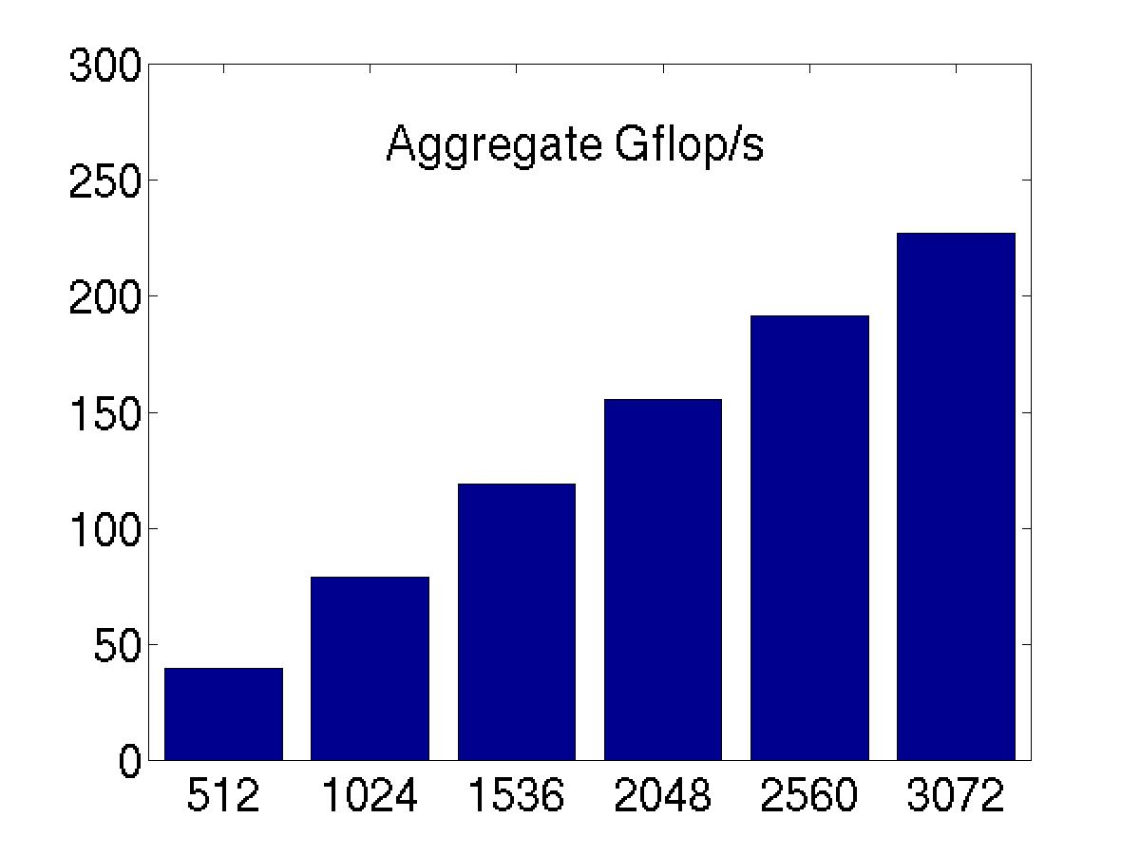
Inside the Parallel Scaling Results on ASCI Red
ONERA M6 wing test case, tetrahedral grid of 2.8 million vertices (about 11 million unknowns)
on up to 3072 ASCI Red nodes (each with dual Pentium Pro 333 MHz processors)

Slide 14
Multiphase Flow
Oil reservoir simulation: fully implicit, time-dependent
First fully implicit, parallel compositional simulator
3D EOS model (8 DoF per cell)
Structured Cartesian mesh
Over 4 million cell blocks, 32 million DoF
Primary PETSc tools: linear solvers (SLES)
  restarted GMRES with Block Jacobi preconditioning
  Point-block ILU(0) on each process
Over 10.6 gigaflops sustained performance on 128 nodes of an IBM SP. 90+ percent parallel efficiency
Results courtesy of collaborators Peng Wang and Jason Abate, Univ. of Texas at Austin, partially funded by DOE ER FE/MICS

Slide 15
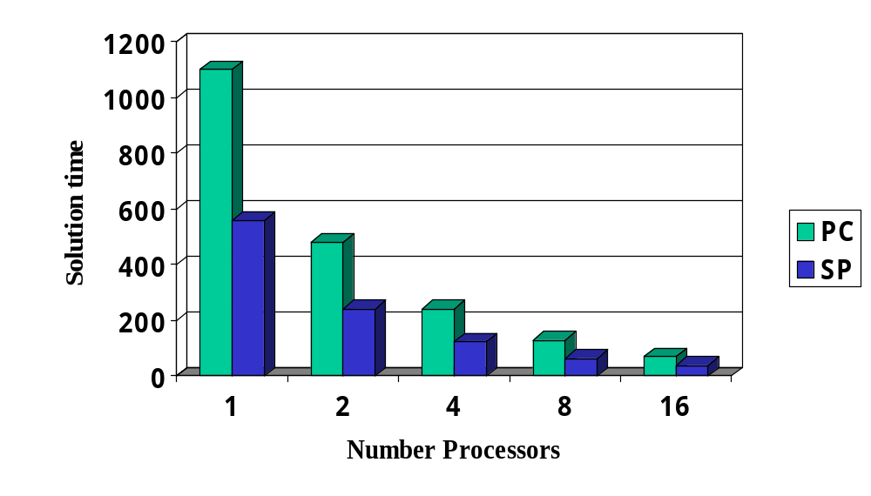
PC and SP Comparison
179,000 unknowns (22,375 cell blocks)
PC: Fast ethernet (100 Megabits/second) network of 300 Mhz Pentium PCs with 66 Mhz bus
SP: 128 node IBM SP with 160 MHz Power2super processors and 2 memory cards

Slide 16
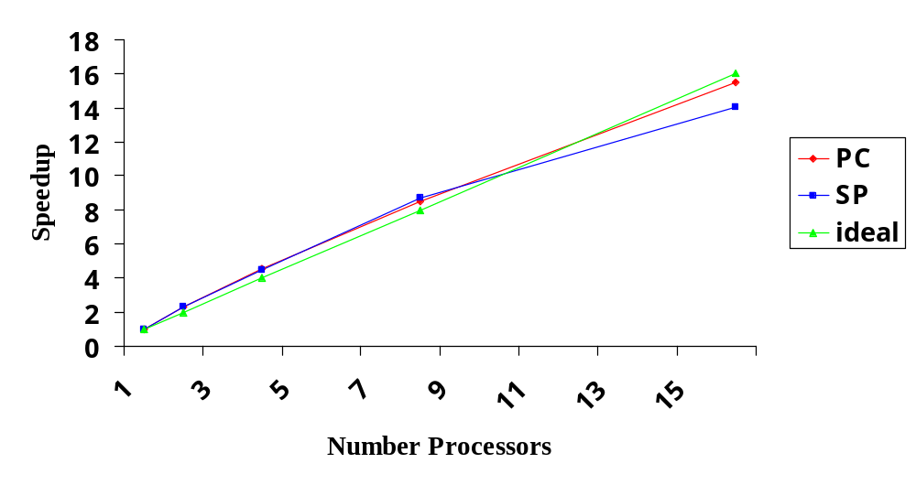
Speedup Comparison

Slide 17
Structures Simulations
ALE3D (LLNL structures code) test problems
Simulation with over 16 million degrees of freedom
Run on NERSC 512 processor T3E and LLNL ASCI Blue Pacific
Primary PETSc tools: multigrid linear solvers (SLES)
  Results courtesy of Mark Adams (Univ. of California, Berkeley)

Slide 18
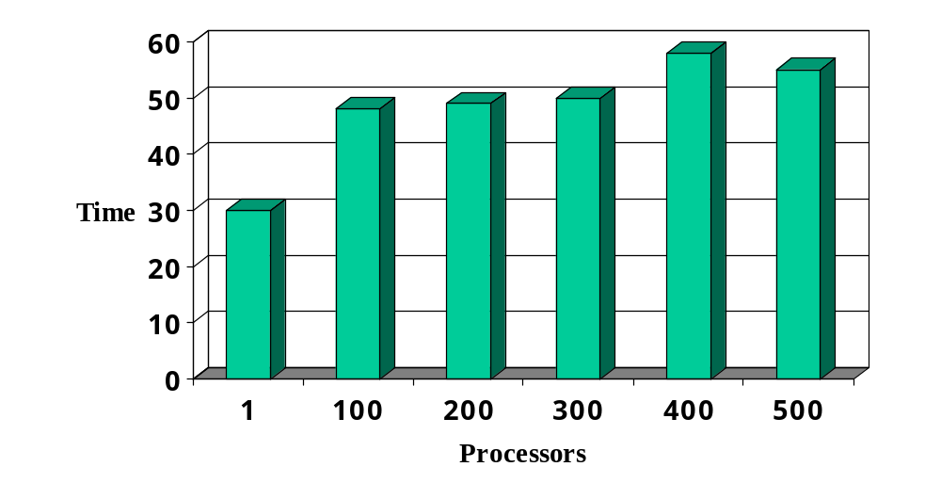
ALE3D Test Problem Performance
NERSC Cray T3E Scaled Performance
15,000 DoF per processor

Slide 19
Tutorial Approach
From the perspective of an application programmer:
Beginner
  basic functionality, intended for use by most programmers
Intermediate
  selecting options, performance evaluation and tuning
Advanced
  user-defined customization of algorithms and data structures
Developer
  advanced customizations, intended primarily for use by library developers
1
3
beginner
advanced
2
4
intermediate
developer

Slide 20
Incremental Application Improvement
Beginner
  Get the application “up and walking”
Intermediate
  Experiment with options
  Determine opportunities for improvement
Advanced
  Extend algorithms and/or data structures as needed
Developer
  Consider interface and efficiency issues for integration and interoperability of multiple toolkits
Full tutorials available at http://www.mcs.anl.gov/petsc/docs/tutorials

Slide 21
Structure of PETSc
PETSc PDE Application Codes
ODE Integrators
Visualization
Nonlinear Solvers,
Unconstrained Minimization
Interface
Linear Solvers
Preconditioners + Krylov Methods
Object-Oriented
Matrices, Vectors, Indices
Grid
Management
Profiling Interface
Computation and Communication Kernels
MPI, MPI-IO, BLAS, LAPACK

Slide 22
PETSc Numerical Components
Nonlinear Solvers
Time Steppers
Newton-based Methods
Other
Euler
Backward
Euler
Pseudo Time
Stepping
Other
Line Search
Trust Region
Krylov Subspace Methods
GMRES
CG
CGS
Bi-CG-STAB
TFQMR
Richardson
Chebychev
Other
Preconditioners
Additive
Schwartz
Block
Jacobi
Jacobi
ILU
ICC
LU
(Sequential only)
Others
Matrices
Compressed
Sparse Row
(AIJ)
Blocked Compressed
Sparse Row
(BAIJ)
Block
Diagonal
(BDIAG)
Dense
Matrix-free
Other
Distributed Arrays
Index Sets
Vectors
Indices
Block Indices
Stride
Other

Slide 23
What is not in PETSc?
Discretizations
Unstructured mesh generation and refinement tools
Load balancing tools
Sophisticated visualization capabilities
But PETSc does interface to external software that provides some of this functionality.

Slide 24
Flow of Control for PDE Solution
Main Routine
Timestepping Solvers (TS)
Nonlinear Solvers (SNES)
Linear Solvers (SLES)
PETSc
PC
KSP
Application
Initialization
Function
Evaluation
Jacobian
Evaluation
Post-
Processing
User code
PETSc code

Slide 25
Flow of Control for PDE Solution
Main Routine
Overture
SAMRAI
Timestepping Solvers (TS)
Nonlinear Solvers (SNES)
Linear Solvers (SLES)
PETSc
PC
KSP
Application
Initialization
SPAI
ILUDTP
Function
Evaluation
Jacobian
Evaluation
Post-
Processing
User code
PETSc code
Other Tools
PVODE

Slide 26
Levels of Abstraction in Mathematical Software
Application-specific interface
  Programmer manipulates objects associated with the application
High-level mathematics interface
  Programmer manipulates mathematical objects, such as PDEs and boundary conditions
Algorithmic and discrete mathematics interface
  Programmer manipulates mathematical objects (sparse matrices, nonlinear equations), algorithmic objects (solvers) and discrete geometry (meshes)
Low-level computational kernels
  e.g., BLAS-type operations
PETSc
emphasis

Slide 27
Solver Definitions: For Our Purposes
Explicit: Field variables are updated using neighbor information (no global linear or nonlinear solves)
Semi-implicit: Some subsets of variables (e.g., pressure) are updated with global solves
Implicit: Most or all variables are updated in a single global linear or nonlinear solve

Slide 28
Focus On Implicit Methods
Explicit and semi-explicit are easier cases
No direct PETSc support for
  ADI-type schemes
  spectral methods
  particle-type methods

Slide 29
Numerical Methods Paradigm
Encapsulate the latest numerical algorithms in a consistent, application-friendly manner
Use mathematical and algorithmic objects, not low-level programming language objects
Application code focuses on mathematics of the global problem, not parallel programming details

Slide 30
PETSc Programming Aids
Correctness Debugging
  Automatic generation of tracebacks
  Detecting memory corruption and leaks
  Optional user-defined error handlers
Performance Debugging
  Integrated profiling using -log_summary
  Profiling by stages of an application
  User-defined events

Slide 31
The PETSc Programming Model
Goals
  Portable, runs everywhere
  Performance
  Scalable parallelism
Approach
  Distributed memory, “shared-nothing”
    Requires only a compiler (single node or processor)
    Access to data on remote machines through MPI
  Can still exploit “compiler discovered” parallelism on each node (e.g., SMP)
  Hide within parallel objects the details of the communication
  User orchestrates communication at a higher abstract level than message passing

Slide 32
Collectivity
MPI communicators (MPI_Comm) specify collectivity (processes involved in a computation)
All PETSc routines for creating solver and data objects are collective with respect to a communicator, e.g.,
  VecCreate(MPI_Comm comm, int m, int M, Vec *x)
  Use PETSC_COMM_WORLD for all processes (like MPI_COMM_WORLD, but allows the same code to work when PETSc is started with a smaller set of processes)
Some operations are collective, while others are not, e.g.,
  collective: VecNorm()
  not collective: VecGetLocalSize()
If a sequence of collective routines is used, they must be called in the same order by each process.

Slide 33
Hello World
#include “petsc.h”
int main( int argc, char *argv[] )
{
PetscInitialize(&argc,&argv,PETSC_NULL,PETSC_NULL);
PetscPrintf(PETSC_COMM_WORLD,“Hello World\n”);
PetscFinalize();
return 0;
}

Slide 34
Hello World (Fortran)
program main
integer ierr, rank
#include "include/finclude/petsc.h"
call PetscInitialize( PETSC_NULL_CHARACTER, ierr )
call MPI_Comm_rank( PETSC_COMM_WORLD, rank, ierr )
if (rank .eq. 0) then
print *, ‘Hello World’
endif
call PetscFinalize(ierr)
end

Slide 35
Fancier Hello World
#include “petsc.h”
int main( int argc, char *argv[] )
{
int rank;
PetscInitialize(&argc,&argv,PETSC_NULL,PETSC_NULL);
MPI_Comm_rank(PETSC_COMM_WORLD,&rank );
PetscSynchronizedPrintf(PETSC_COMM_WORLD,
“Hello World from %d\n”,rank);
PetscSynchronizedFlush(PETSC_COMM_WORLD);
PetscFinalize();
return 0;
}

Slide 36
Data Objects
Vectors (Vec)
  focus: field data arising in nonlinear PDEs
Matrices (Mat)
  focus: linear operators arising in nonlinear PDEs (i.e., Jacobians)
beginner
Object creation
Object assembly
Setting options
Viewing
User-defined customizations
beginner
intermediate
intermediate
advanced
tutorial outline: data objects

Slide 37
Vectors
What are PETSc vectors?
  Fundamental objects for storing field solutions, right-hand sides, etc.
  Each process locally owns a subvector of contiguously numbered global indices
Create vectors via
  VecCreate(MPI_Comm,Vec *)
    MPI_Comm - processes that share the vector
  VecSetSizes( Vec, int, int )
    number of elements local to this process
    or total number of elements
  VecSetType(Vec,VecType)
    Where VecType is
      VEC_SEQ, VEC_MPI, or VEC_SHARED
    VecSetFromOptions(Vec) lets you set the type at runtime
proc 0
proc 1
proc 2
proc 3
proc 4
data objects: vectors
beginner

Slide 38
Creating a vector
Use PETSc to get value from command line
  Vec x;
  int n;
  …
  PetscInitialize(&argc,&argv,(char*)0,help);
  PetscOptionsGetInt(PETSC_NULL,"-n",&n,PETSC_NULL);
  …
  VecCreate(PETSC_COMM_WORLD,&x);
  VecSetSizes(x,PETSC_DECIDE,n);
  VecSetType(x,VEC_MPI);
  VecSetFromOptions(x);
Global size
PETSc determines local size

Slide 39
How Can We Use a PETSc Vector
In order to support the distributed memory “shared nothing” model, as well as single processors and shared memory systems, a PETSc vector is a “handle” to the real vector
  Allows the vector to be distributed across many processes
  To access the elements of the vector, we cannot simply do
  for (i=0; i<n; i++) v[i] = i;
  We do not want to require that the programmer work only with the “local” part of the vector; we want to permit operations, such as setting an element of a vector, to be performed by any process.
Recall how data is stored in the distributed memory programming model…

Slide 40
Sample Parallel System Architecture
Systems have an increasingly deep memory hierarchy (1, 2, 3, and more levels of cache)
Time to reference main memory 100’s of cycles
Access to shared data requires synchronization
  Better to ensure data is local and unshared when possible
SMP
...
CPUs
CPUs
Cache
Cache
Main Memory
Main Memory
Interconnect

Slide 41
How are Variables in Parallel Programs Interpreted?
Single process (address space) model
  OpenMP and threads in general
  Fortran 90/95 and compiler-discovered parallelism
  System manages memory and (usually) thread scheduling
  Named variables refer to the same storage
Single name space model
  HPF
  Data distribution part of the language, but programs still written as if there is a single name space
Distributed memory (shared nothing)
  Message passing
  Names variables in different processes are unrelated

Slide 42
Distributed Memory Model
Process 0
Process 1
Address Space
A(10)
A(10)
Different Variables!
Integer A(10)
…
print *, A
Integer A(10)
do i=1,10
A(i) = i
enddo
...
This A is completely different from this one

Slide 43
Vector Assembly
A three step process
  Each process tells PETSc what values to set or add to a vector component. Once all values provided,
  Begin communication between processes to ensure that values end up where needed
  (allow other operations, such as some computation, to proceed)
  Complete the communication
VecSetValues(Vec,…)
  number of entries to insert/add
  indices of entries
  values to add
  mode: [INSERT_VALUES,ADD_VALUES]
VecAssemblyBegin(Vec)
VecAssemblyEnd(Vec)
data objects: vectors
beginner

Slide 44
Parallel Matrix and Vector Assembly
Processes may generate any entries in vectors and matrices
Entries need not be generated on the process on which they ultimately will be stored
PETSc automatically moves data during the assembly process if necessary
data objects: vectors and matrices
beginner

Slide 45
One Way to Set the Elements of A Vector
VecGetSize(x,&N); /* Global size */
MPI_Comm_rank( PETSC_COMM_WORLD, &rank );
if (rank == 0) {
for (i=0; i<N; i++) VecSetValues(x,1,&i,&i,INSERT_VALUES);
}
/* These two routines ensure that the data is distributed to the other processes */
VecAssemblyBegin(x);
VecAssemblyEnd(x);
Vector index
Vector value

Slide 46
A Parallel Way to Set the Elements of A Distributed Vector
VecGetOwnershipRange(x,&low,&high);
for (i=low; i<high; i++) VecSetValues(x,1,&i,&i,INSERT_VALUES);
/* These two routines must be called (in case some other process contributed a value owned by another process) */
VecAssemblyBegin(x);
VecAssemblyEnd(x);

Slide 47
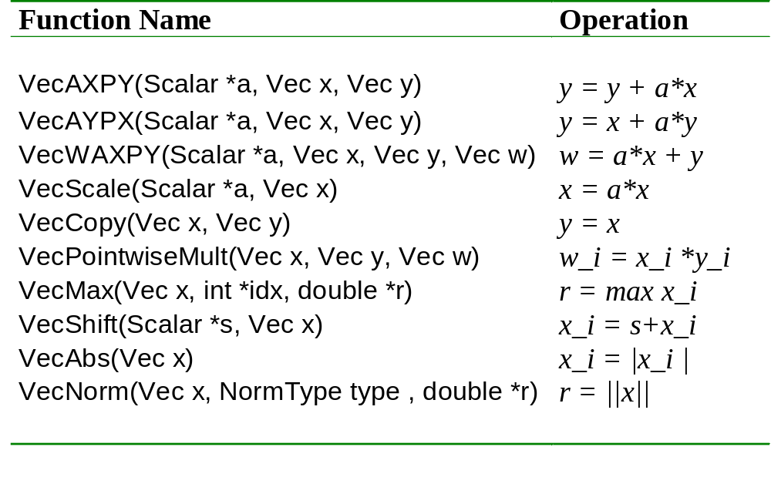
Selected Vector Operations
data objects: vectors
beginner

Slide 48
Simple Example Programs
Location: petsc/src/sys/examples/tutorials/
E
1
ex2.c - synchronized printing
Location: petsc/src/vec/examples/tutorials/
ex1.c, ex1f.F, ex1f90.F - basic vector routines
ex3.c, ex3f.F - parallel vector layout
E
1
E
  And many more examples ...
1
data objects: vectors
E
- on-line exercise
beginner

Slide 49
A Complete PETSc Program
#include petscvec.h
int main(int argc,char **argv)
{
Vec x;
int n = 20,ierr;
PetscTruth flg;
PetscScalar one = 1.0, dot;
PetscInitialize(&argc,&argv,0,0);
PetscOptionsGetInt(PETSC_NULL,"-n",&n,PETSC_NULL);
VecCreate(PETSC_COMM_WORLD,&x);
VecSetSizes(x,PETSC_DECIDE,n);
VecSetFromOptions(x);
VecSet(&one,x);
VecDot(x,x,&dot);
PetscPrintf(PETSC_COMM_WORLD,"Vector length %dn",(int)dot);
VecDestroy(x);
PetscFinalize();
return 0;
}

Slide 50
Working With Local Vectors
It is sometimes more efficient to directly access the storage for the local part of a PETSc Vec.
  E.g., for finite difference computations involving elements of the vector
PETSc allows you to access the local storage with
  VecGetArray( Vec, double *[] );
You must return the array to PETSc when you are done with it
  VecRestoreArray( Vec, double *[] )
This allows PETSc to handle and data structure conversions
  For most common uses, these routines are inexpensive and do not involve a copy of the vector.

Slide 51
Example of VecGetArray
Vec vec;
Double *avec;
…
VecCreate(PETSC_COMM_SELF,&vec);
VecSetSizes(vec,PETSC_DECIDE,n);
VecSetFromOptions(vec);
VecGetArray(vec,&avec);
/* compute with avec directly, e.g., */
PetscPrintf(PETSC_COMM_WORLD,
“First element of local array of vec in each process is %f\n”, avec[0] );
VecRestoreArray(vec,&avec);

Slide 52
Matrices
What are PETSc matrices?
  Fundamental objects for storing linear operators (e.g., Jacobians)
Create matrices via
  MatCreate(…,Mat *)
    MPI_Comm - processes that share the matrix
    number of local/global rows and columns
  MatSetType(Mat,MatType)
    where MatType is one of
      default sparse AIJ: MPIAIJ, SEQAIJ
      block sparse AIJ (for multi-component PDEs): MPIAIJ, SEQAIJ
      symmetric block sparse AIJ: MPISBAIJ, SAEQSBAIJ
      block diagonal: MPIBDIAG, SEQBDIAG
      dense: MPIDENSE, SEQDENSE
      matrix-free
      etc.
    MatSetFromOptions(Mat) lets you set the MatType at runtime.
data objects: matrices
beginner

Slide 53
Matrices and Polymorphism
Single user interface, e.g.,
  Matrix assembly
    MatSetValues()
  Matrix-vector multiplication
    MatMult()
  Matrix viewing
    MatView()
Multiple underlying implementations
  AIJ, block AIJ, symmetric block AIJ, block diagonal, dense, matrix-free, etc.
A matrix is defined by its properties, the operations that you can perform with it.
  Not by its data structures
data objects: matrices
beginner

Slide 54
Matrix Assembly
Same form as for PETSc Vectors:
MatSetValues(Mat,…)
  number of rows to insert/add
  indices of rows and columns
  number of columns to insert/add
  values to add
  mode: [INSERT_VALUES,ADD_VALUES]
MatAssemblyBegin(Mat)
MatAssemblyEnd(Mat)
data objects: matrices
beginner

Slide 55
Matrix Assembly Example
simple 3-point stencil for 1D discretization
Mat A;
int column[3], i;
double value[3];
…
MatCreate(PETSC_COMM_WORLD,
PETSC_DECIDE,PETSC_DECIDE,n,n,&A);
MatSetFromOptions(A);
/* mesh interior */
value[0] = -1.0; value[1] = 2.0; value[2] = -1.0;
if (rank == 0) { /* Only one process creates matrix */
for (i=1; i<n-2; i++) {
column[0] = i-1; column[1] = i; column[2] = i+1;
MatSetValues(A,1,&i,3,column,value,INSERT_VALUES);
}
}
/* also must set boundary points (code for global row 0 and n-1 omitted) */
MatAssemblyBegin(A,MAT_FINAL_ASSEMBLY);
MatAssemblyEnd(A,MAT_FINAL_ASSEMBLY);
Choose the global
Size of the matrix
Let PETSc decide how to allocate matrix across processes
data objects: matrices
beginner

Slide 56
Parallel Matrix Distribution
  Each process locally owns a submatrix of contiguously numbered global rows.
proc 0
proc 1
proc 2
proc 3
}
proc 3: locally owned rows
proc 4
MatGetOwnershipRange(Mat A, int *rstart, int *rend)
  rstart: first locally owned row of global matrix
  rend -1: last locally owned row of global matrix
data objects: matrices
beginner

Slide 57
Matrix Assembly Example With Parallel Assembly
simple 3-point stencil for 1D discretization
Mat A;
int column[3], i, start, end,istart,iend;
double value[3];
…
MatCreate(PETSC_COMM_WORLD,
PETSC_DECIDE,PETSC_DECIDE,n,n,&A);
MatSetFromOptions(A);
MatGetOwnershipRange(A,&start,&end);
/* mesh interior */
istart = start; if (start == 0) istart = 1;
iend = end; if (iend == n-1) iend = n-2;
value[0] = -1.0; value[1] = 2.0; value[2] = -1.0;
for (i=istart; i<iend; i++) {
column[0] = i-1; column[1] = i; column[2] = i+1;
MatSetValues(A,1,&i,3,column,value,INSERT_VALUES);
}
/* also must set boundary points (code for global row 0 and n-1 omitted) */
MatAssemblyBegin(A,MAT_FINAL_ASSEMBLY);
MatAssemblyEnd(A,MAT_FINAL_ASSEMBLY);
Choose the global
Size of the matrix
Let PETSc decide how to allocate matrix across processes
data objects: matrices
beginner

Slide 58
Why Are PETSc Matrices The Way They Are?
No one data structure is appropriate for all problems
  Blocked and diagonal formats provide significant performance benefits
  PETSc provides a large selection of formats and makes it (relatively) easy to extend PETSc by adding new data structures
Matrix assembly is difficult enough without being forced to worry about data partitioning
  PETSc provides parallel assembly routines
  Achieving high performance still requires making most operations local to a process but programs can be incrementally developed.
Matrix decomposition by consecutive rows across processes is simple and makes it easier to work with other codes.
  For applications with other ordering needs, PETSc provides “Application Orderings” (AO), described later.

Slide 59
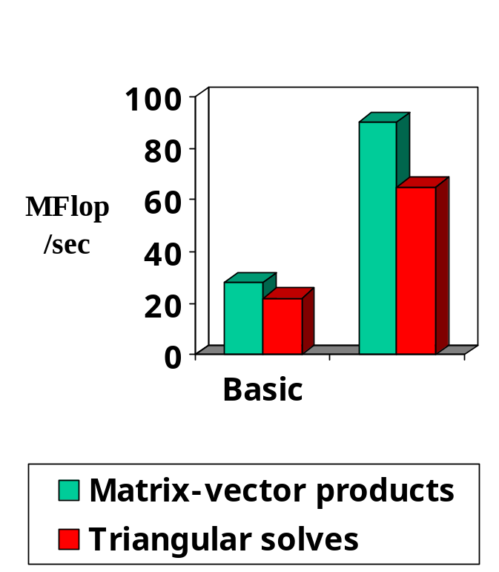
Blocking: Performance Benefits
More issues discussed in full tutorials available via PETSc web site.
3D compressible Euler code
Block size 5
IBM Power2
data objects: matrices
beginner

Slide 60
Viewers
beginner
Printing information about solver and data objects
Visualization of field and matrix data
Binary output of vector and matrix data
beginner
intermediate
tutorial outline: viewers

Slide 61
Viewer Concepts
Information about PETSc objects
  runtime choices for solvers, nonzero info for matrices, etc.
Data for later use in restarts or external tools
  vector fields, matrix contents
  various formats (ASCII, binary)
Visualization
  simple x-window graphics
    vector fields
    matrix sparsity structure
beginner
viewers

Slide 62
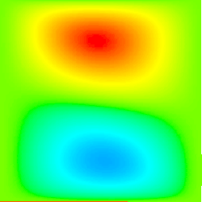
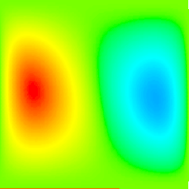
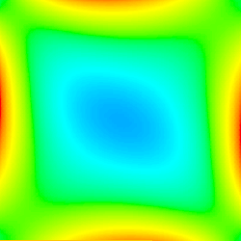
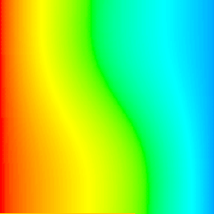
Viewing Vector Fields
VecView(Vec x,PetscViewer v);
Default viewers
  ASCII (sequential): PETSC_VIEWER_STDOUT_SELF
  ASCII (parallel): PETSC_VIEWER_STDOUT_WORLD
  X-windows: PETSC_VIEWER_DRAW_WORLD
Default ASCII formats
  PETSC_VIEWER_ASCII_DEFAULT
  PETSC_VIEWER_ASCII_MATLAB
  PETSC_VIEWER_ASCII_COMMON
  PETSC_VIEWER_ASCII_INFO
  etc.
Solution components,
using runtime option
-snes_vecmonitor
velocity: u
velocity: v
vorticity: 
temperature: T
beginner
viewers

Slide 63
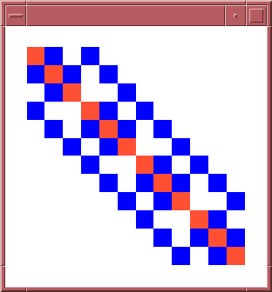
Viewing Matrix Data
MatView(Mat A, PetscViewer v);
Runtime options available after matrix assembly
  -mat_view_info
    info about matrix assembly
  -mat_view_draw
    sparsity structure
  -mat_view
    data in ASCII
  etc.
beginner
viewers

Slide 64
More Viewer Info
Viewer creation
  ViewerASCIIOpen()
  ViewerDrawOpen()
  ViewerSocketOpen()
Binary I/O of vectors and matrices
  output: ViewerBinaryOpen()
  input: VecLoad(), MatLoad()
intermediate
viewers

Slide 65
Running PETSc Programs
The easiest approach is to use the PETSc Makefile provided with the examples
  Ensures that all of the correct libraries are used and that the correct compilation options are used.
Make sure that you have your PETSc environment setup correctly:
  setenv PETSC_DIR <directory with PETSc installed>
  setenv PETSC_ARCH <name of PETSc architecture>
Copy an example file and the makefile from the directory to your local directory:
  cp ${PETSC_DIR}/src/vec/examples/tutorials/ex1.c .
  cp ${PETSC_DIR}/src/vec/examples/tutorials/makefile .
Make and run the program:
  make BOPT=g ex1
  mpirun –np 2 ex1
Edit the example to explore PETSc

Slide 66
End of Day 1

Slide 67
Solvers: Usage Concepts
Solver Classes
Usage Concepts
Linear (SLES)
Nonlinear (SNES)
Timestepping (TS)
Context variables
Solver options
Callback routines
Customization
tutorial outline: solvers
important concepts

Slide 68
Linear PDE Solution
Main Routine
PETSc
Linear Solvers (SLES)
Solve
Ax = b
PC
KSP
Application
Initialization
Evaluation of A and b
Post-
Processing
User code
PETSc code
solvers:linear
beginner

Slide 69
Linear Solvers
Goal: Support the solution of linear systems,
Ax=b,
particularly for sparse, parallel problems arising
within PDE-based models
User provides:
  Code to evaluate A, b
solvers:linear
beginner

Slide 70
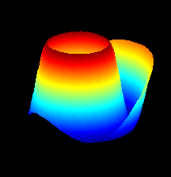
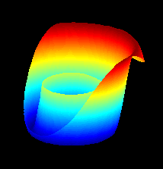
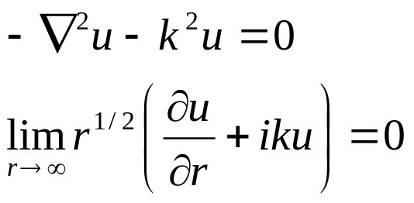
Sample Linear Application:
Exterior Helmholtz Problem
Solution Components
Real
Imaginary
Collaborators: H. M. Atassi, D. E. Keyes,
L. C. McInnes, R. Susan-Resiga
solvers:linear
beginner

Slide 71
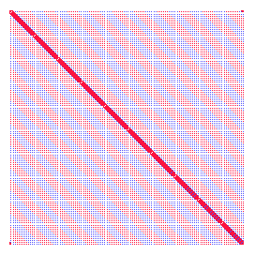
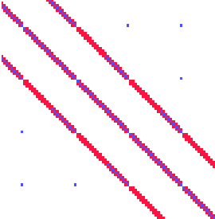
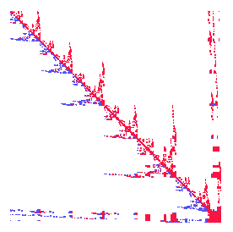
Helmholtz: The Linear System
Logically regular grid, parallelized with DAs
Finite element discretization (bilinear quads)
Nonreflecting exterior BC (via DtN map)
Matrix sparsity structure (option: -mat_view_draw)
Natural ordering
Close-up
Nested dissection ordering
solvers:linear
beginner

Slide 72
Linear Solvers (SLES)
SLES: Scalable Linear Equations Solvers
Application code interface
Choosing the solver
Setting algorithmic options
Viewing the solver
Determining and monitoring convergence
Providing a different preconditioner matrix
Matrix-free solvers
User-defined customizations
beginner
beginner
beginner
beginner
intermediate
intermediate
advanced
advanced
tutorial outline: solvers: linear

Slide 73
Objects In PETSc
How should a matrix be described in a program?
  Old way:
    Dense matrix:
      double precision A(10,10)
    Sparse matrix:
      integer ia(11), ja(max_nz)
      double precision a(max_nx)
  New way:
    Mat M
Hides the choice of data structure
  Of course, the library still needs to represent the matrix with some choice of data structure, but this is an implementation detail
Benefit
  Programs become independent of particular choices of data structure, making it easier to modify and adapt

Slide 74
Operations In PETSc
How should operations like “solve linear system” be described in a program?
  Old way:
    mpiaijgmres( ia, ja, a, comm, x, b, nlocal, nglobal, ndir, orthmethod, convtol, &its )
  New way:
    SLESSolve( sles, b, x, &its )
Hides the choice of algorithm
  Algorithms are to operations as data structures are to objects
Benefit
  Programs become independent of particular choices of algorithm, making it easier to explore algorithmic choices and to adapt to new methods.
In PETSc, operations have their own handle, called a “context variable”

Slide 75
Context Variables
Are the key to solver organization
Contain the complete state of an algorithm, including
  parameters (e.g., convergence tolerance)
  functions that run the algorithm (e.g., convergence monitoring routine)
  information about the current state (e.g., iteration number)
solvers:linear
beginner

Slide 76
Creating the SLES Context
C/C++ version
  ierr = SLESCreate(PETSC_COMM_WORLD,&sles);
Fortran version
  call SLESCreate(PETSC_COMM_WORLD,sles,ierr)
Provides an identical user interface for all linear solvers
  uniprocess and parallel
  real and complex numbers
solvers:linear
beginner

Slide 77
SLES Structure
Each SLES object actually contains two other objects:
  KSP — Krylov Space Method
    The iterative method
    The context contains information on method parameters (e.g., GMRES search directions), work spaces, etc
  PC — Preconditioners
    Knows how to apply a preconditioner
    The context contains information on the preconditioner, such as what routine to call to apply it

Slide 78
Linear Solvers in PETSc 2.0
Krylov Methods (KSP)
Preconditioners (PC)
Conjugate Gradient
GMRES
CG-Squared
Bi-CG-stab
Transpose-free QMR
etc.
Block Jacobi
Overlapping Additive Schwarz
ICC, ILU via BlockSolve95
ILU(k), LU (direct solve, sequential only)
Arbitrary matrix
etc.
solvers:linear
beginner

Slide 79
Basic Linear Solver Code (C/C++)
SLES sles; /* linear solver context */
Mat A; /* matrix */
Vec x, b; /* solution, RHS vectors */
int n, its; /* problem dimension, number of iterations */
MatCreate(PETSC_COMM_WORLD,PETSC_DECIDE,PETSC_DECIDE,n,n,&A);
MatSetFromOptions(A);
/* (code to assemble matrix not shown) */
VecCreate(PETSC_COMM_WORLD,&x);
VecSetSizes(x,PETSC_DECIDE, n);
VecSetFromOptions(x);
VecDuplicate(x,&b);
/* (code to assemble RHS vector not shown)*/
SLESCreate(PETSC_COMM_WORLD,&sles);
SLESSetOperators(sles,A,A,DIFFERENT_NONZERO_PATTERN);
SLESSetFromOptions(sles);
SLESSolve(sles,b,x,&its);
SLESDestroy(sles);
Indicate whether the preconditioner has the same nonzero pattern as the matrix each time a system is solved. This default works with all preconditioners. Other values (e.g., SAME_NONZERO_PATTERN) can be used for particular preconditioners. Ignored when solving only one system
solvers:linear
beginner

Slide 80
Basic Linear Solver Code (Fortran)
SLES sles
Mat A
Vec x, b
integer n, its, ierr
call MatCreate( PETSC_COMM_WORLD,PETSC_DECIDE,n,n,A,ierr )
call MatSetFromOptions( A, ierr )
call VecCreate( PETSC_COMM_WORLD,x,ierr )
call VecSetSizes( x, PETSC_DECIDE, n, ierr )
call VecSetFromOptions( x, ierr )
call VecDuplicate( x,b,ierr )
call SLESCreate(PETSC_COMM_WORLD,sles,ierr)
call SLESSetOperators(sles,A,A,DIFFERENT_NONZERO_PATTERN,ierr)
call SLESSetFromOptions(sles,ierr)
call SLESSolve(sles,b,x,its,ierr)
call SLESDestroy(sles,ierr)
C then assemble matrix and right-hand-side vector
solvers:linear
beginner

Slide 81
Customization Options
Command Line Interface
  Applies same rule to all queries via a database
  Enables the user to have complete control at runtime, with no extra coding
Procedural Interface
  Provides a great deal of control on a usage-by-usage basis inside a single code
  Gives full flexibility inside an application
solvers:linear
beginner

Slide 82
Setting Solver Options at Runtime
-ksp_type [cg,gmres,bcgs,tfqmr,…]
-pc_type [lu,ilu,jacobi,sor,asm,…]
-ksp_max_it <max_iters>
-ksp_gmres_restart <restart>
-pc_asm_overlap <overlap>
-pc_asm_type [basic,restrict,interpolate,none]
etc ...
1
2
1
2
solvers:linear
beginner
intermediate

Slide 83
Linear Solvers: Monitoring Convergence
-ksp_monitor - Prints preconditioned residual norm
-ksp_xmonitor - Plots preconditioned residual norm
-ksp_truemonitor - Prints true residual norm || b-Ax ||
-ksp_xtruemonitor - Plots true residual norm || b-Ax ||
User-defined monitors, using callbacks
1
2
3
1
2
3
solvers:linear
beginner
intermediate
advanced

Slide 84
Setting Solver Options within Code
SLESGetKSP(SLES sles,KSP *ksp)
  KSPSetType(KSP ksp,KSPType type)
  KSPSetTolerances(KSP ksp,PetscReal rtol, PetscReal atol,PetscReal dtol, int maxits)
  etc....
SLESGetPC(SLES sles,PC *pc)
  PCSetType(PC pc,PCType)
  PCASMSetOverlap(PC pc,int overlap)
  etc....
solvers:linear
beginner

Slide 85
Recursion: Specifying Solvers for Schwarz Preconditioner Blocks
Specify SLES solvers and options with “-sub” prefix, e.g.,
  Full or incomplete factorization
    -sub_pc_type lu
    -sub_pc_type ilu -sub_pc_ilu_levels <levels>
  Can also use inner Krylov iterations, e.g.,
    -sub_ksp_type gmres -sub_ksp_rtol <rtol>
    -sub_ksp_max_it <maxit>
solvers: linear: preconditioners
beginner

Slide 86
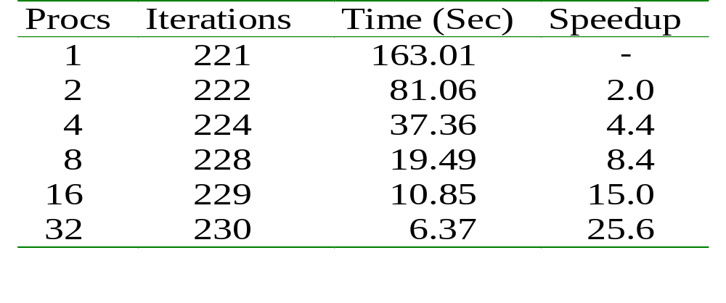
Helmholtz: Scalability
128x512 grid, wave number = 13, IBM SP
GMRES(30)/Restricted Additive Schwarz
1 block per proc, 1-cell overlap, ILU(1) subdomain solver
solvers:linear
beginner

Slide 87
SLES: Review of Basic Usage
SLESCreate( ) - Create SLES context
SLESSetOperators( ) - Set linear operators
SLESSetFromOptions( ) - Set runtime solver options for [SLES, KSP,PC]
SLESSolve( ) - Run linear solver
SLESView( ) - View solver options actually used at runtime (alternative: -sles_view)
SLESDestroy( ) - Destroy solver
solvers:linear
beginner

Slide 88
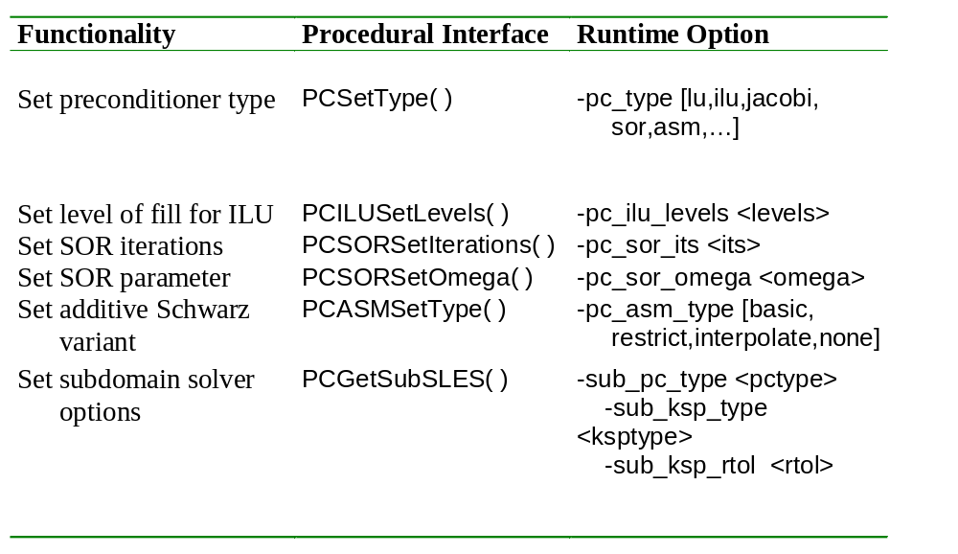
SLES: Review of Selected Preconditioner Options
1
2
1
2
And many more options...
solvers: linear: preconditioners
beginner
intermediate

Slide 89
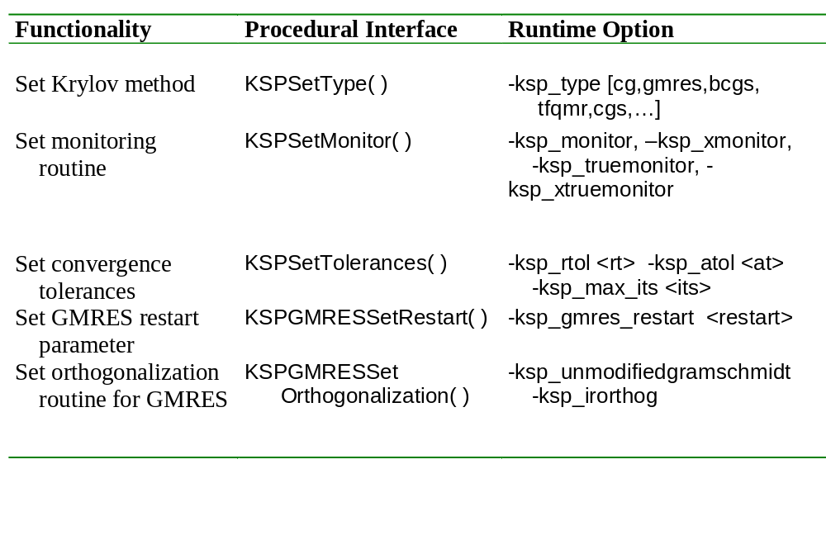
SLES: Review of Selected Krylov Method Options
1
2
And many more options...
1
2
solvers: linear: Krylov methods
beginner
intermediate

Slide 90
Why Polymorphism?
Programs become independent of the choice of algorithm
Consider the question:
  What is the best combination of iterative method and preconditioner for my problem?
How can you answer this experimentally?
  Old way:
    Edit code. Make. Run. Edit code. Make. Run. Debug. Edit. …
  New way:…

Slide 91
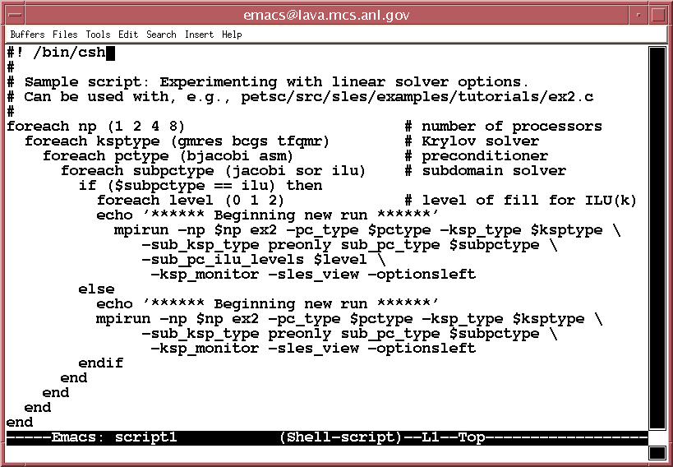
SLES: Runtime Script Example
solvers:linear
intermediate

Slide 92
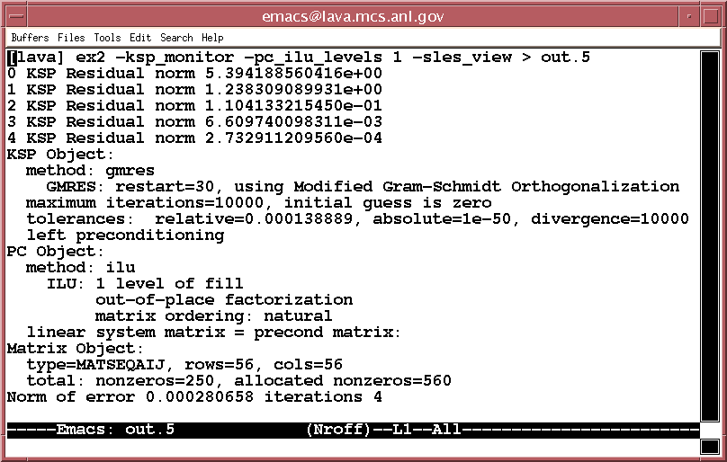
Viewing SLES Runtime Options
solvers:linear
intermediate

Slide 93
Providing Different Matrices to Define Linear System and Preconditioner
Solve Ax=b
Precondition via: M A M (M x) = M b
-1
-1
-1
L
R
R
L
Krylov method: Use A for matrix-vector products
Build preconditioner using either
  A - matrix that defines linear system
  or P - a different matrix (cheaper to assemble)
SLESSetOperators(SLES sles,
  Mat A,
  Mat P,
  MatStructure flag)
solvers:linear
advanced

Slide 94
Matrix-Free Solvers
Use “shell” matrix data structure
  MatCreateShell(…, Mat *mfctx)
Define operations for use by Krylov methods
  MatShellSetOperation(Mat mfctx,
    MatOperation MATOP_MULT,
    (void *) int (UserMult)(Mat,Vec,Vec))
Names of matrix operations defined in petsc/include/mat.h
Some defaults provided for nonlinear solver usage
solvers:linear
advanced

Slide 95
User-defined Customizations
Restricting the available solvers
  Customize PCRegisterAll( ), KSPRegisterAll( )
Adding user-defined preconditioners via
  PCShell preconditioner type
Adding preconditioner and Krylov methods in library style
  Method registration via PCRegister( ), KSPRegister( )
Heavily commented example implementations
  Jacobi preconditioner: petsc/src/sles/pc/impls/jacobi.c
  Conjugate gradient: petsc/src/sles/ksp/impls/cg/cg.c
3
4
3
4
solvers:linear
advanced
developer

Slide 96
SLES: Example Programs
Location: petsc/src/sles/examples/tutorials/
ex1.c, ex1f.F - basic uniprocess codes
ex23.c - basic parallel code
ex11.c - using complex numbers
ex4.c - using different linear system and
preconditioner matrices
ex9.c - repeatedly solving different linear systems
ex22.c - 3D Laplacian using multigrid
ex15.c - setting a user-defined preconditioner
E
1
2
E
3
  And many more examples ...
1
2
3
solvers:linear
E
- on-line exercise
beginner
intermediate
advanced

Slide 97
Now What?
If you have a running program, are you done?
  Yes, if your program answers your question.
  No, if you now need to run much larger problems or many more problems.
How can you tune an application for performance?
  PETSc approach:
    Debug the application by focusing on the mathematically operations. The parallel matrix assembly operations are an example.
    Once the code works,
      Understand the performance
      Identify performance problems
      Use special PETSc routines and other techniques to optimize only the code that is underperforming

Slide 98
Profiling and Performance Tuning
Profiling:
beginner
Integrated profiling using -log_summary
User-defined events
Profiling by stages of an application
intermediate
intermediate
Performance Tuning:
intermediate
Matrix optimizations
Application optimizations
Algorithmic tuning
intermediate
advanced
tutorial outline: profiling and performance tuning

Slide 99
Profiling
Integrated monitoring of
  time
  floating-point performance
  memory usage
  communication
All PETSc events are logged if PETSc was compiled with
-DPETSC_LOG (default); can also profile application code segments
Print summary data with option: -log_summary
Print redundant information from PETSc routines: -log_info
Print the trace of the functions called: -log_trace
profiling and performance tuning
beginner

Slide 100
User-defined Events
int USER_EVENT;
int user_event_flops
PetscLogEventRegister(&USER_EVENT,”User event name”, “eventColor”);
PetscLogEventBegin(USER_EVENT,0,0,0,0);
[ code to monitor]
PetscLogFlops(user_evnet_flops);
PetscLogEvent End(USER_EVENT,0,0,0,0);
profiling and performance tuning
intermediate

Slide 101
Nonlinear Solvers (SNES)
SNES: Scalable Nonlinear Equations Solvers
beginner
Application code interface
Choosing the solver
Setting algorithmic options
Viewing the solver
Determining and monitoring convergence
Matrix-free solvers
User-defined customizations
beginner
beginner
beginner
intermediate
advanced
advanced
tutorial outline: solvers: nonlinear

Slide 102
Nonlinear PDE Solution
Main Routine
Nonlinear Solvers (SNES)
Solve
F(u) = 0
Linear Solvers (SLES)
PETSc
PC
KSP
Application
Initialization
Function
Evaluation
Jacobian
Evaluation
Post-
Processing
User code
PETSc code
solvers: nonlinear
beginner

Slide 103
Nonlinear Solvers
Goal: For problems arising from PDEs,
support the general solution of F(u) = 0
User provides:
  Code to evaluate F(u)
  Code to evaluate Jacobian of F(u) (optional)
    or use sparse finite difference approximation
    or use automatic differentiation
      AD support via collaboration with P. Hovland and B. Norris
      Coming in next PETSc release via automated interface to ADIFOR and ADIC (see http://www.mcs.anl.gov/autodiff)
solvers: nonlinear
beginner

Slide 104
Nonlinear Solvers (SNES)
Newton-based methods, including
  Line search strategies
  Trust region approaches
  Pseudo-transient continuation
  Matrix-free variants
User can customize all phases of the solution process
solvers: nonlinear
beginner

Slide 105
Sample Nonlinear Application:
Driven Cavity Problem
Velocity-vorticity formulation
Flow driven by lid and/or bouyancy
Logically regular grid, parallelized with DAs
Finite difference discretization
source code:
Solution Components
velocity: u
velocity: v
petsc/src/snes/examples/tutorials/ex19.c
vorticity: 
temperature: T
Application code author: D. E. Keyes
solvers: nonlinear
beginner

Slide 106
Basic Nonlinear Solver Code (C/C++)
SNES snes; /* nonlinear solver context */
Mat J; /* Jacobian matrix */
Vec x, F; /* solution, residual vectors */
int n, its; /* problem dimension, number of iterations */
ApplicationCtx usercontext; /* user-defined application context */
...
MatCreate(PETSC_COMM_WORLD,PETSC_DECIDE,PETSC_DECIDE,n,n,&J);
MatSetFromOptions(J);
VecCreate(PETSC_COMM_WORLD,&x);
VecSetSizes(x,PETSC_DECIDE,n);
VecSetFromOptions(x);
VecDuplicate(x,&F);
SNESCreate(PETSC_COMM_WORLD,&snes);
SNESSetFunction(snes,F,EvaluateFunction,usercontext);
SNESSetJacobian(snes,J,J,EvaluateJacobian,usercontext);
SNESSetFromOptions(snes);
SNESSolve(snes,x,&its);
SNESDestroy(snes);
solvers: nonlinear
beginner

Slide 107
Basic Nonlinear Solver Code (Fortran)
SNES snes
Mat J
Vec x, F
int n, its
...
call MatCreate(PETSC_COMM_WORLD,PETSC_DECIDE, PETSC_DECIDE,n,n,J,ierr)
call MatSetFromOptions( J, ierr )
call VecCreate(PETSC_COMM_WORLD,x,ierr)
call VecSetSizes(x,PETSC_DECIDE,n,ierr)
call VecSetFromOptions(x,ierr)
call VecDuplicate(x,F,ierr)
call SNESCreate(PETSC_COMM_WORLD, snes,ierr)
call SNESSetFunction(snes,F,EvaluateFunction,PETSC_NULL,ierr)
call SNESSetJacobian(snes,J,J,EvaluateJacobian,PETSC_NULL,ierr)
call SNESSetFromOptions(snes,ierr)
call SNESSolve(snes,x,its,ierr)
call SNESDestroy(snes,ierr)
solvers: nonlinear
beginner

Slide 108
Solvers Based on Callbacks
User provides routines to perform actions that the library requires. For example,
  SNESSetFunction(SNES,...)
    uservector - vector to store function values
    userfunction - name of the user’s function
    usercontext - pointer to private data for the user’s function
Now, whenever the library needs to evaluate the user’s nonlinear function, the solver may call the application code directly with its own local state.
usercontext: serves as an application context object. Data are handled through such opaque objects; the library never sees irrelevant application data.
important concept
solvers: nonlinear
beginner

Slide 109
Sample Application Context:
Driven Cavity Problem
typedef struct {
/* - - - - - - - - - - - - - - - - basic application data - - - - - - - - - - - - - - - - - */
double lid_velocity, prandtl, grashof; /* problem parameters */
int mx, my; /* discretization parameters */
int mc; /* number of DoF per node */
int draw_contours; /* flag - drawing contours */
/* - - - - - - - - - - - - - - - - - - - - parallel data - - - - - - - - - - - - - - - - - - - - - */
MPI_Comm comm; /* communicator */
DA da; /* distributed array */
Vec localF, localX; /* local ghosted vectors */
} AppCtx;
solvers: nonlinear
beginner

Slide 110
Sample Function Evaluation Code:
Driven Cavity Problem
UserComputeFunction(SNES snes, Vec X, Vec F, void *ptr)
{
AppCtx *user = (AppCtx *) ptr; /* user-defined application context */
int istart, iend, jstart, jend; /* local starting and ending grid points */
Scalar *f; /* local vector data */
….
/* (Code to communicate nonlocal ghost point data not shown) */
VecGetArray( F, &f );
/* (Code to compute local function components; insert into f[ ] shown on next slide) */
VecRestoreArray( F, &f );
….
return 0;
}
solvers: nonlinear
beginner

Slide 111
Sample Local Computational Loops:
Driven Cavity Problem
#define U(i) 4*(i)
#define V(i) 4*(i)+1
#define Omega(i) 4*(i)+2
#define Temp(i) 4*(i)+3
….
for ( j = jstart; j<jend; j++ ) {
row = (j - gys) * gxm + istart - gxs - 1;
for ( i = istart; i<iend; i++ ) {
row++; u = x[U(row)];
uxx = (two * u - x[ U (row-1)] - x [U (row+1) ] ) * hydhx;
uyy = (two * u - x[ U (row-gxm)] - x [ U (row+gxm) ] ) * hxdhy;
f [U(row)] = uxx + uyy –
p5 * (x [ (Omega (row+gxm)] - x [Omega (row-gxm)] ) * hx;
} }
….
The PDE’s 4 components (U,V,Omega,Temp) are interleaved in the unknown vector.
#define statements provide easy access to each component.
solvers: nonlinear
beginner

Slide 112
Finite Difference Jacobian Computations
Compute and explicitly store Jacobian via 1st-order FD
  Dense: -snes_fd, SNESDefaultComputeJacobian()
  Sparse via colorings: MatFDColoringCreate(), SNESDefaultComputeJacobianColor()
Matrix-free Newton-Krylov via 1st-order FD, no preconditioning unless specifically set by user
  -snes_mf
Matrix-free Newton-Krylov via 1st-order FD, user-defined preconditioning matrix
  -snes_mf_operator
solvers: nonlinear
beginner

Slide 113
Uniform access to all linear and nonlinear solvers
-ksp_type [cg,gmres,bcgs,tfqmr,…]
-pc_type [lu,ilu,jacobi,sor,asm,…]
-snes_type [ls,tr,…]
-snes_line_search <line search method>
-sles_ls <parameters>
-snes_convergence <tolerance>
etc...
1
2
1
2
solvers: nonlinear
beginner
intermediate

Slide 114
Customization via Callbacks:
Setting a user-defined line search routine
SNESSetLineSearch(SNES snes,int(*ls)(…),void *lsctx)
where available line search routines ls( ) include:
  SNESCubicLineSearch( ) - cubic line search
  SNESQuadraticLineSearch( ) - quadratic line search
  SNESNoLineSearch( ) - full Newton step
  SNESNoLineSearchNoNorms( ) - full Newton step but calculates no norms (faster in parallel, useful when using a fixed number of Newton iterations instead of usual convergence testing)
  YourOwnFavoriteLineSearchRoutine( )
2
3
2
3
solvers: nonlinear
intermediate
advanced

Slide 115
SNES: Review of Basic Usage
SNESCreate( ) - Create SNES context
SNESSetFunction( ) - Set function eval. routine
SNESSetJacobian( ) - Set Jacobian eval. routine
SNESSetFromOptions( ) - Set runtime solver options for [SNES,SLES, KSP,PC]
SNESSolve( ) - Run nonlinear solver
SNESView( ) - View solver options actually used at runtime (alternative: -snes_view)
SNESDestroy( ) - Destroy solver
solvers: nonlinear
beginner

Slide 116
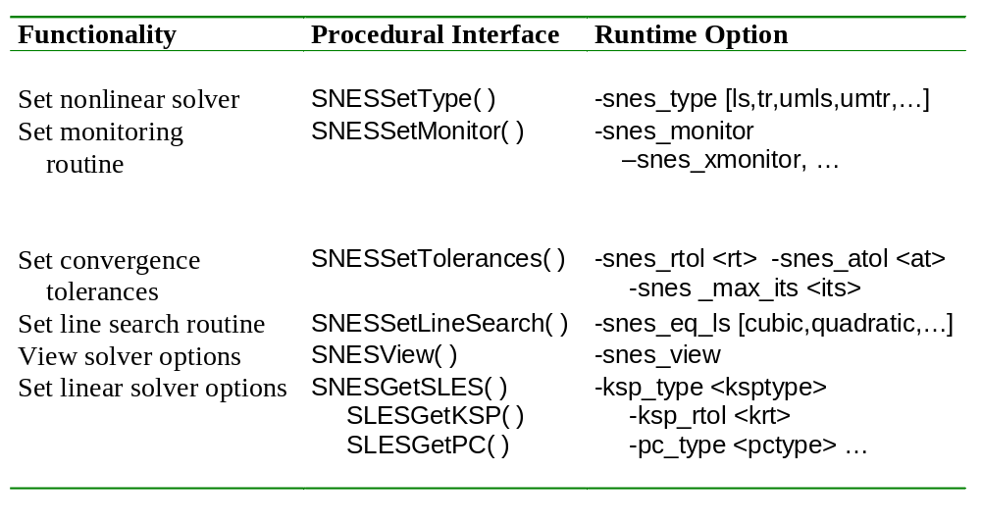
SNES: Review of Selected Options
1
2
And many more options...
1
2
solvers: nonlinear
beginner
intermediate

Slide 117
SNES: Example Programs
Location: petsc/src/snes/examples/tutorials/
ex1.c, ex1f.F - basic uniprocess codes
ex2.c - uniprocess nonlinear PDE (1 DoF per node)
ex5.c, ex5f.F, ex5f90.F - parallel nonlinear PDE (1 DoF per node)
ex18.c - parallel radiative transport problem with multigrid
ex19.c - parallel driven cavity problem with multigrid
1
E
E
E
2
  And many more examples ...
1
2
solvers: nonlinear
E
- on-line exercise
beginner
intermediate

Slide 118
Timestepping Solvers (TS)
(and ODE Integrators)
beginner
Application code interface
Choosing the solver
Setting algorithmic options
Viewing the solver
Determining and monitoring convergence
User-defined customizations
beginner
beginner
beginner
intermediate
advanced
tutorial outline: solvers: timestepping

Slide 119
Time-Dependent PDE Solution
Main Routine
Timestepping Solvers (TS)
Nonlinear Solvers (SNES)
PETSc
Linear Solvers (SLES)
Solve
U t = F(U,Ux,Uxx)
PC
KSP
Application
Initialization
Function
Evaluation
Jacobian
Evaluation
Post-
Processing
User code
PETSc code
solvers: timestepping
beginner

Slide 120
Timestepping Solvers
Goal: Support the (real and pseudo) time
evolution of PDE systems
U_{t} = F(U,Ux,Uxx,t)
User provides:
  Code to evaluate F(U,Ux,Uxx,t)
  Code to evaluate Jacobian of F(U,Ux,Uxx,t)
    or use sparse finite difference approximation
    or use automatic differentiation (coming soon!)
solvers: timestepping
beginner

Slide 121
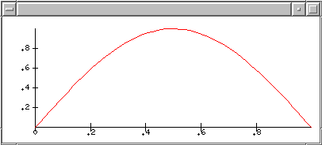


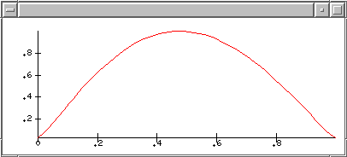
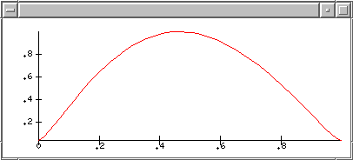
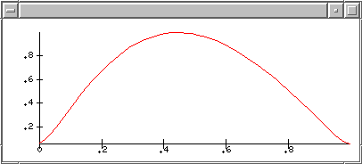
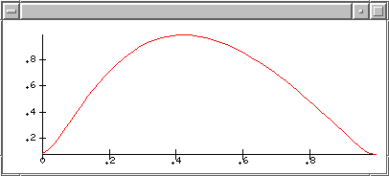
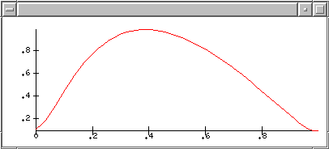
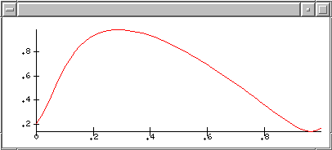
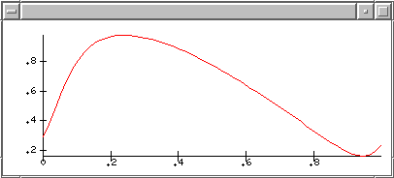
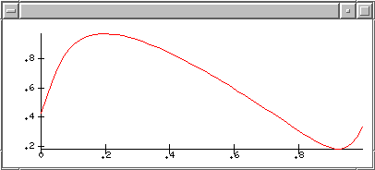
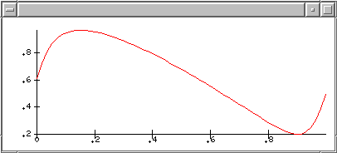
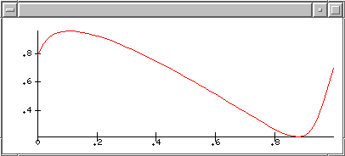
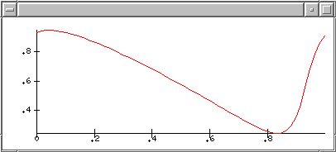

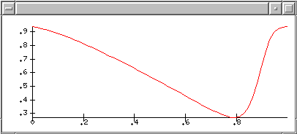
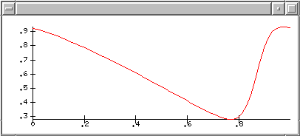
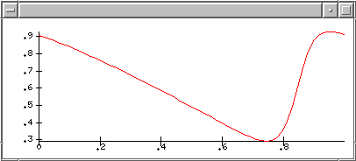
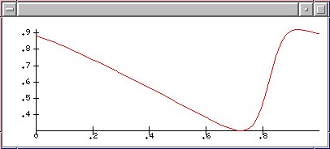
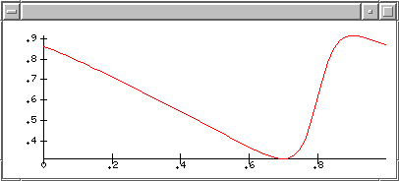
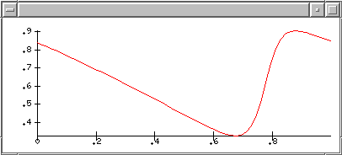
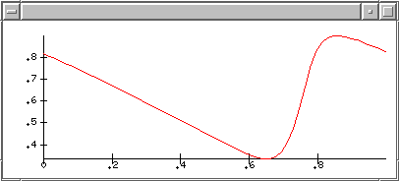
























Sample Timestepping Application:
Burger’s Equation
U_{t}= U U_{x} +  U_{xx}
_{U(0,x) = sin(2x)}
_{U(t,0) = U(t,1)}
solvers: timestepping
beginner

Slide 122
Actual Local Function Code
U_{t} = F(t,U) = U_{i} (U_{i+1} - U _{i-1})/(2h) +
 (U_{i+1} - 2U_{i} + U _{i-1})/(h*h)
Do 10, i=1,localsize
  F(i) = (.5/h)*u(i)*(u(i+1)-u(i-1)) +
    (e/(h*h))*(u(i+1) - 2.0*u(i) + u(i-1))
10 continue
solvers: timestepping
beginner

Slide 123
Timestepping Solvers
Euler
Backward Euler
Pseudo-transient continuation
Interface to PVODE, a sophisticated parallel ODE solver package by Hindmarsh et al. of LLNL
  Adams
  BDF
solvers: timestepping
beginner

Slide 124
Timestepping Solvers
Allow full access to all of the PETSc
  nonlinear solvers
  linear solvers
  distributed arrays, matrix assembly tools, etc.
User can customize all phases of the solution process
solvers: timestepping
beginner

Slide 125
TS: Review of Basic Usage
TSCreate( ) - Create TS context
TSSetRHSFunction( ) - Set function eval. routine
TSSetRHSJacobian( ) - Set Jacobian eval. routine
TSSetFromOptions( ) - Set runtime solver options for [TS,SNES,SLES,KSP,PC]
TSSolve( ) - Run timestepping solver
TSView( ) - View solver options actually used at runtime (alternative: -ts_view)
TSDestroy( ) - Destroy solver
solvers: timestepping
beginner

Slide 126

TS: Review of Selected Options
1
2
1
2
And many more options...
solvers: timestepping
beginner
intermediate

Slide 127
TS: Example Programs
Location: petsc/src/ts/examples/tutorials/
ex1.c, ex1f.F - basic uniprocess codes (time- dependent nonlinear PDE)
ex2.c, ex2f.F - basic parallel codes (time-dependent nonlinear PDE)
ex3.c - uniprocess heat equation
ex4.c - parallel heat equation
1
E
2
  And many more examples ...
1
2
solvers: timestepping
E
- on-line exercise
beginner
intermediate

Slide 128
Mesh Definitions: For Our Purposes
Structured: Determine neighbor relationships purely from logical I, J, K coordinates
Semi-Structured: In well-defined regions, determine neighbor relationships purely from logical I, J, K coordinates
Unstructured: Do not explicitly use logical I, J, K coordinates
beginner
data layout

Slide 129
Structured Meshes
PETSc support provided via DA objects
beginner
data layout

Slide 130

Unstructured Meshes
One is always free to manage the mesh data as if unstructured
PETSc does not currently have high-level tools for managing such meshes
PETSc can manage unstructured meshes though lower-level VecScatter utilities
beginner
data layout

Slide 131
Semi-Structured Meshes
No explicit PETSc support
  OVERTURE-PETSc for composite meshes
  SAMRAI-PETSc for AMR
beginner
data layout

Slide 132
Parallel Data Layout and Ghost Values: Usage Concepts
Managing field data layout and required ghost values is the key to high performance of most PDE-based parallel programs.
Mesh Types
Usage Concepts
Structured
  DA objects
Unstructured
  VecScatter objects
Geometric data
Data structure creation
Ghost point updates
Local numerical computation
tutorial outline: data layout
important concepts

Slide 133
Ghost Values
Local node
Ghost node
Ghost values: To evaluate a local function f(x) , each process requires its local portion of the vector x as well as its ghost values – or bordering portions of x that are owned by neighboring processes.
beginner
data layout

Slide 134
Communication and Physical Discretization
Communication
Local
Numerical
Computation
Geometric
Data
Data Structure
Creation
Ghost Point
Data Structures
Ghost Point
Updates
stencil
[implicit]
DACreate( )
DA
AO
Loops over
I,J,K
indices
DAGlobalToLocal( )
structured meshes
1
elements
edges
vertices
VecScatter
AO
Loops over
entities
VecScatterCreate( )
VecScatter( )
unstructured meshes
2
1
2
beginner
intermediate
data layout

Slide 135
DA: Parallel Data Layout and
Ghost Values for Structured Meshes
beginner
Local and global indices
Local and global vectors
DA creation
Ghost point updates
Viewing
beginner
beginner
intermediate
intermediate
tutorial outline: data layout: distributed arrays

Slide 136
Communication and Physical Discretization:
Structured Meshes
Communication
Local
Numerical
Computation
Geometric
Data
Data Structure
Creation
Ghost Point
Data Structures
Ghost Point
Updates
stencil
[implicit]
DACreate( )
DA
AO
Loops over
I,J,K
indices
DAGlobalToLocal( )
structured meshes
data layout: distributed arrays
beginner

Slide 137
Global and Local Representations
Local node
Ghost node
5
9
0
1
2
3
4
Global: each process stores a unique local set of vertices (and each vertex is owned by exactly one process)
Local: each process stores a unique local set of vertices as well as ghost nodes from neighboring processes
data layout: distributed arrays
beginner

Slide 138
Global and Local Representations (cont.)
Proc 1
9 10 11
6 7 8
3 4 5
0 1 2
Global Representation:
Proc 0
0
1
2
3
4
5
6
7
8
9
10
11
Proc 0
Proc 1
Local Representations:
6 7 8
3 4 5
0 1 2
6 7 8
3 4 5
0 1 2
Proc 1
Proc 1
3
4
5
6
7
8
9
10
11
0
1
2
3
4
5
6
7
8
0
1
2
3
4
5
6
7
8
Proc 0
Proc 0
0
1
2
3
4
5
6
7
8
data layout: distributed arrays
beginner

Slide 139
Logically Regular Meshes
DA - Distributed Array: object containing information about vector layout across the processes and communication of ghost values
Form a DA
  DACreate1d(….,DA *)
  DACreate2d(….,DA *)
  DACreate3d(….,DA *)
Create the corresponding PETSc vectors
  DACreateGlobalVector( DA, Vec *) or
  DACreateLocalVector( DA, Vec *)
Update ghostpoints (scatter global vector into local parts, including ghost points)
  DAGlobalToLocalBegin(DA, …)
  DAGlobalToLocalEnd(DA,…)
data layout: distributed arrays
beginner

Slide 140
Distributed Arrays
Data layout and ghost values
Proc 10
Proc 10
Proc 0
Proc 1
Proc 0
Proc 1
Box-type
stencil
Star-type
stencil
data layout: distributed arrays
beginner

Slide 141
Vectors and DAs
The DA object contains information about the data layout and ghost values, but not the actual field data, which is contained in PETSc vectors
Global vector: parallel
  each process stores a unique local portion
  DACreateGlobalVector(DA da,Vec *gvec);
Local work vector: sequential
  each process stores its local portion plus ghost values
  DACreateLocalVector(DA da,Vec *lvec);
  uses “natural” local numbering of indices (0,1,…nlocal-1)
data layout: distributed arrays
beginner

Slide 142
DACreate1d(…,*DA)
DACreate1d(MPI_Comm comm,DAPeriodicType wrap,int M,int dof,int s,int *lc,DA *inra)
  MPI_Comm — processes containing array
  DA_[NONPERIODIC,XPERIODIC]
  number of grid points in x-direction
  degrees of freedom per node
  stencil width
  Number of nodes for each cell (use PETSC_NULL for the default)
data layout: distributed arrays
beginner

Slide 143
DACreate2d(…,*DA)
DACreate2d(MPI_Comm comm,DAPeriodicType wrap,DAStencilType stencil_type, int M,int N,int m,int n,int dof,int s,int *lx,int *ly,DA *inra)
  DA_[NON,X,Y,XY]PERIODIC
  DA_STENCIL_[STAR,BOX]
  number of grid points in x- and y-directions
  processes in x- and y-directions
  degrees of freedom per node
  stencil width
  Number of nodes for each cell (use PETSC_NULL for the default) as tensor-product
And similarly for DACreate3d()
data layout: distributed arrays
beginner

Slide 144
Updating the Local Representation
Two-step process that enables overlapping computation and communication
DAGlobalToLocalBegin(DA, Vec global_vec, insert,
Vec local_vec )
  global_vec provides data
  Insert is either INSERT_VALUES or ADD_VALUES and specifies how to update values in the local vector, local_vec (a pre-existing local vector)
DAGlobalToLocal End(DA,…)
  Takes same arguments
data layout: distributed arrays
beginner

Slide 145
Ghost Point Scatters:
Burger’s Equation Example
call DAGlobalToLocalBegin(da,u_global,INSERT_VALUES,ulocal,ierr)
call DAGlobalToLocalEnd(da,u_global,INSERT_VALUES,ulocal,ierr)
call VecGetArray( ulocal, uv, ui, ierr )
#define u(i) uv(ui+i)
C Do local computations (here u and f are local vectors)
do 10, i=1,localsize
  f(i) = (.5/h)*u(i)*(u(i+1)-u(i-1)) +
    (e/(h*h))*(u(i+1) - 2.0*u(i) + u(i-1))
10 continue
call VecRestoreArray( ulocal, uv, ui, ierr )
call DALocalToGlobal(da,f,INSERT_VALUES,f_global,ierr)
data layout: distributed arrays
beginner

Slide 146
Global Numbering used by DAs
Proc 2
Proc 3
Proc 2
Proc 3
26 27 28 29 30
21 22 23 24 25
16 17 18 19 20
11 12 13 14 15
6 7 8 9 10
1 2 3 4 5
22 23 24 29 30
19 20 21 27 28
16 17 18 25 26
7 8 9 14 15
4 5 6 12 13
1 2 3 10 11
Proc 0
Proc1
Proc 0
Proc1
Natural numbering, corresponding to the entire problem domain
PETSc numbering used by DAs
data layout: distributed arrays
intermediate

Slide 147
Mapping Between Global Numberings
Natural global numbering
  convenient for visualization of global problem, specification of certain boundary conditions, etc.
Can convert between various global numbering schemes using AO (Application Orderings)
  DAGetAO(DA da, AO *ao);
  AO usage explained in next section
Some utilities (e.g., VecView()) automatically handle this mapping for global vectors attained from DAs
data layout: distributed arrays
intermediate

Slide 148
Distributed Array Example
src/snes/examples/tutorial/ex5.c, ex5f.F
  Uses functions that help construct vectors and matrices naturally associated a DA
    DAGetMatrix
    DASetLocalFunction
    DASetLocalJacobian

Slide 149
End of Day 2

Slide 150
Unstructured Meshes
Setting up communication patterns is much more complicated than the structured case due to
  mesh dependence
  discretization dependence
    cell-centered
    vertex-centered
    cell and vertex centered (e.g., staggered grids)
    mixed triangles and quadrilaterals
Can use VecScatter
  Introduction in this tutorial
  See additional tutorial material available via PETSc web site
data layout: vector scatters
beginner

Slide 151
Communication and Physical Discretization
Communication
Local
Numerical
Computation
Geometric
Data
Data Structure
Creation
Ghost Point
Data Structures
Ghost Point
Updates
stencil
[implicit]
DACreate( )
DA
AO
Loops over
I,J,K
indices
DAGlobalToLocal( )
structured mesh
1
elements
edges
vertices
VecScatter
AO
Loops over
entities
VecScatterCreate( )
VecScatter( )
unstructured mesh
2
1
2
beginner
intermediate
data layout

Slide 152
Unstructured Mesh Concepts
AO: Application Orderings
  map between various global numbering schemes
IS: Index Sets
  indicate collections of nodes, cells, etc.
VecScatter:
  update ghost points using vector scatters/gathers
ISLocalToGlobalMapping
  map from a local (calling process) numbering of indices to a global (across-processes) numbering
data layout: vector scatters
intermediate

Slide 153
Setting Up the Communication Pattern
(the steps in creating VecScatter)
Renumber objects so that contiguous entries are adjacent
  Use AO to map from application to PETSc ordering
Determine needed neighbor values
Generate local numbering
Generate local and global vectors
Create communication object (VecScatter)
data layout: vector scatters
intermediate

Slide 154
Cell-based Finite Volume
Application Numbering
Proc 0
Proc1
1
2
3
4
0
5
6
7
11
10
9
8
global indices defined by application
data layout: vector scatters
intermediate

Slide 155
PETSc Parallel Numbering
Proc 0
Proc 1
0
1
6
7
2
3
8
9
4
5
10
11
global indices numbered contiguously on each process
data layout: vector scatters
intermediate

Slide 156
Remapping Global Numbers:
An Example
Process 0
  nlocal: 6
  app_numbers: {1,2,0,5,11,10}
  petsc_numbers: {0,1,2,3,4,5}
Process 1
  n_local: 6
  app_numbers: {3,4,6,7,9,8}
  petsc_numbers: {6,7,8,9,10,11}
Proc 0
Proc 1
PETSc
numbers
0
1
6
7
2
3
8
9
4
5
10
11
application
numbers
1
2
3
4
0
5
6
7
11
10
9
8
data layout: vector scatters
intermediate

Slide 157
Remapping Numbers (1)
Generate a parallel object (AO) to use in mapping between numbering schemes
AOCreateBasic( MPI_Comm comm,
  int nlocal,
  int app_numbers[ ],
  int petsc_numbers[ ],
  AO *ao );
data layout: vector scatters
intermediate

Slide 158
Remapping Numbers (2)
AOApplicationToPetsc(AO *ao,
  int number_to_convert,
  int indices[ ]);
For example, if indices[ ] contains the cell neighbor lists in an application numbering, then apply AO to convert to new numbering
data layout: vector scatters
intermediate

Slide 159
Neighbors
using global PETSc numbers (ordering of the global PETSc vector)
Process 0
Process1
0
1
6
1
6
7
2
3
8
3
8
9
4
5
10
5
10
11
ghost cells
data layout: vector scatters
intermediate

Slide 160
Local Numbering
Proc 0
Proc1
0
1
6
6
0
1
2
3
7
7
2
3
4
5
8
8
4
5
At end of local vector
ghost cells
data layout: vector scatters
intermediate

Slide 161


Summary of the Different Orderings
Local points at the end
L
o
c
a
l
O
r
d
e
r
i
n
g
o
n
P
r
o
c
e
s
s
0
L
o
c
a
l
O
r
d
e
r
i
n
g
o
n
P
r
o
c
e
s
s
1
7
8
1
2
1
2
7
8
5
6
1
1
1
1
5
6
3
4
1
0
1
0
3
4
1
2
9
9
1
2

Slide 162
Global and Local Representations
Global representation
  parallel vector with no ghost locations
  suitable for use by PETSc parallel solvers (SLES, SNES, and TS)
Local representation
  sequential vectors with room for ghost points
  used to evaluate functions, Jacobians, etc.
data layout: vector scatters
intermediate

Slide 163
Global and Local Representations
Global representation:
0
1
2
3
4
5
6
7
8
9
10
11
Proc 0
Proc1
Local Representations:
0
1
2
3
4
5
6
8
10
Proc 0
0
1
2
3
4
5
6
7
8
Proc1
6
7
8
9
10
11
1
3
5
0
1
2
3
4
5
6
7
8
data layout: vector scatters
intermediate

Slide 164
Creating Vectors
Sequential
VecCreateSeq(PETSC_COMM_SELF, 9, Vec *lvec);
Parallel
VecCreateMPI(PETSC_COMM_WORLD,
6,PETSC_DETERMINE,Vec *gvec)
data layout: vector scatters
intermediate

Slide 165
Local and Global Indices
Process 0
  int indices[] = {0,1,2,3,4,5,6,8,10};
  ISCreateGeneral(PETSC_COMM_WORLD,
  9, indices, IS *isg);
  ISCreateStride(PETSC_COMM_SELF, 9,0,1,IS* isl);
Process 1
  int indices = {6,7,8,9,10,11,1,3,5};
  ISCreateGeneral(PETSC_COMM_WORLD,
  9, indices, IS *isg);
  ISCreateStride(PETSC_COMM_SELF, 9,0,1,IS* isl);
ISCreateGeneral() - Specify global numbers of locally owned cells, including ghost cells
ISCreateStride() - Specify local numbers of locally owned cells, including ghost cells
data layout: vector scatters
intermediate

Slide 166
Creating Communication Objects
VecScatterCreate(Vec gvec,
  IS gis,
  Vec lvec,
  IS lis
  VecScatter gtol);
Determines all required messages for mapping data from a global vector to local (ghosted) vectors
data layout: vector scatters
intermediate

Slide 167
Performing a Global-to-Local Scatter
Two-step process that enables overlapping computation and communication
VecScatterBegin(VecScatter gtol,
  Vec gvec,
  Vec lvec,
  INSERT_VALUES
  SCATTER_FORWARD);
VecScatterEnd(...);
data layout: vector scatters
intermediate

Slide 168
Performing a Local-to-Global Scatter
VecScatterBegin(VecScatter gtol,
  Vec lvec,
  Vec gvec,
  ADD_VALUES,
  SCATTER_REVERSE);
VecScatterEnd(...);
data layout: vector scatters
intermediate

Slide 169
Setting Values in Global Vectors and Matrices using a Local Numbering
Create mapping
  ISLocalToGlobalMappingCreateIS(IS gis, ISLocalToGlobalMapping *lgmap);
Set mapping
  VecSetLocalToGlobalMapping(Vec gvec, ISLocalToGlobalMapping lgmap);
  MatSetLocalToGlobalMapping(Mat gmat, ISLocalToGlobalMapping lgmap);
Set values with local numbering
  VecSetValuesLocal(Vec gvec,int ncols, int localcolumns, Scalar *values, …);
  MatSetValuesLocal(Mat gmat, ...);
  MatSetValuesLocalBlocked(Mat gmat, ...);
data layout: vector scatters
intermediate

Slide 170
Sample Function Evaluation
int FormFunction(SNES snes, Vec Xglobal, Vec Fglobal, void *ptr)
{
AppCtx *user = (AppCtx *) ptr;
double x1, x2, f1, f2, *x, *f ;
int *edges = user->edges;
VecScatterBegin(user->scatter, Xglobal, user->Xlocal, SCATTER_FORWARD, INSERT_VALUES);
VecScatterEnd(user->scatter, Xglobal, user->Xlocal, SCATTER_FORWARD, INSERT_VALUES);
VecGetArray(Xlocal,&X); VecGetArray(Flocal,&F);
for (i=0; i < user->nlocal; i++) {
x1 = X[edges[2*i]]; x2 = X[edges[2*i+1]]; /* then compute f1, f2 */
F[edges[2*i]] += f1; F[edges[2*i+1]] += f2;
}
VecRestoreArray(Xlocal,&X); VecRestoreArray(Flocal,&F);
VecScatterBegin(user->scatter, user->Flocal, Fglobal, SCATTER_REVERSE, INSERT_VALUES);
VecScatterEnd(user->scatter, user->Flocal, Fglobal, SCATTER_REVERSE, INSERT_VALUES);
return 0;
}
Predefined Scatter Context
data layout: vector scatters
intermediate

Slide 171
Communication and Physical Discretization
Communication
Local
Numerical
Computation
Geometric
Data
Data Structure
Creation
Ghost Point
Data Structures
Ghost Point
Updates
stencil
[implicit]
DACreate( )
DA
AO
Loops over
I,J,K
indices
DAGlobalToLocal( )
structured mesh
1
elements
edges
vertices
VecScatter
AO
Loops over
entities
VecScatterCreate( )
VecScatter( )
unstructured mesh
2
1
2
beginner
intermediate
data layout

Slide 172
Unstructured Meshes: Example Programs
Location:
  petsc/src/snes/examples/tutorials/ex10d/ex10.c
  2 process example (PETSc requires that a separate tool be used to divide the unstructured mesh among the processes).

Slide 173
Matrix Partitioning and Coloring
Intermediate
Partitioner object creation and use
Sparse finite differences for Jacobian computation (using colorings)
intermediate
tutorial outline: data objects: matrix partitioning and coloring

Slide 174
Partitioning for Load Balancing
MatPartitioning - object for managing the partitioning of meshes, vectors, matrices, etc.
Interface to parallel partitioners, i.e., the adjacency matrix, is stored in parallel
MatPartitioningCreate(
  MPI_Comm comm
  MatPartitioning *matpart);
data objects: matrices: partitioning
intermediate

Slide 175
Setting Partitioning Software
MatPartitioningSetType(
  MatPartitioning matpart,
  MatPartitioningType MATPARTITIONING_PARMETIS);
PETSc interface could support other packages (e.g., Pjostle, just no one has written wrapper code yet)
data objects: matrices: partitioning
intermediate

Slide 176
Setting Partitioning Information
MatPartitioningSetAdjacency(
  MatPartitioning matpart,
  Mat adjacency_matrix);
MatPartitioningSetVertexWeights(
  MatPartitioning matpart,
  int *weights);
MatPartitioningSetFromOptions(
  MatPartitioning matpart);
data objects: matrices: partitioning
intermediate

Slide 177
Partitioning
MatPartitioningApply(
  MatPartitioning matpart,
  IS* processforeachlocalnode);
…
MatPartitioningDestroy(
  MatPartitioning matpart);
data objects: matrices: partitioning
intermediate

Slide 178
Constructing Adjacency Matrix
MatCreateMPIAdj( (Uses CSR input format)
  MPI_Comm comm,
  int numberlocalrows,
  int numbercolums,
  int rowindices[ ],
  int columnindices[ ],
  int values[ ],
  Mat *adj)
Other input formats possible, e.g., via MatSetValues( )
data objects: matrices: partitioning
intermediate

Slide 179
Finite Difference Approximation of Sparse Jacobians
Two-stage process:
Compute a coloring of the Jacobian (e.g., determine columns of the Jacobian that may be computed using a single function evaluation)
Construct a MatFDColoring object that uses the coloring information to compute the Jacobian
example: driven cavity model: petsc/src/snes/examples/tutorials/ex8.c
data objects: matrices: coloring
intermediate

Slide 180
Coloring for Structured Meshes
DAGetColoring (
  DA da,
  ISColorType ctype,
  ISColoring *coloringinfo );
DAGetMatrix(
  DA da,
  MatType mtype,
  Mat *sparsematrix );
For structured meshes (using DAs) we provide parallel colorings
data objects: matrices: coloring
intermediate

Slide 181
Coloring for Unstructured Meshes
MatGetColoring (
  Mat A,
  MatColoringType
    MATCOLORING_NATURAL
    MATCOLORING_SL
    MATCOLORING_LF
    MATCOLORING_ID
  ISColoring *coloringinfo)
Automatic coloring of sparse matrices currently implemented only for sequential matrices
If using a “local” function evaluation, the sequential coloring is enough
data objects: matrices: coloring
intermediate

Slide 182
Actual Computation of Jacobians
MatFDColoringCreate (
  Mat J,
  ISColoring coloringinfo,
  MatFDColoring *matfd)
MatFDColoringSetFunction(
  MatFDColoring matfd,
  int (*f)(void),void *fctx)
MatFDColoringSetFromOptions(
  MatFDColoring)
data objects: matrices: coloring
intermediate

Slide 183
Computation of Jacobians within SNES
User calls: SNESSetJacobian(
  SNES snes,
  Mat A ,
  Mat J,
  SNESDefaultComputeJacobianColor( ),
  fdcoloring);
where SNESSetJacobian() actually uses …. MatFDColoringApply(
  Mat J,
  MatFDColoring coloring,
  Vec x1,
  MatStructure *flag,
  void *sctx)
to form the Jacobian
data objects: matrices: coloring
intermediate

Slide 184
Driven Cavity Model
Example code: petsc/src/snes/examples/tutorials/ex19.c
Solution Components
Velocity-vorticity formulation, with flow driven by lid and/or bouyancy
Finite difference discretization with 4 DoF per mesh point
velocity: u
velocity: v
[u,v,,T]
vorticity: 
temperature: T
1
2
solvers: nonlinear
beginner
intermediate

Slide 185
Driven Cavity Program
Part A: Parallel data layout
Part B: Nonlinear solver creation, setup, and usage
Part C: Nonlinear function evaluation
  ghost point updates
  local function computation
Part D: Jacobian evaluation
  default colored finite differencing approximation
Experimentation
1
2
solvers: nonlinear
beginner
intermediate

Slide 186
Driven Cavity Solution Approach
A
Main Routine
B
Nonlinear Solvers (SNES)
Solve
F(u) = 0
Linear Solvers (SLES)
PETSc
PC
KSP
Application
Initialization
Function
Evaluation
Jacobian
Evaluation
Post-
Processing
C
D
solvers: nonlinear
User code
PETSc code

Slide 187
Driven Cavity:
Running the program (1)
Matrix-free Jacobian approximation with no preconditioning (via -snes_mf) … does not use explicit Jacobian evaluation
1 process: (thermally-driven flow)
  mpirun -np 1 ex19 -snes_mf -snes_monitor -grashof 1000.0 -lidvelocity 0.0
2 processes, view DA (and pausing for mouse input):
  mpirun -np 2 ex19 -snes_mf -snes_monitor -da_view_draw -draw_pause -1
View contour plots of converging iterates
  mpirun ex19 -snes_mf -snes_monitor -snes_vecmonitor
solvers: nonlinear
beginner

Slide 188
Driven Cavity:
Running the program (2)
Use MatFDColoring for sparse finite difference Jacobian approximation; view SNES options used at runtime
  mpirun ex8 -snes_view -mat_view_info
Set trust region Newton method instead of default line search
  mpirun ex8 -snes_type tr -snes_view -snes_monitor
Set transpose-free QMR as Krylov method; set relative KSP convergence tolerance to be .01
  mpirun ex8 -ksp_type tfqmr -ksp_rtol .01 -snes_monitor
solvers: nonlinear
intermediate

Slide 189
Debugging and Error Handling
Automatic generation of tracebacks
Detecting memory corruption and leaks
Optional user-defined error handlers
beginner
beginner
developer
tutorial outline: debugging and errors

Slide 190
Debugging
Support for parallel debugging
-start_in_debugger [gdb,dbx,noxterm]
-on_error_attach_debugger [gb,dbx,noxterm]
-on_error_abort
-debugger_nodes 0,1
-display machinename:0.0
When debugging, it is often useful to place a breakpoint in the function PetscError( ).
beginner
debugging and errors

Slide 191

Sample Error Traceback
Breakdown in ILU factorization due to a zero pivot
beginner
debugging and errors

Slide 192

Sample Memory Corruption Error
beginner
debugging and errors

Slide 193

Sample Out-of-Memory Error
beginner
debugging and errors

Slide 194

Sample Floating Point Error
beginner
debugging and errors

Slide 195
Performance Requires
Managing Memory
Real systems have many levels of memory
  Programming models try to hide memory hierarchy
    Except C—register
Simplest model: Two levels of memory
  Divide at largest (relative) latency gap
  Processes have their own memory
    Managing a processes memory is known (if unsolved) problem
  Exactly matches the distributed memory model
profiling and performance tuning
intermediate

Slide 196
Sparse Matrix-Vector Product
Common operation for optimal (in floating-point operations) solution of linear systems
Sample code:
for row=0,n-1
m = i[row+1] - i[row];
sum = 0;
for k=0,m-1
sum += *a++ * x[*j++];
y[row] = sum;
Data structures are a[nnz], j[nnz], i[n], x[n], y[n]
profiling and performance tuning
intermediate

Slide 197
Simple Performance Analysis
Memory motion:
  nnz (sizeof(double) + sizeof(int)) +
  n (2*sizeof(double) + sizeof(int))
  Perfect cache (never load same data twice)
Computation
  nnz multiply-add (MA)
Roughly 12 bytes per MA
Typical WS node can move ½-4 bytes/MA
  Maximum performance is 4-33% of peak
profiling and performance tuning
intermediate

Slide 198
More Performance Analysis
Instruction Counts:
  nnz (2*load-double + load-int + mult-add) +
  n (load-int + store-double)
Roughly 4 instructions per MA
Maximum performance is 25% of peak (33% if MA overlaps one load/store)
Changing matrix data structure (e.g., exploit small block structure) allows reuse of data in register, eliminating some loads (x and j)
Implementation improvements (tricks) cannot improve on these limits
profiling and performance tuning
intermediate

Slide 199

Alternative Building Blocks
Performance of sparse matrix - multi-vector multiply:
Results from 250 MHz R10000 (500 MF/sec peak)
BAIJ is a block AIJ with blocksize of 4
Multiple right-hand sides can be solved in nearly the same time as a single RHS
profiling and performance tuning
intermediate

Slide 200
Matrix Memory Pre-allocation
PETSc sparse matrices are dynamic data structures. Can add additional nonzeros freely
Dynamically adding many nonzeros
  requires additional memory allocations
  requires copies
  can kill performance
Memory pre-allocation provides the freedom of dynamic data structures plus good performance
profiling and performance tuning
intermediate

Slide 201
Indicating Expected Nonzeros
Sequential Sparse Matrices
MatCreateSeqAIJ(…., int *nnz,Mat *A)
nnz[0] - expected number of nonzeros in row 0
nnz[1] - expected number of nonzeros in row 1
row 0
row 1
row 2
row 3
sample nonzero pattern
another sample
nonzero pattern
profiling and performance tuning
intermediate

Slide 202
Symbolic Computation of Matrix Nonzero Structure
Write code that forms the nonzero structure of the matrix
  loop over the grid for finite differences
  loop over the elements for finite elements
  etc.
Then create matrix via MatCreateSeqAIJ(), MatCreateMPIAIJ(), ...
profiling and performance tuning
intermediate

Slide 203
Parallel Sparse Matrices
Each process locally owns a submatrix of contiguously numbered global rows.
Each submatrix consists of diagonal and off-diagonal parts.
diagonal portions
proc 0
off-diagonal portions
proc 1
proc 2
}
proc 3: locally owned rows
proc 3
proc 4
profiling and performance tuning
intermediate

Slide 204
Indicating Expected Nonzeros
Parallel Sparse Matrices
MatCreateMPIAIJ(…., int d_nz, int *d_nnz,int o_nz,
int *o_nnz,Mat *A)
d_nnz[ ] - expected number of nonzeros per row in diagonal portion of local submatrix
o_nnz[ ] - expected number of nonzeros per row in off-diagonal portion of local submatrix
profiling and performance tuning
intermediate

Slide 205

Verifying Predictions
Use runtime option: -log_info
Output:
[proc #] Matrix size: % d X % d; storage space: % d unneeded, % d used
[proc #] Number of mallocs during MatSetValues( ) is % d
profiling and performance tuning
intermediate

Slide 206
Application Code Optimizations
Coding techniques to improve performance of user code on cache-based RISC architectures
profiling and performance tuning
intermediate

Slide 207
Cache-based CPUs
floating
point
units
memory
cache
registers
slow
fast
profiling and performance tuning
intermediate

Slide 208
Variable Interleaving
real u(maxn), v(maxn)
…
u(i) = u(i) + a*u(i-n)
v(i) = v(i) + b*v(i-n)
Consider direct-mapped cache:
V
V
U
V
U
V
U
V
V
U
U
V
V
V
V
V
U
U
U
V
V
V
V
V
U
U
U
V
V
V
V
V
U
U
V
V
V
V
U
U
V
V
V
U
U
U
V
U
U
U
U
Doubles number of cache misses
  Halves performance
n-way associative caches defeated by n+1 components
  Many problems have at least four to five components per point
profiling and performance tuning
intermediate

Slide 209
Techniques:
Interleaving Field Variables
X
Not
  double u[ ], double v[ ] ,double p[ ], ...
Not
  double precision fields(largesize,nc)
Instead
  double precision fields(nc,largesize)
profiling and performance tuning
intermediate

Slide 210
Techniques:
Reordering to Reuse Cache Data
Sort objects so that repeated use occurs together
  e.g., sort edges by the first vertex they contain
Reorder to reduce matrix bandwidth
  e.g., RCM ordering
profiling and performance tuning
intermediate

Slide 211
Effects on Performance: Sample
Incompressible Euler code
Unstructured grid
Edge-based discretization (i.e., computational loops are over edges)
Block size 4
Results collated by Dinesh Kaushik (ODU)
profiling and performance tuning
intermediate

Slide 212

Effects on Performance:
Sample Results on IBM SP
profiling and performance tuning
intermediate

Slide 213
Other Features of PETSc
Summary
New features
Interfacing with other packages
Extensibility issues
References
tutorial outline: conclusion

Slide 214
Summary
Creating data objects
Setting algorithmic options for linear, nonlinear and ODE solvers
Using callbacks to set up the problems for nonlinear and ODE solvers
Managing data layout and ghost point communication
Evaluating parallel functions and Jacobians
Consistent profiling and error handling

Slide 215
New Features
Version 2.1.x
  Simple interface for multigrid on structured meshes
  VecPack – manages treating several distinct vectors as one
    useful for design optimization problems written as a nonlinear system
  Parallel interface to SuperLU
Next release
  Automatically generated Jacobians via ADIC and ADIFOR
    Fully automated for structured mesh parallel programs using DAs
    General parallel case under development
Under development
  Interface to SLEPc eigenvalue software under development by V. Hernandez and J. Roman
  Support for ESI interfaces (see http://z.ca.sandia.gov/esi)
  Support for CCA-compliant components (see http://www.cca-forum.org)

Slide 216
Multigrid Structured Mesh Support:
DMMG: New Simple Interface
General multigrid support
  PC framework wraps MG for use as preconditioner
    See MGSetXXX(), MGGetXXX()
    Can access via -pc_type mg
  User provides coarse grid solver, smoothers, and interpolation/restriction operators
DMMG - simple MG interface for structured meshes
  User provides
    “Local” function evaluation
    [Optional] local Jacobian evaluation
Proc 10
Proc 0
Proc 1

Slide 217
Multigrid Structured Mesh Support:
Sample Function Computation
int Function(DALocalInfo *info,double **u,double **f,AppCtx *user)
…
lambda = user->param;
hx = 1.0/(info->mx-1);
hy = 1.0/(info->my-1);
for (j=info->ys; j<info->ys+info->ym; j++) {
for (i=info->xs; i<info->xs+info->xm; i++) {
f[j][i] = … u[j][i] … u[j-1][i] ….
}
}

Slide 218
Multigrid Structured Mesh Support:
Sample Jacobian Computation
int Jacobian (DALocalInfo *info,double **u,Mat J,AppCtx *user)
MatStencil mrow,mcols[5];
double v[5];
…
for (j=info->ys; j<info->ys+info->ym; j++) {
row.j = j;
for (i=info->xs; i<info->xs+info->xm; i++) {
v[0] = …; col[0].j = j - 1; col[0].i = i;
v[1] = …; col[1].j = j; col[1].i = i-1;
v[2] = …; col[2].j = j; col[2].i = i;
v[3] = …; col[3].j = j; col[3].i = i+1;
v[4] = …; col[4].j = j + 1; col[4].i = i;
MatSetValuesStencil(jac,1,&row,5,col,v,INSERT_VALUES);
}
}

Slide 219
Multigrid Structured Mesh Support:
Nonlinear Example
2-dim nonlinear problem with 4 degrees of freedom per mesh point
Function() and Jacobian() are user-provided functions
DMMG dmmg;
DMMGCreate(comm,nlevels,user,&dmmg)
DACreate2d(comm,DA_NONPERIODIC,DA_STENCIL_STAR,4, 4,PETSC_DECIDE,PETSC_DECIDE,4,1,0,0,&da)
DMMGSetDM(dmmg,da)
DMMGSetSNESLocal(dmmg,Function,Jacobian,0,0)
DMMGSolve(dmmg)
solution = DMMGGetx(damg)
All standard SNES, SLES, PC and MG options apply.

Slide 220
Multigrid Structured Mesh Support:
Jacobian via Automatic Differentiation
Collaboration with P. Hovland and B. Norris (see http://www.mcs.anl.gov/autodiff)
Additional alternatives
  Compute sparse Jacobian explicitly using AD
    DMMGSetSNESLocal(dmmg,Function,0,ad_Function,0)
      PETSc + ADIC automatically generate ad_Function
  Provide a “matrix-free” application of the Jacobian using AD
    DMMGSetSNESLocal(dmmg,Function, 0,0,admf_Function)
      PETSc + ADIC automatically generate admf_Function
Similar situation for Fortran and ADIFOR

Slide 221
Using PETSc with Other Packages
Linear algebra solvers
  AMG
  BlockSolve95
  DSCPACK
  hypre
  ILUTP
  LUSOL
  SPAI
  SPOOLES
  SuperLU, SuperLU_Dist
Optimization software
  TAO
  Veltisto
Mesh and discretization tools
  Overture
  SAMRAI
  SUMAA3d
ODE solvers
  PVODE
Others
  Matlab
  ParMETIS

Slide 222
Using PETSc with Other Packages:
Linear Solvers
Interface Approach
  Based on interfacing at the matrix level, where external linear solvers typically use a variant of compressed sparse row matrix storage
Usage
  Install PETSc indicating presence of any optional external packages in the file petsc/bmake/$PETSC_ARCH/base.site, e.g.,
    PETSC_HAVE_SPAI = -DPETSC_HAVE_SPAI
    SPAI_INCLUDE = -I/home/username/software/spai_3.0/include
    SPAI_LIB = /home/username/software/spai_3.0/lib/${PETSC_ARCH}/libspai.a
  Set preconditioners via the usual approach
    Procedural interface: PCSetType(pc,”spai”)
    Runtime option: -pc_type spai
  Set preconditioner-specific options via the usual approach, e.g.,
    PCSPAISetEpsilon(), PCSPAISetVerbose(), etc.
    -pc_spai_epsilon <eps> -pc_spai_verbose etc.

Slide 223
Using PETSc with Other Packages:
Linear Solvers
AMG
  Algebraic multigrid code by J. Ruge, K. Steuben, and R. Hempel (GMD)
  http://www.mgnet.org/mgnet-codes-gmd.html
  PETSc interface by D. Lahaye (K.U.Leuven), uses MatSeqAIJ
BlockSolve95
  Parallel, sparse ILU(0) for symmetric nonzero structure and ICC(0)
  M. Jones (Virginia Tech.) and P. Plassmann (Penn State Univ.)
  http://www.mcs.anl.gov/BlockSolve95
  PETSc interface uses MatMPIRowbs
ILUTP
  Drop tolerance ILU by Y. Saad (Univ. of Minnesota), in SPARSKIT
  http://www.cs.umn.edu/~saad/
  PETSc interface uses MatSeqAIJ

Slide 224
Using PETSc with Other Packages:
Linear Solvers (cont.)
LUSOL
  Sparse LU, part of MINOS
  M. Saunders (Stanford Univ)
  http://www.sbsi-sol-optimize.com
  PETSc interface by T. Munson (ANL), uses MatSeqAIJ
SPAI
  Sparse approximate inverse code by S. Barnhard (NASA Ames) and M. Grote (ETH Zurich)
  http://www.sam.math.ethz.ch/~grote/spai
  PETSc interface converts from any matrix format to SPAI matrix
SuperLU
  Parallel, sparse LU
  J. Demmel, J. Gilbert, (U.C. Berkeley) and X. Li (NERSC)
  http://www.nersc.gov/~xiaoye/SuperLU
  PETSc interface uses MatSeqAIJ
  Currently only sequential interface supported; parallel interface under development

Slide 225
Using PETSc with Other Packages:
TAO – Optimization Software
TAO - Toolkit for Advanced Optimization
  Software for large-scale optimization problems
  S. Benson, L. McInnes, and J. Moré
  http://www.mcs.anl.gov/tao
Initial TAO design uses PETSc for
  Low-level system infrastructure - managing portability
  Parallel linear algebra tools (SLES)
    Veltisto (library for PDE-constrained optimization by G. Biros, see http://www.cs.nyu.edu/~biros/veltisto) – uses a similar interface approach
TAO is evolving toward
  CCA-compliant component-based design (see http://www.cca-forum.org)
  Support for ESI interfaces to various linear algebra libraries (see http://z.ca.sandia.gov/esi)

Slide 226
TAO Interface
TAO_SOLVER tao; /* optimization solver */
Vec x, g; /* solution and gradient vectors */
ApplicationCtx usercontext; /* user-defined context */
TaoInitialize();
/* Initialize Application -- Create variable and gradient vectors x and g */ ...
TaoCreate(MPI_COMM_WORLD,”tao_lmvm”,&tao);
TaoSetFunctionGradient(tao,x,g, FctGrad,(void*)&usercontext);
TaoSolve(tao);
/* Finalize application -- Destroy vectors x and g */ ...
TaoDestroy(tao);
TaoFinalize();
software interfacing: TAO
Similar Fortran interface, e.g., call TaoCreate(...)

Slide 227
Using PETSc with Other Packages:
PVODE – ODE Integrators
PVODE
  Parallel, robust, variable-order stiff and non-stiff ODE integrators
  A. Hindmarsh et al. (LLNL)
  http://www.llnl.gov/CASC/PVODE
  L. Xu developed PVODE/PETSc interface
Interface Approach
  PVODE
    ODE integrator – evolves field variables in time
    vector – holds field variables
    preconditioner placeholder
Usage
  TSCreate(MPI_Comm,TS_NONLINEAR,&ts)
  TSSetType(ts,TS_PVODE)
  ….. regular TS functions
  TSPVODESetType(ts,PVODE_ADAMS)
  …. other PVODE options
  TSSetFromOptions(ts) – accepts PVODE options
PETSc
  ODE integrator placeholder
  vector
  sparse matrix and preconditioner

Slide 228
Using PETSc with Other Packages:
Mesh Management and Discretization
SUMAA3d
  Scalable Unstructured Mesh Algorithms and Applications
  L. Freitag (ANL), M. Jones (VA Tech), P. Plassmann (Penn State)
  http://www.mcs.anl.gov/sumaa3d
  L. Freitag and M. Jones developed SUMAA3d/PETSc interface
SAMRAI
  Structured adaptive mesh refinement
  R. Hornung, S. Kohn (LLNL)
  http://www.llnl.gov/CASC/SAMRAI
  SAMRAI team developed SAMRAI/PETSc interface
Overture
  Structured composite meshes and discretizations
  D. Brown, W. Henshaw, D. Quinlan (LLNL)
  http://www.llnl.gov/CASC/Overture
  K. Buschelman and Overture team developed Overture/PETSc interfaces

Slide 229
Using PETSc with Other Packages:
Matlab
Matlab
  http://www.mathworks.com
Interface Approach
  PETSc socket interface to Matlab
    Sends matrices and vectors to interactive Matlab session
  PETSc interface to MatlabEngine
    MatlabEngine – Matlab library that allows C/Fortran programmers to use Matlab functions in programs
    PetscMatlabEngine – unwraps PETSc vectors and matrices so that MatlabEngine can understand them
Usage
    PetscMatlabEngineCreate(MPI_Comm,machinename, PetscMatlabEngine eng)
    PetscMatlabEnginePut(eng,PetscObject obj)
      Vector
      Matrix
    PetscMatlabEngineEvaluate(eng,”R = QR(A);”)
    PetscMatlabEngineGet(eng,PetscObject obj)

Slide 230
Using PETSc with Other Packages:
ParMETIS – Graph Partitioning
ParMETIS
  Parallel graph partitioning
  G. Karypis (Univ. of Minnesota)
  http://www.cs.umn.edu/~karypis/metis/parmetis
Interface Approach
  Use PETSc MatPartitioning() interface and MPIAIJ or MPIAdj matrix formats
Usage
  MatPartitioningCreate(MPI_Comm,MatPartitioning ctx)
  MatPartitioningSetAdjacency(ctx,matrix)
  Optional – MatPartitioningSetVertexWeights(ctx,weights)
  MatPartitioningSetFromOptions(ctx)
  MatPartitioningApply(ctx,IS *partitioning)

Slide 231
Recent Additions
Hypre (www.llnl.gov/casc/hypre) via PCHYPRE, includes
  EUCLID (parallel ILU(k) by David Hysom)
  BoomerAMG
  PILUT
DSCPACK, a Domain-Separator Cholesky Package for solving sparse spd problems, by Padma Raghavan
SPOOLES (SParse Object Oriented Linear Equations Solver), by Cleve Ashcraft
Both SuperLU and SuperLU_Dist sequential and parallel direct sparse solvers, by Xiaoye Li et al.

Slide 232
Extensibility Issues
Most PETSc objects are designed to allow one to “drop in” a new implementation with a new set of data structures (similar to implementing a new class in C++).
Heavily commented example codes include
  Krylov methods: petsc/src/sles/ksp/impls/cg
  preconditioners: petsc/src/sles/pc/impls/jacobi
Feel free to discuss more details with us in person.

Slide 233
Caveats Revisited
Developing parallel, non-trivial PDE solvers that deliver high performance is still difficult, and requires months (or even years) of concentrated effort.
PETSc is a toolkit that can ease these difficulties and reduce the development time, but it is not a black-box PDE solver nor a silver bullet.
Users are invited to interact directly with us regarding correctness and performance issues by writing to petsc-maint@mcs.anl.gov.

Slide 234
References
Documentation: http://www.mcs.anl.gov/petsc/docs
  PETSc Users manual
  Manual pages
  Many hyperlinked examples
  FAQ, Troubleshooting info, installation info, etc.
Publications: http://www.mcs.anl.gov/petsc/publications
  Research and publications that make use PETSc
MPI Information: http://www.mpi-forum.org
Using MPI (2nd Edition), by Gropp, Lusk, and Skjellum
Domain Decomposition, by Smith, Bjorstad, and Gropp

