Slide 1


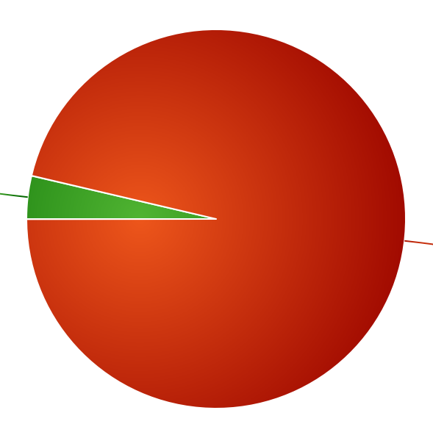


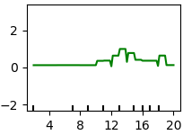

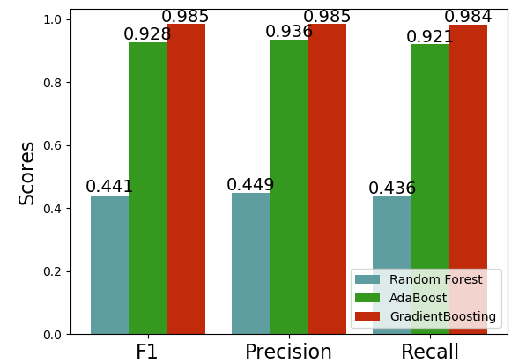




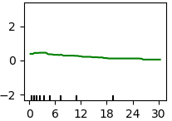
On The Rails (Predicting Public Transit)
Michael Moniger
mdmoniger@gmail.com | ln/michael-moniger | github.com/mdmoniger
Background
Methods
Results
Conclusion
According to the EPA, a typical passenger vehicle emits about 4.6 metric tons of carbon dioxide per year¹. This amounts to annual emissions of over 1.1 billion metric tons of CO₂ emissions nationwide.
NREL’s Transportation Secure Data Center provides public access to a variety of travel surveys and studies. Here, I focus on the California Travel Survey to explore behavior that may influence the adoption of more energy-efficient travel behavior, such as using public transit.
After adjusting for a massive class imbalance, I trained and compared three boosting algorithms, then grid searched over each to determine the hyperparameters that provided the highest F1 score.
Table 1. Feature Importances
Feature | Score
------------------------------------------
Departure time | 0.392
Arrival time | 0.264
Trip duration | 0.120
Activity duration | 0.090
Activity count | 0.072
Air trip distance | 0.036
Trip distance | 0.026
Since partial dependence plots indicate stronger effect on the target variable when the y-axis is farther from 0, one can see that the most important features are time-dependent. The first plot shows that public transit is more widely used between the hours of 12:00 and 3:00 PM, while the second indicates more use for shorter trips. Therefore, to reduce carbon emissions, we should focus primarily on incentivizing and streamlining short intracity systems, such as bus routes and light rail services.
I then extracted feature importances from the best model and plotted partial dependence plots to visualize the relationship between feature and target variables.
Each score represents the proportion of information gain attributed to its respective feature.
Public Transit:
3.68%
Other:
96.32%
Discussion
The Data
Partial dependence plots visually represent the “shape” of the relationship between feature and target variables.
500,000 travel surveys with hundreds of geographic and demographic features; in addition, I engineered many features, including trip duration.
Stack
Figure 1. Class Imbalance
Results
Objectives
Partial dependence
Build a predictive model to determine the likelihood that a given trip will utilize available public transit.
Determine which features most strongly predict whether an individual trip will be serviced by public transit.
For the most important features, determine the magnitude and direction by which each is related to mode of transportation.
Departure Time (hour of day)
References
Partial dependence
1. Sources of Greenhouse Gas Emissions. EPA. https://www.epa.gov/ghgemissions/sources-greenhouse-gas-emissions
2. Transportation Secure Data Center. National Renewable Energy. https://www.nrel.gov/transportation/secure-transportation-data/
Figure 2. Model Scores
In terms of all three scoring metrics, GradientBoosting algorithm outperformed both Random Forest and AdaBoost.
Trip Duration (minutes)
Figure 3. Partial Dependence Plots
Notes:
<number>

