Slide 1
CENTRALISED
WIRELESS
HOME APPLIANCE CONTROL

Slide 2
C e n t r a l i z e d
h o m e
a p p l i a n c e
c o n t r o l a n a l y s i s &
u s i n g
I O T w i t h
v i s u a l i z a t i o n o f
p o w e r
c o n s u m e d b y u s e r d e v i c e s

Slide 3
CURRENT PROBLEMS
Less ease of access to appliances at home Distribution of electricity by Electricity Board
No proper fault detection mechanism at home because of no real time monitoring system
No centralized system

Slide 4


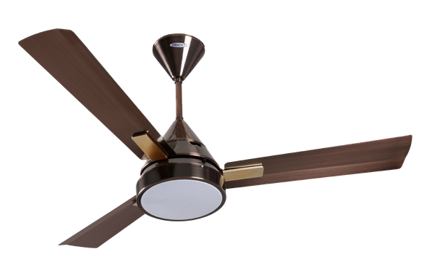
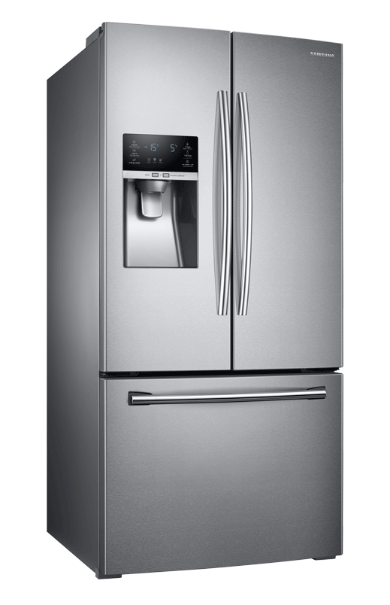














CENTRALIZED SYSTEM
Toilet + Bathroom
Kitchen
Drawing hall
Bedroo 1
Bedroom 2
m
Distribution Board
(attached to MCBs)

Slide 5
E S T I M A T E D C O S T O F O U R S Y S T E M
Sensor cost = Rs100 x 8 = Rs800
Relay cost = Rs60 x 8 Arduino board Raspberry pi
= Rs480
= Rs200
= Rs1500
~ Rs 3000

Slide 6
certain devices which only require monitoring
and not control
System can be more customized according to user needs
Additional sensors and relay switches will have to be added
no relay
switches

Slide 7
T A L K A C ' S !
L E T ' S
A B O U T
1.5 ton split AC consumes ~6.8 units of power during its 14 hr cycle assuming its compressor works for only 4 hrs in that cycle
Cost = Rs 40.8/day
If the user forgets to switch it off for some 6 hr duration..
Cost incurred = Rs 58.28/day
For that day, considering only an AC, we save ~42.8% energy!! Promising!

Slide 8



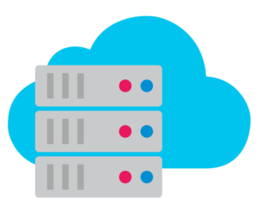
arduino uno controller
I N S I D E
Distribution Board
sensors
sensor data
relay switches
measured data
W H A T ' S
raspberry pi
power calculation, timestamp
Android app
Firebase cloud storage

Slide 9
I N N O V A T I O N
Both Web and Android interface
Voice control for switching devices on/off on web
interface
Dynamic and static graphs for visualization of power consumption over a duration of time
Realtime monitoring to alarm user if the usage becomes unsafe, over system notifications
Provision to switch devices on/off on scheduled times of
a day
Electric bill generation
An intelligent energy distribution system with
a fixed power use of every home set from Electricity Board(EB) office
Secured system over Raspberry pi

Slide 10
P R O J E C T D E M ^{F}O^{ir}

Slide 11
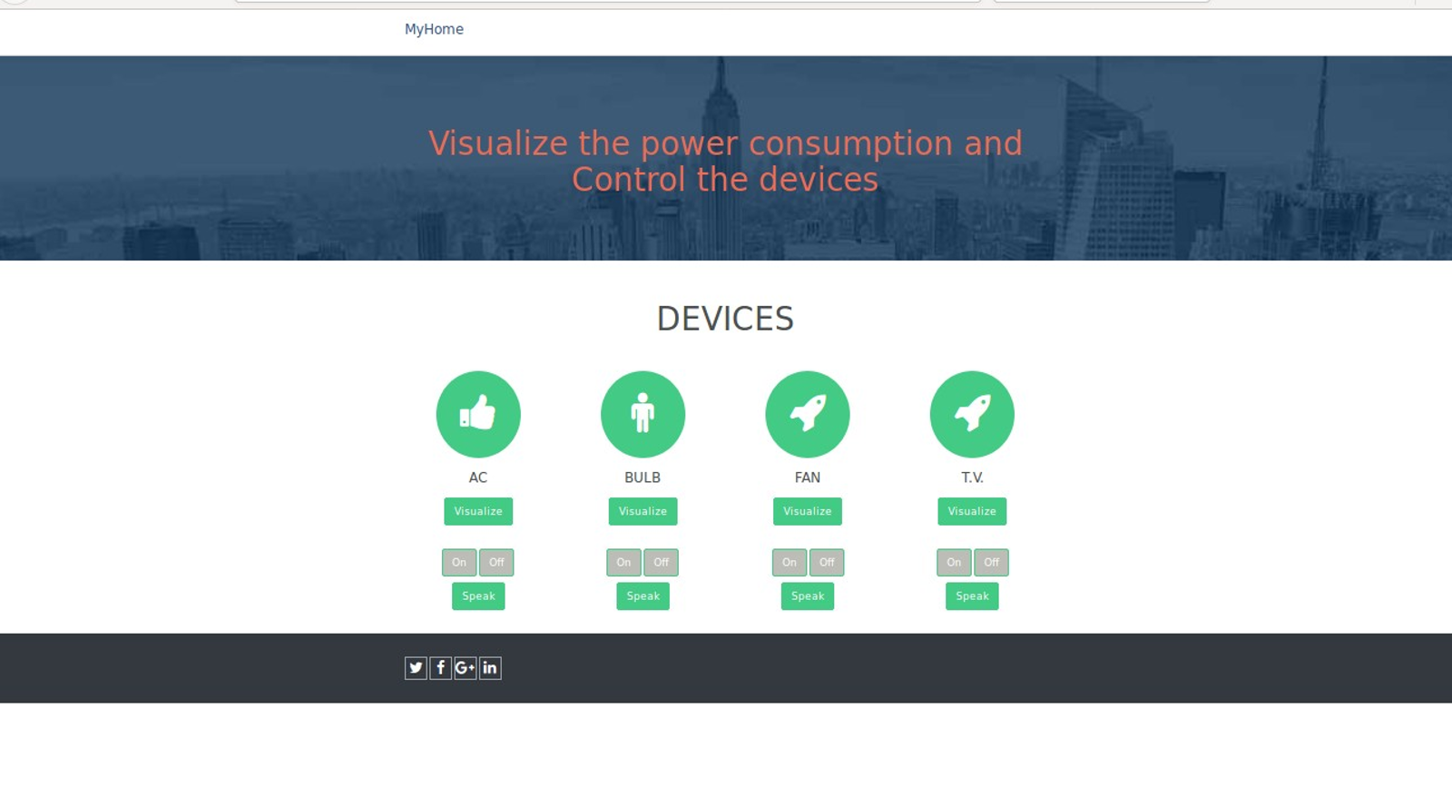
SCREENSHOTS FROM WEB INTERFACE

Slide 12
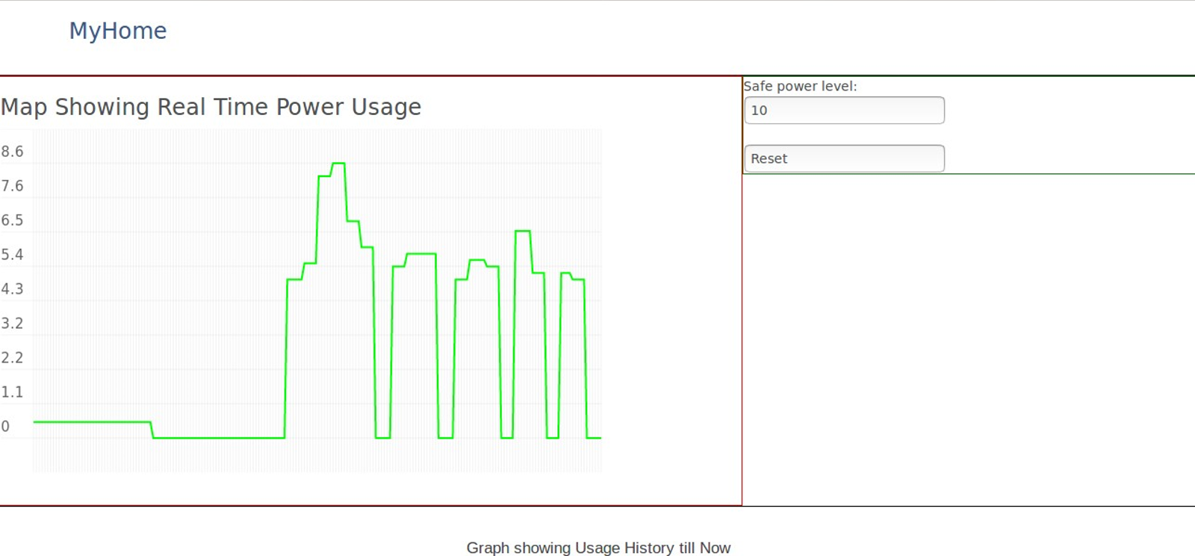

Slide 13
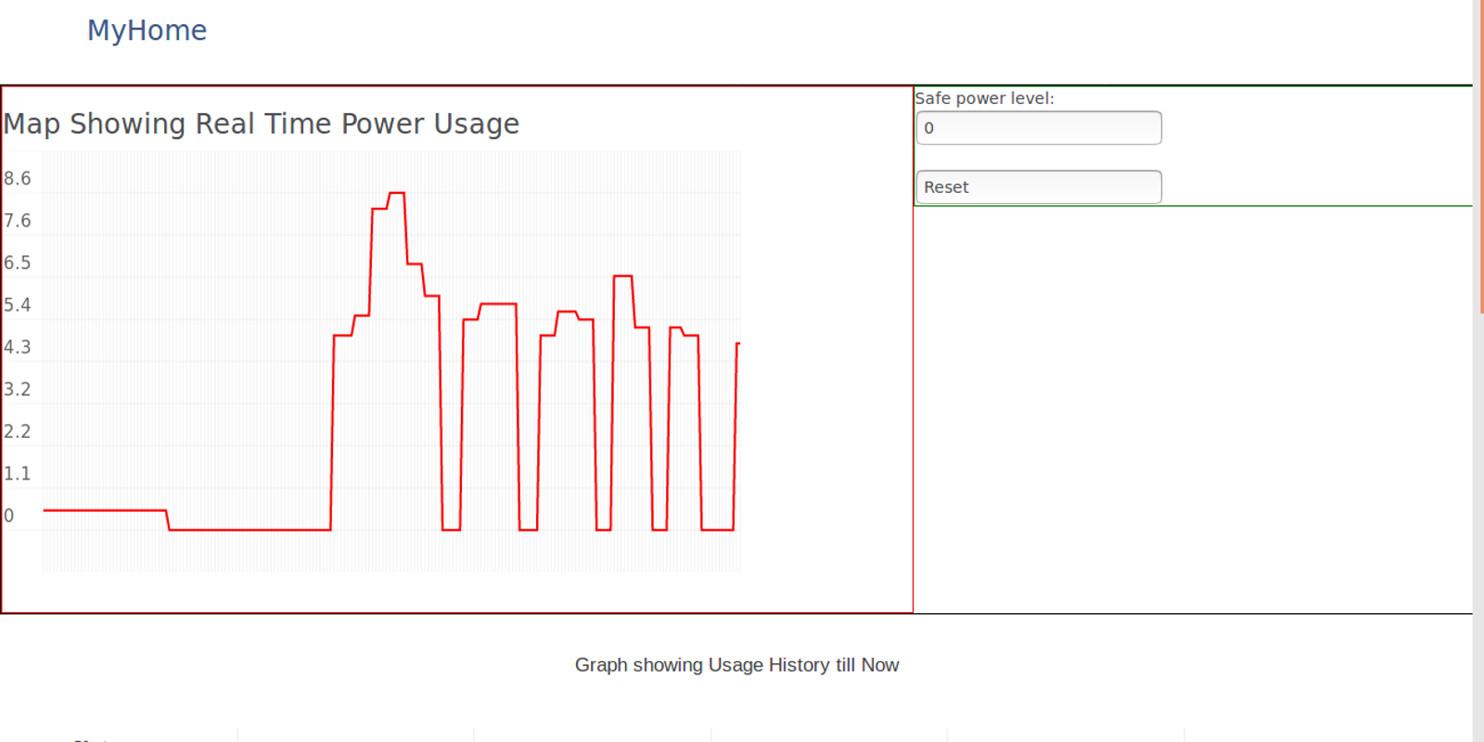

Slide 14
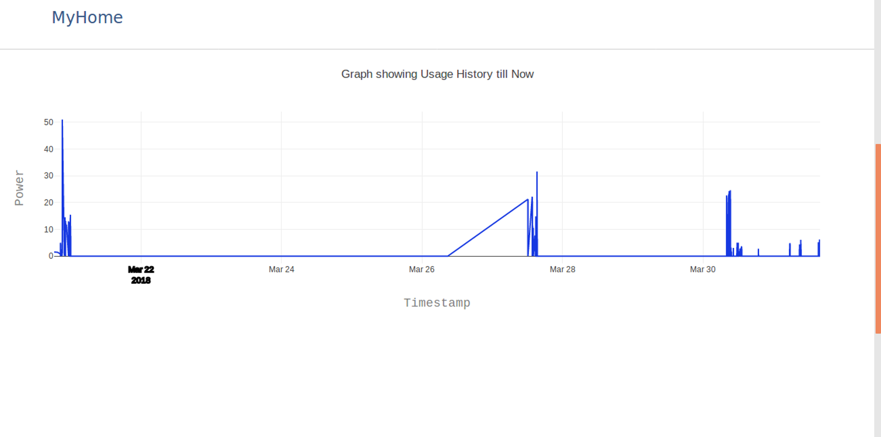

Slide 15
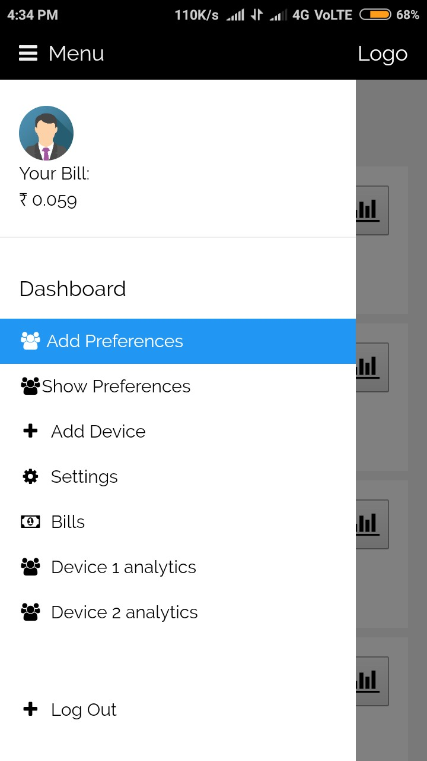
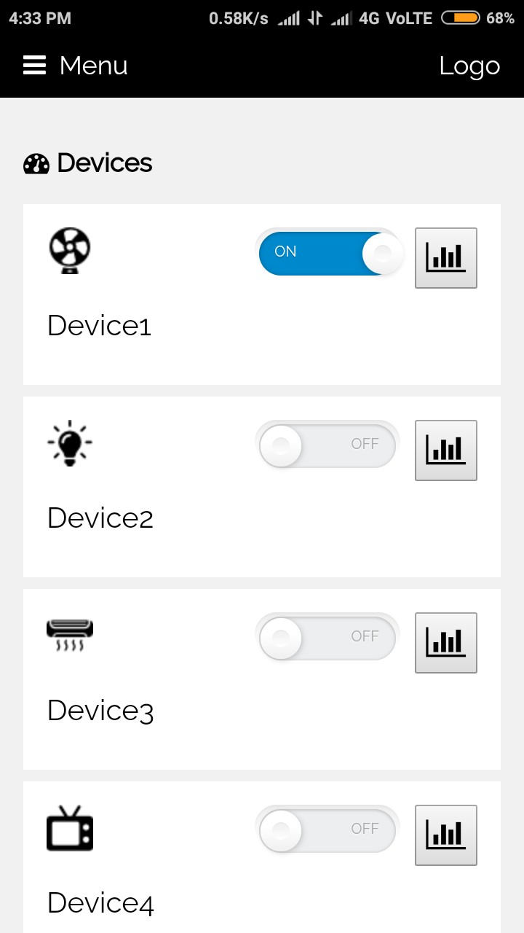
SCREENSHOTS
FROM ANDROID INTERFACE

Slide 16
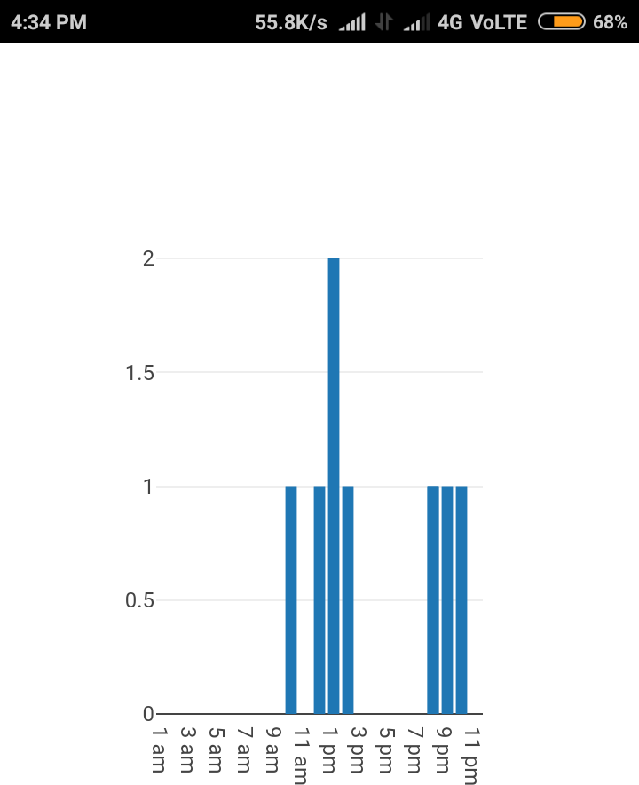
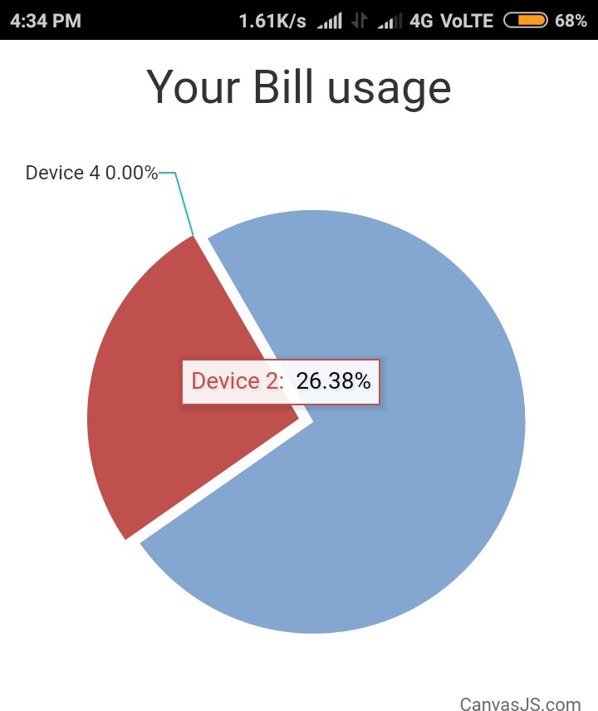
Add subheading

Slide 17
