Slide 1
ALGO-Verify
Trust-Lab IITB

Slide 2
The Problem
In today's digital world, the verification of academic credentials, such as degrees and certificates, is often a complex and time-consuming process. Traditional methods of verification rely on centralized systems that can be prone to fraud, inefficiencies, and a lack of transparency. Additionally, these systems often compromise the privacy and security of individuals' sensitive information.

Slide 3
The Solution
To address these challenges, we propose the development of an Algorand-based document verification application that leverages the power of blockchain technology to streamline and secure the verification process. Our goal is to create a decentralized and tamper-proof system that enhances trust, transparency, and privacy while reducing the administrative burden associated with document verification.

Slide 4
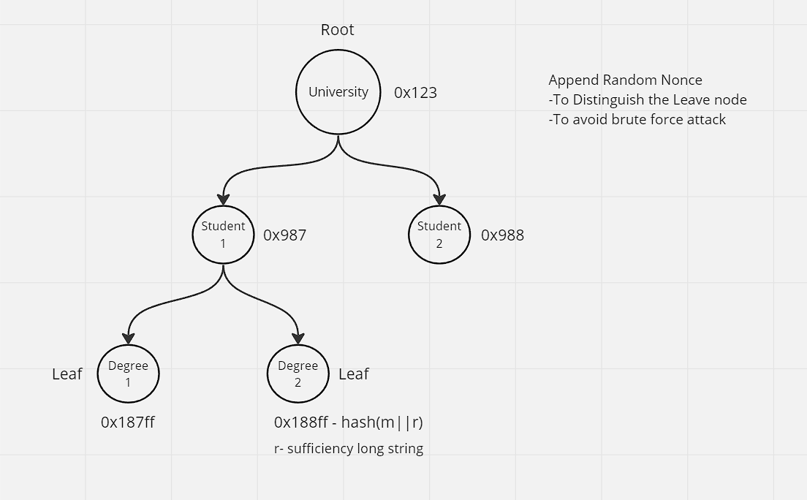
Background Information

Slide 5
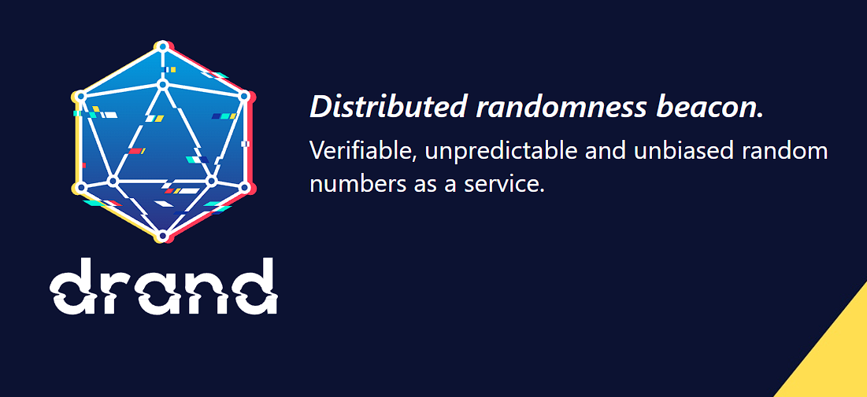
Background Information

Slide 6
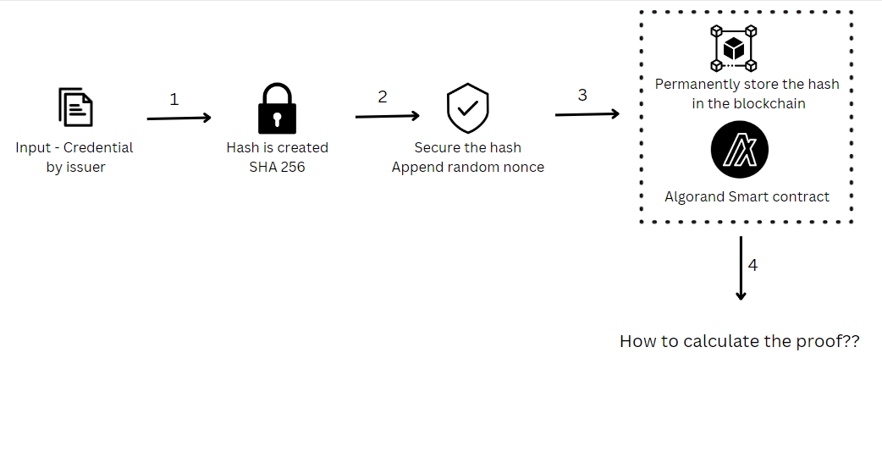
Background Information

Slide 7
Background Information
Bind the wallet to a real identity with KYC
Use to sign documents, proving the real identity agreed to sign the document
Verify: check the real identity bound to the document, without exposing their full identity, and check against the signature

Slide 8
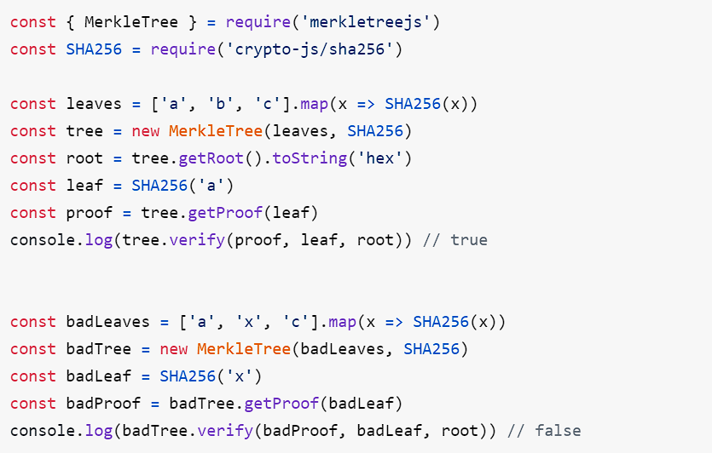
Merkle Hash

Slide 9
Doubts
Are we sending the hashes as a transactions in the blockchain? Only root
If we append random no to our hash then how we will verify the hash student will get (m1, r1, h2) as its opening of h3
but we may want to structure the student's data in a more structured form, so that they can selectively reveal parts of their information (say to a potential employer when they are applying for a job)
How to generate random nonce(Private)?

Slide 10
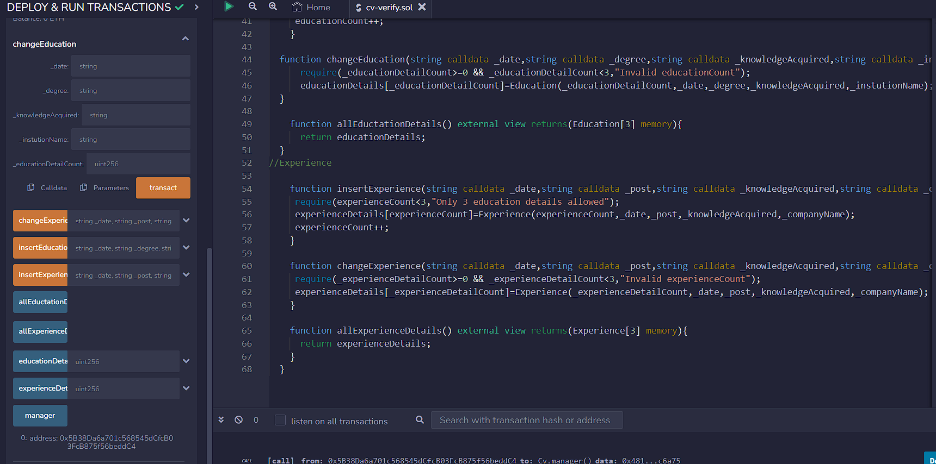
Extras (Solidity code)

