Slide 1
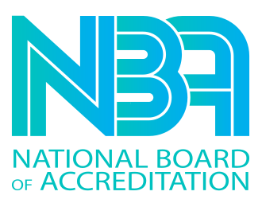





GALGOTIAS COLLEGE OF ENGINEERING AND TECHNOLOGY
DEPARTMENT OF COMPUTER SCIENCE AND ENGINEERING

Slide 2

TECHNOTHON- 2022
Team Name: ETHERnals
Name of team members: Mohammad Mudassir , Kunal Gupta
Organization Name: Galgotias College of Engineering and Technology
City, State: Greater Noida , Uttar Pradesh

Slide 3

TECHNOTHON- 2022
Description of Problem: Whenever someone wants to donate from other countries they have to pay lots of money in exchanges and in conversion fees and it take lots of time also.

Slide 4

TECHNOTHON- 2022
Proposed solution: We will create a decentralised blockchain platform where anyone can donate from anywhere in the world without exchange fees in just seconds.
We know that blockchain is a distributed , immutable ledger so no any central authority can control this and it is transparent as well so that everyone will know the flow of donation money.

Slide 5

TECHNOTHON- 2022
Technical feasibility: We need to develop smart contracts for this project by using Solidity programming language and also some frontend by using HTML, CSS, JS and then we will connect front end with web3.js and also integrate web3 with metamask(wallet).

Slide 6
TECHNOTHON- 2022
Societal Impact:The blockchain solution circumvents the bank as intermediary and thus bears only the costs required to conduct transactions on the Ethereum blockchain. Ether is divisible in up to 18 decimal places, allowing a large number of investors to invest reasonable small amounts in a student project (Buterin 2014). This is economically viable due to the decreased transaction costs.

Slide 7
TECHNOTHON- 2022
Environmental Sustainability: Ethereum 2.0 will reduce energy consumption by 99%.
Ethereum has a set of upgrades that address the environmental sustainability problems and more. This set of upgrades was originally called ‘SERANITY’ or ‘ETH2.0’ .

Slide 8

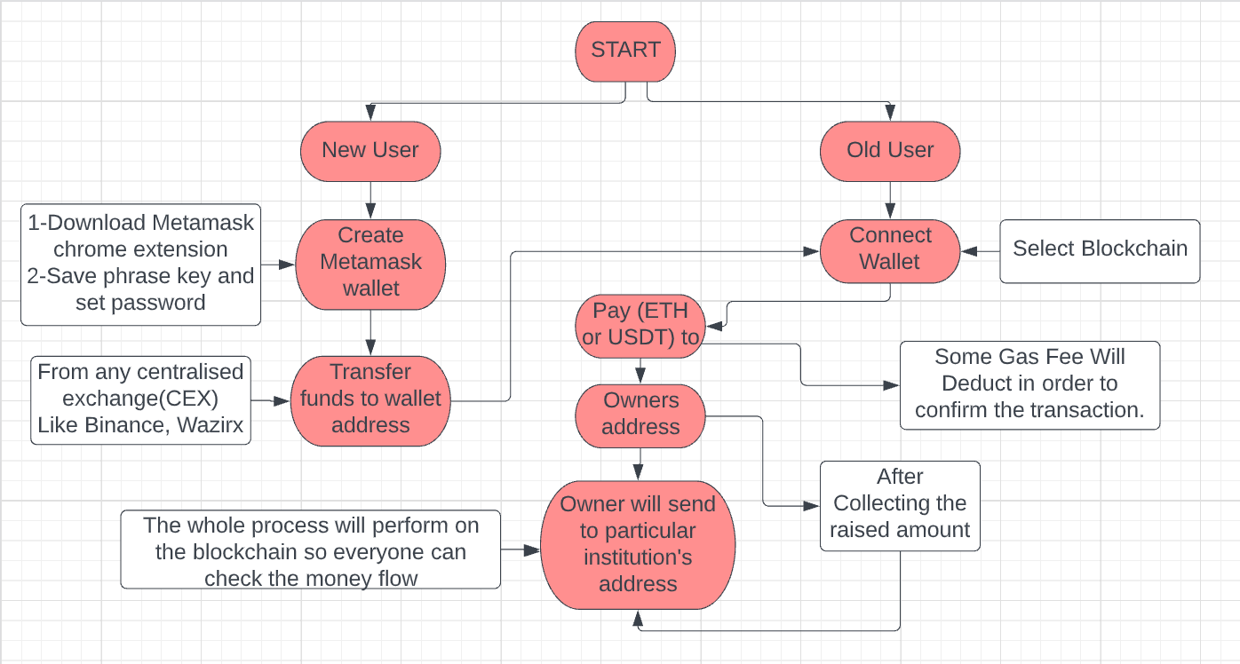
TECHNOTHON- 2022
Flowchart/ Block Diagram

