Slide 1
Customer
Behavior Analysis
By Mohammed Muqtadir Ahmed

Slide 2
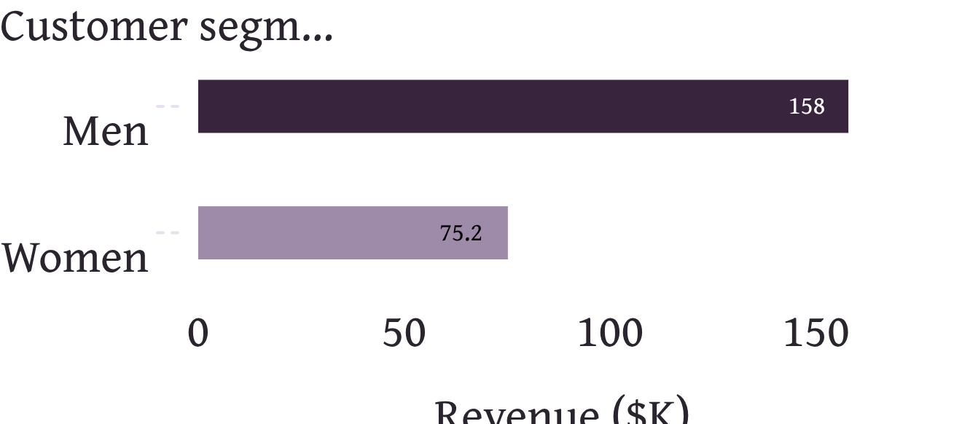
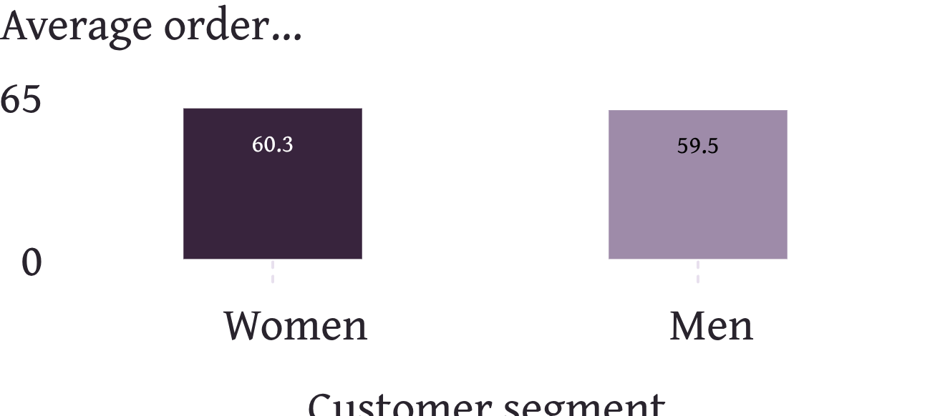
EXECUTIVE READOUT
Revenue is constrained by customer count, not basket size
Average order value stays close to $60 across the major customer and order segments.
3,900 customers generated $233,081 in revenue. Men represent 68% of customers and 68% of revenue, or $157.9K.
Women generate $75.2K, with nearly identical AOV: $60.25 versus $59.54 for men.
The gap is audience mix, not spending power. Growth should prioritize acquiring more of the right customers and increasing basket size.

Slide 3
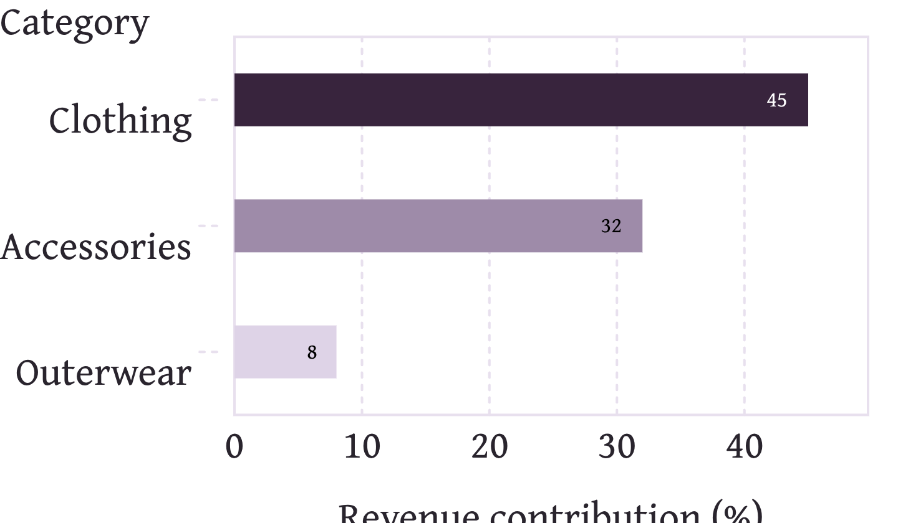
CATEGORY MIX
Clothing and Accessories carry the business
77%
of revenue comes from Clothing and Accessories.
Clothing contributes 45% of revenue, or $104K; Accessories contributes 32%, or $74K.
Outerwear contributes 8% and has the lowest AOV at $57.17.
Category contribution and AOV observations from the dataset.

Slide 4
RECOMMENDATION 01
Recommendations: make basket size the first growth test
Test the increment before scaling acquisition.
01
02
03
Bundle
Measure
Hold out
Test Clothing plus Accessories bundles and a free-shipping threshold around $75.
Measure AOV, units per order and conversion, not revenue alone.
Use a holdout group so the incremental effect is visible.
NEXT TEST
Target acquisition and redesign subscription. Run a targeted acquisition test for women in Clothing and Accessories.
Replace blanket subscription discounts with perks tied to higher spend: free shipping thresholds, early access or tiered rewards.
Move New customers toward subscription with a post-first-purchase offer.

Slide 5
RECOMMENDATION 02
Recommendations: protect margin and fix weak lines
Discount discipline
Product review
Reduce discount depth on Hat, Sneakers and Coat in a controlled test.
Review Jeans and Shirt for fit, quality or pricing issues.
Merchandising
Outerwear
Feature Gloves, Sandals and Boots in merchandising.
Review Outerwear pricing, range and premium SKU coverage.

Slide 6
READ BEFORE ACTING
Important caveats
DATA SCOPE | The dataset has no cost, margin, date or repeat-order data.
DISCOUNTS | Discount findings are observational, not proof of cause.
SEGMENT MIX | Loyal customers are 80% of the dataset because the segment is defined as more than 10 previous purchases.
VALIDATION | Use experiments and tighter segmentation to validate the recommendations.

Slide 7
APPENDIX
Project Workflow
1
2
Prepare
Load
Prepare the data in Python: clean fields, fill missing review ratings, create age groups and purchase-frequency days.
Load the cleaned DataFrame into SQL Server and verify the table.
3
4
Answer
Visualize
Answer 10 business questions with SQL queries covering revenue, discounts, products, shipping, subscription and segments.
Connect Power BI to SQL Server and build KPI cards, category and age-group visuals, plus slicers for subscription, gender, category and shipment type.

