Slide 1
Understanding Segmentation and Paging in Operating Systems
Presented by: Musarraf Ansari
Registration number: 2141001054

Slide 2
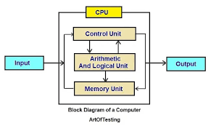
What is memory management?
The process of managing and organising computer memory is known as memory management.
Primary objectives:
Effective memory distribution among processes.
Memory spaces are protected.
Support for multitasking.

Slide 3
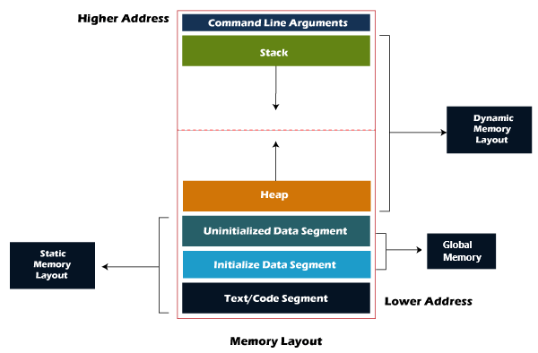
Segmentation Overview
Segments of memory are arranged logically into code, data, and stack categories. Each segment has a limit and a base address.
Advantages
The organisation is logical.
Segment-level sharing and protection.

Slide 4
How Segmentation Operates
Logical address: <segment number, offset>.
Actions to take:
In the segment table, find the segment number.
Check if offset < limit.
Base address plus offset is the physical address.
As an example:
Segment 2, offset 150.
Segment table: Base = 4000, Limit = 500.
Physical address = 4000 + 150 = 4150.

Slide 5
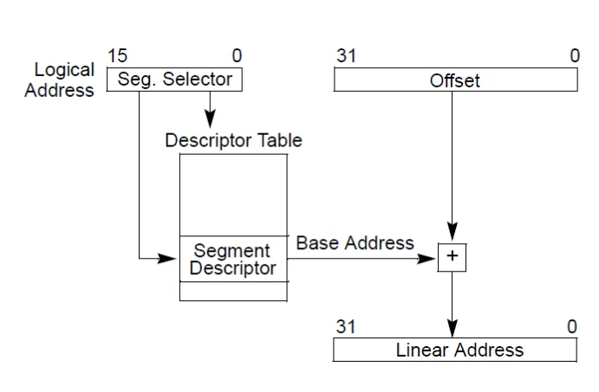

Slide 6
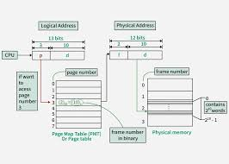
An Overview of Paging
separates memory into pages of a set size, such as 4KB.
Page frames make up physical memory.
Benefits:
Simplifies allocation.
Eliminates external fragmentation.

Slide 7
The Operation of Paging
Logical address: <page number, offset>.
Actions to take:
Use the page table to find the page number.
Obtain the frame number.
The physical address is equal to the frame number times the page size plus offset.
As an example::
Page size = 4KB.
Logical address: Page 3, offset 1024.
Page table: Page 3 → Frame 7.
Physical address = 7 × 4096 + 1024 = 29696.

Slide 8
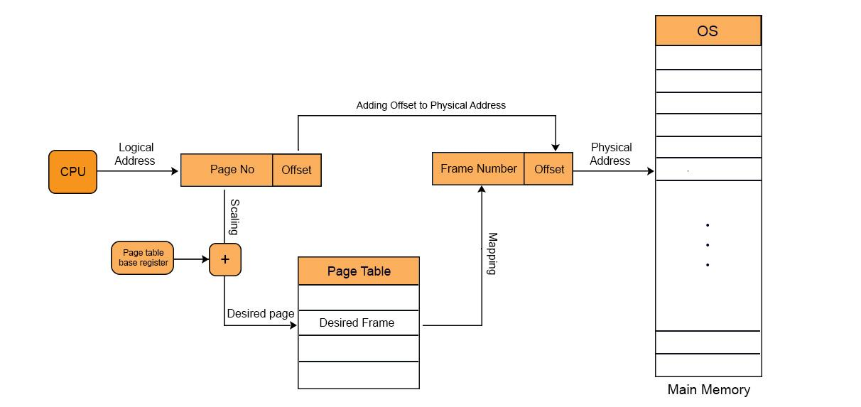

Slide 9
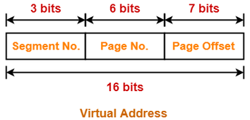
Segmentation with Paging
Combines benefits of both:
Logical organisation (segmentation).
Fixed-size allocation (paging).
Process:
Logical address → Segment → Page → Physical address.

Slide 10
Segmentation + Paging
Logical address: Segment 1, offset 5000.
Page size = 4KB.
Steps:
Segment table: Segment 1 → Page table.
Offset 5000 = Page 1, offset 904 (5000 ÷ 4096 = 1, 5000 mod 4096 = 904).
Page table: Page 1 → Frame 5.
Physical address = 5 × 4096 + 904 = 21384.

Slide 11
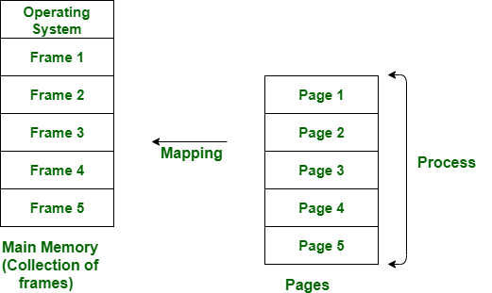

Slide 12
Comparing Segmentation and Paging
Segmentation:
Advantages: Easy sharing and logical structure.
Cons: complicated management and external fragmentation.
Paging:
Advantages: Easy allocation and no external fragmentation.
Cons: Lack of logical grouping and internal fragmentation.
Together:
Pros: Flexible, efficient.
Cons:The complexity has increased.

Slide 13
Where Are These Used?
Segmentation: Older systems (e.g., Intel 8086).
Paging: Modern OS like Linux, Windows.
Combined: x86 architecture, modern multitasking OS.

Slide 14
Important takeaways
Memory is logically organised by segmentation, while allocation is made simpler by paging.
Both allow for effective, secure memory management.
In contemporary systems, a combined approach is typical.
OS design requires an understanding of address translation.

