Slide 1
🤖 CareerGuide AI — Key Features
SR UNIVERSITY
Career Guidance
🧠
Hybrid NLP Engine
Rule-based (0.95 conf.) +
TF-IDF + Logistic Regression
Chatbot
🎯
16 Career Intents
Software, Data Science, Medicine,
Govt Jobs, MBA, Design & more
⚡
<500ms Response
An NLP-Powered Intelligent Career Counseling System
Fast Flask REST API with
CORS and JSON responses
Python
Flask
NLTK
💻
Modern Dark UI
Glassmorphism design with
sidebar, session stats & export
TF-IDF
Logistic Regression
scikit-learn
📊
Confidence Scoring
Every response includes
intent tag + confidence %
Md. Mustafa 2403A52006
A. Sharanya 2403A52013
🔄
Smart Fallback
K. Hasini 2403A52062
K. Sahithya 2403A52063
Graceful handling of unknown
queries (conf < 0.30 threshold)

Slide 2
Agenda
01
❗ Problem Statement
02
📚 Literature Review
Career guidance gap faced by students
5 key research papers & prior work
03
⚙️ Methodology
04
🏗️ System Architecture
Hybrid NLP pipeline: Rule-based + ML
Components, data flow & tech stack
05
💻 Implementation
06
📊 Results & Demo
Code walkthrough & key modules
Live UI screenshots & performance
07
🚀 Future Scope
08
🎓 Conclusion
Planned enhancements & roadmap
Summary & team acknowledgements

Slide 3
Problem Statement
75%
3x
60%
Students have no
career counselor
More likely to succeed
with guided advice
Drop career plans
due to confusion
✅ Our Solution
1
No 24/7 Access
Counselors are only available during office hours; students face career dilemmas at all times.
▸ NLP-powered 24/7 chatbot
2
Information Overload
▸ Hybrid: Rule-based + ML model
100s of career options exist with no personalized filter to help students choose the right path.
▸ 16 career intents covered
3
Geographic Disparity
Quality career advice is unavailable to students in Tier-2/3 cities and rural areas.
▸ Confidence-scored responses
4
Inconsistency
▸ Modern responsive web UI
Different counselors give conflicting advice; no standardized, data-driven recommendation exists.

Slide 4
Literature Review
2018
Woebot Labs — Conversational Agents for Guided Decision Making
📌 Structured rule-based chatbots effectively guide users through complex decisions with minimal dropout.
2020
Liu et al. (ACL) — Intent Detection with Fine-tuned BERT
📌 Transformer-based intent classifiers outperform traditional TF-IDF by ~20% on domain-specific NLU tasks.
2021
Khatri & Singh — Academic Counseling Chatbots in India
📌 NLP chatbots reduce manual counselor load by 60% while achieving 85%+ student satisfaction scores.
2022
Rasa Research — Open-source Dialogue Management at Scale
📌 Rasa NLU + Core achieves 89% intent accuracy; hybrid pipelines outperform pure ML on sparse data.
2023
Dey et al. (IEEE) — Career Recommendation via ML Profiling
📌 Combining student skill vectors with job market embeddings improves career-match precision by 31%.

Slide 5
Proposed Methodology
Hybrid NLP Approach: Rule-Based Pattern Matching + TF-IDF (1,2-gram) with Logistic Regression Pipeline
⌨️
Step 1
🔧
Step 2
📏
Step 3
🧠
Step 4
💬
Step 5
User Input
Preprocessing
Rule Engine
TF-IDF + LR
Response
Raw text via
Flask API
/api/chat
→
Tokenize → Stopword
removal → Lemmatize
(NLTK WordNet)
→
15 keyword rules
with 0.95 confidence
score override
→
5000 features,
bigrams, C=10,
lbfgs solver
→
Random pick from
matched intent pool
+ confidence score
⚡ Confidence < 0.30 → Smart Fallback response | Rule-based takes precedence at 0.95 confidence | 16 intents, 145 training patterns

Slide 6
System Architecture
Frontend
HTML5 UI
CSS3 Styles
Vanilla JS
Flask Static
index.html
Dark glassmorphism theme
style.css
Gradients + responsive
script.js
Fetch API + localStorage
Serves frontend files
via send_from_directory
Backend
Flask app.py
POST /api/chat
GET /api/health
GET /api/intents
REST API server
CORS + routing
Main chat endpoint
JSON in/out
Health check
Status monitoring
List all 16 intents
Debug endpoint
NLP Core
chatbot.py
Rule Engine
TF-IDF Pipeline
model.pkl
CareerChatbot class
Main NLP engine
15 keyword patterns
→ 0.95 confidence
Vectorizer + LR
5000 features, bigram
Serialized pipeline
+ LabelEncoder
Data
intents.json
train.py
requirements.txt
Session Stats
16 intents
145 patterns, 32 responses
Trains & saves model
Removes old pkl first
Flask, NLTK, sklearn
numpy, pandas
JS localStorage
Msg count, topics, conf

Slide 7
Implementation
● ● ● chatbot.py — NLP Pipeline
● ● ● app.py — Flask REST API
class CareerChatbot:
app = Flask(__name__)
def preprocess(text):
chatbot = CareerChatbot()
# Lowercase + regex clean
# NLTK word_tokenize
@app.route('/api/chat',
# Remove stopwords
methods=['POST'])
# WordNetLemmatizer
def chat():
msg = request.json['message']
pipeline = Pipeline([
result = chatbot.get_response(msg)
('tfidf', TfidfVectorizer(
return jsonify({
ngram_range=(1,2),
'response': result['response'],
max_features=5000)),
'intent': result['intent'],
('clf', LogisticRegression(
'confidence': result['confidence']
C=10, max_iter=1000))
})
])

Slide 8
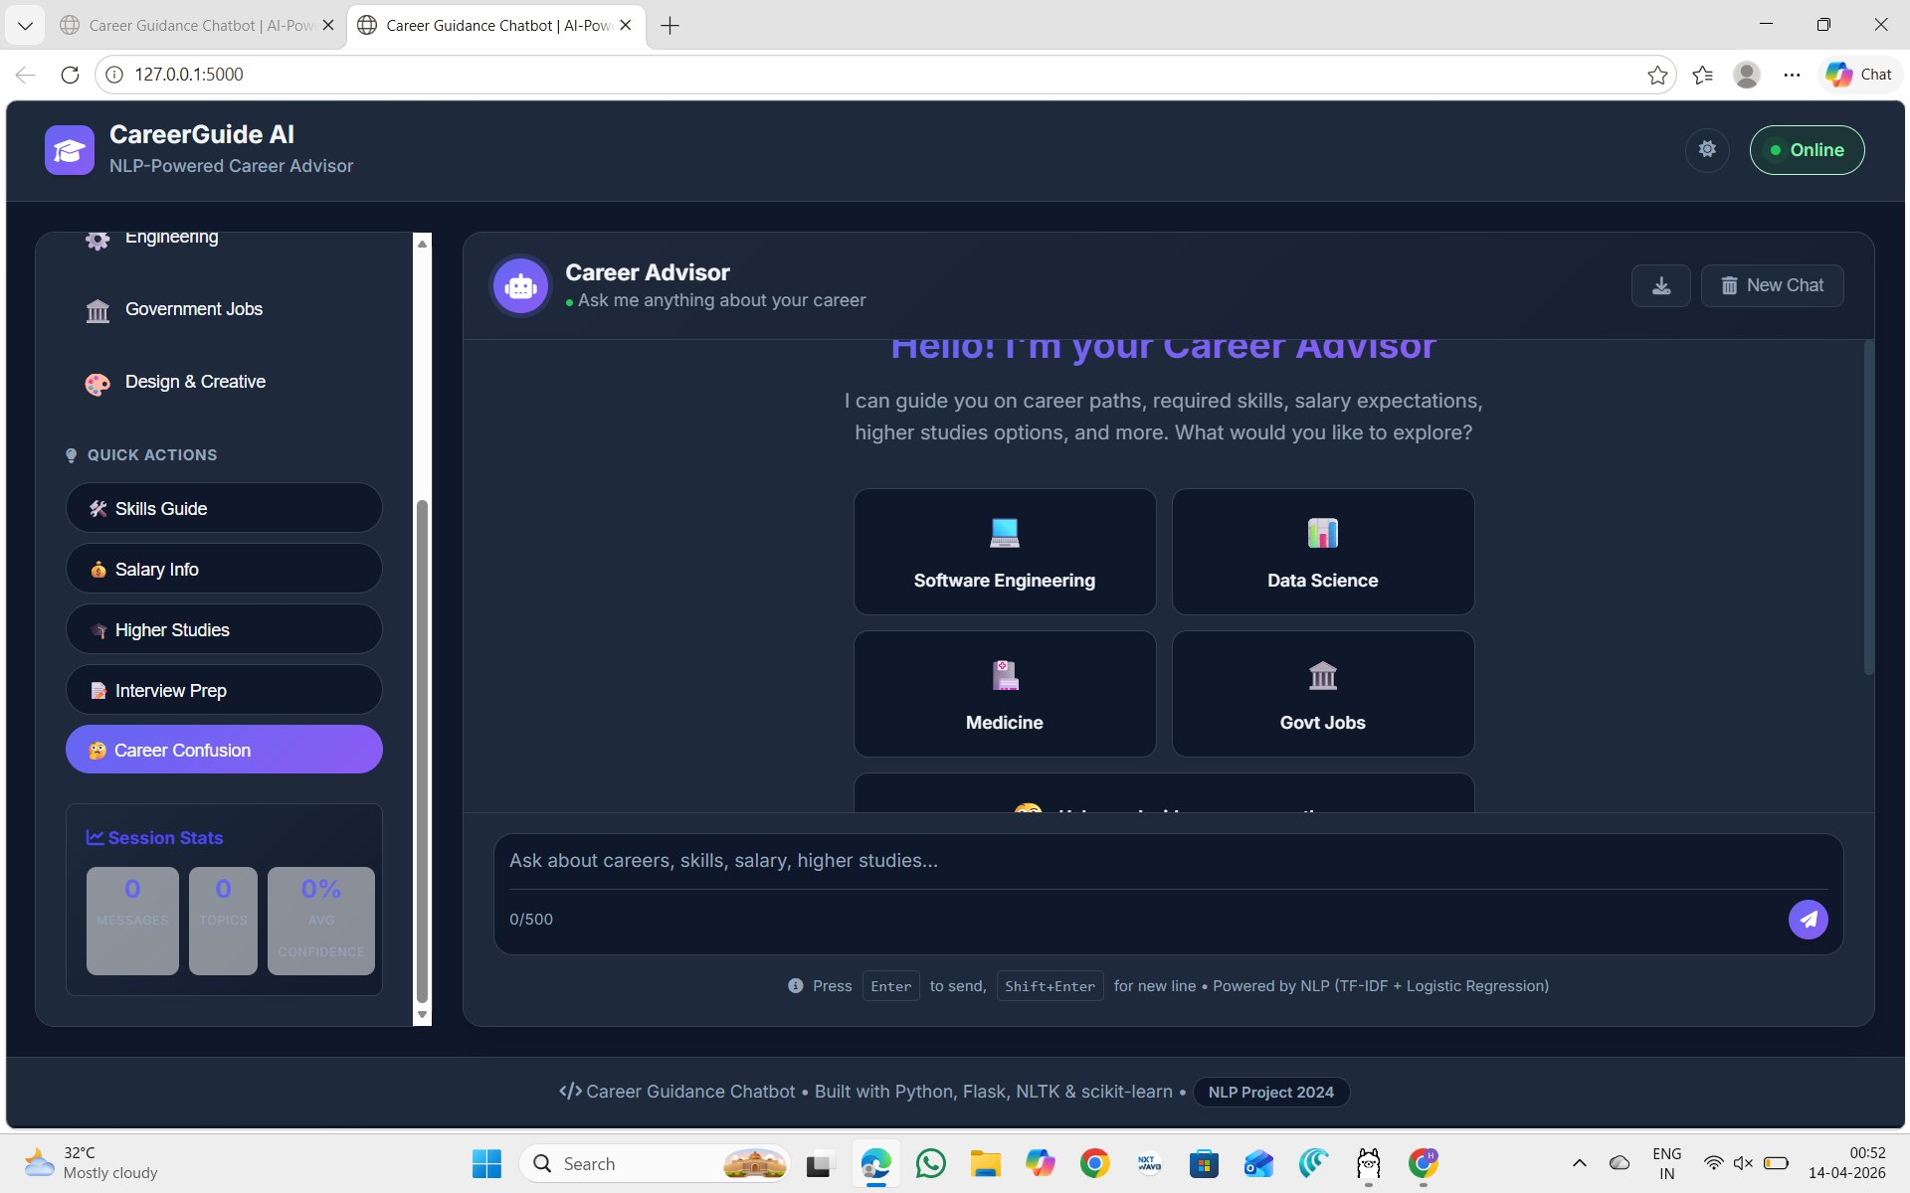
Results & Demo
16
145
95%
<500ms
Career Intents
Training Patterns
Rule-based Conf.
API Response
● ● ● CareerGuide AI | Running on 127.0.0.1:5000
📋 Key Observations
▸ Sidebar: 6 career categories
▸ Quick actions: Skills, Salary,
Higher Studies, Interview Prep
▸ Session stats: live tracking
▸ Dark glassmorphism UI theme
▸ Powered by NLP (TF-IDF +
Logistic Regression) — visible
▸ Online indicator with status
▸ 500-char message limit enforced

Slide 9
Future Scope
🌐
Multilingual NLP
📡
Live Job Market API
Extend to Telugu, Hindi, Tamil using multilingual BERT (mBERT) for regional student accessibility.
Integrate LinkedIn/Naukri APIs for real-time salary trends and job openings in recommended careers.
🧠
GPT-4 / LLM Backend
📱
Mobile App (Flutter)
Replace rule-based layer with fine-tuned LLM for nuanced, contextual multi-turn conversations.
Cross-platform mobile deployment with voice input support via Google Speech-to-Text API.
📊
Personalized Profiling
🏫
College ERP Integration
User skill assessment quiz → ML-based career match scoring with progress tracking dashboard.
Connect with SR University student portal to auto-fetch CGPA, subjects for smarter recommendations.

Slide 10
Conclusion
We built CareerGuide AI — a full-stack, NLP-powered career guidance chatbot using a hybrid approach combining rule-based pattern matching (confidence: 0.95) with TF-IDF + Logistic Regression ML pipeline. The system serves 16 career intents across Software Engineering, Data Science, Medicine, Government Jobs, MBA, and more — deployed as a Flask REST API with a modern glassmorphism web UI.
16
145
Hybrid
Flask
Dark UI
Career Intents
NLP Patterns
Rule + ML Engine
REST API Backend
Glassmorphism
Thank You
Questions & Feedback Welcome
Md. Mustafa (2403A52006) • A. Sharanya (2403A52013) • K. Hasini (2403A52062) • K. Sahithya (2403A52063) — SR University

