Slide 1
Online B2B Retail
Product Sale Priority
A Classification (DM) Project by MD Naseem Ashraf

Slide 2
There was once a programmer...
Who was given a task by his employer, a B2B Online Retailer to rank products they are selling into three classes;
Class 1 – High Sales Priority Products
Class 2 – Medium Sales Priority Products
Class 3 – Low Sales Priority Products

Slide 3
Some factors for classification
Quantity ordered
Frequency of orders by customers
Broad base of customers
Money earned over each transactions etc...

Slide 4
The Challenege
Original Data Set only has Daily Transactions for a year
Cancellations
Lost orders
Redundant records
The programmer who classified the products quit his job because he was made to classify products on a weekend....
Just kidding!! The truth is I don't have any class data!! :"(

Slide 5
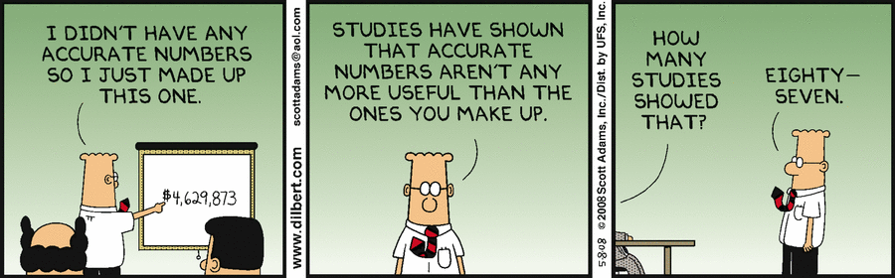
What to do without data?
There was once a Statistician, a Physicist and a Chemist...
Also...this.

Slide 6
DataPreprocessing
Clean Transaction data – Remove cancelations, redundancies, incomplete entries etc.
Transaction data >> Product sales statistics
Generate classification of each product's sale priority class
> 541,908 Total Transacations
> 406,828 Complete Case Transactions > 401,603 Unique Transaction(-Redundancy)
> 392,731 Preprocessed Transactions (-Cancelations)
> Dropping useless attributes of source dataset like customer country etc.

Slide 7
Data Preprocessing: Classifying
# TransactionFreq
tfreq <- finaldataset$TransactionFreq[finaldataset$ProductID==currentid]
# Customers
tcust <- finaldataset$Customers[finaldataset$ProductID==currentid]
# Earnings
meanEarningPerTransaction <- finaldataset$UnitPrice[finaldataset$ProductID==currentid] * finaldataset$MeanQuantityPerTransaction[finaldataset$ProductID==currentid]
If(Conditons....)
  Classify as 1
else
  If(Conditons....)
    Classify as 2
  else
    Classify as 3

Slide 8
Original Dataset
InvoiceNo - Alphanumeric
StockCode – Alphanumeric, non-unique
Description – String, unique
Quantity – Numeric, Integer
InvoiceDate – Numeric, Decimal
UnitPrice – Numeric, Decimal
CustomerID – Alphanumeric, non-unique
Country – String, non-unique

Slide 9
Data Exploration
New preprocessed dataset
ProductID – Integer, Unique, Generated
Description – Char, Unique
TransactionFreq – Double, Counted for each occurance of each product
TotalQuantity – Integer, Counted for each product
Customers – Integer, Counted for each product
MeanQuantityPerTransaction – Double, Computed for each product
MeanQuantityPerCustomer – Double, Computed for each product
UnitPrice – Double
MeanEarningPerTransaction – Double, Computed for each product
SalePriorityClass – Factor, Generated, Levels 3: 1, 2, 3

Slide 10
Techniques used to Explore Data
Barplots of Classes
Correlation Table and a Correlation Plot
A very telling, attribute/features Parallel Plot
A few Box and Whisker plots
A Feature Importance Plot
A Recursive Feature Elimination visualization
Histograms? What histograms? 8/

Slide 11
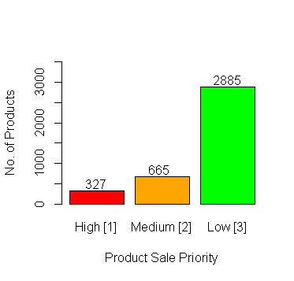
Class Statistics
The SalePriorityClass is split in three classes;
Total Products: 3877

Slide 12
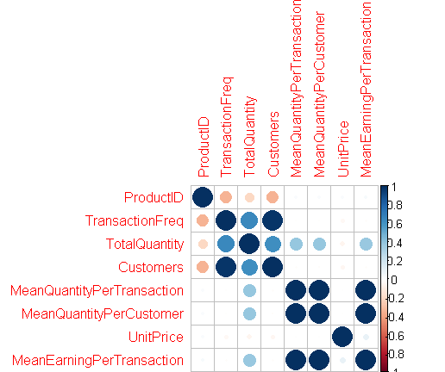
Corellation Plot

Slide 13
Corellation Table
1 | -0.35 | -0.2 | -0.35 | 0.03 | 0.03 | 0.02 | 0.3
-0.35 | 1 | 0.65 | 0.97 | -0.01 | -0.01 | -0.04 | -0.01
-0.2 | 0.65 | 1 | 0.62 | 0.39 | 0.39 | -0.06 | 0.38
-0.35 | 0.97 | 0.62 | 1 | -0.01 | -0.01 | -0.05 | -0.01
0.03 | -0.01 | 0.39 | -0.01 | 1 | 1 | 0 | 0.99
0.03 | -0.01 | 0.39 | -0.01 | 1 | 1 | 0 | 0.99
0.02 | -0.04 | -0.06 | -0.05 | 0 | 0 | 1 | 0.09
0.03 | -0.01 | 0.38 | -0.01 | 0.99 | 0.99 | 0.09 | 1
TransactionFreq TotalQuantity
Customers (Total)
and the mean computations

Slide 14
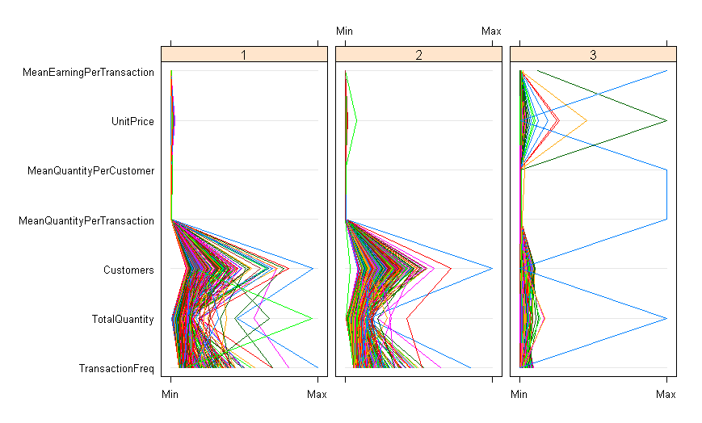
Parallel Plot

Slide 15
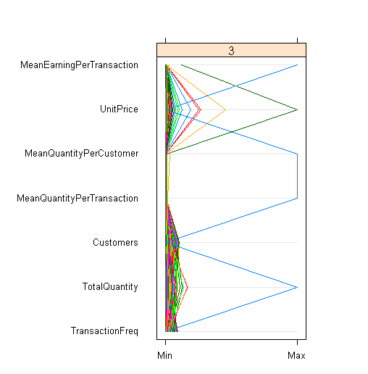
We should talk about.....Class 3
TransactionFreq = 1
TotalQuantity = 80995
Customers = 1
MeanQuantityPerTransaction = 80995
MeanQuantityPerCustomer = 80995
UnitPrice = 2.08
MeanEarningPerTransaction = 168469.6
SalePriorityClass = 3

Slide 16
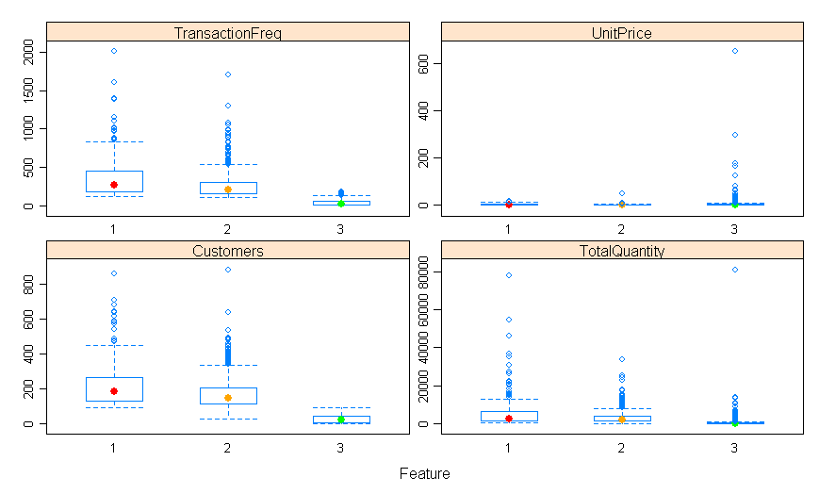
Box and Whisker Plot

Slide 17
Are they really a class apart?
MeanEarningPerTransaction – Class 1 [High] = 24.11086, 409.25576
                Class 2 [Medium] = 1.940245, 79.951064
Class 3 [Low] = 0.001, 168469.600
UnitPrice – Class 1 [High] = 0.29, 18.00
Class 2 [Medium] = 0.1, 50.0
Class 3 [Low] = 0.001, 649.500
MeanQuantityPerCustomer
MeanQuantityPerTransaction
Customers (Total)
....and So On

Slide 18
Model Building Hypothesis
Checking the significance of Attributes
Using mlbench library we can score features on their relative importance while leveraing Random Forests. This gives us the following Feature Importance Plot...
control <- trainControl(method="repeatedcv", number=10, repeats=3)
model <- train(SalePriorityClass~., data=kll, method="lvq", preProcess="scale", trControl=control)
importance <- varImp(model, scale=FALSE)
print(importance)
plot(importance)

Slide 19
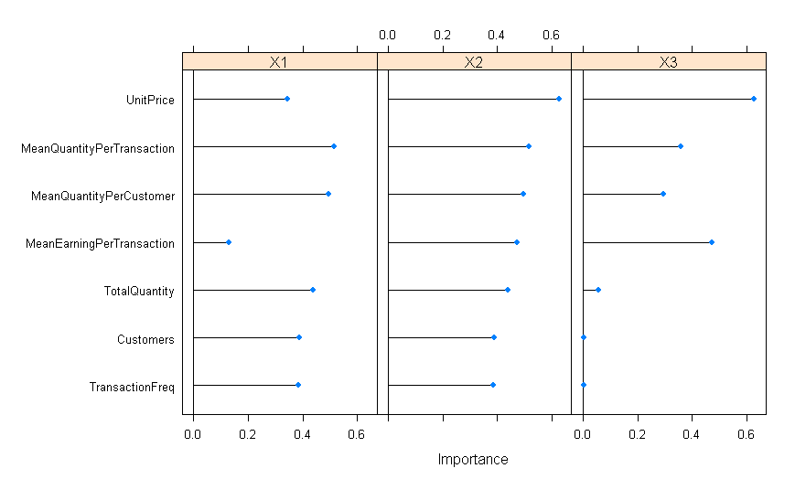
Feature Importance Plot

Slide 20
Recursive Feature Elimination
Then we use the RFE from the Caret library in R to perform a RandomForest based model simulation and come up with the best possible model features to obtain our required output.
control <- rfeControl(functions=rfFuncs, method="cv", number=10)
results <- rfe(X,Y, sizes=c(1:Xn), rfeControl=control)
print(results)
And the winner is.......

Slide 21
Recursive Feature Elimination
Recursive feature selection
Outer resampling method: Cross-Validated (10 fold)
Resampling performance over subset size:
Variables Accuracy Kappa AccuracySD KappaSD Selected
1 0.6639 0.1662 0.028045 0.065013
2 0.9969 0.9924 0.003182 0.007879
3 0.9987 0.9968 0.003288 0.008162
4 0.9987 0.9968 0.002516 0.006235 *
5 0.9984 0.9962 0.002501 0.006195
6 0.9982 0.9956 0.002740 0.006770
7 0.9979 0.9949 0.003408 0.008442
The top 4 variables (out of 4):
MeanEarningPerTransaction, Customers, TransactionFreq, TotalQuantity
Look at the most significant features found!
"Watson....we are onto something...."

Slide 22
Models to evaluate
Model 1:
SalePriorityClass ~ (TransactionFreq, TotalQuantity, Customers, MeanQuantityPerTransaction, MeanQuantityPerCustomer, UnitPrice, MeanEarningPerTransaction)
Model 2:
SalePriorityClass ~ (TransactionFreq, Customers, MeanQuantityPerTransaction, MeanEarningPerTransaction)
Model 3:
SalePriorityClass ~ (TransactionFreq, Customers, MeanEarningPerTransaction)

Slide 23
Before we play with Multiclass Classification
Standard binary classification methods are useless or erroneous to use.
One against two binary classification methods are also very erroneous. And might over look those products that seemingly overlap classes in attributes.
What will we use then?
KNN, SVM and LDA. There are others too like Multinomial etc, but not covered in the report.

Slide 24
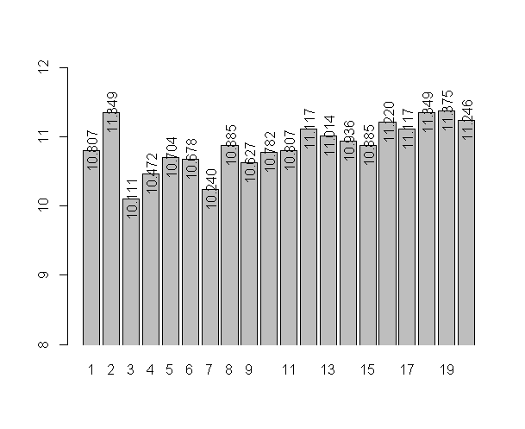
KNN
Crossvalidation produces, this error percentage in the 20 models simulated.

Slide 25
Comparing KNN Models
Best two are picked.
Model 1 Performance (K=3) Model 1 Performance (K=7)
knn.pred 1 2 3 knn.pred 1 2 3
1 13 9 0 1 13 5 0
2 21 43 3 2 21 48 7
3 0 2 298 3 0 1 294
Accuracy = 0.9100257 Accuracy = 0.9125964

Slide 26
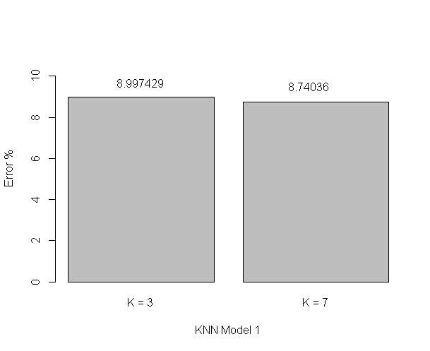

Slide 27
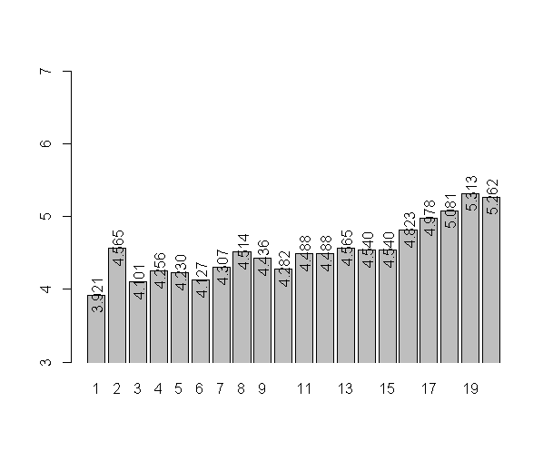
Crossvalidating Model 2
Using K= 1,3,6.

Slide 28
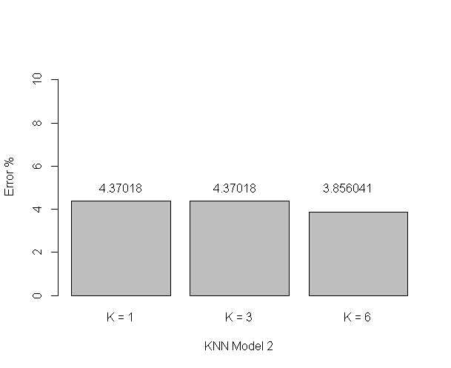
KNN Model 2 Performances

Slide 29
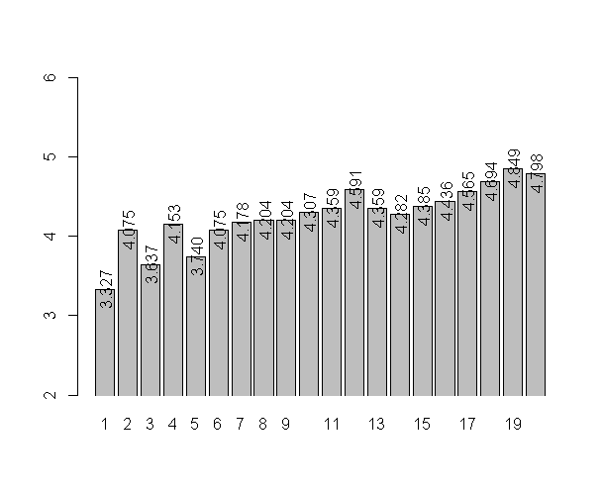
KNN Model 3 Corssvalidation
Considering K= 1,3,5

Slide 30
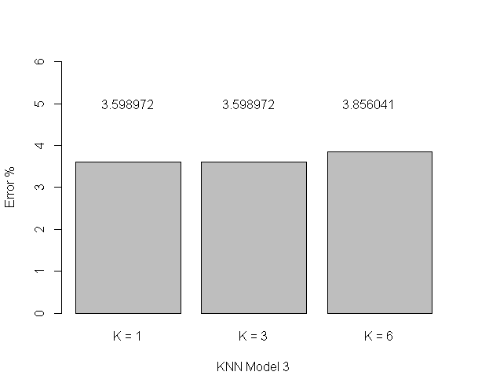
KNN Model 3 Performances

Slide 31
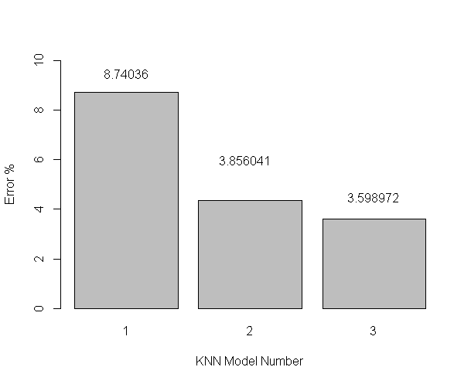
Best KNN Model goes to....

Slide 32
SVM
SVM Models with same features are taken all with Radial kernel and tune with C (Cost range of) = (10^-1:2) and Gammas = (.5,1,2).
SVM models are tuned to obtain best Cost and Gamma values for highest accuracy of the prediction model.
As we already used a few analytical methods when picking our significant features, we have a near perfect set of model features to be used, showing little difference form a tuned model.
......More plots follows

Slide 33
SVM Tuned Model 1 Performance
Model 1 Performance Tuned Model 1 Performance (C=1.1, G=(0.5,1,2))
pred 1 2 3 pred 1 2 3
1 5 0 1 1 9 1 1
2 29 52 1 2 25 52 1
3 0 2 299 3 0 1 299
Error = 0.0848329 Error = 0.07455013
Model 2 Performance Tuned Model 2 Performance (C=1.1, G=(0.5,1,2))
pred 1 2 3 pred 1 2 3
1 7 1 0 1 6 1 0
2 27 52 1 2 28 53 1
3 0 1 300 3 0 0 300
Error = 0.07712082 Error = 0.07712082
Model 3 shows similar behavior to Model 2 (as some of the features are heavily correlated).

Slide 34
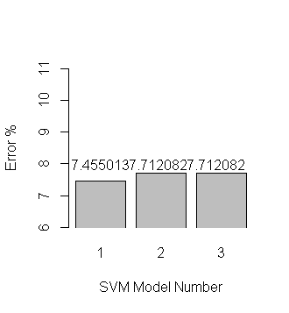
May the best SVM Win!

Slide 35
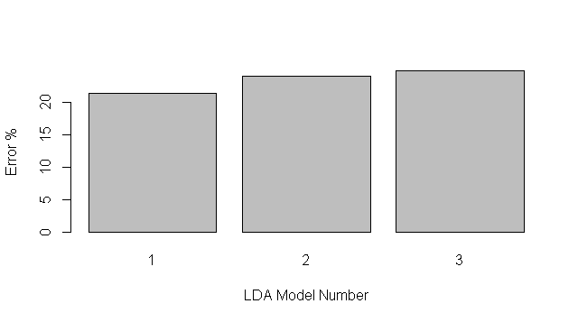
LDA Models

Slide 36
LDA Model Performance Details
LDA Model 1 LDA Model 2 LDA Model 3
pred 1 2 3 pred 1 2 3 pred 1 2 3
1 6 5 0 1 4 4 0 1 5 5 0
2 8 16 1 2 9 15 1 2 9 12 0
3 0 11 70 3 1 13 70 3 0 15 71
Accuracy =
0.7863248 ~ 78.63% 0.7606838 ~ 76.06% 0.7521368 ~ 75.21%
Note: LDA models are not run with rigorus sampling and manipulation.

Slide 37
Conclusion & Thoughts
KNN performs the best of LDA, KNN and SVM.
Some late thoughts SVM is performed on a Radial kernel, swithcing kernels may impact performance.
Decision tree based nested if..else classification is used to generate/simulate data which is the reason for such high inherent accuracy (and ignoring decision tree based classification models.)
Also, there is no need to perform any specific sampling to fix distributions etc, as the dataset is agregated dataset from a raw transactions dataset.

