Slide 1
Soil Classification using Artificial Neural Network(ANN)

Slide 2
Sources of Data
Project Name | Location | Number of Sample
Elevated Expressway/Road from Mithamain Sadar to Karimganj Upazilla | Mithamain (Kishoreganj) | 60
Geotechnical Investigation Chattogram-Cox’s Bazar Highway | Cox’s Bazar | 60

Slide 3
Algorithm used for analysis
Multiple Linear Regression
Random Forest Regressor
Artificial Neural Network (ANN)

Slide 4
Hyperparameters of our ANN Model
Layers | Number of Neurons | Activation Function
Input Layer | 3 | ---
Hidden Layer | 15 | Relu
Hidden Layer | 15 | Relu
Hidden Layer | 15 | Relu
Output Layer | 2 | Linear

Slide 5
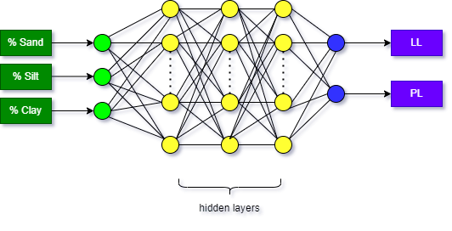
Structure of ANN Model

Slide 6
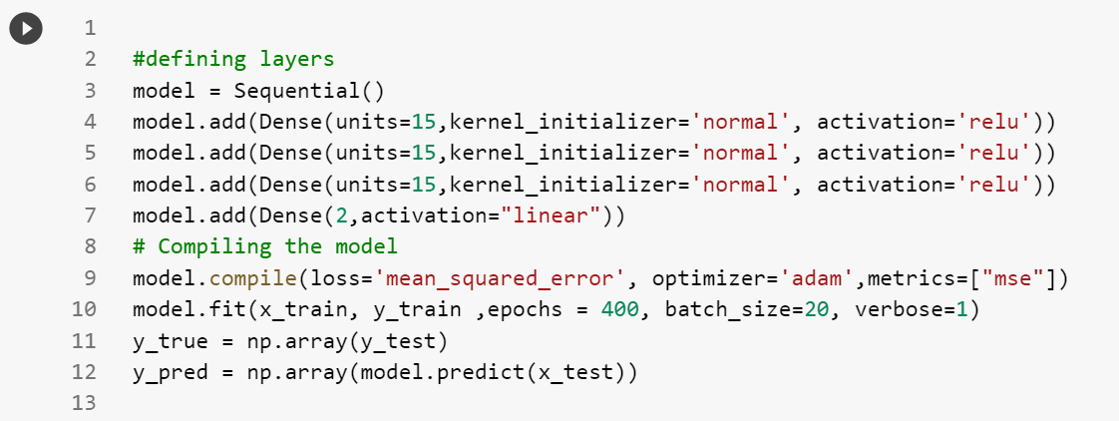
Structure of ANN Model

Slide 7
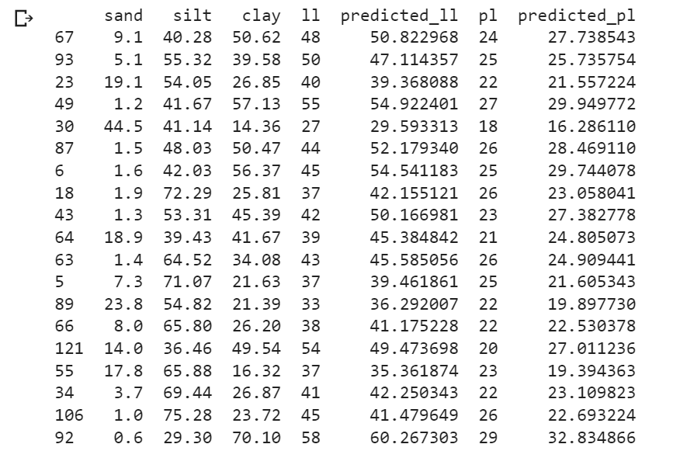
Data Comparison After Prediction

Slide 8
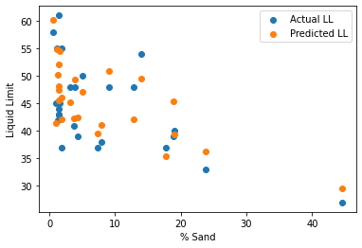
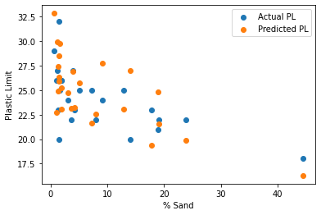
Graphs Obtained from ANN Model
Comparison between actual and predicted data

Slide 9
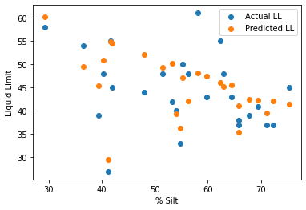
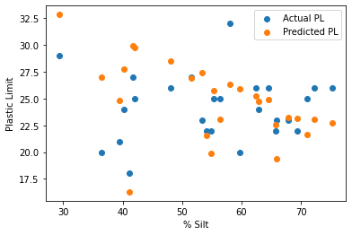
Graphs Obtained from ANN Model
Comparison between actual and predicted data

Slide 10
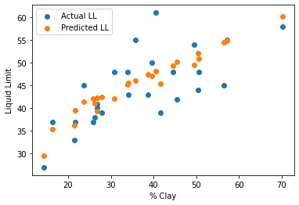
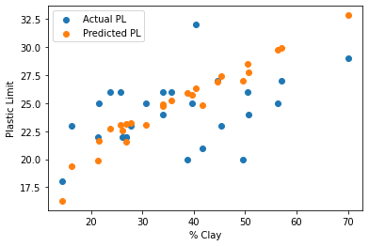
Graphs Obtained from ANN Model
Comparison between actual and predicted data

Slide 11
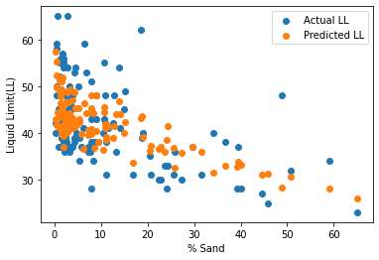
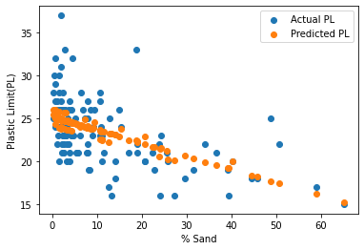
Graphs Obtained from Linear Regression Model
Comparison between actual and predicted data

Slide 12
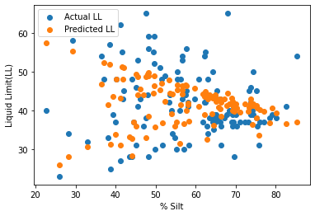
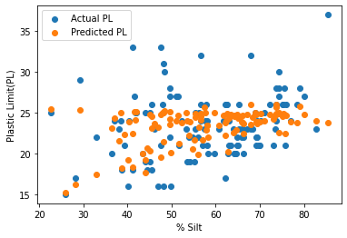
Graphs Obtained from Linear Regression Model
Comparison between actual and predicted data

Slide 13
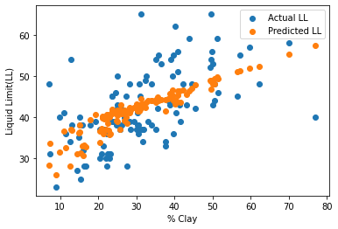
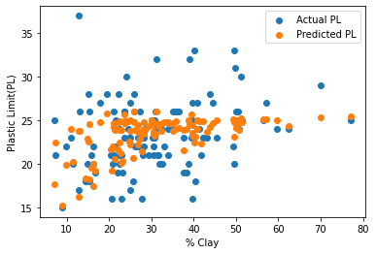
Graphs Obtained from Linear Regression Model
Comparison between actual and predicted data

Slide 14
Size of the Dataset
Type of dataset | Number of rows
Total Data | 120 rows
Training Data | 80% (96 rows)
Testing Data | 20% (24 rows)

Slide 15

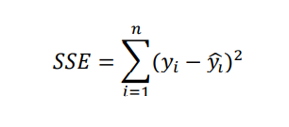
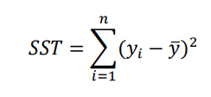
Calculation Of R-Squared Value
R² values | Accuracy
0.67 | Substantial
0.33 | Moderate
0.19 | Weak
Reference:
Chin, W. W. (1998). The partial least squares approach to structural equation modeling. Modern Methods for Business Research, 295(2), 295–336.

Slide 16
Comparison Among Three Models
Parameters | ANN |  | Multiple Linear Regression |  | Random Forest
 | LL | PL | LL | PL | LL | PL
MSE | 28.13 | 10.45 | 26.78 | 4.62 | 61.29 | 9.34
MAE | 4.56 | 2.54 | 4.37 | 1.71 | 6.58 | 2.29
R2_score | 0.67 | 0.36 | 0.03 | 0.37 | 0.06 | -1.08

Slide 17
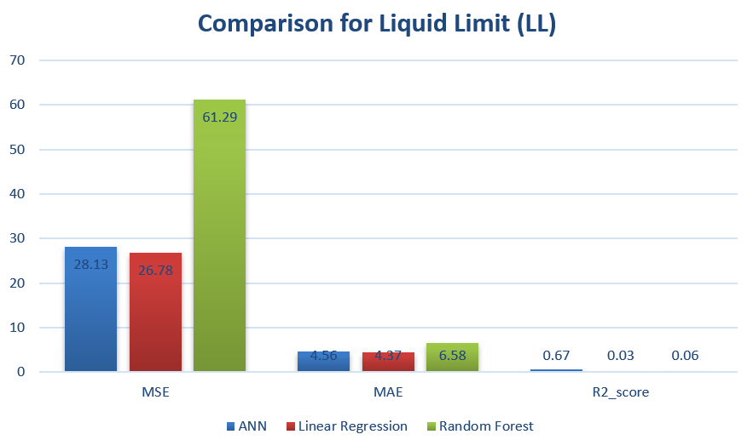
Comparison Among Three Models

Slide 18
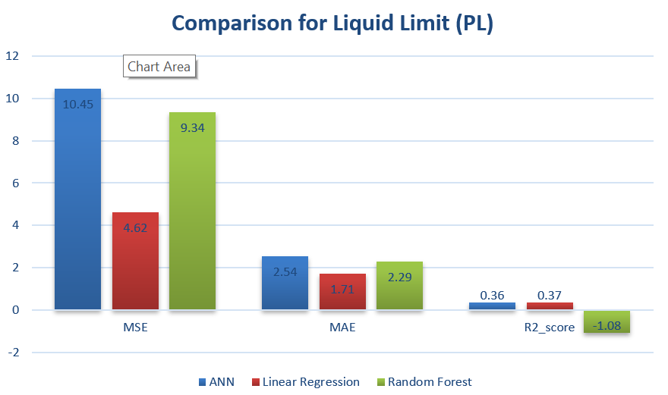
Comparison Among Three Models

Slide 19
Thanks

