Slide 1
Racial Segregation in Louisville KY
Math 560
Group members:
1. Michael Nestor

Slide 2
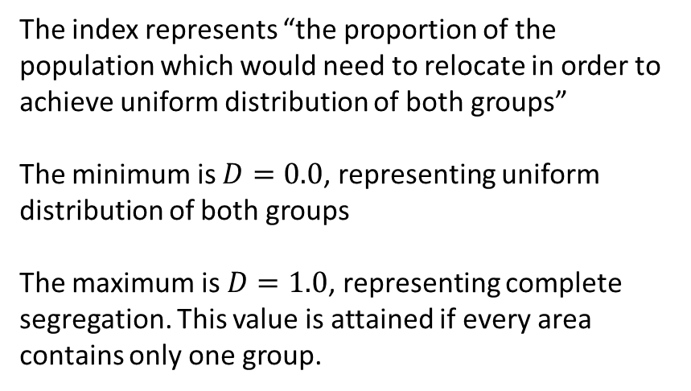
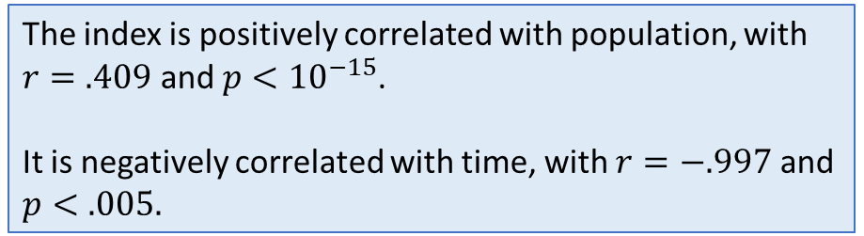
The Dissimilarity Index
The Dissimilarity Index is the most popular measure of spatial segregation
The index represents “the proportion of the population which would need to relocate in order to achieve uniform distribution of both groups”
The minimum is $D=0.0$, representing uniform distribution of both groups
The maximum is $D=1.0$, representing complete segregation. This value is attained if every area contains only one group.
The index is positively correlated with population, with $r=.409$ and $p<{10}^{−15}$.
It is negatively correlated with time, with $r=−.997$ and $p<.005.$

Slide 3
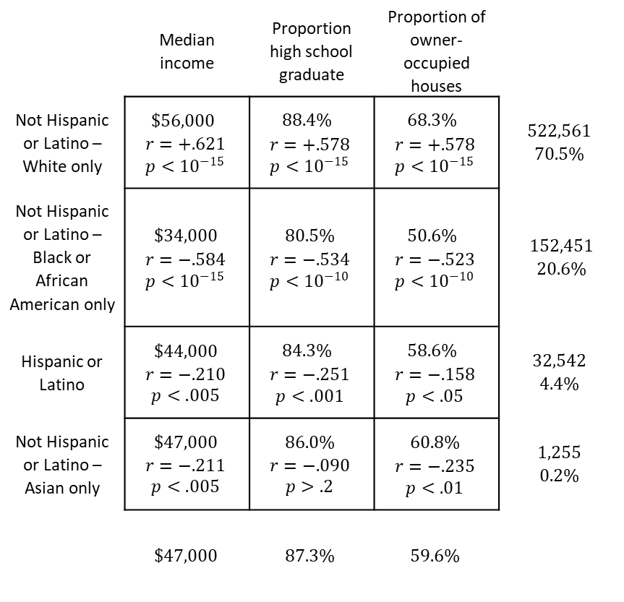
Local Data from the US 2010 Census
Sample correlation matrix of race and statistics of interest
 | Median income | Proportion high school graduate | Proportion of owner-occupied houses
Not Hispanic or Latino – White only | $\$56,000$ $$\begin{matrix}r=+.621 \\ p<{10}^{−15}\end{matrix}$$ | $88.4\%$ $$\begin{matrix}r=+.578 \\ p<{10}^{−15}\end{matrix}$$ | $68.3\%$ $$\begin{matrix}r=+.578 \\ p<{10}^{−15}\end{matrix}$$ | $$522,561$$ $$70.5\%$$
Not Hispanic or Latino – Black or African American only | $$\$34,000$$ $$\begin{matrix}r=−.584 \\ p<{10}^{−15}\end{matrix}$$ | $$80.5\%$$ $$\begin{matrix}r=−.534 \\ p<{10}^{−10}\end{matrix}$$ | $50.6\%$ $$\begin{matrix}r=−.523 \\ p<{10}^{−10}\end{matrix}$$ | $152,451$ $$20.6\%$$
Hispanic or Latino | $$\$44,000$$ $$\begin{matrix}r=−.210 \\ p<.005\end{matrix}$$ | $84.3\%$ $$\begin{matrix}r=−.251 \\ p<.001\end{matrix}$$ | $58.6\%$ $$\begin{matrix}r=−.158 \\ p<.05\end{matrix}$$ | $$32,542$$ $$4.4\%$$
Not Hispanic or Latino – Asian only | $$\$47,000$$ $$\begin{matrix}r=−.211 \\ p<.005\end{matrix}$$ | $$86.0\%$$ $$\begin{matrix}r=−.090 \\ p>.2\end{matrix}$$ | $$60.8\%$$ $$\begin{matrix}r=−.235 \\ p<.01\end{matrix}$$ | $$1,255$$ $$0.2\%$$
 | $$\$47,000$$ | $$87.3\%$$ | $$59.6\%$$
The census divides Louisville geographically into 191 census tracts, which act as the sample points.
Race data is self-reported with 14 categories. For this project, only the three most populous groups of one race alone and Hispanic or Latino are included.
Statistics of interest such as income, education, and housing are measured by census tract, allowing the analysis of their correlation with racial proportion.
The null hypothesis is that the sample correlation matrix shown is not significantly different from the zero matrix.

Slide 4
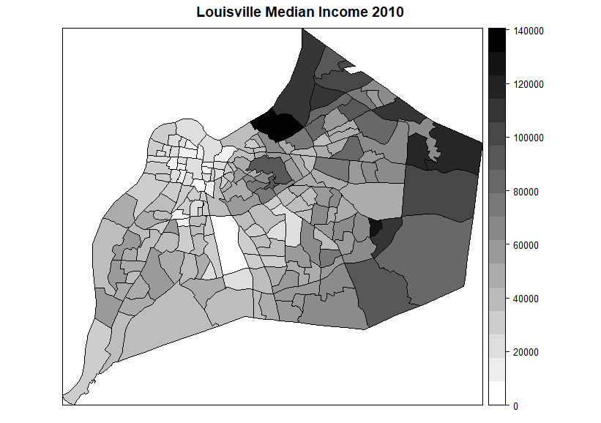
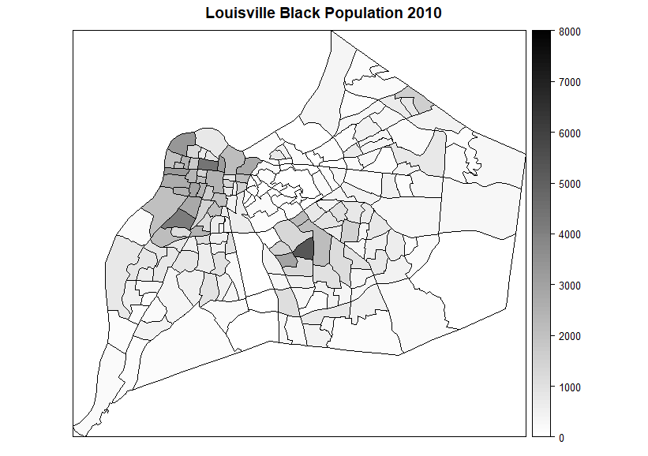
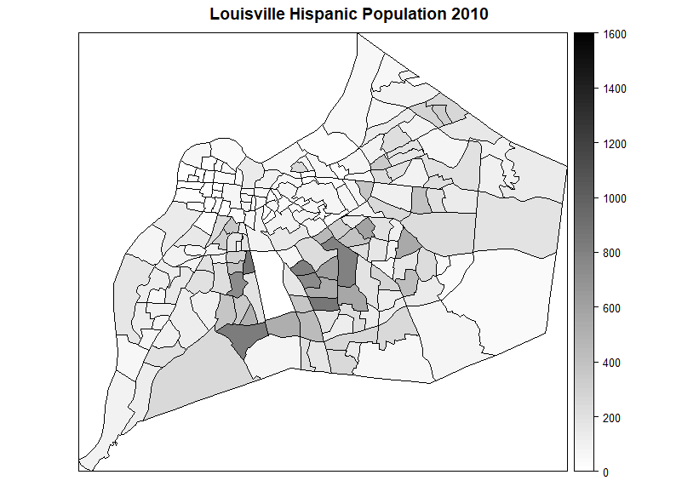
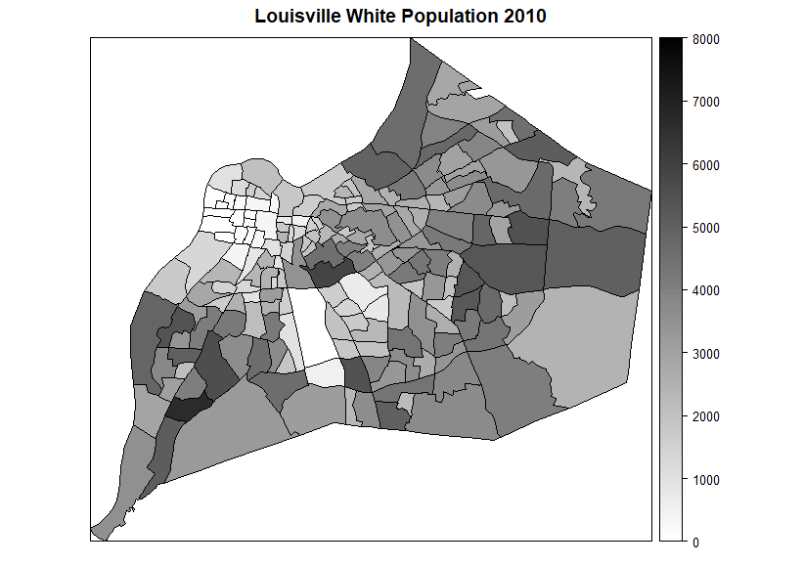
Visualization of spatial data
The Census Bureau hosts cartographic boundary shapefiles for census tracts, and the R package spplot allows for rich visualization of the dataset.

