Slide 1
Does Race Predict Socioeconomic Status in Louisville, Kentucky?
Michael Nestor

Slide 2
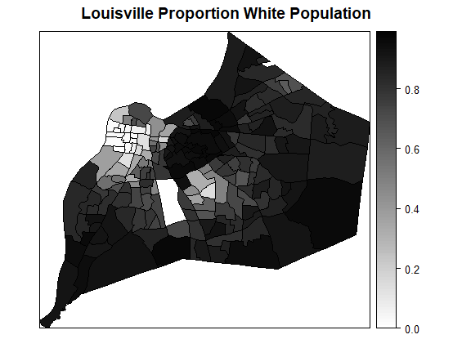
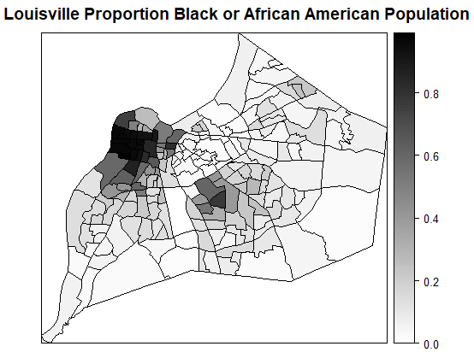
Methods: Population proportion of racial categories by census tract
US Census provides demographics on 191 census tracts in Louisville, and our study uses the four largest census racial categories, in addition to Hispanic or Latino which is counted separately.
Compare racial proportion to categorical variables including income, education, and housing.
For each racial group and categorial variable, take as null hypothesis there is not significant correlation between the proportion of that racial group and the categorical variable.

Slide 3
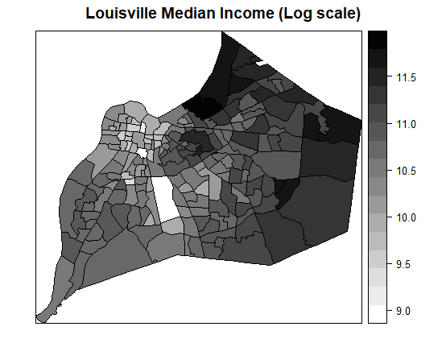
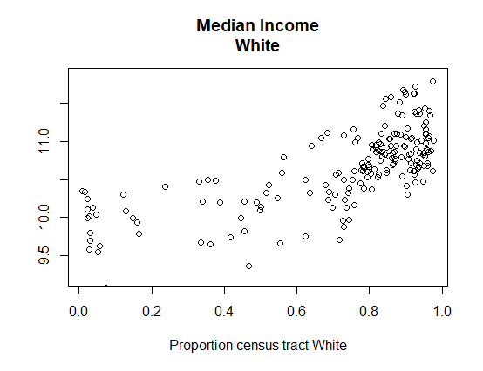
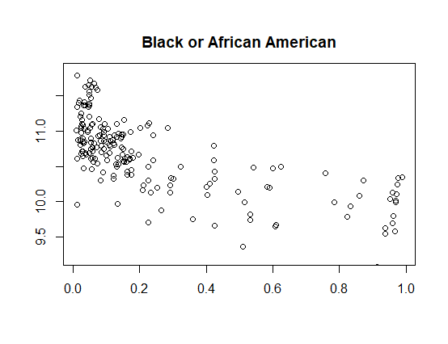
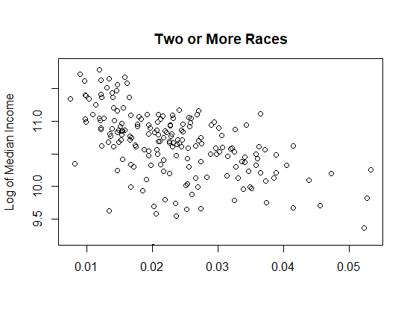


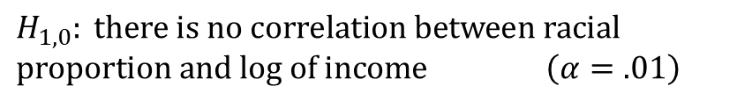
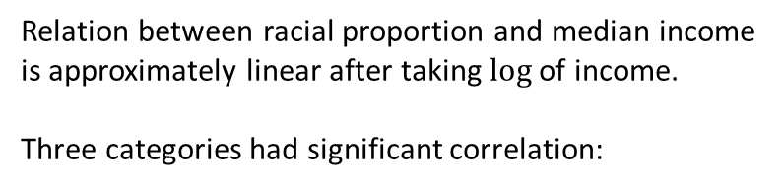

Results: Median Income
$H_{1,0}: \text{there} \text{is} \text{no} \text{correlation} \text{between} \text{racial} \text{proportion} \text{and} \text{log} \text{of} \text{income}$ $\left(α=.01\right)$
Relation between racial proportion and median income is approximately linear after taking $\text{log}$ of income.
Three categories had significant correlation:
$r=+.71$1
$$r=−.702$$
$$r=−.549$$

Slide 4
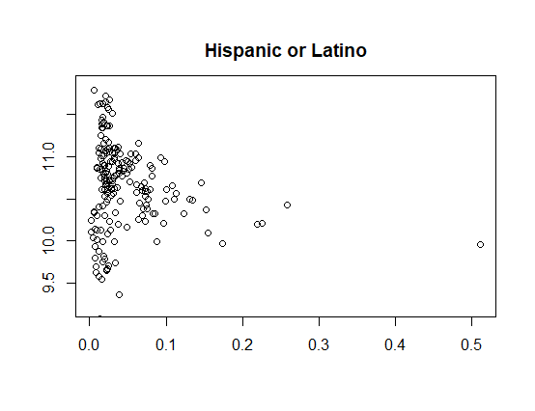
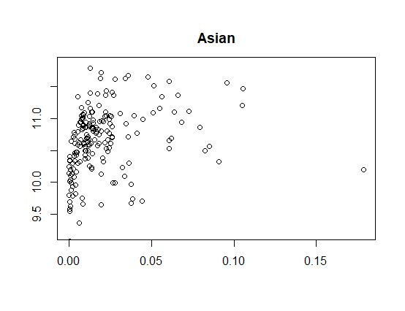
More Median Income by charts
Hispanic or Latino: weaker overall correlation, but lower variability.
Asian: no clear correlation between median income and proportion population Asian.

Slide 5
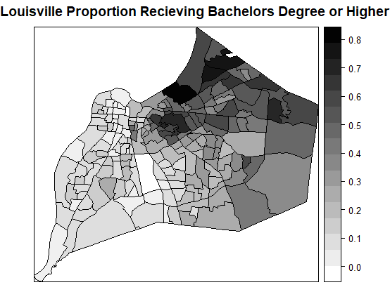
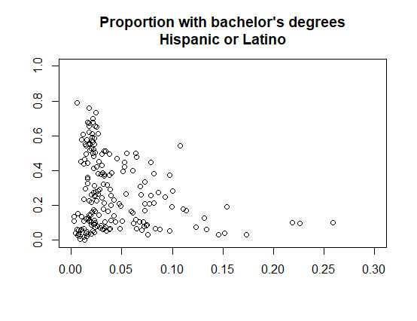
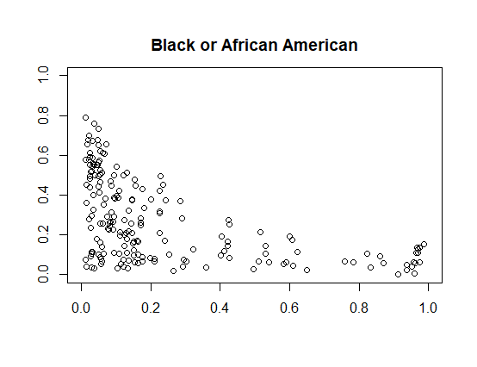
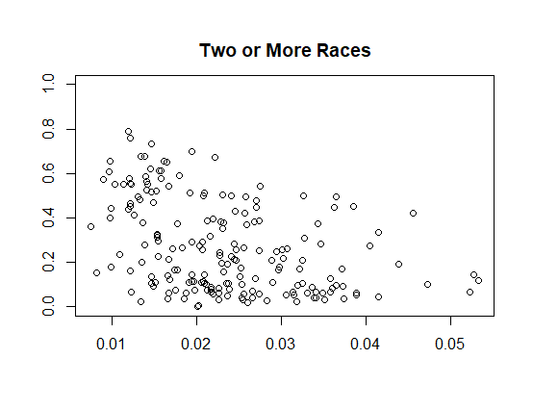
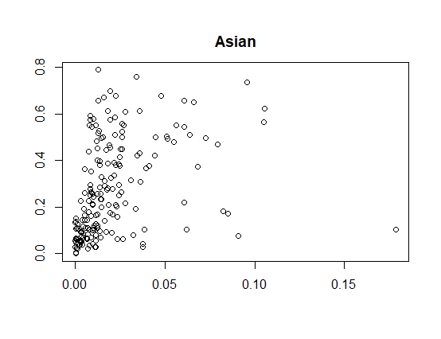


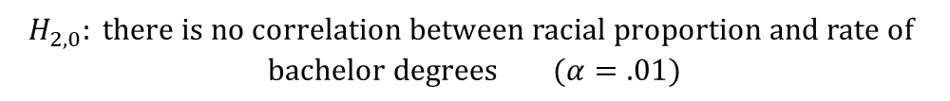


Education
To measure education, we considered the proportion of each census tract which received a bachelor degree or higher.
$H_{2,0}: \text{there} \text{is} \text{no} \text{correlation} \text{between} \text{racial} \text{proportion} \text{and} \text{rate} \text{of} \text{bachelor} \text{degrees}$ $(α=.01)$
All four racial categories in addition to Hispanic or Latino were significantly correlated with rates of college attendance. Only White and Asian had positive correlation.
$$r=−.235$$
$$r=−.511$$
$$r=−.409$$
$$r=+.368$$

Slide 6
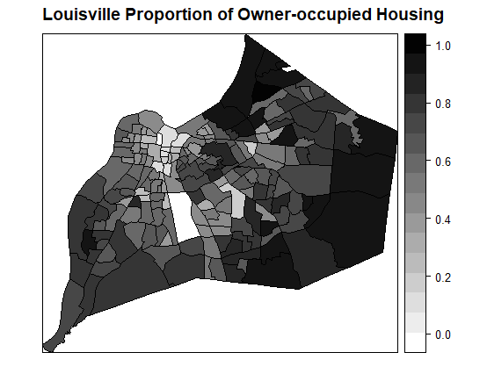
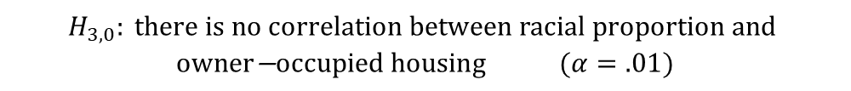
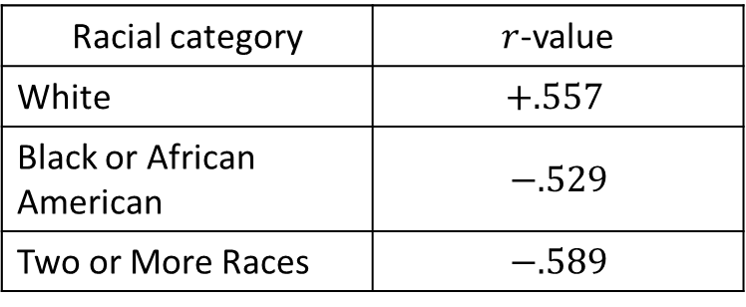
Housing
The census records the proportion of home-occupants which own their home as opposed to renting. This specific variable was considered due to its relation to generational wealth through home equity.
$H_{3,0}: \text{there} \text{is} \text{no} \text{correlation} \text{between} \text{racial} \text{proportion} \text{and} \text{owner}\text{−}\text{occupied} \text{housing}$ $(α=.01)$
Result: three categories showed significant correlation.
Racial category | $r$-value
White | $$+.557$$
Black or African American | $−.529$
Two or More Races | $−.589$
Note: The rate of bachelor degrees and owner-occupied housing are both correlated with income.

Slide 7
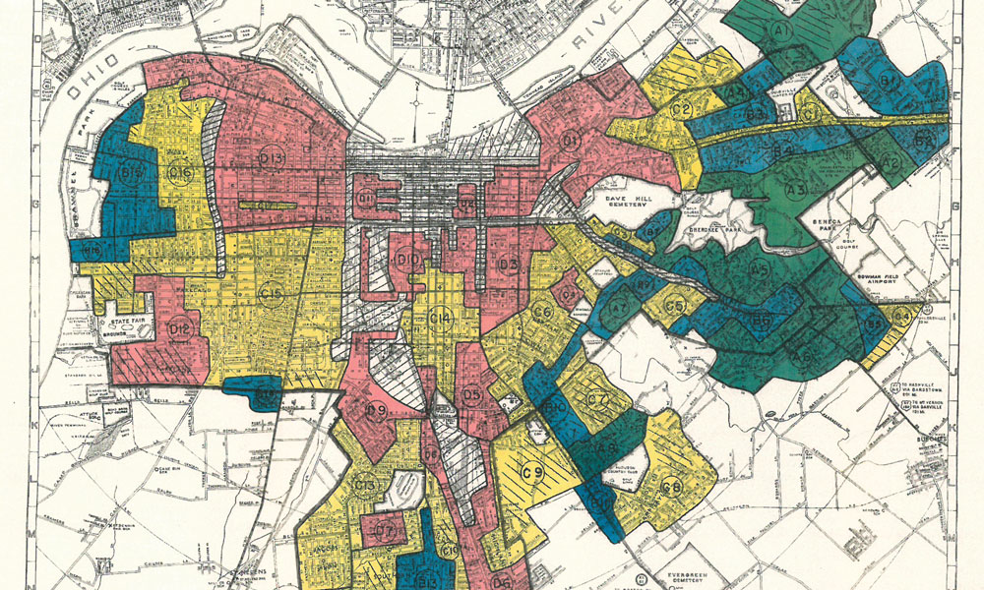
Conclusion
Most categorial variables we considered are correlated with proportion of race in each census tracts.
Furthermore, the categorical variables are themselves correlated, demonstrating the complex and interconnected nature of residential segregation.
Shapiro et al. (2013) identifies income, college attendance and home ownership as three of five key factors explaining wealth inequality, a distinct but closely related issue.
Map source: Redlining Louisville by Joshua Poe

