Slide 1

Discovering the Predictive Attributes of Diabetes Mellitus in the Pima Indian Population
Maurica Nez
Colorado State University Global
MIS581: Business Intelligence and Data Analytics
Instructor: Dr. Morad
Due Date: 10/8/2023
Module 8: Portfolio Project
Notes:
This presentation will cover my semester research project for the capstone course in Business Intelligence and Data Analytics.

Slide 2
Purpose
Explore the variables of the Pima Indians Diabetes data set.
Is it possible to predict diabetes?
Notes:
This research investigates the variables of the Pima Indians Diabetes data set.
The purpose of this research is to explore the predictive capabilities of the variables in the Pima Indians Diabetes data set.
Determine if data mining can be used to predict diabetes.

Slide 3
Why research diabetes?
Global killer
Top four priority diseases to research
Leading cause of kidney failure
Increases risk of cardiovascular disease
Notes:
The World’s Health Organization has declared diabetes to be a serious global issue (WHO, 2016). Diabetes Mellitus is one of the top four “priority noncommunicable diseases (NCDs) targeted for action by world leaders” (WHO, 2016, p. 6). Diabetes mellitus “is the leading cause of kidney failure” (Vital Signs, 2018, p. 1). In 2012, diabetes killed 1.5 million people and was associated with an additional “2.2 million deaths, by increasing the risks of cardiovascular and other diseases” (WHO, 2016, p.6). The instances of diabetes in the world population have almost quadrupled “since 1980” (WHO, 2016, p. 6).

Slide 4
What is Diabetes?
Too much insulin causes cells to become insulin resistant
Early detection is difficult
The silent killer
Symptoms may take a decade to diagnose
Results in kidney failure
May be preventable if caught early!
Notes:
Type 2 diabetes mellitus is where too much insulin is produced causing the cells to reduce the number of receptors (Klandorf & Stark, 2022). The cells become insulin resistant due to the lack of transport receptors. The initial symptoms are less pronounced when compared to type 1 and early detection is difficult (Chang et al., 2022). Therefore, type 2 has been labeled “the silent killer” (Klandorf & Stark, 2022, p. 1). Type 2 diabetes does not have a cure, but it is treatable. The advancement of type 2 diabetes mellitus symptoms may be slowed, and kidney failure may be preventable (Chang et al., 2022). However, the difficulty lies in the timing of discovering the condition because it may take a decade to present with symptoms (Abbasi et al., 2016).

Slide 5
Overview of Study
Data mining techniques
Pima Indians Diabetes data set
Clean data set for analysis
R, SAS, and Tableau
Descriptive and predictive analysis
Summary statistics
Correlation Matrix
Classification Tree
Confusion table
Notes:
This research will use data mining techniques to investigate the variables of the Pima Indians Diabetes data set. Descriptive and predictive analysis will be performed using three different analytical tools.
The distribution of the data will be analyzed using Tableau and SAS.
The R programming language will be used to clean, partition the data, and to create a classification tree.
The train and test model will be compared to one another using sensitivity and specificity testing.
The correlation matrix and models will identify what variables can predict diabetes by answering each research question and determine support for hypothesis statements.

Slide 6
Research Questions & Hypothesis
What independent variables have a correlation with the outcome variable?
H1: The independent variables will not have a positive correlation coefficient with the dependent outcome variable.
H2: The independent variables will have a positive correlation coefficient with the dependent outcome variable.
What independent variables predict the outcome variable?
H1: None of the independent variables will predict the dependent variable.
H2: An independent variable will be found to predict the dependent variable.
Notes:
This research seeks to determine what variables in the data set have a correlation and predictive relationship with the outcome variable. Both research questions will explore the nature of the relationship between the independent and dependent variables.
What independent variables have a correlation with the outcome variable?
What independent variables predict the outcome variable?
Hypothesis
The hypotheses questions will investigate the research questions as follows. The first set of hypotheses statements will determine which variables have a correlation with the outcome variable.
H1: The independent variables will not have a positive correlation coefficient with the dependent outcome variable.
H2: The independent variables will have a positive correlation coefficient with the dependent outcome variable.
The second set of hypotheses statements will determine if the variables that were found to have a correlation with the outcome variable may be used to predict the outcome variable.
H1: None of the independent variables will predict the dependent variable.
H2: An independent variable will be found to predict the dependent variable.

Slide 7
Literature Review
Diabetes research is incorporating data mining
Medical community hasn’t trusted the research
Create easy to interpret models
Successful models include Artificial Neural Networks, K-nearest neighbor, logistic regression, Naïve Bayes
Each model provides insight & the performance is dependent on the data
More studies are required and encouraged
Notes:
One study states that machine learning has not been accepted within the medical community because “the internal decision-making process” is not trusted (Chang et al., 2022, p 1).
To combat the mistrust, the researchers used R coding to examine the Pima Indians diabetes dataset and build models that are easy to interpret.
A study from 2023 shows that machine and deep learning methods are beginning to take the lead in research. The techniques Deepa and Kumar used were Support Vector Machine, Artificial Neural Networks, K-nearest neighbor, and logistic regression (Deepa & Kumar, 2023).
They found that each model had its merit, and the performance was dependent on the data used. They concluded that future studies need to use “more samples as well as further machine learning and data mining techniques” (Deepa & Kumar, 2023, p. 12).
Another study noted that there is “an evident gap in research on diabetes with respect to data mining and machine learning” (Kavakiotis et al., 2017, p. 10).

Slide 8
Research Design & Methods
The Pima Indians Diabetes data set
Contains “diagnostic measurements”
9 variables
768 rows
Tools used:
RStudio
SAS
Tableau
Notes:
The data set contains the “diagnostic measurements” that are associated with diabetes mellitus (Kaggle, 2016, p. 1). There are nine variables in the Pima Indians Diabetes dataset. The dataset contains 768 rows that document the variables for each participant in the study that collected the data. All participants in the study “are females at least 21 years old and of Pima Indian heritage” (Kaggle, 2016, p. 1).
Three data mining tools are used to conduct the analysis. SAS and Tableau allow for the visualization of the data distribution. The summary statistics, correlation matrix, classification tree, and confusion matrix were completed using Rstudio.

Slide 9
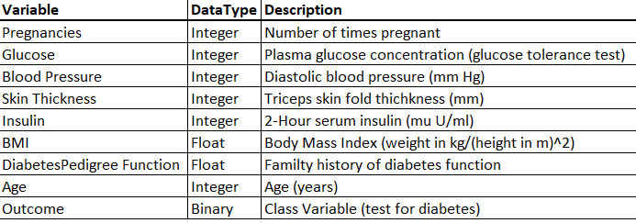
Data Dictionary
Notes:
The data dictionary was included to provide a description for each variable in the data set. Notice the Outcome variable is a binary data type. The binary, dependent variable is suitable for classification analysis using a decision tree method.

Slide 10
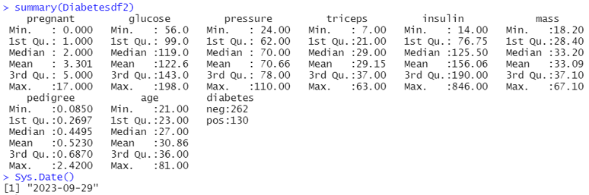
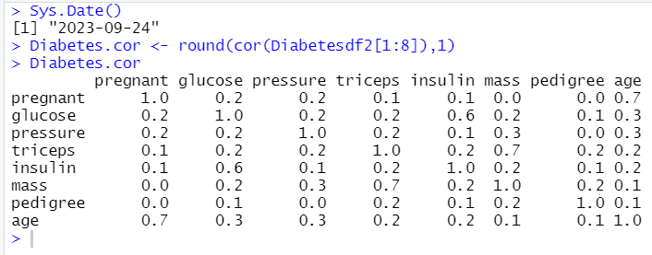
Results
Summary Statistics
Correlation Matrix
Notes:
The results of our analysis are as follows: The top figure shows the summary statistics for the data set. Notice the minimum values for every variable except for pregnancy is realistic. This data set was cleaned to remove impossible zero values and was cleaned again to remove the NA values. Also note that the data set is smaller. The cleaned data set only had 392 rows. There are 292 negative and 130 positive outcomes.
The bottom figure displays the results of the correlation matrix. Values closest to positive 1 are selected. Glucose and insulin have a correlation value of 0.6. Age and pregnancy had a correlation value of 0.7.

Slide 11
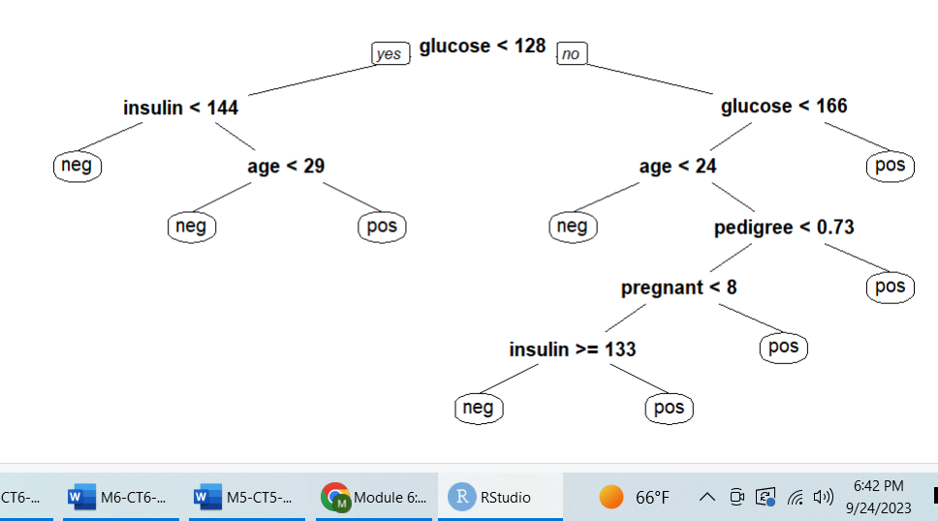
Train Partition Classification Tree
Notes:
The train partition model had a sensitivity value of 0.73 and a specificity of 0.91. The classification tree model is on the right track. The tree clearly shows a decision tree style. However, the overall tree is still overly complex for the end-user. Notice this model includes the pedigree variable that did not have a high correlation coefficient.

Slide 12
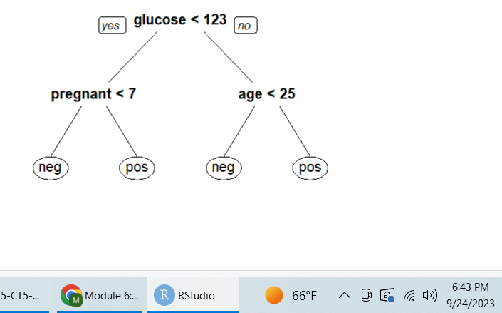
Test Partition Classification Tree
Notes:
The model result is straightforward and designed with the end user in mind. The glucose, age, and pregnancy status were the final variables selected to predict the diabetes status. The model clearly displays a decision tree where the user may input the glucose concentration value of the patient and follow the diagram.

Slide 13
Discussion
The 1st research question is answered.
The 1st Null Hypothesis is NOT supported.
The 2nd research question is answered.
The 2nd Null Hypothesis is NOT supported.
Notes:
The first research question sought to find variables that had a correlation with the outcome variable.
The first null hypothesis stated that no independent variable will have a positive correlation coefficient with the dependent variable.
Glucose, Insulin, Age, and Pregnancy were found to have correlation coefficients above 0.5. Therefore, the correlation analysis results satisfies the 1st research question, and the 1st null hypothesis is not supported.
The 2nd research question sought to find what variables can predict the outcome.
The 2nd Null Hypothesis stated that no variables will predict the outcome variable.
The variables selected by the Classification Tree model align with the variables found to have high correlation values. Therefore, the 2nd research question is satisfied, and the 2nd null hypothesis is not supported.

Slide 14
Conclusion
Diabetes research is ongoing due to the complexity of the condition.
Data mining provides many opportunities for further research.
Additional data sets, variables, and models may be explored
Predictive models are a foundation for developing preventative treatments.
Notes:
Diabetes is a pandemic with many complex contributing factors that require analysis.
Further research using data mining techniques may be valuable in providing more evidence that diabetes is predictable. Comparison models, different partition parameters, and accuracy tests may be used to explore the Pima Indians Diabetes data set.
In the future, an alternative approach and a different data set may be used to add to the overall research. For example, a data set containing metabolite biomarkers could explore the topic at a more intricate level using data analysis (Long et al., 2020). A more inclusive data set would include males and have alternative variables. If males were included in the data set used in this analysis, the pregnancy variable would most likely not have been in the final model.
There are many variables associated with diabetes that merit continued investigation using machine learning, artificial intelligence, and any other form of analysis (Luo et al., 2023).

Slide 15
References
Abbasi, A., Sahlqvist, A.-S., Lotta, L., Brosnan, J. M., Vollenweider, P., Giabbanelli, P., Nunez, D. J., Waterworth, D., Scott, R. A., Langenberg, C., & Wareham, N. J. (2016). A Systematic Review of Biomarkers and Risk of Incident Type 2 Diabetes: An Overview of Epidemiological, Prediction and Aetiological Research Literature. PLoS ONE, 11(10), 120. https://doi.org/10.1371/journal.pone.0163721
Chang, V., Bailey, J., Xu, Q. A., & Sun, Z. (2022). Pima Indians diabetes mellitus classification based on machine learning (ML) algorithms. Neural computing & applications, 1–17. Advance online publication. https://doi.org/10.1007/s00521-022-07049-z
Deepa, K., & Ranjeeth Kumar, C. (2023). Early diagnosis of diabetes mellitus using data mining and machine learning techniques. Journal of Intelligent & Fuzzy Systems, 44(3), 3999–4011. https://doi.org/10.3233/JIFS-222574
Kaggle. (2016). Pima Indians Diabetes Data Set. Retrieved from https://www.kaggle.com/datasets/uciml/pima-indians-diabetes database?resource=download

Slide 16
Kavakiotis, I., Tsave, O., Salifoglou, A., Maglaveras, N., Vlahavas, I., & Chouvarda, I. (2017). Machine Learning and Data Mining Methods in Diabetes Research. Computational and Structural Biotechnology Journal, 15, 104–116. https://doi.org/10.1016/j.csbj.2016.12.005
Klandorf, H., Stark, S. W., (2022). Diabetes mellitus. Magill’s Medical Guide (Online Edition). https://edss ebscohost.com.csuglobal.idm.oclc.org/eds/detail/detail?vid=1&sid=
3d6f0d06-8b3d-402aa0a7980652984094%40redis&bdata=JnNpdGU9ZWRzLWxpdmU%3d#AN=
86194054&db=ers
Long, J., Yang, Z., Wang, L., Han, Y., Peng, C., Yan, C., & Yan, D. (2020). Metabolite biomarkers of type 2 diabetes mellitus and pre-diabetes: a systematic review and meta-analysis. BMC endocrine disorders, 20(1), 174. https://doi.org/10.1186/s12902-020-00653-x
Luo, X., Sun, J., Pan, H., Zhou, D., Huang, P., Tang, J., Shi, R., Ye, H., Zhao, Y., & Zhang, A. (2023). Establishment and health management application of a prediction model for high-risk complication combination of type 2 diabetes mellitus based on data mining. PLoS ONE, 17(8), 118. https://doi.org/10.1371/journal.pone.0289749

Slide 17
Vital Signs. (2018). Native Americans with Diabetes: Better diabetes care cand decrease kidney disease. Centers for Disease Control and Prevention. Retrieved from https://www.cdc.gov/vitalsigns/aian-diabetes/index.html
Worlds Health Organization. (2016). Global Report on Diabetes. https://www.who.int/publications/i/item/9789241565257

