Slide 1
HMS

Slide 2
USER GROUP
Admin
Admission
Nurse
Doctor
LabTech
Pharm
Programmer
User

Slide 3
Admission
Home
New Patient
Create a Visit (Add History, Add Allergy, Examination, Order Lab Test, Prescription Drugs, Treatment)
Give Admission
Give Appointment
Add History
Add Allergy
Examination
Search
Registry
Admission Registry
OPD Registry

Slide 4
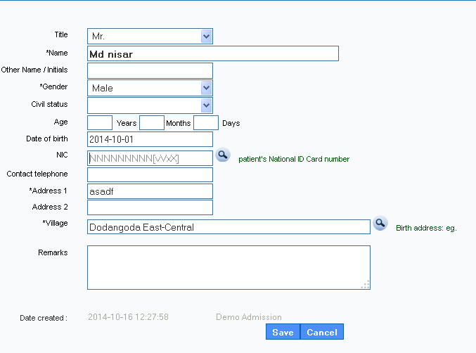
New Patient

Slide 5
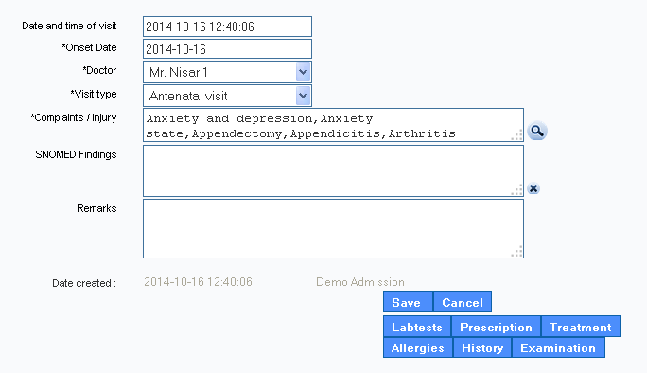
Create a Visit

Slide 6
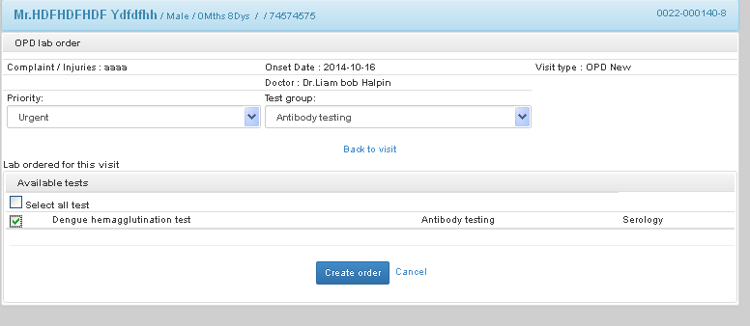
Lab Order

Slide 7
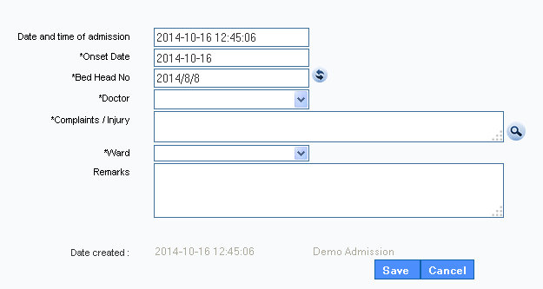
Give an Admission

Slide 8
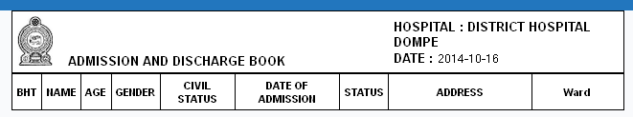
REGISTRY

Slide 9
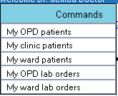
DOCTOR

Slide 10
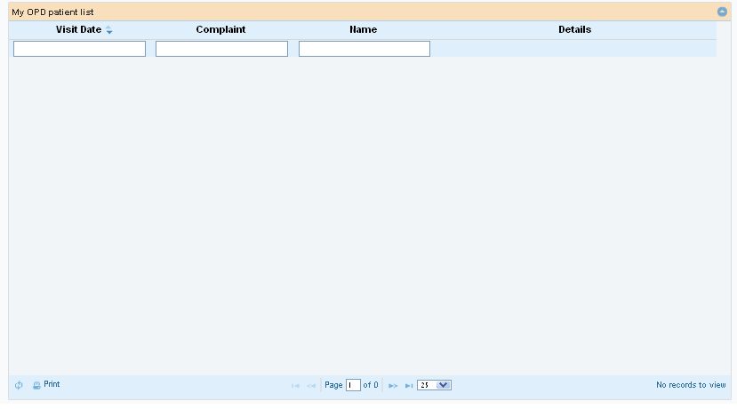
MY OPD Patient

Slide 11
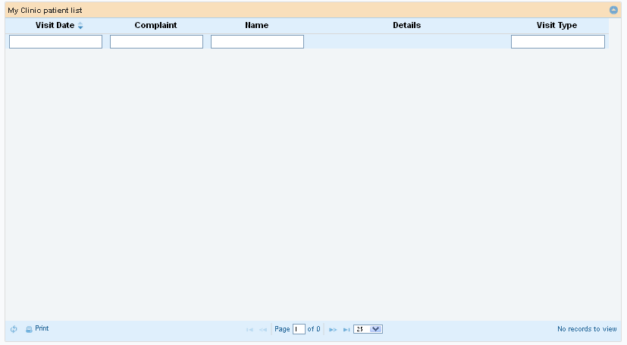
My Clinic Patient

Slide 12
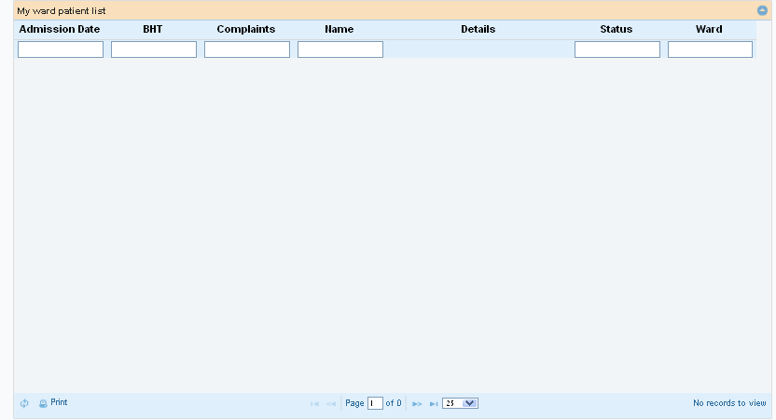
MY Ward Patient

Slide 13
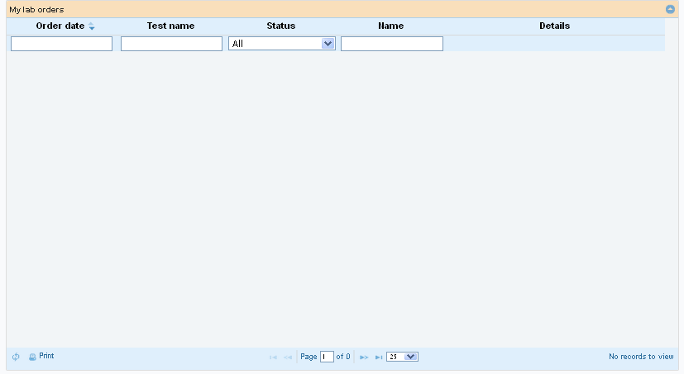
My OPD LAB Order

Slide 14
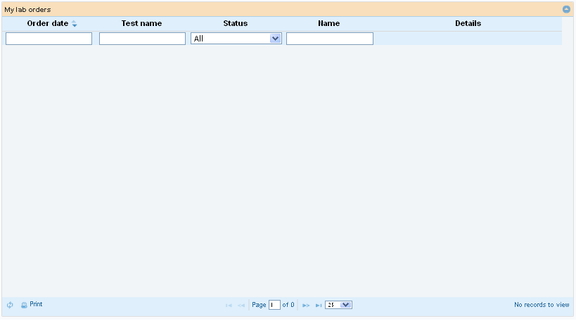
My ward lab order

Slide 15

LABTech

Slide 16
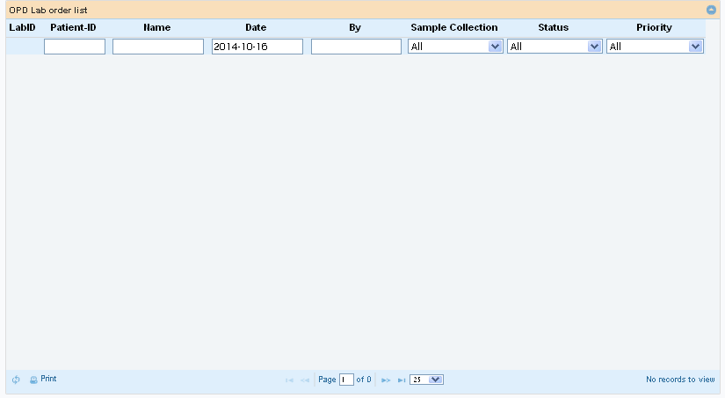
OPD Lab Order

Slide 17
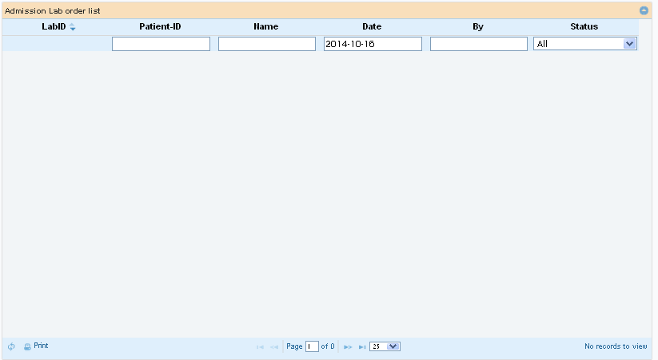
Admission Lab Order

Slide 18
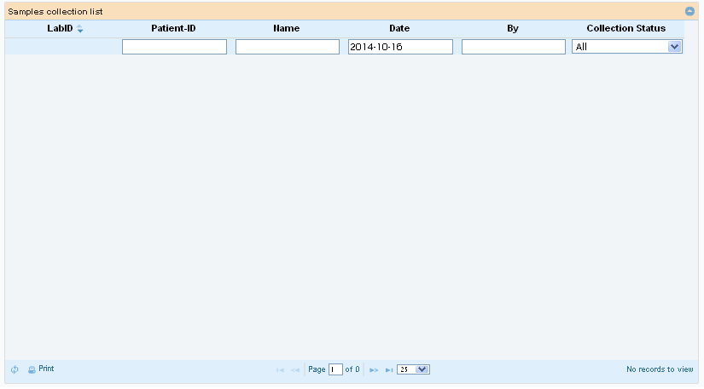
Collection Room

