Slide 1
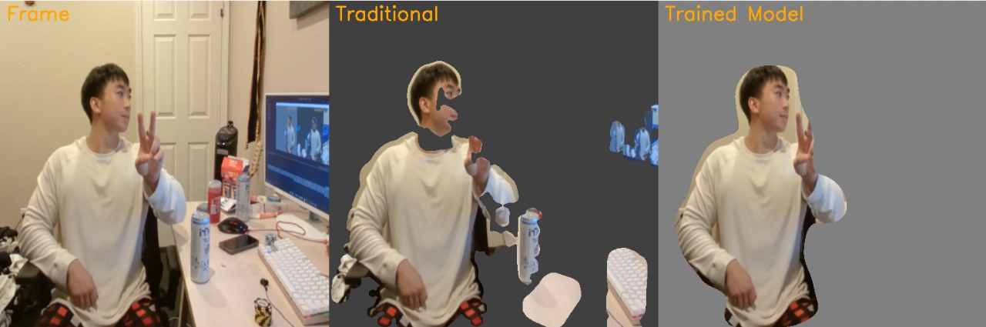
ICUNet:
A Personalized Detection Pipeline
By Matthew Do, Daniel Lee, & Alvin Nguyen

Slide 2
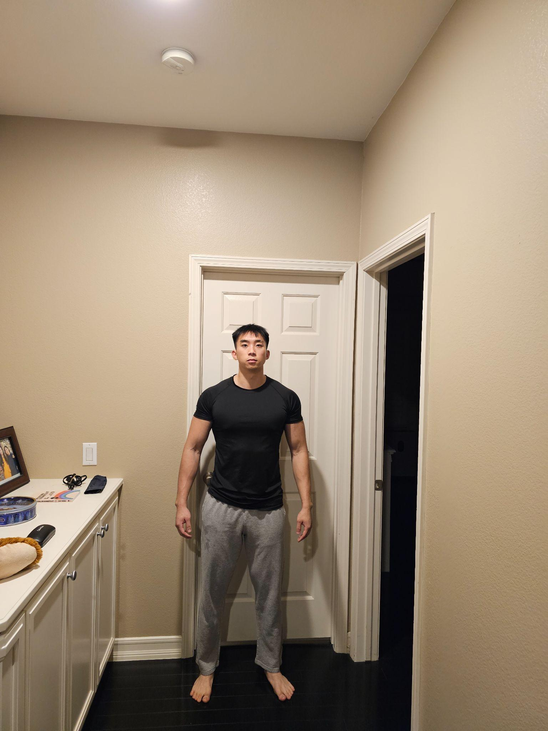
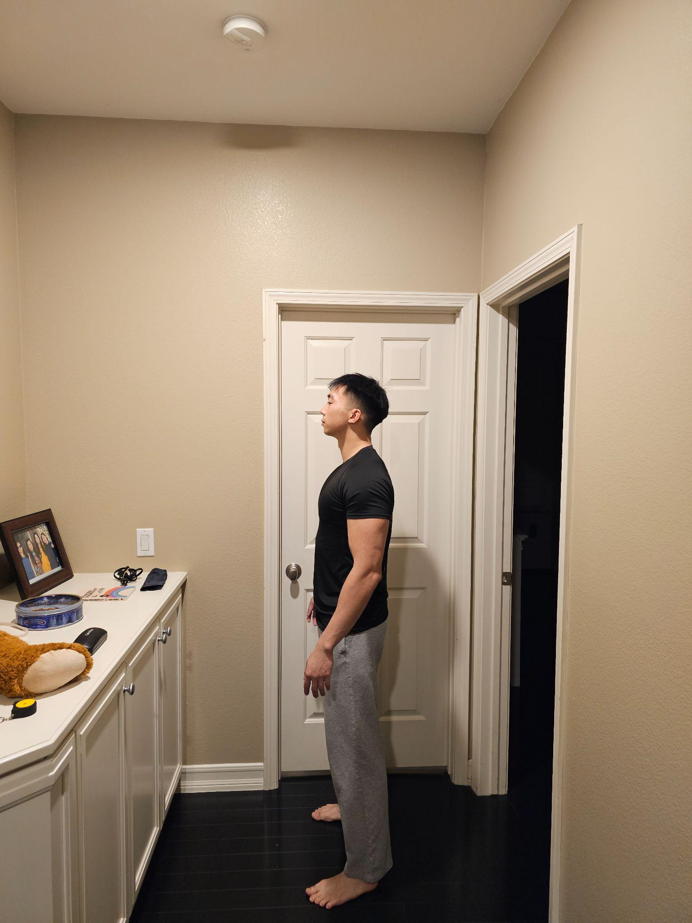
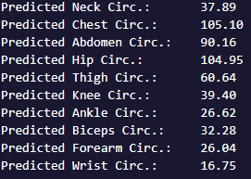

Previous Work: BFNet

Slide 3
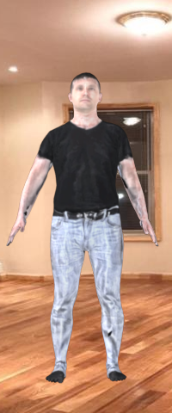
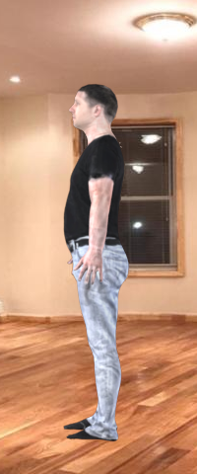
BFNet Limitations
Fixed distance training images
Fixed pose
Not enough data
Camera is 2.4 m (7.874 ft) away
and 1.6 m (5.25 ft) high
⇒ Not personalized!!!

Slide 4
Can we make something that learns about you specifically?
YES!
We will demonstrate this through binary image segmentation from a live video feed.

Slide 5
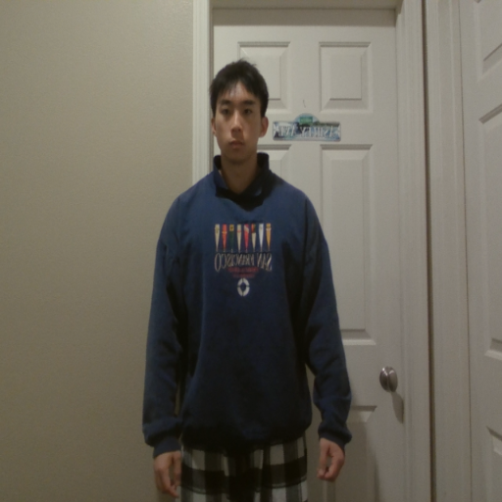
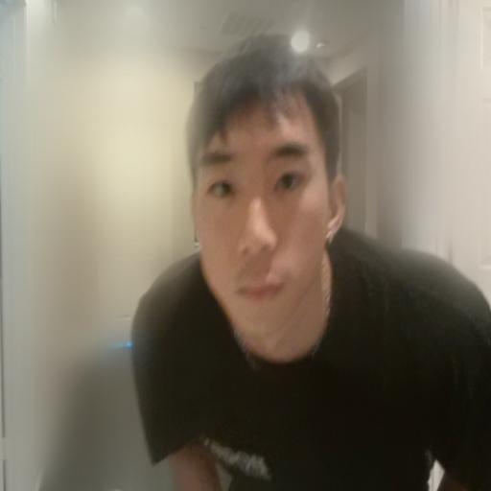

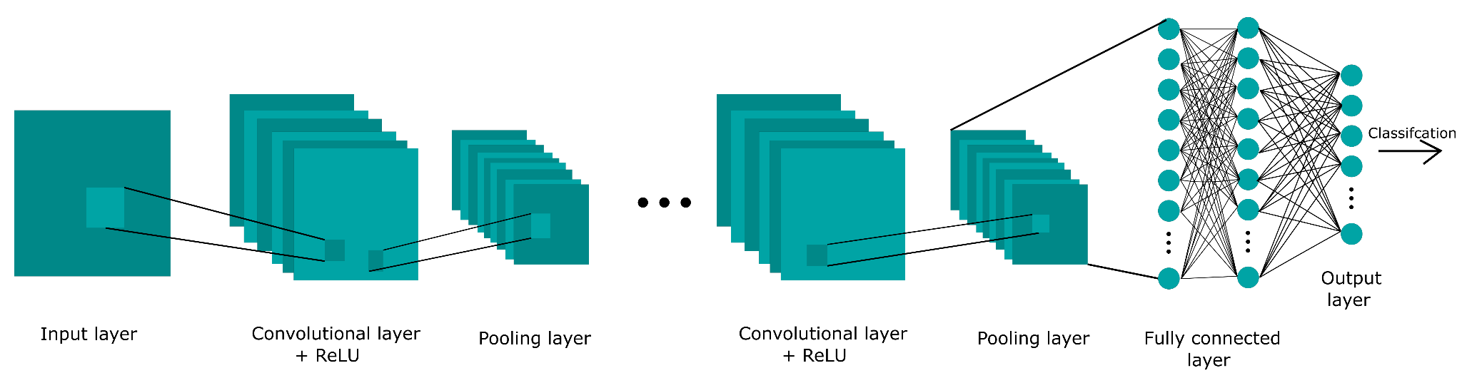
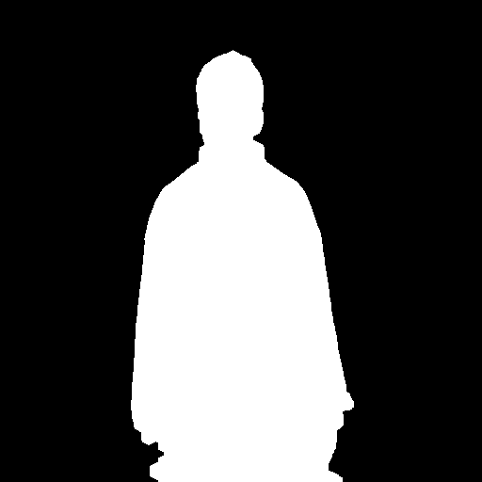
Project Pipeline
Stage 1 : Personalized Data Collection
Stage 2 : Training model
Stage 3: Predict person from live video
Person = clear,
Background = blurry

Slide 6
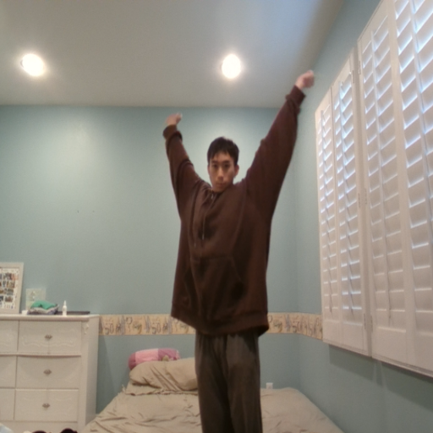
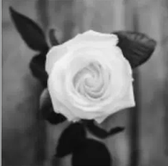
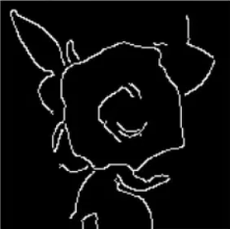


Stage 1: Collecting your data
Computer Vision Techniques: Edge & Contour Detection
A saved frame & its mask
Edge
Contour

Slide 7


Stage 2: Training A Neural Network
512x512 RGB frame
512x512 binary mask
NEURAL
NETWORK
as a dataloader
+
1 = person, 0 = background
Compare predicted model output against true binary mask to train the model’s parameters
Since we only predict 1 for person and 0 for background, we use binary cross entropy loss
512x512 model output

Slide 8
Stage 2: Why Spark?
Images == lots of data!
Spark uses distributed processing to load & process ALL the data in parallel across multiple workers
Spark scales!

Slide 9
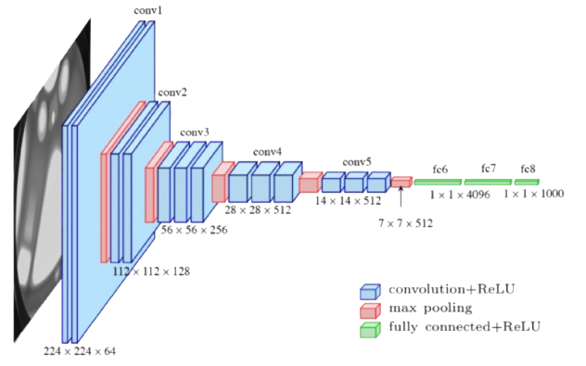
Stage 2: Model Architecture
(1) Pretrained MobileNetV3-large
Convolutional Neural Network
Efficient due to:
Inverted Residual Blocks
Depthwise Convolutions
Linear Bottleneck
Squeeze-and-Excitation Block
(2) Atrous Spatial Pyramid Pooling
(3) Upsampling
More feature processing!
Learns features at multiple scales
Does not change feature map shape
Makes output 512x512
Trainable!

Slide 10
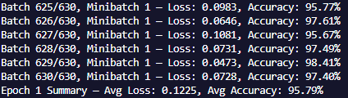
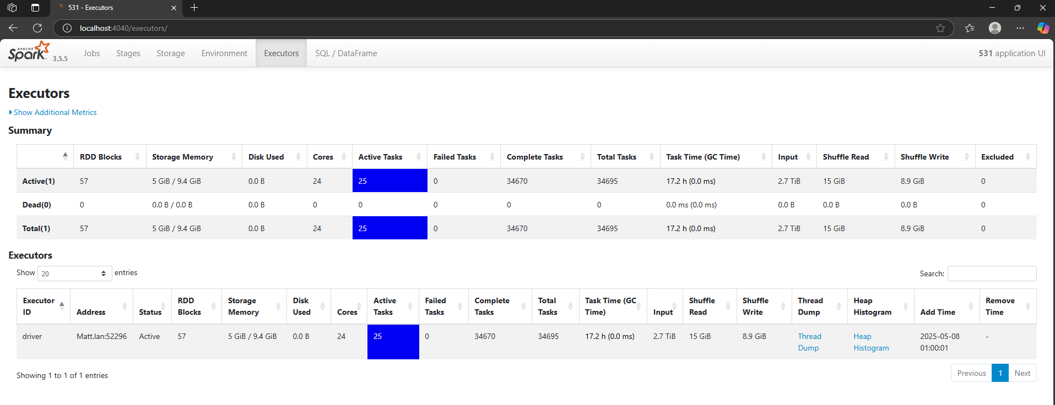
Stage 2: Training Results

Slide 11
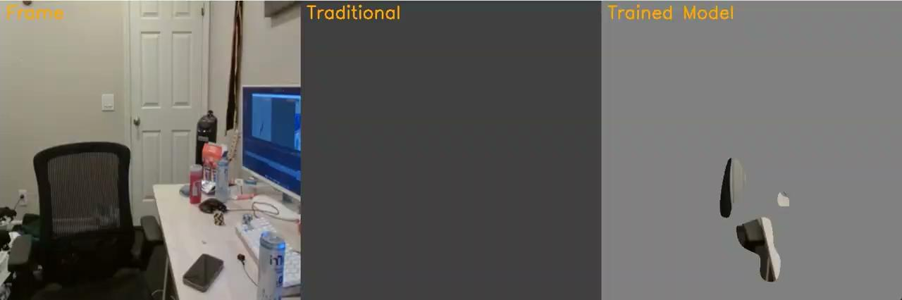
Stage 3: Image Segmentation from Live Video

Slide 12
Thank You !!!
Questions?

