Slide 1
Contact Information
Meredith Doellman
Office: 290E Galvin Life Sciences Center
Email: mdoellma@nd.edu
Office hours:
3:00-5:00pm Thursday, Jordan Cafe
Appointment by email

Slide 2
Learning Outcomes
Implement simulation models with ordinary differential equations (ODEs)
Practice python
custom functions
for loops
plotting

Slide 3
Today’s Class
Simulation modeling review
Intro to problems 1 & 2
Work through Exercise 10 in pairs
Fork from mdoellma/Intro_Biocomp_ND_318_Tutorial10

Slide 4
For Next Week
Monday (10/30)
No reading or quiz
Friday (11/3)
Exercise 9: Simulation modeling with ordinary differential equations
Work through the exercise together
One member of each team submits a pull request
Due by start of next tutorial

Slide 5
State variables and parameters
State variables
Change through time
Provide a starting value
”Updated” at each time step, based on:
Parameter values
State variable value from previous time step
Parameters
Do NOT change through time
Provide values at start
dNdt=r*(1-N/K)*N
One differential equation for each state variable
dNdt=r*(1-N/K)*N

Slide 6
Python function: Simulation model
def ddSim(arguments):
“unpack” first argument, assign state variables
calculate change in state variables with time (model equation)
(given parameter values and current values of state variables)
(one equation for each state variable)
return list of change in state variables with time

Slide 7
Python function: Simulation model
def ddSim (y,t,r,K):
N=y[0]
dNdt=r*(1-N/K)*N
return [dNdt]

Slide 8
Python function: Simulation model
def ddSim (y,t,r,K):
N=y[0]
dNdt=r*(1-N/K)*N
return [dNdt]
y,t,r,K **order matters**
y = list of state variable values
t = time step
r,K,etc. = individually list all parameter values

Slide 9
Linking function to ODE integration
def ddSim (y,t,r,K):
N = y[0]
dNdt = r*(1-N/K)*N
return [dNdt]
params = (0.3,10)
N0 = [0.01]
times = range(0,600)
modelSim = spint.odeint(func=ddSim,y0=N0,t=times,args=params)

Slide 10
Linking function to ODE integration
def ddSim (y0,t,r,K):
N = y0[0]
dNdt = r*(1-N/K)*N
return [dNdt]
params = (0.3,10)
N0 = [0.01]
times = range(0,600)
modelSim = spint.odeint(func=ddSim,y0=N0,t=times,args=params)

Slide 11
Linking function to ODE integration
def ddSim (y,t,r,K):
N = y[0]
dNdt = r*(1-N/K)*N
return [dNdt]
params = (0.3,10)
N0 = [0.01]
times = range(0,600)
modelSim = spint.odeint(func=ddSim,y0=N0,t=times,args=params)

Slide 12
Linking function to ODE integration
def ddSim (y,t,r,K):
N = y[0]
dNdt = r*(1-N/K)*N
return [dNdt]
params = (0.3,10)
N0 = [0.01]
times = range(0,600)
modelSim = spint.odeint(func=ddSim,y0=N0,t=times,args=params)
Notes:
*if more parameters, all are in params/args and listed after y0 and t in function args

Slide 13
Pseudocode (from Wed. Lecture)
### Load the necessary packages
### Custom function that defines the model differential equations
### Define parameters, initial values for state variables, and time steps
### Simulate the model using odeint
### put model output in a dataframe for plotting purposes
### plot simulation output

Slide 14
Hints for #1
Write only one function (same as Wed. lecture)
Input different parameter values for each question
Use a for loop to run model for a list of parameter values
Make three plots, multiple lines per plot

Slide 15
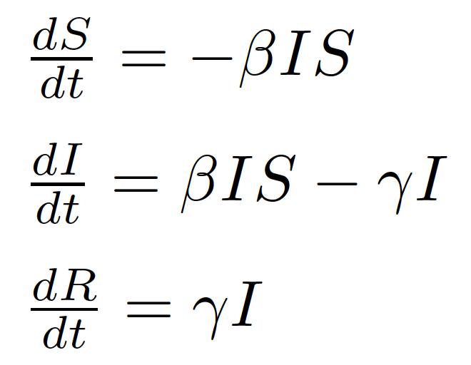
Question #2
Epidemiological model
N=S+I+R is a constant
One direction
S
susceptible hosts
I
infected hosts
R
resistant hosts
β
γ

Slide 16

SIR model
The change of SIR through time
How bad is the disease:
Maximum daily incidence
Maximum daily prevalence
Percent affected
Basic reproduction number

Slide 17
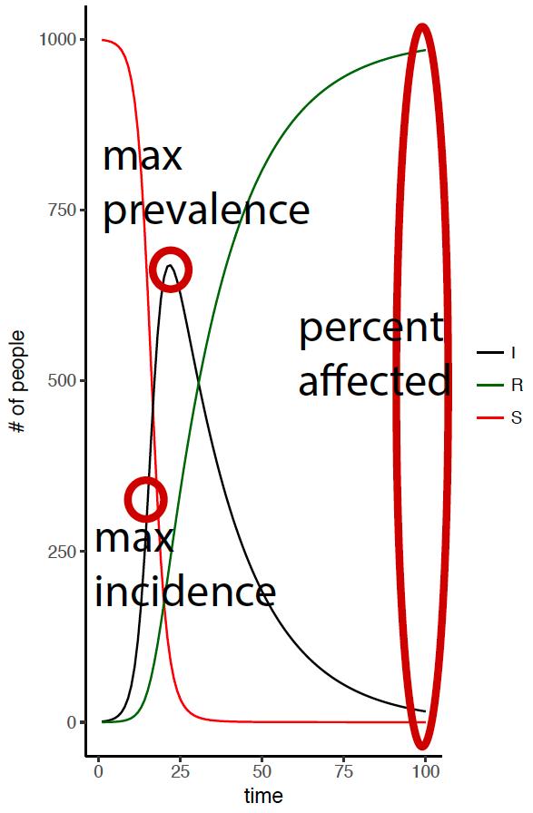
SIR model
The change of SIR through time
How bad is the disease:
Maximum daily incidence
Maximum daily prevalence
Percent affected
Basic reproduction number

Slide 18
Hints for #2
R0 is calculated with initial state variable values(beta*(the # of individuals at time=0)/gamma)
maximum daily incidence: calculate the change in number infected (I) between each day of the simulation and then find the maximum daily change
maximum daily prevalence: calculate the fraction of the total population that is infected each day of the simulation and then find the maximum value
percent affected: for the last day of the simulation calculate (I+R)/(S+I+R)

Slide 19
Useful code
storage=pandas.DataFrame({"time":times,"r1":0,"r2":0,"r3":0,"r4":0,"r5":0})
store_rs.iloc[:,i]=sim[:,0]
sim=si.odeint(func=ddSim,y0=N0s[i],t=times,args=pars)
numpy.max(sim[:,1]/numpy.sum(sim,axis=1))

