Slide 1
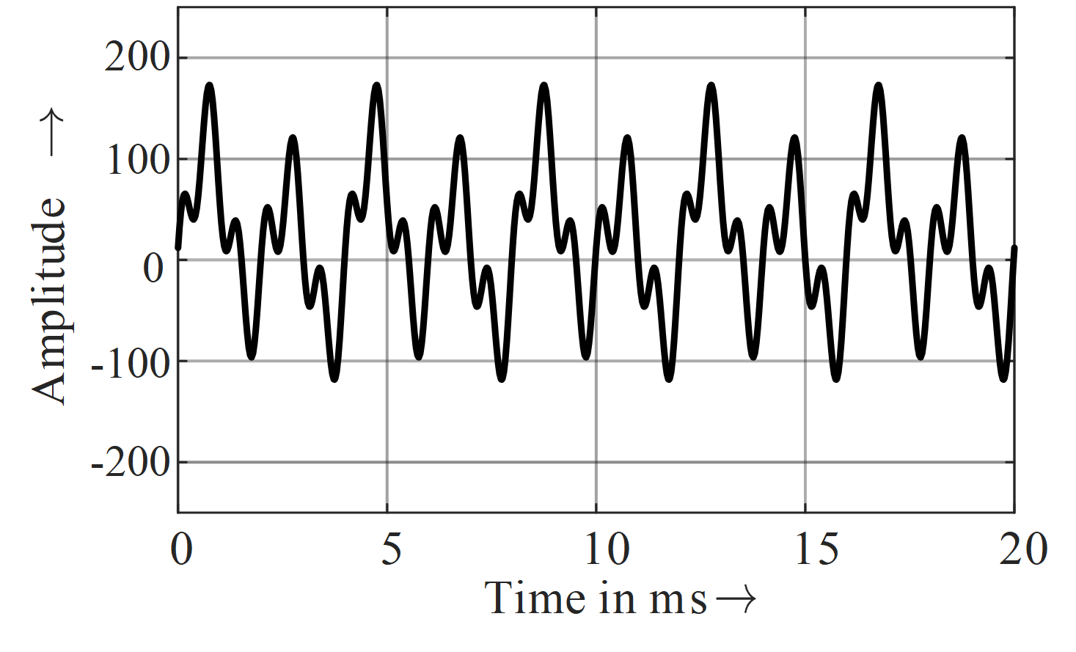
Your title
First Name Last Name Affiliation, Country | First Name Last Name Affiliation, Country | First Name Last Name Affiliation, Country
Introduction
A display board of about 1000 mm x 1500 mm (portrait format) will be provided for each author. Please use standard A0 format (841 mm x 1189 mm) as printing format.
Font Type is Open Sans. The font size for text boxes is 48 points. Your poster must be legible from a 5 m distance.
Results
Please avoid commercial references or product advertisement.
You have about 5 minutes to present your poster during a guided poster tour
Table 1 – Example of a table
A | B | C
0.02 | 0.06 | 0.08
0.002 | 0.221 | 0.222
0.222 | 0.888 | 0.999
Methodology
You can include as many sections as you want, but please try to not overload the poster with text. Pictures, graphs and tables are preferred.
The poster should include the research/industry problem, the applied methodology/solution and the conclusions.
Figure 2 – Example of a diagram
Conclusions
Indicate the open issues and further work
Do not forget to print the poster and bring it to the workshop !
Figure 1 – Example of a figure

